Slide 1
Digital System Design
Final Project Presentation
Group 7

Slide 2
Agenda
CPU Architecture
Cache
Extension - Compression
Extension - Branch Prediction
Results
Assignments

Slide 3
Cache

Slide 4
Cache
Cache
Slow memory
Write buffer(128 + 128 bits) with addr_reg(28bits)
 |  |  | …

Slide 5
Cache
Cache
Slow memory
Write buffer(128 bits) with addr_reg(28bits)
 |  |  | …

Slide 6
Cache
IDLE: Wait for proc_read and proc_write
READ: Read memory data from write buffer if buffer is not busy
WRITE_BACK(for read): Control Write Buffer — write dirty data to memory, which allows our cpu not to stall when we write data to memory
WRITE_ALLOCATE(for write): Update Cache, and Write back dirty data when we are writing

Slide 7
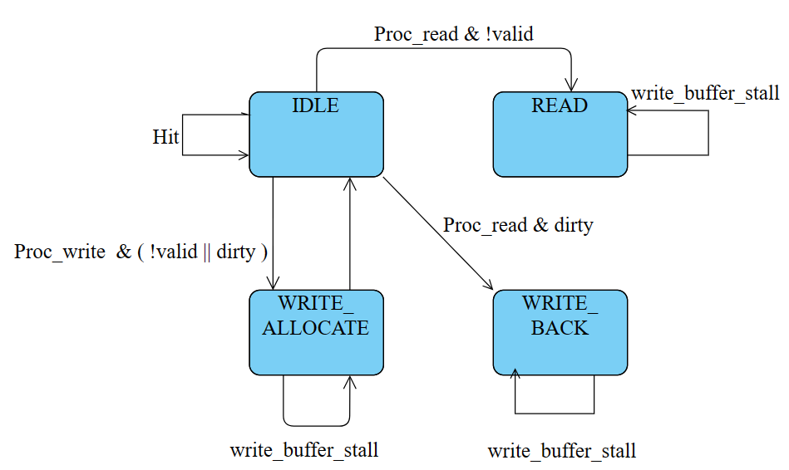
Cache

Slide 8
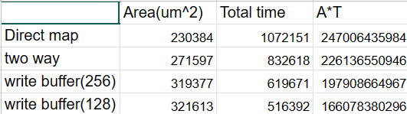
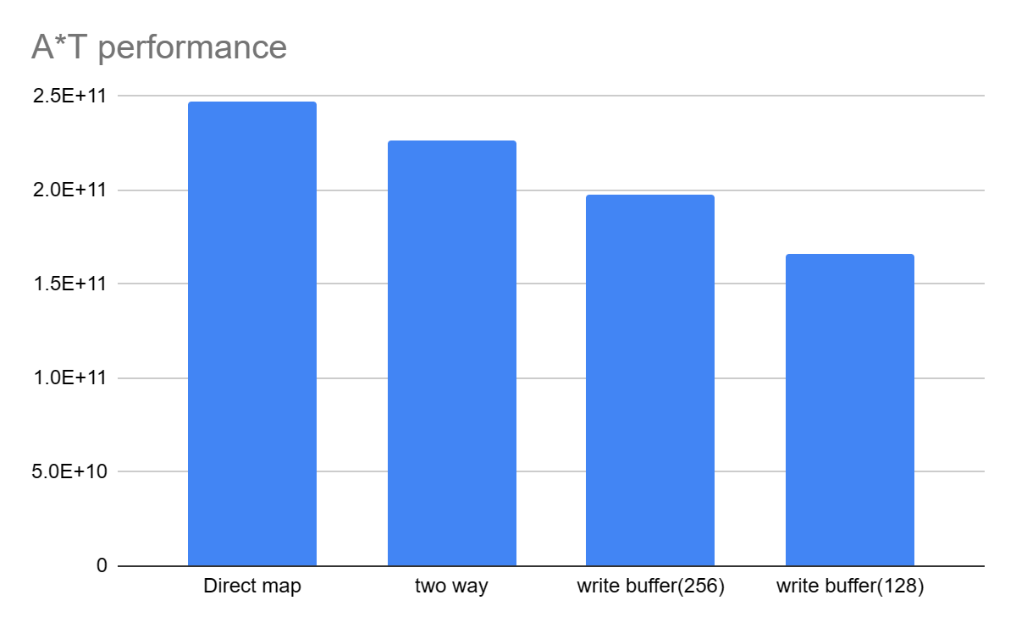
Cache(with two bit branch predictor)

Slide 9
Extension - Compression

Slide 10
Compression
Problems needed to be solved:
Extract Information in C instructions
PC Increment Selection
Address Alignment
Solution:
Decompressor
PC+4 or PC+2 depending on fetched instruction
Registers storing low/high address

Slide 11
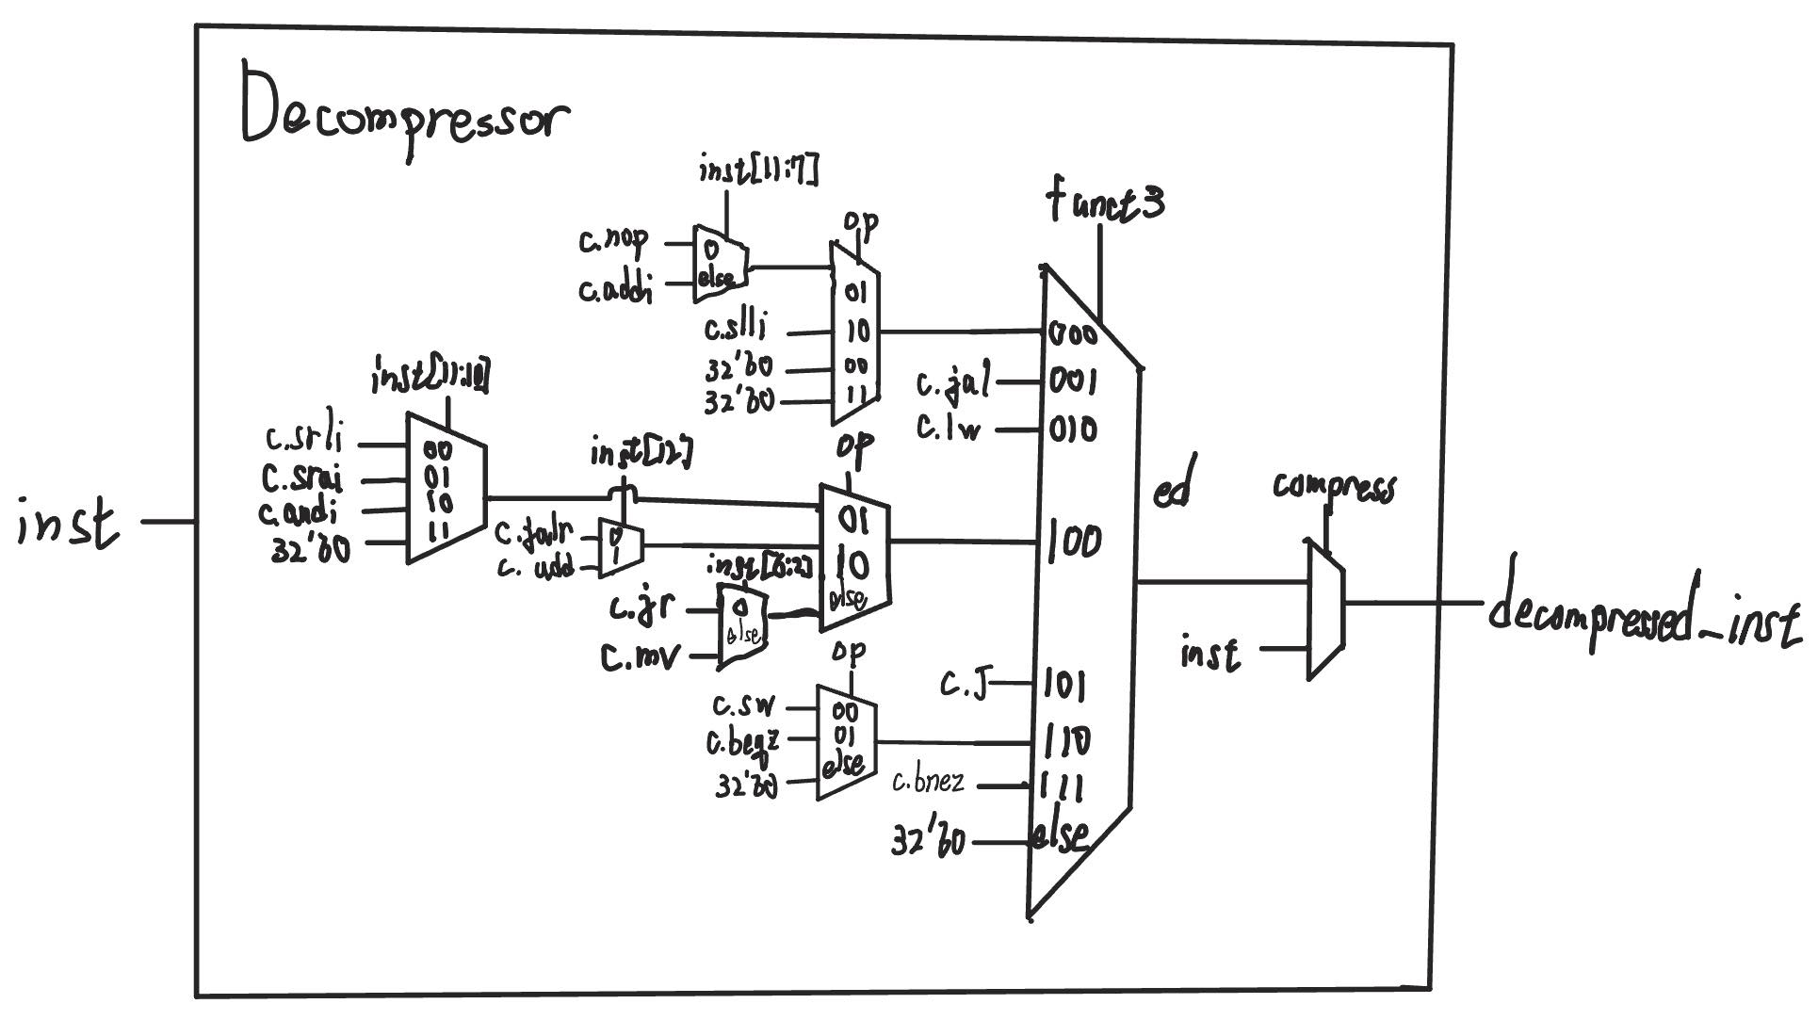
Decompressor
Architecture:

Slide 12
Compression
Strategy:
ICACHE_addr = PC[31:2] or PC[31:2] + 1, depending on PC[1]
Use 2 registers to store low/high part of ICACHE_rdata
Determine compressed instruction from high_data register
Determine the original instruction into Decompressor
Adjustment:
If PC jump/branch to 2 bytes boundary, ICACHE_data = PC[31:2]
When looking ahead, stall PC & insert a nop

Slide 13
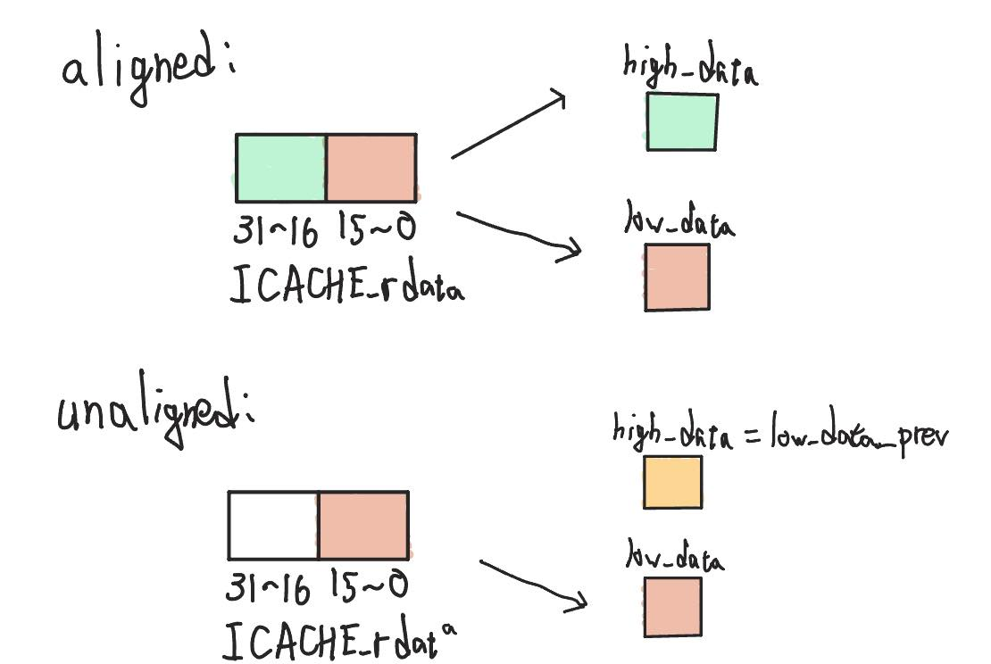

Compression
inst = { ICACHE_rdata[23:16], ICACHE_rdata[31:24], high_data[7:0], high_data[15:8] }
a
inst = { low_data[7:0], low_data[15:8], high_data[7:0], high_data[15:8] }

Slide 14
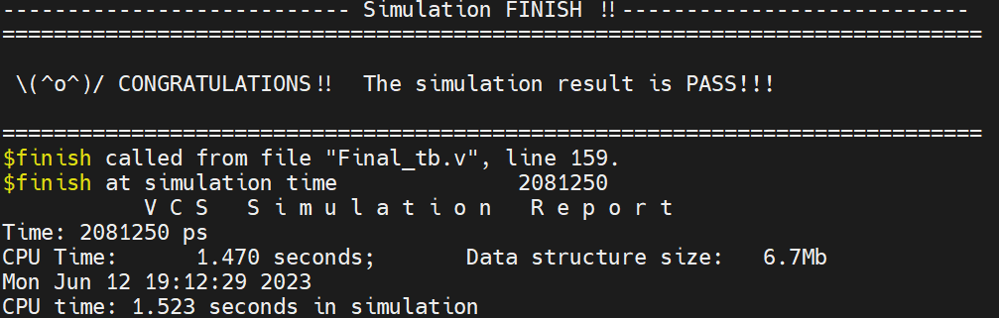
Compression
Performance:
Area: 335,525 um^2
Sdc/Tb cycle time: 4.2/4.5 ns
Gate-level simulation time: 2081.25ns
A*T value: 6.98E11
Critical path: Dcache data -> Branch comparator -> IF/ID register flush or not

Slide 15
Extension - Branch Prediction

Slide 16
Branch Prediction
success / fail
Branch
Prediction Checker
taken / not taken
•
correct PC
[31:0]
IF/ID
ID/EX
prediction
Prediction Unit
Branch Comparator
next PC
[31:0]
prediction
•
Branch
Detection
imm
[31:0]
Register
File
Immediate Generator
rs1 [4:0]
rs1 data [31:0]
+
4
+
•
•
PC
Instruction Memory
•
•
inst [31:0]
rs2 [4:0]
rs2 data [31:0]

Slide 17
Prediction Unit
Predictor Type | Q_sort RTL Time (ns) | Synthesis Area (um^2) | Q_sort Gate-Level Time (ns) | A*T
always not-taken | 442926.750 | 290995 | 670042.750 | 194,979,090,036
always taken | 455302.750
1-bit local | 447991.250
2-bit local | 443609.250
2-bit local + 2-bit PC table | 442828.750 | 316636 | 671310.250 | 212,560,992,319
2-bit local + 4-bit PC table | 443108.750
2-bit local + 1-bit global history | 449244.250
2-bit local + 2-bit global history | 449219.750
2-bit local + 4-bit global history | 449181.250
2-bit local + 2-bit PC table + 2-bit global history | 449282.750
2-bit local + 4-bit PC table + 2-bit global history | 449132.250

Slide 18
Prediction Unit: 2-Bit PC Table
Prediction Unit
local
FSM 00
local
FSM
01
prediction
result
DEMUX
MUX
prediction
local
FSM
10
local
FSM
11
ID PC [1:0]
IF PC [1:0]

Slide 19
Results

Slide 20
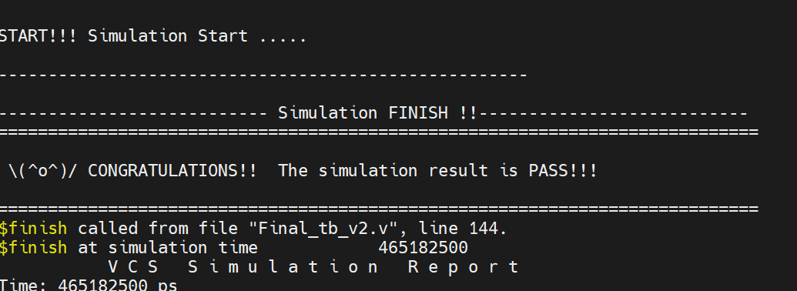
Q-Sort
Function:
Branch Predictor: 2-bit predictor
Cache: Write back policy with write back buffer
Compression
Cycle Time(testbench):5.0ns
Total simulation time(T): 465182ns
Area(A): 321613um^2
A*T = 149,608,578,566

Slide 21
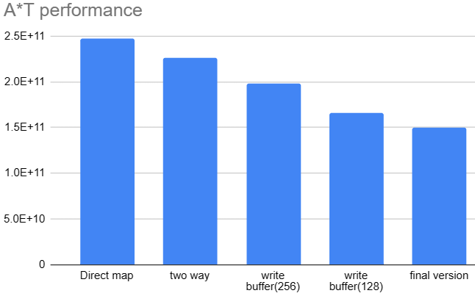

Slide 22
Assignments

Slide 23
Assignments
吳庭毅
Compression
田祐行
Optimize Branch predictor
林沛翰
Optimize Cache: write back and write buffer

