Slide 1
Lab3 Verilog FIR
R12943168 陳瀚坪

Slide 2
Outline
Block Diagram
Waveform
Tap/Data RAM access sequence & its control
Axilite access timing
Axistream X, Y access timing
Special cases handling
Testbench
Code Review Questions

Slide 3
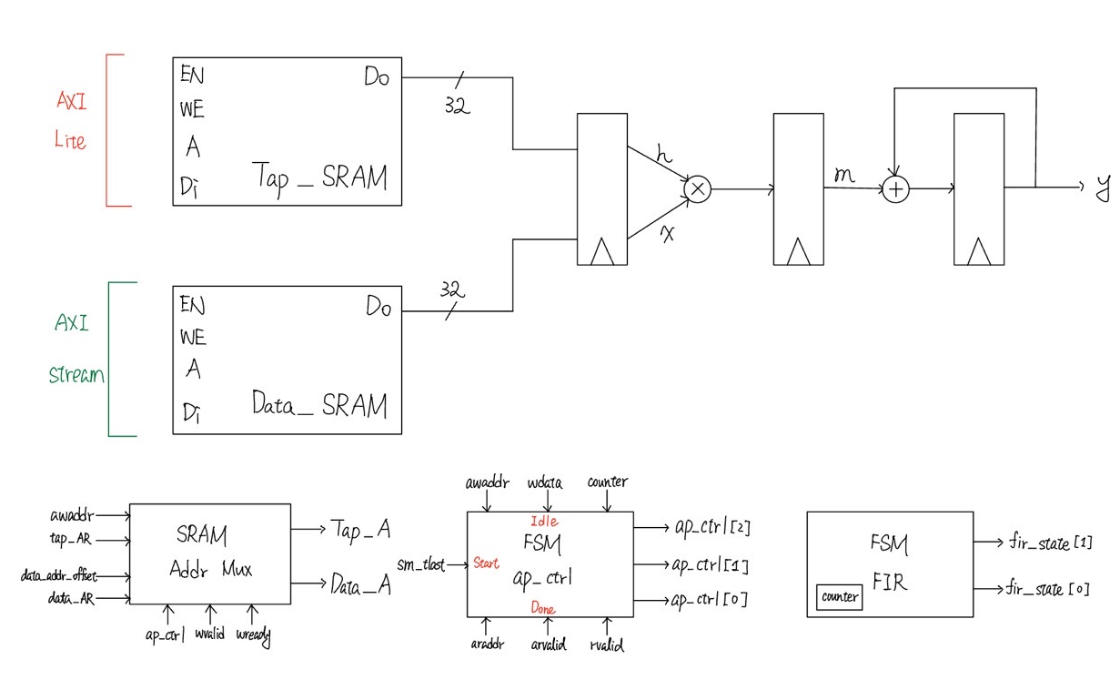
Block Diagram
Datapath

Slide 4
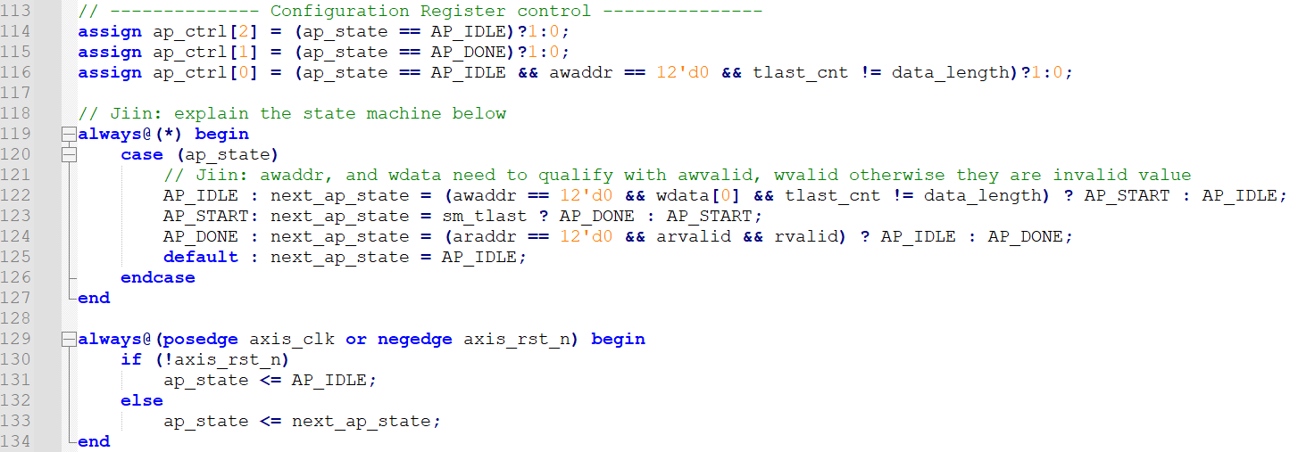
Block Diagram
FSM (ap_ctrl)

Slide 5
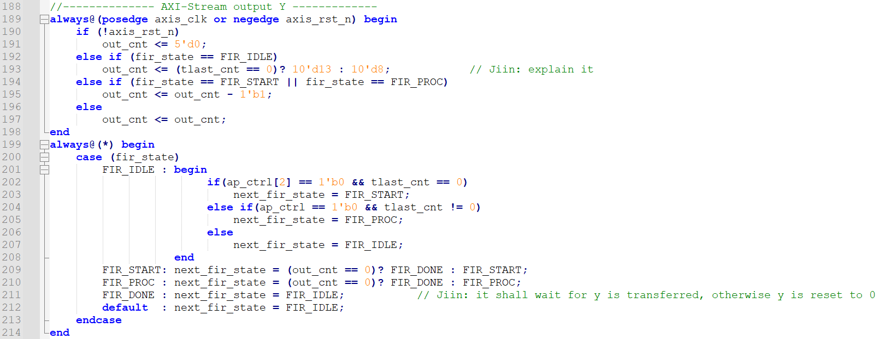
Block Diagram
FSM (filter)

Slide 6
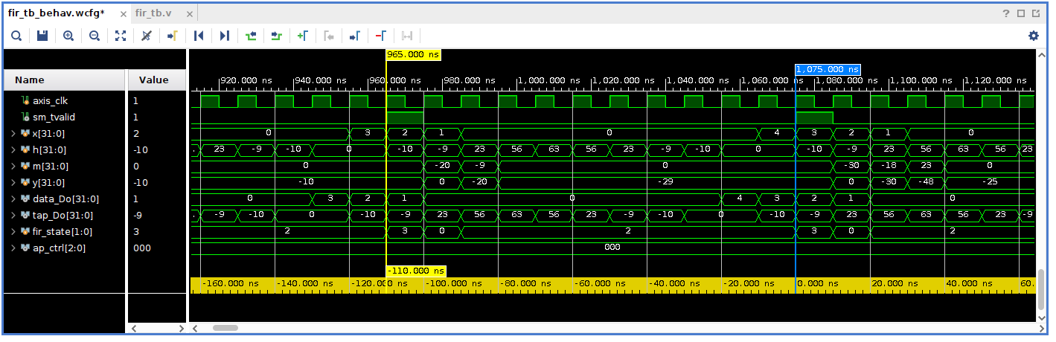
Waveform
Waveform (11T / per Y)
ap_ctrl
fir_state

Slide 7
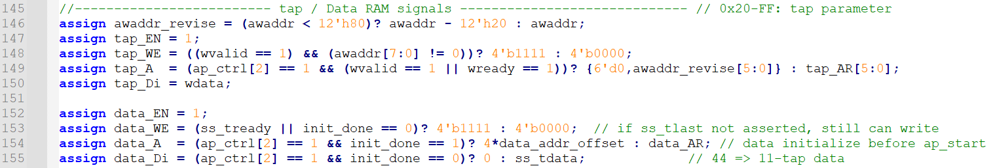
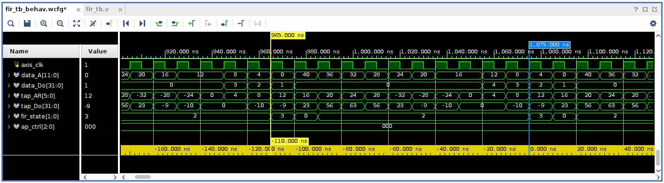
Tap/Data RAM access sequence & its control

Slide 8
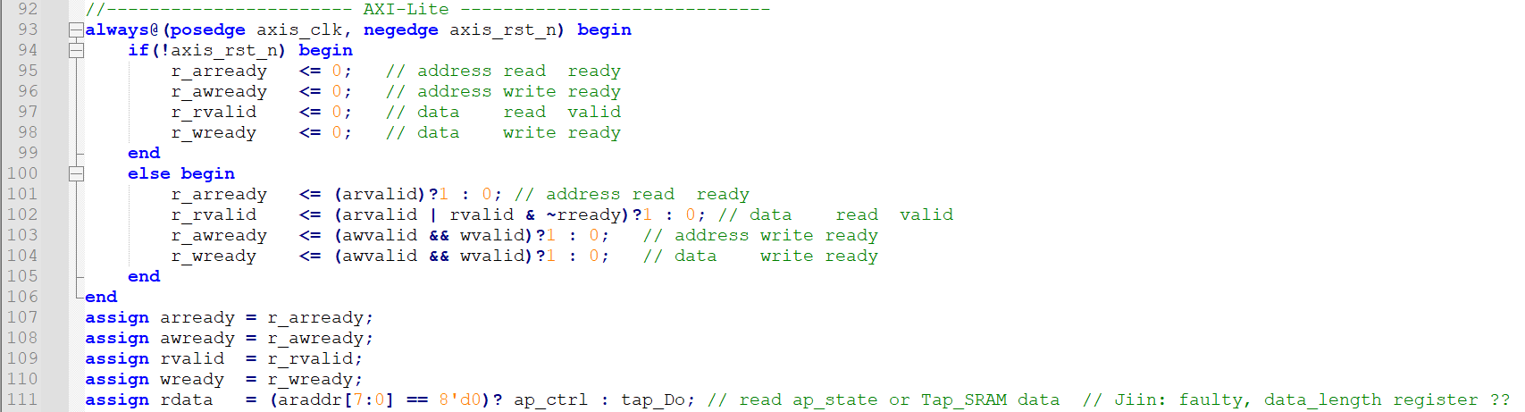
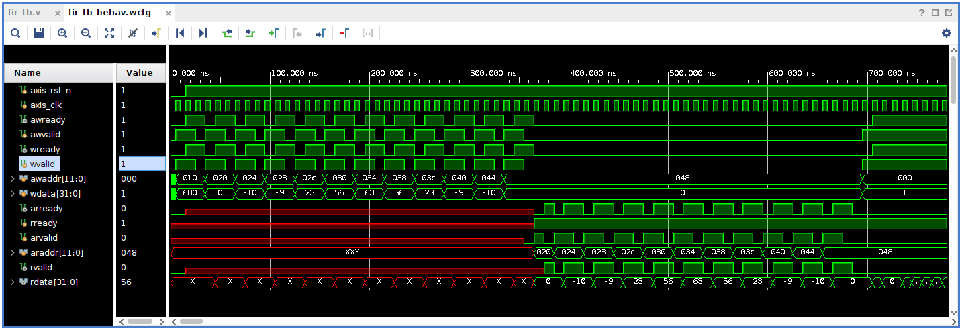
Axilite access timing

Slide 9
Special cases handling
Special Case
  X input too fast / too slow
  Y output too fast / too slow
To Do List
  Add Input data register
  Add Output data register

Slide 10
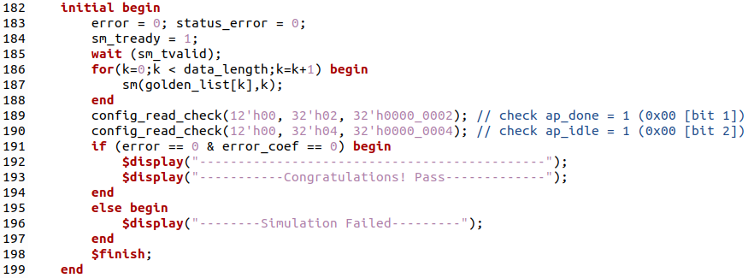
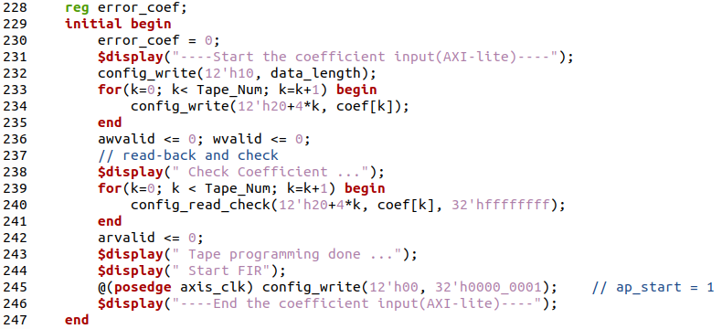
Testbench

Slide 11
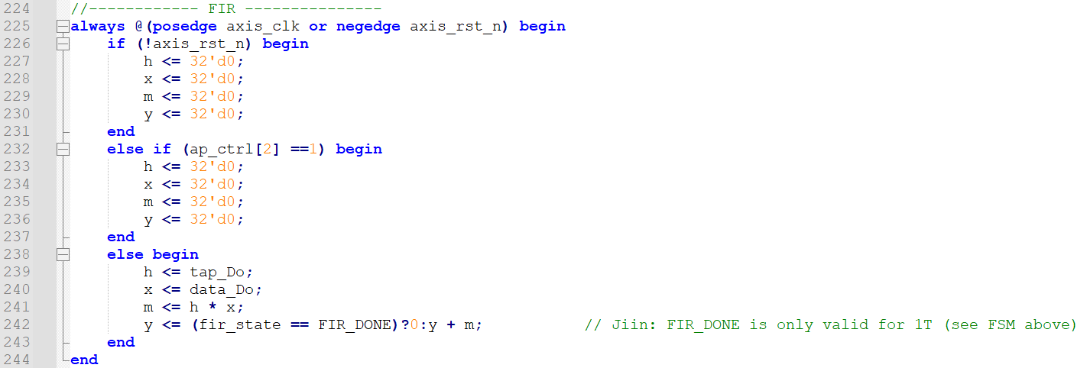
Code Review Questions
FIR

Slide 12
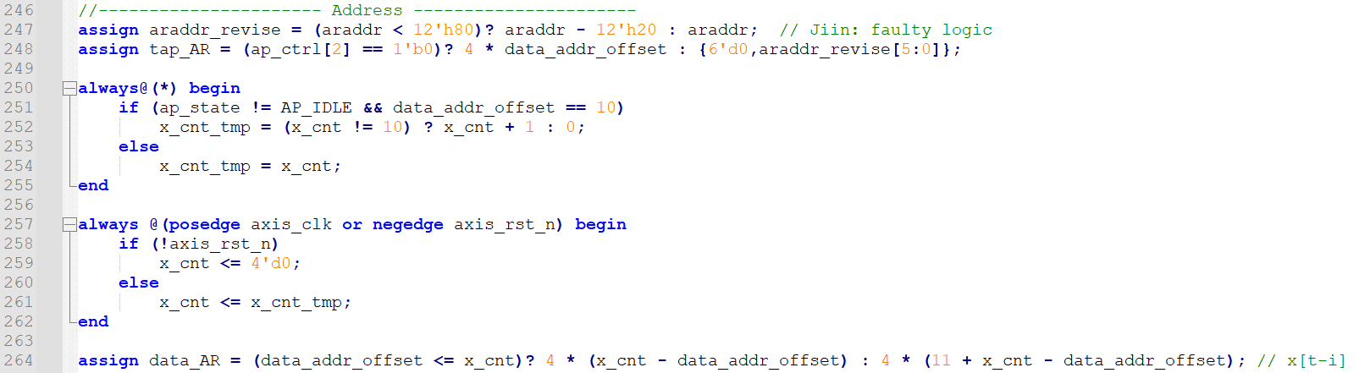
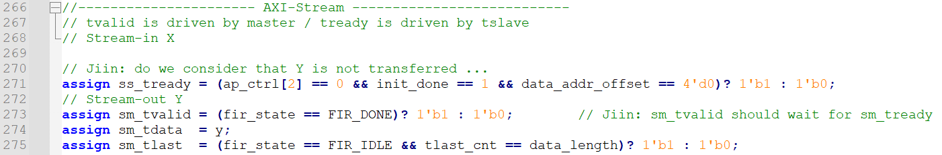
Code Review Questions
Address
AXI-Stream

