Slide 1
Lab4 Caravel-FIR Hardware-Software Codesign
陳瀚坪 姜維 吳鎧帆

Slide 2
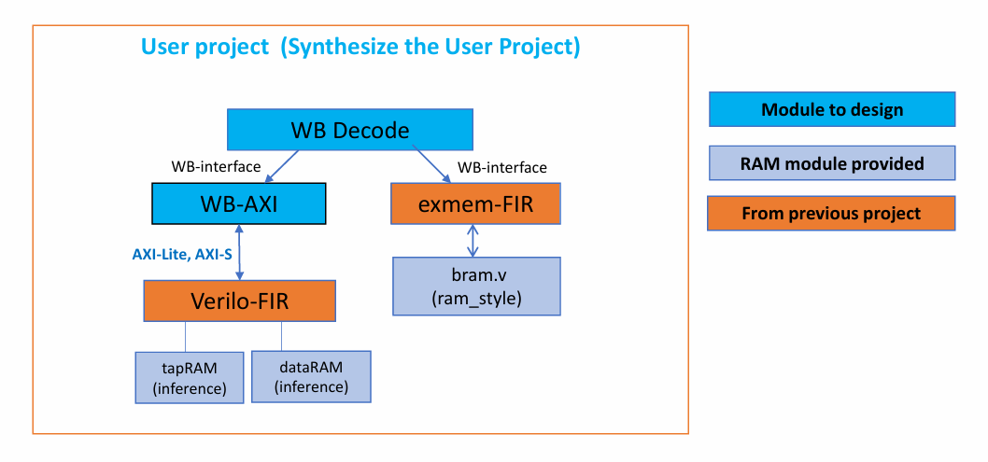
Block Diagram
Datapath
0x_3000
0x_3800

Slide 3
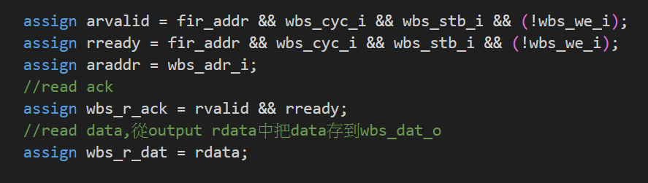
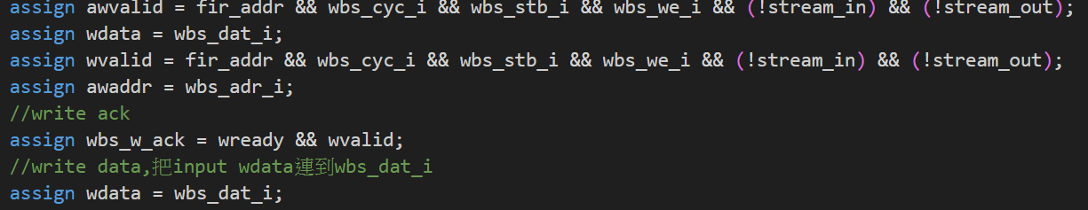
AXI read and write

Slide 4
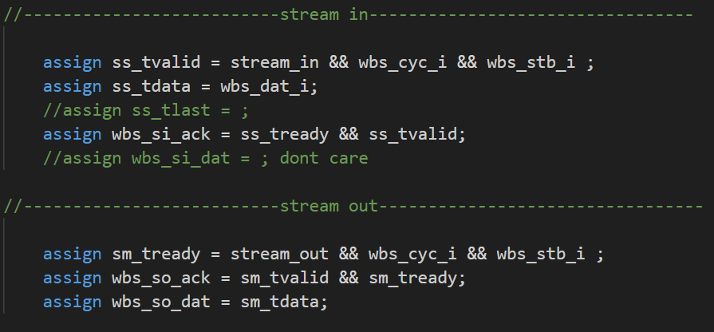
stream in and out

Slide 5
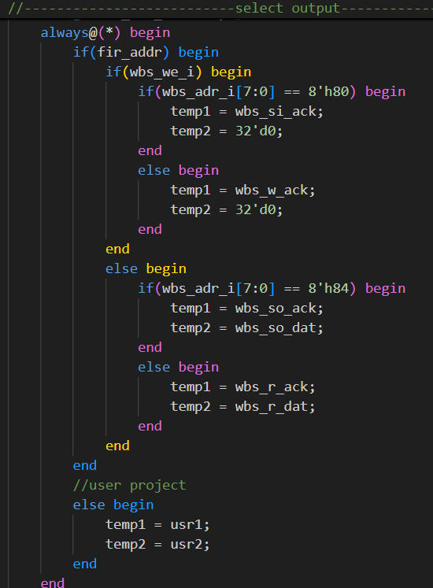

Slide 6
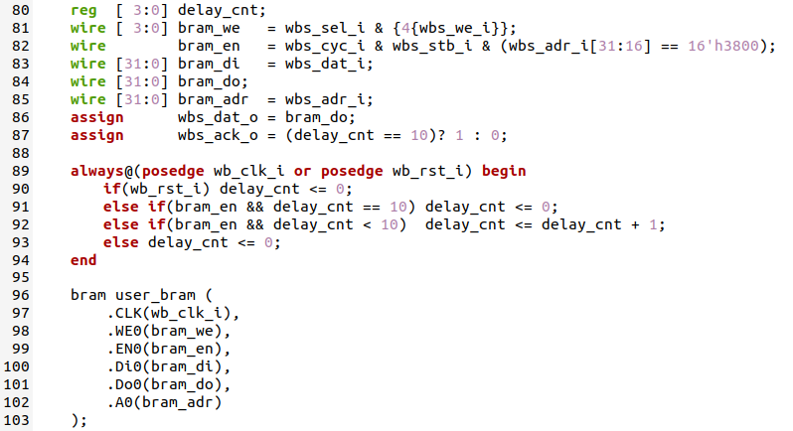
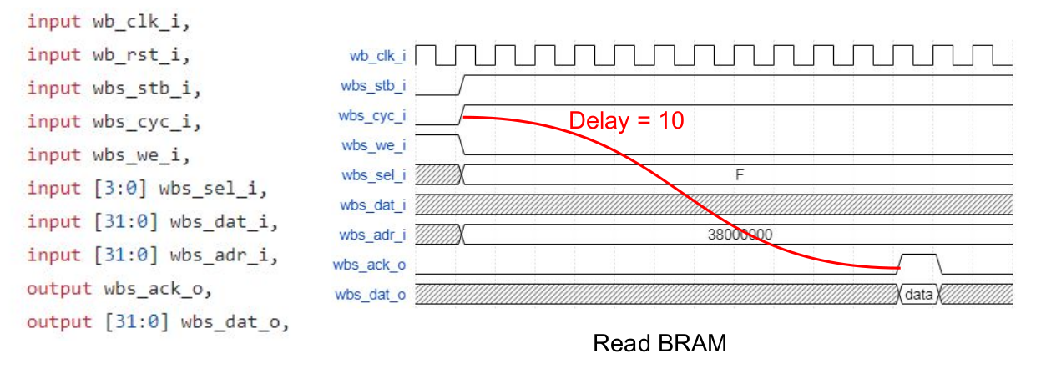
Block Diagram
Exmem FIR

Slide 7
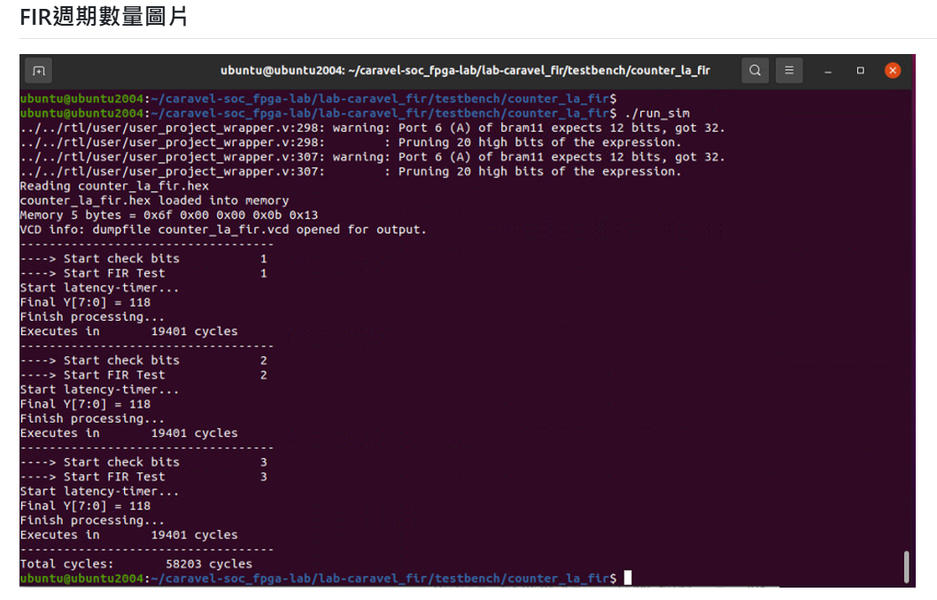
Waveform
Waveform (303T / per Y)
32’d10614 = 32’h2976 (76_{h} = 118_{d})

Slide 8
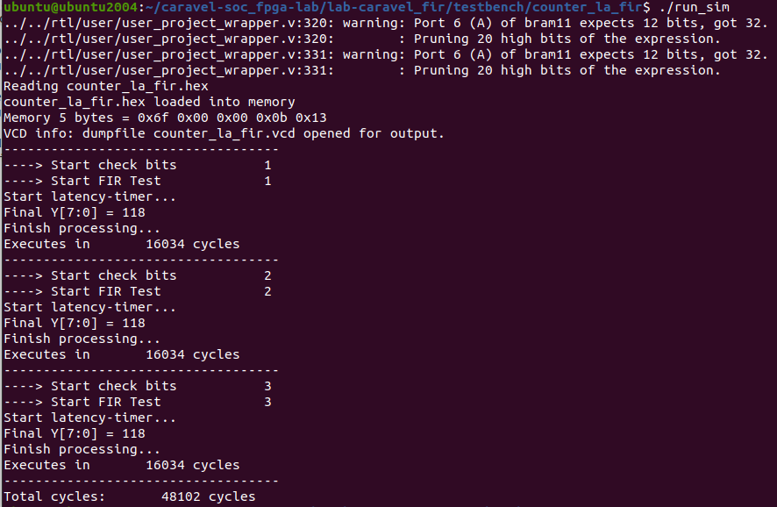
Waveform (Instruction Reorder )
Waveform (243T / per Y)
36cycle(SS) + 67cycle(Fir.v) + 140cycle(SM)

Slide 9
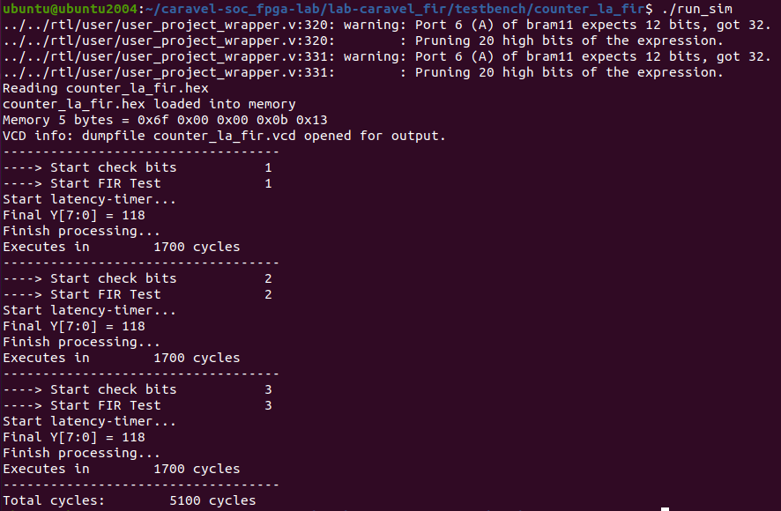
Waveform (Instruction Reorder & -O2)
Waveform (23T / per Y)
9cycle(SS) + 14cycle(Fir.v)

Slide 10
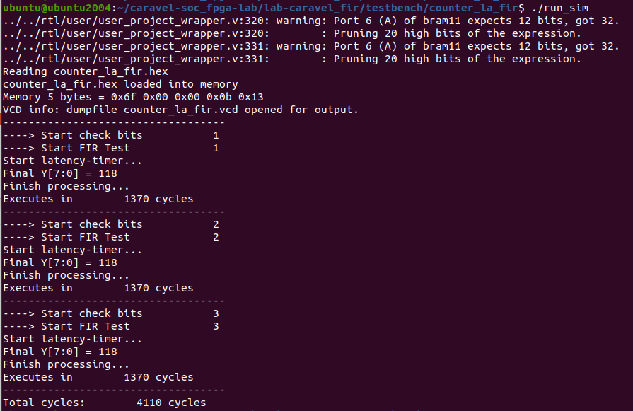
Waveform (Instruction Reorder 2 & -O2)
Waveform (16T / per Y)
2cycle(SS) + 14cycle(Fir.v)

Slide 11
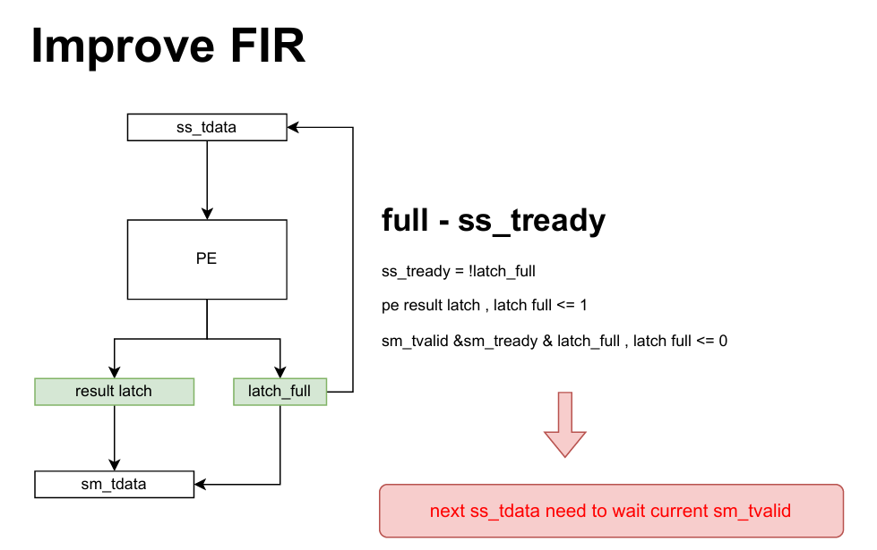
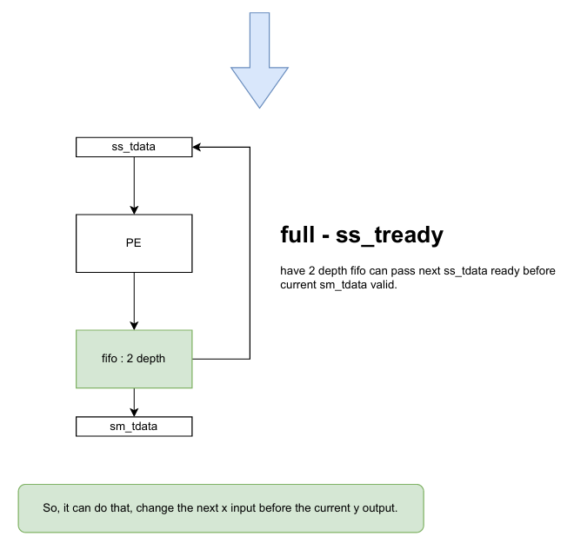
Improve FIR

Slide 12
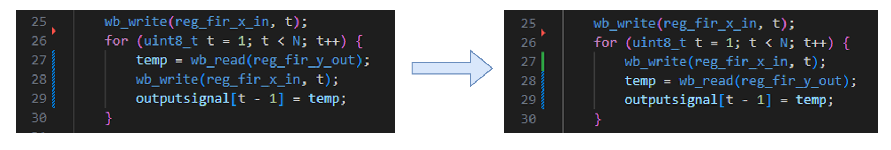
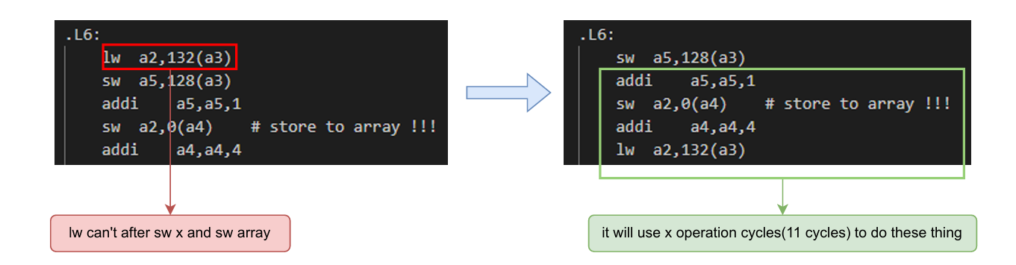
Fir.c

Slide 13
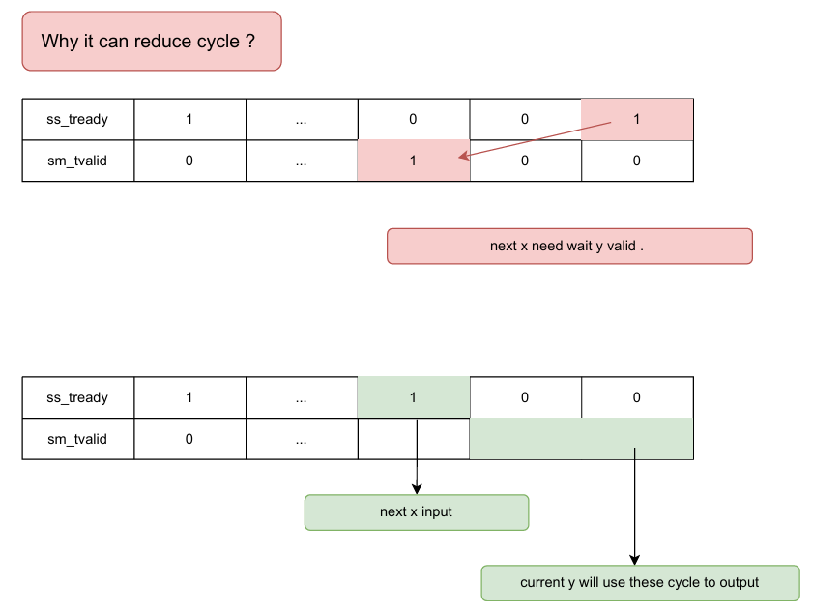
Why it can reduce cycle ?

Slide 14
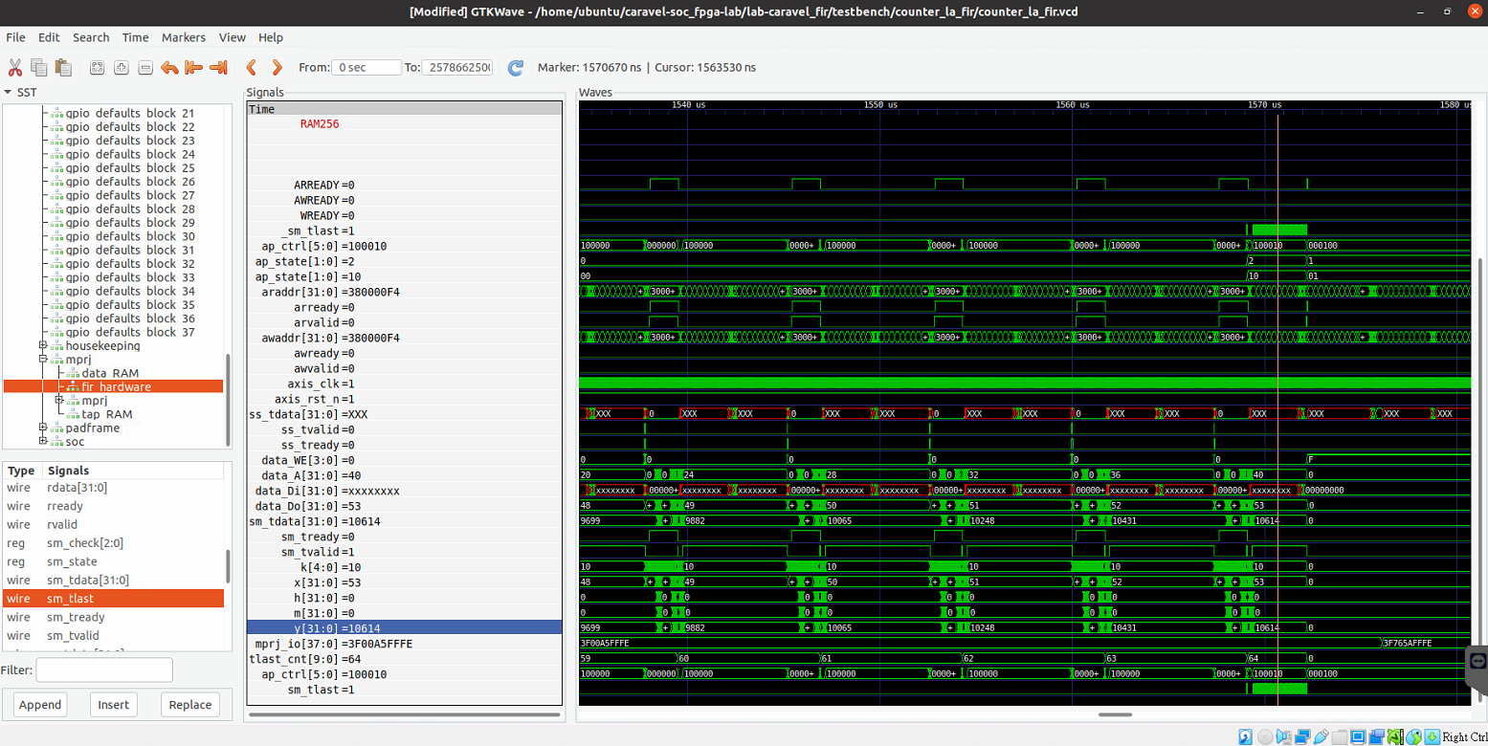
Waveform
Waveform

Slide 15
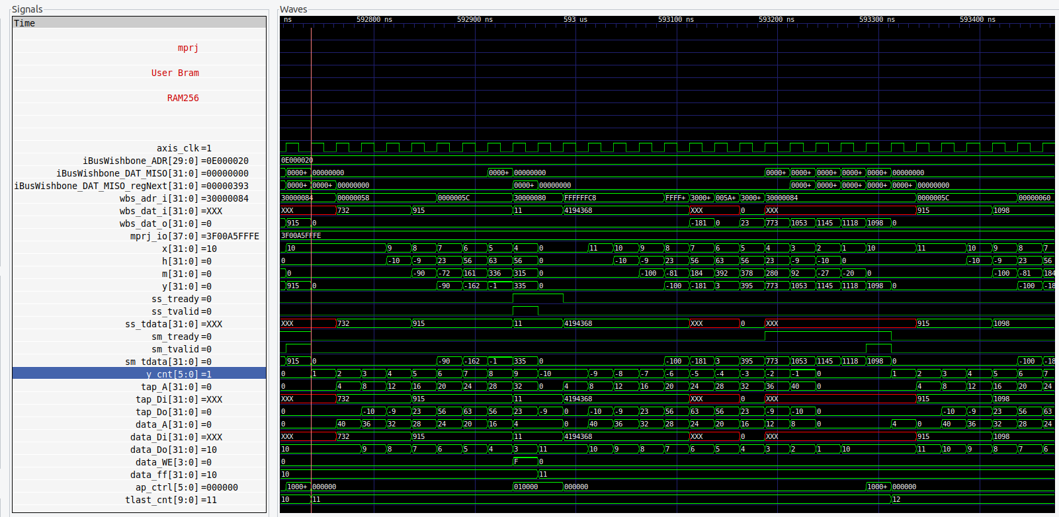
Waveform (Optimization)

Slide 16
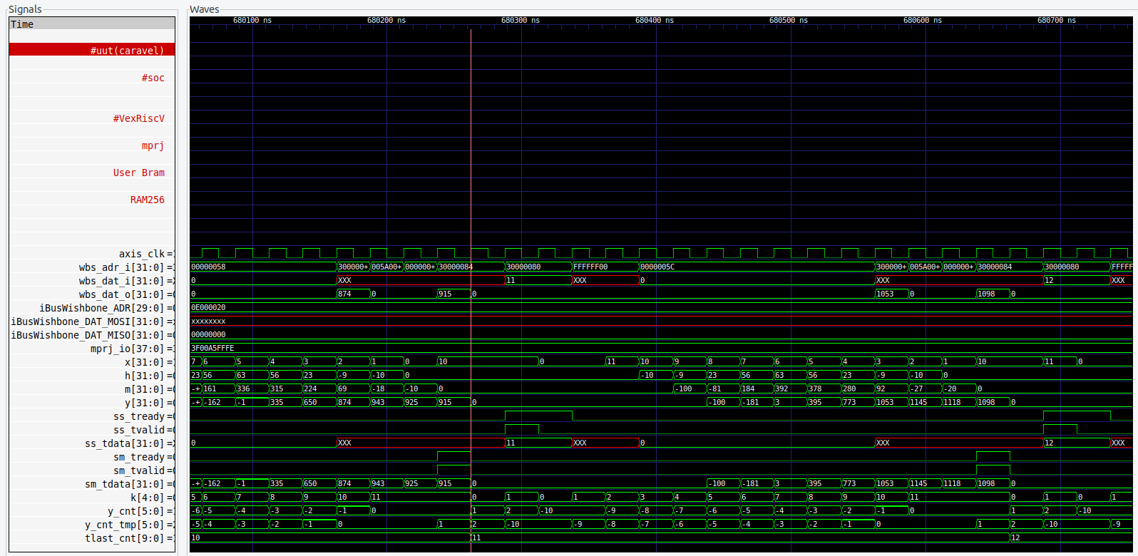
Waveform (Optimization 2)

Slide 17
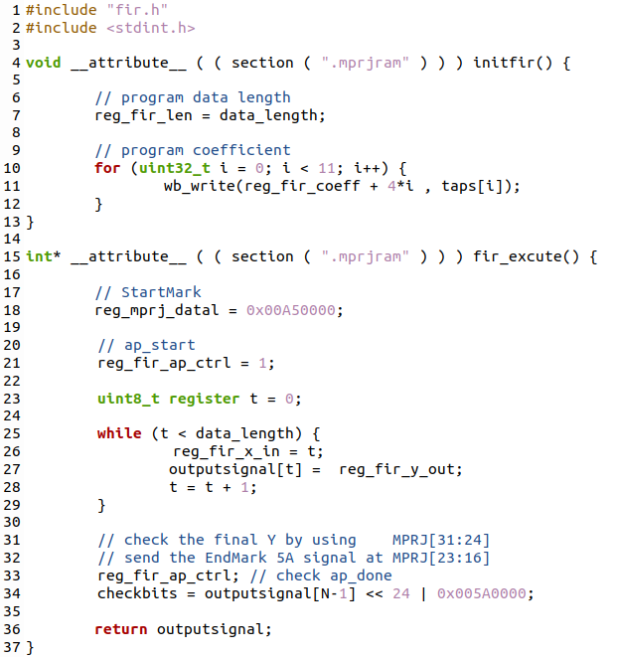
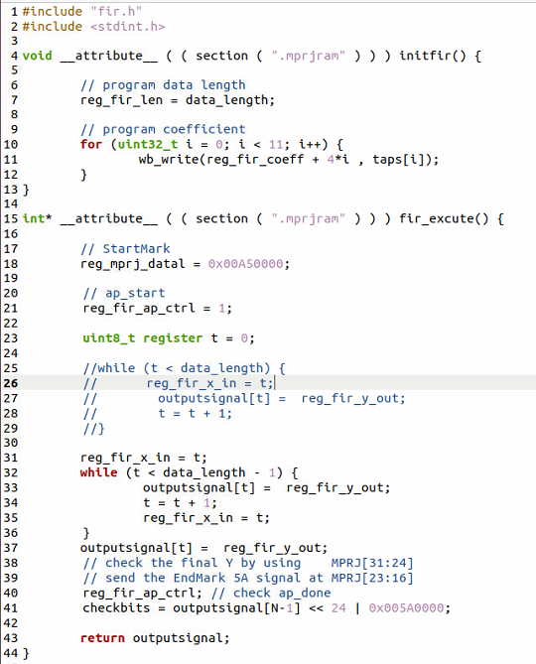
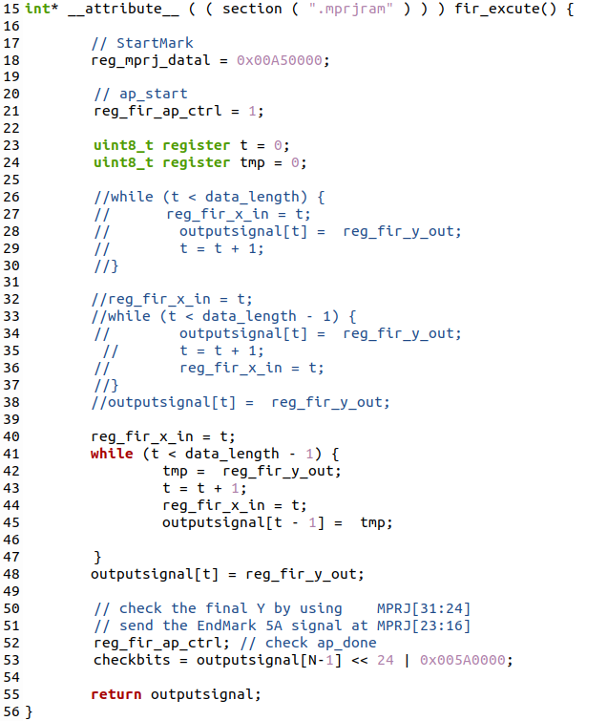
Fir.c (Optimization)

Slide 18
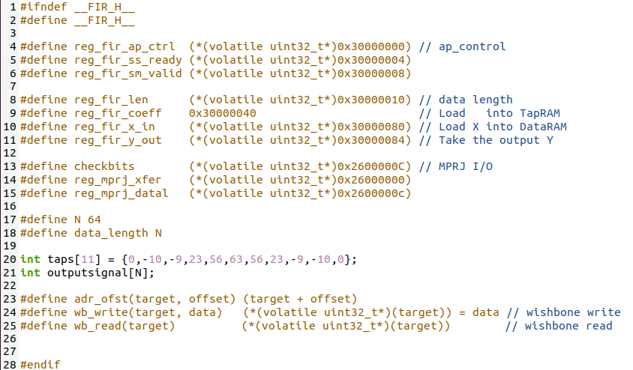
Fir.h

Slide 19
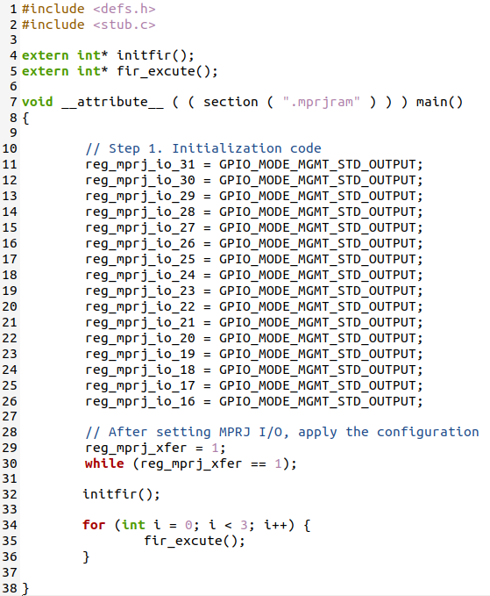
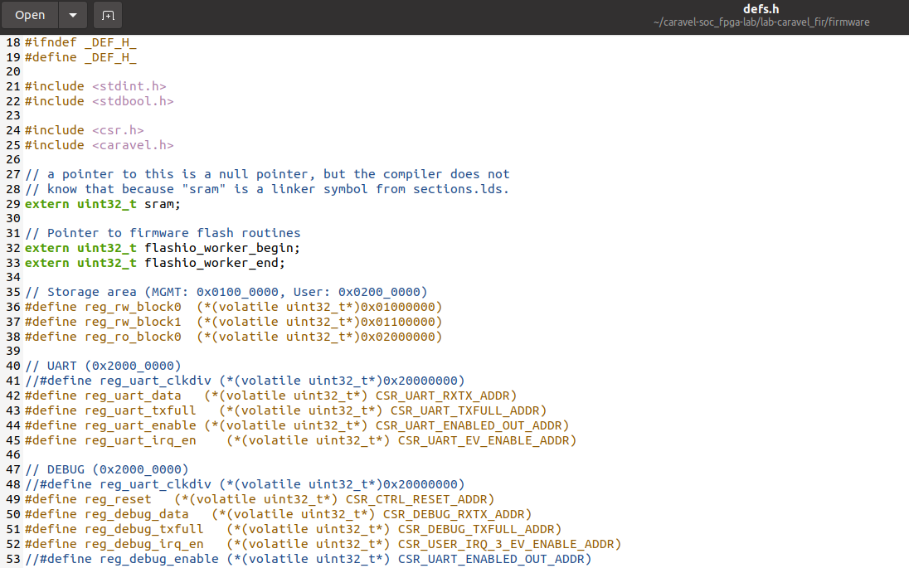
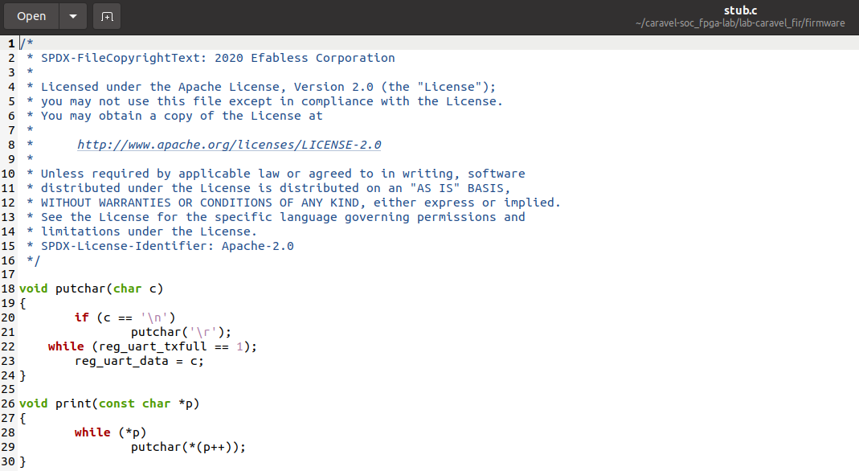
Fir_control.c

