Slide 1


GROUP INNOVATION COUNCIL
– march 2018
Blockchain and
Distributed Ledger Technology

Slide 2



AGENDA
15:30 – 15:35
15:35 – 16:20
16:20 – 16:55
16:55 – 17:00
(5 mins)
(45 mins)
(35 mins)
(5 mins)
Welcome & Opening Statement by Peng Khim Ng
Panel Discussion on Blockchain & DLT facilitated by Greg Morwood
Shaping the house view on Blockchain & DLT led by Peng Khim
MOJO

Slide 3
The Blockchain numbers
77%
150+
Of global financial services industry expected to adopt blockchain as part of a production system or process by 2020, according to PwC
Proof-of-concept (POC) conducted by Chinese vendors. Forrester estimated that 30% of them are already in production
10
The number of years since Satoshi Nakamoto first publicly conceptualized the use of bitcoin on the blockchain public ledger
100+
17,000+
Financial Institutions on R3 and RippleNet. Two other major consortia - Hyperledger and Enterprise Ethereum Alliance (EEA) also have over 100 members
Blockchain nodes built for SMEs by PingAn Group, storing tamper-resistant data for KYC information sharing

Slide 4
AGENDA
15:30 – 15:35
15:35 – 16:20
16:20 – 16:55
16:55 – 17:00
(5 mins)
(45 mins)
(35 mins)
(5 mins)
Welcome & Opening Statement by Peng Khim Ng
Panel Discussion on Blockchain & DLT facilitated by Greg Morwood
Shaping the house view on Blockchain & DLT led by Peng Khim
MOJO

Slide 5



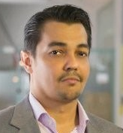
The panel
Dr. Paul Sin – Deloitte Hong Kong
Stanley WK Yong – IBM Singapore
Anthony Lewis – R3 Singapore
Mike Cowans– Ripple Singapore
Paul has 20 years of IT management & consulting experience focusing on financial services sector, currently leading the FinTech practice and Asia Pacific Blockchain Lab in Deloitte. Prior to Deloitte, Paul served as CEO of Fintech, CIO for bank, brokerage firm, and global conglomerate, as well as practice leader for EY, PwC, and IBM, specialized in emerging technologies and advanced analytics.
Stanley is the Global Lead on Central Bank Digital Currency solutions at IBM Blockchain, where he leads a team that builds out crypto-token management products, and advises Central Banks on strategies to deal with the rise of digital currencies
Antony is Director of Research for R3’s Lab & Research Centre in Singapore. In this role he researches and explains the evolving concepts, technologies and vendors in the distributed ledger technology landscape for R3 members, policymakers, and the wider Singapore and APAC community.
He has been working professionally in the distributed ledger industry since 2013 and also writes a personal blog explaining this technology at ‪www.bitsonblocks.net.
Mike Cowans leads Ripple's commercial team and activities across Asia Pacific as Ripple's Regional Sales Director, based in Singapore. With a well-established track record in the technology industry spanning more than 15 years, Mike has previously led sales teams at IBM, FileNet, and Interwoven, and has significant experience supporting large, global banks with the launch and integration of transformational technologies.

Slide 6
AGENDA
15:30 – 15:35
15:35 – 16:20
16:20 – 16:55
16:55 – 17:00
(5 mins)
(45 mins)
(35 mins)
(5 mins)
Welcome & Opening Statement by Peng Khim Ng
Panel Discussion on Blockchain & DLT facilitated by Greg Morwood
Shaping the house view on Blockchain & DLT led by Peng Khim
MOJO

Slide 7







What is Blockchain
 | Blockchain is a type of distributed database system that maintains exact copies of data across a network of computers (nodes) without the need for a database master
 | Cryptography is used to ensure that copies across the network are identical and enforced specific access permission
 | Transaction represent a transfer of information between two or more addresses within the network
 | There are different models for how transactions are validated and consensus between nodes is achieved
 | Blockchain can either be implemented as public, private or hybrid solutions
 | Smart contracts are computer protocols that facilitate, verify, execute and enforce the terms of a commercial agreement with the ability to execute and move value
Source: Accenture

Slide 8


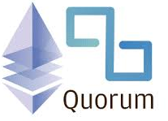


In the market, there are a number of blockchain software companies without an obvious leader.
Description | Specialized distributed ledger platform for financial industry | Modular blockchain platform | Enterprise-focused version of Ethereum. | Payments Blockchain | Data structure and consensus algorithm that is fast, secure, and fair
Consortium | R3 (Company) - Consortium of 70 Financial Inst.) | Linux foundation | Quorum developers | Ripple Labs | Hashgraph Council (Up to 39 Businesses and Organizations)
Information Privacy | Private | Public, Private, Hybrid | Private | Public | Public, Private
Consensus | Specific and uses Notary nodes | Configurable consensus model (e.g. NOOPS or PBFT) | Configurable consensus model (e.g. RAFT) | Ripple Protocol | Specific and uses Virtual Voting Consensus model
Smart contracts | Smart contract code written in Kotlin or Java | Smart contract code (e.g., Go, Java) | Smart contract code (Solidity) |  | Smart contract code (Java)
Other Notes: | Specialized for use with regulated financial institutions. |  | Uses Ether as transaction currency Competitive with SWIFT, R3, Ripple and other interbank payment solutions | Provides Enhanced Messaging system Inter leger Protocol to link different block chain tools | Next Generation Blockchain Uses Gossip protocol to propagate messages to achieve high TPS
Associated banks | Citibank Barclays Goldman Sach JP Morgan | ANZ | JP Morgan* *(Mulling to Spin off Quorum 23rd Mar Reuters news) | MUFG Mizuho Bank of Yokohama | Unknown
Notes:
[‎26/‎03/‎2018 8:28 AM] Yee Seng Chua:
https://www.reuters.com/article/us-blockchain-jpmorgan/jpmorgan-mulls-spin-off-of-blockchain-project-quorum-sources-idUSKBN1GY36O
[‎26/‎03/‎2018 8:28 AM] Yee Seng Chua:
https://www.reuters.com/article/us-blockchain-jpmorgan/jpmorgan-mulls-spin-off-of-blockchain-project-quorum-sources-idUSKBN1GY36O

Slide 9





To understand Blockchain – its important to how the consensus works
 | Compute | Throughput | Security | Examples
Leader-based Systems | Low | Moderate (> 1000 TPS) Low Scalability | Immutable Audit Susceptible to DDOS Attack Non-repudiation | Hyperledger Fabric, R3 Corda, Quorum
Proof of Work Blockchain | High | Low TPS (< 30 TPS) Low Scalability | Miner can influence data DDOS Resilient Non-repudiation | Bitcoin Ethereum
Economy-based | Low | High Availability Moderate TPS (> 1000 TPS) | Immutable Audit DDOS Resilient Non-repudiation | Casper, IOTA, EOS, Tezos
Voting-based Systems | Low | Poor Scalability Low TPS High Availability | Immutable Audit Non-repudiation | None – Not practical
Virtual Voting | Low | High (>100,000 TPS) High Availability High Scalability | Immutable Audit DDOS Resilient Non-repudiation | SWIRLD - Hashgraph

Slide 10
To-date, DBS had participated and experimented on Blockchain in the last 2 years
 | Initiatives | Category | What is it about | What problem does it try to solve? | Current Stage
1 | Trade Safe | Trade related | A blockchain platform to share trade finance invoice data confidentially between banks | Detect and arrests fraudulent invoices (e.g duplicate invoicing) | POC Completed. No further plans.
2 | Project Ubin Phase 1 | Inter-bank Payment | Proof-of-concept (PoC) to conduct inter-bank payments using Blockchain Digital Cash-on-Ledger concept | Evaluate implications of having a tokenized form of SGD on a DL, and its potential benefits to our financial ecosystem | POC Completed. No further plans.
3 | Project Ubin Phase 2 | Inter-bank Payment | Test the concept of decentralizing Liquidity Saving Mechanisms (LSM), maintaining privacy of banking transactions Domestic Delivery Versus Payment on Securities, SGS Bond chain settlement | To prove that RTGS functions may be decentralized without comprising privacy Pending SGX on prioritization | POC Completed. On hold – pending SGX
4 | Global Trade Connectivity Network (GTCN) | Trade related | Collaboration between MAS and HKMA to digitize trade-finance documents using Blockchain on Singapore and HK trade corridor | Extension of the NTP platform to support cross border trade finance on Blockchain | Initial Study

Slide 11
Potential Use cases
IMPROVED VALIDATION AND AUTHENTICATION | A Blockchain supports swift distribution of authentication rights, thereby improving security and helping to prevent fraud
ACCELERATED PURCHASE ORDER MANAGEMENT | Purchase order and good receipt data would be exchanged on the blockchain at an accelerated pace when compared to current performance level
RESHAPED INVOICE PROCESSING | Invoice scanning would no longer be required, with the exchange of invoices supported by the blockchain
ACCELERATED SETTLEMENTS | Settlements would be accelerated as reconciliations and vendor enquiries would not longer be required due to complete transparency and real-time access to the shared database
REDUCED MONEY LAUNDERING RISK | Due to historic payment being retained, suspicious transactions can be more easily identified
ENHANCED STAKEHOLDER TRUSTS | Transactions are stored and a tamper-proof audit trail is maintained
STRONG AUDIT TRAIL | Blockchain helps to increase trusts among clients and vendors through shared public IDs, simple and fair referral mechanisms and reliability in delivery and timely payment of invoices
Source: Accenture

Slide 12
From our internal NorthStar Workshop
Where are our commercials?
Do we partner to build capabilities now?
Your Path to NorthStar | 2018 |  |  | 2019 |  |  | 2020
Focus Area | Training & Exploration |  |  | Build Capabilities & Evaluate |  |  | Launch & Scale Up
 | % of FTE trained in Blockchain technology | Form Blockchain Platform Council | Explore 4 use-cases in X-border, Commodities Supply Chain, Healthcare & Risk KYC | Running of Blockchain Centre of Excellence | Explore other use-cases in blockchain (CBG/IBG/T&M/SU) | Scale up Blockchain FTE & Budget | Press Release 1st ever Production Grade Blockchain Implementation in Market | Build Production Grade with Ecosystem Partners on Blockchain
Business Initiatives | Identify Key customers & partners in the 4 ecosystem |  |  | Identify & engage other customers/partners to participate in ecosystem | New Business Development from POCs |  | Launch 1st ever DBS Blockchain Business
Tech Initiatives | Identify Technology Partner | Build Blockchain Sandbox Environment | Build POC with identified customers & partners | Scale up Infrastructure to support Testing | Build up DAH2 capabilities for development and support | Industry testing with identified customers/partners | Build & Scale up infrastructure to support production | Work with Tech Counterpart on Implementation Plan to scale up

Slide 13

Next Regional Innovation Council
Monday 7 May @ DAX
Topic
The Future of Payments
CLOSING
Thank You

Slide 14
Appendix

Slide 15




Industrial Led Use Case: Blockchain for Real time Low Value e-Payment
Objective: To improve Traceability, Reconciliation and Intraday Liquidity Monitoring
High Value Payment – SWIFT GPII and CLS
Real time Cross Border Low Value Payment – Potentially Blockchain
Pay
Between 2 countries
Fulfilment
Border
DBS Bank
Singapore
Consumer
Business
K Bank
Thailand
Payment Ack
DBS Pre-fund THB Account Ledger with MAS
SGD – Cash Collateral (NDC) pledged against THB account
Realtime visibility of THB account ledger at MAS (Risk is mitigated) – THB Payment honored
1
2
Settlement
Using MEPS+ to settle Locally
MAS
MEPS+
BoT
BAHTNET
Using BAHTNET to settle Locally

Slide 16
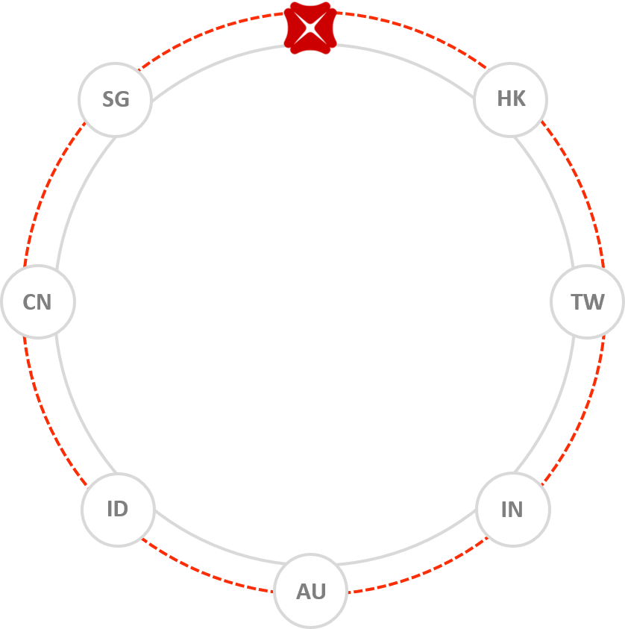
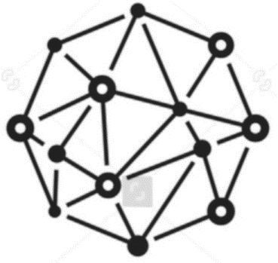
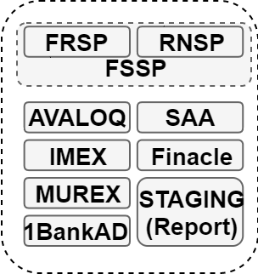
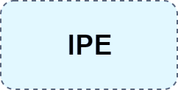

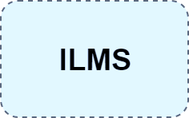
Internal Use Case: Blockchain for Inter-branch Payment & Funding
Blockchain to provide real time and tamper-proof update
Centralized common pool for auto funding
To reduce buffer in individual settlement funding account
FX Conversion
FX rates published by RET/TZ.
Common Pool
Common pool of fund for payment settlement in different countries.
Auto Sweeping
A new function to gradually disperse the fund from common pool, if any of the collateral account drop below threshold level.
Initial Study:
After discussion with T&M Ops and Tech, it was concluded that this use case is NOT essential for now. Due to:
The ILMS implementation over the last two years had achieved the purpose of intraday nostro reporting.
ILMS already has auto-sweeping functionality.

Slide 17

Internal Use Case: Blockchain for Securities Settlement
Problem statement:
Client selling shares in HK Exchange. On Settlement day, there is a need to sight funds in DBSSG Nostro account with DBS HK before releasing the funds to customer and Recon team need to perform nostro account reconciliation daily
Current Process:
Using Blockchain:
MT 940 recon
Settlement + 1 Day
MT 940 recon
Settlement +1 Day
Instruction – sell shares in HK Exch.
Instruction – sell shares in HK Exch.
1
1
DBS
Singapore
(Client)
Sell
DBS
Hong Kong Br
(Custodian)
DBS
Singapore
(Client)
Sell
DBS
Hong Kong Br
(Custodian)
Receive cash on Settlement + 1 Day
Settlement confirmation
Potentially Receive cash on Settlement Day
Settlement confirmation
4
3
2
Sight
Fund
2
On receiving Settlement confirmation message, SG Custody will generate Credit Client instr. and drop to repair, pending sight funds in DBSHK account
Once funds sighted or receives MT940, Credit client instr. will be released from repair Queue.
Settle / CHATS
Sell
3
4
Settle / CHATS
Sell
5
CCASS will CR funds to DBS HK Br Account
IPE HK Br will CR funds to DBSSG Nostro account
How Blockchain optimized Settlement:
MT940 Statement not required as information is on distributed ledger
Improved reconciliation and traceability as blockchain captures complete settlement information
Integrate with internal payment system for immediate cash settlement to Improve customer journey / experience
HK Exchange
CCASS
HK Exchange
CCASS
6
Sight
Fund

Slide 18
Use Case of Blockchain in Cross-border Trade Flow
Improve Traceability
Blockchain enables the linking of various ecosystems together, improving traceability in a trade transaction lifecycle.
Improve Efficiency
Reduce manual efforts on duplicated data input and document reconciliation
2. Mitigate Risk
Lower the risk of trade fraud and duplicate financing

Slide 19
Set Questions for Panel Discussion
There is probably no innovation area in the business world that is currently more hyped and less broadly understood at the moment than blockchain.
What do you see as the most compelling use cases in the Blockchain/DLT sphere now for Banks to be involved in – the ones where we will see real value for our involvement, even if it is just the value of being actively involved in the journey.
There is the original blockchain plus many variants, such as Hyperledger, Ripple, Ethereum, Hashgraph, the R3 consortium with Corda and numerous other technologies all vying to be the one unifying technology in the Distributed Ledger world.
Do you foresee that eventual there be just one blockchain platform “to rule them all”, or will we end up with a variety of platforms used in various ecosystems and use-cases?
What are the blockchain consortia doing that individual start-ups are not?
Regulators globally are grappling with how the question of how best to control blockchain-related activities.
What do you see as the key regulatory challenges facing the use of the blockchain for financial services solutions?
(While not wanting to stay into a discussion on crypto-currencies too much) In the long term, will central bank-issued digital versions of fiat currencies be essential to the future of financial transaction settlements on the blockchain?

Slide 20
Appendix (FYR only) – Other Stats
Blockchain Startups Absorbed 5X More Capital Via ICOs Than Equity Financings In 2017⁰
Bitcoin hit a high of nearly $20,000 in December 2017; and then lost two-thirds of its value in just over a month¹
Since the beginning of 2017. the daily value of Bitcoin against the US Dollar has fluctuated about 20 times more than the Singapore Dollar did against the US Dollar²
‘Long Island Iced Tea’ changed its name to ‘Long Blockchain Corp” saw its stock leaped more than 200 percent at the open of trading³
Startups and Projects raised $5.6 billion in 2017 through ICOs⁴
EOS, a blockchain platform that is still under development, raised $700 million, with the value of all EOS in circulation now at $3.8 billion⁵
According to Forrester, Chinese blockchain vendors have conducted more than 150 proof-of-concepts (POC) initiatives for their customers, 30% of them are estimated to be already running in production environment⁶
Ping An has built over 17,000 blockchain nodes for SMEs⁷ ; and filed 57 blockchain related patents⁷
100+ global financial institutions and regulators on R3⁸
100+ financial institutions on RippleNet; 11 of the world’s top 100 banks by total assets are on RippleNet
Since mid-2014, more than 50 of world’s major financial services institutions have invested in blockchain, with Citi, Goldman Sachs, JP Morgan amongst the most active ones¹⁰
Over 100 members on Hyperledger and the Enterprise Ethereum Alliance¹¹
10% - predicted amount of the world’s gross domestic product that will be stored in blockchain technology by 2025, according to a 2015 survey from the World Economic Forum ¹²
77% of global financial services industry is expected to adopt blockchain as part of a production system or process by 2020, according to PwC¹³
Notes:
Source:
0. https://www.cbinsights.com/research/blockchain-vc-ico-funding/
http://www.mas.gov.sg/News-and-Publications/Speeches-and-Monetary-Policy-Statements/Speeches/2018/Crypto-Tokens-The-Good-The-Bad-and-The-Ugly.aspx
http://www.mas.gov.sg/News-and-Publications/Speeches-and-Monetary-Policy-Statements/Speeches/2018/Crypto-Tokens-The-Good-The-Bad-and-The-Ugly.aspx
https://www.cnbc.com/2017/12/21/long-island-iced-tea-micro-cap-adds-blockchain-to-name-and-stock-soars.html
hhttp://www.businessinsider.sg/how-much-raised-icos-2017-tokendata-2017-2018-1/?r=UK&IR=T
http://fortune.com/2018/03/16/john-oliver-eos-brock-pierce-scandal-cryptocurrency/
Forrester, Vendor Landscape: Blockchain Technology Providers in Asia Pacific
http://livewebcast.todayir.com/pingan_17ar/ppt.pdf
http://stock.pingan.com/main/a/20180207/17242172.shtml (each node contains data about the SME that cannot be forged and tampered, which helps with SME financing, http://tech.pingan.com/en/paas_block.shtml )
8. https://www.reuters.com/article/us-r3-blockchain/bank-backed-r3-launches-new-version-of-its-blockchain-idUSKCN1C80MS
9. https://ripple.com/insights/ripplenet-grows-to-over-100-financial-institutions/
10. CB insights
11. CB insights, Blockchain Investment Trends in Review
12. Scientific America, Jan 2018
13. PwC. https://www.pwc.com/gx/en/industries/financial-services/assets/pwc-global-fintech-report-2017.pdf

