Slide 1
How to count with the scanner
Day 1 · Counting crew
Scan the pallet. Type what is there. Scan the rack.
That is the whole job — these slides show every step.
Notes:
Welcome. Today you learn the scanner. The job is three steps, over and over: scan the pallet label, type how many cases are really there, scan the rack label. Everything else is the scanner helping you when something is unusual. The film shows the same steps slowly; these slides are the same lesson to keep.

Slide 2
Before you start
Part 1
The scanner, its buttons, and your language.
Notes:
The scanner, its buttons, and your language.

Slide 3
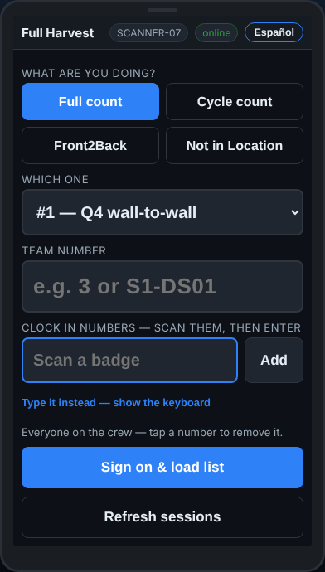
This is your scanner
Part 1 · Before you start
The trigger reads a barcode. Wait for the beep.
The number keys type a quantity, then Enter.
The screen asks one thing at a time, in big letters. Read the top, do what it says.
Pallet · Quantity · Rack — over and over
Notes:
Hold up a scanner. Show the trigger, the number keys and the screen. The screen in the middle of every slide is the real app.

Slide 4
English or Spanish
Part 1 · Before you start
The Español button at the top right switches the whole screen to Spanish.
It stays that way on this scanner until somebody switches it back.
The office always reads English, whichever you use.
Notes:
Tap Español once; tap English to go back. Nothing else changes.

Slide 5
Signing on
Part 2
Your team card, your badges, and your aisle.
Notes:
Your team card, your badges, and your aisle.

Slide 6
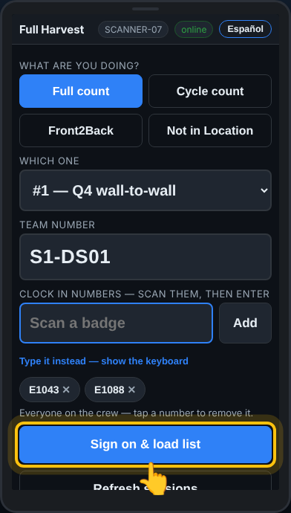
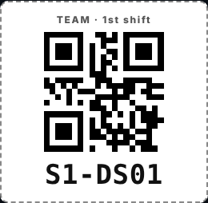
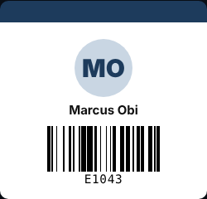
The team card, then every badge
Part 2 · Signing on
1 · Scan the team’s QR card into Team number. No typing.
2 · Everybody on the crew scans their badge. Each name shows on the screen.
3 · Tap Sign on & load list. The scanner downloads the count and keeps working with no Wi-Fi.
Notes:
Each team has a printed card with a QR code. Scan it where it says Team number. Then each person scans their own badge. Tap a number on the screen to remove it if it is wrong. Then Sign on.

Slide 7
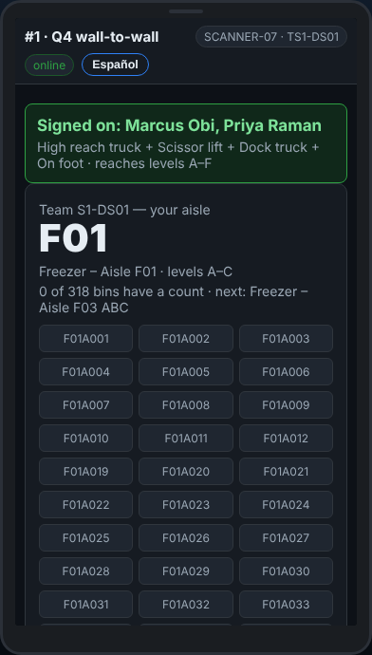
Your aisle
Part 2 · Signing on
The scanner gives your team its aisle and the levels you count.
Only your team works this aisle right now.
When you are at the aisle, tap Start counting.
Aisle F01 · levels A–C
Notes:
The aisle is chosen by the office. You never pick one. If the screen says the aisle is still being counted by another team, wait: it starts by itself when the racking is free.

Slide 8
Counting a pallet
Part 3
Three steps, over and over: the pallet, the quantity, the rack.
Notes:
Three steps, over and over: the pallet, the quantity, the rack.

Slide 9
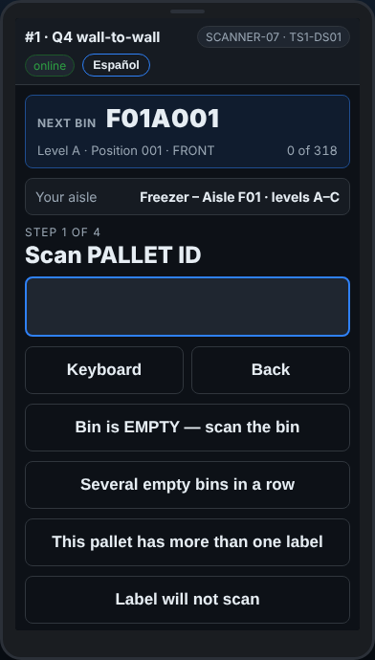
Where to go next
Part 3 · Counting a pallet
The box at the top says Next bin — the spot to go to.
It walks you down the aisle in order, so nothing is missed.
Follow it. Do not jump around the aisle.
Notes:
Point at the Next bin box. Explain the code: F01 is the aisle, A the level, 001 the position.

Slide 10
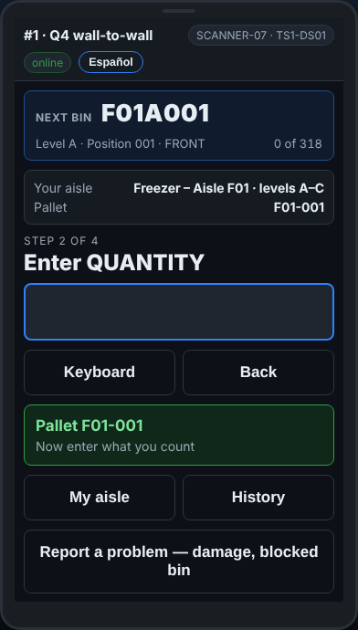
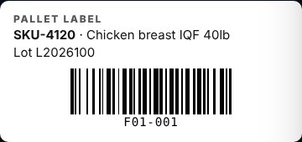
1 · Scan the pallet label
Part 3 · Counting a pallet · Step 1
Point the scanner at the barcode on the pallet label. Pull the trigger. Wait for the beep.
The scanner shows the pallet number. It does not tell you how many should be there.
A blind count: you count what is in front of you
Notes:
Show a real pallet label. The barcode is what the scanner reads. The scanner says Pallet F01-001 and nothing about what is on it: that is on purpose.

Slide 11
2 · Count, then type the quantity
Part 3 · Counting a pallet · Step 2
Count the cases that are really there.
Type the number on the number keys, then press Enter.
Never type what you think it should be. A big number may need typing twice.
Notes:
This is the step that matters. If the pallet says 48 and you count 45, type 45. The office works out the rest.

Slide 12
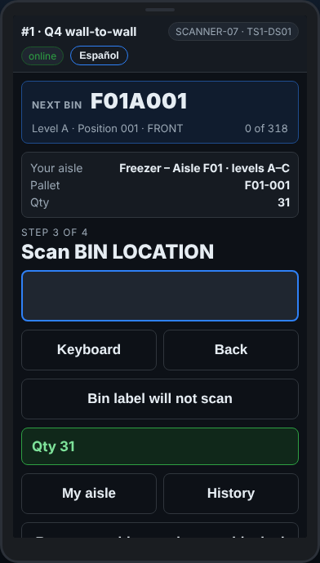
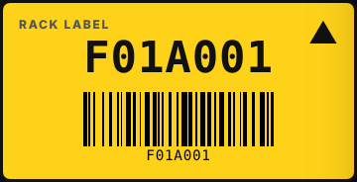
3 · Scan the rack label
Part 3 · Counting a pallet · Step 3
Scan the yellow rack label of the spot the pallet is sitting in.
That tells the system where the pallet is.
The scanner checks it is in your aisle and on your levels.
Notes:
Show a rack label. It is on the beam under the pallet. Scan the one for the spot the pallet is in, not the one next to it.

Slide 13
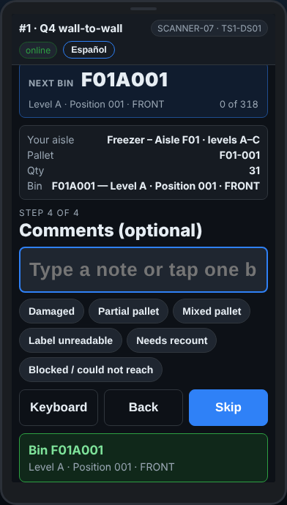
4 · A comment, if there is one
Part 3 · Counting a pallet · Step 4
The scanner offers quick reasons — damaged, partial, and so on. Tap one if it fits.
Nothing to say? Tap Skip. On count day it also moves on by itself.
The pallet is saved. The scanner sends it to the office by itself.
Saved — now the next pallet, the same three steps
Notes:
Most pallets need no comment. Do not stop to type notes; tap a reason only when something is wrong with the pallet.

Slide 14
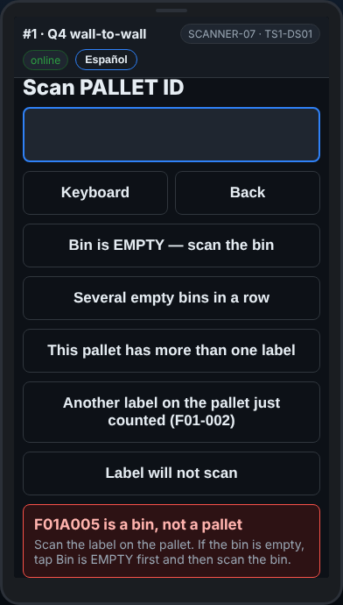
The wrong label? It tells you
Part 3 · Counting a pallet
If you scan the rack label when it asks for the pallet, the scanner says so and records nothing.
Just scan the right one.
Notes:
Nothing bad happens from a wrong scan. Read the message and scan the right label.

Slide 15
When a bin is different
Part 4
Several pallets in one spot, and an empty spot.
Notes:
Several pallets in one spot, and an empty spot.

Slide 16
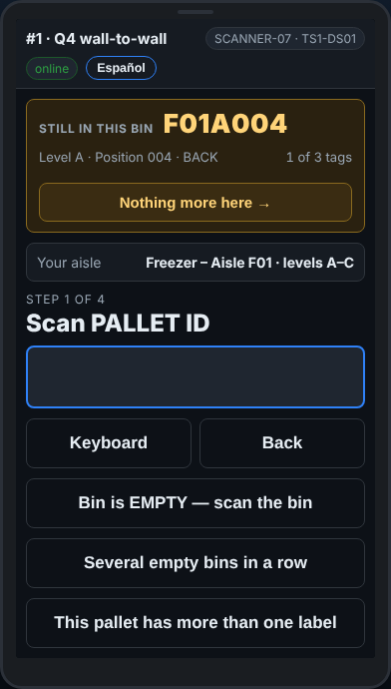
More than one pallet in a spot
Part 4 · When a bin is different
After the first pallet the box turns orange: Still in this bin, with a count — 1 of 3.
Count every pallet in the spot before you move on. Same three steps for each.
The scanner expects more but there are none? Tap Nothing more here →.
Never leave a spot half counted
Notes:
A spot with three pallets is normal in the freezer. The orange box keeps you there until every pallet is counted.

Slide 17
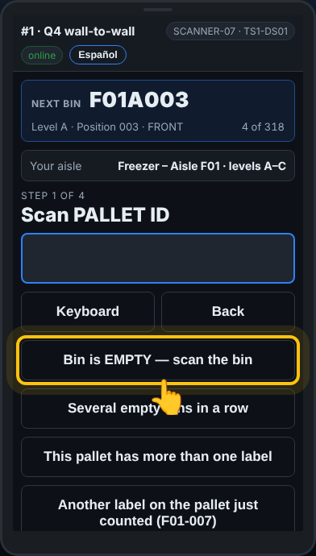
An empty spot
Part 4 · When a bin is different
Nothing in the spot? That counts too.
Tap Bin is EMPTY — scan the bin, then scan the rack label.
Now the office knows it was checked and is empty.
Notes:
An empty spot that is not recorded looks like a spot nobody reached. Always record it.

Slide 18
Labels
Part 5
Two labels on one pallet, a label that will not scan, and a pallet nobody expected.
Notes:
Two labels on one pallet, a label that will not scan, and a pallet nobody expected.

Slide 19
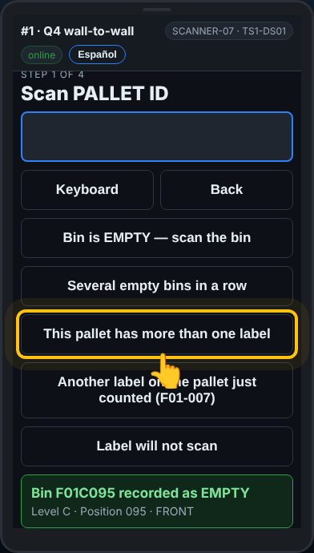
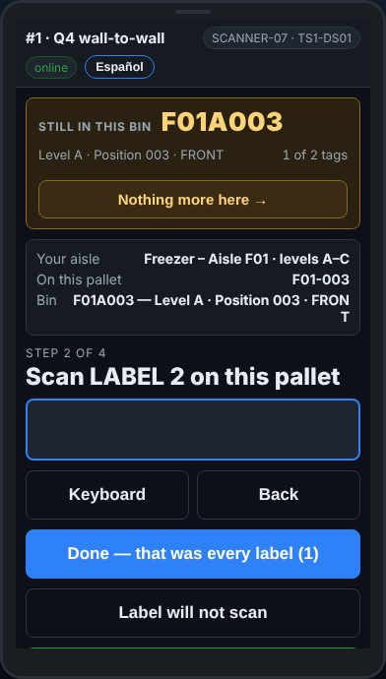
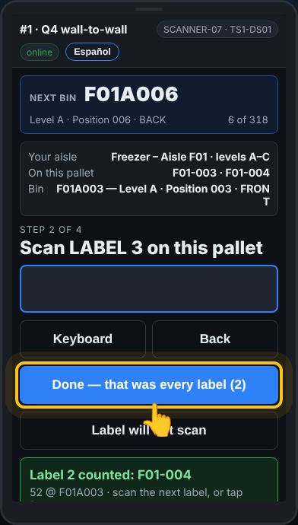
A pallet with two labels
Part 5 · Labels
Tap This pallet has more than one label · scan the rack once · label 1 and its cases · label 2 and its cases · Done
Notes:
Some pallets carry two loads, each with its own label. Each label gets its own quantity. The rack is scanned once.

Slide 20
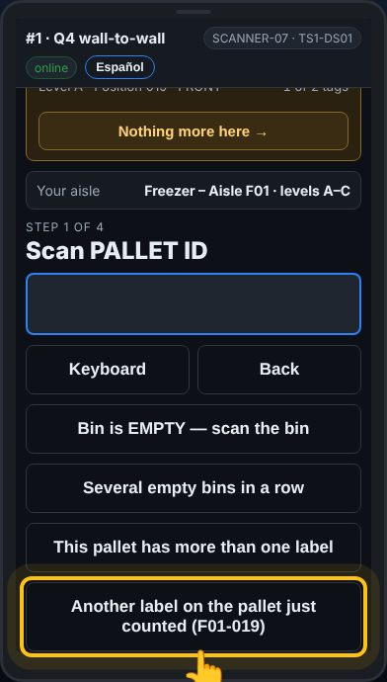
Saw the second label too late?
Part 5 · Labels
Already counted the pallet and then spotted another label?
Tap Another label on the pallet just counted.
Scan it, type its cases, then Done.
Notes:
The scanner keeps the same spot, so you do not scan the rack again.

Slide 21
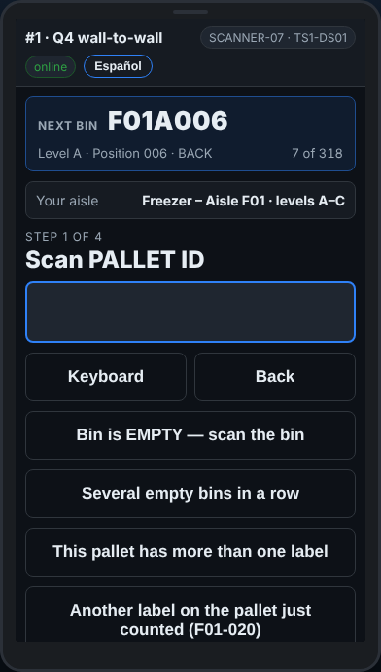
A label that will not scan
Part 5 · Labels
Ice, a rip, a faded label. Never skip the pallet.
Tap Label will not scan. Can you read the number? Tap I can read it — let me type it and type it.
The office gets a list of labels to replace. You keep counting.
The pallet still gets counted
Notes:
If nothing on the label can be read, tap Nothing readable on it: the pallet is still counted, under its spot.

Slide 22
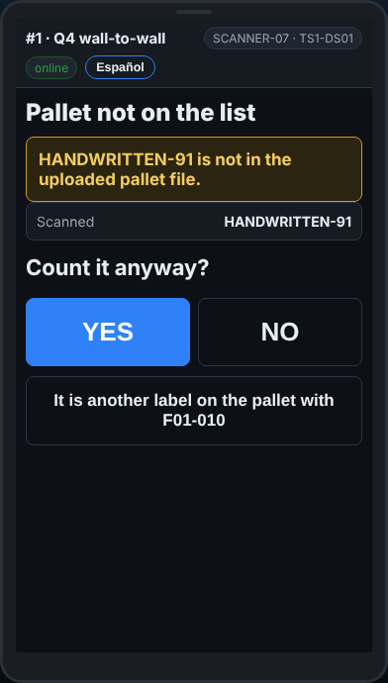
A pallet nobody expected
Part 5 · Labels
A pallet that is not on the list? The scanner asks Count it anyway?
Tap YES and count it like any other. Wrong barcode? Tap NO.
If the scanner ever asks why, pick a reason and tap Accept and continue.
Not sure? Ask your lead
Notes:
Found stock is never lost: the office sees it and adds it to the system.

Slide 23
Help and fixes
Part 6
Mistakes, messages, no Wi-Fi, problems, and the SOS button.
Notes:
Mistakes, messages, no Wi-Fi, problems, and the SOS button.

Slide 24
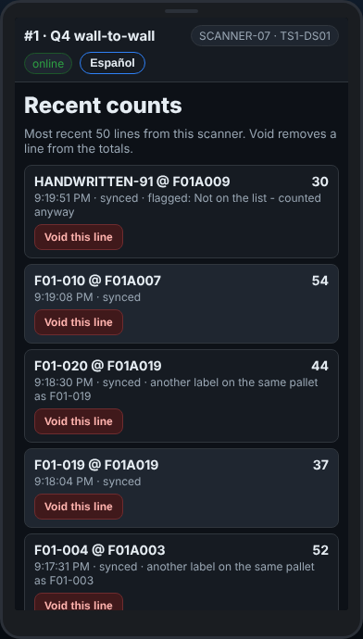
Made a mistake?
Part 6 · Help and fixes
Before finishing the pallet: Back goes back one step.
Already saved: tap History — your last 50 lines. Void this line takes a wrong one out.
Notes:
Void only your own wrong line. The office keeps a record that it was voided.

Slide 25
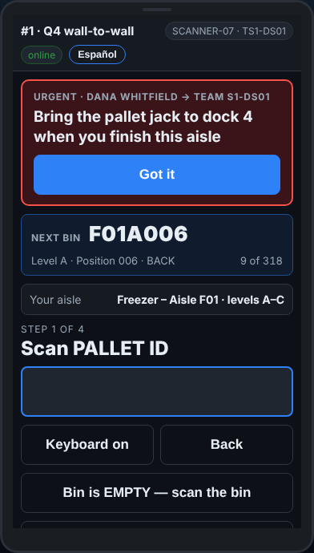
A message from the office
Part 6 · Help and fixes
Your lead can send a message to your scanner. It buzzes and stays on the screen.
Read it, then tap Got it — the office sees that you read it.
Notes:
A red message is urgent. Nothing is blocked: you can keep scanning under it.

Slide 26
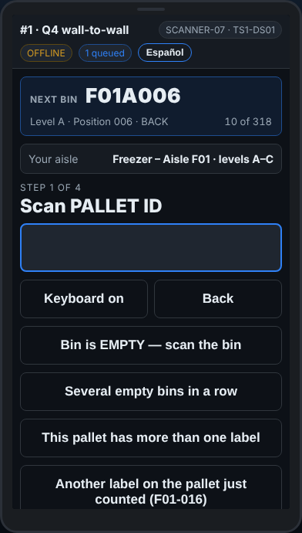
No Wi-Fi? Keep counting
Part 6 · Help and fixes
In the freezer the Wi-Fi can drop. The top of the screen says OFFLINE.
Keep counting. Everything is saved on the scanner.
When the signal is back, the lines go to the office on their own. Nothing to type again.
Nothing is lost
Notes:
The number next to OFFLINE is how many lines are waiting. They send by themselves.

Slide 27
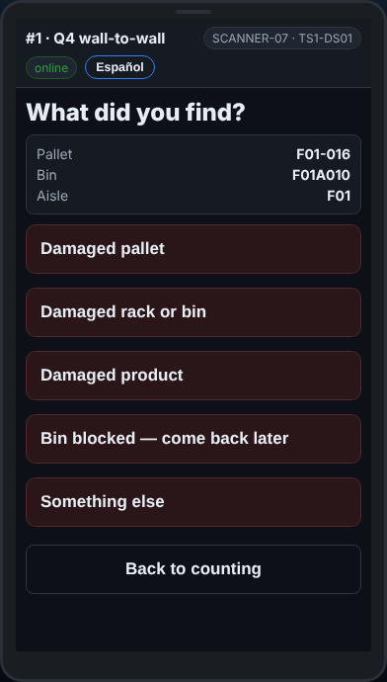
Something wrong with the spot
Part 6 · Help and fixes
Damaged pallet, broken rack, a spot blocked by a truck?
Tap Report a problem, pick what it is, and scan to confirm.
It goes on the office’s fix list. It is not an emergency.
Notes:
Use Report a problem for things that need fixing later. Use SOS for help now.

Slide 28
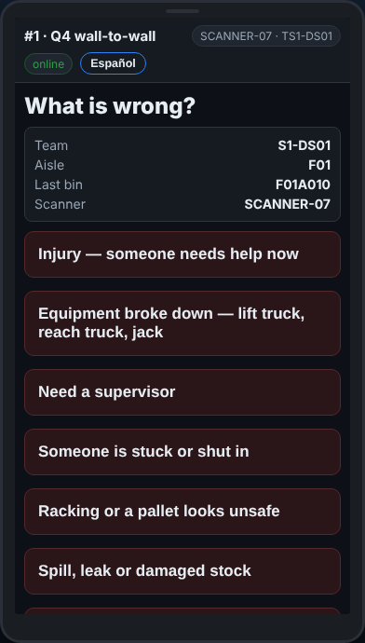
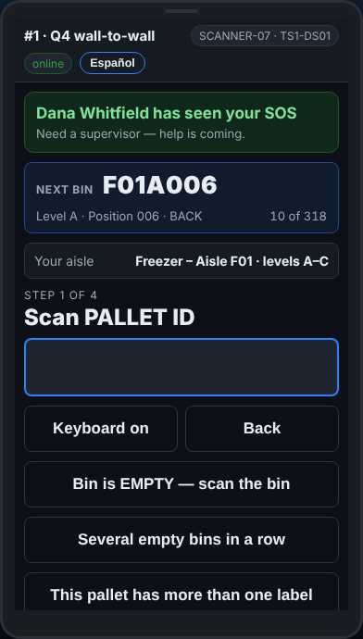
SOS — when you need help now
Part 6 · Help and fixes
Hurt, stuck, equipment broken, or you need a supervisor.
Tap the red SOS — I need help and pick what is wrong.
The office sees your team, your aisle and your last spot right away. When a supervisor picks it up, your scanner says who has seen it.
No signal? It says it was NOT sent — go and find someone
Notes:
Use it for real emergencies. The office gets a loud alert.

Slide 29
Second counts, and finishing
Part 7
Counting a spot again, handing the aisle back, and signing off.
Notes:
Counting a spot again, handing the aisle back, and signing off.

Slide 30
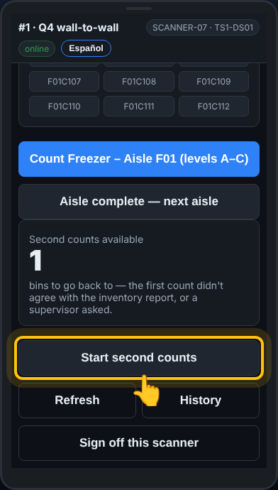
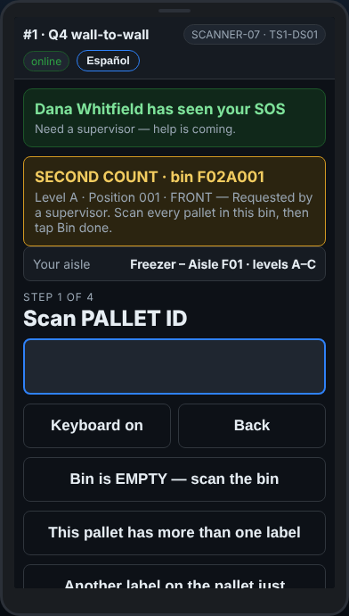
Second counts
Part 7 · Second counts, and finishing
Sometimes the office needs a spot counted again, by a different team.
When there are some for you, My aisle shows Start second counts.
Go to the spot and count everything in it — pallet, quantity, rack. Then tap Bin done — nothing more here.
You are not told the first count
Notes:
A second count is blind too. Count what is there.

Slide 31
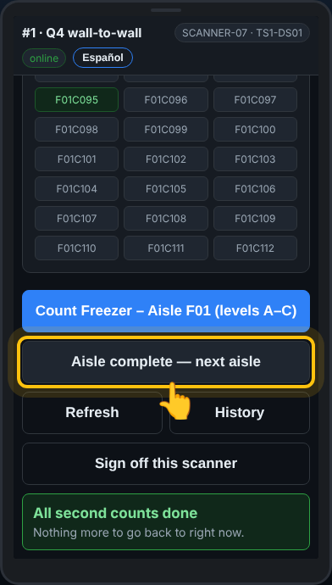
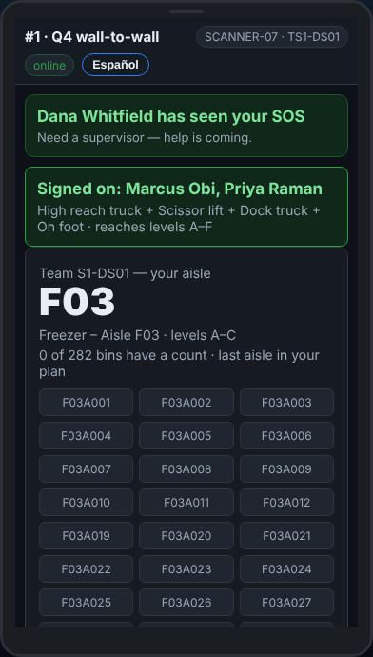
Finishing the aisle, and signing off
Part 7 · Second counts, and finishing
Only when every spot on your levels is counted: open My aisle and tap Aisle complete — next aisle. The scanner gives you the next one.
Break or home? Tap Sign off this scanner and put the scanner on its charger.
Notes:
The next crew signs on with their own card and badges.

Slide 32
The five rules
The rules
Count what is really there. Never what it should be.
Never skip a pallet. No label? Label will not scan.
Follow Next bin. Every spot, in order, empty ones too.
No Wi-Fi? Keep counting.
Not sure? Ask your lead. Help now? SOS.
Notes:
Read the five rules out loud. Then hand out the scanners and start the practice at the desk.

Slide 33
The buttons, on one page
The rules
Bin is EMPTY | Nothing in the spot. Then scan the rack
Nothing more here → | The scanner expects more pallets, there are none
This pallet has more than one label | Rack once, then each label with its cases, then Done
Another label on the pallet just counted | A second label seen after saving
Label will not scan | Type what is printed, or count it without a label
Back / Keyboard | One step back / type by hand
History → Void this line | Take a wrong line out
Report a problem | Damage or a blocked spot. Not an emergency
SOS — I need help | An emergency. The office comes
Aisle complete — next aisle | Only when the whole aisle is counted
Start second counts | Spots to count again, on My aisle
Sign off this scanner | Break or end of shift. Charger
Notes:
Print this slide for the break room.

Slide 34
Pallet · Quantity · Rack
That is the job
Count what is really there. Never skip a pallet.
Not sure? Ask your lead — or press SOS if you need help now.
Notes:
Questions, then the practice at the desk with the test book.

