Slide 1
ENEE 303 Recitation 08
Instructor: Dr. Agisilaos Iliadis
TA: Chang-Mu Han
04/03/2020
All pictures are from Microelectronic Circuits, Sedra and Smith, 6th and 7th edition.

Slide 2
Week Notes
Transistor amplifiers
Review for MOSFET and BJT
Voltage transfer characteristics
Small signal voltage gain
Small signal operation and models
3 example problems

Slide 3
Week Notes
To build a voltage amplifier with the transistor, MOSFET or BJT
To obtain a linear amplifier from the nonlinear transistors
To model the transistor operation so that we can analyze and design transistor amplifiers

Slide 4
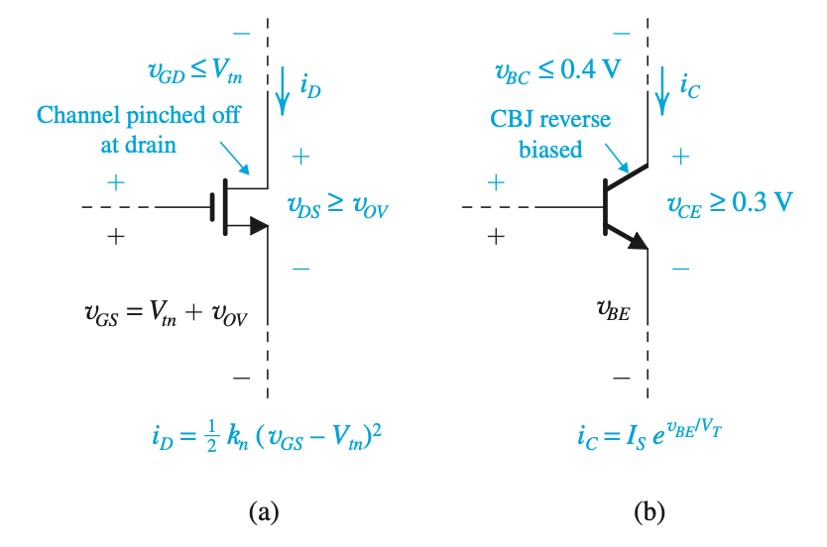
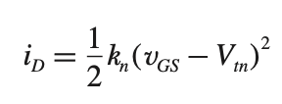

Basic principles
Recall the current equations for MOSFET and BJT
MOSFET:
BJT:
Transistors are basically transconductance amplifiers

Slide 5
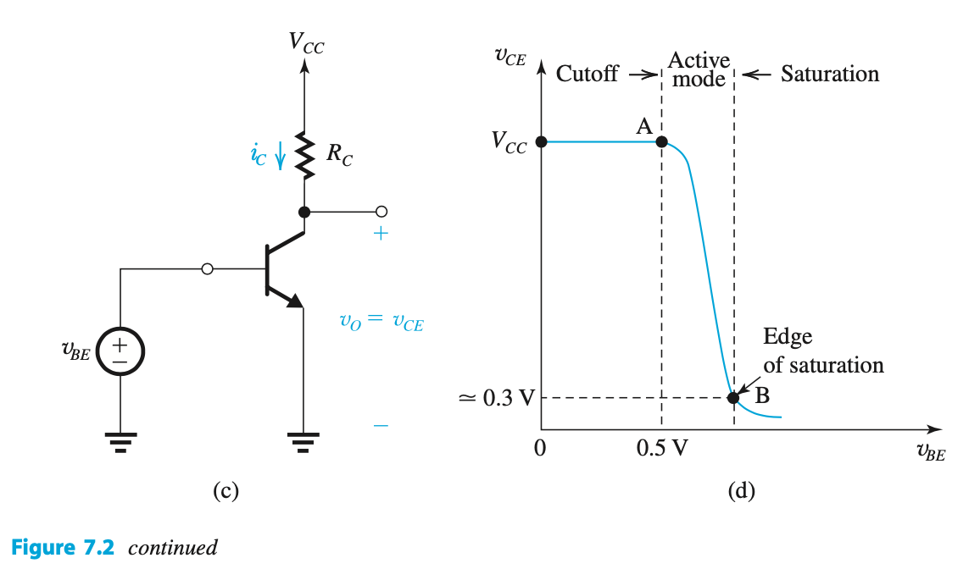

Voltage transfer characteristics
To use transistor to build a voltage amplifier, we need a load resistance

Slide 6
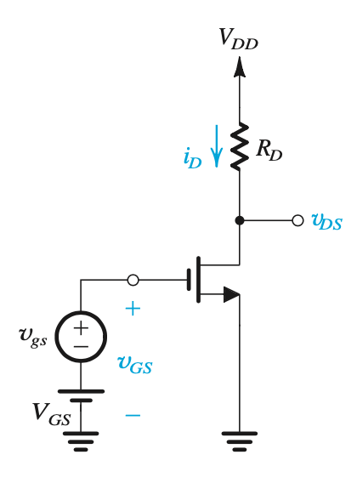
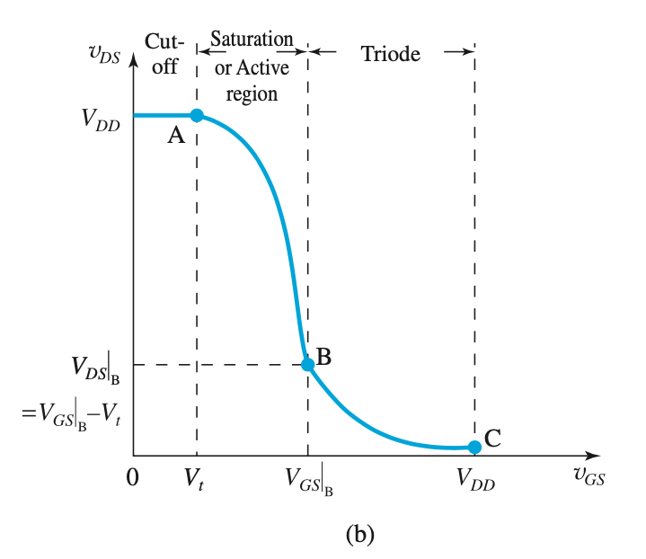
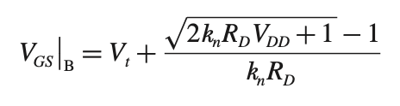

Voltage transfer characteristics
Linear amp by biasing MOSFET to operate in the active region and by keeping the input signal small
Q

Slide 7
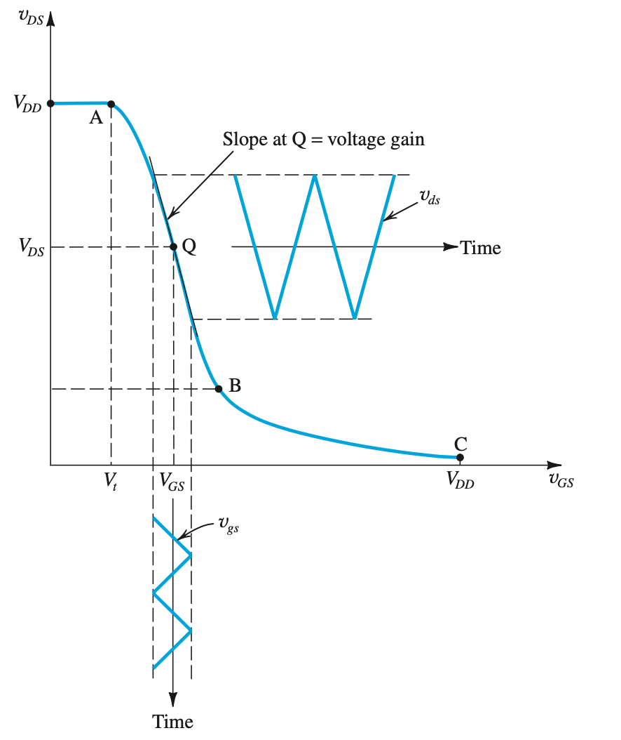
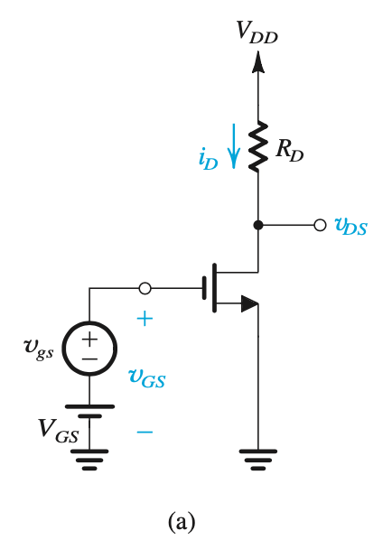

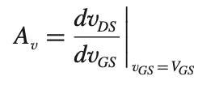




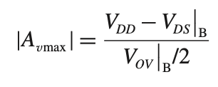
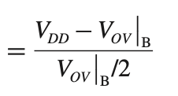
Small signal voltage gain
MOSFET case

Slide 8
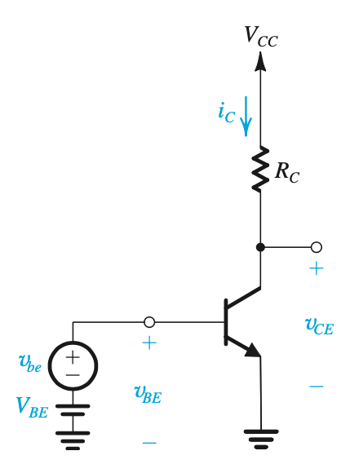
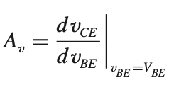

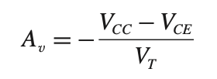


Small signal voltage gain
BJT case
$$v_{CE}=V_{CC}−I_{C}R_{C}=V_{CC}−I_{S}e^{\frac{v_{BE}}{V_{T}}}R_{C}$$

Slide 9
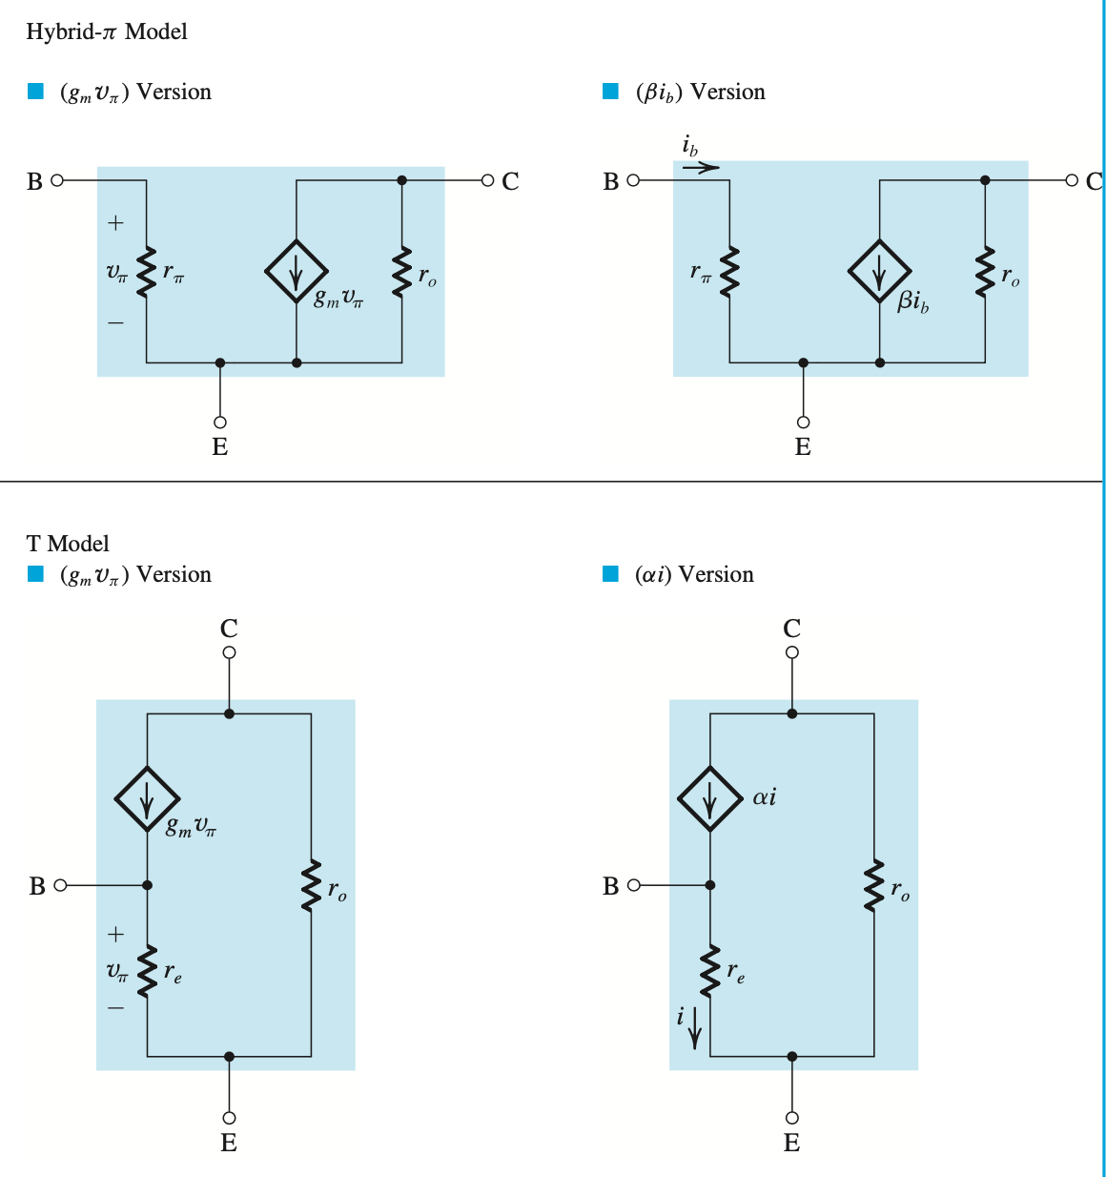
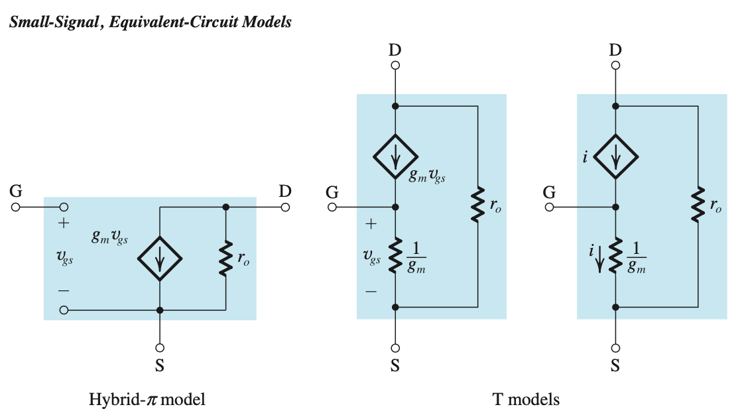

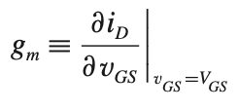
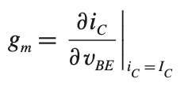








Small signal models
$$BJT$$
$$MOSFET$$
Small signal condition: $v_{gs}≪2(V_{GS}−V_{t})$

Slide 10
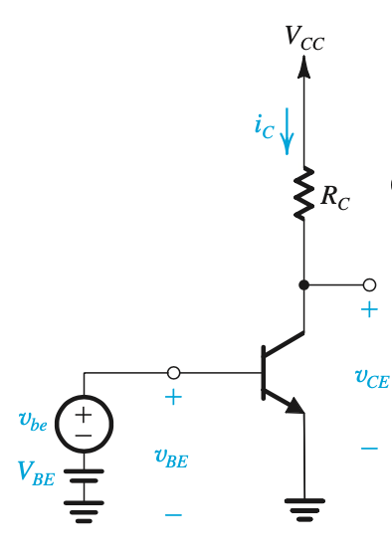
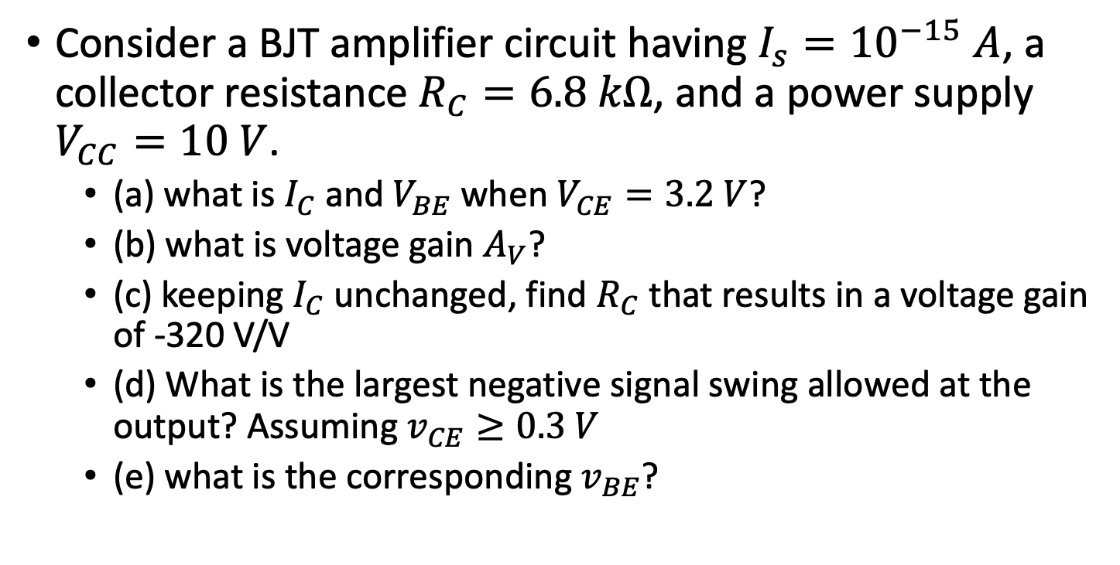
Example Problem 1
Consider a BJT amplifier circuit having $I_{s}={10}^{−15} A$, a collector resistance $R_{C}=6.8 kΩ$, and a power supply $V_{CC}=10 V$.
(a) what is $I_{C}$ and $V_{BE}$when $V_{CE}=3.2 V$?
(b) what is voltage gain $A_{V}$?
(c) keeping $I_{C}$ unchanged, find $R_{C}$ that results in a voltage gain of -320 V/V
(d) What is the largest negative signal swing allowed at the output? Assuming $v_{CE}≥0.3 V$
(e) what is the corresponding $v_{BE}$?

Slide 11


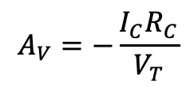






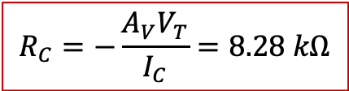
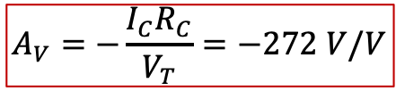
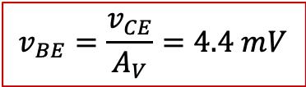
Example problem 1 continued
(a)
$$V_{CC}−I_{C}R_{C}=V_{CE}$$
(b)
$$A_{V}=−\frac{I_{C}R_{C}}{V_{T}}=−272 V/V$$
$$I_{C}=1 mA$$
$I_{C}=I_{S}e^{\frac{V_{BE}}{V_{T}}}$
$$V_{BE}=690 mV$$
$$A_{V}=−\frac{I_{C}R_{C}}{V_{T}}$$
(c)
To keep $I_{C}$ unchanged and
$$R_{C}=−\frac{A_{V}V_{T}}{I_{C}}=8.28 kΩ$$
(d)
$$V_{CE}=V_{CC}−I_{C}R_{C}=1.72 V$$
Since $v_{CE}≥0.3 V$, the largest allowable negative signal is
$$1.72−0.3=1.42 V$$
(e)
$$A_{V}=−320 V/V$$
$$v_{BE}=\frac{v_{CE}}{A_{V}}=4.4 mV$$

Slide 12
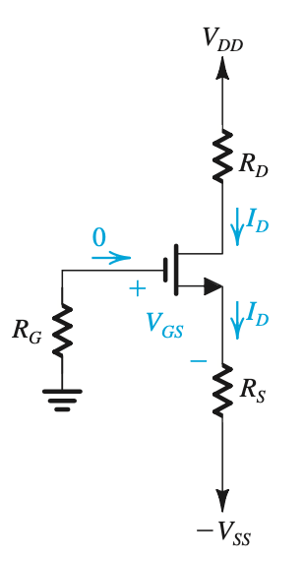

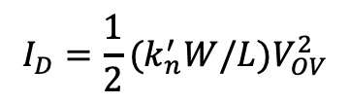




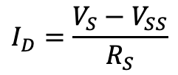
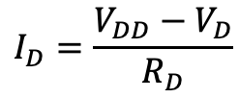

Example problem 2
$$I_{D}=\frac{1}{2}{(k}_{n}^{′}W/L{)V}_{OV}^{2}$$
$$V_{OV}=V_{GS}−V_{t}=1 V$$
$$V_{G}−V_{S}=V_{OV}+V_{t}$$
$$V_{S}=−2 V$$
$$I_{D}=\frac{V_{S}−V_{SS}}{R_{S}}$$
$$R_{S}=6 kΩ$$
$$I_{D}=\frac{V_{DD}−V_{D}}{R_{D}}$$
$$R_{D}=6 kΩ$$
Because of the standard resistor, there only exists
$$R=6.2 kΩ$$
From the textbook of 6ed

Slide 13




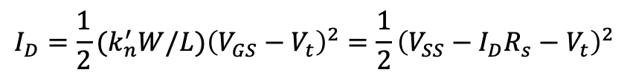


Example problem 2 continued
If we choose
$$R_{S}=R_{D}=6.2kΩ$$
${V_{GS}=V}_{G}−V_{S}=−V_{S}=$ $V_{SS}−I_{D}R_{s}$
$$I_{D}=\frac{1}{2}{(k}_{n}^{′}W/L){\left(V_{GS}−V_{t}\right)}^{2}=\frac{1}{2}{\left(V_{SS}−I_{D}R_{s}−V_{t}\right)}^{2}$$
$$R_{S}^{2}I_{D}^{2}−\left(2+R_{S}\left(V_{SS}−V_{t}\right)\right)I_{D}+{\left(V_{SS}−V_{t}\right)}^{2}=0$$
$$I_{D}=0.49 mA or 0.86 mA$$
$$V_{s}>0$$
$$V_{s}=−1.96 V$$
$$V_{D}=1.96 V$$

Slide 14
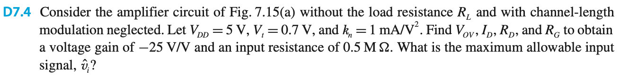
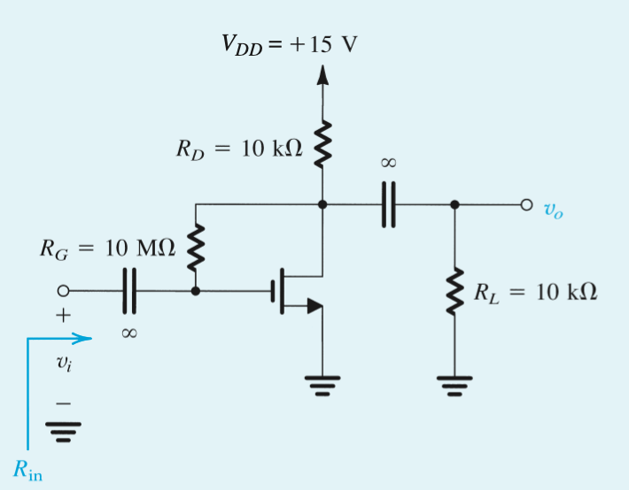
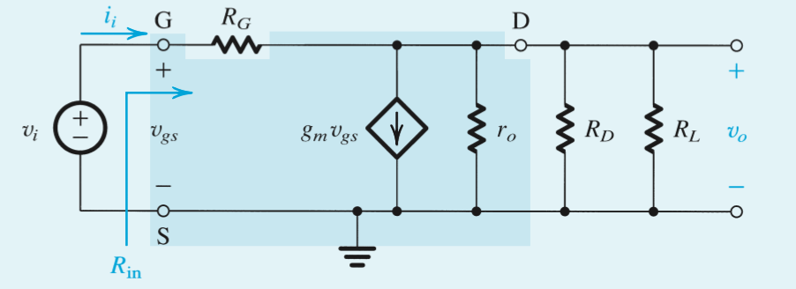



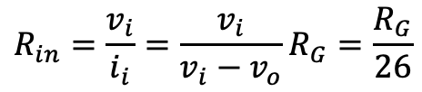
Example problem 3
We want
$$A_{v}=−25 V/V$$
and
$$R_{in}=0.5 MΩ$$
By KVL
$$R_{in}=\frac{v_{i}}{i_{i}}=\frac{v_{i}}{v_{i}−v_{o}}R_{G}=\frac{R_{G}}{26}$$
$$R_{G}=26R_{in}=13 MΩ$$

Slide 15



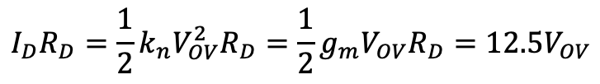



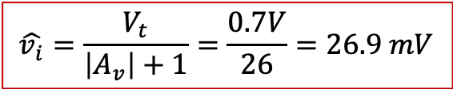


Example problem 3 continued
$$A_{v}=−g_{m}R_{D}$$
, we have
$$g_{m}R_{D}=25=k_{n}V_{OV}R_{D}$$
$$I_{D}R_{D}=\frac{1}{2}k_{n}V_{OV}^{2}R_{D}=\frac{1}{2}g_{m}V_{OV}R_{D}=12.5V_{OV}$$
$$V_{OV}=V_{DD}−I_{D}R_{D}−V_{t}=5−12.5V_{OV}−0.7$$
$$V_{OV}=0.319 V$$
$$g_{m}=k_{n}V_{OV}=319 μA/V$$
$$R_{D}=78.5 kΩ$$
To obtain max allowable input signal, we need to keep the MOSFET in saturation. In other words,
$$v_{DS}≥v_{GS}−V_{t}$$
For the equality condition,
$$v_{DS}=v_{GS}−V_{t}$$
$$V_{DS}−\left|A_{v}\right|\hat{v_{i}}=V_{GS}+\hat{v_{i}}−V_{t}$$
$$\hat{v_{i}}=\frac{V_{t}}{\left|A_{v}\right|+1}=\frac{0.7V}{26}=26.9 mV$$

Slide 16
