Slide 1
ENEE 303 Recitation 09
Instructor: Dr. Agisilaos Iliadis
TA: Chang-Mu Han
04/10/2020
All pictures are from Microelectronic Circuits, Sedra and Smith, 6th and 7th edition.

Slide 2
Week Notes
Three basic configurations of transistor amplifiers and characterizing these amplifiers
Common source/emitter
Common gate/base
Common drain/collector
4 example problems + 1 optional example problem

Slide 3
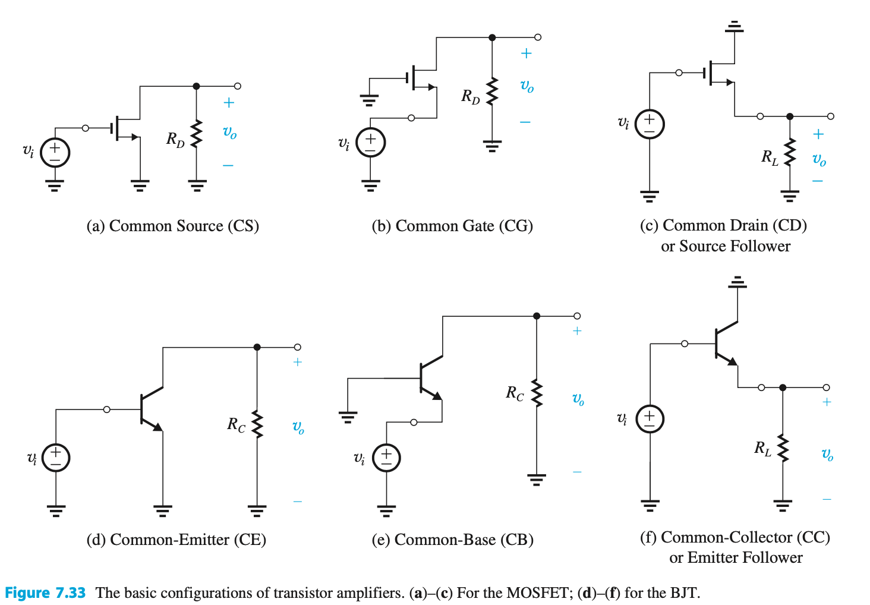
Basic configurations

Slide 4
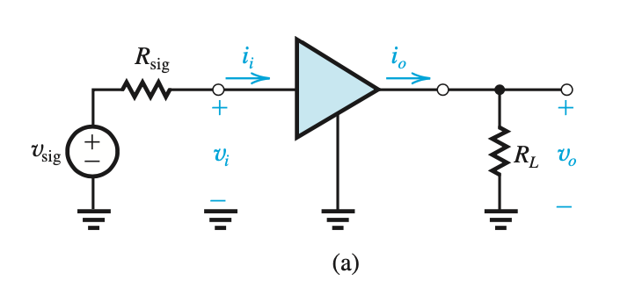
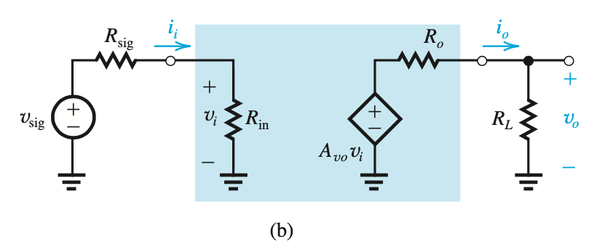



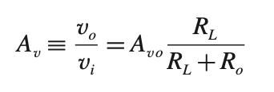

Characterizing transistor amplifiers
Unilateral amplifier: input resistance is independent of load resistance

Slide 5
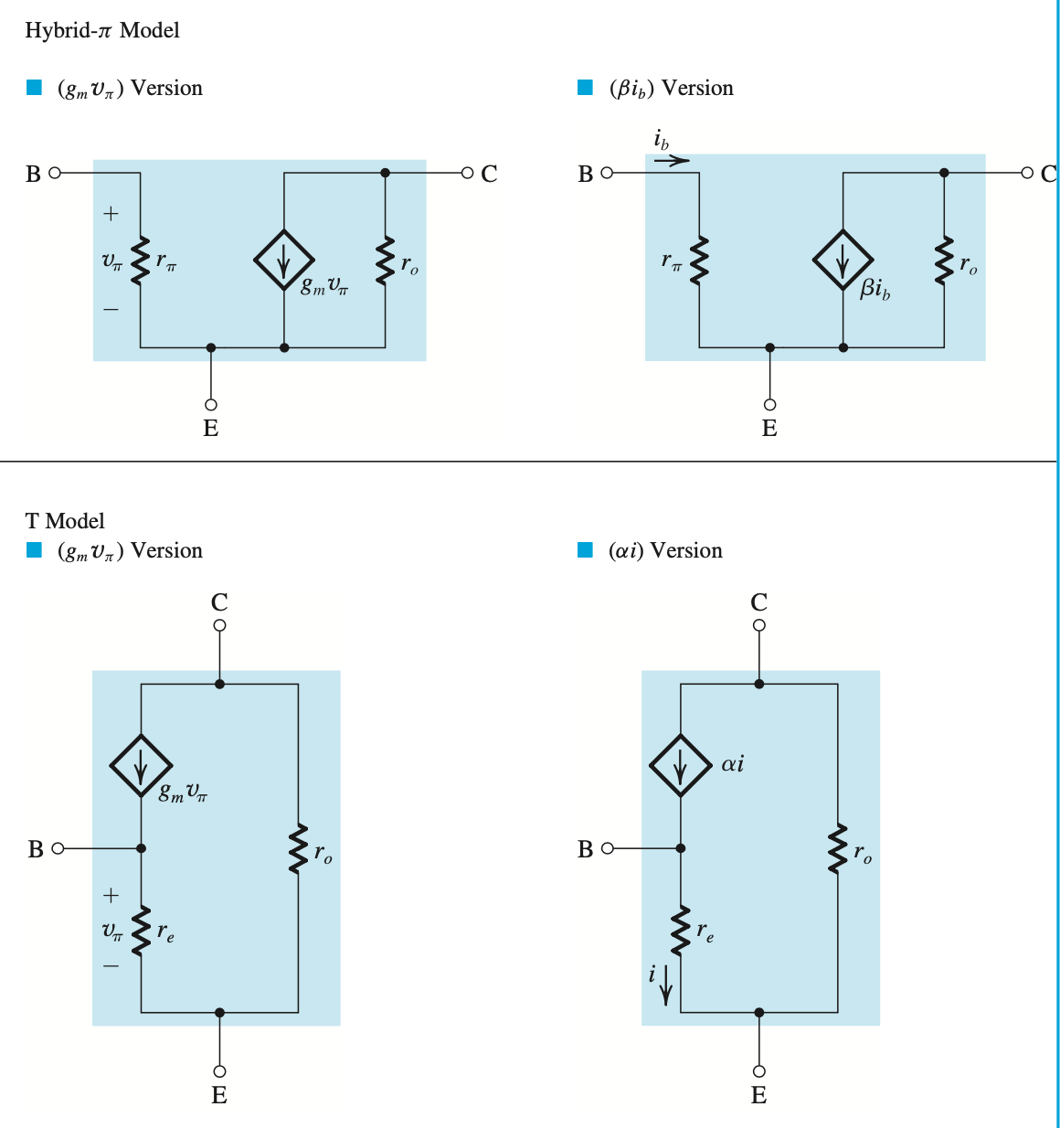
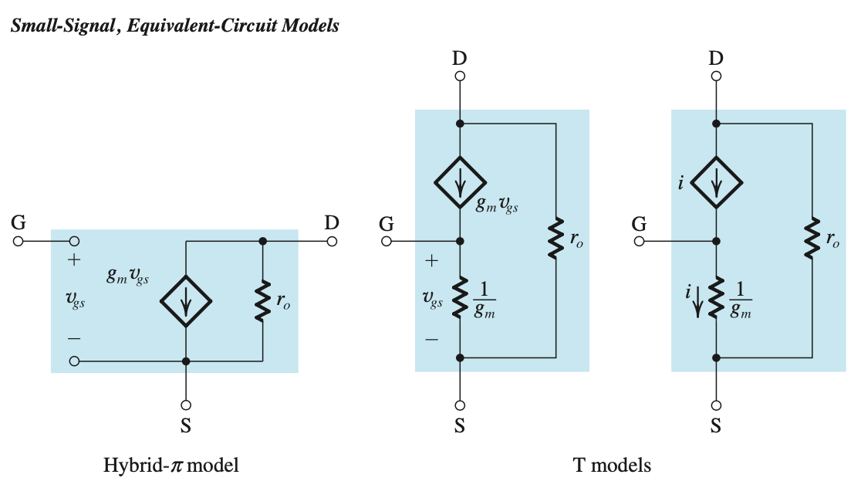

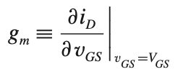
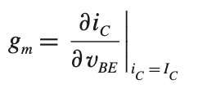





Small signal models
$$BJT$$
$$MOSFET$$
Small signal condition: $v_{gs}≪2(V_{GS}−V_{t})$

Slide 6
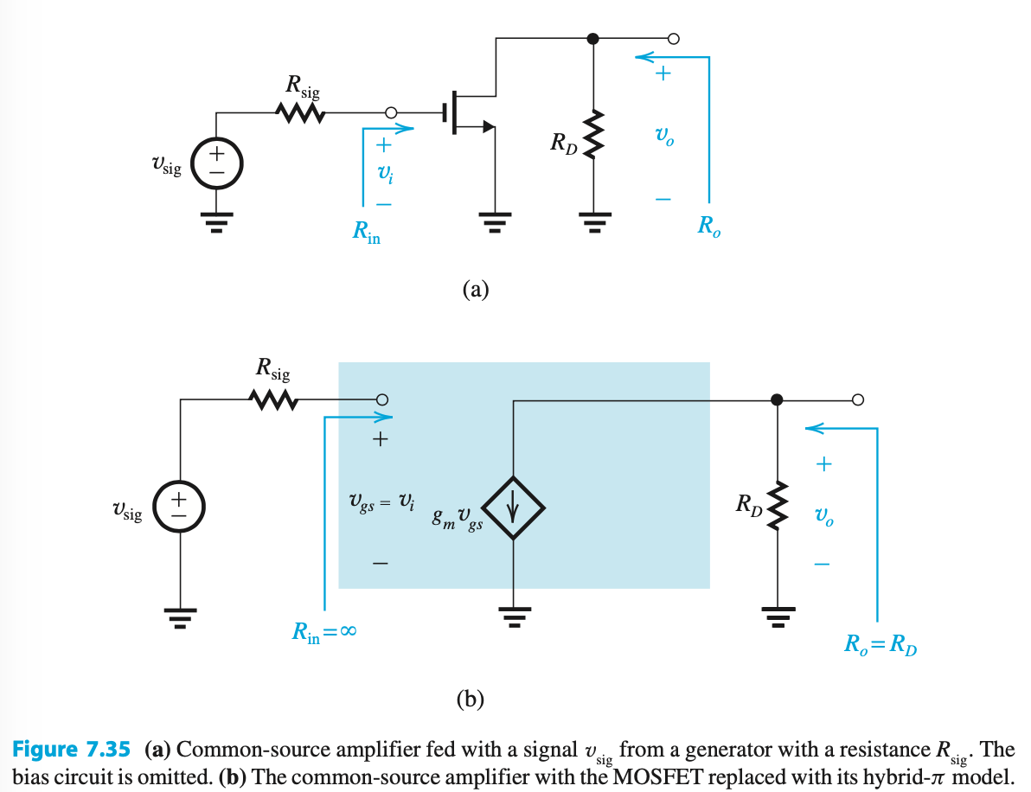
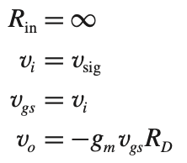
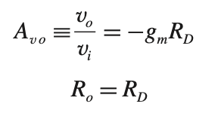


The common-source/emitter amplifiers
Characteristics of the CS amplifier

Slide 7
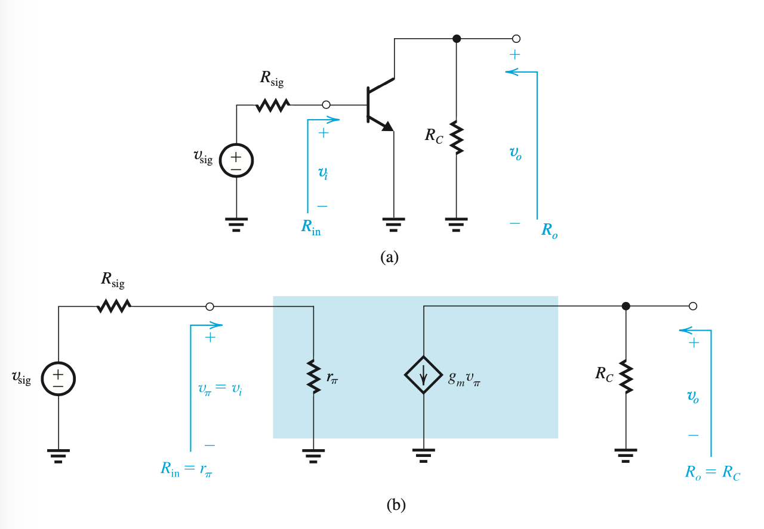

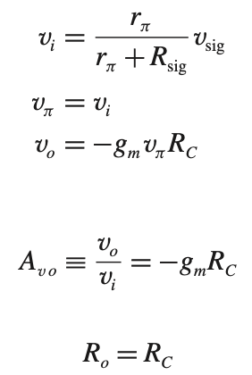

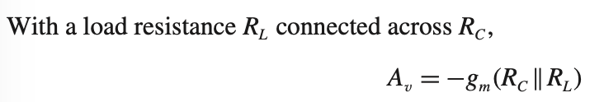

The common-source/emitter amplifiers
Characteristics of the CE amplifier

Slide 8
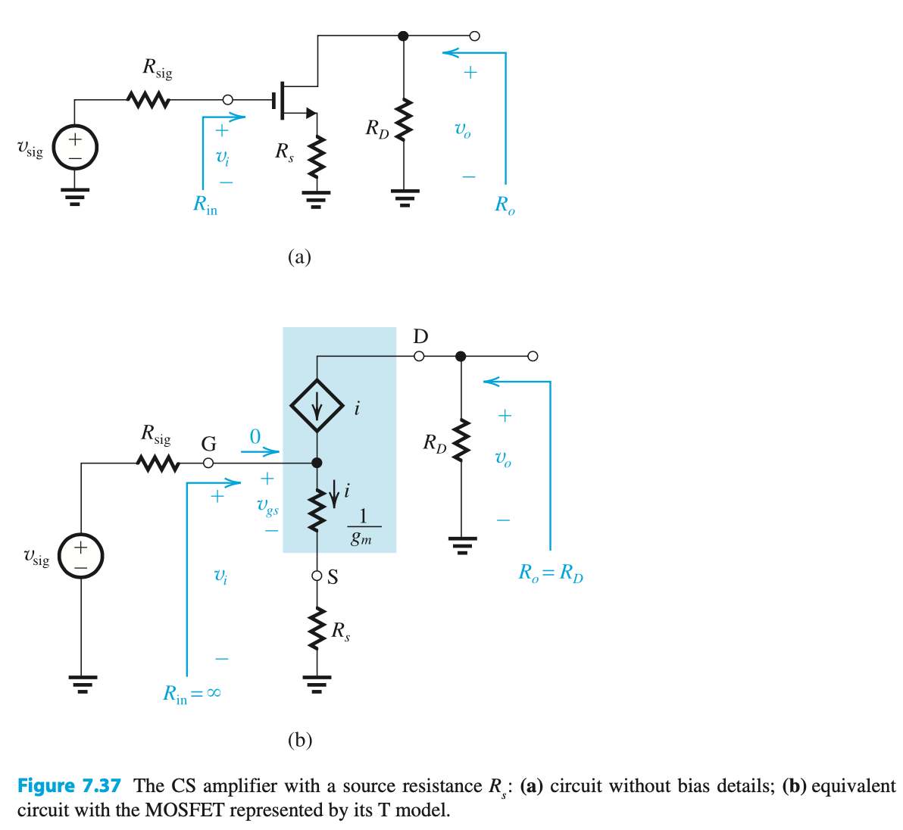
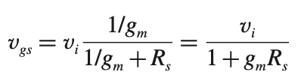


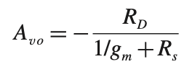

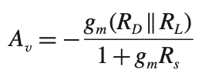
The common-source/emitter amplifiers with a source/emitter resistance
Characteristics of the CS amplifier with a source resistance

Slide 9
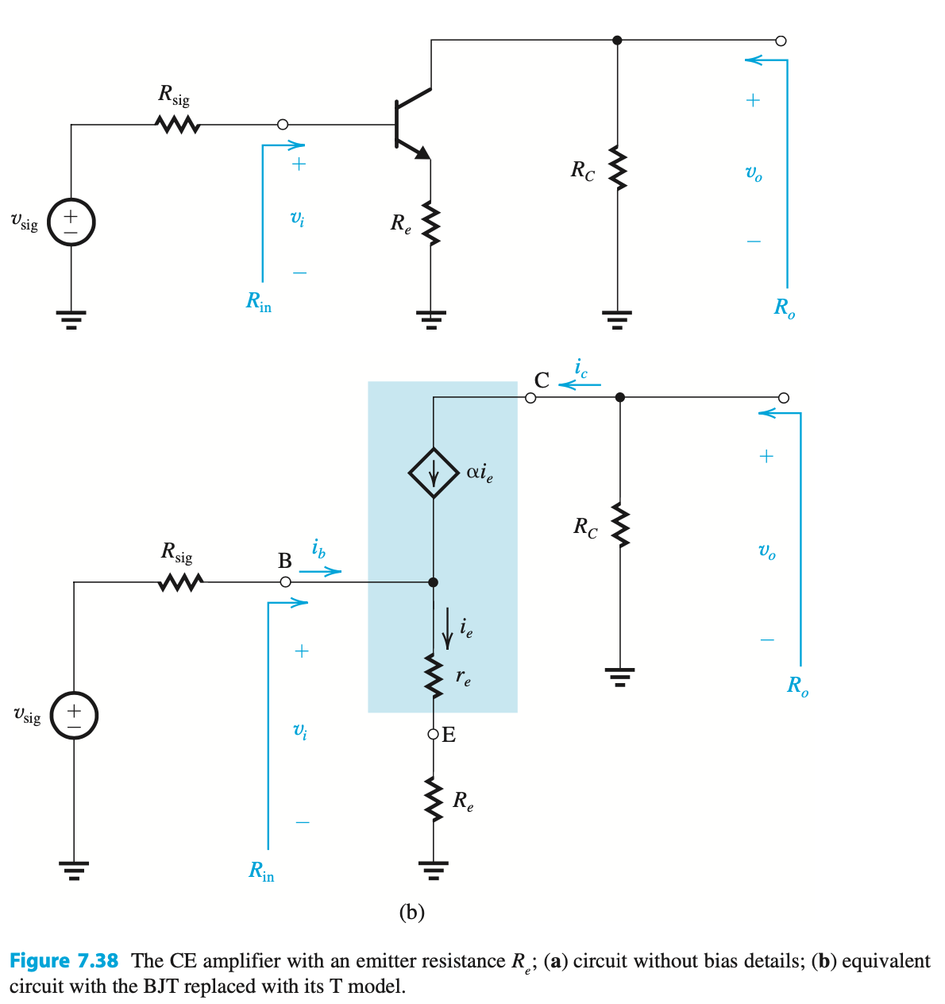
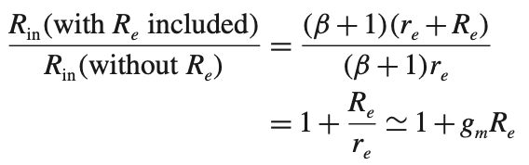



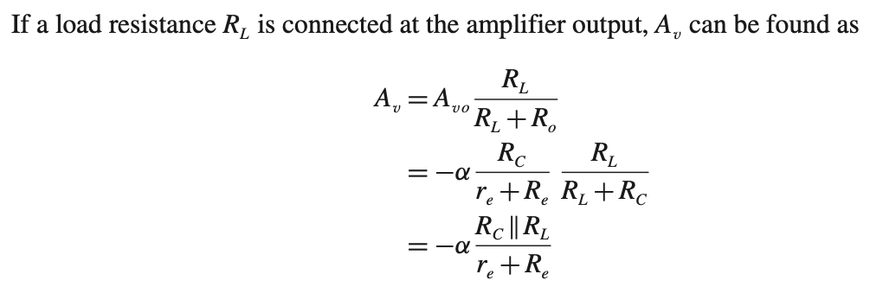
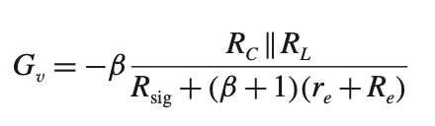
The common-source/emitter amplifiers with a source/emitter resistance
Characteristics of the CE amplifier with a source resistance

Slide 10

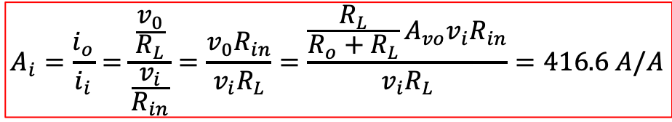

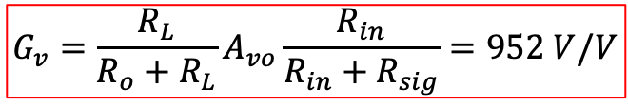

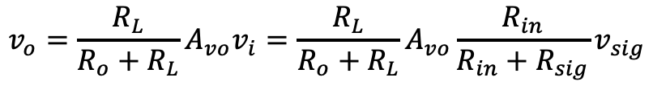


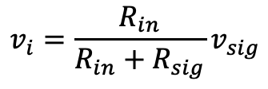
Example problem 1
An amplifier with an input resistance of 100 kΩ, an open-circuit voltage gain of 100 V/V, and an output resistance of 100 Ω is connected between a 20 kΩ signal source and a 2 kΩ load. Find the overall voltage gain G_{v}. Also find the current gain, defined as the ratio of the load current to the current drawn from the signal source.
$$v_{i}=\frac{R_{in}}{R_{in}+R_{sig}}v_{sig}$$
$$v_{o}=\frac{R_{L}}{R_{o}+R_{L}}A_{vo}v_{i}=\frac{R_{L}}{R_{o}+R_{L}}A_{vo}\frac{R_{in}}{R_{in}+R_{sig}}v_{sig}$$
$$G_{v}=\frac{R_{L}}{R_{o}+R_{L}}A_{vo}\frac{R_{in}}{R_{in}+R_{sig}}=952 V/V$$
$R_{in}=100$ kΩ
$R_{sig}=20$ kΩ
$R_{L}=2$ kΩ
$$A_{i}=\frac{i_{o}}{i_{i}}=\frac{\frac{v_{0}}{R_{L}}}{\frac{v_{i}}{R_{in}}}=\frac{v_{0}R_{in}}{v_{i}R_{L}}=\frac{\frac{R_{L}}{R_{o}+R_{L}}A_{vo}v_{i}R_{in}}{v_{i}R_{L}}=416.6 A/A$$
$R_{o}=100$ Ω
$A_{vo}=100$ V/V

Slide 11
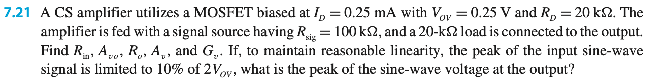

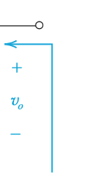
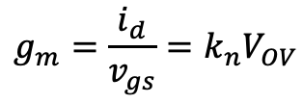
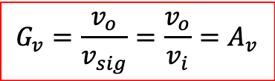
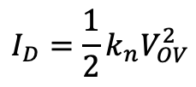





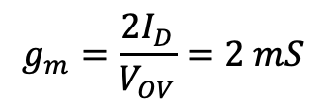

Example Problem 2
$$I_{D}=\frac{1}{2}k_{n}V_{OV}^{2}$$
$$g_{m}=\frac{i_{d}}{v_{gs}}=k_{n}V_{OV}$$
$$R_{L}=20 kΩ$$
$$g_{m}=\frac{2I_{D}}{V_{OV}}=2 mS$$
$$R_{o}=R_{D}$$
$$A_{vo}=−g_{m}R_{0}=−4 V/V$$
$$A_{v}=\frac{v_{o}}{v_{i}}=−g_{m}(R_{D}|\left|R_{L}\right)=−20 V/V$$
$$G_{v}=\frac{v_{o}}{v_{sig}}=\frac{v_{o}}{v_{i}}=A_{v}$$
$$|v_{sig}|=10\%\left(2V_{OV}\right)=0.05 V$$
$${|v}_{0}\left|=G_{V}\right|v_{sig}|=1 V$$

Slide 12
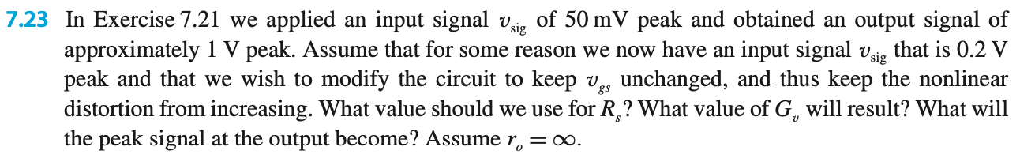
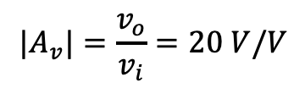

Example problem 3
$$R_{L}=20 kΩ$$
$$R_{L}=20 kΩ$$
$${|A}_{v}|=\frac{v_{o}}{v_{i}}=20 V/V$$

Slide 13

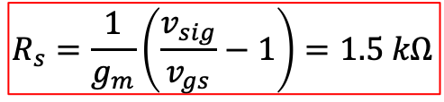

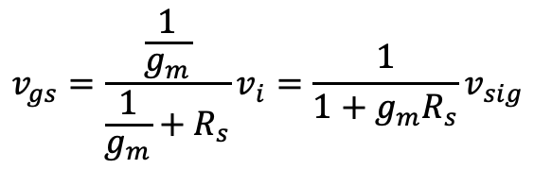



Example problem 3 continued
$$v_{sig} =200 mV$$
$$v_{gs}=\frac{\frac{1}{g_{m}}}{\frac{1}{g_{m}}+R_{s}}v_{i}=\frac{1}{1+g_{m}R_{s}}v_{sig}$$
$$R_{s}=\frac{1}{g_{m}}\left(\frac{v_{sig}}{v_{gs}}−1\right)=1.5 kΩ$$
$$v_{gs}=50 mV$$
$$G_{v}=$$
$$=−5 V/V$$
$${|v}_{0}\left|=G_{V}\right|v_{sig}|=1 V$$

Slide 14
Example problem 4
Design a CE amplifier with a resistance R_{e} in the emitter to meet the following specifications:
(i) Input resistance R_{in} = 15 kΩ.
(ii) When fed from a signal source with a peak amplitude of 0.15 V and a source resistance of 30 kΩ, the peak amplitude of v_{BE} is 5 mV.
Specify R_{e} and the bias current I_{C} . The BJT has β = 74. If the total resistance in the collector is 6 kΩ, find the overall voltage gain G_{v} and the peak amplitude of the output signal v_{o} .

Slide 15
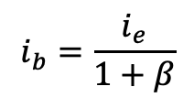




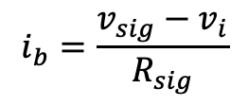

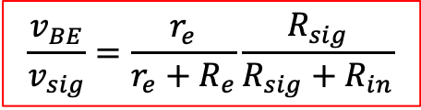




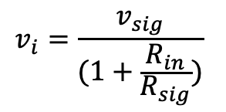



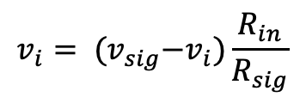
Example problem 4 continued
$$R_{in}=\frac{v_{i}}{i_{b}}$$
$$R_{L}$$
$$i_{e}=i_{b}+i_{c}=\left(1+β\right)i_{b}$$
$$i_{b}=\frac{i_{e}}{1+β}$$
$$v_{i}=i_{e}(r_{e}+R_{e})$$
$$R_{in}=\left(1+β\right)\left(r_{e}+R_{e}\right)=15 \text{k}\text{Ω}$$
$$\frac{v_{BE}}{v_{i}}=\frac{r_{e}}{r_{e}+R_{e}}$$
$$v_{i}=i_{b}R_{in}$$
$$i_{b}=\frac{v_{sig}−v_{i}}{R_{sig}}$$
$$v_{i}= {(v}_{sig}−v_{i})\frac{R_{in}}{R_{sig}}$$
Input resistance R_{in} = 15 kΩ
$R_{sig}=30$ kΩ
$$v_{i}=\frac{v_{sig}}{(1+\frac{R_{in}}{R_{sig}})}$$
$$\frac{v_{BE}}{v_{sig}}=\frac{r_{e}}{r_{e}+R_{e}}\frac{R_{sig}}{R_{sig}+R_{in}}$$
$$r_{e}=100 Ω$$
$$v_{sig}=0.15 V$$
$$R_{e}=200 Ω$$
$v_{BE}=5 mV$
β = 74

Slide 16

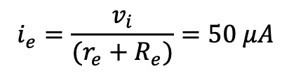
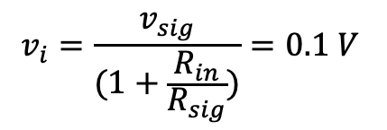

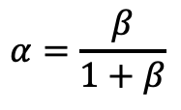
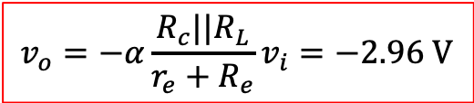

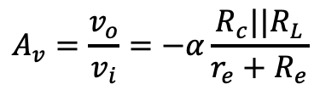
Example problem 4 continued
$$v_{i}=\frac{v_{sig}}{(1+\frac{R_{in}}{R_{sig}})}=0.1 V$$
$$i_{e}=\frac{v_{i}}{(r_{e}+R_{e})}=50 μA$$
$$i_{c}=αi_{e}$$
$$α=\frac{β}{1+β}$$
$$i_{c}=49.3 μA$$
$$=−9.86 V/V$$
$$A_{v}=\frac{v_{o}}{v_{i}}=−α\frac{R_{c}||R_{L}}{r_{e}+R_{e}}$$
$$v_{o}=−α\frac{R_{c}||R_{L}}{r_{e}+R_{e}}v_{i}=−2.96 V$$

Slide 17
Example problem 5 (optional)
Specify the parameters R_{in} , A_{vo} , and R_{o} of an amplifier that is to be connected between a 100-kΩ source and a 2-kΩ load and is required to meet the following specifications:
(a) No more than 5% of the signal strength is lost in the connection to the amplifier input;
(b) If the load resistance changes from the nominal value of 2 kΩ to a low value of 1 kΩ, the change in output voltage is limited to 5% of nominal value; and
(c) The nominal overall voltage gain is 10 V/V.

Slide 18
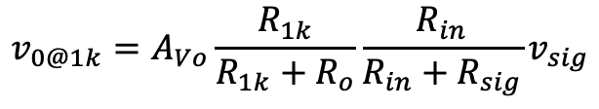

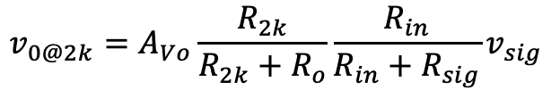

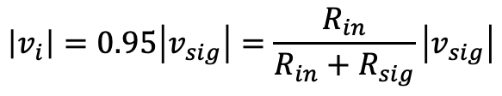

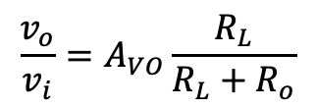
Example problem 5 continued
$R_{sig}=100$ kΩ
$$\left|v_{i}\right|=0.95\left|v_{sig}\right|=\frac{R_{in}}{R_{in}+R_{sig}}\left|v_{sig}\right|$$
$$R_{in}=1.9 MΩ$$
$R_{L}=2$ kΩ
$$v_{0@2k}=A_{Vo}\frac{R_{2k}}{R_{2k}+R_{o}}\frac{R_{in}}{R_{in}+R_{sig}}v_{sig}$$
$$\frac{v_{o}}{v_{i}}=A_{VO}\frac{R_{L}}{R_{L}+R_{o}}$$
$$v_{0@1k}=A_{Vo}\frac{R_{1k}}{R_{1k}+R_{o}}\frac{R_{in}}{R_{in}+R_{sig}}v_{sig}$$

Slide 19





Example problem 5 continued
$$\frac{v_{0@1k}}{v_{0@2k}}=\frac{\frac{R_{1k}}{R_{1k}+R_{o}}}{\frac{R_{2k}}{R_{2k}+R_{o}}}$$
, where $v_{0@1k}=0.95v_{0@2k}$
$$R_{o}=111 Ω$$
$$G_{v}=\frac{v_{o}}{v_{sig}}=A_{Vo}\frac{R_{1k}}{R_{1k}+R_{o}}\frac{R_{in}}{R_{in}+R_{sig}}=10 V/V$$
$$A_{Vo}=11.7 V/V$$

