Slide 1

Accelerating Data Science Workflows using NVIDIA RAPIDS

Slide 2
NVIDIA RAPIDS
RAPIDS – Rapid Accelerated Platform for Integrating Data Science
RAPIDS Data Science framework is a collection of libraries
Designed to run end-to-end data science pipelines completely on GPU
Code Syntax designed to have familiar look to Python (Pandas, Numpy ets.)
Uses NVIDIA,CUDA drivers and high-bandwidth GPU memory for computation

Slide 3
Data Science Pipeline
Data Preprocessing
Hyperparameter Tuning
Data Retrieval
Model Training
GPUs
Data Science Pipeline with NVIDIA RAPIDS
Data Preprocessing
Hyperparameter Tuning
Data Retrieval
Model Training
GPUs

Slide 4
cuDF, cuPY and cuML
Uses low level CUDA code for fast, GPU optimized implementations of algorithms
Still maintains and easy to use Python layer on top
Integrated smoothly with Data Science Libraries
cuDF, cuPY and cuML etc are a few Data Science libraries offered in RAPIDS

Slide 5
cuDF
Can only use single CPU core with Pandas
Fine for smaller datasets but can create a bottleneck for larger datasets
Possible to speed up things using Parallel Processing
cuDF is a GPU DataFrame library with pandas-like API
cuDF is a single-GPU library
For multi-GPU RAPIDS uses Dask and dask-cuDF package

Slide 6
cuDF vs Pandas Benchmarking

Slide 7
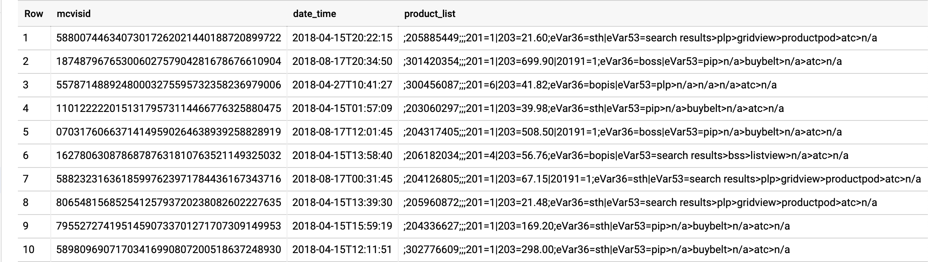
Dataset
Dataset Description (Add to Carts data from Clickstream)
~10M Rows
3 Columns (MCVISID, DATE_TIME, Cart Adds)

Slide 8
Machine Configurations
N1-highmem-8 (Google Compute ENgine)
8 CPUs
52 GB Memory
1 X NVIDIA Tesla V100

Slide 9
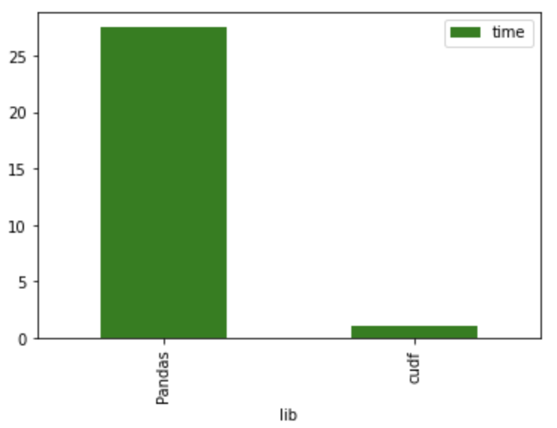
Reading CSV
Pandas Average Reading Time – 27.56 seconds
cuDF Average Reading Time
– 1 second
Note: Ran the same operation 15 times and obtained mean time

Slide 10
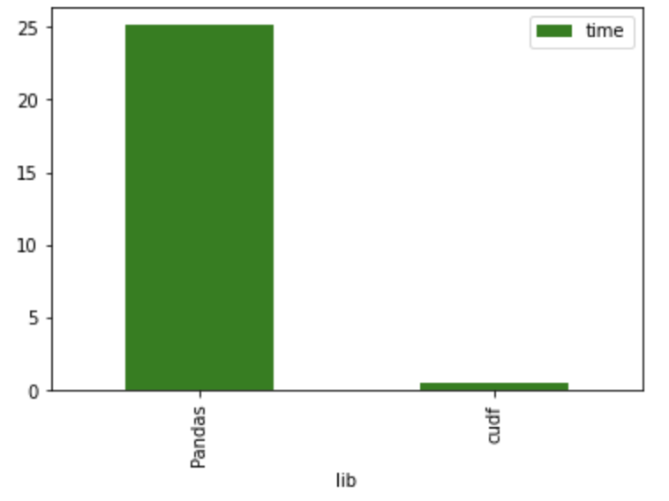
Group By
Pandas Average GroupBy Time – 25.14 seconds
cuDF Average GroupBy Time
– 0.52 seconds
Note: Ran the same operation 15 times and obtained mean time

Slide 11
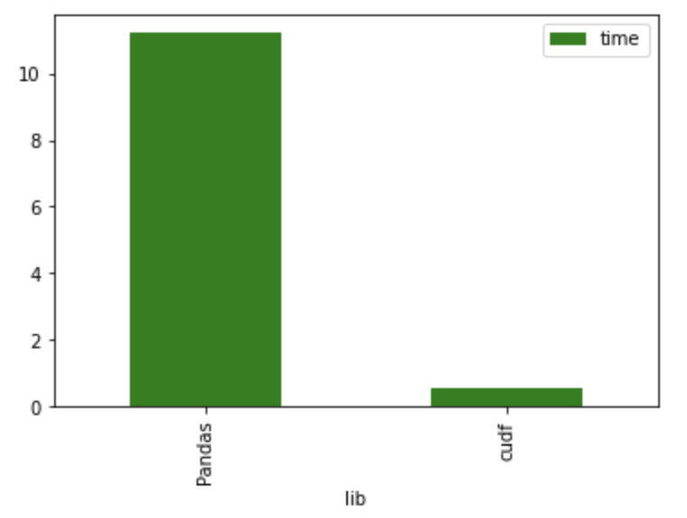
Sorting
Pandas Average Sorting Time – 11.23 seconds
cuDF Average Sorting Time
– 0.55 seconds
Note: Ran the same operation 15 times and obtained mean time

Slide 12
Syntax and Installation
Installation with the help of conda
Pandas like API
import cudf
df = cudf.read_csv(path)
df.head(2)
df.sort_values(by=[‘col’])
df.groupby(‘col’)
df.to_csv(path)

Slide 13
Pros and Cons
Pros | Cons
Pandas like syntax so not a very steep learning curve | Installing NVIDIA Drivers can get complicated but can be avoided now with AI Platform Notebooks
Time saved up in individual functions adds up when operated in a pipeline manner | Online Community is small since this is relatively new.
Reduced time automatically reduces the time a machine is used, hence lower costs | Some functionalities from Pandas missing Eg:- df.apply(lambda x: func(x))
Works better with larger datasets | Pandas outperforms cuDF for smaller datasets (Aroun 10,000 data points is when you start to notice the speed up)

Slide 14
CuML

Slide 15
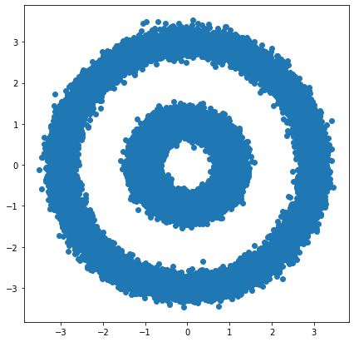
DBSCAN Dataset
Total 100,000 Points

Slide 16
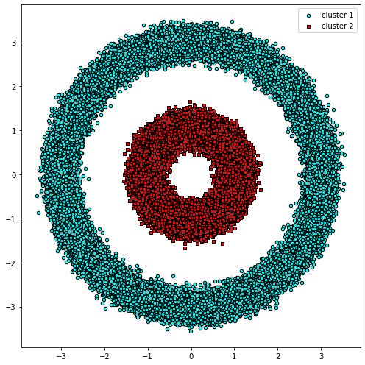
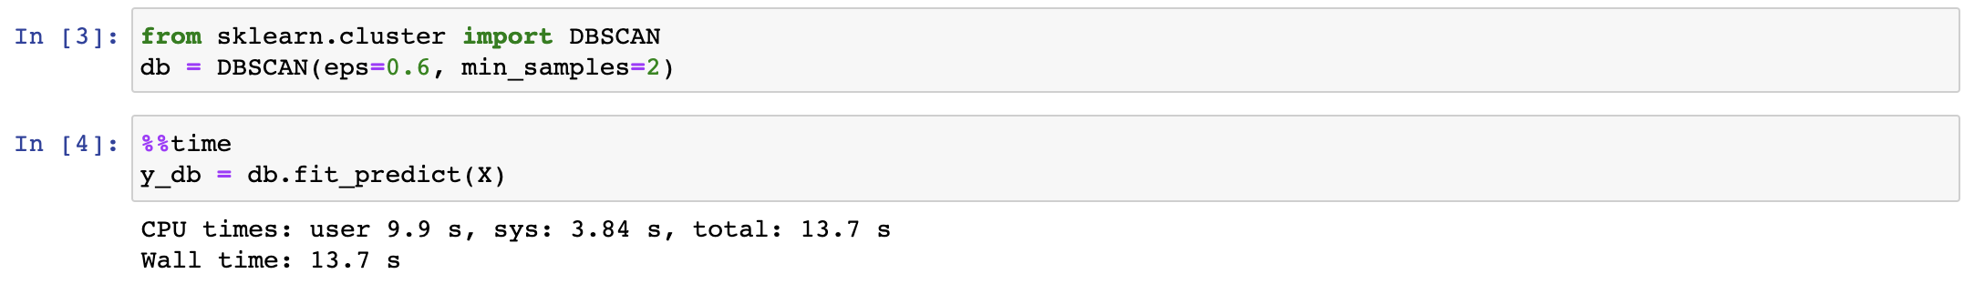
DBSCAN with scikit-learn

Slide 17
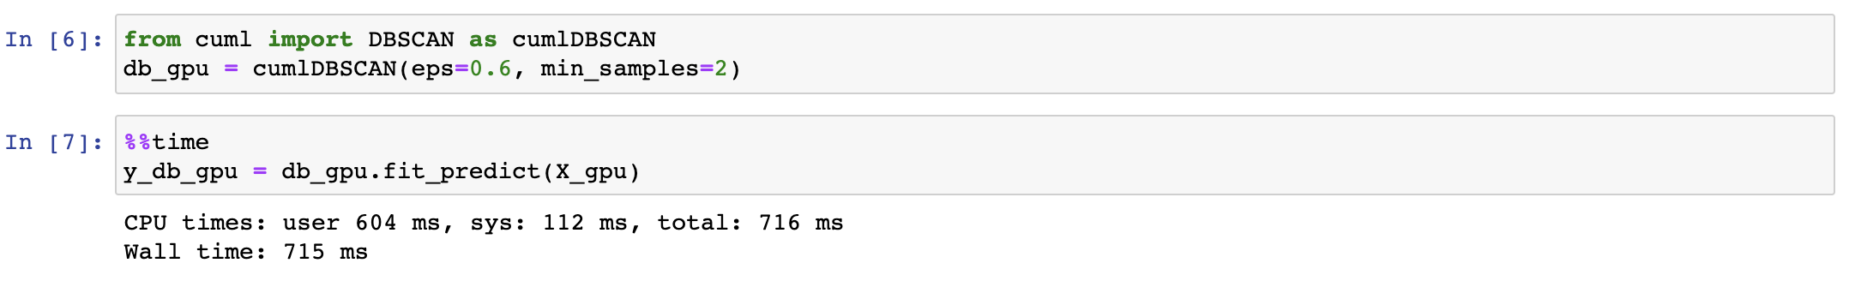
DBSCAN with cuML

Slide 18
Experiment
Create numpy array with random data points
Increase and Decrease number of data points
Apply scikit-learn DBSCAN and cuML DBSCAN

Slide 19
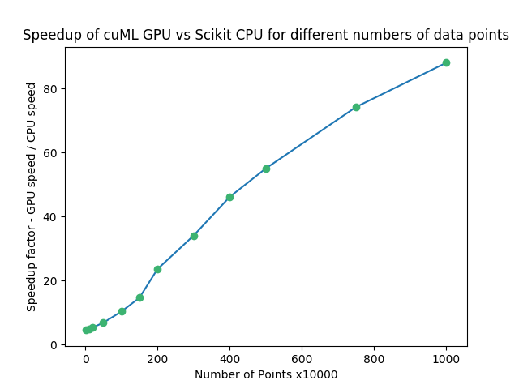
Experiment
Even with 10,000 points we get a speed up of 4.54X (far left)
On higher end of things, with 10,000,000 points, we get a speed up of 88.04X when switching to GPU

Slide 20
Which Library to use
Amount of Speed Up depends on amount of data processing
Larger Datasets benefit from GPU Acceleration
Some overhead time associated with transferring data b/w GPU and CPU

Slide 21
HomeDepot Usecase

Slide 22

Similar and Coordinating Colors
Application that generates similar and coordinating color recomendations
~450K Different paint Colors
Uses k Nearest Neighbors to determine the most similar and coordinating colors

Slide 23
Similar and Coordinating Colors
Current Implementation
Scheduled to run everyday at 9AM
Mixture of Pandas and Pyspark for data preprocessing
scikit-learn for K Nearest Neighbors
Executed on a Google Dataproc cluster with 4 worker nodes (n1-standard-4)
Job takes approximately 3 hours
cuDF Implementation
Scheduled to run everyday at 9AM
Job uses cuDF for data preprocessing and cuML for K Nearest Neighbors
Executed in Google Compute engine with 1 GPU (Tesla K80)
Job takes approximately 30 minutes

Slide 24
Cost Comparison
Daily | Weekly | Monthly | Yearly
~4$ | ~28$ | ~123$ | ~1476$
~0.2$ | ~1.4$ | ~6.50$ | ~78$
Dataproc (Pandas + Pyspark)
Compute Engine (cuDF + cuML)
Note: Price calculated using Google Pricing Calculator https://cloud.google.com/products/calculator

Slide 25
Key Takeaways
Accelerate not just model training but also data preprocessing with NVIDIA RAPIDS
The learning curve is not very steep and completely worth it
More Efficient usage of GPUs

Slide 26
Further Research
Hyperparameter Tuning with NVIDIA RAPIDS
cuPY (NVIDIA RAPIDS version of Numpy)

Slide 27
Questions

