Slide 1
Deep Learning Day: Causal Inference, Treatment Effects, and Consumer Choice
SUSAN ATHEY
THE ECONOMICS OF TECHNOLOGY PROFESSOR, STANFORD GSB
FACULTY DIRECTOR, GOLUB CAPITAL SOCIAL IMPACT LAB; ASSOCIATE DIRECTOR, STANFORD INSTITUTE FOR HUMAN CENTERED AI
IN COLLABORATION WITH: DAVID BLEI, ROB DONNELLY, PULAK GHOSH, FRAN RUIZ, AYUSH KANODIA, MITCHELL LINEGAR, TOBIAS SCHMIDT
HTTPS://ATHEY.PEOPLE.STANFORD.EDU/

Slide 2
Artificial Intelligence/Machine Learning Desired Properties for Applications
Desired properties
Causal inference FRAMEWORK
Interpretability
Stability/Robustness
Transferability
Fairness/Non-discrimination
“Human-like” AI
Reasonable decisions in never-experienced situations
Goal: learn model of how the world works
Impact of interventions can be context-specific
Model maps contexts and interventions to outcomes
Formal language to separate out correlates and causes
Ideal causal model is by definition stable, interpretable
Transferability: straightforward for new context dist’n
Fairness: Many aspects of discrimination relate to correlation v. causation
Performance may depend on physical and mental ability, psychological factors (e.g. risk taking)
Gender and race may be correlated with factors that shift these distributions, relatively limited direct causal effects

Slide 3
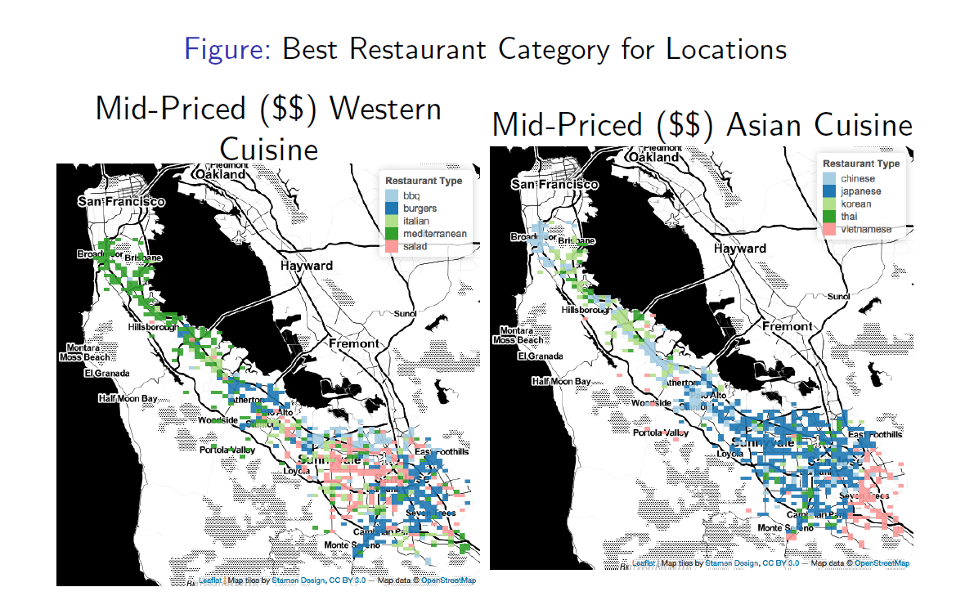
Counterfactual Questions
What would happen if I opened a new restaurant of a given cuisine type in a given location?
Who would the restaurant steal customers from?
Vs:
Given restaurant characteristics (and existing distribution of restaurant locations), what is best prediction of foot traffic?
Estimate each consumer’s preferences for rest. characteristics and travel
Use learned preferences to estimate how consumers would select restaurants if we counterfactually changed the cuisine of a restaurant in a location (ignoring congestion)
Athey, Blei, Donnelly, Ruiz and Schmidt, AEA P&P, 2018

Slide 4
Two Big Challenges for Estimation of Counterfactuals
Prediction vs. Causal Inference
Statistical Power
Availability of experimental or quasi-experimental variation in data to separate correlation from causal effects
Customizing ML optimization for estimating causal effects and counterfactuals of interest
Effect sizes small – firms usually already doing reasonable things
Personalization is hard—never enough data!
Historical observational data may not be informative about causal effects

Slide 5
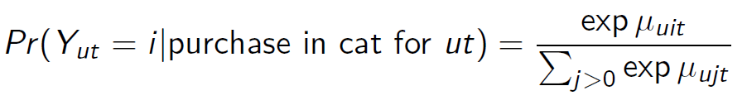



Multinomial Logit and Utility Maximization
Suppose that user u has the following utility from purchasing item i at time t:
Consumer maximizes utility among items in category by making the choice i that solves:
Then, if error has type I extreme value distribution and independent across items, then:
Thus, data about i’s purchases can be used to estimate i’s mean utilities for each item. If
and prices vary over time, can estimate consumer’s price sensitivity.
$$U_{uit}=μ_{uit}+ε_{uit}$$
$${\max_{i}{U}}_{uit}$$
McFadden (1972, 1973) established connection between utility maximization and MNL
With preferences known, can do counterfactual analysis
Application: Impact of expanding BART on transportation choices
$$μ_{uit}=θ_{ui}−δ_{u}p_{it}$$

Slide 6
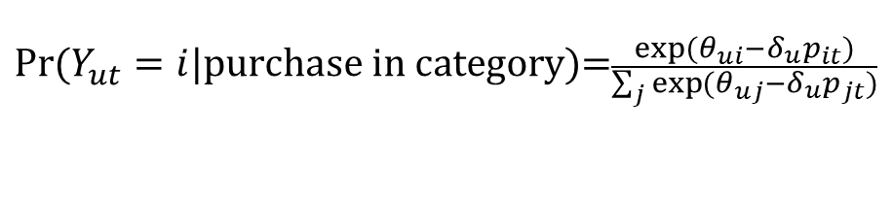
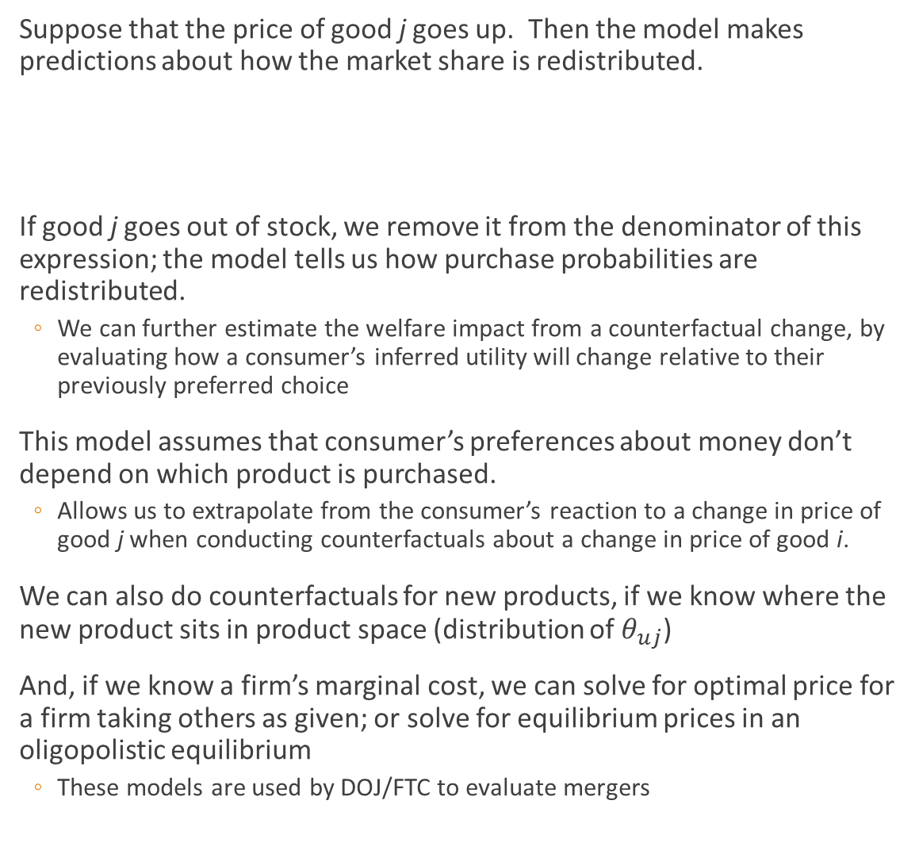
Multinomial Logit and Utility Maximization
Suppose that the price of good j goes up. Then the model makes predictions about how the market share is redistributed.
If good j goes out of stock, we remove it from the denominator of this expression; the model tells us how purchase probabilities are redistributed.
We can further estimate the welfare impact from a counterfactual change, by evaluating how a consumer’s inferred utility will change relative to their previously preferred choice
This model assumes that consumer’s preferences about money don’t depend on which product is purchased.
Allows us to extrapolate from the consumer’s reaction to a change in price of good j when conducting counterfactuals about a change in price of good i.
We can also do counterfactuals for new products, if we know where the new product sits in product space (distribution of $θ_{uj}$)
And, if we know a firm’s marginal cost, we can solve for optimal price for a firm taking others as given; or solve for equilibrium prices in an oligopolistic equilibrium
These models are used by DOJ/FTC to evaluate mergers
$$Pr⁡(Y_{ut}=i|\text{purchase} \text{in} \text{category}\text{)=}\frac{\exp{(θ_{ui}−δ_{u}p_{it})}}{\sum_{j}{\exp{(θ_{uj}−δ_{u}p_{jt})}}}$$
How do you use the utility maximization framework?

Slide 7
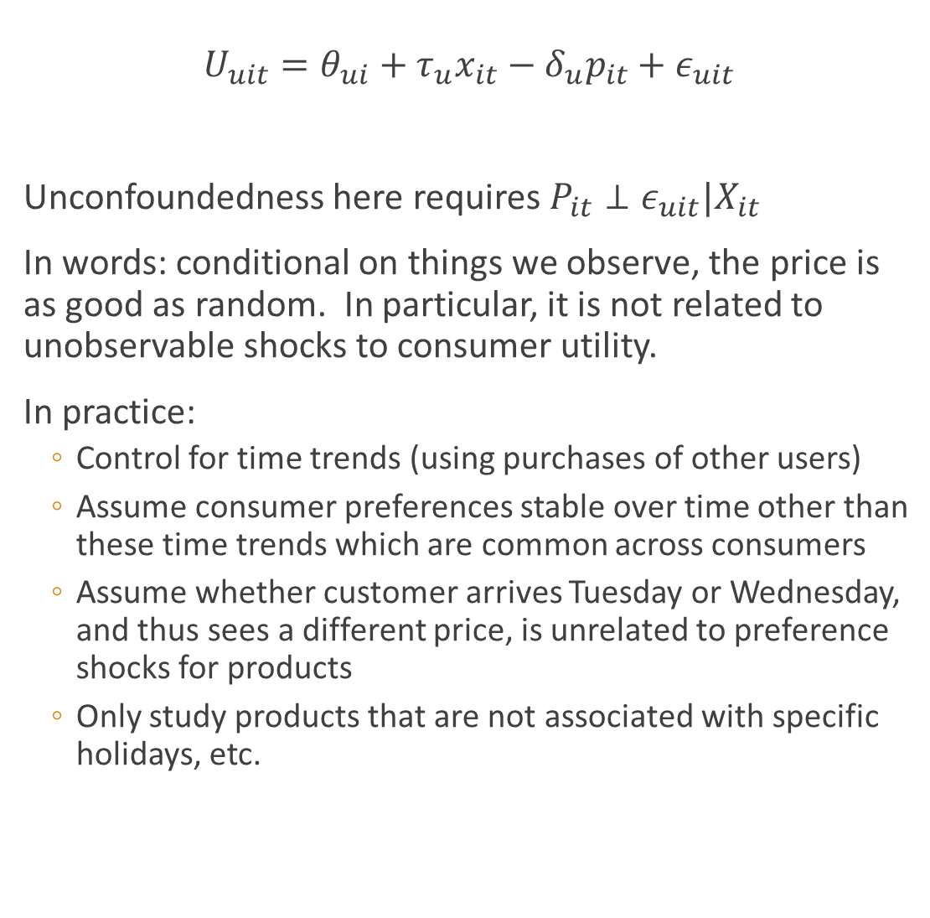
Correlation vs. causation in the multinomial logit
$$U_{uit}=θ_{ui}+τ_{u}x_{it}−δ_{u}p_{it}+ε_{uit}$$
Unconfoundedness here requires $P_{it}⊥ε_{uit}|X_{it}$
In words: conditional on things we observe, the price is as good as random. In particular, it is not related to unobservable shocks to consumer utility.
In practice:
Control for time trends (using purchases of other users)
Assume consumer preferences stable over time other than these time trends which are common across consumers
Assume whether customer arrives Tuesday or Wednesday, and thus sees a different price, is unrelated to preference shocks for products
Only study products that are not associated with specific holidays, etc.
How can we be sure we are estimating the causal effect of prices on purchases?
Concern: what if unobserved consumer preferences change at the same time as prices? E.g., firm raises price when demand is high for other reasons.

Slide 8
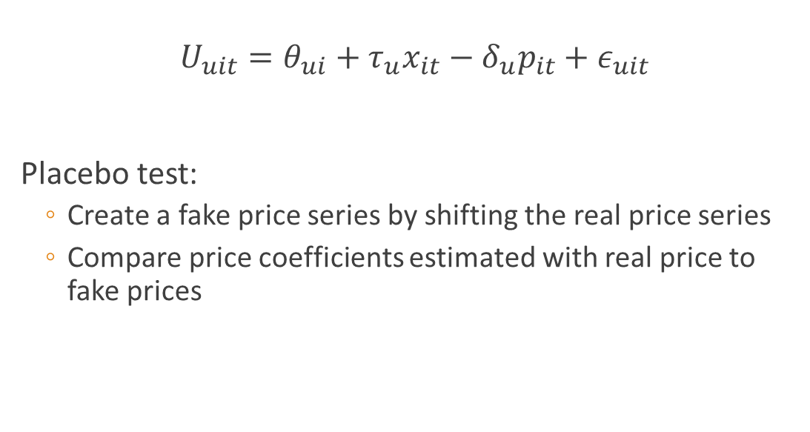
Supplementary Analysis: Placebo Tests
$$U_{uit}=θ_{ui}+τ_{u}x_{it}−δ_{u}p_{it}+ε_{uit}$$
Placebo test:
Create a fake price series by shifting the real price series
Compare price coefficients estimated with real price to fake prices
If consumer utility from a product is gradually increasing over time alongside price, could get a bias in the coefficient on price

Slide 9
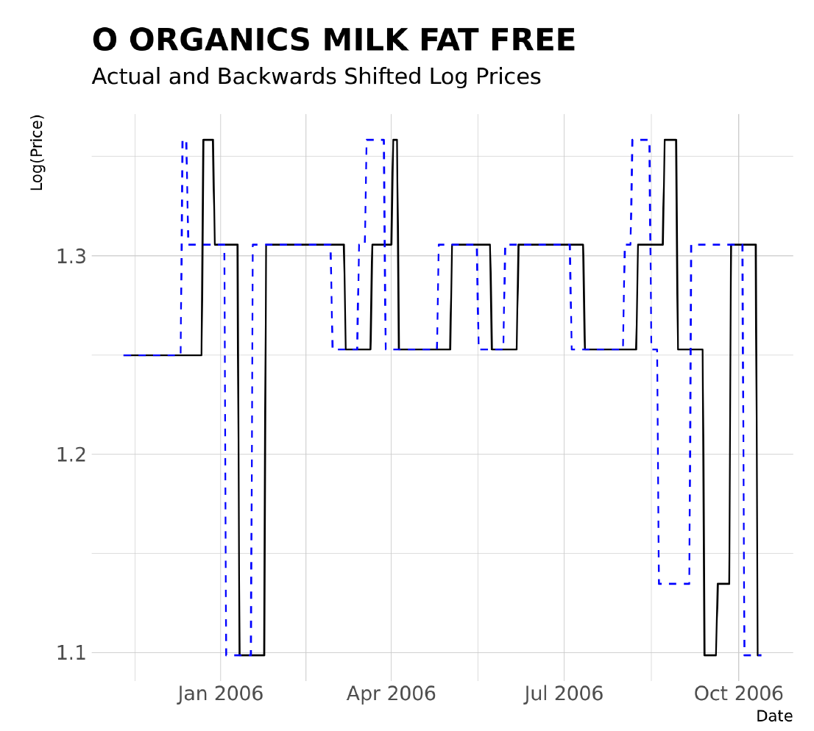
Shifting the price series

Slide 10
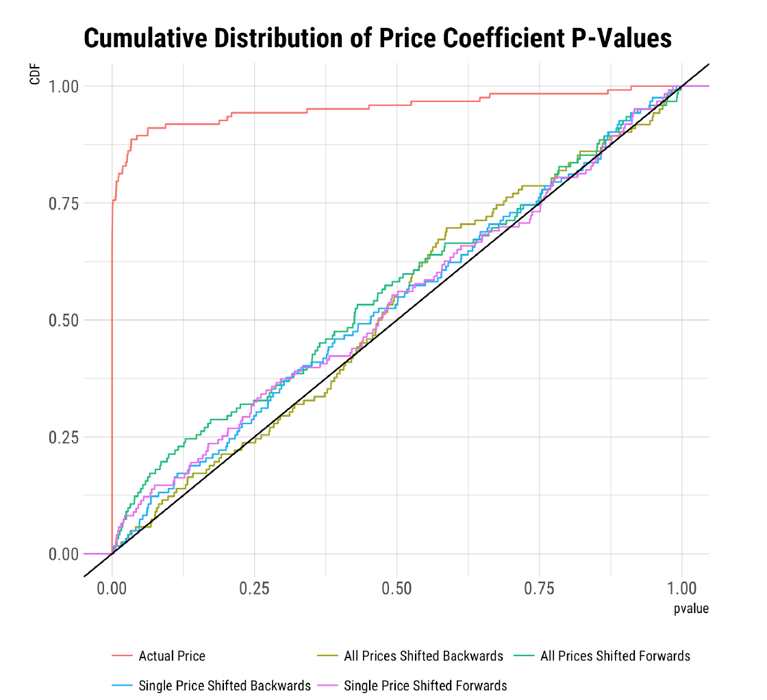
Shifting the price series
Price shifting exercise conducted for each of about 100 categories
If there were no effect of price, then p-values from hypothesis test that price coefficient is zero would be uniformly distributed across categories
We see uniformly distributed price coefficients for the fake price series but not the real one

Slide 11
Our approach: matrix factorization + nested logit
Traditional economics and marketing
Study one category (e.g. paper towels) at a time
Small number of latent parameters (price sensitivity, product quality)
Assume items are substitutes within a category, ignore other categories
Our approach
Use the utility maximization approach
Study many categories in parallel. Maintain assumption that categories are independent, and that items are substitutes within categories (select categories where that is true)
Nested logit: consider one “shock” to an individual’s need to purchase in the category at all
Use matrix factorization or neural nets for the user-item preference parameters

Slide 12







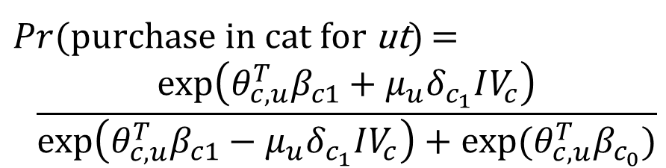
Nested Factorization Model
Purchase in Category?
No
Yes
Item 1
Item 2
Item 3
Error induces correlation across item choices versus “no purchase” decision
Latent vectors
Price
$$U_{u1t}=μ_{u1t}+ε_{u1t}$$
$$U_{u2t}=μ_{u2t}+ε_{u2t}$$
$Pr⁡(\text{purchase} \text{in} \text{cat} \text{for} \text{ut}\text{) }$=
$$\frac{exp⁡\left(θ_{c,u}^{T}β_{c1}+μ_{u}δ_{c_{1}}IV_{c}\right)}{\exp\left(θ_{c,u}^{T}β_{c1}−μ_{u}δ_{c_{1}}IV_{c}\right)+\exp{(θ_{c,u}^{T}β_{c_{0}})}}$$
$$U_{u3t}=μ_{u3t}+ε_{u3t}$$

Slide 13
Computational Issues
Standard in economics and marketing
MCMC Bayesian
Very limited in scalability
We use variational Bayes
Approximate posterior with parameterized distribution
Minimize KL-divergence to true posterior
Use stochastic gradient descent
Introducing price, time-varying covariates slows down computation
Substitutability within categories leads to nonlinearities, motivates computational tricks
See Ruiz, Athey and Blei AOAS, 2019; Donnelly, Athey, Ruiz and Blei, 2019
Could also use neural networks instead of matrix factorization; see Rudolph, Ruiz, Athey and Blei; Liu, Ruiz, Athey and Blei, NeurIPS, 2017

Slide 14
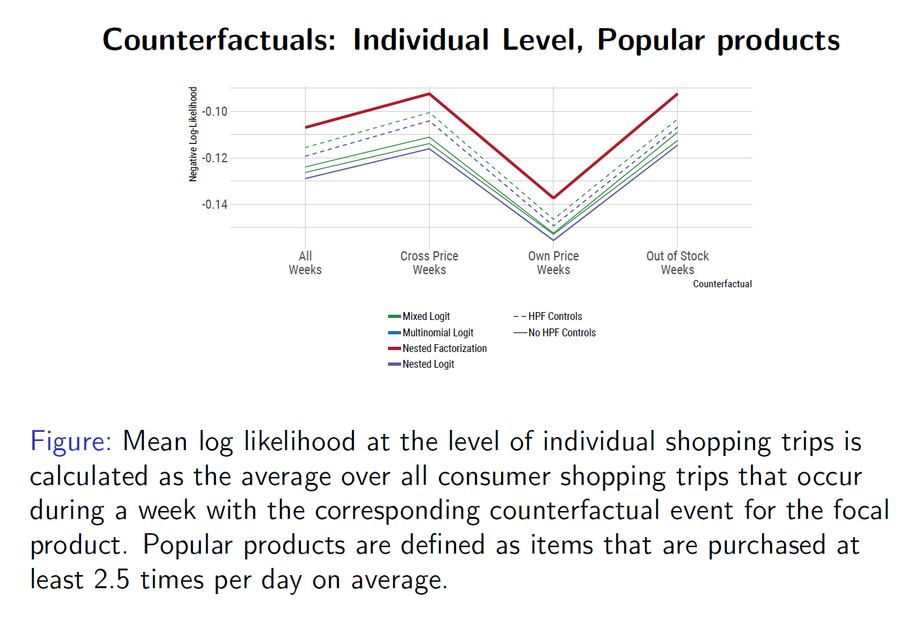
How to do model selection?
Don’t just evaluate predictive accuracy, but assess how the model performs in weeks with price changes

Slide 15
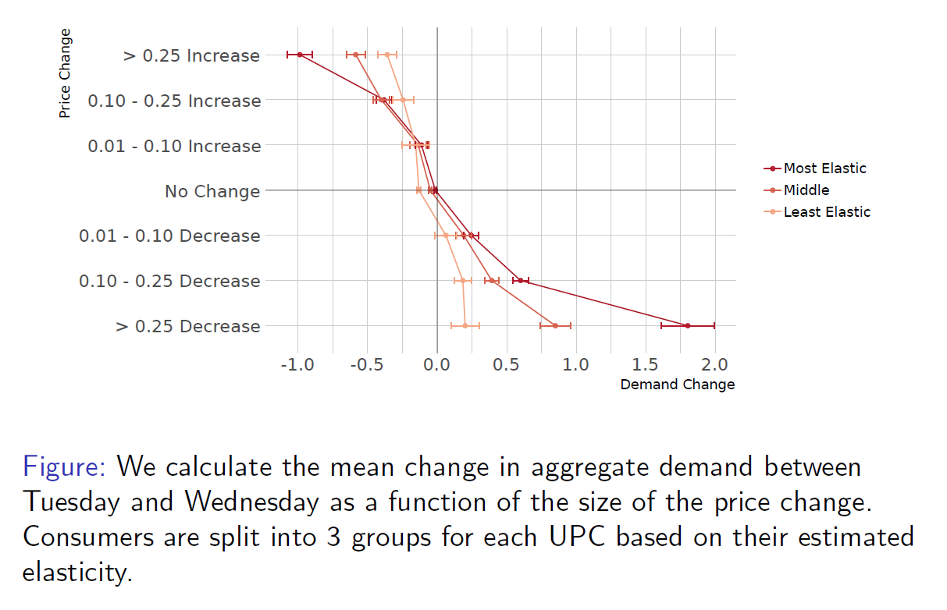
Evaluating performance for relevant “counterfactuals” in test set
For each user-item, divide users into three groups according to price sensitivity
For each item-week with a price change on Tues night, calculate difference between purchases from Tues-Wed in test set
Result: we successfully identified price sensitive consumers

Slide 16
Conclusions
Counterfactual inference differs from prediction
Learn parameters of utility through revealed preference, then predict responses to alternative situations
Find dataset that is large enough and has sufficient variation in price to isolate causal effects and assess credibility of estimation strategy
Select counterfactuals where it is possible to assess and validate
Evaluate value of personalized targeting, how it varies with alternative data sizes
Not all data is created equal!
Can assess extent of information leakage from other users, value of data retention, and economies of scope in data
Benefits from estimating richer model large relative to the value of more data from a fixed model

