Slide 1
Lab03 Solution
Hank Huang

Slide 2
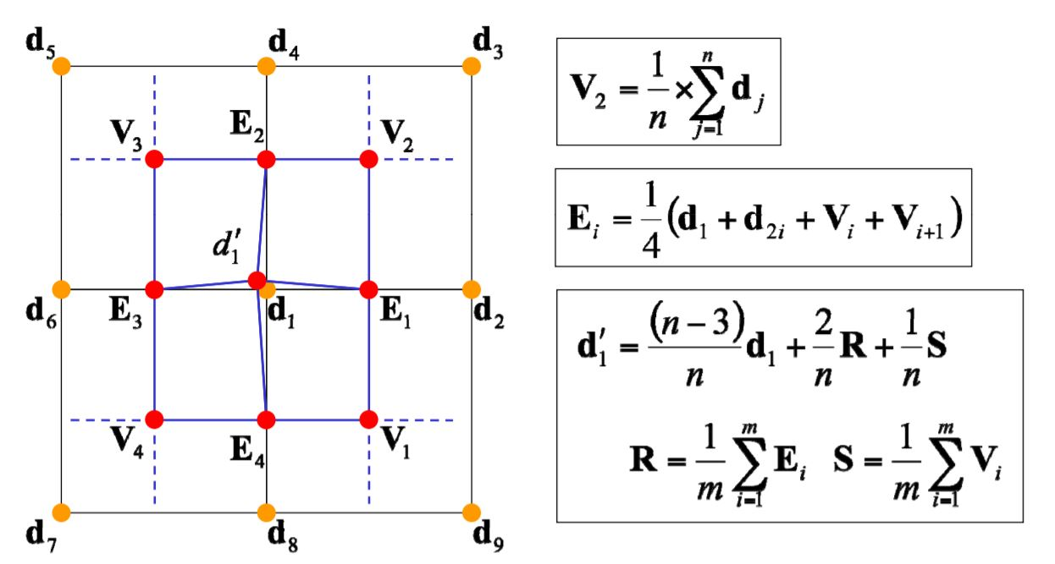
Catmull Clark Subdivision
Subdivision scheme by taking average of polygon mesh faces and edges to recompute new vertices
Ref: http://graphics.stanford.edu/courses/cs468-10-fall/LectureSlides/10_Subdivision.pdf

Slide 3
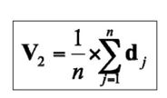

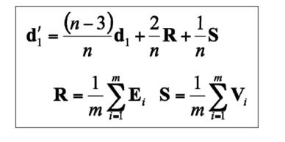
Implementation
1. Compute all vertex adjacencies
2. Compute face points
- average of quad vertices (centroid)
3. Compute edge points
- average of two adjacent vertices and their corresponding face points
4. Compute gravity center
- use average of all face points and edge points to compute new center point
5. Replace old vertices with vertices from 2-4
Eq1. Face point formula
Eq2. Edge point formula
Eq3. Gravity center formula

Slide 4
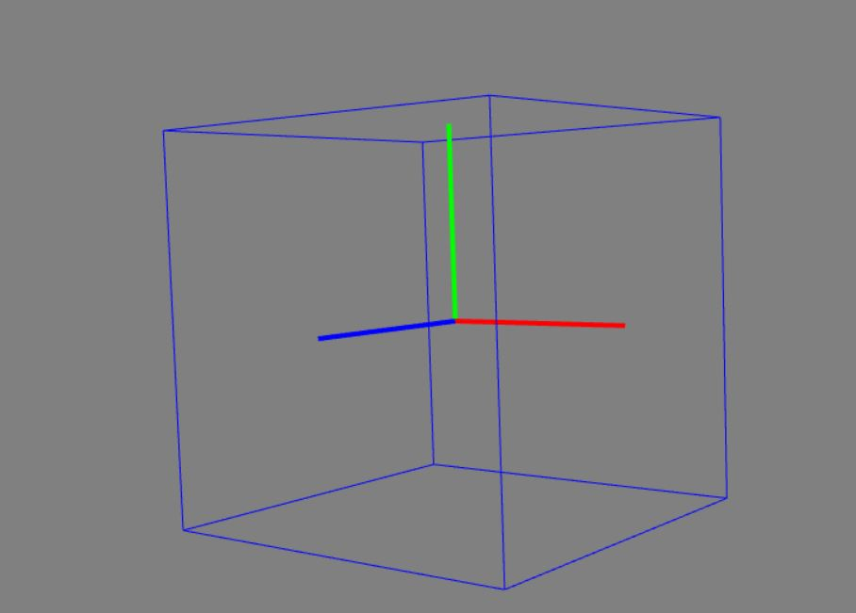
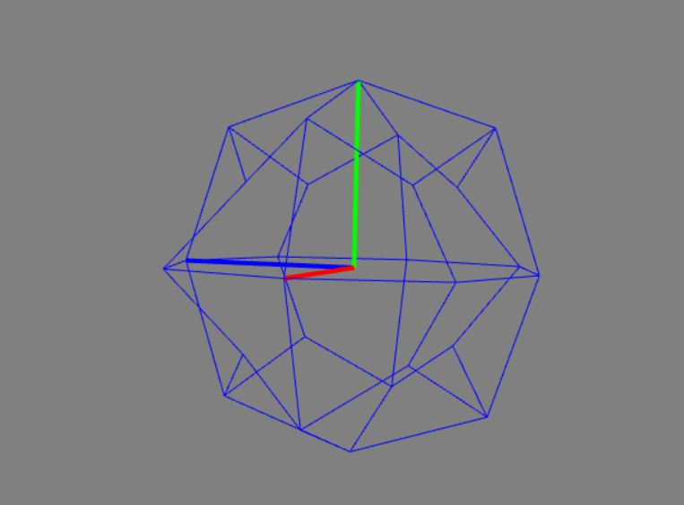
Results
Fig 1. Cube before subdivision
Fig 2. Cube after one subdivision

