Slide 1

STARK HEALTH CLINIC - DIABETES PREDICTION PROJECT
Leveraging machine learning to predict diabetes onset and empower proactive healthcare interventions.

Slide 2

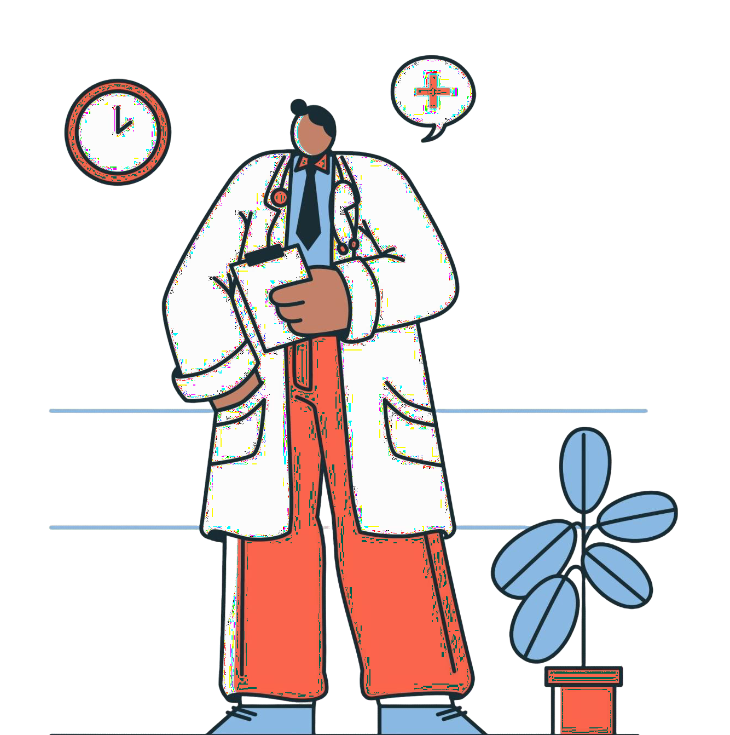
BUSINESS INTRODUCTION
Stark Health Clinic is a leading healthcare provider that leverages technology and predictive modeling to enhance its operations. By integrating machine learning into its systems, the clinic identifies diseases early, improving patient outcomes and resource allocation.

Slide 3
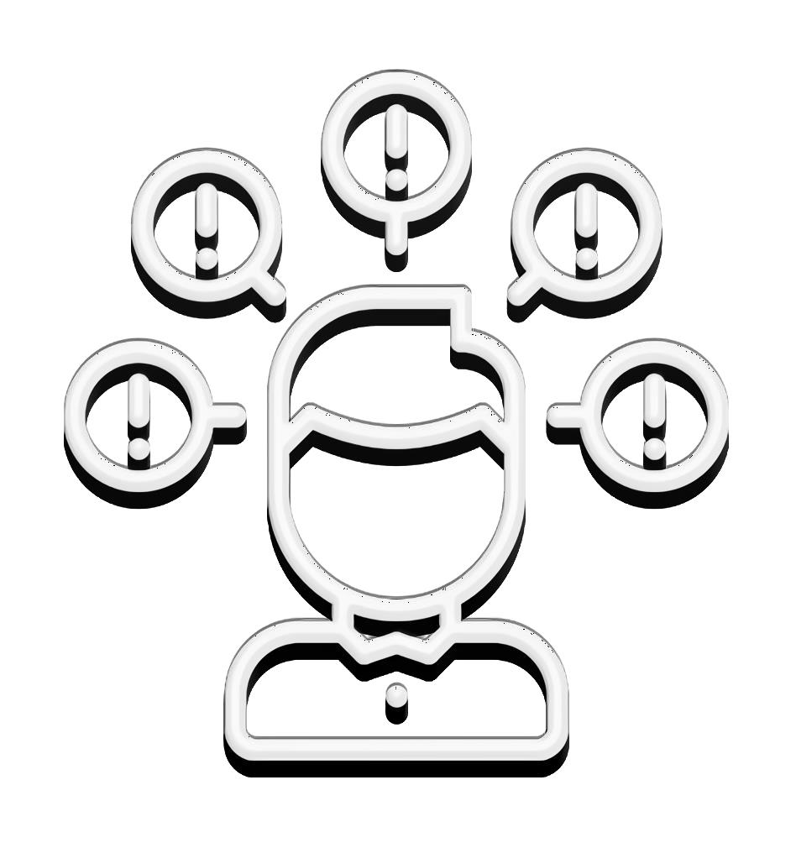
Problem: The company needs an effective way to identify individuals at risk of diabetes early to provide timely interventions, minimize complications, and reduce healthcare costs. Currently, there is no automated solution to analyze data and predict diabetes risk efficiently.

Slide 4

THE COMPANY BENEFITS:
Proactive Risk Management: The model will help identify individuals at risk of diabetes early, reducing the likelihood of long-term complications and lowering associated healthcare costs.
Improved Patient Outcomes: Early detection enables patients to manage their condition more effectively, leading to a better quality of life and fewer hospitalizations.
Increased Efficiency: Automating the diabetes prediction process allows healthcare providers to focus on high-priority cases, ensuring optimal use of resources.
Cost Savings: Preventing complications and avoiding unnecessary care expenses will significantly reduce the hospital’s budget, freeing up funds to address other health challenges.
Stronger Reputation: Implementing innovative, data-driven solutions positions the hospital as a leader in healthcare innovation and fosters greater trust among patients.

Slide 5


This is a classification problem where the goal is to build a machine learning model that can accurately determine whether a patient has diabetes using the provided data. The priority is to identify all diabetic patients, minimizing missed cases (false negatives), while ensuring the predictions are accurate and actionable.

Slide 6
Data Preprocessing and Feature Engineering:
1. Cleaned the data by checking missing and duplicate values.
2. Performed normalization.
4. Performed Encoding by converting categorical variables into numerical form by using OneHotEncoder.
5.Prepared the dataset by splitting the data into training and test sets.
Model Development:
Trained three classification models, including Logistic Regression, Random Forest, and Decision Tree Classifier.
Evaluated the models using metrics such as accuracy, precision, recall, F1-score, and AUC-ROC
Model Selection
Selected the best-performing model based on a balance of recall and precision for diabetic cases.

Slide 7
Model: Decision Tree Classifier
The trained models achieved the following results:
Recall for diabetic was 0.73, indicating the model captures 73% of diabetic cases.
Accuracy: 95%, ensuring high reliability overall.
Precision: The model has a precision of 72% for identifying diabetic cases, meaning that when it predicts someone has diabetes, it is correct 72% of the time. This helps minimize unnecessary false alarms while focusing on cases that genuinely require attention.
The confusion matrix shows that this model makes far fewer mistakes when it comes to missing positive cases (false negatives) compared to other models. This aligns well with the company’s priority of focusing on early detection.

