Slide 1
Team 1: 백신 어딨지 PRO
COMP217015 Java Programming (Spring’21)
Team members: 김영호, 배지훈, 한강민

Slide 2
Overview of Project
저희 프로젝트의 주제는 정부에서 백신 관리 프로그램의 수주를 받았을 때를 가정하여 만들어진 프로그램 입니다.
저희 프로그램을 Github을 협업툴로써 작업하였고, Class Diagram을 통해 설계하였습니다.
https://github.com/kanei0415/VaccineCMSJavaSwing

Slide 3
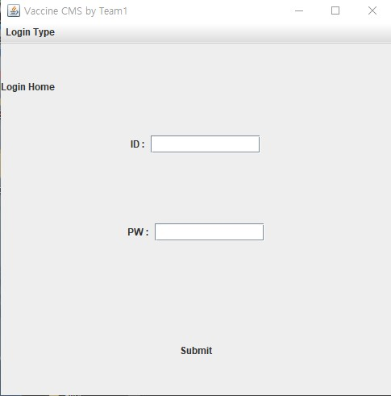
Detailed Project Description ( 1 / 13 )

Slide 4
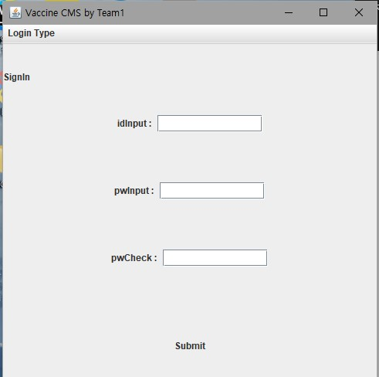
Detailed Project Description ( 2 / 13 )

Slide 5
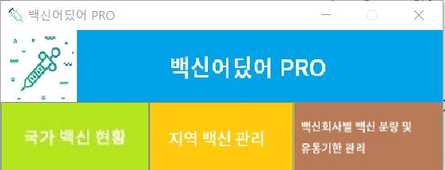
Detailed Project Description ( 3 / 13 )

Slide 6
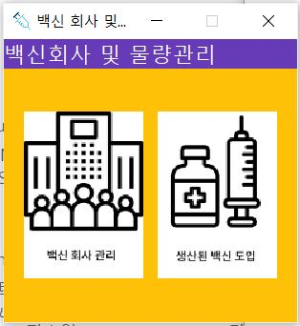
Detailed Project Description ( 4 / 13 )

Slide 7
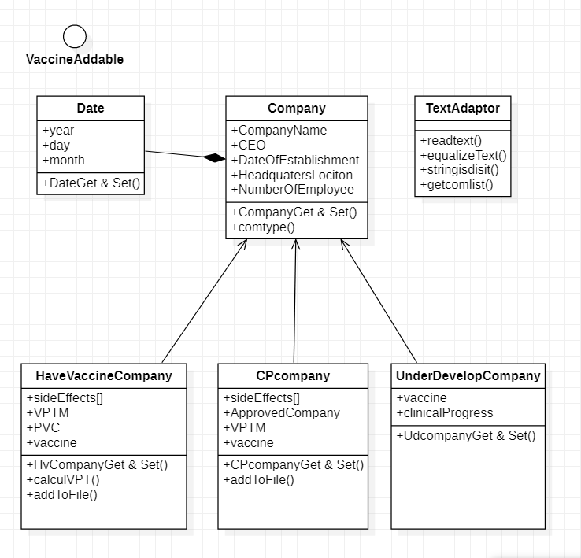
Detailed Project Description ( 5 / 13 )

Slide 8
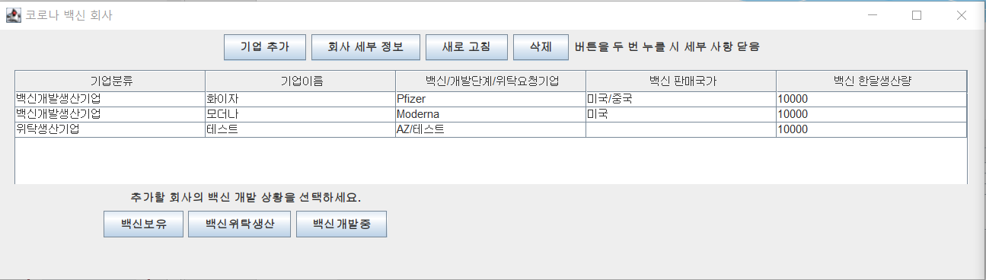
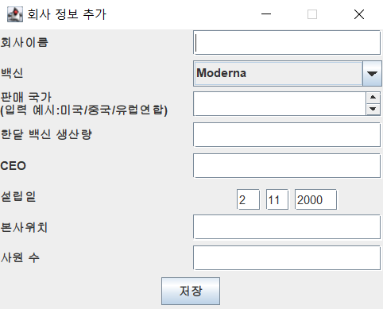
Detailed Project Description ( 6 / 13 )

Slide 9
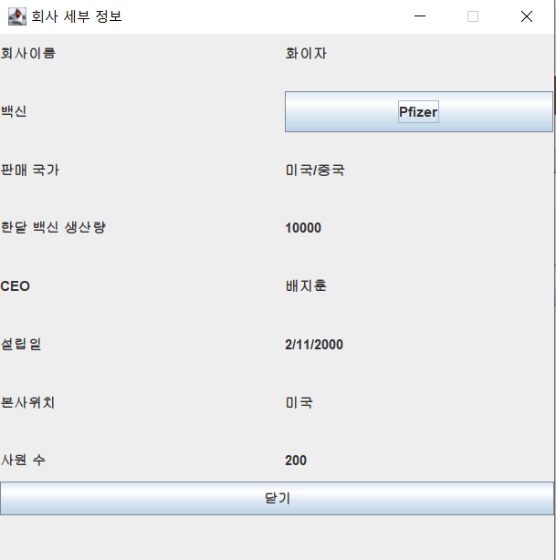
Detailed Project Description ( 7 / 13 )

Slide 10
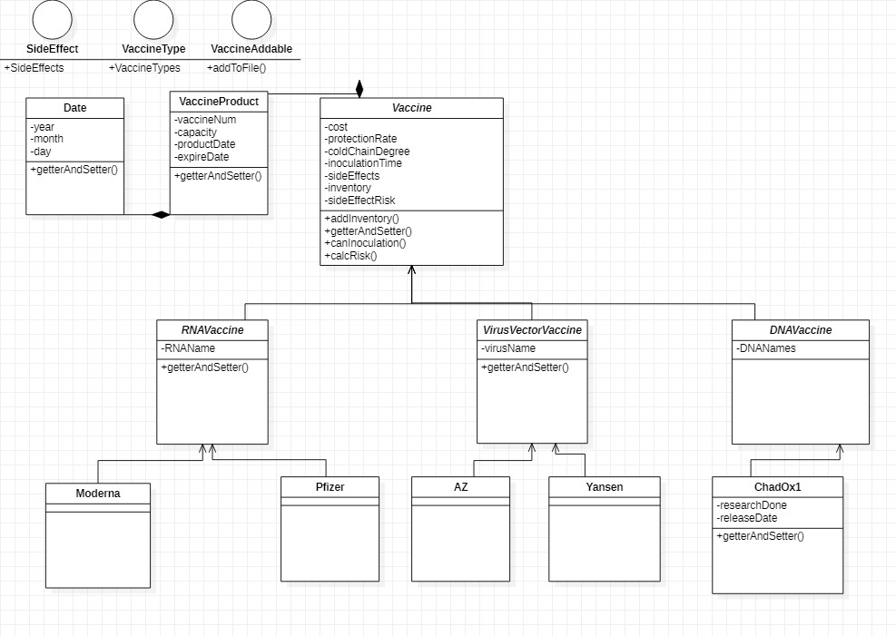
Detailed Project Description ( 8 / 13 )

Slide 11
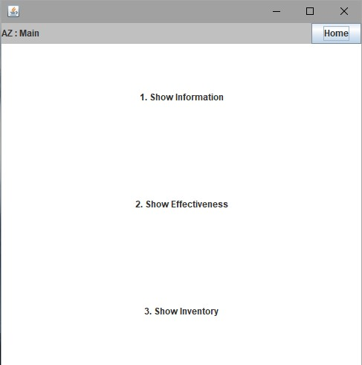
Detailed Project Description ( 9 / 13 )

Slide 12
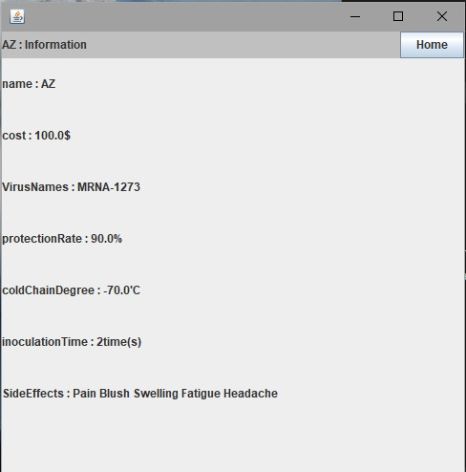
Detailed Project Description ( 10 / 13 )

Slide 13
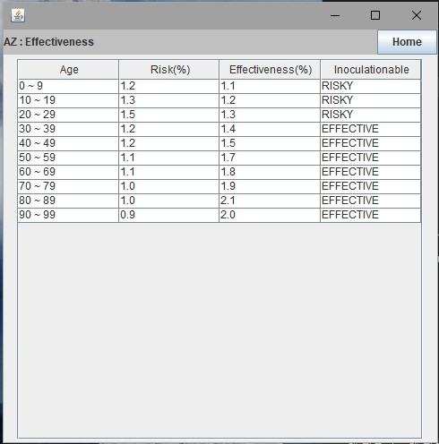
Detailed Project Description ( 11 / 13 )

Slide 14
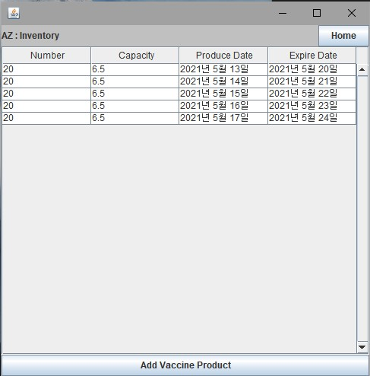
Detailed Project Description ( 12 / 13 )

Slide 15
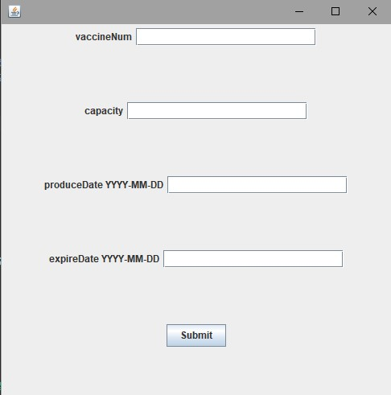
Detailed Project Description ( 13 / 13 )

Slide 16
Summary of Project Code
Total Lines of Code: 4000+
Whether to reflect the required technologies in your project:
Class: O
Inheritance: O
File I/O: O
Collection (which collection?): O - ArrayList
Swing-like GUI: O
Object Serialization/Deserialization: O
Utility Libraries: X
Optional technologies:
Multi-threading: O
Other: Describe what other technologies you used if any
README file: O
Describe in your README how to run your code, what environments to be configured, and so forth, for testing your code.

Slide 17
Demo
직접 시연 하겠습니다

Slide 18
Q & A

