Slide 1
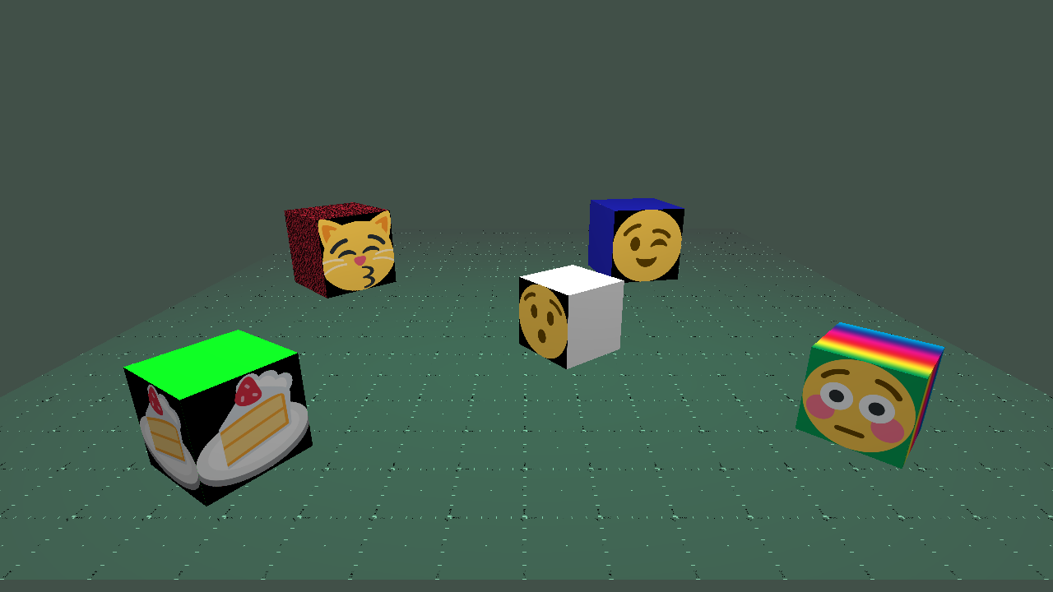
Neckerworld – A Computer Vision Game

Slide 2
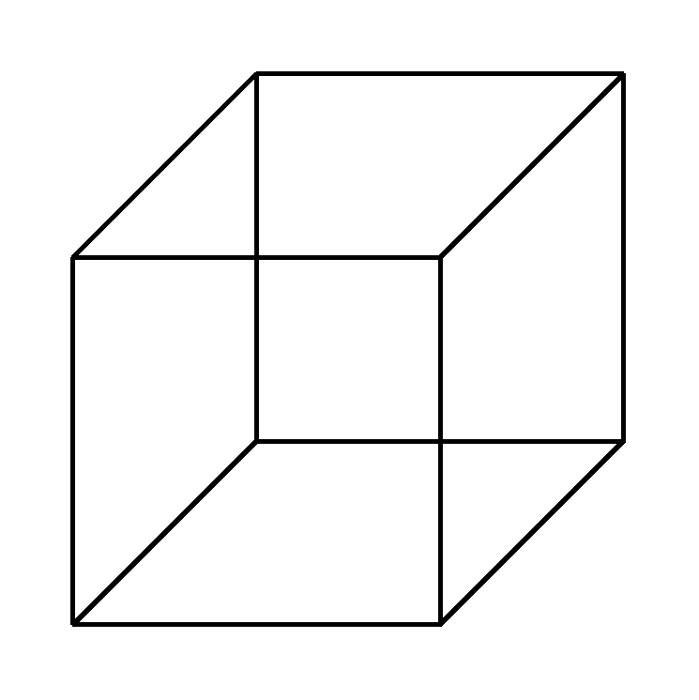
The Necker Cube Illusion

Slide 3
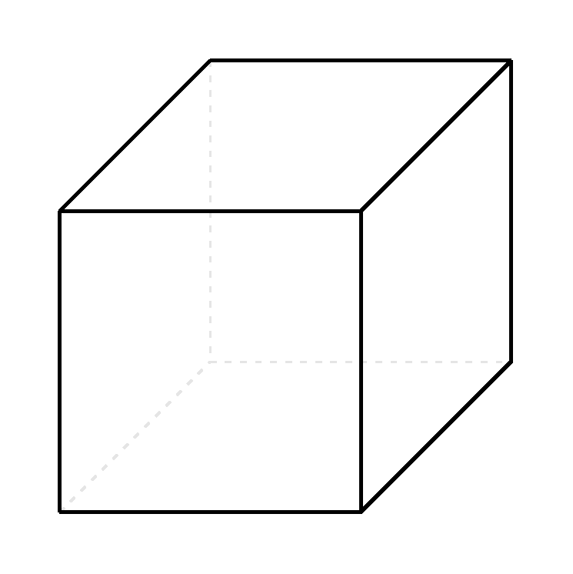
The Necker Cube Illusion

Slide 4
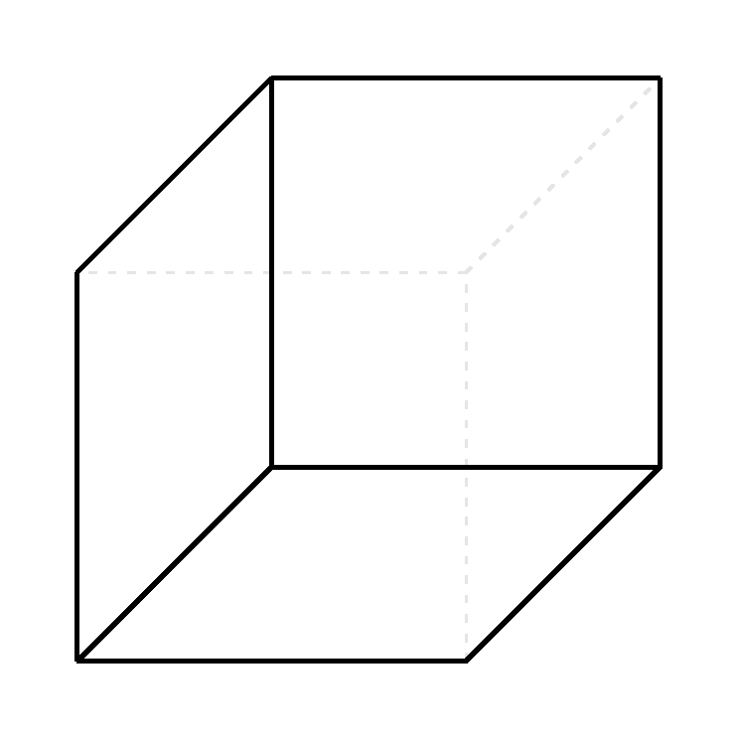
The Necker Cube Illusion

Slide 5
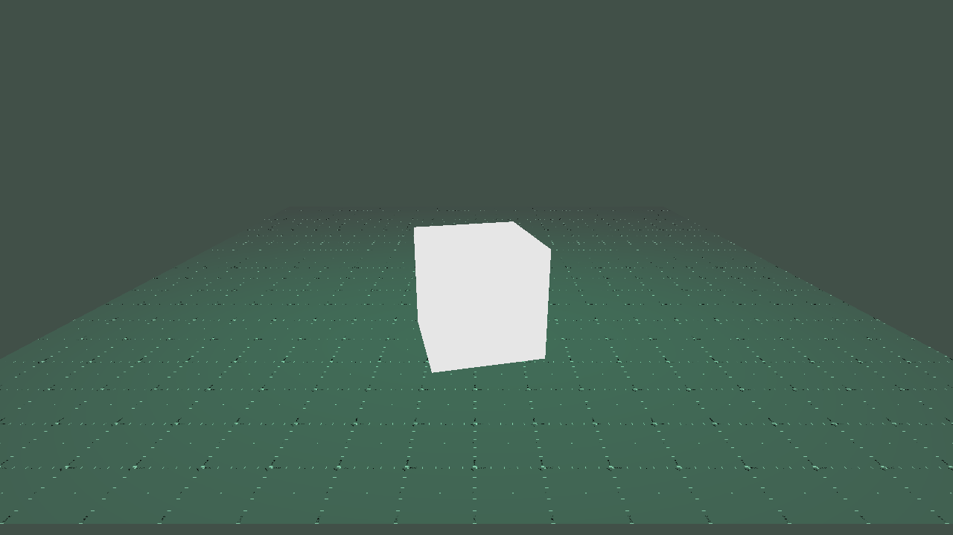
The Cube – A Basis for Studies of Visual Perception
Colored Surface Only

Slide 6
The Cube – A Basis for Studies of Visual Perception
Textured Surfaces

Slide 7
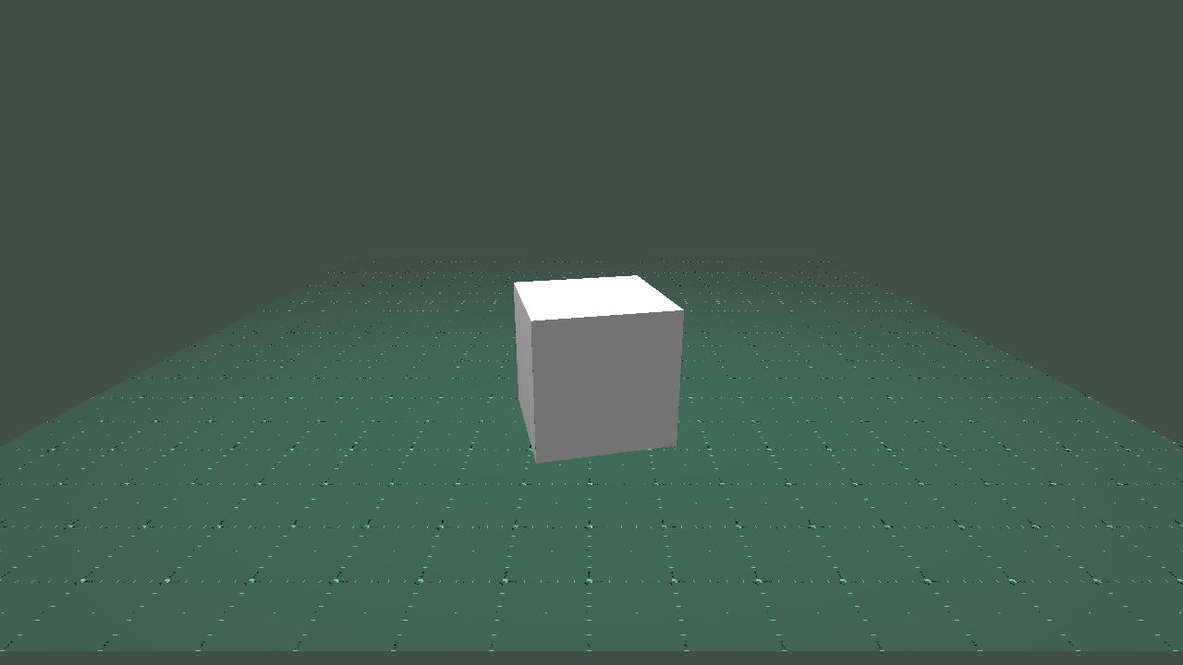
The Cube – A Basis for Studies of Visual Perception
Shaded Surfaces

Slide 8
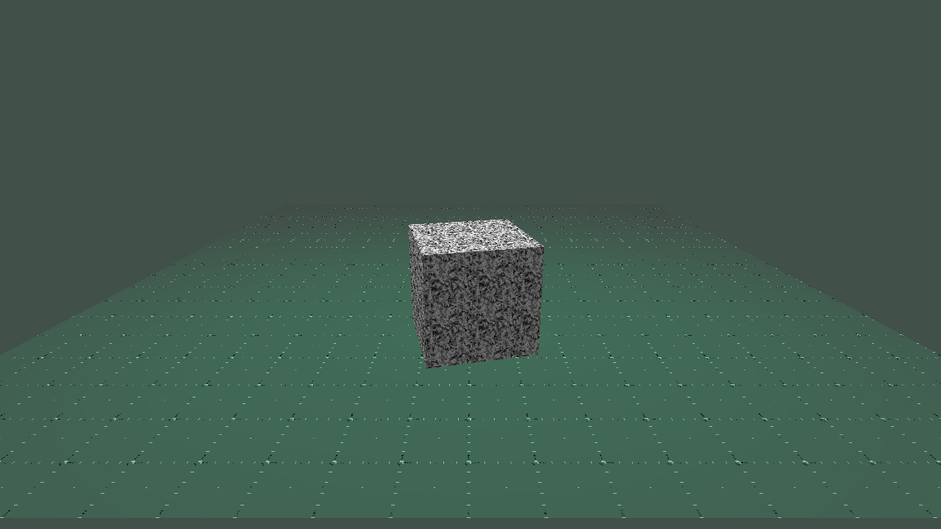
The Cube – A Basis for Studies of Visual Perception
Shaded Textured Surfaces

Slide 9
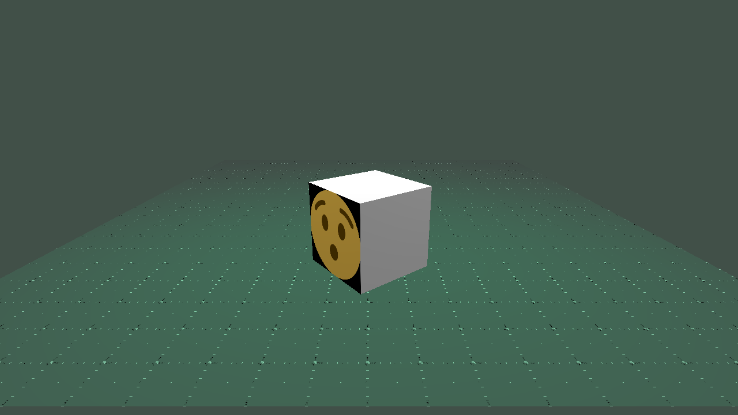
The Cube – A Basis for Studies of Visual Perception
Shaded Surfaces with Features

Slide 10
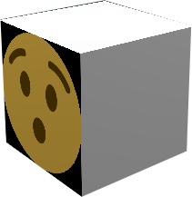
The Cube – A Basis for Studies of Visual Perception
Studies and experiments in size constancy
Rules about occlusion of image objects
Perceived motion

Slide 11
Neckerworld – A Computer Vision Game
Visual Systems are very different
They are uniquely engineered to serve the needs of the organism
They have evolved over 100's of millions of years
The human visual system serves humans well,
but not zebras, owls, rats, bees, or spiders

Slide 12
Neckerworld – A Computer Vision Game
Three guiding principals of the human visual system:
Find something to eat
Don't get eaten
Find a mate

Slide 13
Neckerworld – Game Design
All players and resources in the game are cubes
The cube players are guided solely
through autonomous computer vision programs
No human manual control or input permitted
Requires competent programs to do object detection
and playing field knowledge representation

Slide 14
Neckerworld – Game Design
Game points are scored through three activities:
Finding and reaching food resources
Killing off predators
Mating and having child cubes

Slide 15
Neckerworld – Game Technology
Playing Field
Server
Cube Player
Program
Playing Field
Server
Messaging Protocol

Slide 16
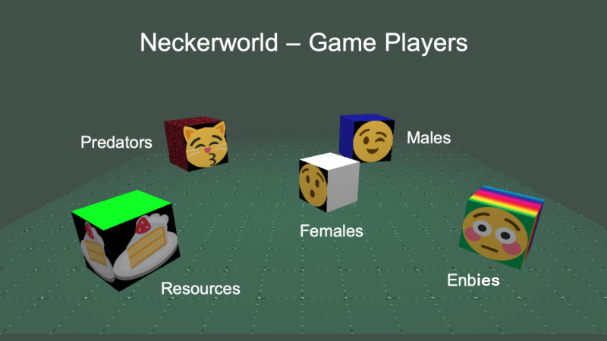
Neckerworld – Game Players
Predators
Males
Females
Enbys
Resources

Slide 17
Neckerworld – Field View

Slide 18
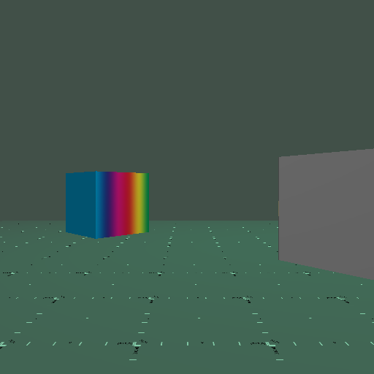
Neckerworld – Cube's Eye View

Slide 19
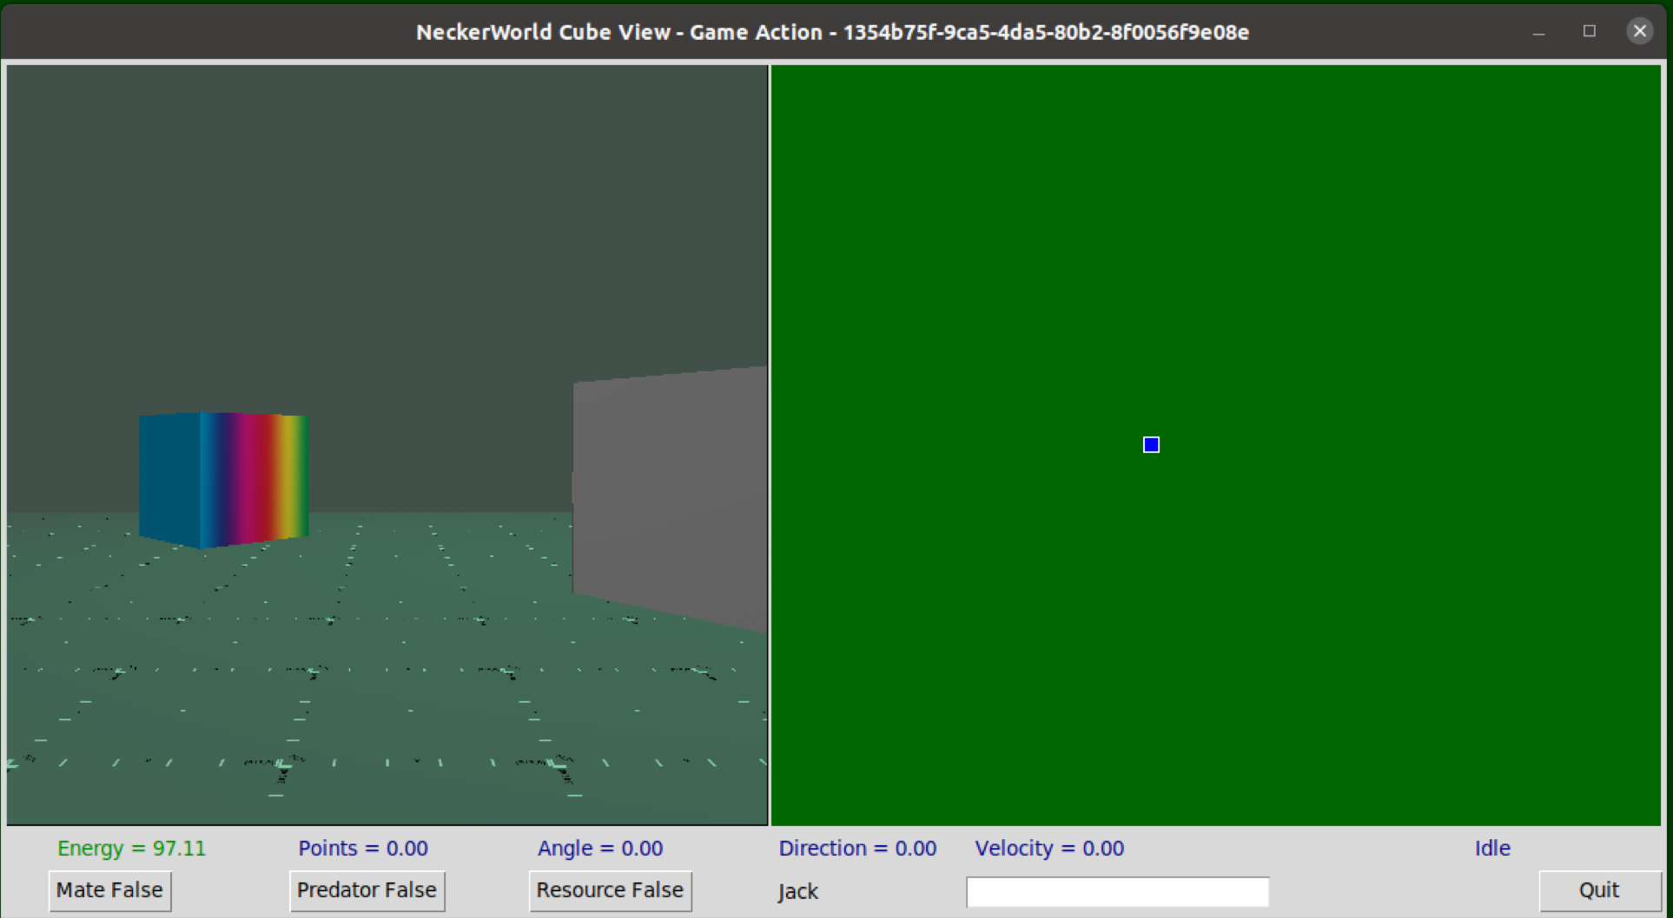
Neckerworld – Cube Control Panel

Slide 20
Neckerworld – Cube Control Panel

Slide 21
Neckerworld – Game On

Slide 22
Neckerworld – Fundamental Questions
Given only the cube view, why do we perceive a larger 3D space?
Given constant motion of the view, why does the world appear stable?
How do we internally represent the objects around us?
What is the relationship between object detection and internal representations?
And many more ...

Slide 23
Neckerworld – AI and ML
Object detection – identifying an object in an image, placing a bounding box around the object and assigning a probability of a class to it.
Object classification – assigning a class to an image.
Image segmentation – identifying all pixels associated with a particular subset of an image.

Slide 24
Neckerworld – Object Detection Goals
Determine if there is one or more objects in the image.
Identify the type of object.
Provide a probability for the type.
Draw a bounding box around the object.
Determine its spatial position relative to the camera.

Slide 25
Neckerworld – Object Detection Outcomes
There is an object and you nailed it.
There were no objects and you agreed.
There was an object but you didn't see it.
There were no objects but you said you found one.

Slide 26
Neckerworld – Object Detection Score
95% sure it's a Female
50% sure it's a Male
10% chance that it's a Predator
1% chance it's a Resource.

Slide 27
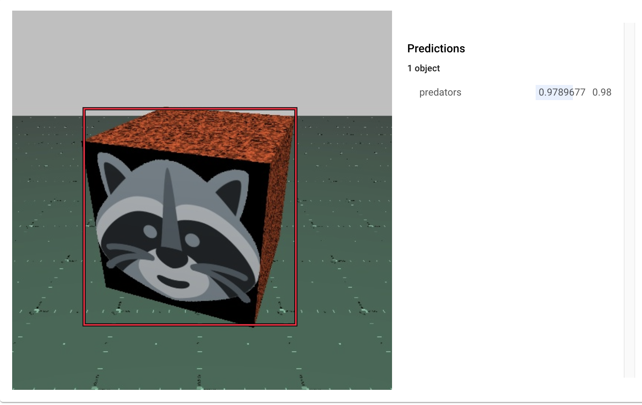
Neckerworld – Object Bounding Box

Slide 28
Neckerworld – Object Detection
Create a visual neural net model.
Train the neural net to identify the object.
Validate the model/training with validation images.
Test the model with final test images.
Deploy the model into production.

Slide 29
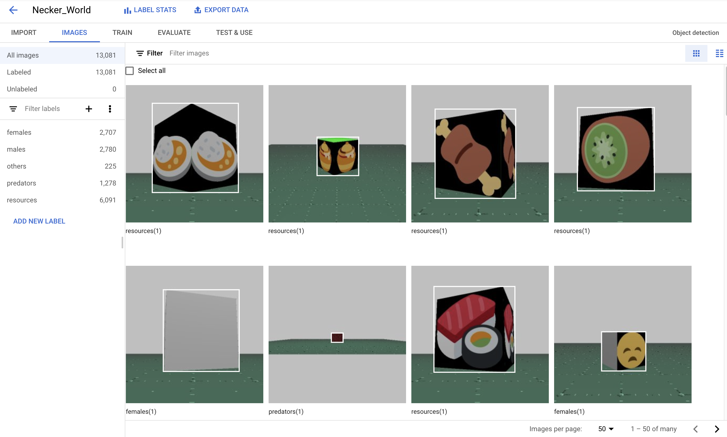
Neckerworld – Object Detection

Slide 30
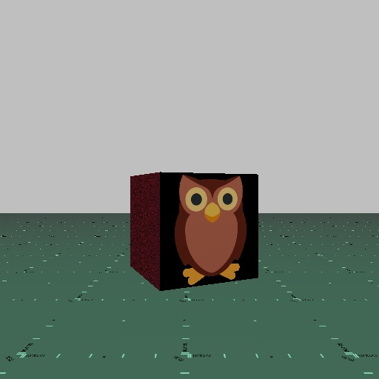
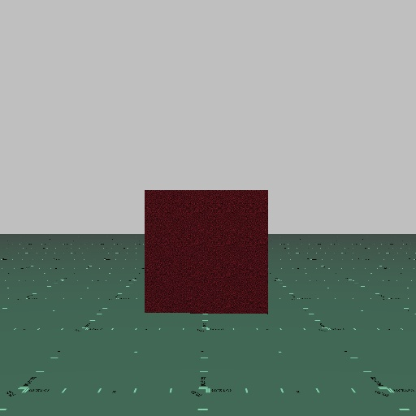
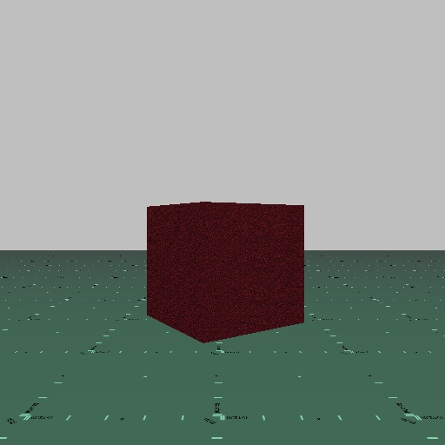
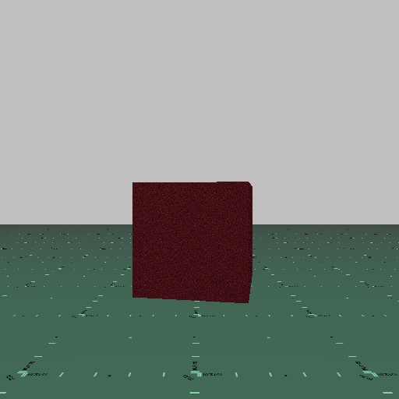
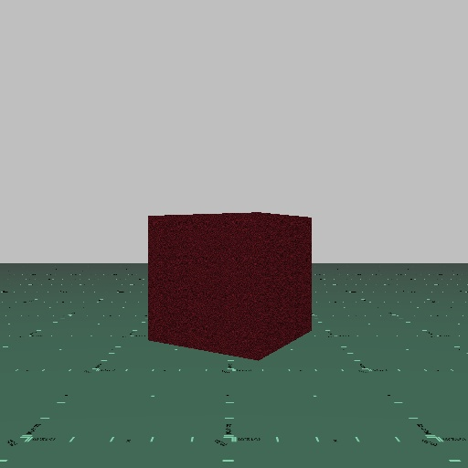
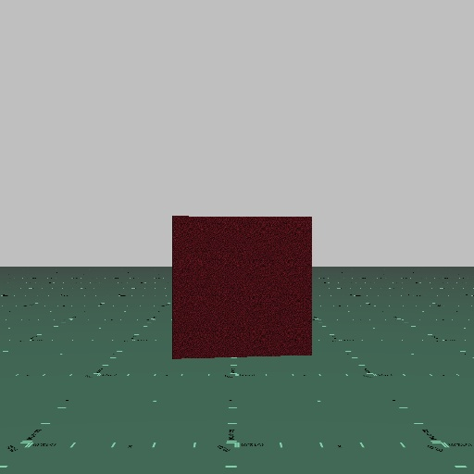
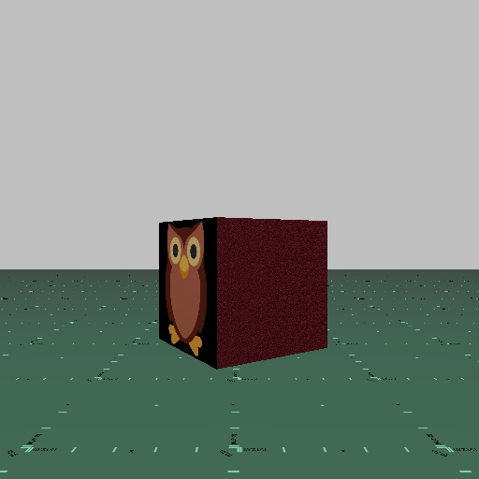
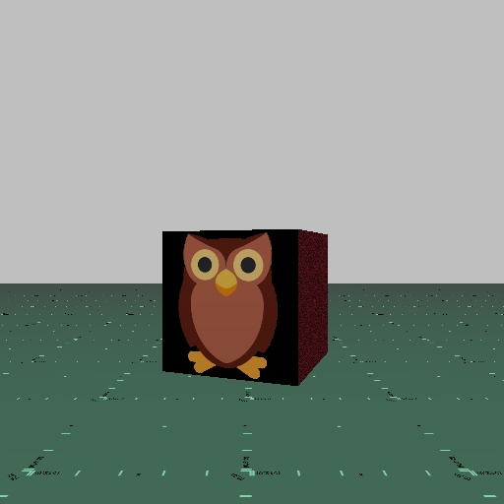
Neckerworld – Generate 8 Random Rotations

Slide 31
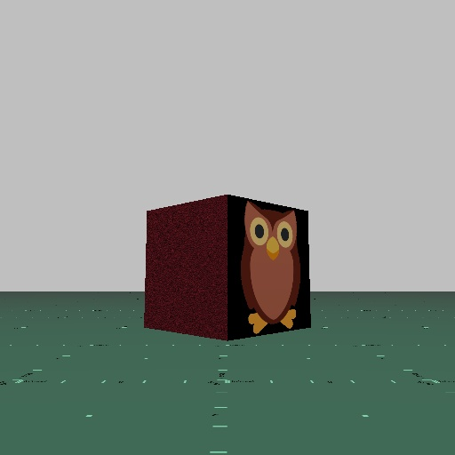
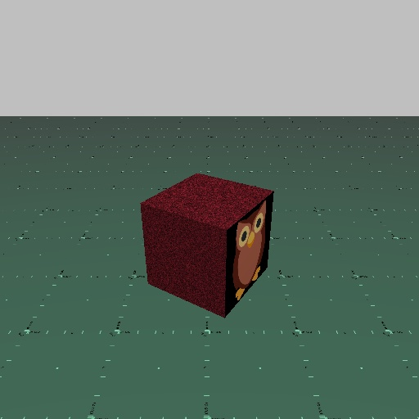
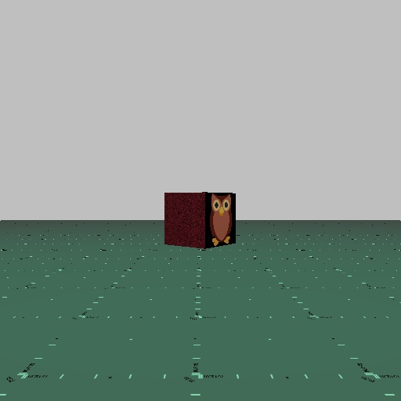
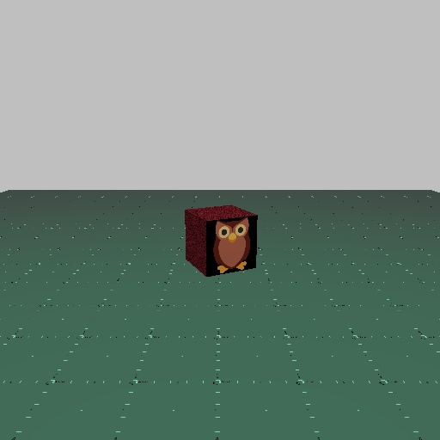
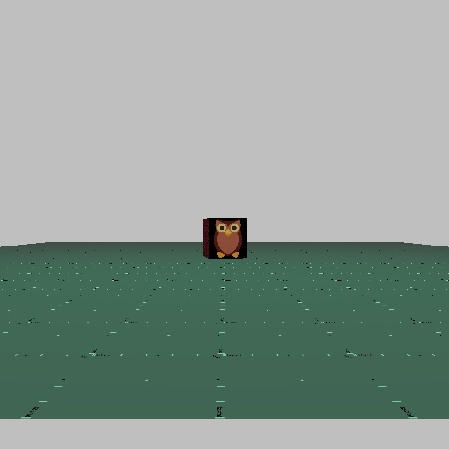
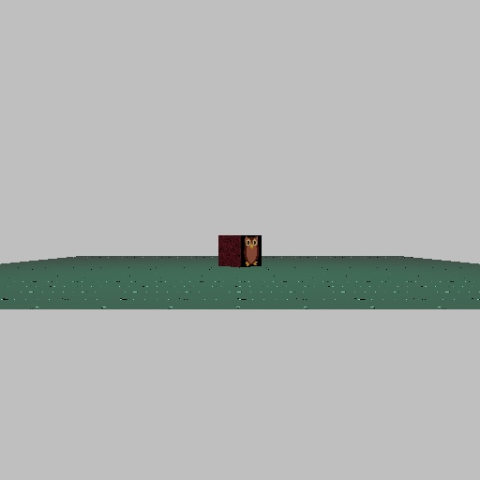
Neckerworld – Create 7 Different Views

Slide 32
Neckerworld – Training Images
37 |  | Male Players
+ 36 |  | Female Players
+ 3 |  | Enby Players
+ 17 |  | Predators
+ 81 |  | Resources
x 7 |  | Unique Views
x 8 |  | Random Rotations
= 9744 |  | Training Images

Slide 33
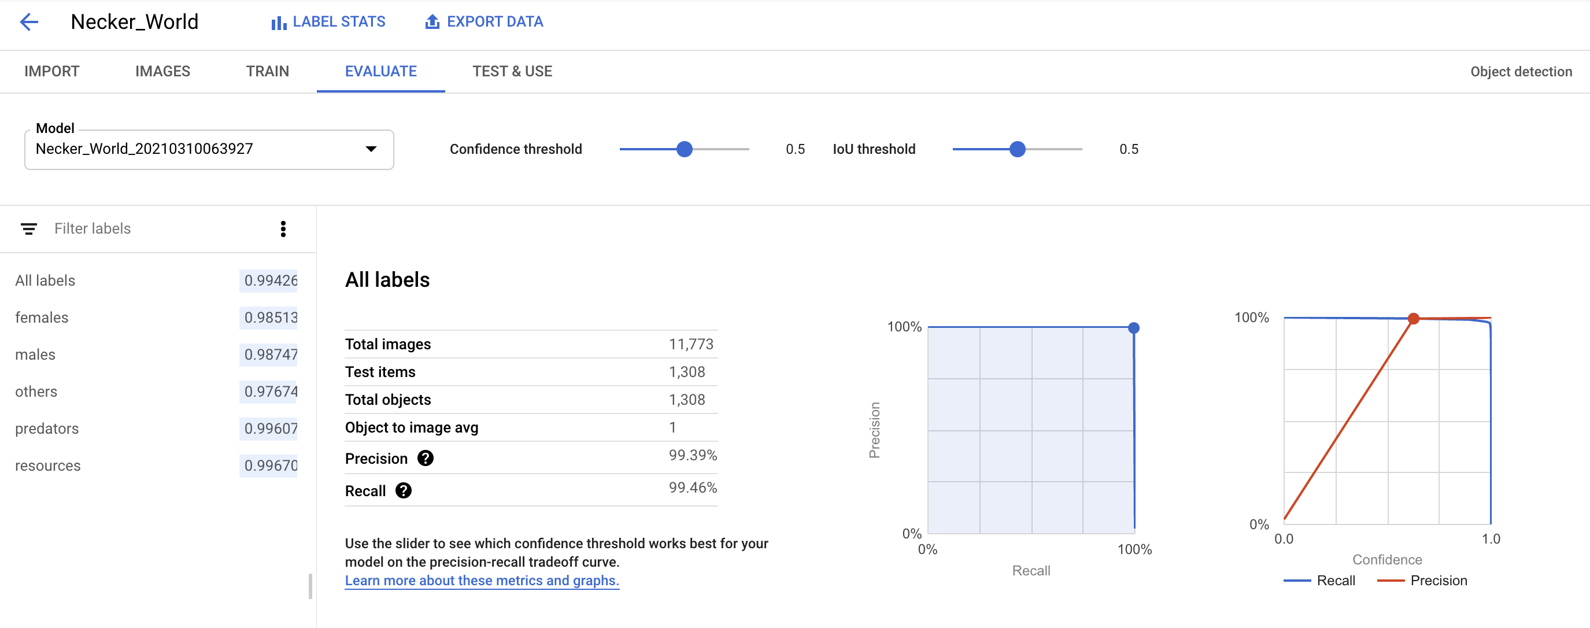
Neckerworld – Training Results

Slide 34
Neckerworld – Precision, Recall and IoU
Precision - is the ability of a classifier to identify relevant objects only. It is the proportion of true positive detections.
Recall - measures the ability of the model to find all relevant cases (that is, all ground-truths) - the proportion of true positives detected among all ground-truths.
Intersection over Union - evaluates the overlap between the ground-truth mask and the predicted mask.
From: Kiprono Elijah Koech - Object Detection Metrics With Worked Example

Slide 35
Neckerworld – Intersection over Union (IoU)
Ground Truth
Prediction
Intersection
Union

Slide 36
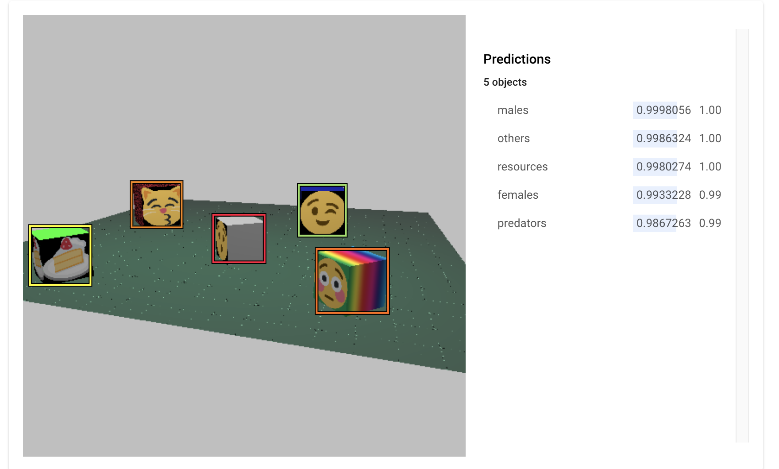
Neckerworld – Predictions

Slide 37
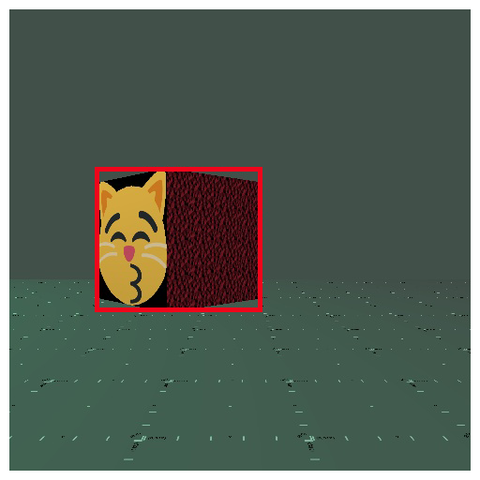
Neckerworld – Inverse Perspective Projection

Slide 38
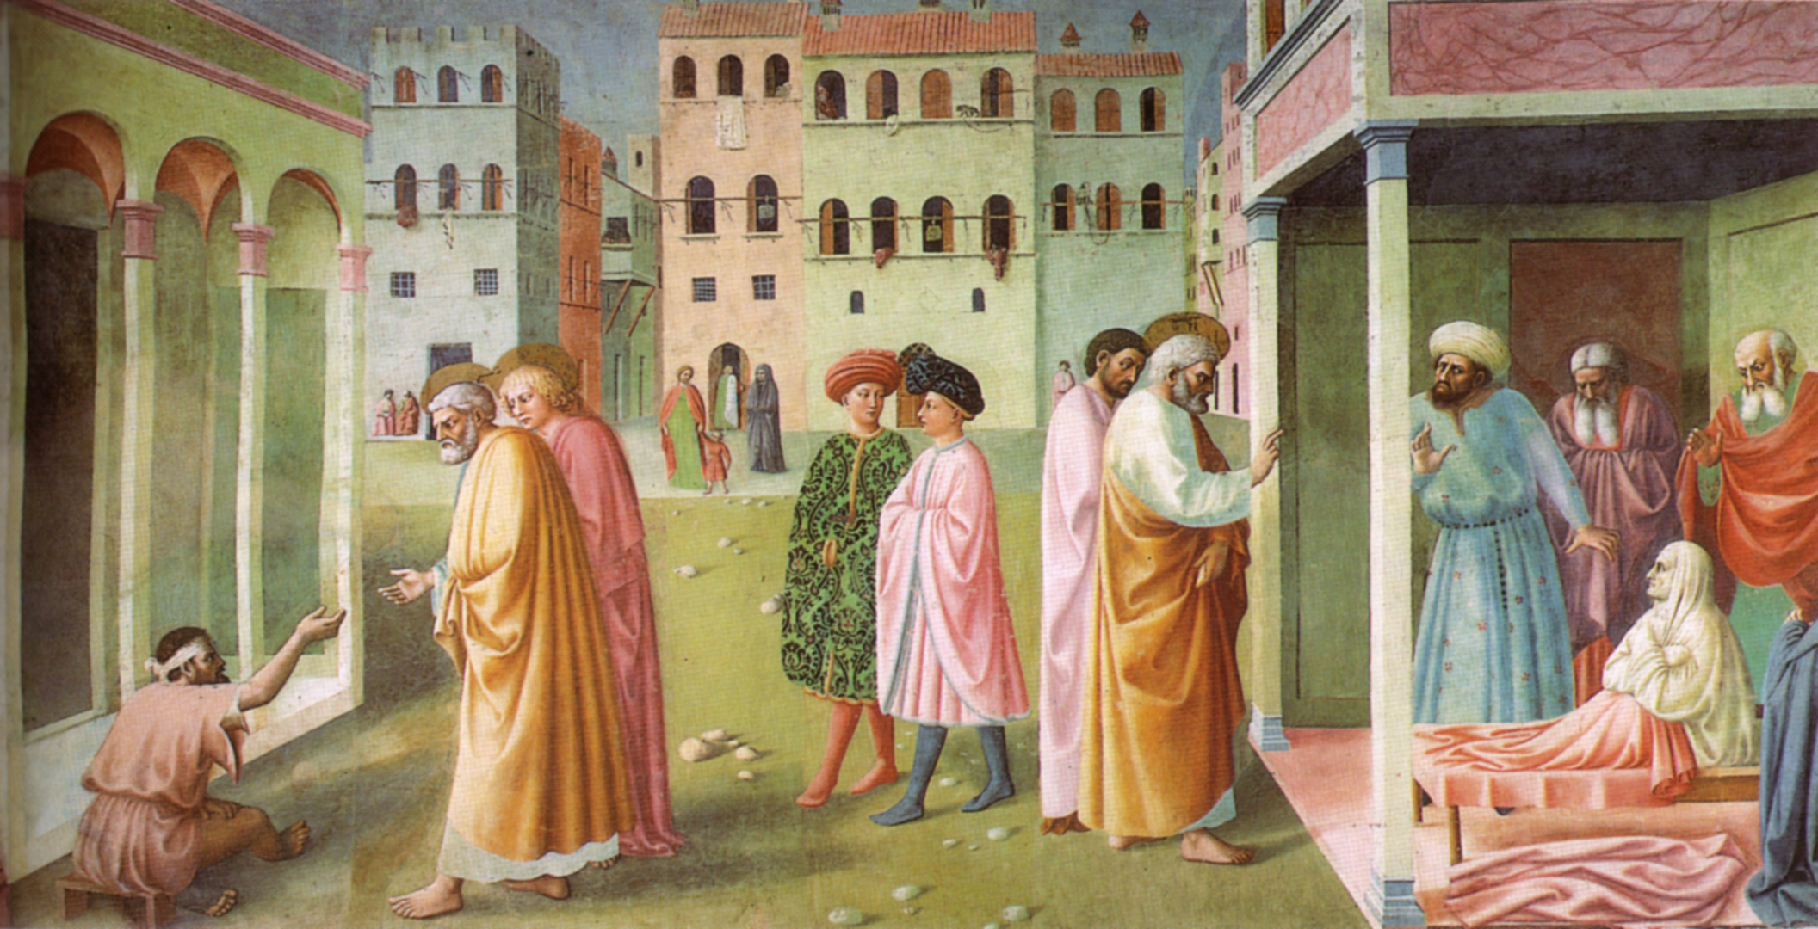
Neckerworld – Perspective Projection in Art
Masolino da Panicale's St. Peter Healing a Cripple and the Raising of Tabitha (c. 1423),
the earliest extant artwork known to use a consistent vanishing point.

Slide 39
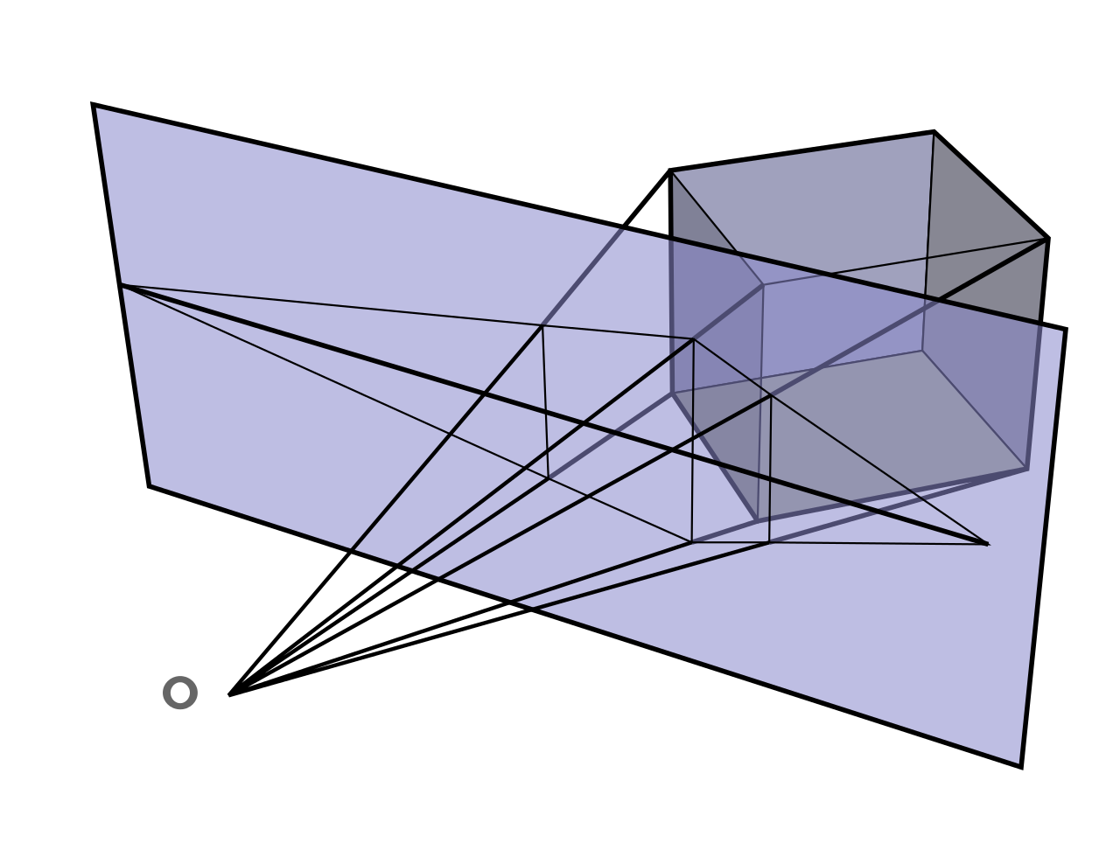
Neckerworld – Perspective Projection Plane

Slide 40
Neckerworld – Coordinate Systems
Object Coordinates
World Coordinates
Camera or View Coordinates
Normalized Display Coordinates
Viewport Coordinates
Window Coordinates
Screen Coordinates

Slide 41
Neckerworld – A Computer Vision Game
Questions?
Contact
Hank Magnuski
hank.magnuski@gmail.com

Slide 42
Neckerworld – A Computer Vision Game
Questions?
Contact
Hank Magnuski
hank.magnuski@gmail.com

