Slide 1
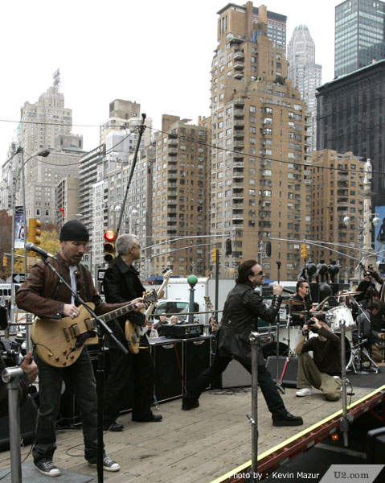
Java Course Review

Slide 2
Java Course Review
What is Java?
  An object-oriented programming language developed by Sun Microsystems
  Consists of a Java Virtual Machine, which runs java byte code files (.class files)
  Also, a java compiler, which converts .java files into .class files

Slide 3
Java Course Review
What types of variables used in java?
  int
  double
  String
  JLabel
  What are 3 variable naming no no’s?

Slide 4
Java Course Review
Java classes
  Each java program is a class that contains a main method where the program starts running
  A constructor can be defined which will get called when an instance of the class is created
  Methods are called by using the name of the method followed by the () and inside any _______________ needed to be passed to the method

Slide 5
Java Course Review
Java naming conventions
  Java classes are named using ____________________
  A class defining a circle would be spelled______
  An object is a specific instance of a class
  3 objects of the circle class could be spelled c1, c2 and c3

Slide 6
Java Course Review
Import statements
  What do import statements accomplish?
  What is a typical import statement we have used?

Slide 7
Java Course Review
Printing to the console window
  What are the two commands to print stuff to the console window??
  Write a method called output10 that loops and prints out the numbers 1-10 on separate lines
  Write a method called output10NoLineBreaks that prints out the numbers -1 to -10 on the SAME line separated by a space

Slide 9
Java Course Review
Methods
  Methods are subprograms that can can be called by using the name of the method and the ()
  Example
    public void printReport() {
    System.out.println(“Daily Report for Salon”);
    System.out.println(“Number of Customers”);
    …more commands here
    }
  To activate or call the above method, use…

Slide 10
Java Course Review
Methods cont’d
  Methods can also have _____________ or variables in the parentheses of the method that act as inputs to the method
  Parameters can help a programmer create powerful, reusable methods

Slide 11
Java Course Review
  For example
    To find the area of any triangle
    public double area(double len, double height)
    {
    return .5*len*height;
    }
    //To call this method and find the area of a 12 length by 4.5 h triangle and print it use…

Slide 12
Java Course Review
Looping
  Allows a programmer to repeat commands a certain number of times
  Typical loop format
  Set control var
  while(condition){
    //take some action
    Increment control variable
    }

Slide 13
Java Course Review
Looping – cont’d
  How many times will the following loop get executed?
  int i = 5;
  while(i<0){
    System.out.println(“I am in the loop”);
    i++;
    }
  How about this one?
  int i = 0;
  while(i<8){
    System.out.println(“I am in the loop”);
    i++;
    System.out.print(i*i);
    }

Slide 14
Java Course Review
Logical Operators
  Logical AND
  Logical OR
  Logical Negation
  What is the value of
  (5!=3)&&(4<8|| 1>0)?
  ((!(3>=3))&&(1<5))?
  !(-1>0)?

Slide 15
Java Course Review
Mathematical Operators
  +
  -
  / double
  / integer
  *
  %

Slide 16
Java Course Review
Scope of variables
  Describe the scope of;
    Globals
    Local variables
    Parameters

Slide 17
Java Course Review
Arrays
  Arrays are collections of variables of the same type, grouped under a single name.
  Array sizes are _________ at the time an array is created with the new command
  In order to utilize an array, use a subscript inside the [ ] ‘s.

Slide 18
Java Course Review
Arrays – cont’d
  Use an array to store 5 different randomly generated integers between 1 and 1000. You may assume that java.util.* has been imported
  public static void main(String[] args) {
    Random r = new Random();
    int[ ] nums = new int[5];
    for (int i=0; i<5; i++) {
    nums[i] = r.nextInt(1000)+1;
    }

Slide 19
Java Course Review
java.util.Random
Random r = new Random();
What is the range of r.nextInt(5)?
What is the range of r.nextInt(10)?
What is the range of r.nextInt(3)+1?

Slide 20
Java Course Review
Java applets
  Although we didn’t have time to cover java applets in this class, they are special java programs that contain an init() and run() method that can be run from within a browser
  Applets can run from a web page but have certain limitations for security reasons (can’t write to the local hard disk or open any new network connections)

Slide 21
Java Course Review
Object Oriented Programming
  Java is designed for oo programming
  This means that once a class is defined, another class can utilize that class by making an instance of the first class inside its code
  OO programming allows us to reuse existing logic from programs in other programs which saves time and money

Slide 22
Java Course Review
Remember to review your glossary terms for the final exam

Slide 23

Java Course Review

