Slide 1

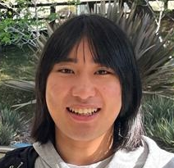
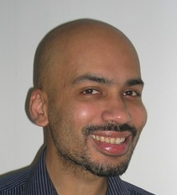

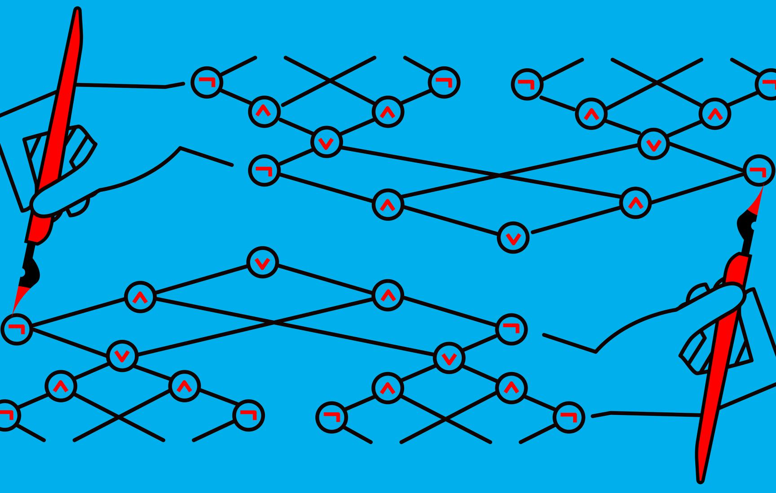
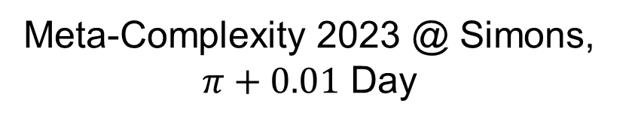
Robustness of Average-case Meta-complexity
Rahul Ilango
(MIT)
Hanlin Ren
(Oxford)
Rahul Santhanam
(Oxford)
Meta-Complexity 2023 @ Simons, $π+0.01$ Day
0 / 21

Slide 2
Motivation
Motivation
Our results
Discussions

Slide 3
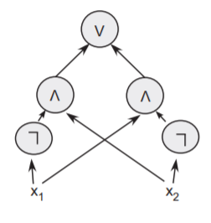
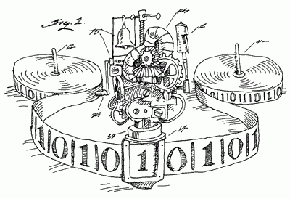

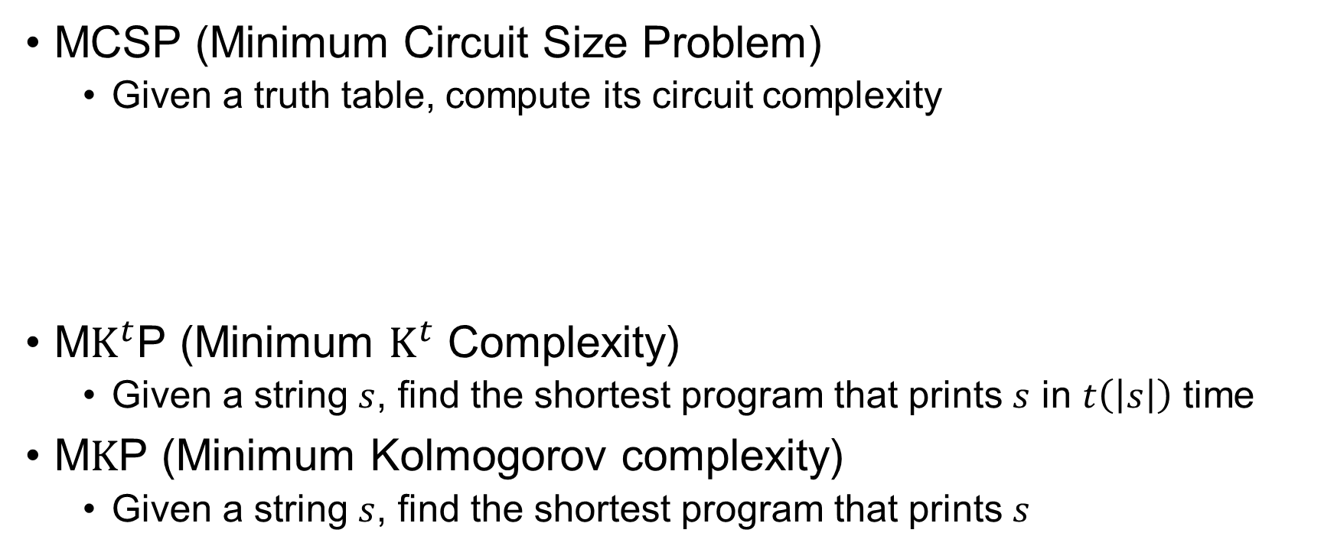

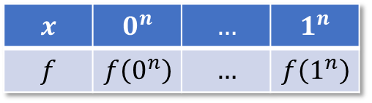
Meta-Complexity Zoo
MCSP (Minimum Circuit Size Problem)
Given a truth table, compute its circuit complexity
M$K^{t}$P (Minimum $K^{t}$ Complexity)
Given a string $s$, find the shortest program that prints $s$ in $t\left(\left|s\right|\right)$ time
M$K$P (Minimum Kolmogorov complexity)
Given a string $s$, find the shortest program that prints $s$
$$x$$ | $$0^{n}$$ | $$…$$ | $$1^{n}$$
$$f$$ | $$f\left(0^{n}\right)$$ | $$…$$ | $$f\left(1^{n}\right)$$
$$Circuit_Complexity\left(f\right)$$
“$K^{poly}$” when $t=poly\left(\left|s\right|\right)$
, period.
1 / 21

Slide 4


Two Questions We Address…
Q1: Average-case meta-complexity?
Q2: Robustness of meta-complexity?
2 / 21
Notes:
https://pixabay.com/vectors/bulb-light-lamp-idea-electricity-29050/
https://pixabay.com/photos/question-mark-symbol-icon-character-2309040/

Slide 5


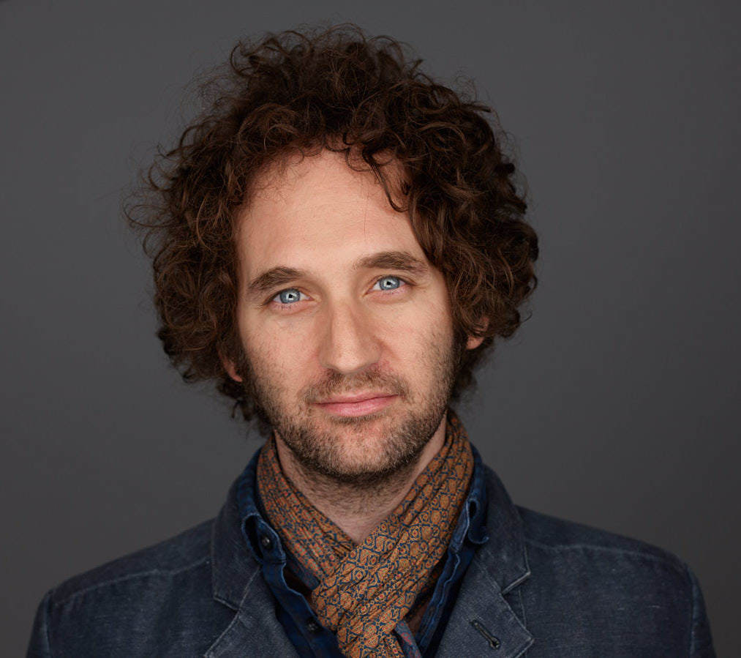
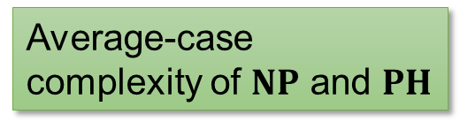
Average-Case Meta-Complexity
Errorless average-case complexity
Error-prone average-case complexity
Error-prone average-case complexity
Error-prone average-case complexity
Average-case complexity of $NP$ and $PH$
One-way functions!
3 / 21

Slide 6
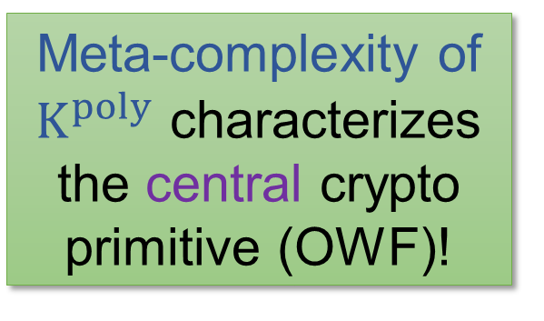

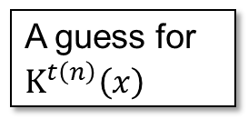

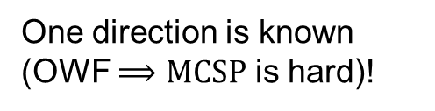
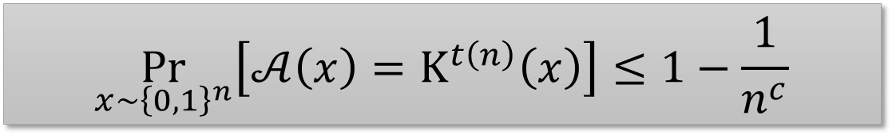
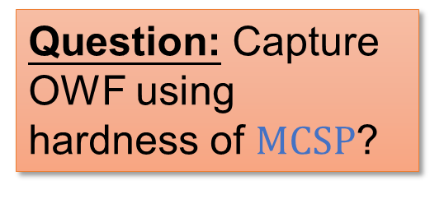
The Liu-Pass Result
Theorem: The following are equivalent:
$K^{poly}$ is error-prone average-case hard
OWFs exist
Meta-complexity of $K^{poly}$ characterizes the central crypto primitive (OWF)!
Poly-time heuristic
A guess for $K^{t\left(n\right)}\left(x\right)$
$$x$$
(uniform distribution)
Exists an absolute constant $c$, for every poly-time heuristic $𝒜$,
Question: Capture OWF using hardness of $MCSP$?
$$\underset{x\sim {\left\{0,1\right\}}^{n}}{Pr}\left[𝒜\left(x\right)=K^{t\left(n\right)}\left(x\right)\right]≤1−\frac{1}{n^{c}}$$
One direction is known (OWF $⟹MCSP$ is hard)!
4 / 21

Slide 7
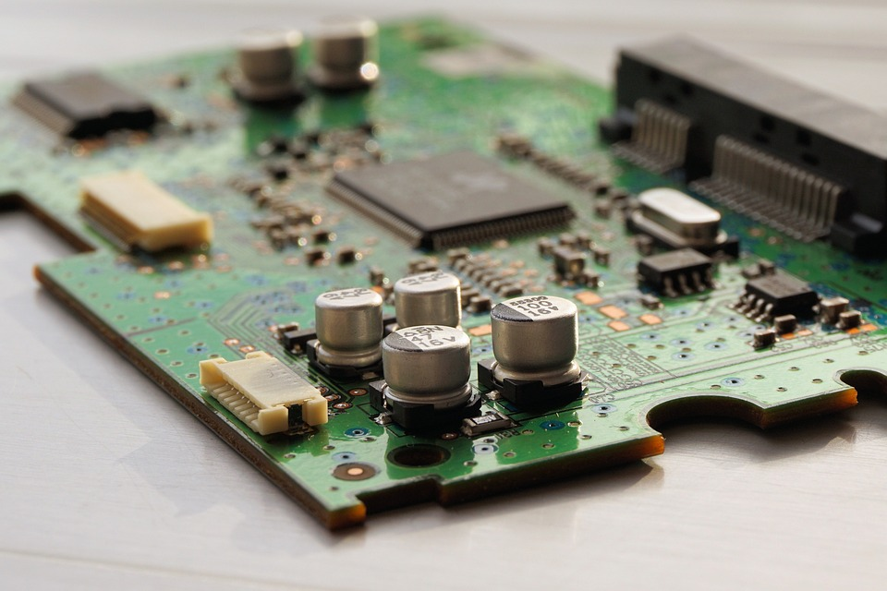
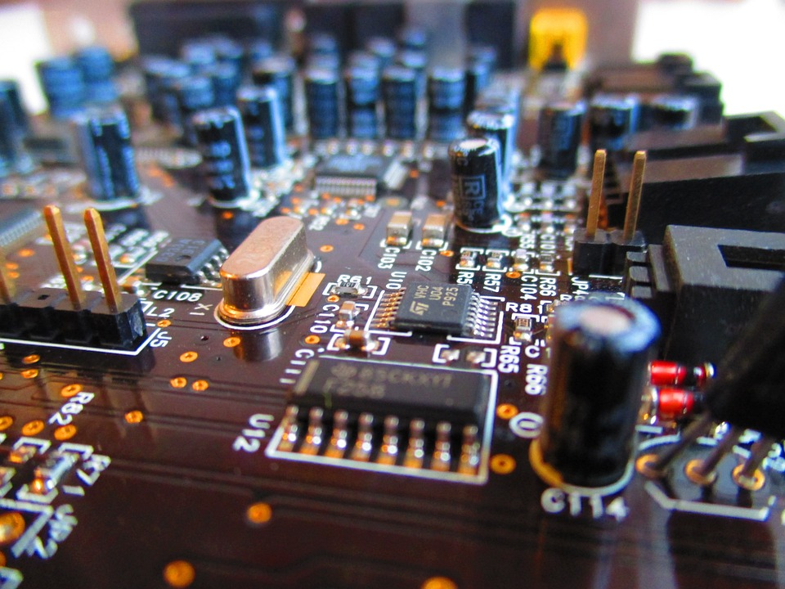
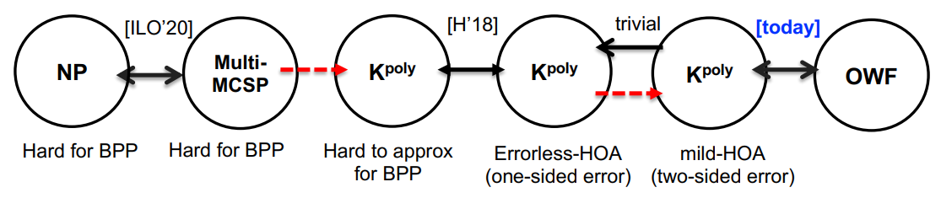



Robustness of Meta-Complexity
Open: Is $MCSP\left[2^{n/2}\right]$ $NP$-complete?
Open: Can you reduce $MCSP\left[2^{n/4}\right]$ to $MCSP\left[2^{n/2}\right]$?
Open: Can you reduce $\left(AND,NOT\right)$-$MCSP$ to $NAND$-$MCSP$?
vs.
easy
hard
easy
hard
vs.
$$MCSP\left[2^{n/4}\right]$$
$$MCSP\left[2^{n/2}\right]$$
(from Rafael’s talk)
5 / 21
Notes:
https://pixabay.com/photos/circuit-board-printed-circuit-board-1429589/
https://pixabay.com/photos/circuit-board-electronic-circuit-973311/

Slide 8
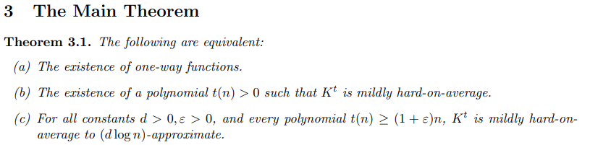
Some Robustness from Liu-Pass!
6 / 21

Slide 9
Our results
Motivation
Our results
Discussions

Slide 10






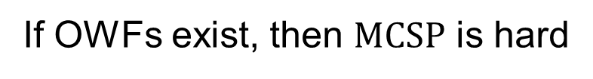
OWF $⟹$ Hardness of $MCSP$
OWF $\underset{⇒}{HILL}$ PRG $\underset{⇒}{GGM}$ PRF
$$≈_{c}$$
Pseudorandom functions
Truly random functions
Easy!
Hard!
$$MCSP$$
If OWFs exist, then $MCSP$ is hard
against error-prone heuristics to approximate, under some locally sampleable distributions!
7 / 21
Notes:
https://pixabay.com/illustrations/thinker-think-wisdom-response-1027594/

Slide 11
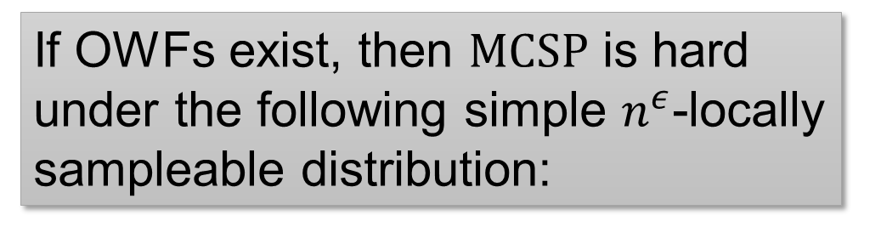
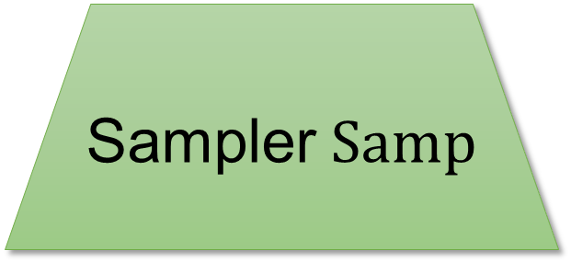
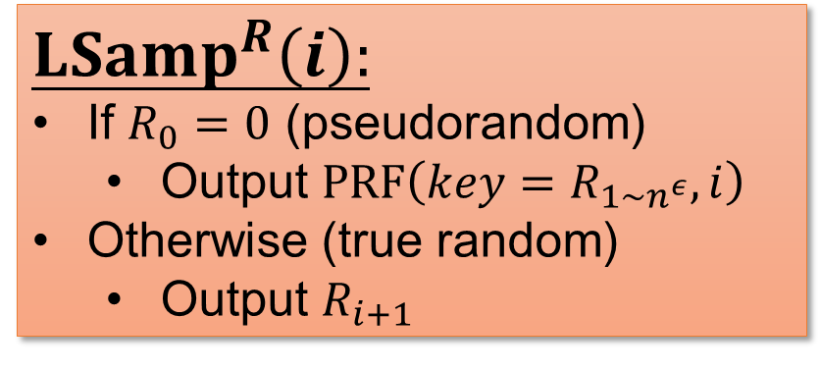
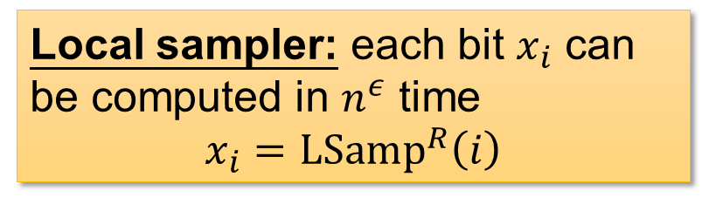


Locally Sampleable Distributions
Output $x=Samp\left(R\right)$
If OWFs exist, then $MCSP$ is hard under the following simple $n^{ε}$-locally sampleable distribution:
Sampler $Samp$
$LSamp^{R}\left(i\right):$
If $R_{0}=0$ (pseudorandom)
Output $PRF\left(key=R_{1∼n^{ε}},i\right)$
Otherwise (true random)
Output $R_{i+1}$
Randomness $R$
Local sampler: each bit $x_{i}$ can be computed in $n^{ε}$ time
$$x_{i}={LSamp}^{R}\left(i\right)$$
8 / 21
Notes:
https://pixabay.com/illustrations/thinker-think-wisdom-response-1027594/

Slide 12

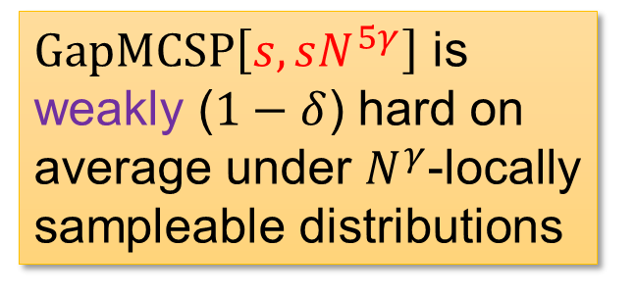
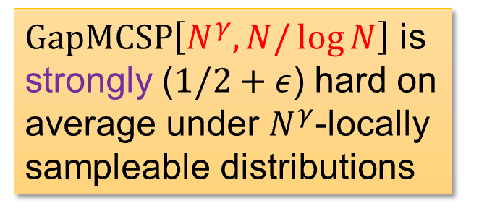

Characterization of OWFs using $MCSP$
Theorem: the following are equivalent.
OWFs exist.
$MCSP$ is hard on average to approximate, over some locally sampleable distribution
OWF
This work
[HILL, GGM]
$GapMCSP\left[s,sN^{5γ}\right]$ is weakly ($1−δ$) hard on average under $N^{γ}$-locally sampleable distributions
$GapMCSP\left[N^{γ},N/\log{N}\right]$ is strongly ($1/2+ε$) hard on average under $N^{γ}$-locally sampleable distributions
(robustness!)
9 / 21

Slide 13

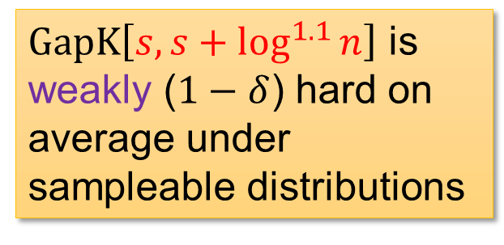
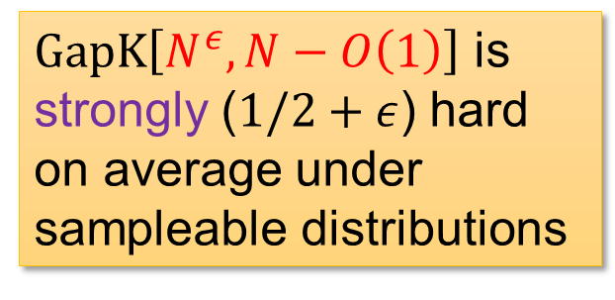
Characterization of OWFs using (Unbounded) Kolmogorov Complexity
Theorem: the following are equivalent.
OWFs exist.
$K$ is hard on average to approximate, over some (poly-time) sampleable distribution.
OWF
This work
[HILL, GGM]
$GapK\left[s,s+\log^{1.1}{n}\right]$ is weakly ($1−δ$) hard on average under sampleable distributions
$GapK\left[N^{ε},N−O\left(1\right)\right]$ is strongly ($1/2+ε$) hard on average under sampleable distributions
10 / 21

Slide 14
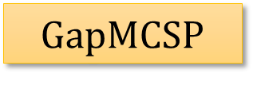

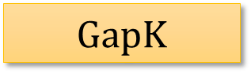
Error-Prone Average-Case Meta-Complexity
$$GapMCSP$$
$${GapK}^{poly}$$
$$GapK$$
(under derand assumptions)
OWF
Error-prone average-case meta-complexity is VERY robust, because they correspond to one-way functions!
11 / 21

Slide 15
Going Into Some Proofs…
Theorem: the following are equivalent.
OWFs exist.
$K$ is hard on average to approximate, over some (poly-time) sampleable distribution.
OWF
This work
[HILL, GGM]
$GapK\left[s,s+\log^{1.1}{n}\right]$ is weakly ($1−δ$) hard on average under sampleable distributions
$GapK\left[N^{ε},N−O\left(1\right)\right]$ is strongly ($1/2+ε$) hard on average under sampleable distributions
12 / 21

Slide 16
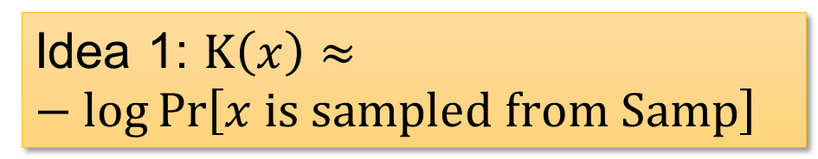




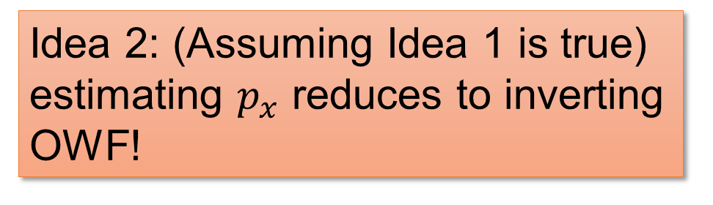


No OWF $⟹$ $GapK$ is Easy on Average
How to approximate $K$ over $Samp$?
Idea 1: $K\left(x\right)≈−\log{\operatorname{Pr}\left[x is sampled from Samp\right]}$
Output $x=Samp\left(R\right)$
Sampler $Samp$
Let’s call this quantity $p_{x}$.
Idea 2: (Assuming Idea 1 is true) estimating $p_{x}$ reduces to inverting OWF!
Randomness $R$
13 / 21

Slide 17

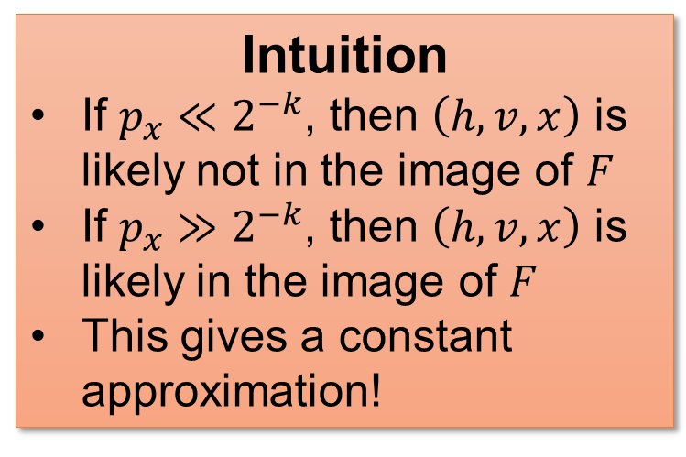
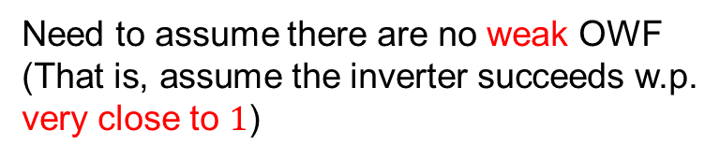
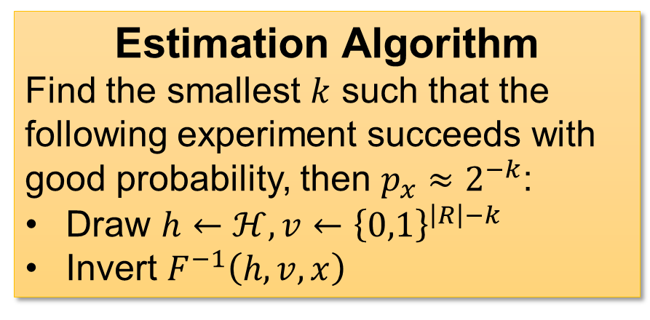

Estimating $p_{x}$
[Impagliazzo-Luby]
$F\left(h,R\right)=\left(h,h\left(R\right),Samp\left(R\right)\right)$ where $h$ comes from a pairwise independent hash family $ℋ$
Estimation Algorithm
Find the smallest $k$ such that the following experiment succeeds with good probability, then $p_{x}≈2^{−k}$:
Draw $h←ℋ, v←{\left\{0,1\right\}}^{\left|R\right|−k}$
Invert $F^{−1}\left(h,v,x\right)$
Intuition
If $p_{x}≪2^{−k}$, then $\left(h,v,x\right)$ is likely not in the image of $F$
If $p_{x}≫2^{−k}$, then $\left(h,v,x\right)$ is likely in the image of $F$
This gives a constant approximation!
Need to assume there are no weak OWF
(That is, assume the inverter succeeds w.p. very close to $1$)
14 / 21

Slide 18
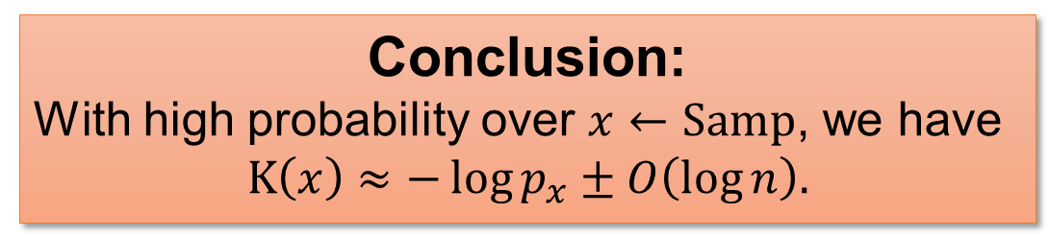

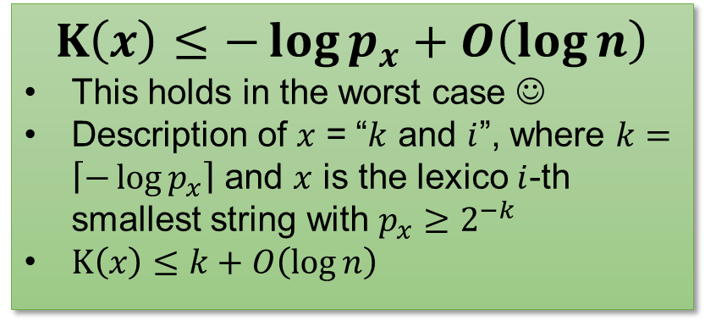


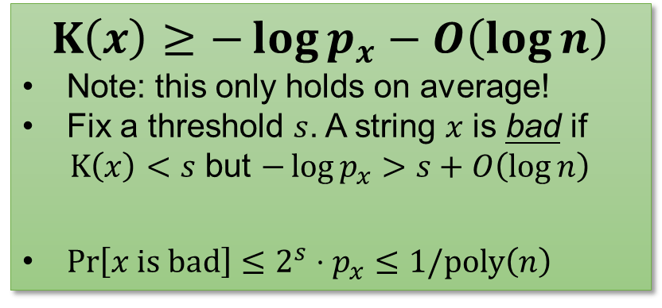
$$K\left(x\right)≈−\log{p_{x}}$$
$$K\left(x\right)≥−\log{p_{x}}−O\left(\log{n}\right)$$
Note: this only holds on average!
Fix a threshold $s$. A string $x$ is bad if
$K\left(x\right)<s$ but $−\log{p_{x}}>s+O\left(\log{n}\right)$
$\operatorname{Pr}\left[x is bad\right]≤2^{s}⋅p_{x}≤1/poly\left(n\right)$
$$K\left(x\right)≤−\log{p_{x}}+O\left(\log{n}\right)$$
This holds in the worst case ☺
Description of $x$ = “$k$ and $i$”, where $k=\left\lceil −\log{p_{x}}\right\rceil$ and $x$ is the lexico $i$-th smallest string with $p_{x}≥2^{−k}$
$K\left(x\right)≤k+O\left(\log{n}\right)$
Only $2^{s}$ bad strings
$$p_{x}<2^{−s}/poly\left(n\right)$$
“coding theorem”
Conclusion:
With high probability over $x←Samp$, we have
$$K\left(x\right)≈−\log{p_{x}}±O\left(\log{n}\right).$$
15 / 21

Slide 19
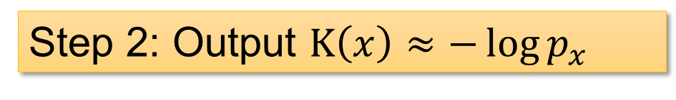

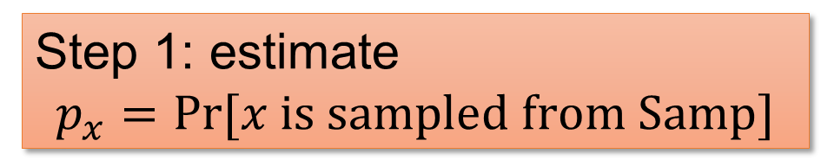




Putting It Together
Input: $x$; want to estimate $K\left(x\right)$
Step 1: estimate
$$p_{x}=Pr⁡[x is sampled from Samp]$$
Output $x=Samp\left(R\right)$
Sampler $Samp$
Universal hashing + inverting OWF
Step 2: Output $K\left(x\right)≈−\log{p_{x}}$
Randomness $R$
Where do we make mistakes?
good
$K\left(x\right)$ is small but $p_{x}$ is also small
Input space
Our invertor fails
16 / 21

Slide 20







$K\left(x\right)≤−\log{p_{x}}+O\left(\log{n}\right)$: Coding Theorems
Description of $x$ = “$k$ and $i$”, where $k=\left\lceil −\log{p_{x}}\right\rceil$ and $x$ is the lexico $i$-th smallest string with $p_{x}≥2^{−k}$
Heavy output $x$
Coding theorem
Sampler $Samp$
$$Complexity\left(x\right)≾−\log{p_{x}}$$
Randomness $R$
Our other equivalences are also proved via coding theorems!
$MCSP$ result: we proved a coding theorem for circuit complexity under locally sampleable distributions
$K^{poly}$ result: we proved a coding theorem for $K^{poly}$ assuming derandomization and $∄OWF$
17 / 21

Slide 21
Discussions
Motivation
Our results
Discussions

Slide 22





Perspective: Excluding Pessiland?
Informal Corollary
Pessiland doesn’t exist if $GapK$ is $NP$-hard.
[Saks-Santhanam 22]
$PH$ collapses if $GapK$ is $NP$-hard.
$ω\left(\log{n}\right)$-additive approximation
Non-adaptive randomized reductions
Non-adaptive randomized reductions
$ω\left(\log{n}\right)$-additive approximation
A $coNP/_{poly}$ Barrier?
[Bogdanov-Trevisan]: worst-case to average-case reduction for $NP⟹NP∈coNP/_{poly}$
[Hirahara-Watanabe]: “oracle-independent reduction” from $NP$ to MCSP $⟹NP∈coNP/_{poly}$
[Saks-Santhanam]: randomized reductions from $NP$ to $GapK⟹NP∈coNP/_{poly}$
18 / 21

Slide 23




Perspective: Excluding Pessiland?
Informal Corollary
Pessiland doesn’t exist if $K$ is $NP$-hard.
[Saks-Santhanam 22]
$PH$ collapses if $K$ is $NP$-hard.
$ω\left(\log{n}\right)$-additive approximation
Non-adaptive randomized reductions
$ω\left(\log{n}\right)$-additive approximation
Non-adaptive randomized reductions
OWF
[Liu-Pass], [Allender-Cheraghchi-Myrisiotis-Tirumala-Volkovich], this work…
[Ostrovsky], [Ostrovsky-Wigderson], [Vadhan]…
NP
?
Zero-knowledge
Meta-complexity
[Allender-Das], [Allender-Gouwar-Hirahara-Robelle], [Saks-Santhanam], [Allender-Hirahara-Tirumala]…

Slide 24





Discussion: Meta-Complexity in CZK
Corollary: one can approximate $K$ by a CZK protocol!
(computational zero-knowledge)
Surprisingly, this result is unconditional!
Caveats: Only average-case; infinitely often; $ω\left(\log{n}\right)$ approx gap
Proof:
If OWFs exist, then $PSPACE=IP⊆CZK$, we are done.
If OWFs don’t exist, then $K$ is easy to approx, we are also done.
Can you find a different proof without OWF?
Remark: Excluding Pessiland = unconditionally showing that $NP$ has average-case CZK protocols
19 / 21

Slide 25


Perspective: Average-Case Reductions?
Let’s forget about OWF…
IL (or this work)
easy
HILL
$K$ is “somewhat” easy on average
($1/2+ε$, large gap, sampleable distribution)
No PRG
No OWF
$K$ is “very” easy on average
($1−1/poly\left(n\right)$, $ω\left(\log{n}\right)$ additive gap, sampleable distribuition)
Q: What on earth is going on, inside this reduction?
Q: Can you obtain average-case reductions for other problems?
20 / 21

Slide 26





Summary
Error-prone average-case meta-complexity is VERY robust, because they correspond to one-way functions!
Step 1: estimate
$$p_{x}=Pr⁡[x is sampled from Samp]$$
[IL], universal hash
$$∄OWF$$
Coding theorems
Step 2: Output $K\left(x\right)≈−\log{p_{x}}$
[HILL, GGM]
$K$ is “very” easy
$K$ is “somewhat” easy
Thank you!
Questions are welcome!
21 / 21

