Slide 1

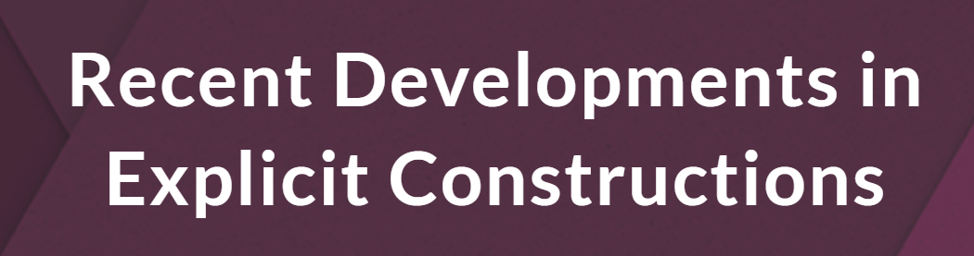





The Iterative Win-Win Paradigm (Part I): Pseudodeterministic Construction of Primes
Hanlin Ren
Oxford
Algorithm PSEUDO
Joint work with Lijie Chen, Zhenjian Lu, Igor Oliveira, and Rahul Santhanam
November 9, 2023
$$p_{1}$$
$$p_{1}$$
❌
$$p_{2}$$
$$p_{1}$$
$$p_{1}$$
0 / 21

Slide 2
Primes & Dense Properties

Slide 3




Finding a prime
Problem: Given an integer $n$, find an $n$-bit prime number.
Binary number $N∈\left[2^{n−1},2^{n}\right)$ without divisors except $1$ and $N$ itself
Example I
Input: $n=6$
Output: 100101
Explanation: this is $37$ in binary, which is a prime
Example II
Input: $n=82,589,933$
Output: 111111111…11111
Explanation: Left as an easy exercise ☺
$n$ 1’s
Today’s question: can we find an $n$-bit prime in $poly\left(n\right)$ time?
1 / 21

Slide 4
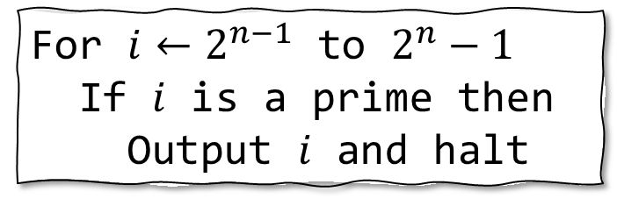
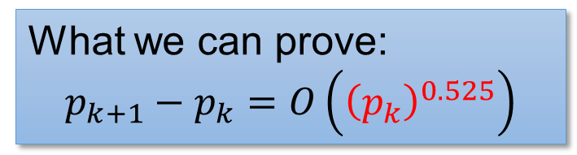
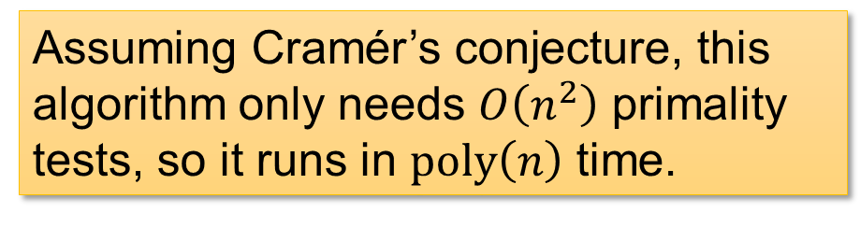
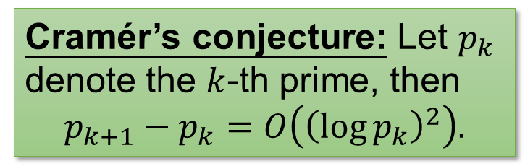
A Naïve Algorithm
For $i←2^{n−1}$ to $2^{n}−1$
If $i$ is a prime then
Output $i$ and halt
Cramér’s conjecture: Let $p_{k}$ denote the $k$-th prime, then
$$p_{k+1}−p_{k}=O\left({\left(\log{p_{k}}\right)}^{2}\right).$$
Can use [AKS04] deterministic primality test!
Assuming Cramér’s conjecture, this algorithm only needs $O\left(n^{2}\right)$ primality tests, so it runs in $poly\left(n\right)$ time.
What we can prove:
$$p_{k+1}−p_{k}=O\left({\left(p_{k}\right)}^{0.525}\right)$$
Far from what we want! ☹
2 / 21

Slide 5

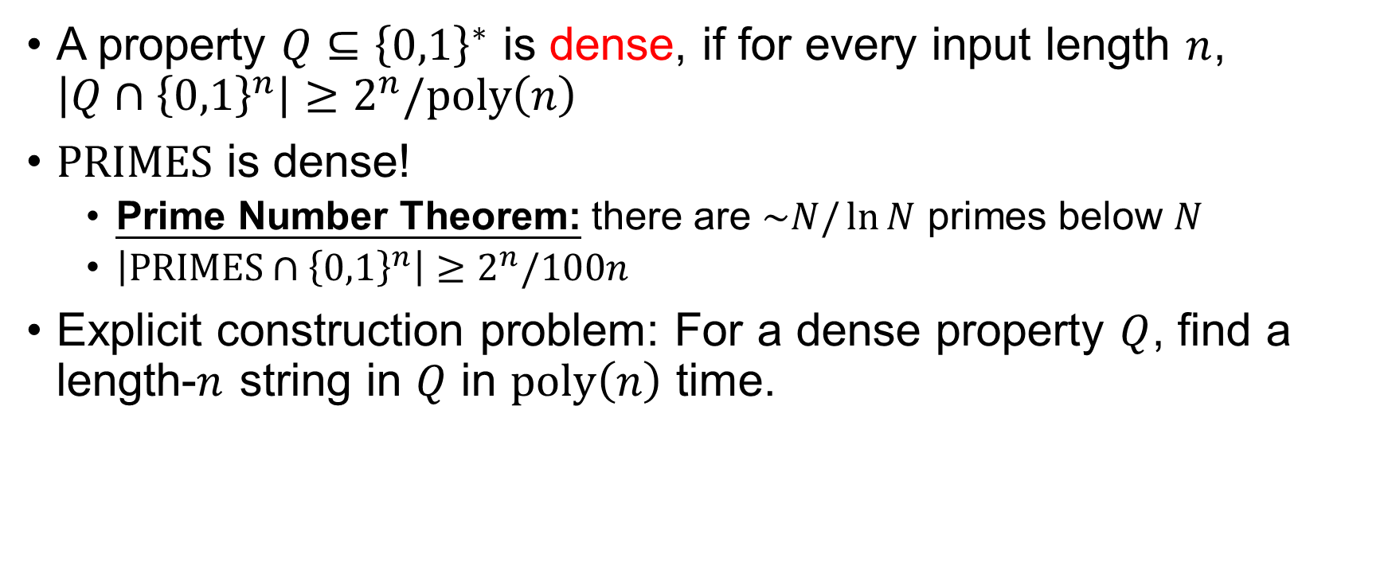

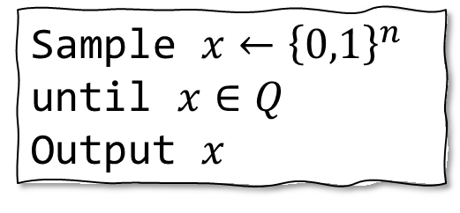
Dense Properties
A property $Q⊆{\left\{0,1\right\}}^{∗}$ is dense, if for every input length $n$, $\left|Q∩{\left\{0,1\right\}}^{n}\right|≥2^{n}/poly\left(n\right)$
$PRIMES$ is dense!
Prime Number Theorem: there are $\sim N/\ln{N}$ primes below $N$
$\left|PRIMES∩{\left\{0,1\right\}}^{n}\right|≥2^{n}/100n$
Explicit construction problem: For a dense property $Q$, find a length-$n$ string in $Q$ in $poly\left(n\right)$ time.
Easy with randomness!
Sample $x←{\left\{0,1\right\}}^{n}$ until $x∈Q$
Output $x$
Deterministic algorithms are open…
(even for the special case of $PRIMES$)
3 / 21

Slide 6
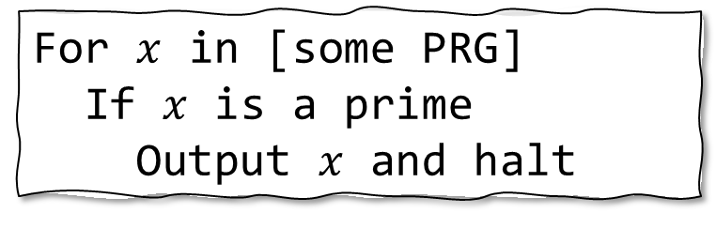
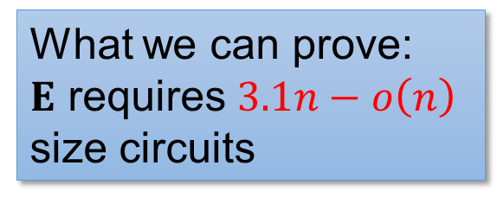
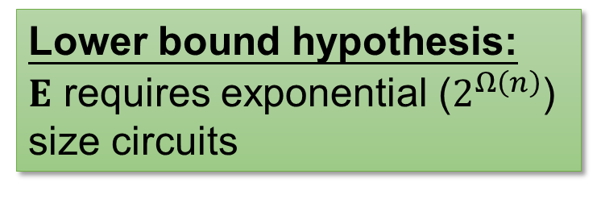
Hardness vs Randomness
PRG: Pseudorandom generator
For $x$ in [some PRG]
If $x$ is a prime
Output $x$ and halt
Lower bound hypothesis: $E$ requires exponential ($2^{Ω\left(n\right)}$) size circuits
Assuming the lower bound hypothesis, the PRG hits every dense property
In particular, the PRG contains a prime
What we can prove:
$E$ requires $3.1n−o\left(n\right)$ size circuits
Far from what we want! ☹
4 / 21

Slide 7


Our result
Question: Can you find $n$-bit primes in deterministic $poly\left(n\right)$ time, unconditionally?
Our result: Yes, with the following two caveats:
The algorithm only succeeds on infinitely many $n$;
The algorithm is not deterministic, but pseudodeterministic.
Next: what does “pseudodeterministic” mean?
5 / 21

Slide 8






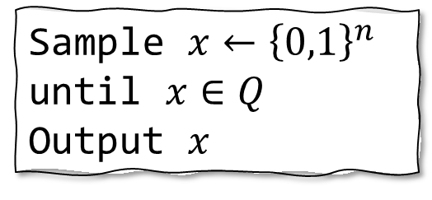
Intermediate notion between deterministic and randomized algorithms
Sample $x←{\left\{0,1\right\}}^{n}$ until $x∈Q$
Output $x$
One drawback of rejection sampling:
it outputs different primes on different executions
Deterministic algorithms
Randomized algorithms
Algorithm DET
Let’s require different executions of RAND to output the same prime!
Algorithm RAND
$$p$$
$$p_{1}$$
$$p_{2}$$
❌
$$p_{3}$$
$$p_{2}$$
$$p_{4}$$
6 / 21

Slide 9




Pseudodeterministic algorithms
A randomized algorithm is pseudodeterministic, if on most of its computational branches, it outputs the same answer.
Any (bounded) observer thinks the algorithm is deterministic!
Pseudodeterministic algorithms
Deterministic algorithms
Randomized algorithms
Algorithm DET
Algorithm RAND
Algorithm PSEUDO
$$p$$
$$p_{1}$$
$$p_{2}$$
❌
$$p_{3}$$
$$p_{2}$$
$$p_{4}$$
$$p_{1}$$
$$p_{1}$$
❌
$$p_{2}$$
$$p_{1}$$
$$p_{1}$$
7 / 21

Slide 10
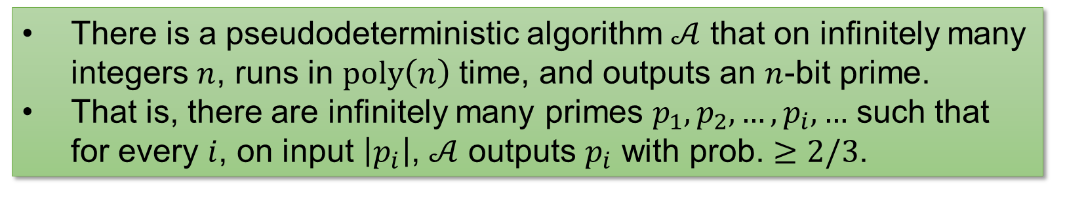


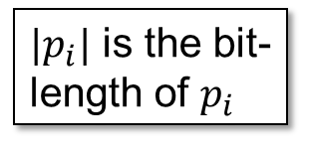
Our result
There is a pseudodeterministic algorithm $𝒜$ that on infinitely many integers $n$, runs in $poly\left(n\right)$ time, and outputs an $n$-bit prime.
That is, there are infinitely many primes $p_{1},p_{2},…,p_{i},…$ such that for every $i$, on input $\left|p_{i}\right|$, $𝒜$ outputs $p_{i}$ with prob. $≥2/3$.
“canonical” primes
$|p_{i}|$ is the bit-length of $p_{i}$
Moreover, this holds for every dense property in poly-time, not only $PRIMES$!
Spoiler ahead: little number theory but heavy complexity theory ☺
Previously, Oliveira-Santhanam’17 achieved subexponential ($2^{n^{o\left(1\right)}}$) time for the same task.
8 / 21

Slide 11
Warm-Up: sub-exponential time

Slide 12

Warm-up: Pseudodeterministic constructions in subexponential time
Oliveira-Santhanam 17: there is a pseudodeterministic algorithm that finds $n$-bit primes in $2^{n^{o\left(1\right)}}$ time infinitely often.
Idea I: Uniform hardness vs randomness
Idea II: Win-win analysis
9 / 21

Slide 13

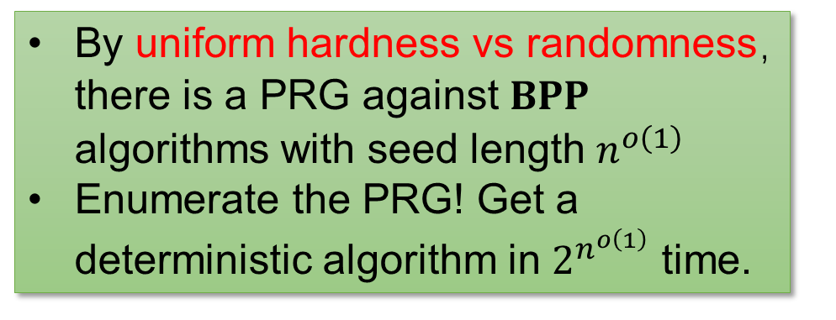
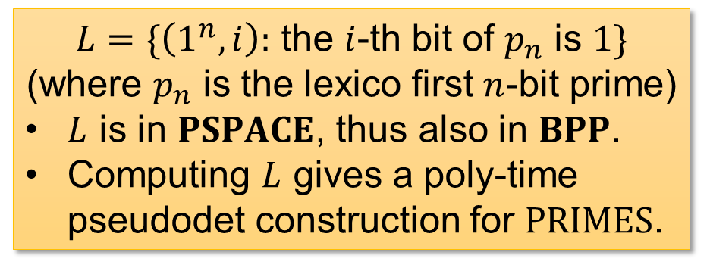
Idea II: Win-win Analysis
Is $PSPACE=BPP$?
YES
NO
$L=\{\left(1^{n},i\right):$ the $i$-th bit of $p_{n}$ is $1\}$
(where $p_{n}$ is the lexico first $n$-bit prime)
$L$ is in $PSPACE$, thus also in $BPP$.
Computing $L$ gives a poly-time pseudodet construction for $PRIMES$.
By uniform hardness vs randomness，there is a PRG against $BPP$ algorithms with seed length $n^{o\left(1\right)}$
Enumerate the PRG! Get a deterministic algorithm in $2^{n^{o\left(1\right)}}$ time.
10 / 21

Slide 14







Idea I: Hardness vs Randomness
These results need $IP=PSPACE$!
Given a hard function $f$
$$f∈PSPACE$$
against non-uniform circuits
Recap
uniform $BPP$ machines?
Is $PSPACE=BPP$?
NW94, IW97
IW01, TV07
YES
NO
Randomness is powerful, so pseudodet algo possible
Derand. is possible, so det algo possible
Can construct a PRG $G_{f}$
against non-uniform circuits
uniform $BPP$ machines!
11 / 21

Slide 15


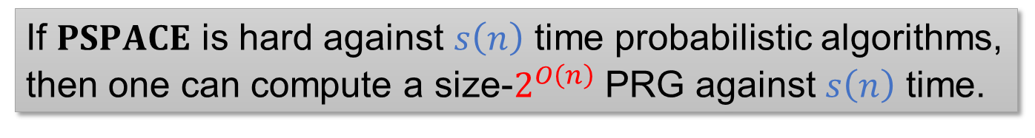


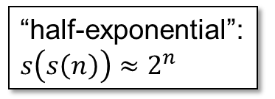
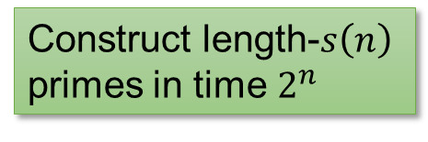

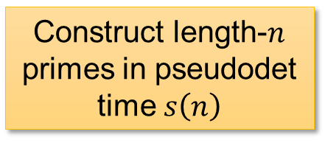


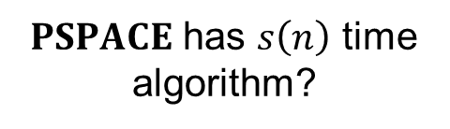


Subexponential Time…?
If $PSPACE$ is hard against $s\left(n\right)$ time probabilistic algorithms, then one can compute a size-$2^{O\left(n\right)}$ PRG against $s\left(n\right)$ time.
$PSPACE$ has $s\left(n\right)$ time algorithm?
Time complexity of…
… the overall algorithm
$$2^{o\left(n\right)}$$
$$2^{n^{o\left(1\right)}}$$
… YES case
YES
NO
“half-exponential”: $s\left(s\left(n\right)\right)≈2^{n}$
Construct length-$n$ primes in pseudodet time $s\left(n\right)$
$$2^{polylog\left(n\right)}$$
Construct length-$s\left(n\right)$ primes in time $2^{n}$
… NO case
$$poly(n)$$
$$poly(n)$$
$$2^{polylog\left(n\right)}$$
$$2^{n^{o\left(1\right)}}$$
$$2^{o\left(n\right)}$$
$$s\left(n\right)$$
12 / 21

Slide 16

A refined win-win analysis!
Over not only $2$ cases, but $O\left(\log{n}\right)$ many ☺

Slide 17




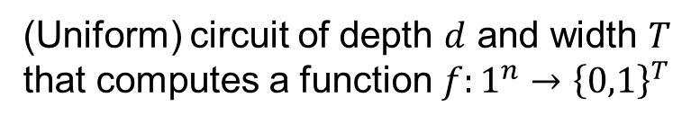

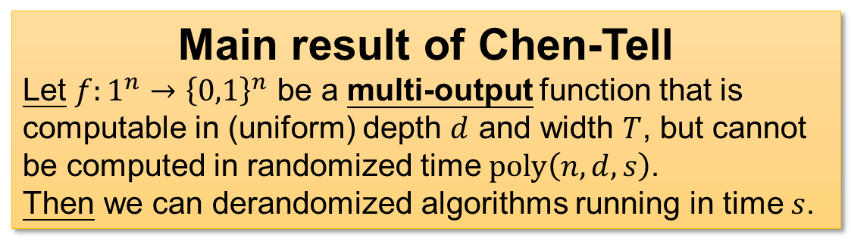

The Chen-Tell generator: Scaled-down uniform hardness-randomness tradeoff
$$T≫d$$
H vs R
Generators in IW01, TV07
$$IP=PSPACE$$
(Uniform) circuit of depth $d$ and width $T$
that computes a function $f:1^{n}→{\left\{0,1\right\}}^{T}$
scaled-down
scaled-down
$$d$$
The GKR protocol
H vs R
Chen-Tell Generator
Main result of Chen-Tell
Let $f:1^{n}→{\left\{0,1\right\}}^{n}$ be a multi-output function that is computable in (uniform) depth $d$ and width $T$, but cannot be computed in randomized time $poly\left(n,d,s\right)$.
Then we can derandomized algorithms running in time $s$.
$$∧$$
$$∨$$
$$∨$$
13 / 21

Slide 18
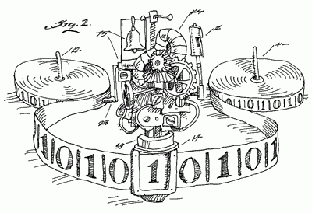

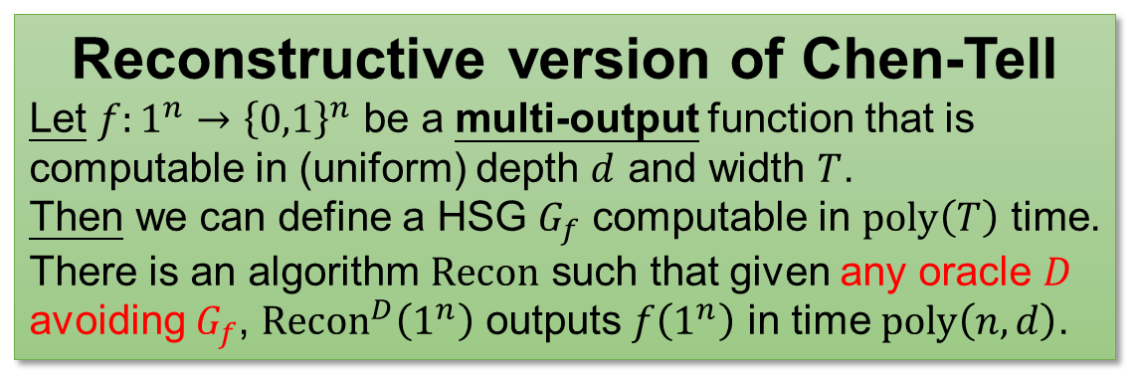


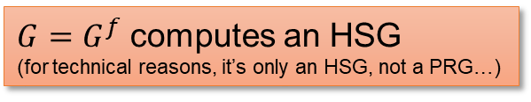
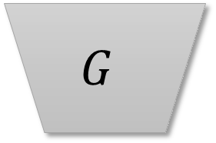
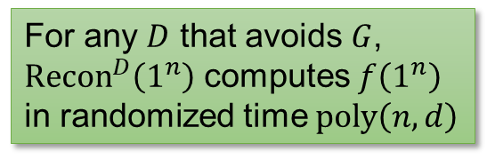
The Chen-Tell generator (reconstructive version)
$$G$$
Reconstructive version of Chen-Tell
Let $f:1^{n}→{\left\{0,1\right\}}^{n}$ be a multi-output function that is computable in (uniform) depth $d$ and width $T$.
Then we can define a HSG $G_{f}$ computable in $poly\left(T\right)$ time.
There is an algorithm $Recon$ such that given any oracle $D$ avoiding $G_{f}$, ${Recon}^{D}\left(1^{n}\right)$ outputs $f\left(1^{n}\right)$ in time $poly\left(n,d\right)$.
$$f$$
$G=G^{f}$ computes an HSG
(for technical reasons, it’s only an HSG, not a PRG…)
$$Recon$$
$$D$$
Main result of Chen-Tell
Let $f:1^{n}→{\left\{0,1\right\}}^{n}$ be a multi-output function that is computable in (uniform) depth $d$ and width $T$, but cannot be computed in randomized time $poly\left(n,d,s\right)$.
Then we can derandomized algorithms running in time $s$.
For any $D$ that avoids $G$, ${Recon}^{D}\left(1^{n}\right)$ computes $f\left(1^{n}\right)$ in randomized time $poly\left(n,d\right)$
14 / 21

Slide 19

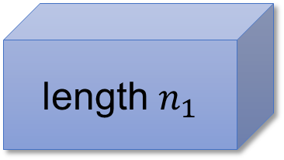


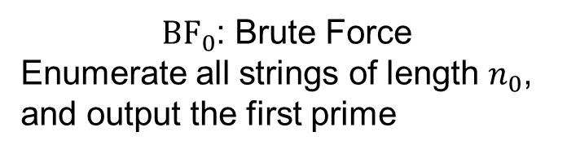

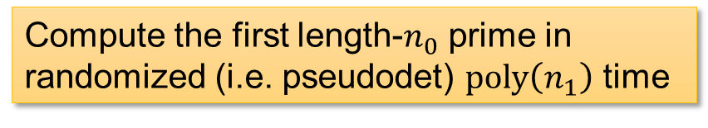

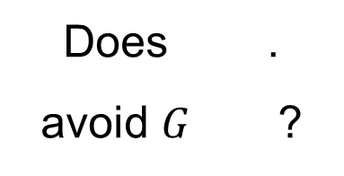


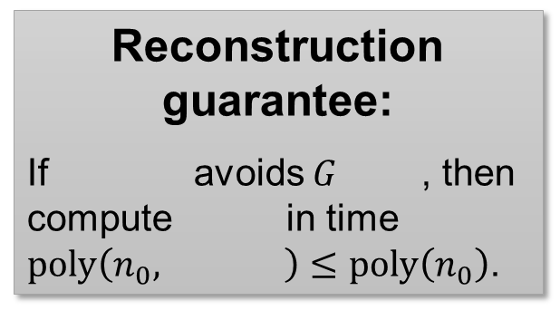
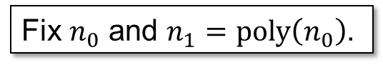









Pseudodeterministic Constructions from Chen-Tell?
Fix $n_{0}$ and $n_{1}=poly\left(n_{0}\right)$.
Compute the first length-$n_{0}$ prime in randomized (i.e. pseudodet) $poly\left(n_{1}\right)$ time
YES
Does .
avoid $G$ ?
$$PRIMES$$
$n_{1}$
“$BPP$ is powerful”, so get pseudodet. algo
$$…$$
$${BF}_{0}$$
NO
Subexponential ($2^{O\left(n_{0}\right)}≤2^{{\left(n_{1}\right)}^{ε}}$) size hitting set $G^{{BF}_{0}}$ that hits ${PRIMES}_{n_{1}}$
length $n_{1}$
Does “$PSPACE=BPP$”?
“derand. is possible”, so get det. algo
Reconstruction guarantee:
If avoids $G$ , then compute in time $poly\left(n_{0}, \right)≤poly\left(n_{0}\right)$.
$$…$$
$$T_{0}=2^{O\left(n_{0}\right)}$$
$n_{1}$
$${BF}_{0}$$
${BF}_{0}$: Brute Force
Enumerate all strings of length $n_{0}$, and output the first prime
length $n_{0}$
$$d_{0}=poly\left(n_{0}\right)$$
$${BF}_{0}$$
$n_{1}$
$$…$$
15 / 21

Slide 20
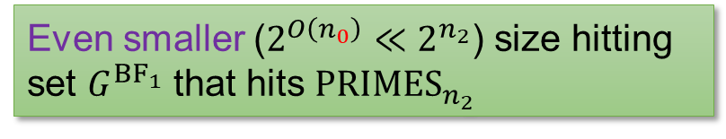


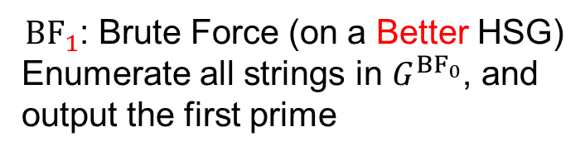
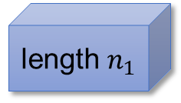






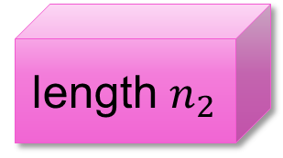








Apply it again?
Now, let $n_{2}=poly\left(n_{1}\right)$.
Compute the first length-$n_{1}$ prime in the HSG $G^{{BF}_{0}}$ in pseudodet $poly\left(n_{2}\right)$ time
YES
Does .
avoid $G$ ?
$$PRIMES$$
$n_{2}$
$$…$$
$${BF}_{1}$$
NO
Even smaller ($2^{O\left(n_{0}\right)}≪2^{n_{2}}$) size hitting set $G^{{BF}_{1}}$ that hits ${PRIMES}_{n_{2}}$
length $n_{2}$
$$…$$
$T_{1}=2^{O\left(n_{0}\right)}$ (still!)
Reconstruction guarantee:
If avoids $G$ , then compute in time $poly\left(n_{1}, \right)≤poly\left(n_{1}\right)$.
length $n_{1}$
${BF}_{1}$: Brute Force (on a Better HSG)
Enumerate all strings in $G^{{BF}_{0}}$, and output the first prime
$$d_{1}=poly\left(n_{1}\right)$$
$n_{2}$
$${BF}_{1}$$
$$…$$
$${BF}_{1}$$
$n_{2}$
length $n_{0}$
$$…$$
16 / 21

Slide 21
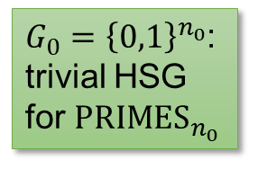

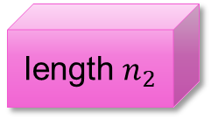
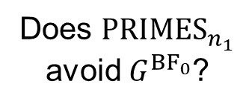

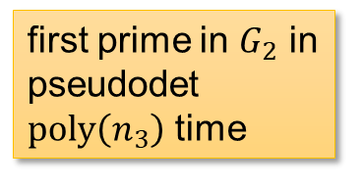
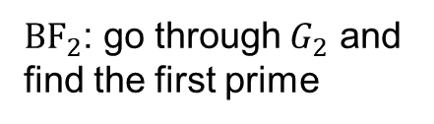

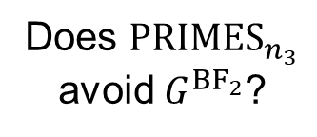
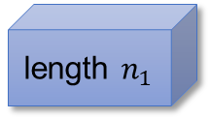


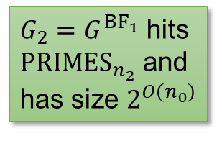










… and again
$$PRIMES$$
$G_{0}={\left\{0,1\right\}}^{n_{0}}$: trivial HSG for ${PRIMES}_{n_{0}}$
$G_{1}=G^{{BF}_{0}}$ hits ${PRIMES}_{n_{1}}$ and has size $2^{O\left(n_{0}\right)}$
$G_{2}=G^{{BF}_{1}}$ hits ${PRIMES}_{n_{2}}$ and has size $2^{O\left(n_{0}\right)}$
$$…$$
$$…$$
length $n_{i}$
${BF}_{0}$: go through $G_{0}$ and find the first prime
NO
${BF}_{1}$: go through $G_{1}$ and find the first prime
NO
${BF}_{2}$: go through $G_{2}$ and find the first prime
NO
$$…$$
Does ${PRIMES}_{n_{1}}$ avoid $G^{{BF}_{0}}$?
Does ${PRIMES}_{n_{2}}$ avoid $G^{{BF}_{1}}$?
Does ${PRIMES}_{n_{3}}$ avoid $G^{{BF}_{2}}$?
length $n_{2}$
$$…$$
YES
YES
YES
length $n_{1}$
first length-$n_{0}$ prime in pseudodet $poly\left(n_{1}\right)$ time
first prime in $G_{1}$ in pseudodet $poly\left(n_{2}\right)$ time
first prime in $G_{2}$ in pseudodet $poly\left(n_{3}\right)$ time
$$…$$
length $n_{0}$
$$…$$
17 / 21

Slide 22













Each Iteration
$$T_{i}$$
$n_{i}=$ length of prime that we want to find
$G_{i}=$ HSG containing an $n_{i}$-bit prime
$T_{i}=$ size of $G_{i}$
(Turns out that $d_{i}≤poly\left(n_{i}\right)$ is not bottleneck)
$${BF}_{i}$$
Enumerate all strings in $G_{i}$ and output the first prime
$$T_{0}=2^{O\left(n_{0}\right)}$$
$$d_{i}$$
Each iteration:
$n_{i+1}←{\left(n_{i}\right)}^{β}$ for some $β$ that we set
$T_{i+1}←{\left(T_{i}\right)}^{α}$ for some $α$ depending on Chen-Tell
Compute the first prime in $G_{i}$ in randomized (i.e. pseudodet) $poly\left(n_{i+1}\right)$ time
YES
Does ${PRIMES}_{n_{i+1}}$ avoid $G^{{BF}_{i}}$?
Hope: when you set $β$ large enough, $\left\{n_{i}\right\}$ will grow faster than $\left\{T_{i}\right\}$!!
NO
A small hitting set
$$G_{i+1}≔G^{{BF}_{i}}$$
that hits ${PRIMES}_{n_{i+1}}$
$$T_{i}$$
$$n_{i}$$
$$i$$
18 / 21

Slide 23



$\left\{n_{i}\right\}$ vs $\left\{T_{i}\right\}$?
$n_{i}={\left(n_{i−1}\right)}^{β}⇒n_{i}={\left(n_{0}\right)}^{β^{i}}$
$T_{i}={\left(T_{i−1}\right)}^{α}⇒T_{i}={\left(2^{n_{0}}\right)}^{α^{i}}$, for some $α$
$\frac{\log{T_{i}}}{\log{n_{i}}}=\frac{α^{i}\log{n_{0}}}{β^{i}n_{0}}≈{\left(α/β\right)}^{i}n_{0}$, set $β=2α$.
Therefore, when $t=O\left(\log{n_{0}}\right)$, $T_{t}$ will be comparable with $n_{t}$.
Hope: when you set $β$ large enough, $\left\{n_{i}\right\}$ will grow faster than $\left\{T_{i}\right\}$!!
$$T_{i}$$
$$n_{i}$$
$$i$$
19 / 21

Slide 24



Algorithm CLORS23
Algorithm CLORS23:
Let’s say $n=n_{i}$ for some $i$
If $i=t$ (recall that $T_{t}≤poly\left(n_{t}\right)$):
Find the first prime in $G_{i}$ by brute force
Else: Use ${Recon}^{{PRIMES}_{n_{i+1}}}$ to output an $n_{i}$-bit prime
If $G_{t}$ doesn’t contain a prime
But $G_{0}$ does…
There is some $i$, $G_{i}$ contains a prime but $G_{i+1}=G_{{BF}_{i}}$ doesn’t.
${PRIMES}_{n_{i+1}}$ avoids $G_{{BF}_{i}}$, so ${Recon}^{{PRIMES}_{n_{i+1}}}$ computes ${BF}_{i}$ correctly!
If $G_{t}$ contains a prime
We can find this prime using brute force!
20 / 21

Slide 25





Summary
$$PRIMES$$
Win-win over $O\left(log n\right)$ input lengths
$$…$$
$$…$$
Use ${PRIMES}_{N}$ to help construct ${PRIMES}_{n}$?
length $n_{i}$
NO
NO
NO
YES
NO
$$…$$
YES
YES
YES
length $n_{2}$
Solve ${PRIMES}_{n}$
Make progress on ${PRIMES}_{N}$
$$…$$
length $n_{1}$
Thank you!
$$…$$
length $n_{0}$
$$…$$
Questions are welcome!
21 / 21

Slide 26


Circuit Lower Bounds for $BPE^{MCSP}/_{1}$?
Corollary: If $MCSP∈P$, then $BPE/_{1}⊈SIZE\left[2^{n}/n\right]$.
Proof: “has circuit complexity $>2^{n}/n$” is a dense property in $P$, run pseudodeterministic construction on it.
Open problem: Prove that $BPE^{MCSP}/_{1}⊈SIZE\left[2^{n}/n\right]$
Previously
$ZPE^{MCSP}/_{1}⊈P/_{poly}$ (IKV18)
$BPE^{MCSP}/_{2^{εn}}⊈SIZE\left[2^{n}/n\right]$ (HLR23)
22 / 25

Slide 27

Bounded Relativization
OS17 is $PSPACE$-relativizing!
For every oracle $O∈PSPACE$ and every dense property $Q∈P^{O}$, there is a pseudodeterministic construction for $Q$ in $2^{n^{o\left(1\right)}}$ time with oracle access to $O$
$ZPE^{MCSP}/_{1}⊈P/_{poly}$: relativize OS17 with the $MCSP$ oracle
Our proof is not $PSPACE$-relativizing…
Reason: left as an easy exercise ☺
Is our result $PSPACE$-relativizing? A positive answer implies a near-maximum circuit lower bound for ${BPE}^{MCSP}/_{1}$!
23 / 25

Slide 28












Omitted Details: Shaltiel-Umans Generator
$$f$$
$$\tilde{f}$$
$$CT\left(f\right)=\bigcup_{i}{NW\left({\tilde{f}}_{i}\right) }$$
Nisan-Wigderson
Problem with NW: size of $CT\left(f\right)$ is quasi-poly in $T$!
This paper: Shaltiel-Umans as a HSG with learning reconstruction!
$$Recon$$
$$D$$
$$G$$
$$P$$
$$P$$
Shaltiel-Umans
Given a low-deg polynomial $P$, $G^{P}$ produces an HSG
${Recon}^{D,P}$ outputs a $D$-oracle circuit computing $P$ (exactly)
24 / 25

Slide 29

Using SU in Chen-Tell
Shaltiel-Umans
Inside Chen-Tell: each row of $\tilde{f}$ is a low-deg polynomial!
Algorithm ChenTell.$Recon$:
$C_{0}←$trivial circuit for ${row}_{0}$
For $i←$1 to $d$:
Use downward self-reducibility to obtain a circuit $C_{i}^{′}$ for ${row}_{i}$
//$C_{i}^{′}$ is too large
$C_{i}←$SU.${Recon}^{C_{i}^{′},D}$
Return $C_{d}$
$$Recon$$
$$D$$
$$G$$
$$P$$
$$P$$
Given a low-deg polynomial $P$, $G^{P}$ produces an HSG
${Recon}^{D,P}$ outputs a $D$-oracle circuit computing $P$ (exactly)
25 / 25

