Slide 1


Range Avoidance Part II: Beyond Circuit Lower Bounds!
Hanlin Ren
Oxford
November 1, 2022
Based on joint works with Yeyuan Chen, Yizhi Huang, Jiatu Li, Rahul Santhanam, and Zhikun Wang.
$$C$$
0 / 14

Slide 2





Recap: Range Avoidance
Input: a (multi-output) circuit $C:{\left\{0,1\right\}}^{n}→{\left\{0,1\right\}}^{ℓ}$ ($ℓ>n$)
Output: any string $y∉Range\left(C\right)$
I.e. for every $x∈{\left\{0,1\right\}}^{n}$, $C\left(x\right)≠y$
A “non-output” of $C$.
$$y∈{\left\{0,1\right\}}^{ℓ}$$
Range avoidance captures “explicit construction” problems (Korten’21)
Seek for deterministic algorithms
$$C$$
$$x∈{\left\{0,1\right\}}^{n}$$
1 / 14

Slide 3

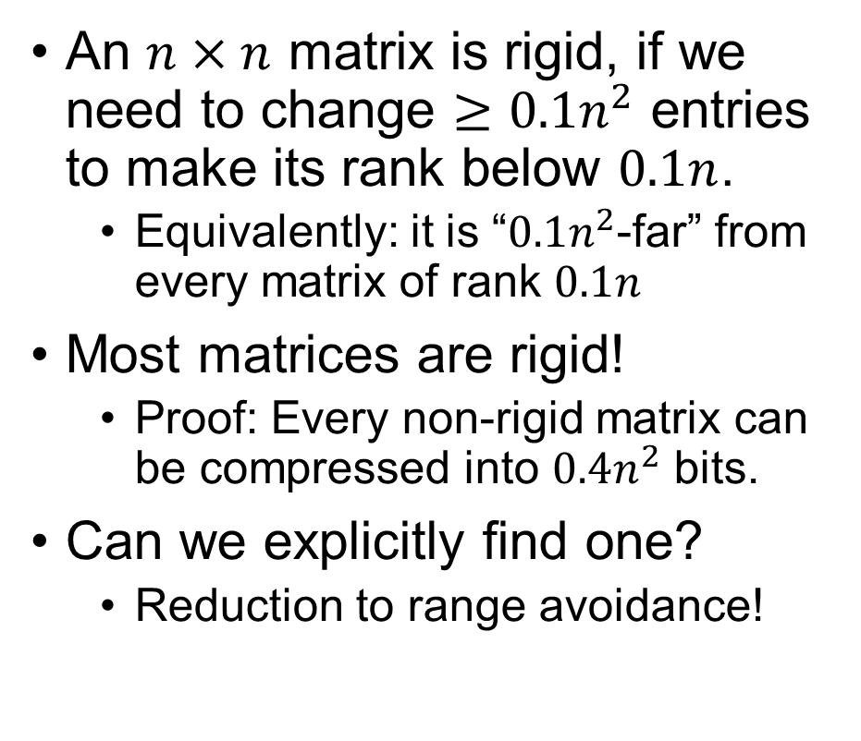
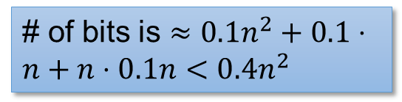




Example: Rigid Matrices
An $n×n$ matrix is rigid, if we need to change $≥0.1n^{2}$ entries to make its rank below $0.1n$.
Equivalently: it is “$0.1n^{2}$-far” from every matrix of rank $0.1n$
Most matrices are rigid!
Proof: Every non-rigid matrix can be compressed into $0.4n^{2}$ bits.
Can we explicitly find one?
Reduction to range avoidance!
Let’s say rank is over $𝔽_{2}$
A non-rigid matrix
$n^{2}$ bits
Decompressor for non-rigid matrices
$0.4n^{2}$ bits
$$=$$
$$×$$
# of bits is $≈0.1n^{2}+0.1⋅n+n⋅0.1n<0.4n^{2}$
2 / 14

Slide 4
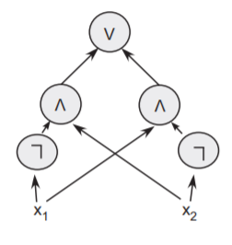
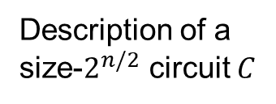
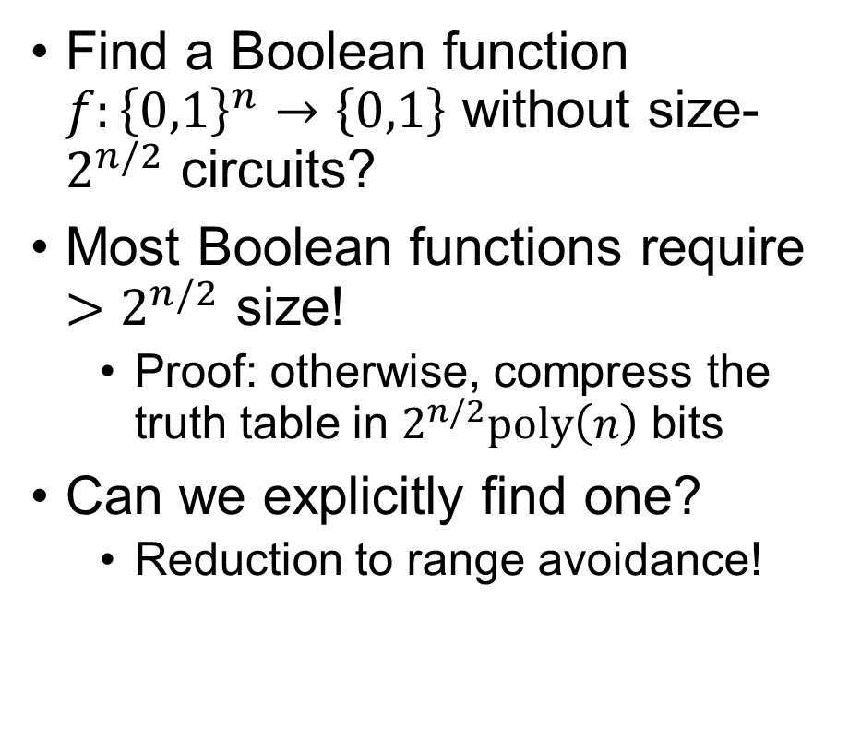




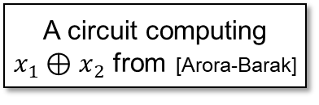


Example: Circuit Lower Bounds
Find a Boolean function $f:{\left\{0,1\right\}}^{n}→\left\{0,1\right\}$ without size-$2^{n/2}$ circuits?
Most Boolean functions require $>2^{n/2}$ size!
Proof: otherwise, compress the truth table in $2^{n/2}poly\left(n\right)$ bits
Can we explicitly find one?
Reduction to range avoidance!
A circuit computing $x_{1}⊕x_{2}$ from [Arora-Barak]
Truth table of $C$
$$01100010011………………001010$$
$2^{n}$ bits
$$TT$$
$2^{n/2}poly\left(n\right)$ bits
Description of a size-$2^{n/2}$ circuit $C$
$TT$ stands for “truth table”.
3 / 14

Slide 5
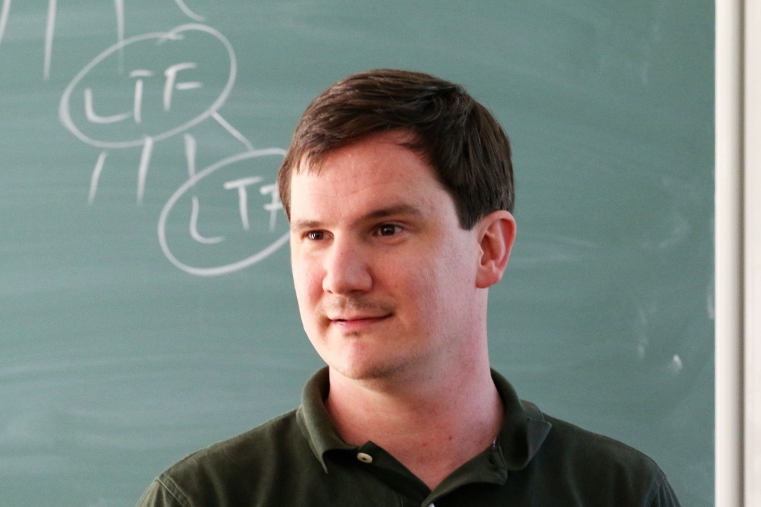
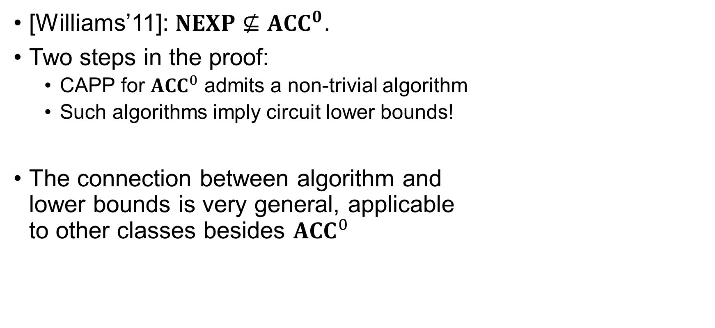
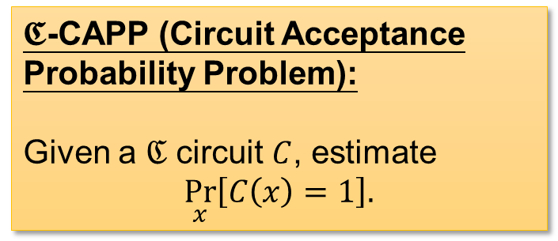

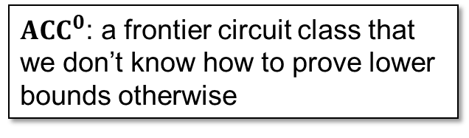
Circuit Lower Bounds via “Algorithmic Method”
${ACC}^{0}$: a frontier circuit class that we don’t know how to prove lower bounds otherwise
[Williams’11]: $NEXP⊈{ACC}^{0}$.
Two steps in the proof:
CAPP for ${ACC}^{0}$ admits a non-trivial algorithm
Such algorithms imply circuit lower bounds!
The connection between algorithm and lower bounds is very general, applicable to other classes besides ${ACC}^{0}$
Nontrivial: Running in $2^{n}/n^{ω\left(1\right)}$ time
$𝕮$-CAPP (Circuit Acceptance Probability Problem):
Given a $ℭ$ circuit $C$, estimate
$$\underset{x}{Pr}\left[C\left(x\right)=1\right].$$
4 / 14

Slide 6
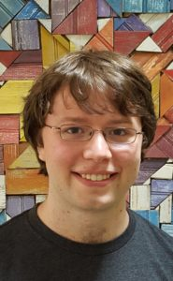
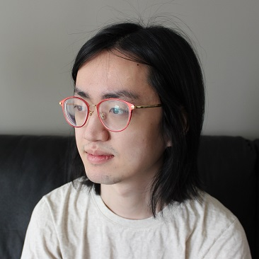
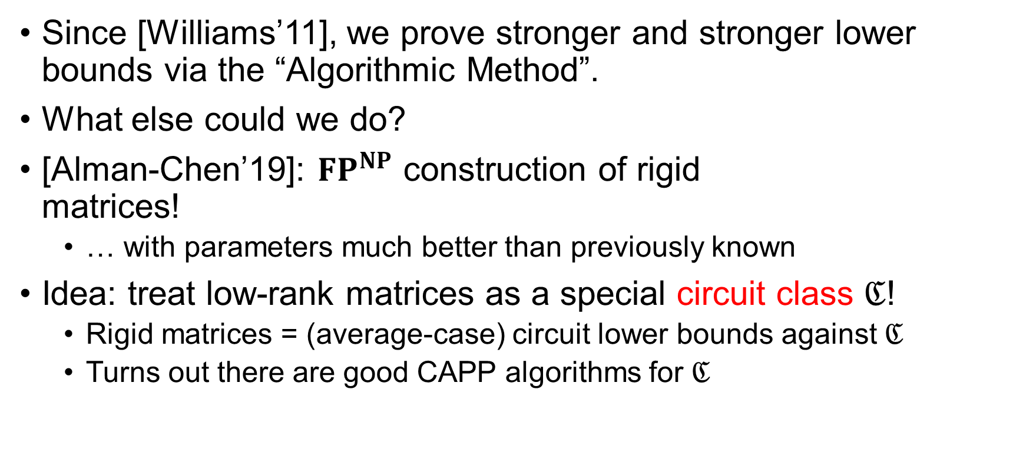
Algorithmic Method for Rigid Matrices
Since [Williams’11], we prove stronger and stronger lower bounds via the “Algorithmic Method”.
What else could we do?
[Alman-Chen’19]: ${FP}^{NP}$ construction of rigid matrices!
… with parameters much better than previously known
Idea: treat low-rank matrices as a special circuit class $ℭ$!
Rigid matrices = (average-case) circuit lower bounds against $ℭ$
Turns out there are good CAPP algorithms for $ℭ$
5 / 14

Slide 7









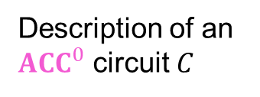

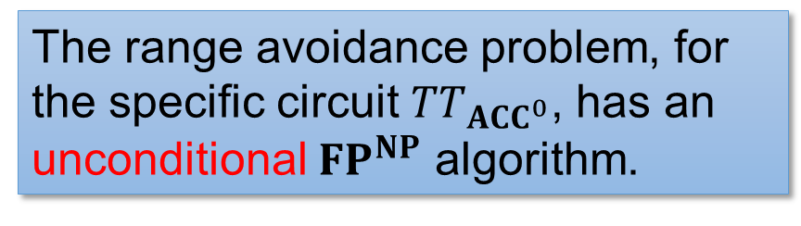
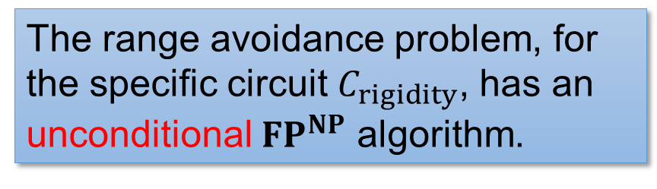



A Range Avoidance Interpretation?
${ACC}^{0}$ Circuit Lower Bounds
Rigid Matrices
Truth table of $C$
A non-rigid matrix
$$01100010011………………001010$$
$2^{n}$ bits
$n^{2}$ bits
$$TT_{{ACC}^{0}}$$
$$C_{rigidity}$$
$poly\left(n\right)$ bits
$$⟨$$
$$,$$
$$,$$
$$⟩$$
$0.4n^{2}$ bits
Description of an ${ACC}^{0}$ circuit $C$
The range avoidance problem, for the specific circuit $TT_{ACC^{0}}$, has an unconditional ${FP}^{NP}$ algorithm.
The range avoidance problem, for the specific circuit $C_{rigidity}$, has an unconditional ${FP}^{NP}$ algorithm.
(for different parameters)
6 / 14

Slide 8

Is it just circuit lower bounds & rigid matrices, or…?
Is there a general “Algorithmic Method” for range avoidance?
What analogue of “CAPP algorithms” imply $FP^{NP}$ algorithms for $𝕮$-Avoid?
7 / 14

Slide 9

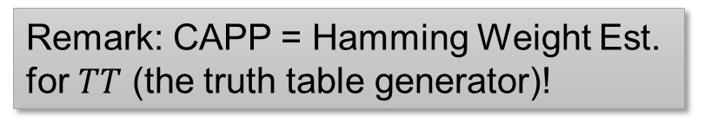

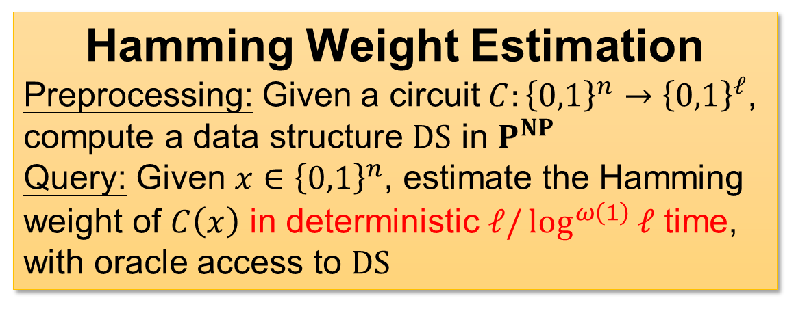
RSW22: Algorithmic Method for Range Avoidance
Non-trivial Hamming Weight Estimation data structures imply ${FP}^{NP}$ algorithms for range avoidance
output
Hamming Weight Estimation
Preprocessing: Given a circuit $C:{\left\{0,1\right\}}^{n}→{\left\{0,1\right\}}^{ℓ}$, compute a data structure $DS$ in $P^{NP}$
Query: Given $x∈{\left\{0,1\right\}}^{n}$, estimate the Hamming weight of $C\left(x\right)$ in deterministic $ℓ/\log^{ω\left(1\right)}{ℓ}$ time, with oracle access to $DS$
$$C$$
input
Remark: CAPP = Hamming Weight Est. for $TT$ (the truth table generator)!
See you tomorrow at my FOCS talk ☺
This result generalises Williams’s Algorithmic Method!
8 / 14

Slide 10












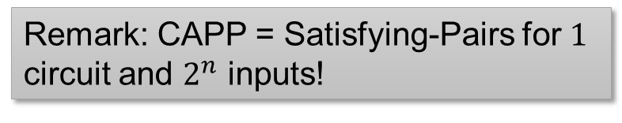









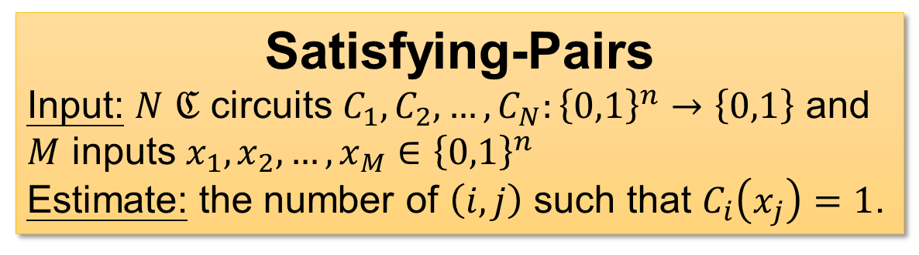




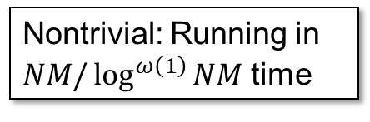
Ongoing Work: Range Avoidance from Satisfying-Pairs
Hamming Weight Est is hard and RSW didn’t have good unconditional results, but…
Non-trivial algorithms for Satisfying-Pairs imply ${FP}^{NP}$ algorithms for range avoidance
Satisfying-Pairs
Input: $N$ $ℭ$ circuits $C_{1},C_{2},…, C_{N}:{\left\{0,1\right\}}^{n}→\left\{0,1\right\}$ and $M$ inputs $x_{1},x_{2},…,x_{M}∈{\left\{0,1\right\}}^{n}$
Estimate: the number of $\left(i,j\right)$ such that $C_{i}\left(x_{j}\right)=1$.
$$x_{1}$$
$$x_{2}$$
$$x_{3}$$
$$x_{4}$$
$$1$$
$$0$$
$$1$$
$$0$$
$$C_{1}$$
$$0$$
$$1$$
$$0$$
$$0$$
$$C_{2}$$
$$1$$
$$1$$
$$1$$
$$0$$
Nontrivial: Running in $NM/\log^{ω\left(1\right)}{NM}$ time
$$C_{3}$$
Remark: CAPP = Satisfying-Pairs for $1$ circuit and $2^{n}$ inputs!
$$1$$
$$0$$
$$0$$
$$1$$
$$C_{4}$$
9 / 14

Slide 11




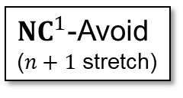
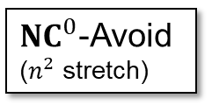





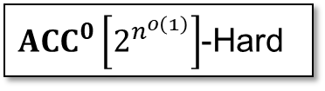

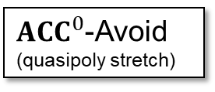
The Landscape of $APEPP$
(w.r.t. ${FP}^{NP}$ reductions)
Inside ${FP}^{NP}$
$APEPP$-complete
$Formula\left[2^{0.01n}\right]$-Hard
$SIZE\left[2^{0.01n}\right]$-Hard
$ACC^{0}\left[2^{n^{o\left(1\right)}}\right]$-Hard
Optimal linear codes
${ACC}^{0}$-Avoid (quasipoly stretch)
${NC}^{1}$-Avoid ($n+1$ stretch)
$SIZE\left[2^{n}/3n\right]$-Hard
Ramsey Graphs
(Razborov-)Rigid matrices
${NC}^{0}$-Avoid ($n^{2}$ stretch)
(Valiant-)Rigid matrices
${NC}^{0}$-Avoid ($n+1$ stretch)
Avoid
easy
hard
10 / 14

Slide 12

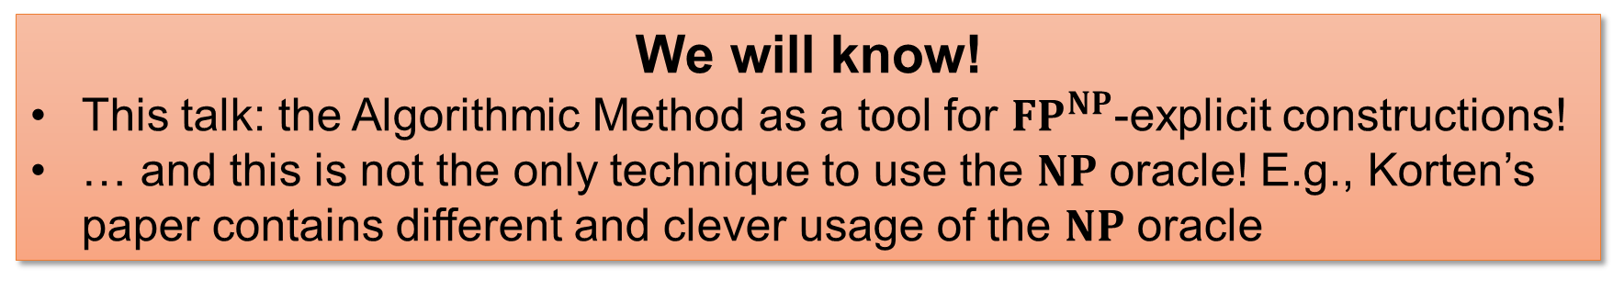
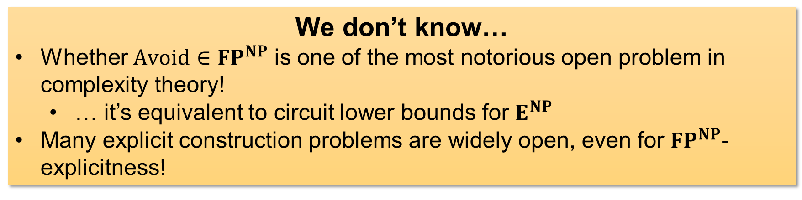
Invitation
${FP}^{NP}$-explicit constructions are interesting!
We don’t know…
Whether $Avoid∈{FP}^{NP}$ is one of the most notorious open problem in complexity theory!
… it’s equivalent to circuit lower bounds for $E^{NP}$
Many explicit construction problems are widely open, even for ${FP}^{NP}$-explicitness!
We will know!
This talk: the Algorithmic Method as a tool for ${FP}^{NP}$-explicit constructions!
… and this is not the only technique to use the $NP$ oracle! E.g., Korten’s paper contains different and clever usage of the $NP$ oracle
11 / 14

Slide 13
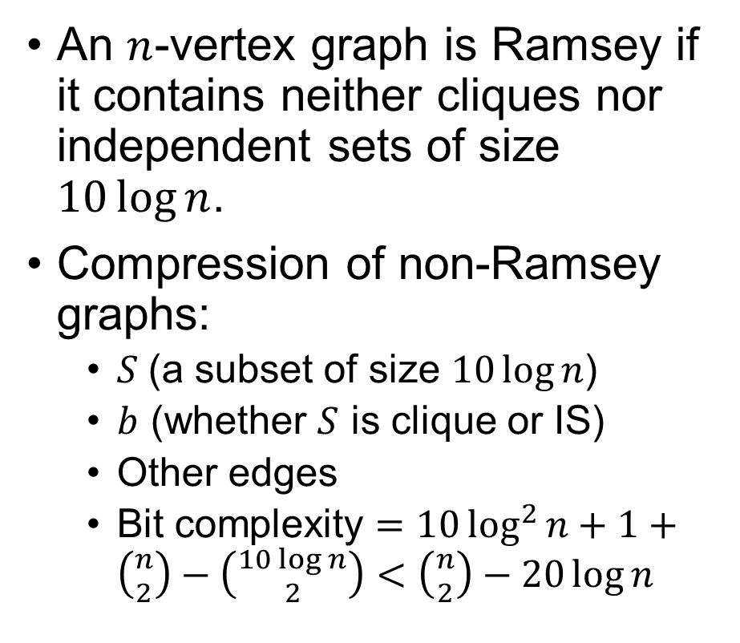



Open Problem 1: Ramsey Graphs
An $n$-vertex graph is Ramsey if it contains neither cliques nor independent sets of size $10\log{n}$.
Compression of non-Ramsey graphs:
$S$ (a subset of size $10\log{n}$)
$b$ (whether $S$ is clique or IS)
Other edges
Bit complexity $=10\log^{2}{n}+1+\left({n \atop 2}\right)−\left({10\log{n} \atop 2}\right)<\left({n \atop 2}\right)−20\log{n}$
A non-Ramsey graph
$ℓ$ bits
Decompressor for non-Ramsey graphs
$ℓ−10\log{ℓ}$ bits
$$\left(S,b,other edges\right)$$
WARNING: the stretch is small!
A test ground for small-stretch avoidance?
12 / 14

Slide 14

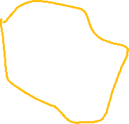

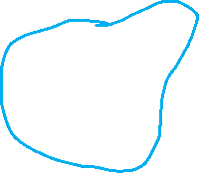
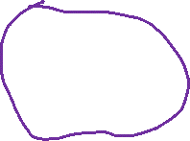




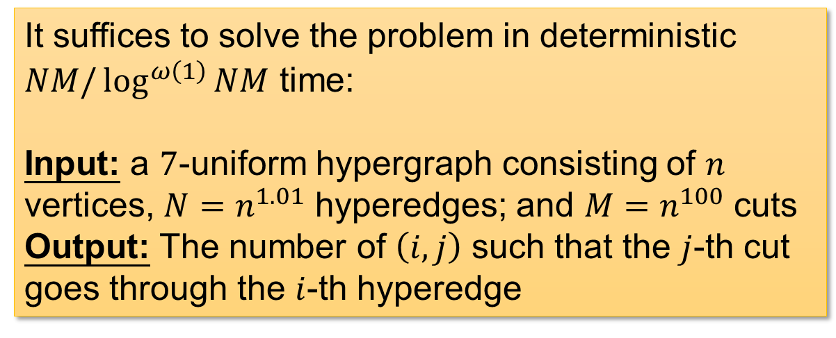
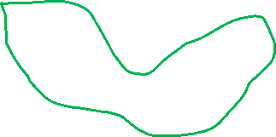
Open Problem 2: ${NC}^{0}$-Avoid
Conjecture: ${NC}_{3}^{0}$-Avoid with $ℓ\left(n\right)=n^{1.01}$ stretch is in ${FP}^{NP}$
$$output$$
$$input$$
It suffices to solve the problem in deterministic $NM/\log^{ω\left(1\right)}{NM}$ time:
Input: a $7$-uniform hypergraph consisting of $n$ vertices, $N=n^{1.01}$ hyperedges; and $M=n^{100}$ cuts
Output: The number of $\left(i,j\right)$ such that the $j$-th cut goes through the $i$-th hyperedge
Each edge contains exactly $7$ vertices
The cut goes through the blue and orange edges, but not the green and purple ones.
13 / 14

Slide 15

The Landscape of $APEPP$
EXPLORE THIS!
(w.r.t. ${FP}^{NP}$ reductions)
Inside ${FP}^{NP}$
with your cool ideas and $NP$ oracle ☺
$APEPP$-complete
$Formula\left[2^{0.01n}\right]$-Hard
$SIZE\left[2^{0.01n}\right]$-Hard
$ACC^{0}\left[2^{n^{o\left(1\right)}}\right]$-Hard
Optimal linear codes
${ACC}^{0}$-Avoid (quasipoly stretch)
${NC}^{1}$-Avoid ($n+1$ stretch)
$SIZE\left[2^{n}/3n\right]$-Hard
Ramsey Graphs
(Razborov-)Rigid matrices
${NC}^{0}$-Avoid ($n^{2}$ stretch)
(Valiant-)Rigid matrices
${NC}^{0}$-Avoid ($n+1$ stretch)
Avoid
easy
Thank you!
hard
Questions are welcome!
14 / 14

