Slide 1

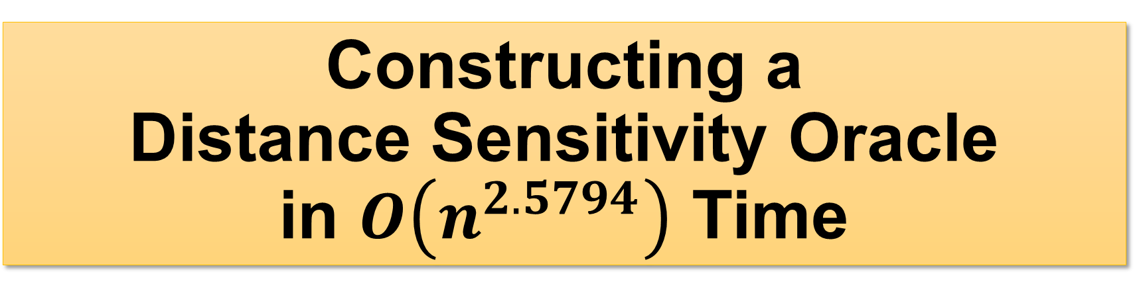



Constructing a Distance Sensitivity Oracle in $O\left(n^{2.5794}\right)$ Time
Hanlin Ren, IIIS, Tsinghua University
Joint work with Yong Gu
$$x$$
$$v$$
$$u$$
1 / 15

Slide 2




Distance Sensitivity Oracles (DSOs)
Given a directed graph $G=\left(V,E\right)$
Query$\left(a,b,x\right)$: the shortest $a→b$ path not passing through $x$?
A natural and well-studied problem in graph algorithms.
$$x$$
$$b$$
$$a$$
2 / 15

Slide 3
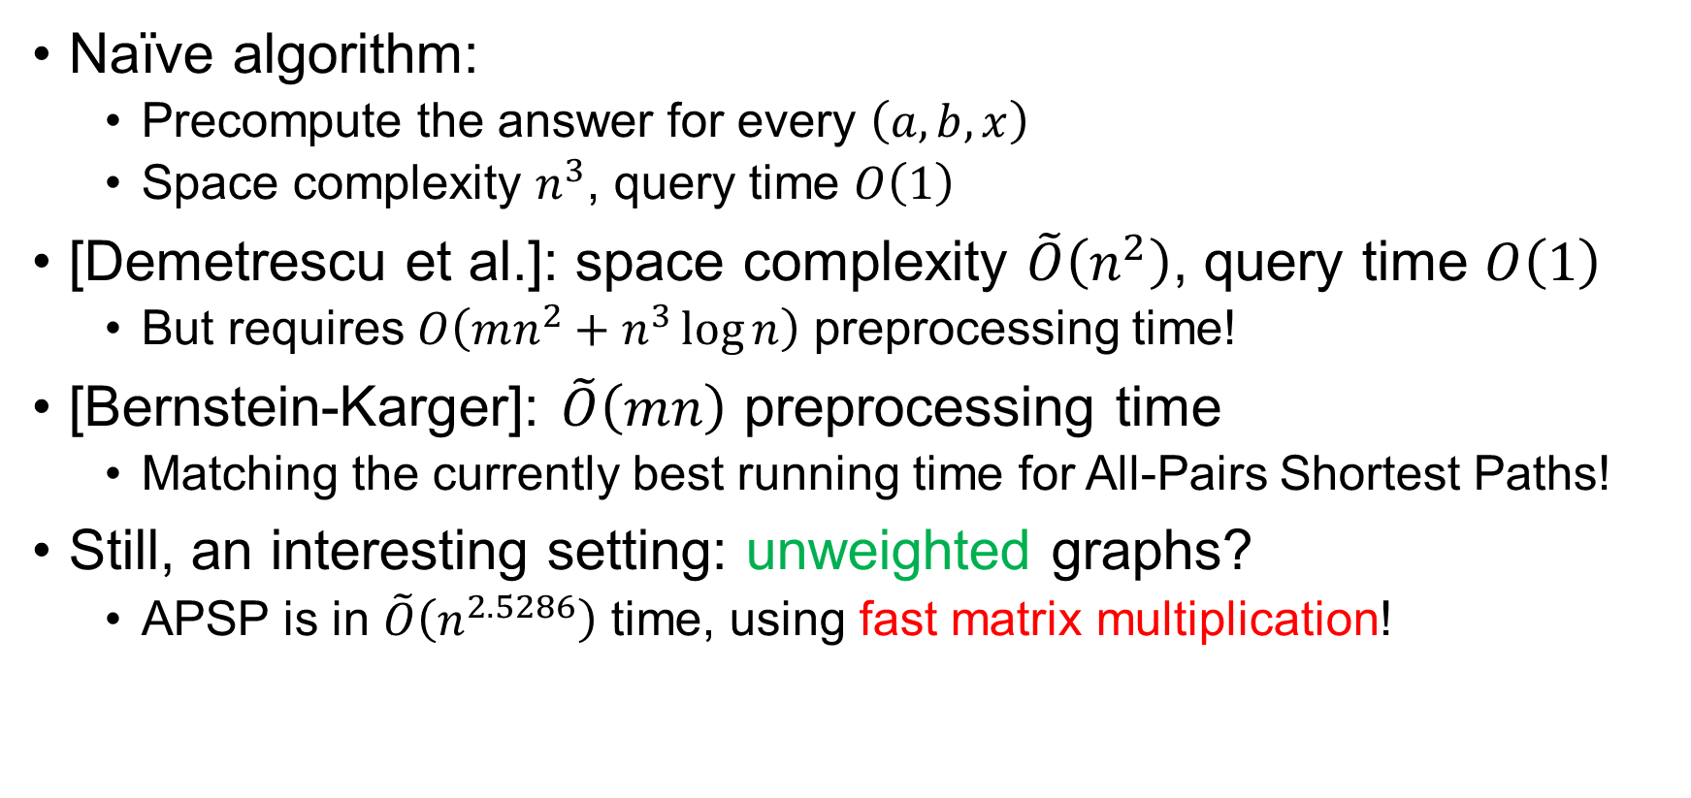
Previous Work
Naïve algorithm:
Precompute the answer for every $\left(a,b,x\right)$
Space complexity $n^{3}$, query time $O\left(1\right)$
[Demetrescu et al.]: space complexity $\tilde{O}\left(n^{2}\right)$, query time $O\left(1\right)$
But requires $O\left(mn^{2}+n^{3}\log{n}\right)$ preprocessing time!
[Bernstein-Karger]: $\tilde{O}\left(mn\right)$ preprocessing time
Matching the currently best running time for All-Pairs Shortest Paths!
Still, an interesting setting: unweighted graphs?
APSP is in $\tilde{O}\left(n^{2.5286}\right)$ time, using fast matrix multiplication!
We consider unweighted graphs in this talk, for simplicity.
Our results extend to graphs with small positive integer weights.
3 / 15

Slide 4
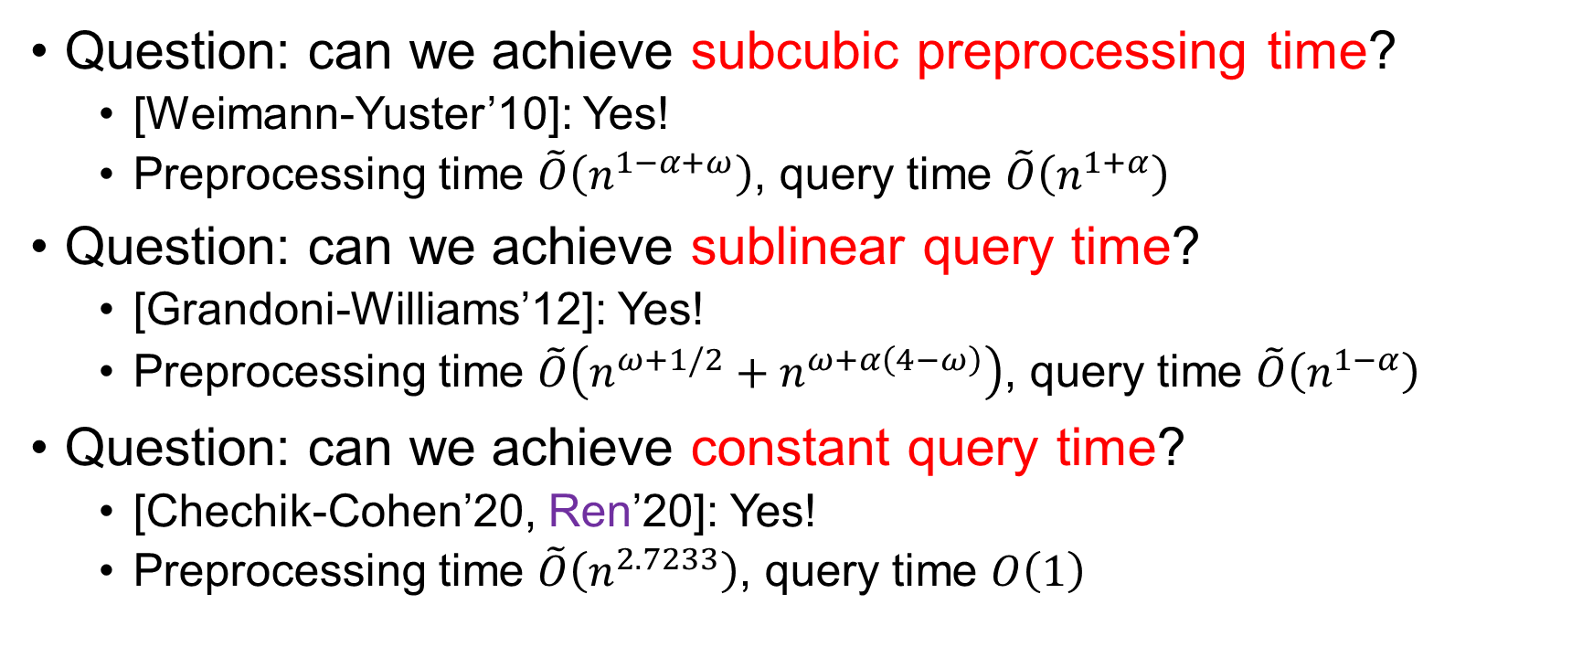

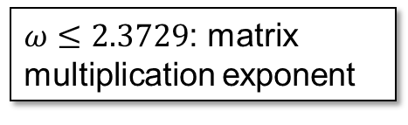
Previous Work via Fast Matrix Mult?
Question: can we achieve subcubic preprocessing time?
[Weimann-Yuster’10]: Yes!
Preprocessing time $\tilde{O}\left(n^{1−α+ω}\right)$, query time $\tilde{O}\left(n^{1+α}\right)$
Question: can we achieve sublinear query time?
[Grandoni-Williams’12]: Yes!
Preprocessing time $\tilde{O}\left(n^{ω+1/2}+n^{ω+α\left(4−ω\right)}\right)$, query time $\tilde{O}\left(n^{1−α}\right)$
Question: can we achieve constant query time?
[Chechik-Cohen’20, Ren’20]: Yes!
Preprocessing time $\tilde{O}\left(n^{2.7233}\right)$, query time $O\left(1\right)$
$ω≤2.3729$: matrix multiplication exponent
$α∈\left(0,1\right)$ is a parameter
4 / 15

Slide 5


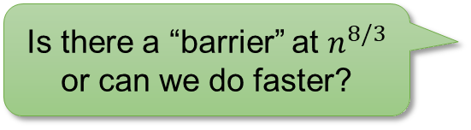






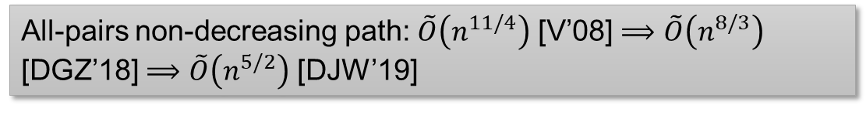


The $n^{8/3}$ Barrier
Preprocessing time of previous DSOs:
Other problems solvable by FMM have seen progress:
Algorithm
Preprocessing time
Prep. time if $ω=2$
Grandoni-Williams’12*
$$O\left(n^{2.8729}\right)$$
$$\tilde{O}\left(n^{8/3}\right)$$
Chechik-Cohen’20
$$O\left(n^{2.8729}\right)$$
$$\tilde{O}\left(n^{14/5}\right)$$
Ren’20
$$O\left(n^{2.7233}\right)$$
$$\tilde{O}\left(n^{8/3}\right)$$
*Plus a transformation in [Ren’20] to bring the query time to $O\left(1\right)$
All-pairs bottleneck path: $\tilde{O}\left(n^{8/3}\right)$ [VWY’07] $⟹$ $\tilde{O}\left(n^{5/2}\right)$ [DP’09]
Is there a “barrier” at $n^{8/3}$ or can we do faster?
All-pairs non-decreasing path: $\tilde{O}\left(n^{11/4}\right)$ [V’08] $⟹$ $\tilde{O}\left(n^{8/3}\right)$ [DGZ’18] $⟹$ $\tilde{O}\left(n^{5/2}\right)$ [DJW’19]
Also assuming $ω=2$ here
5 / 15

Slide 6
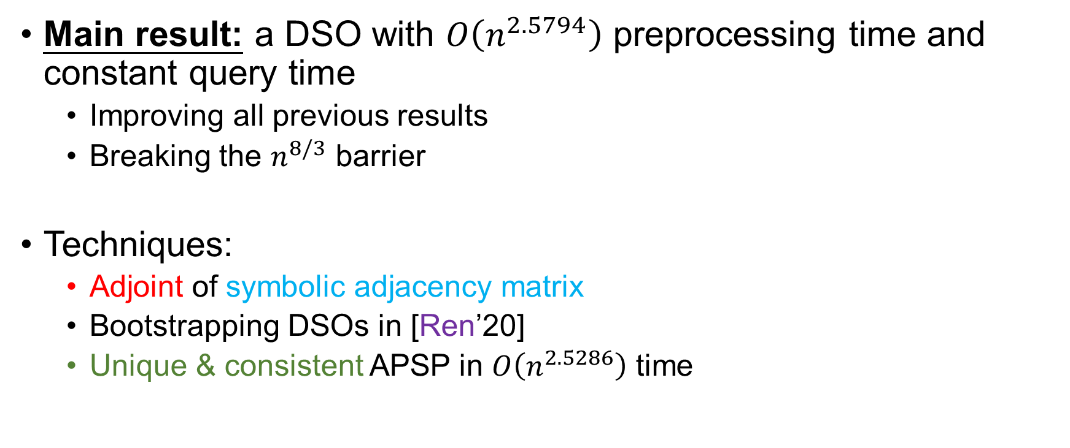
Our Result
Main result: a DSO with $O\left(n^{2.5794}\right)$ preprocessing time and constant query time
Improving all previous results
Breaking the $n^{8/3}$ barrier
Techniques:
Adjoint of symbolic adjacency matrix
Bootstrapping DSOs in [Ren’20]
Unique & consistent APSP in $O\left(n^{2.5286}\right)$ time
6 / 15

Slide 7

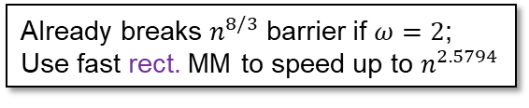













$r$-Truncated DSO
An $r$-truncated DSO is a DSO that returns the correct answer if the answer is $≤r$, and returns $r$ otherwise
Now, our goal is to construct
$r$-truncated DSO
Implicit in [Ren’20]
(Normal) DSO
prep. time $P$
prep. time $P+\tilde{O}\left(n^{2}\right)Q+\tilde{O}\left(n^{3}/r\right)$
query time $Q$
query time $O\left(1\right)$
$r$-truncated DSO
Setting $r=n^{\left(3−ω\right)/2}$
(Normal) DSO
prep. time $\tilde{O}\left(rn^{ω}\right)$
prep. time $\tilde{O}\left(n^{\left(3+ω\right)/2}\right)$
prep. time $\tilde{O}\left(rn^{ω}+n^{2}r+n^{3}/r\right)$
query time $\tilde{O}\left(r\right)$
query time $O\left(1\right)$
Already breaks $n^{8/3}$ barrier if $ω=2$;
Use fast rect. MM to speed up to $n^{2.5794}$
7 / 15

Slide 8



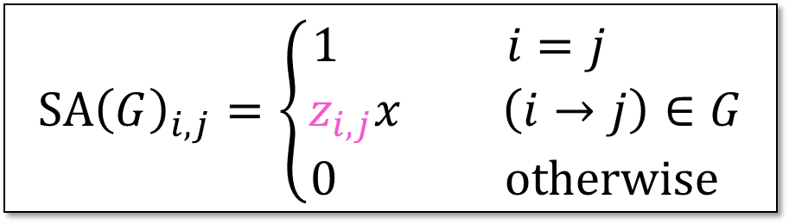

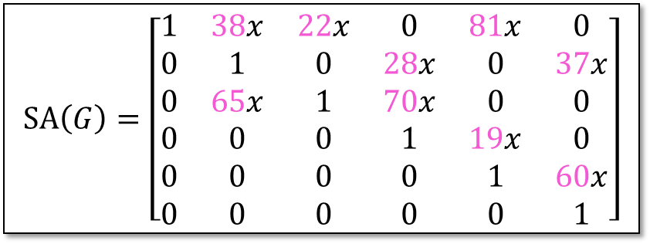


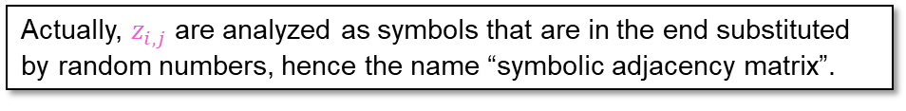

Symbolic Adjacency Matrix
Let $G$ be a directed (unweighted) graph.
Let $z_{i,j}$ be random numbers.
Actually, $z_{i,j}$ are analyzed as symbols that are in the end substituted by random numbers, hence the name “symbolic adjacency matrix”.
$$SA{\left(G\right)}_{i,j}=\left\{\begin{aligned}1 i=j \\ z_{i,j}x \left(i→j\right)∈G \\ 0 otherwise \end{aligned}\right.$$
$$2$$
$$SA\left(G\right)=\left[\begin{matrix}1 & 38x & 22x & 0 & 81x & 0 \\ 0 & 1 & 0 & 28x & 0 & 37x \\ 0 & 65x & 1 & 70x & 0 & 0 \\ 0 & 0 & 0 & 1 & 19x & 0 \\ 0 & 0 & 0 & 0 & 1 & 60x \\ 0 & 0 & 0 & 0 & 0 & 1\end{matrix}\right]$$
$$6$$
$$5$$
$$1$$
$$4$$
$$3$$
8 / 15

Slide 9

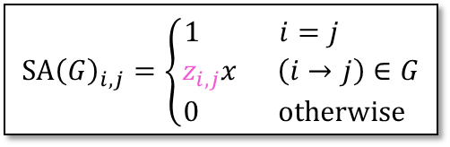


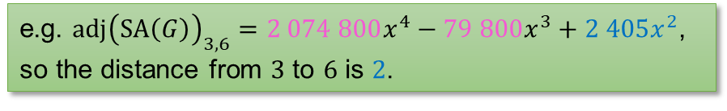

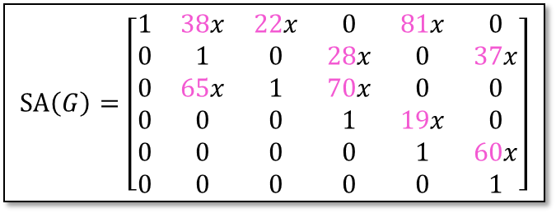




Adjoint of $SA\left(G\right)$
Adjoint: $adj\left(M\right)=\det\left(M\right)⋅M^{−1}$
Theorem [Sankowski’05]. Whp over the choice of $\left\{z_{i,j}\right\}$, the distance from $a$ to $b$ is the lowest degree of $x$ in $adj{\left(SA\left(G\right)\right)}_{a,b}$.
$$2$$
$$SA\left(G\right)=\left[\begin{matrix}1 & 38x & 22x & 0 & 81x & 0 \\ 0 & 1 & 0 & 28x & 0 & 37x \\ 0 & 65x & 1 & 70x & 0 & 0 \\ 0 & 0 & 0 & 1 & 19x & 0 \\ 0 & 0 & 0 & 0 & 1 & 60x \\ 0 & 0 & 0 & 0 & 0 & 1\end{matrix}\right]$$
$$6$$
$$5$$
$$1$$
$$4$$
$$3$$
e.g. $adj{\left(SA\left(G\right)\right)}_{3,6}=2 074 800x^{4}−79 800x^{3}+2 405x^{2}$, so the distance from $3$ to $6$ is $2$.
$$SA{\left(G\right)}_{i,j}=\left\{\begin{aligned}1 i=j \\ z_{i,j}x \left(i→j\right)∈G \\ 0 otherwise \end{aligned}\right.$$
9 / 15

Slide 10
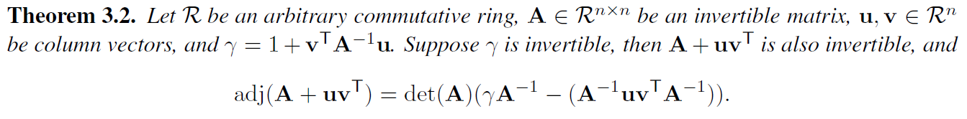
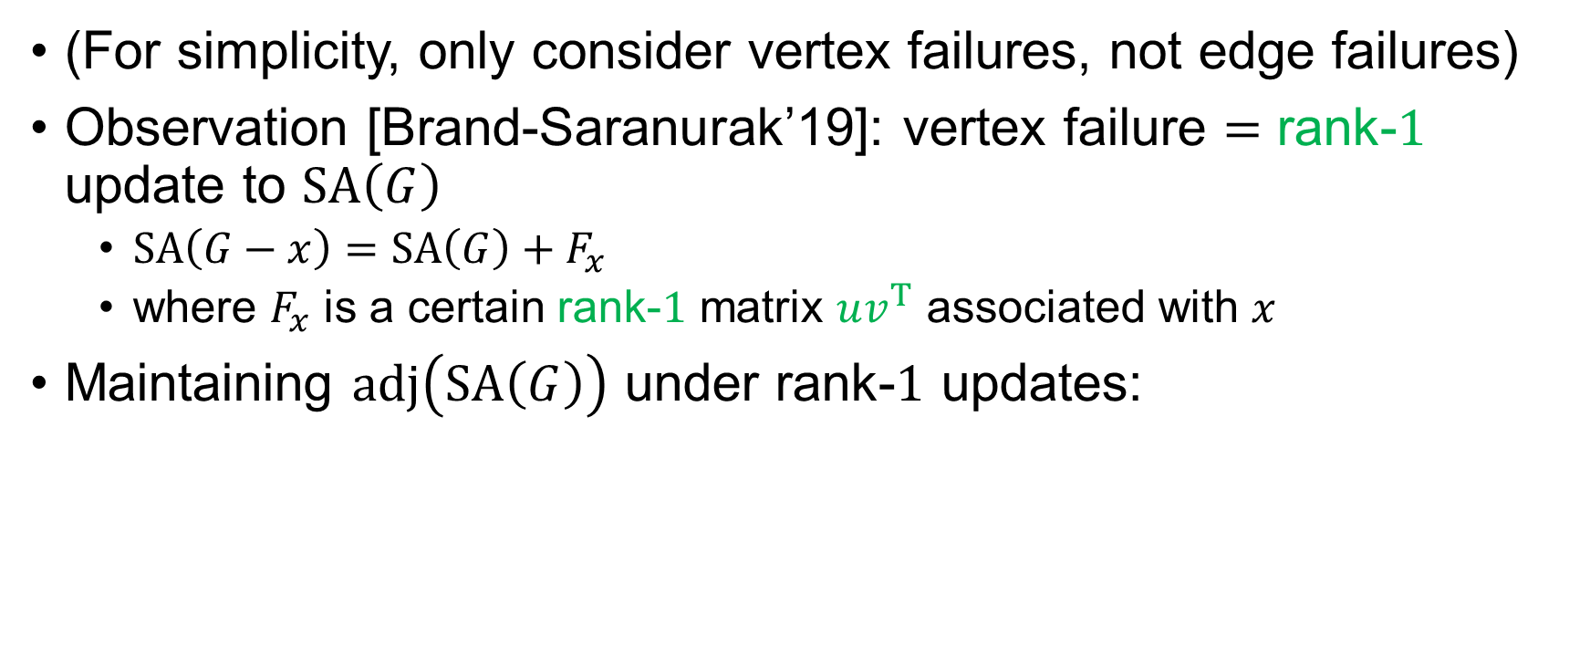
Handling a Vertex Failure
(For simplicity, only consider vertex failures, not edge failures)
Observation [Brand-Saranurak’19]: vertex failure $=$ rank-$1$ update to $SA\left(G\right)$
$SA\left(G−x\right)=SA\left(G\right)+F_{x}$
where $F_{x}$ is a certain rank-$1$ matrix $uv^{T}$ associated with $x$
Maintaining $adj\left(SA\left(G\right)\right)$ under rank-$1$ updates:
$$SA{\left(G\right)}_{i,j}=\left\{\begin{aligned}1 i=j \\ z_{i,j}x \left(i→j\right)∈G \\ 0 otherwise \end{aligned}\right.$$
Proof: Sherman-Morrison-Woodbury formula $+$ matrix determinant lemma.
10 / 15
Notes:
Need to address determinant

Slide 11


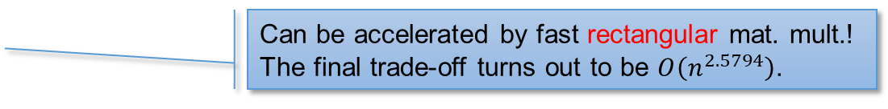

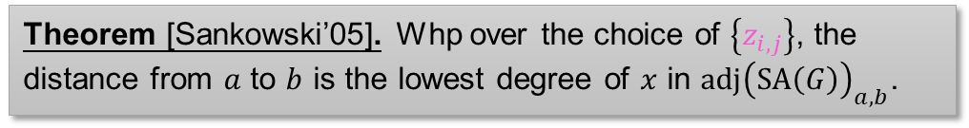

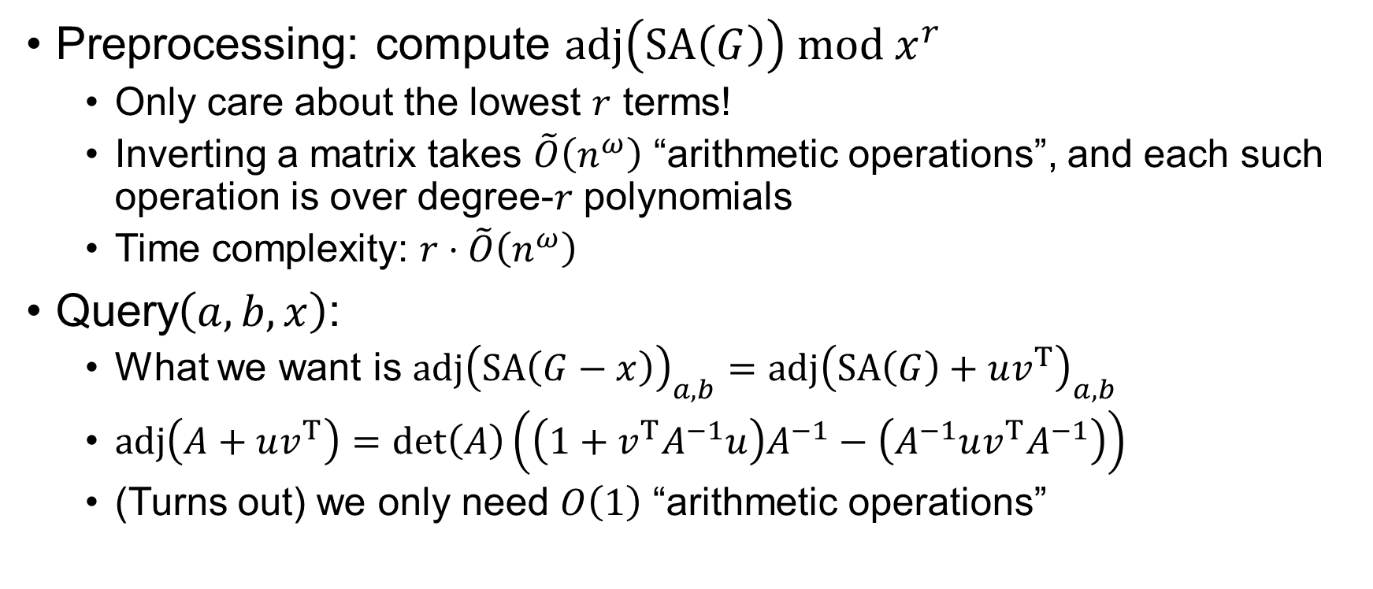

The $r$-Truncated DSO
$r$-truncated DSO
prep. time $\tilde{O}\left(rn^{ω}\right)$
Preprocessing: compute $adj\left(SA\left(G\right)\right) mod x^{r}$
Only care about the lowest $r$ terms!
Inverting a matrix takes $\tilde{O}\left(n^{ω}\right)$ “arithmetic operations”, and each such operation is over degree-$r$ polynomials
Time complexity: $r⋅\tilde{O}\left(n^{ω}\right)$
Query$\left(a,b,x\right)$:
What we want is $adj{\left(SA\left(G−x\right)\right)}_{a,b}=adj{\left(SA\left(G\right)+uv^{T}\right)}_{a,b}$
$adj\left(A+uv^{T}\right)=\det\left(A\right)\left(\left(1+v^{T}A^{−1}u\right)A^{−1}−\left(A^{−1}uv^{T}A^{−1}\right)\right)$
(Turns out) we only need $O\left(1\right)$ “arithmetic operations”
query time $\tilde{O}\left(r\right)$
Can be accelerated by fast rectangular mat. mult.!
The final trade-off turns out to be $O\left(n^{2.5794}\right)$.
Shortest path from $a$ to $b$, $x$ is the failed vertex
Theorem [Sankowski’05]. Whp over the choice of $\left\{z_{i,j}\right\}$, the distance from $a$ to $b$ is the lowest degree of $x$ in $adj{\left(SA\left(G\right)\right)}_{a,b}$.
11 / 15

Slide 12

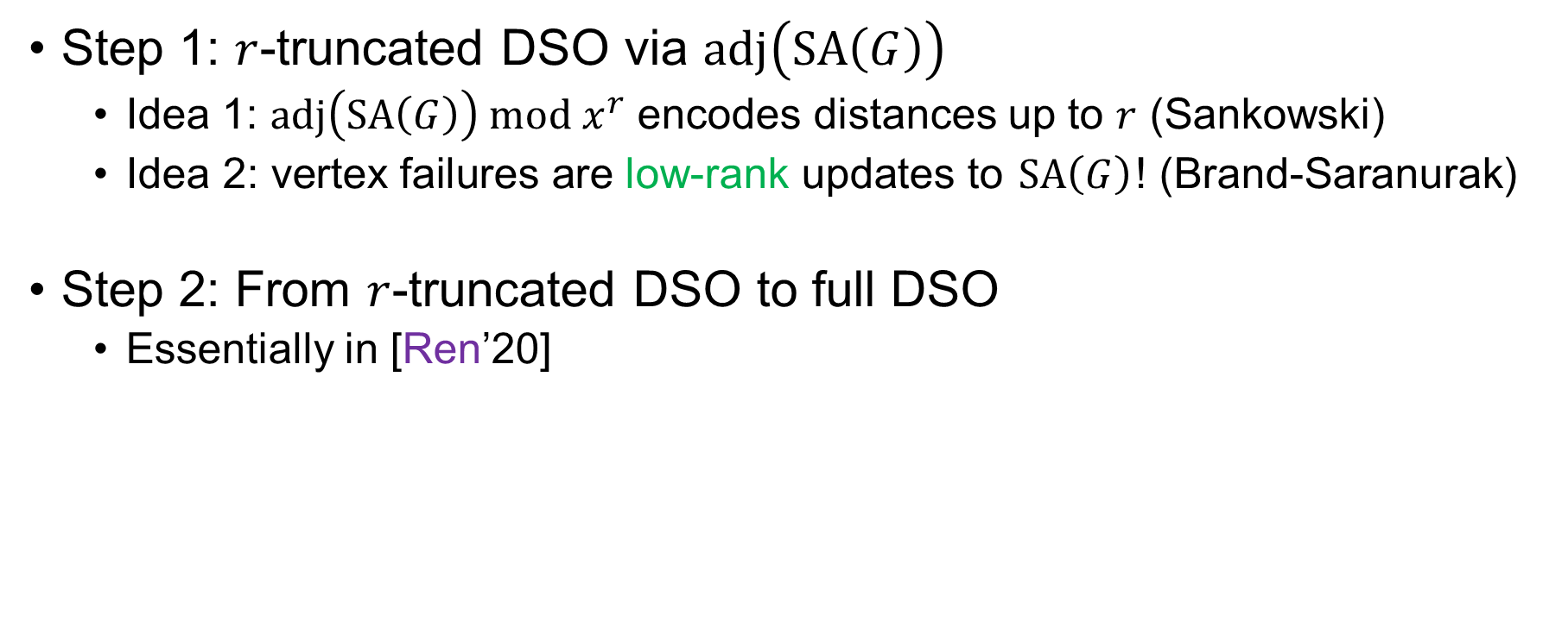


Summary
Step 1: $r$-truncated DSO via $adj\left(SA\left(G\right)\right)$
Idea 1: $adj\left(SA\left(G\right)\right) mod x^{r}$ encodes distances up to $r$ (Sankowski)
Idea 2: vertex failures are low-rank updates to $SA\left(G\right)$! (Brand-Saranurak)
Step 2: From $r$-truncated DSO to full DSO
Essentially in [Ren’20]
$r$-truncated DSO
Setting $r=n^{\left(3−ω\right)/2}$
(Normal) DSO
prep. time $\tilde{O}\left(rn^{ω}\right)$
prep. time $\tilde{O}\left(n^{\left(3+ω\right)/2}\right)$
query time $\tilde{O}\left(r\right)$
query time $O\left(1\right)$
12 / 15

Slide 13




















Unique & Consistent Shortest Paths
(We somehow need this result to bootstrap an $r$-truncated DSO to a full DSO)
Problem: given an unweighted directed graph, compute incoming & outgoing shortest path trees that are consistent
If a $u→v$ path exists in two different trees, they should be the same path
$$u$$
$$v$$
$$T_{in}\left(b\right)$$
×
$$a$$
$$b$$
$$u$$
$$v$$
$$u$$
$$v$$
$$a$$
$$b$$
$$a$$
$$b$$
$$u$$
$$v$$
$$T_{in}\left(b\right)$$
√
$$T_{out}\left(a\right)$$
$$a$$
$$b$$
13 / 15

Slide 14
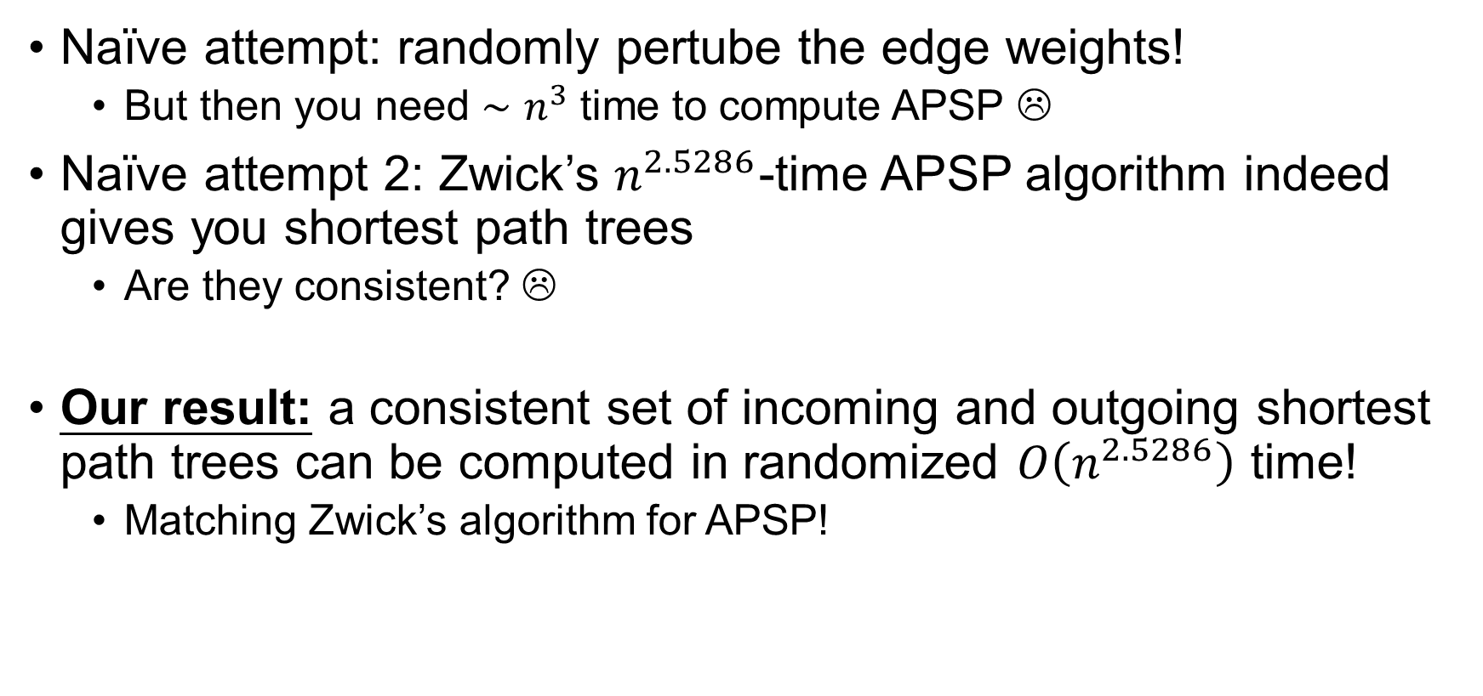
Unique & Consistent Shortest Paths
Naïve attempt: randomly pertube the edge weights!
But then you need $∼n^{3}$ time to compute APSP ☹
Naïve attempt 2: Zwick’s $n^{2.5286}$-time APSP algorithm indeed gives you shortest path trees
Are they consistent? ☹
Our result: a consistent set of incoming and outgoing shortest path trees can be computed in randomized $O\left(n^{2.5286}\right)$ time!
Matching Zwick’s algorithm for APSP!
Other applications of this besides DSO?
14 / 15

Slide 15
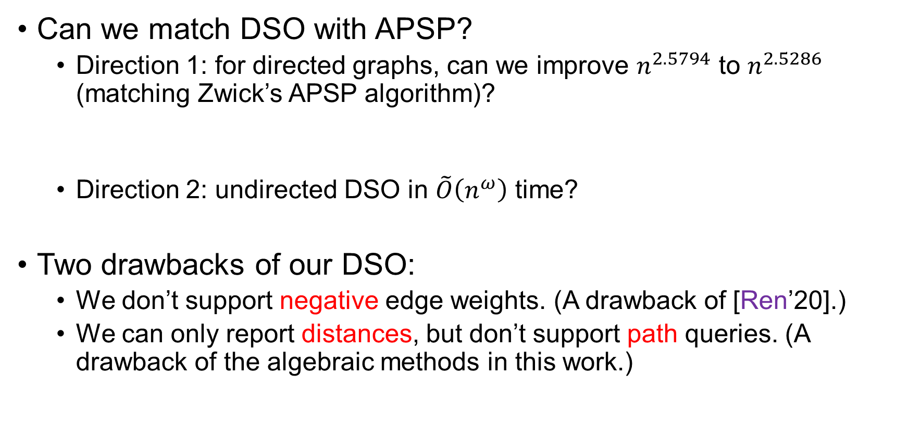
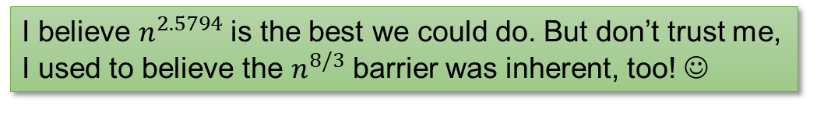
Further Directions
Can we match DSO with APSP?
Direction 1: for directed graphs, can we improve $n^{2.5794}$ to $n^{2.5286}$ (matching Zwick’s APSP algorithm)?
Direction 2: undirected DSO in $\tilde{O}\left(n^{ω}\right)$ time?
Two drawbacks of our DSO:
We don’t support negative edge weights. (A drawback of [Ren’20].)
We can only report distances, but don’t support path queries. (A drawback of the algebraic methods in this work.)
I believe $n^{2.5794}$ is the best we could do. But don’t trust me, I used to believe the $n^{8/3}$ barrier was inherent, too! ☺
15 / 15

Slide 16
Thank you!

