Slide 1
Approximate Distance Oracles Subject to Multiple Vertex Failures
Hanlin Ren, IIIS, Tsinghua University
Joint work with Ran Duan & Yong Gu

Slide 2

The Problem
Problem: given a graph, maintain approx. shortest paths under vertex failures.
$Query\left(u,v,D\right)≈$ shortest path from $u$ to $v$ that avoids $D$
source vertex
target vertex
failed vertex
optimal path

Slide 3



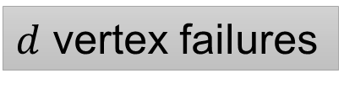
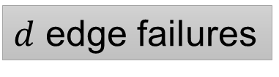
How Hard Is the Problem?
$d$ failures, undirected graph
Desired query time: $poly\left(d,\log{n}\right)$
approx. distance
connectivity
[PT’07]
[DP’10]
[CLPR’10]: $O\left(d\right)$-approx
$d$ edge failures
Fully dynamic connectivity
[CCFK’17]: $\left(1+ε\right)$-approx
??
$d$ vertex failures
[DP’10]
[DP’17]
This work!

Slide 4
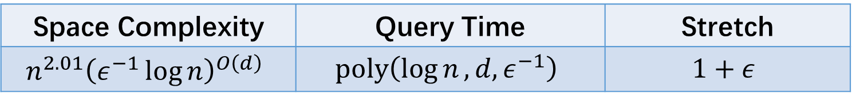

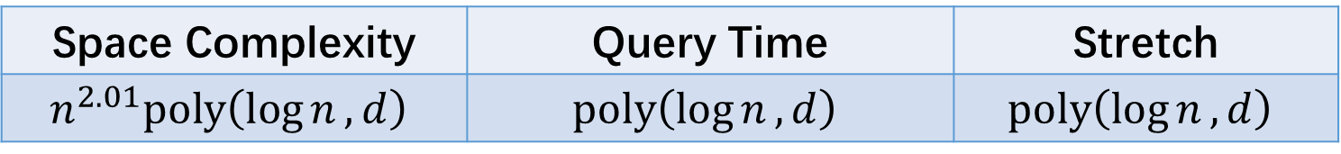
Our Results
We present two oracles:*
Space Complexity | Query Time | Stretch
$$n^{2.01}{\left(ε^{−1}\log{n}\right)}^{O\left(d\right)}$$ | $$poly\left(\log{n},d,ε^{−1}\right)$$ | $$1+ε$$
Space Complexity | Query Time | Stretch
$$n^{2.01}poly\left(\log{n},d\right)$$ | $$poly\left(\log{n},d\right)$$ | $$poly\left(\log{n},d\right)$$
*assuming edge weights in $\left[1, poly\left(n\right)\right]$

Slide 5




Subroutine: Guarding the Failures
Illustration of the difficulty of vertex failures
Find a set of vertices $W$ to “guard the failures”
If $x$ is close to a failure, then $x$ is also close to $W$*
$|W|$ is small.
$\left(1+ε\right)$-approx.
Query time $=poly\left(\left|W\right|\right)$
$$x$$
*in the graph with failures removed

Slide 6
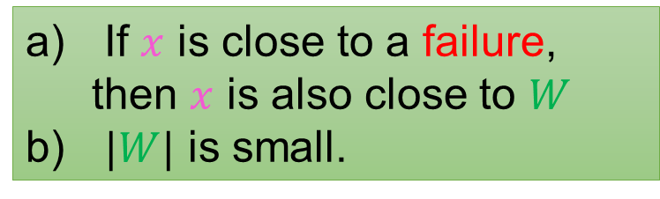





Guarding Edge Failures
$W=$ set of vertices incident to edge failures
$$w$$
$$x$$
$$f$$
$$\left|W\right|≤2d$$
If $x$ is close to a failure, then $x$ is also close to $W$
$|W|$ is small.

Slide 7
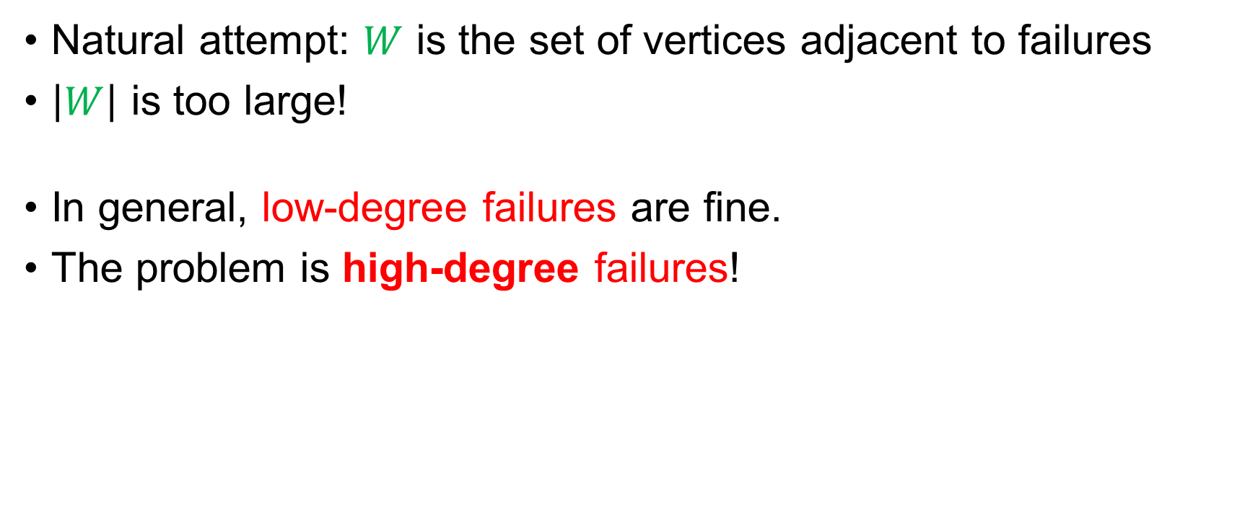
What about Vertex Failures?
Natural attempt: $W$ is the set of vertices adjacent to failures
$\left|W\right|$ is too large!
In general, low-degree failures are fine.
The problem is high-degree failures!
If $x$ is close to a failure, then $x$ is also close to $W$
$|W|$ is small.
☺
☹

Slide 8
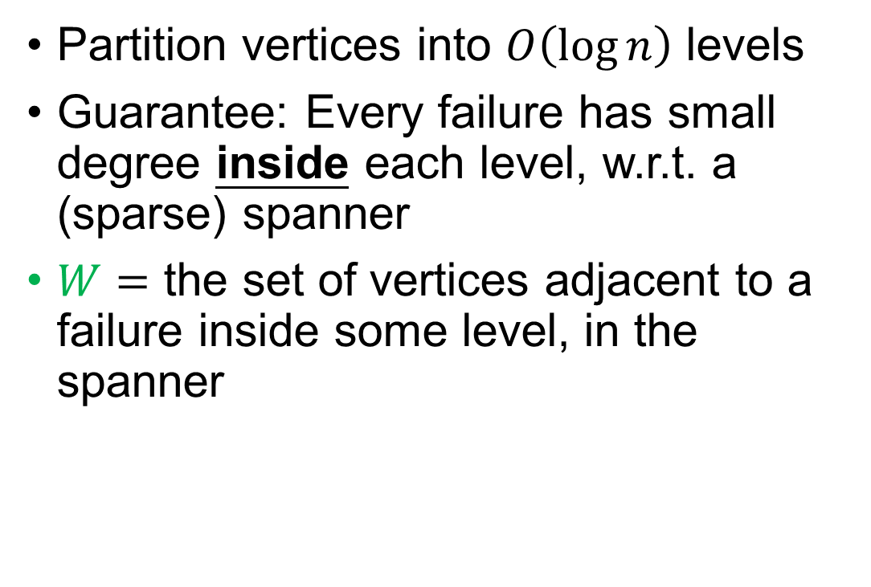
Attempt 2: High-Degree Hierarchy [DP’10]
Partition vertices into $O\left(\log{n}\right)$ levels
Guarantee: Every failure has small degree inside each level, w.r.t. a (sparse) spanner
$W=$ the set of vertices adjacent to a failure inside some level, in the spanner
If $x$ is close to a failure, then $x$ is also close to $W$
$|W|$ is small.
☺

Slide 9


Attempt 2: High-Degree Hierarchy [DP’10]
Claim: a) is true if $x$ and failure are in the same level…
… But false in general!
$$x$$
If $x$ is close to a failure, then $x$ is also close to $W$
$|W|$ is small.

Slide 10

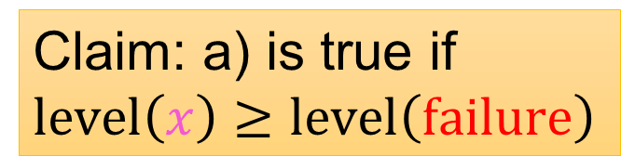


Attempt 3: Tree Covers
$W=\{$vertices incident to failures in the original tree cover$\}∪$
$\{$parents of failures in the extended tree cover$\}$
Claim: a) is true if
$level\left(x\right)≥level\left(failure\right)$
$$LCA$$
$$x$$
If $x$ is close to a failure, then $x$ is also close to $W$
$|W|$ is small.
☺

Slide 11

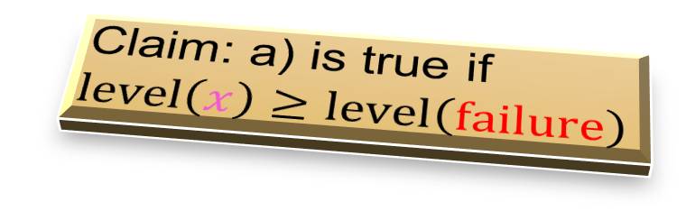
Wrap Up
Now, we can find a set $W$ that satisfies b) and half of a)
We also show: half of a) is enough!
See the longer talk ☺
Claim: a) is true if
$level\left(x\right)≥level\left(failure\right)$
If $x$ is close to a failure, then $x$ is also close to $W$
$|W|$ is small.

Slide 12
Thank you!

