Slide 1
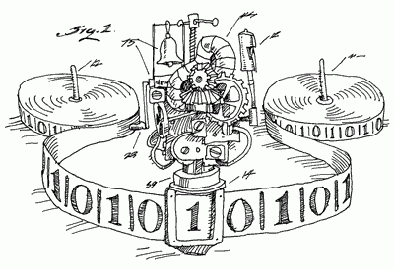
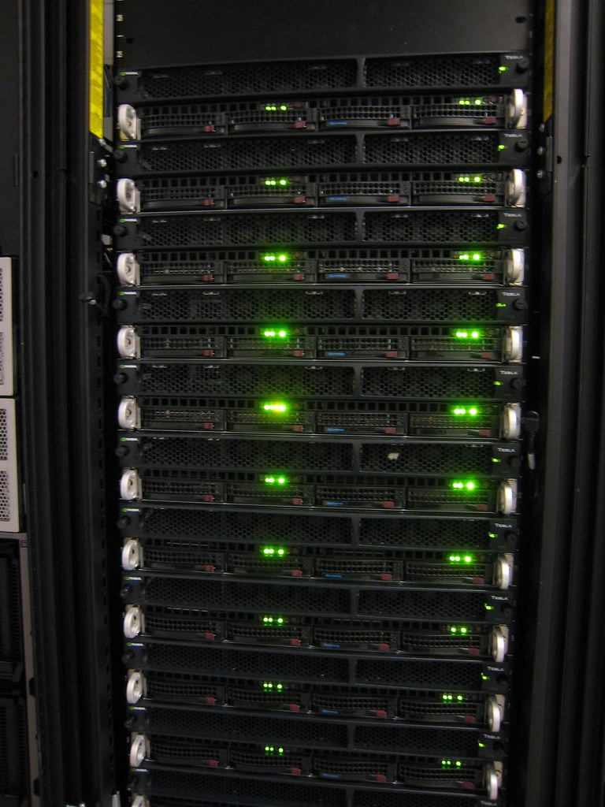
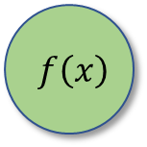
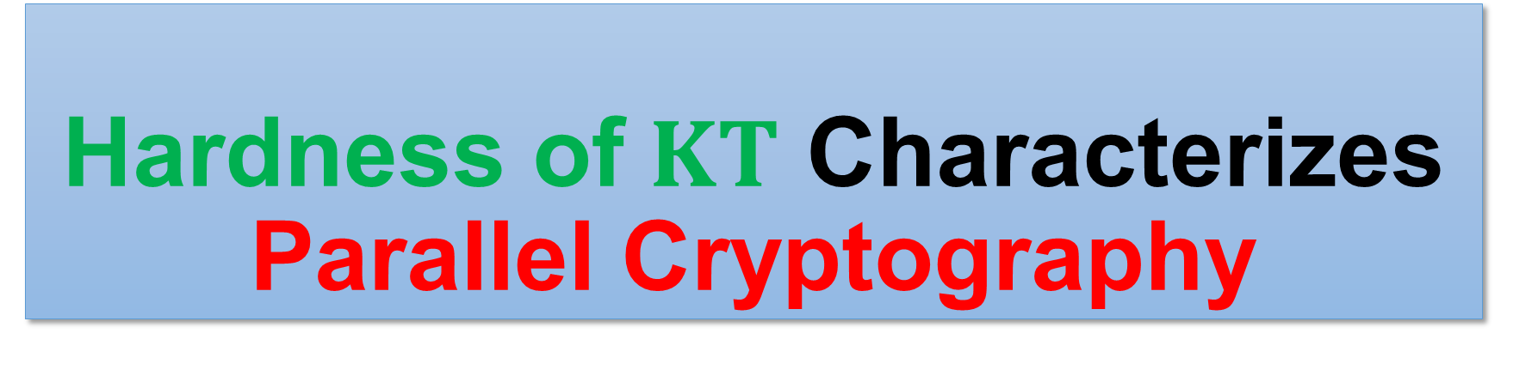



Hardness of $KT$ Characterizes Parallel Cryptography
Hanlin Ren, IIIS, Tsinghua University
Joint work with Rahul Santhanam (Oxford)
Apr 18, Yaoclass Seminar
$$f\left(x\right)$$
$$f\left(x\right)$$
$$x$$
$$x$$
1 / 21

Slide 2
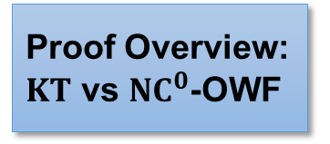
Background: Meta-Complexity
Background: Meta-Complexity
Background: Cryptography
The Liu-Pass Result
Our Results
Proof Overview: $KT$ vs ${NC}^{0}$-OWF
“Complexity of complexity”

Slide 3
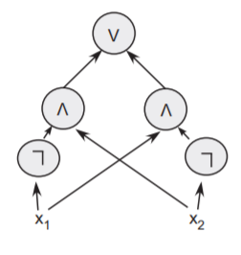

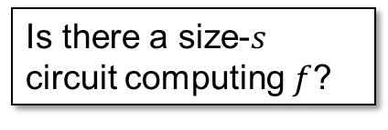



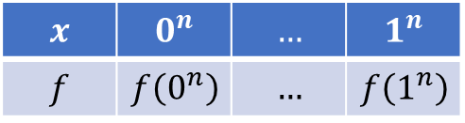


Minimum Circuit Size Problem
Circuits:
DAGs with AND/OR/NOT gates that compute some function
$MCSP$: Given an input function, what’s the smallest circuit computing it?
$MCSP=\left\{\left(f, s\right):Circuit_Complexity\left(f\right)≤s\right\}$
A circuit computing $x_{1}⊕x_{2}$ from [Arora-Barak]
( ,$s$)
$$s$$
$$⟹$$
$$x$$ | $$0^{n}$$ | $$…$$ | $$1^{n}$$
$$f$$ | $$f\left(0^{n}\right)$$ | $$…$$ | $$f\left(1^{n}\right)$$
Is there a size-$s$ circuit computing $f$?
2 / 21

Slide 4

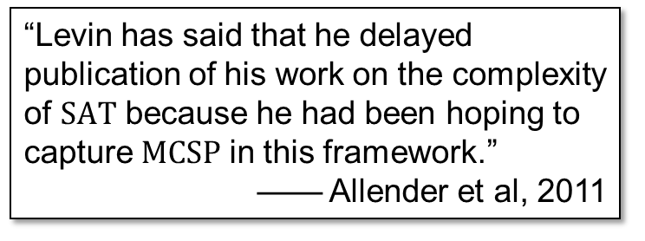
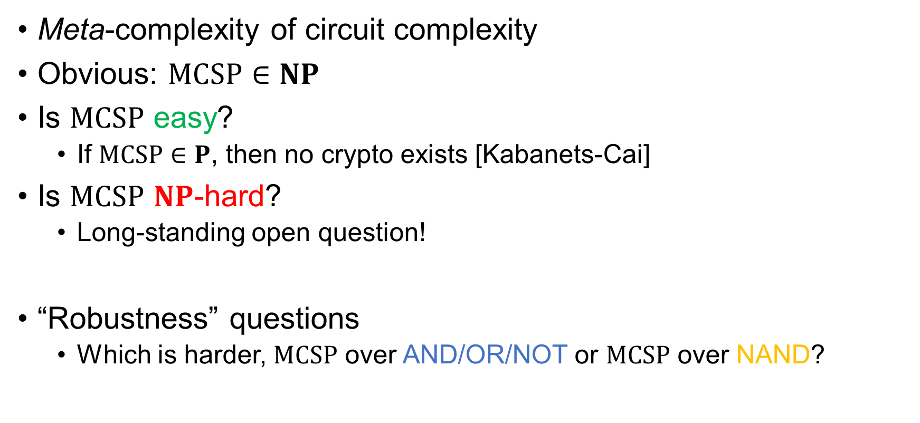
The Complexity of $MCSP$
Meta-complexity of circuit complexity
Obvious: $MCSP∈NP$
Is $MCSP$ easy?
If $MCSP∈P$, then no crypto exists [Kabanets-Cai]
Is $MCSP$ $NP$-hard?
Long-standing open question!
“Robustness” questions
Which is harder, $MCSP$ over AND/OR/NOT or $MCSP$ over NAND?
“Levin has said that he delayed publication of his work on the complexity of $SAT$ because he had been hoping to capture $MCSP$ in this framework.”
—— Allender et al, 2011
3 / 21

Slide 5
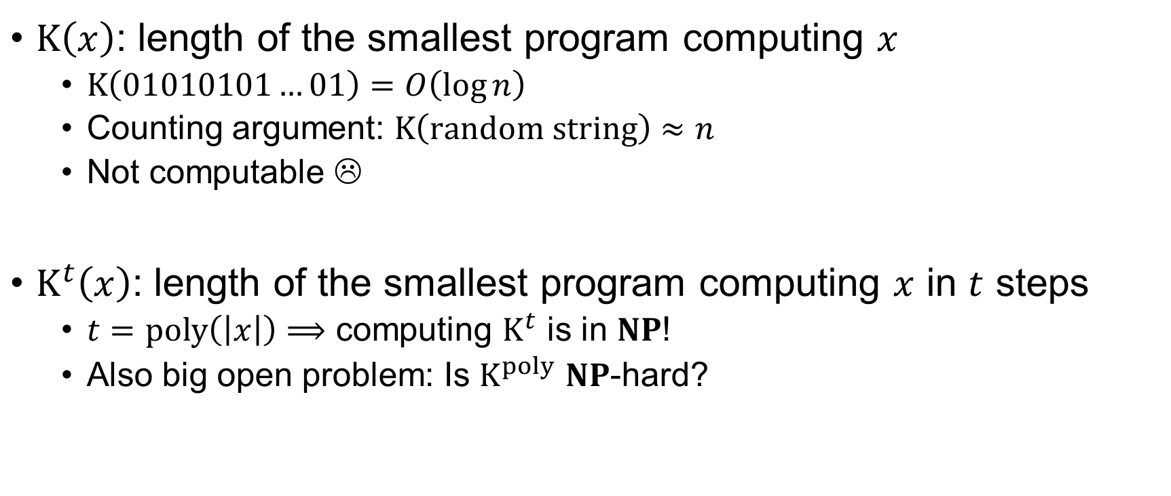

Time-Bounded Kolmogorov Complexity
$K\left(x\right)$: length of the smallest program computing $x$
$K\left(01010101…01\right)=O\left(\log{n}\right)$
Counting argument: $K\left(random string\right)≈n$
Not computable ☹
$K^{t}\left(x\right)$: length of the smallest program computing $x$ in $t$ steps
$t=poly\left(\left|x\right|\right)⟹$ computing $K^{t}$ is in $NP$!
Also big open problem: Is $K^{poly}$ $NP$-hard?
print("01" * (n/2))
Henceforth $K^{poly}$
Meta-complexity of (time-bounded) Kolmogorov complexity!
4 / 21

Slide 6

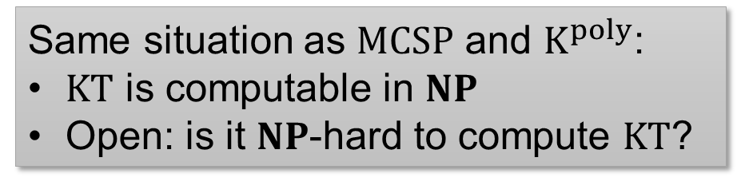

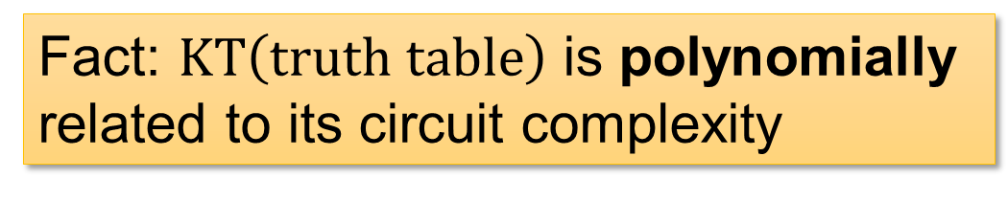
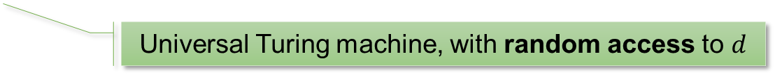





$KT$ Complexity
A Kolmogorov-version of circuit complexity
$KT\left(x\right)≔\min\left\{\left|d\right|+t:∀i,U^{d}\left(i\right)=x_{i} in t steps\right\}$
Universal Turing machine, with random access to $d$
Fact: $KT\left(truth table\right)$ is polynomially related to its circuit complexity
$$x_{i}$$
$$x_{i}$$
… but $KT$ is sometimes more convenient to deal with.
circuit
$$≈$$
Same situation as $MCSP$ and $K^{poly}$:
$KT$ is computable in $NP$
Open: is it $NP$-hard to compute $KT$?
$$i$$
$$i$$
5 / 21

Slide 7
Background: Cryptography
Background: Meta-Complexity
Background: Cryptography
The Liu-Pass Result
Our Results
Proof Overview: $KT$ vs ${NC}^{0}$-OWF

Slide 8

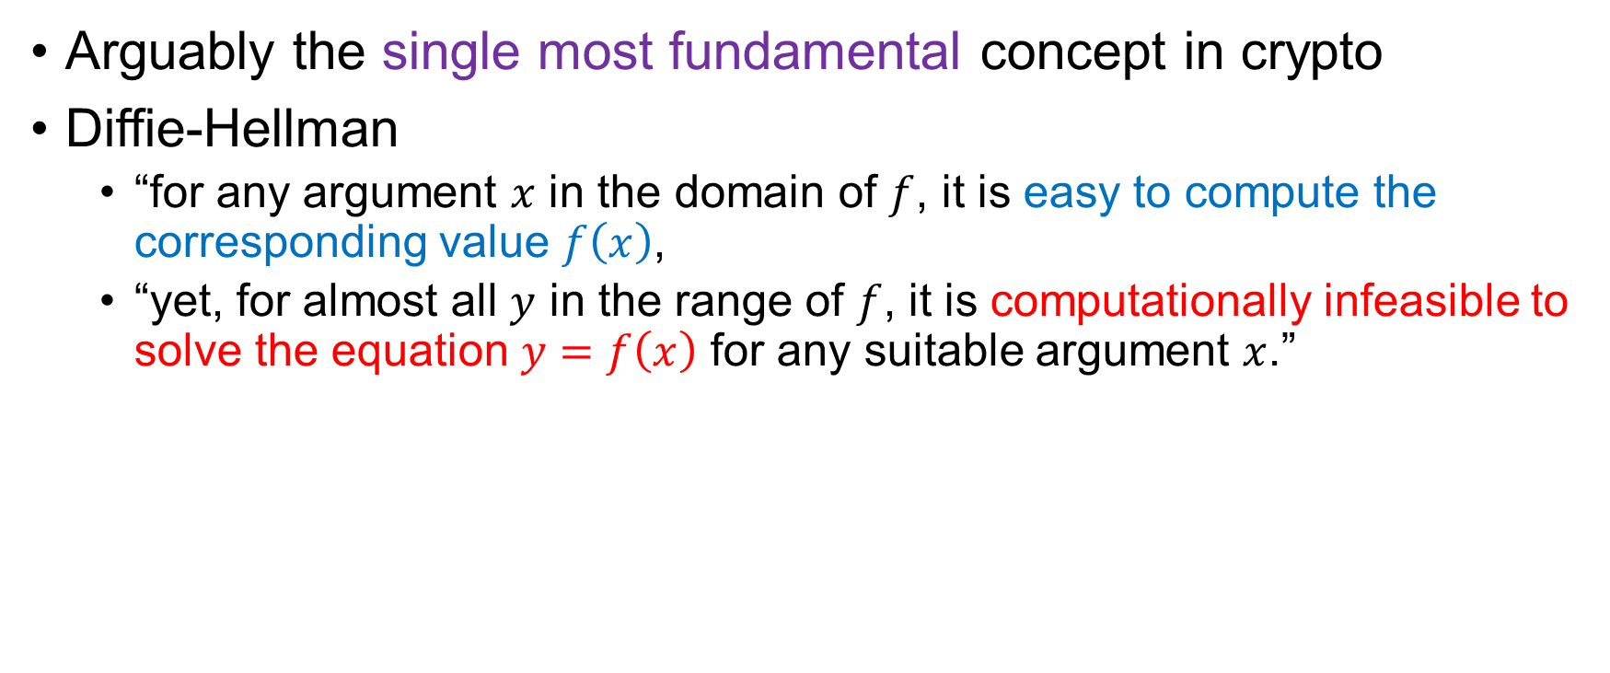
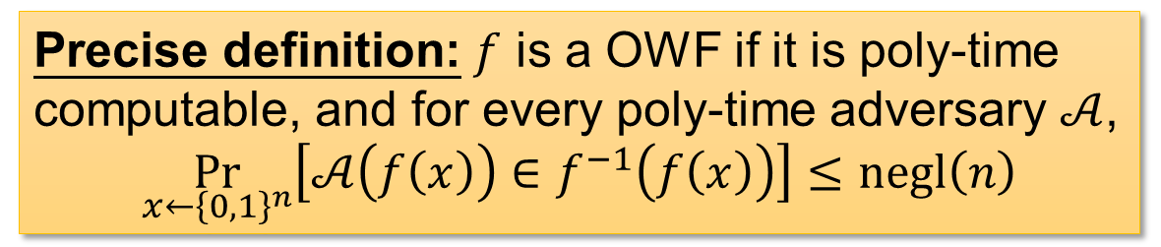

One-Way Functions
Arguably the single most fundamental concept in crypto
Diffie-Hellman
“for any argument $x$ in the domain of $f$, it is easy to compute the corresponding value $f\left(x\right)$,
“yet, for almost all $y$ in the range of $f$, it is computationally infeasible to solve the equation $y=f\left(x\right)$ for any suitable argument $x$.”
easy
A factoring-based candidate
1 def f(x):
2 use x as random bits to sample two primes p, q
3 return p*q
$$f\left(x\right)$$
$$x$$
hard
Precise definition: $f$ is a OWF if it is poly-time computable, and for every poly-time adversary $𝒜$,
$$\underset{x←{\left\{0,1\right\}}^{n}}{Pr}\left[𝒜\left(f\left(x\right)\right)∈f^{−1}\left(f\left(x\right)\right)\right]≤negl\left(n\right)$$
6 / 21
Notes:
The precise def is just to emphasize it’s an average-case definition

Slide 9



OWFs are Fundamental
Why are OWFs fundamental?
Reason 1: necessary for crypto [IL’89]
Reason 2: sufficient for “minicrypt”
OWF $⟺$
Private-key encryption,
Pseudorandom generators,
Digital signatures,
Authentication schemes,
Pseudorandom functions,
Commitment schemes,
Coin-tossing,
ZK proofs…
(from Yanyi’s slides)
easy
$$f\left(x\right)$$
NOT (known to) include:
Public-key encryption,
Obfuscation
$$x$$
hard
7 / 21

Slide 10
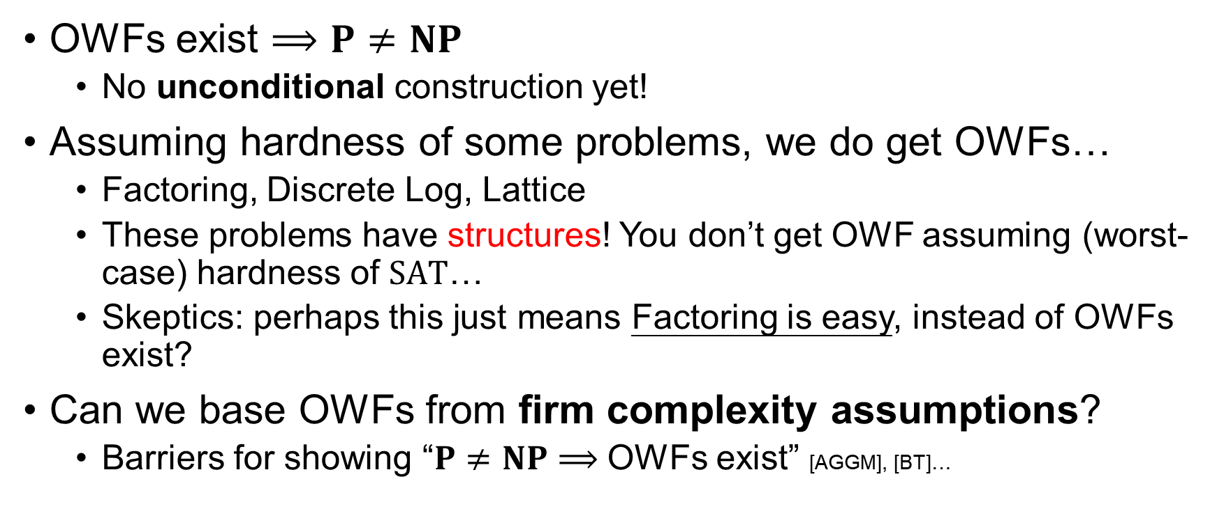
Do OWFs Exist?
OWFs exist $⟹P≠NP$
No unconditional construction yet!
Assuming hardness of some problems, we do get OWFs…
Factoring, Discrete Log, Lattice
These problems have structures! You don’t get OWF assuming (worst-case) hardness of $SAT$…
Skeptics: perhaps this just means Factoring is easy, instead of OWFs exist?
Can we base OWFs from firm complexity assumptions?
Barriers for showing “$P≠NP⟹$ OWFs exist” [AGGM], [BT]…
8 / 21

Slide 11

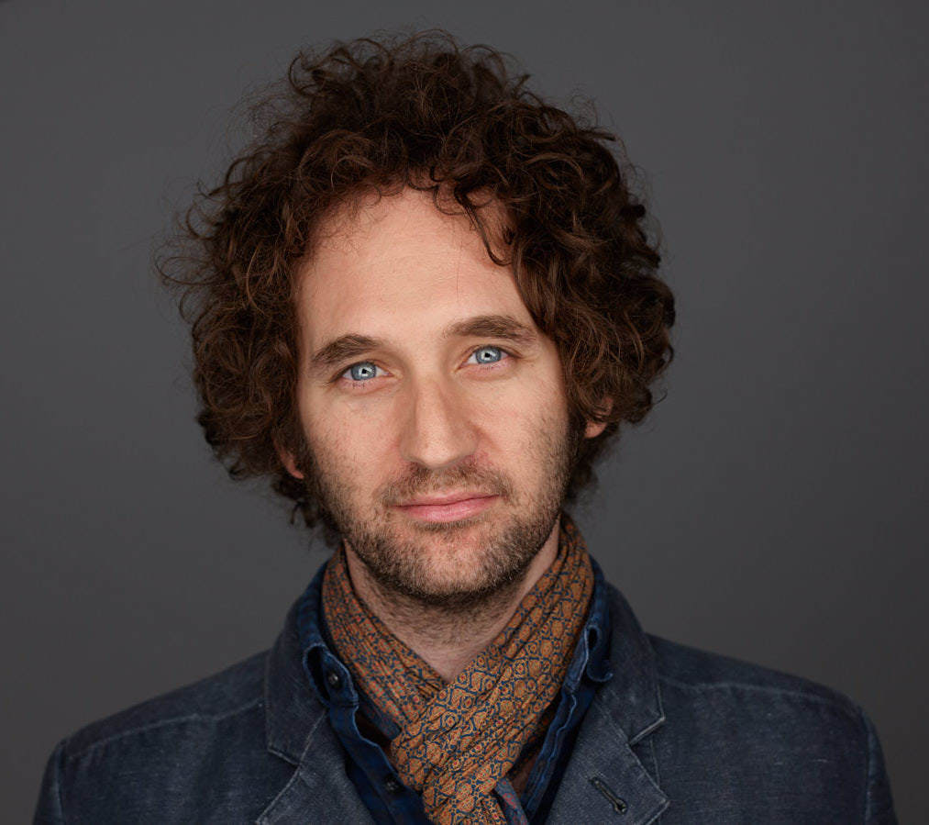
The Liu-Pass Result
Background: Meta-Complexity
Background: Cryptography
The Liu-Pass Result
Our Results
Proof Overview: $KT$ vs ${NC}^{0}$-OWF

Slide 12
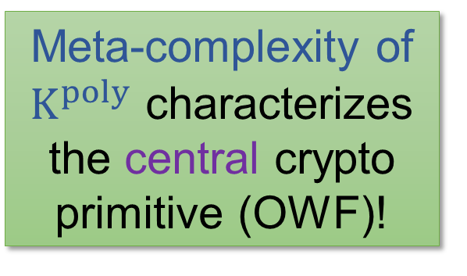

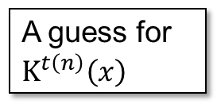

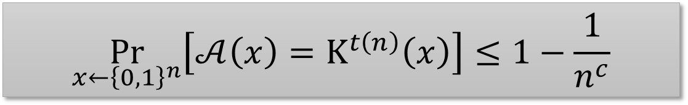
On One-Way Function and Kolmogorov Complexity
[Liu-Pass’20]
Theorem: $K^{poly}$ is bounded-error hard on average if and only if OWFs exist
Poly-time heuristic
A guess for $K^{t\left(n\right)}\left(x\right)$
$$x$$
Meta-complexity of $K^{poly}$ characterizes the central crypto primitive (OWF)!
Exists an absolute constant $c$, for every poly-time heuristic $𝒜$,
$$\underset{x←{\left\{0,1\right\}}^{n}}{Pr}\left[𝒜\left(x\right)=K^{t\left(n\right)}\left(x\right)\right]≤1−\frac{1}{n^{c}}$$
The first such natural average-case problem…
9 / 21

Slide 13
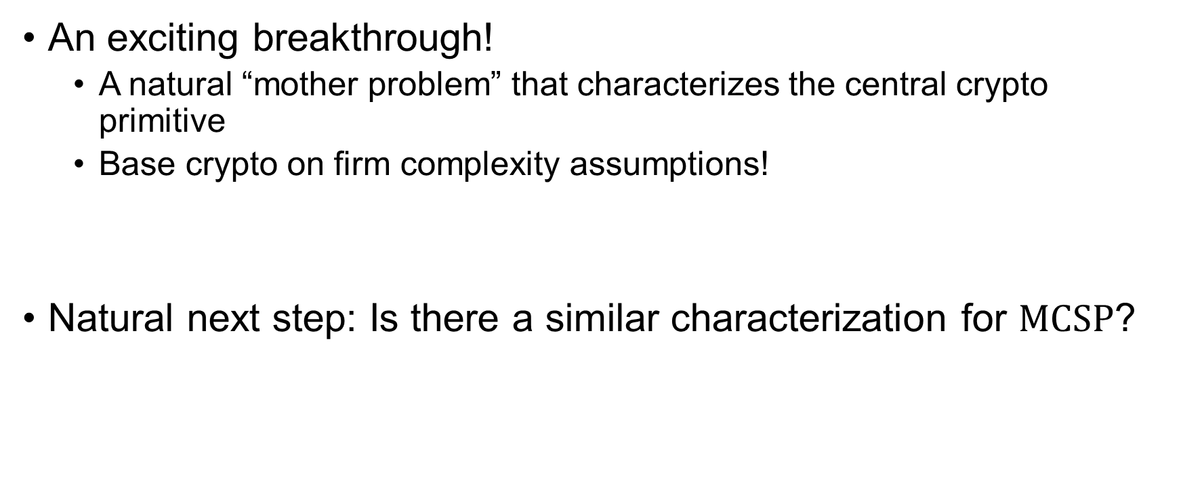
The Liu-Pass Result
An exciting breakthrough!
A natural “mother problem” that characterizes the central crypto primitive
Base crypto on firm complexity assumptions!
Natural next step: Is there a similar characterization for $MCSP$?
(How could you do better than a characterization?)
10 / 21

Slide 14









Why Not $MCSP$?
One-way function exists $⟹^{?}MCSP$ is hard on average
Liu-Pass: (1) OWF $⟹$ PRG (2) PRG $⟹$ $K^{poly}$ is hard
A heuristic for $K^{poly}$
A heuristic for $MCSP$
PRG
$$seed$$
$$output$$
$$K^{t}\left(output\right)≤\left|seed\right|+O\left(1\right)$$
$$Circuit_Complexity\left(output\right)= ???$$
11 / 21

Slide 15
Our Results
Background: Meta-Complexity
Background: Cryptography
The Liu-Pass Result
Our Results
Proof Overview: $KT$ vs ${NC}^{0}$-OWF

Slide 16







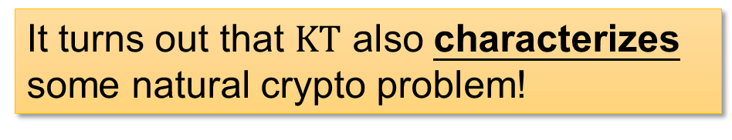

Our Result 1
Theorem (main). The following are equivalent:
$KT$ complexity is (bounded-error) hard on average
There exist one-way functions in (uniform) ${NC}^{0}$
$$output$$
$$O\left(1\right)$$
$$input$$
SUPER easy (${NC}^{0}$)
$$f\left(x\right)$$
${NC}^{0}$: each output bit only depends on $O\left(1\right)$ input bits
$$x$$
hard
It turns out that $KT$ also characterizes some natural crypto problem!
12 / 21

Slide 17
















Cryptography in ${NC}^{0}$
[Applebaum-Ishai-Kushilevitz, FOCS’04]
OWF computable in ${NC}^{1}$ or even $LOGSPACE$ implies OWF computable in ${NC}^{0}$
${NC}^{0}$-OWF follows from most standard crypto assumptions!
$$P$$
$$⋯$$
$${NC}^{2}$$
$$LOGSPACE$$
$${NC}^{1}$$
$${TC}^{0}$$
(contains most arithmetic operations)
$$LOGSPACE$$
$${NC}^{0}$$
$$f\left(x\right)$$
“AIK compiler”
$$f^{∗}\left(x\right)$$
$${AC}^{0}$$
(could do addition)
$$x$$
$$x$$
hard
ALSO hard
$${NC}^{0}$$
13 / 21

Slide 18




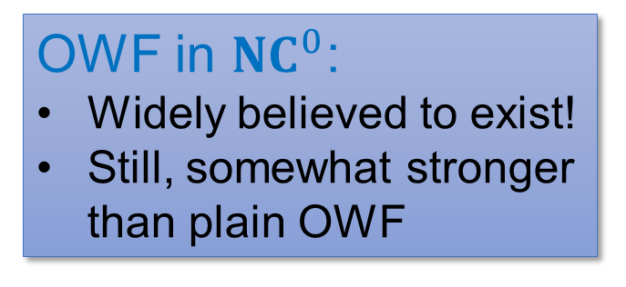








Wrap Up
$$KT\left(x\right)≔\min\left\{\left|d\right|+t:∀i,U^{d}\left(i\right)=x_{i} in t steps\right\}$$
${NC}^{0}$: a super easy class
$$x_{i}$$
$$output$$
$$O\left(1\right)$$
Polynomially related to circuit complexity…
$$input$$
${NC}^{0}$: each output bit only depends on $O\left(1\right)$ input bits
$$i$$
OWF in ${NC}^{0}$:
Widely believed to exist!
Still, somewhat stronger than plain OWF
Our result 1: the following are equivalent
Bounded-error average-case hardness of $KT$
Existence of OWF in ${NC}^{0}$
SUPER easy (${NC}^{0}$)
$$f\left(x\right)$$
$$x$$
hard
14 / 21

Slide 19
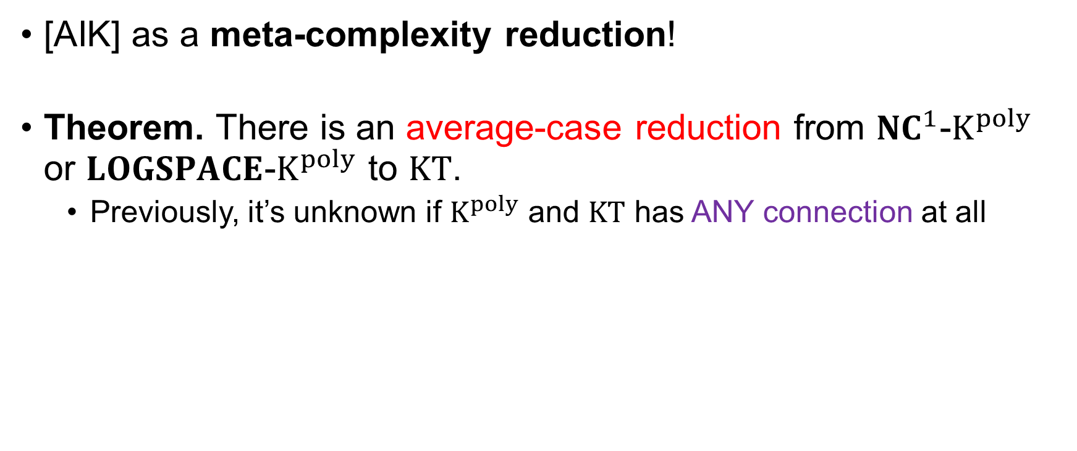
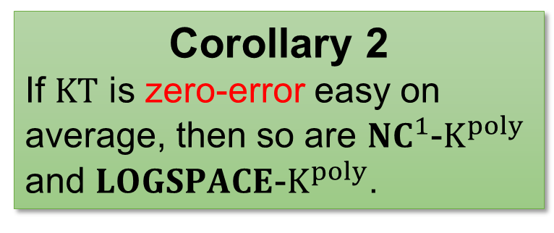
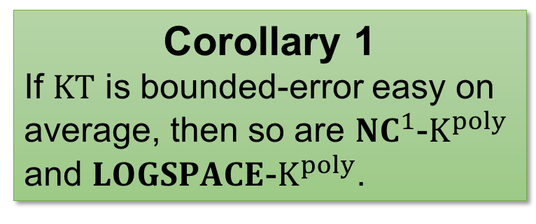
Our Result 2
[AIK] as a meta-complexity reduction!
Theorem. There is an average-case reduction from ${NC}^{1}$-$K^{poly}$ or $LOGSPACE$-$K^{poly}$ to $KT$.
Previously, it’s unknown if $K^{poly}$ and $KT$ has ANY connection at all
Corollary 1
If $KT$ is bounded-error easy on average, then so are ${NC}^{1}$-$K^{poly}$ and $LOGSPACE$-$K^{poly}$.
Corollary 2
If $KT$ is zero-error easy on average, then so are ${NC}^{1}$-$K^{poly}$ and $LOGSPACE$-$K^{poly}$.
15 / 21

Slide 20


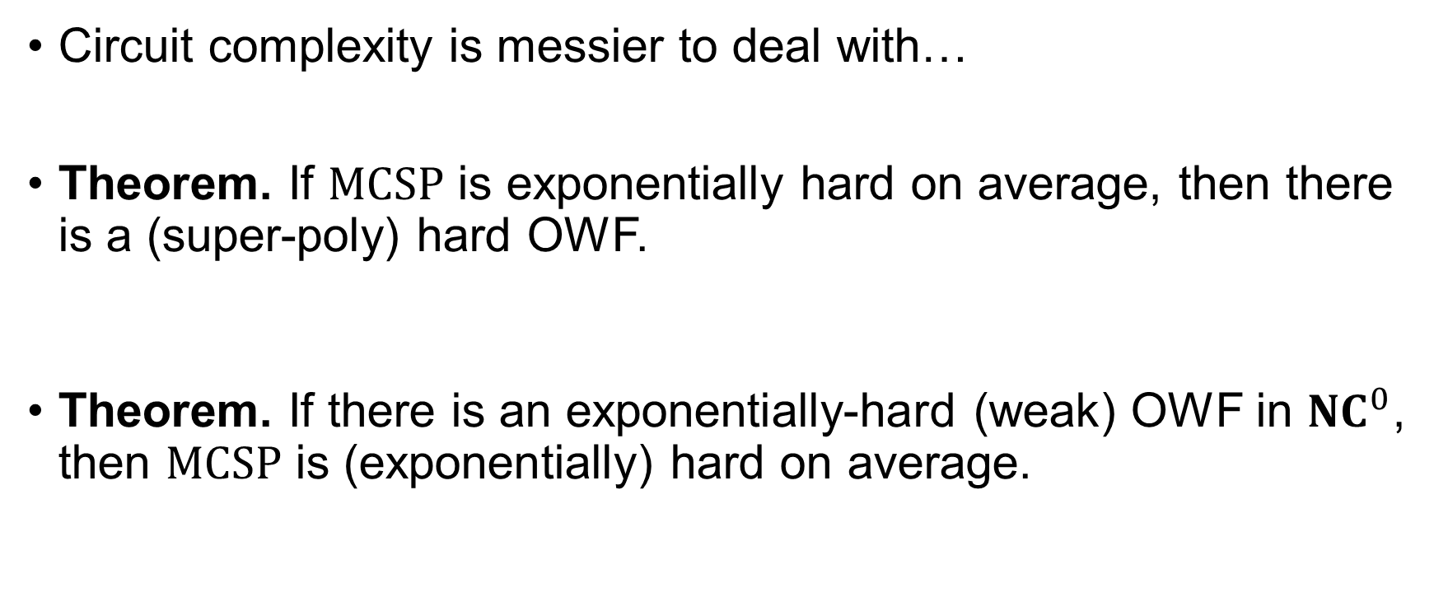
One Slide for $MCSP$…
Circuit complexity is messier to deal with…
Theorem. If $MCSP$ is exponentially hard on average, then there is a (super-poly) hard OWF.
Theorem. If there is an exponentially-hard (weak) OWF in ${NC}^{0}$, then $MCSP$ is (exponentially) hard on average.
Open: implement this OWF in ${NC}^{0}$!
If $KT$ is (super-poly) hard on average, then there is a (super-poly) OWF in ${NC}^{0}$
If there is a (super-poly) OWF in ${NC}^{0}$, then $KT$ is (super-poly) hard on average
16 / 21

Slide 21
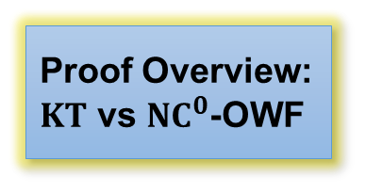
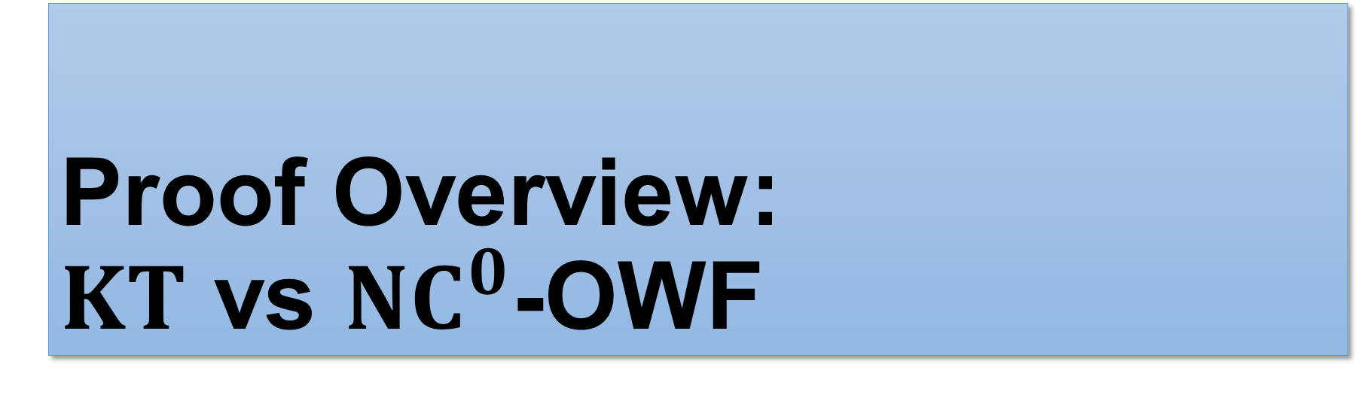
Proof Overview: $KT$ vs ${NC}^{0}$-OWF
Background: Meta-Complexity
Background: Cryptography
The Liu-Pass Result
Our Results
Proof Overview: $KT$ vs ${NC}^{0}$-OWF

Slide 22








Warm-Up: OWF $⟹$ (Worst-Case) Hardness of $K^{poly}$
Small $K^{t}$
Large $K^{t}$
PRG
${\left\{0,1\right\}}^{n}$
$$seed$$
PRG
$$output$$
$$K^{t}\left(output\right)≤\left|seed\right|+O\left(1\right)$$
(Worst-case) algo for $K^{poly}⟹$ distinguisher for ANY PRG!
17 / 21

Slide 23



We Only Have a Heuristic…?
PRG
Heuristic for $K^{poly}$
${\left\{0,1\right\}}^{n}$
“dense” PRG
$$seed$$
PRG
$$output$$
$$K^{t}\left(output\right)≤\left|seed\right|+O\left(1\right)$$
[Liu-Pass]:
OWF $⟹$ “dense” PRG
PRG has to be dense $⟹$ seed length $≥n−O\left(\log{n}\right)$
Note: In [Liu-Pass], “dense” PRG is actually called “condEP-PRG”.
18 / 21

Slide 24







What PRGs Imply Hardness of $KT$?
Goal: design a dense PRG that can be broken by a heuristic for $KT$.
Instead of $K^{poly}$!
“dense” PRG
$$\left|seed\right|≥n−O\left(\log{n}\right)$$
$$\left|output\right|=n$$
$$KT\left(output\right)≤\left|seed\right|+PRG_Time$$
Crypto in ${NC}^{0}$!!!
$$⟹PRG_Time≤O\left(log n\right)$$
19 / 21

Slide 25










Parallel OWF $⟹$ Hardness of $KT$
$$seed$$
“dense” PRG in ${NC}^{1}$
“dense” PRG
A heuristic for $KT$
“dense” PRG in ${NC}^{0}$
OWF in ${NC}^{1}$
OWF
AIK compiler
Other ingredients from [Liu-Pass] (e.g. extractors)
$$output$$
Heuristic for $KT⟹$ no OWF in ${NC}^{0}$!
$$KT\left(output\right)≤\left|seed\right|+O\left(\log{n}\right)$$
20 / 21

Slide 26


Hardness of $KT⟹$ Parallel OWF
Borrowed from [Liu-Pass]: $f\left(d,t\right)=\left(\left|d\right|+t, output\left(d,t\right)\right)$
Adversary sees $\left(s,x\right)$, needs to find a witness of “$KT\left(x\right)≤s$”.
If $KT$ is hard then $f$ is a (weak) OWF
Is $f$ computable in ${NC}^{0}$? ☹
Observation: for most strings $x$, if $KT\left(x\right)=\left|d\right|+t$, then $t$ is small
In particular, this is true if $x$ has large Kolmogorov complexity
$f$ restricted to $t≤O\left(\log{n}\right)$ is still a OWF
$f$ computable in $LOGSPACE$, can apply [AIK]
21 / 21

Slide 27
Thank you!
Questions are welcome! ☺

