Slide 1
Distance Sensitivity Oracles in Subcubic Preprocessing Time
Hanlin Ren, IIIS, Tsinghua University
ESA 2020

Slide 2




Distance Sensitivity Oracles (DSOs)
Given a directed graph $G=\left(V,E\right)$
Query$\left(u,v,x\right)$: the shortest $u→v$ path not passing through $x$?
A natural and well-studied problem in graph algorithms.
$$x$$
$$v$$
$$u$$

Slide 3
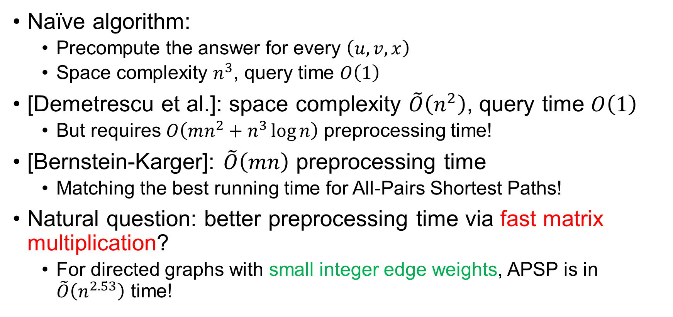
Previous Work
Naïve algorithm:
Precompute the answer for every $\left(u,v,x\right)$
Space complexity $n^{3}$, query time $O\left(1\right)$
[Demetrescu et al.]: space complexity $\tilde{O}\left(n^{2}\right)$, query time $O\left(1\right)$
But requires $O\left(mn^{2}+n^{3}\log{n}\right)$ preprocessing time!
[Bernstein-Karger]: $\tilde{O}\left(mn\right)$ preprocessing time
Matching the best running time for All-Pairs Shortest Paths!
Natural question: better preprocessing time via fast matrix multiplication?
For directed graphs with small integer edge weights, APSP is in $\tilde{O}\left(n^{2.53}\right)$ time!

Slide 4
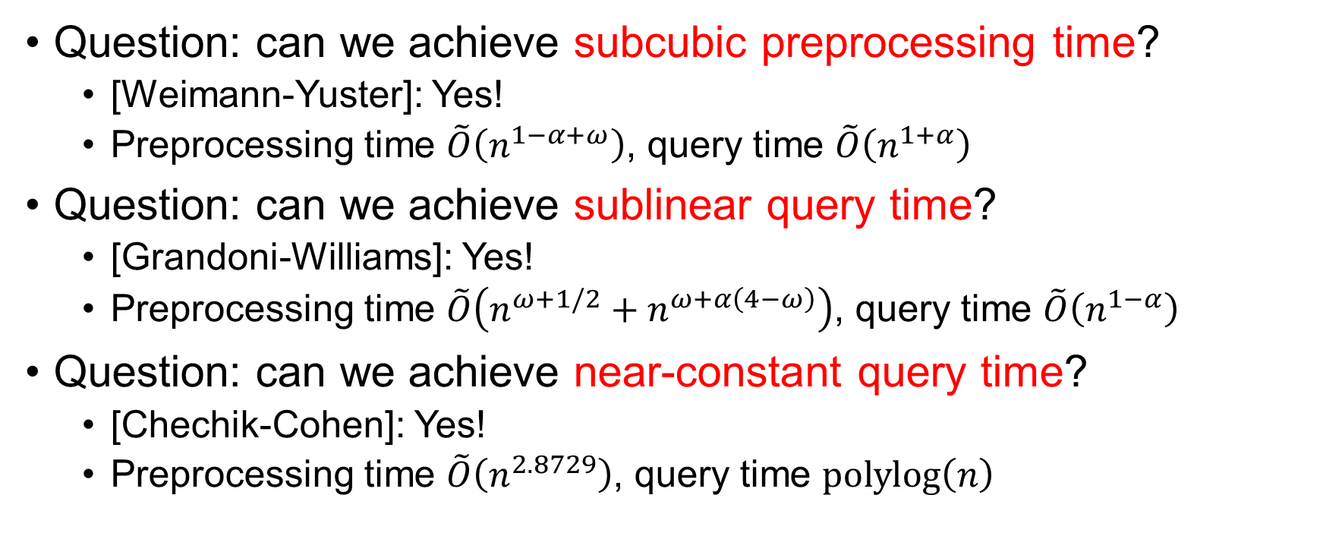

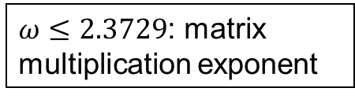
Previous Work via Fast Matrix Mult?
Question: can we achieve subcubic preprocessing time?
[Weimann-Yuster]: Yes!
Preprocessing time $\tilde{O}\left(n^{1−α+ω}\right)$, query time $\tilde{O}\left(n^{1+α}\right)$
Question: can we achieve sublinear query time?
[Grandoni-Williams]: Yes!
Preprocessing time $\tilde{O}\left(n^{ω+1/2}+n^{ω+α\left(4−ω\right)}\right)$, query time $\tilde{O}\left(n^{1−α}\right)$
Question: can we achieve near-constant query time?
[Chechik-Cohen]: Yes!
Preprocessing time $\tilde{O}\left(n^{2.8729}\right)$, query time $polylog\left(n\right)$
$ω≤2.3729$: matrix multiplication exponent
$α∈\left(0,1\right)$ is a parameter

Slide 5
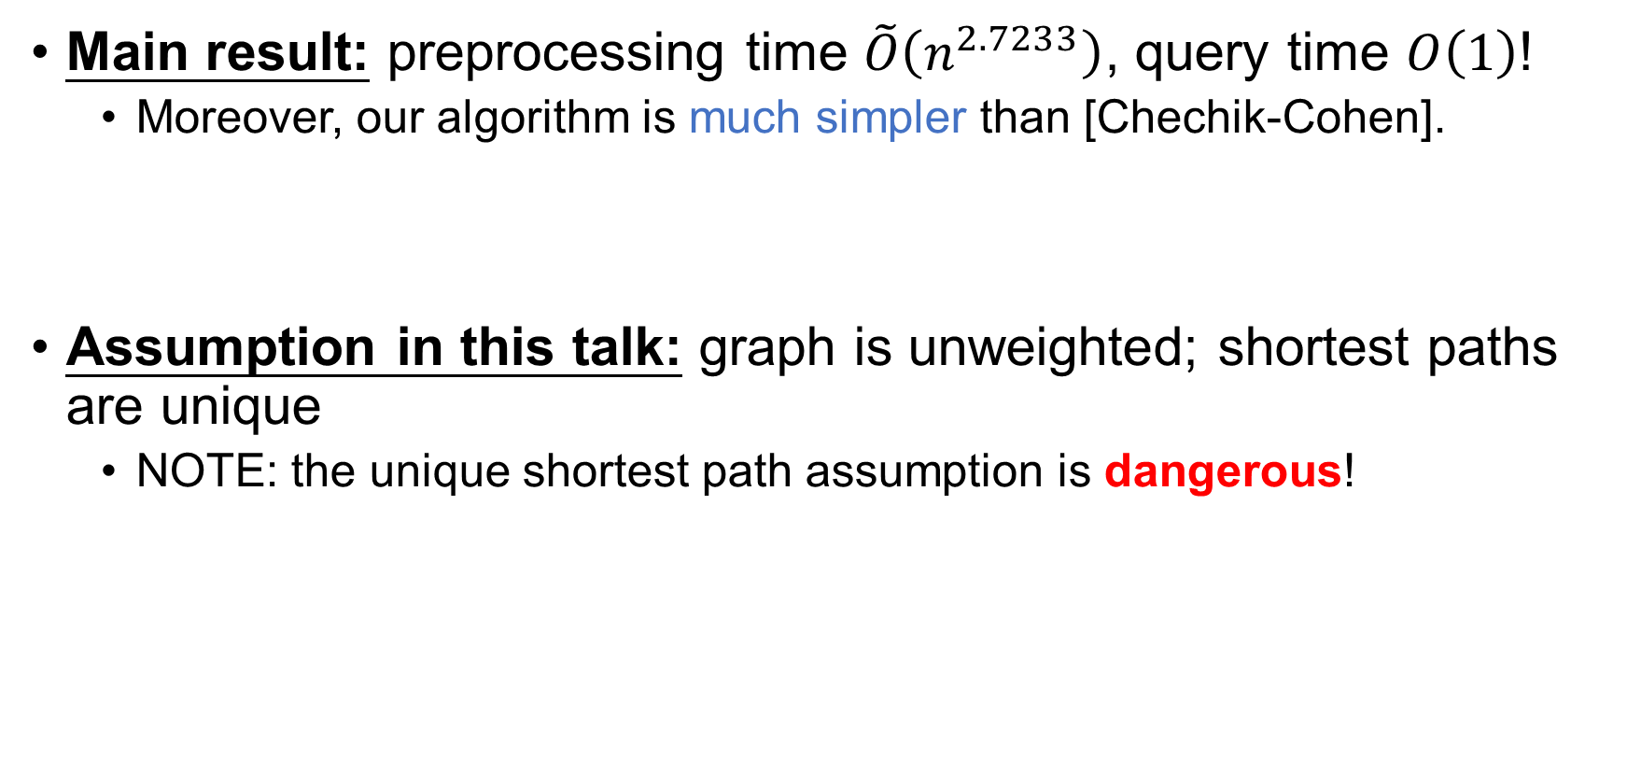
This Work
Main result: preprocessing time $\tilde{O}\left(n^{2.7233}\right)$, query time $O\left(1\right)$!
Moreover, our algorithm is much simpler than [Chechik-Cohen].
Assumption in this talk: graph is unweighted; shortest paths are unique
NOTE: the unique shortest path assumption is dangerous!

Slide 6
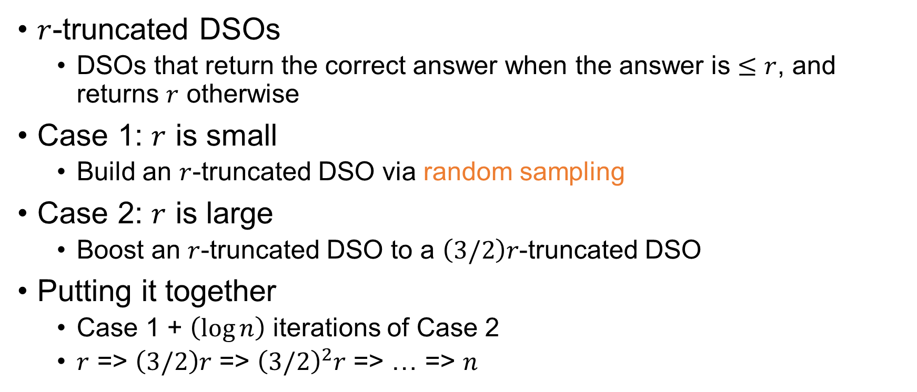
Our Algorithm in a Nutshell
$r$-truncated DSOs
DSOs that return the correct answer when the answer is $≤r$, and returns $r$ otherwise
Case 1: $r$ is small
Build an $r$-truncated DSO via random sampling
Case 2: $r$ is large
Boost an $r$-truncated DSO to a $\left(3/2\right)r$-truncated DSO
Putting it together
Case 1 + $\left(\log{n}\right)$ iterations of Case 2
$r$ => $\left(3/2\right)r$ => ${\left(3/2\right)}^{2}r$ => … => $n$

Slide 7

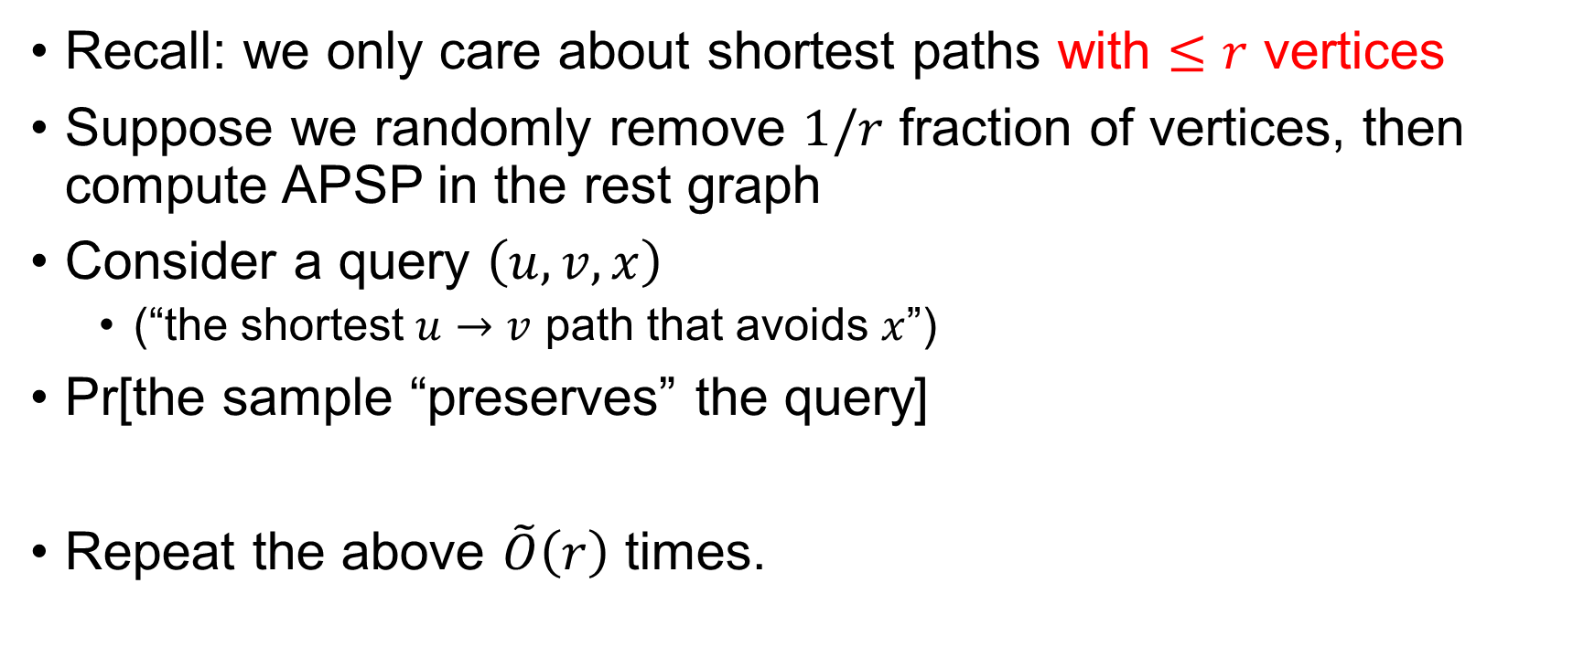

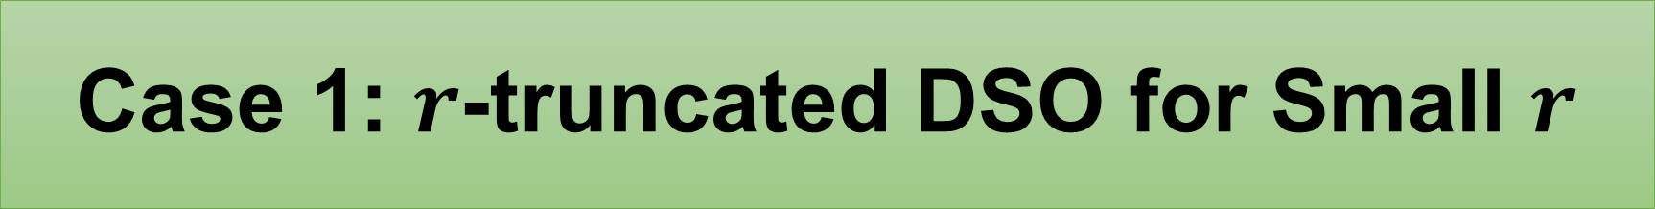

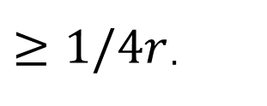



Case 1: $r$-truncated DSO for Small $r$
Recall: we only care about shortest paths with $≤r$ vertices
Suppose we randomly remove $1/r$ fraction of vertices, then compute APSP in the rest graph
Consider a query $\left(u, v, x\right)$
(“the shortest $u→v$ path that avoids $x$”)
Pr[the sample “preserves” the query]
Repeat the above $\tilde{O}\left(r\right)$ times.
[ ]
every vertex in
the answer path
are preserved
Pr[$x$ is removed]
Pr
$$≥\left(1/r\right)⋅$$
$${\left(1−1/r\right)}^{r}$$
$≥1/4r$.
$$u$$
$$x$$
$$v$$

Slide 8



Case 1: $r$-truncated DSO for Small $r$
$$u$$
$$x$$
$$v$$

Slide 9
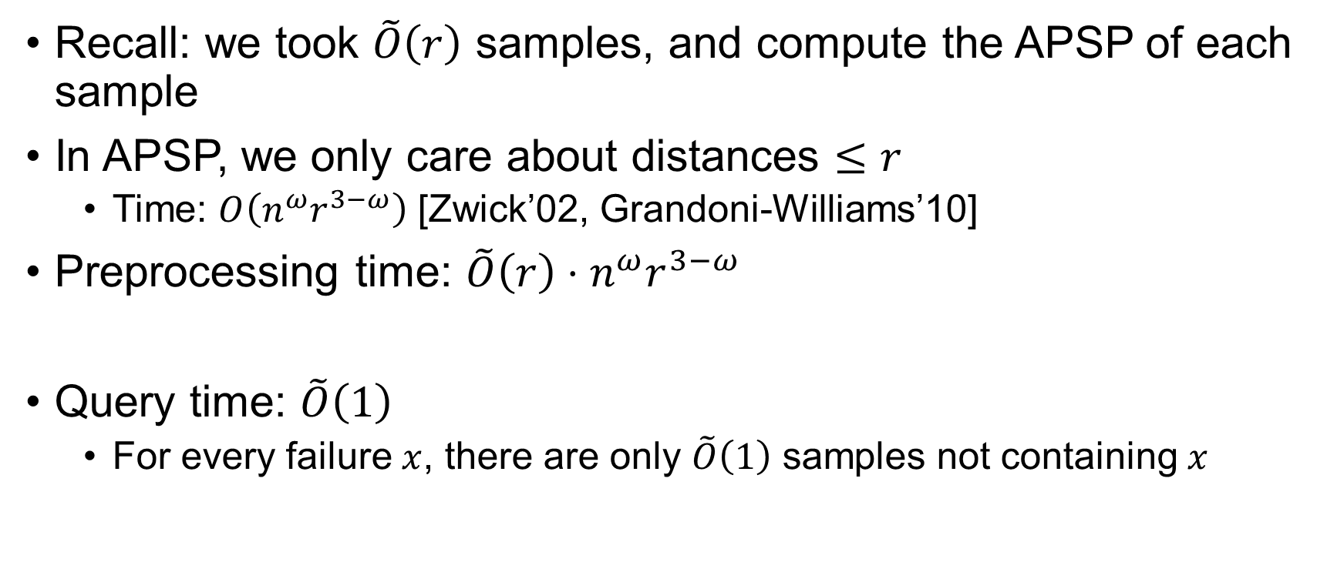
Case 1: Time Complexity
Recall: we took $\tilde{O}\left(r\right)$ samples, and compute the APSP of each sample
In APSP, we only care about distances $≤r$
Time: $O\left(n^{ω}r^{3−ω}\right)$ [Zwick’02, Grandoni-Williams’10]
Preprocessing time: $\tilde{O}\left(r\right)⋅n^{ω}r^{3−ω}$
Query time: $\tilde{O}\left(1\right)$
For every failure $x$, there are only $\tilde{O}\left(1\right)$ samples not containing $x$

Slide 10

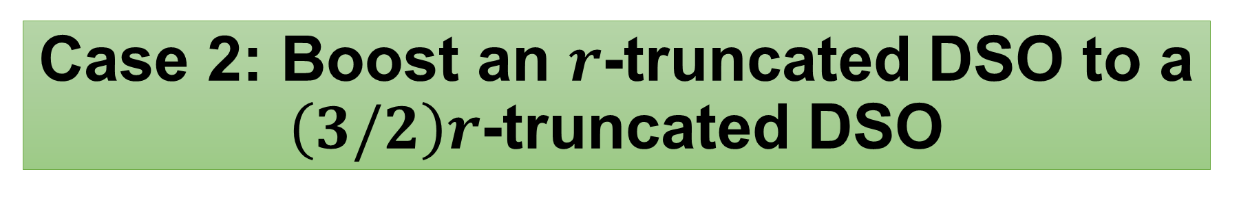




Case 2: Boost an $r$-truncated DSO to a $\left(3/2\right)r$-truncated DSO
Sample $\tilde{O}\left(n/r\right)$ vertices, denoted as $H$
“Hitting set” (or bridging set)
Query$\left(u,v,x\right)$:
For every $h∈H$, return minimum of $D_{old}\left(u,h,x\right)+D_{old}\left(h,v,x\right)$
$$u$$
$$x$$
$$v$$
$$H$$

Slide 11

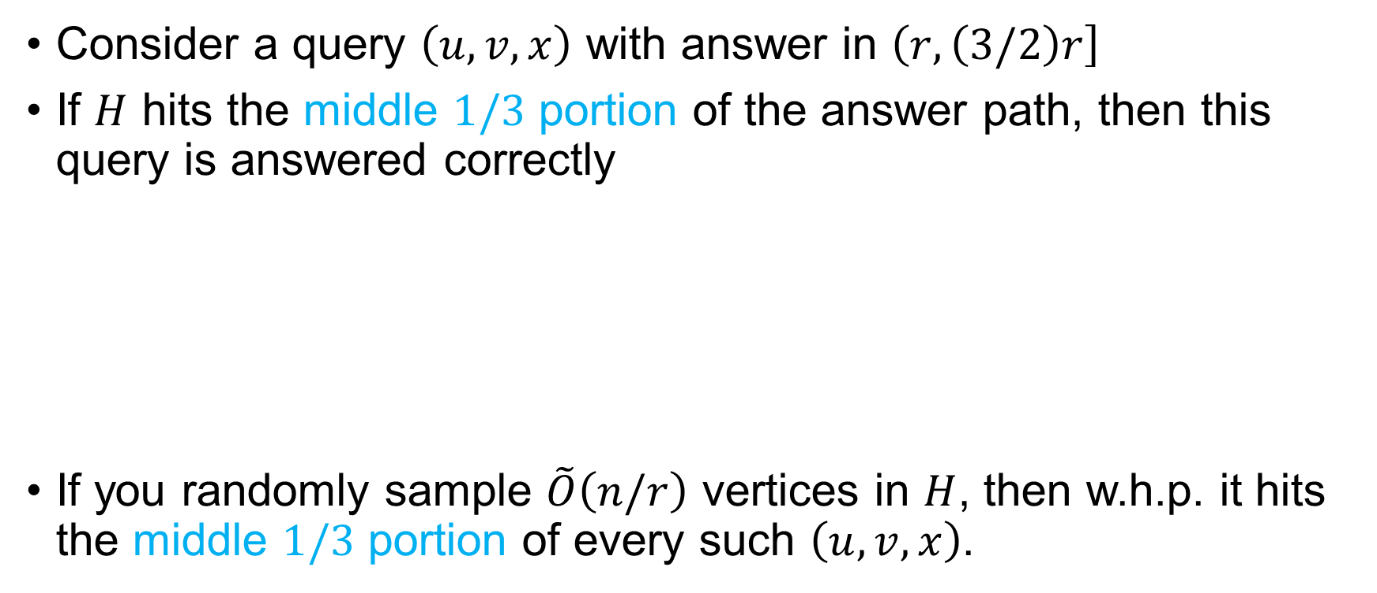





Case 2: Analysis
Consider a query $\left(u,v,x\right)$ with answer in $\left(r, \left(3/2\right)r\right]$
If $H$ hits the middle $1/3$ portion of the answer path, then this query is answered correctly
If you randomly sample $\tilde{O}\left(n/r\right)$ vertices in $H$, then w.h.p. it hits the middle $1/3$ portion of every such $\left(u, v, x\right)$.
$$≤r$$
$$≤r$$
$$u$$
$$h$$
$$v$$
$$x$$

Slide 12

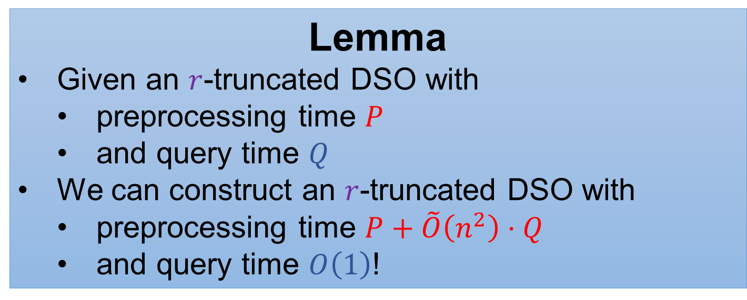
Case 2: Wait, What’s Your Query Time?
Query time: $\tilde{O}\left(n/r\right)$.
… But we want $O\left(1\right)$ query time.
Lemma
Given an $r$-truncated DSO with
preprocessing time $P$
and query time $Q$
We can construct an $r$-truncated DSO with
preprocessing time $P+\tilde{O}\left(n^{2}\right)⋅Q$
and query time $O\left(1\right)$!

Slide 13
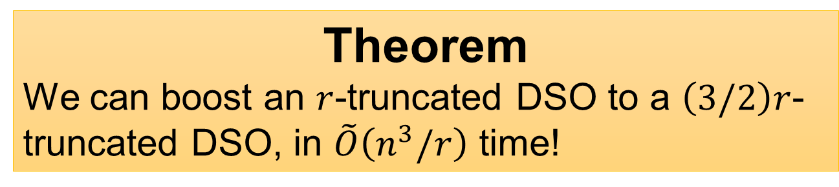
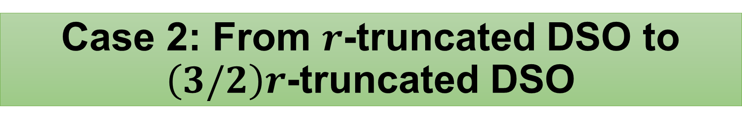
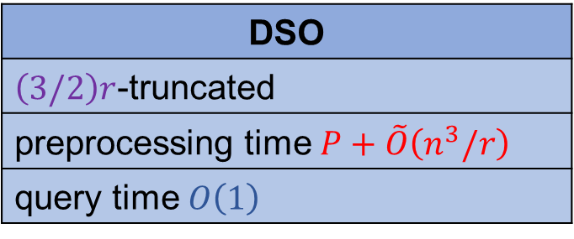
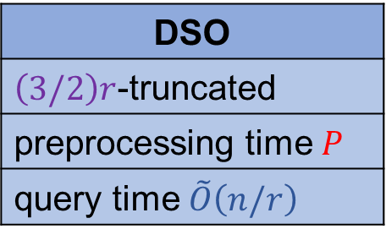
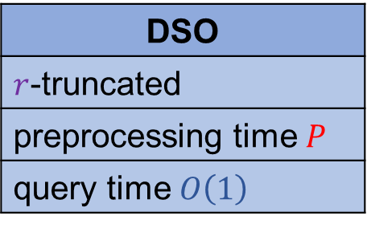
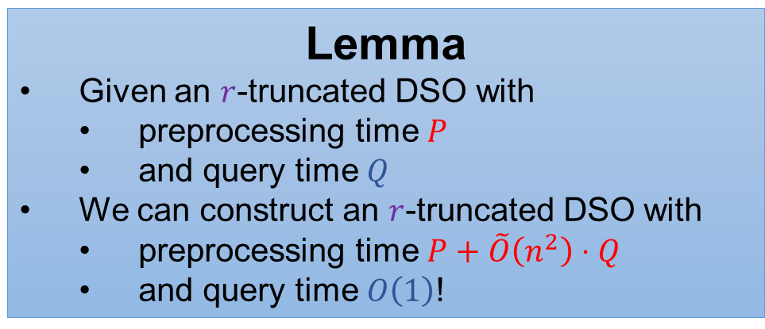
Case 2: From $r$-truncated DSO to $\left(3/2\right)r$-truncated DSO
DSO
$\left(3/2\right)r$-truncated
preprocessing time $P$
query time $\tilde{O}\left(n/r\right)$
DSO
$\left(3/2\right)r$-truncated
preprocessing time $P+\tilde{O}\left(n^{3}/r\right)$
query time $O\left(1\right)$
Theorem
We can boost an $r$-truncated DSO to a $\left(3/2\right)r$-truncated DSO, in $\tilde{O}\left(n^{3}/r\right)$ time!
Lemma
Bridging set
Lemma
Given an $r$-truncated DSO with
preprocessing time $P$
and query time $Q$
We can construct an $r$-truncated DSO with
preprocessing time $P+\tilde{O}\left(n^{2}\right)⋅Q$
and query time $O\left(1\right)$!
DSO
$r$-truncated
preprocessing time $P$
query time $O\left(1\right)$

Slide 14

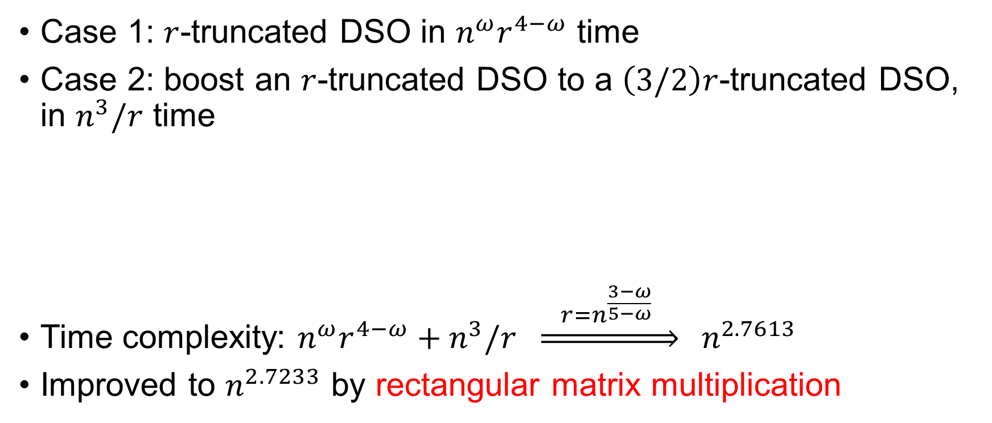


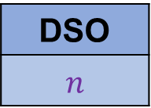


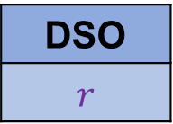

Putting it Together
Case 1: $r$-truncated DSO in $n^{ω}r^{4−ω}$ time
Case 2: boost an $r$-truncated DSO to a $\left(3/2\right)r$-truncated DSO, in $n^{3}/r$ time
Time complexity: $n^{ω}r^{4−ω}+n^{3}/r \underset{⇒}{ r=n^{\frac{3−ω}{5−ω}} } n^{2.7613}$
Improved to $n^{2.7233}$ by rectangular matrix multiplication
Case 1
Case 2
Case 2
Case 2
$$n^{ω}r^{4−ω}$$
DSO
$$r$$
$$n^{3}/r$$
DSO
$$\left(3/2\right)r$$
$$n^{3}/\left(\left(3/2\right)r\right)$$
DSO
$$\left(9/4\right)r$$
$$…$$
DSO
$$n$$

Slide 15
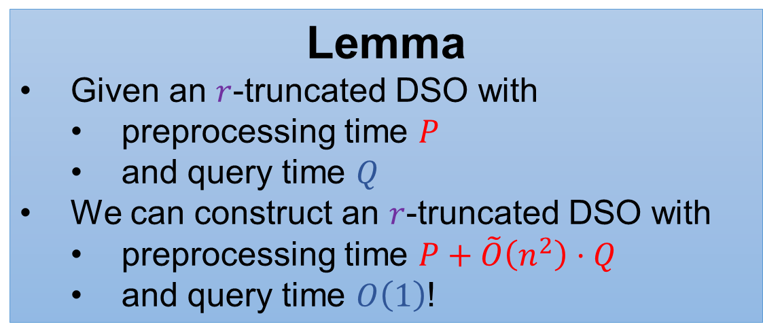
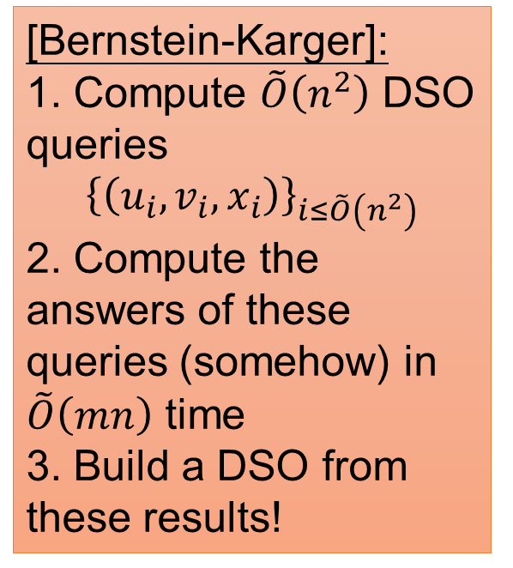
The Lemma
Lemma
Given an $r$-truncated DSO with
preprocessing time $P$
and query time $Q$
We can construct an $r$-truncated DSO with
preprocessing time $P+\tilde{O}\left(n^{2}\right)⋅Q$
and query time $O\left(1\right)$!
[Bernstein-Karger]:
1. Compute $\tilde{O}\left(n^{2}\right)$ DSO queries
$${\left\{\left(u_{i},v_{i},x_{i}\right)\right\}}_{i≤\tilde{O}\left(n^{2}\right)}$$
2. Compute the answers of these queries (somehow) in $\tilde{O}\left(mn\right)$ time
3. Build a DSO from these results!
by the slower DSO!
Proof Strategy:
Mimic the algorithm in [Bernstein-Karger]!

Slide 16

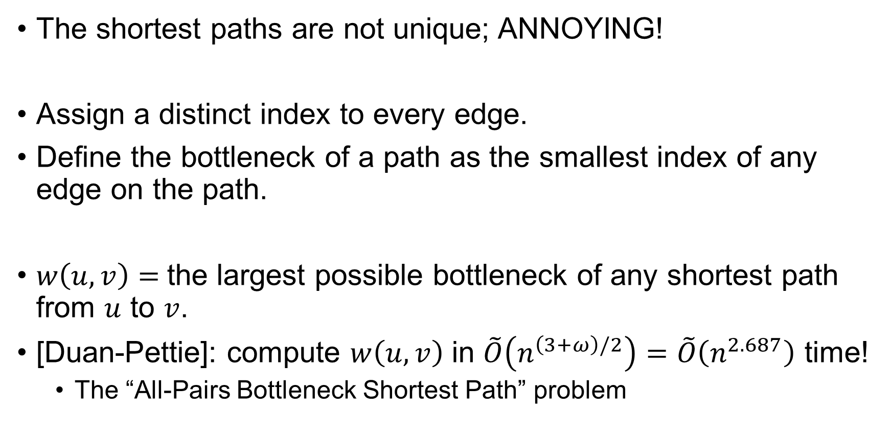




Bonus Slides: How to Break Ties?
The shortest paths are not unique; ANNOYING!
Assign a distinct index to every edge.
Define the bottleneck of a path as the smallest index of any edge on the path.
$w\left(u,v\right)=$the largest possible bottleneck of any shortest path from $u$ to $v$.
[Duan-Pettie]: compute $w\left(u,v\right)$ in $\tilde{O}\left(n^{\left(3+ω\right)/2}\right)=\tilde{O}\left(n^{2.687}\right)$ time!
The “All-Pairs Bottleneck Shortest Path” problem
$$6$$
$$8$$
$$3$$
$$9$$
$$4$$

Slide 17


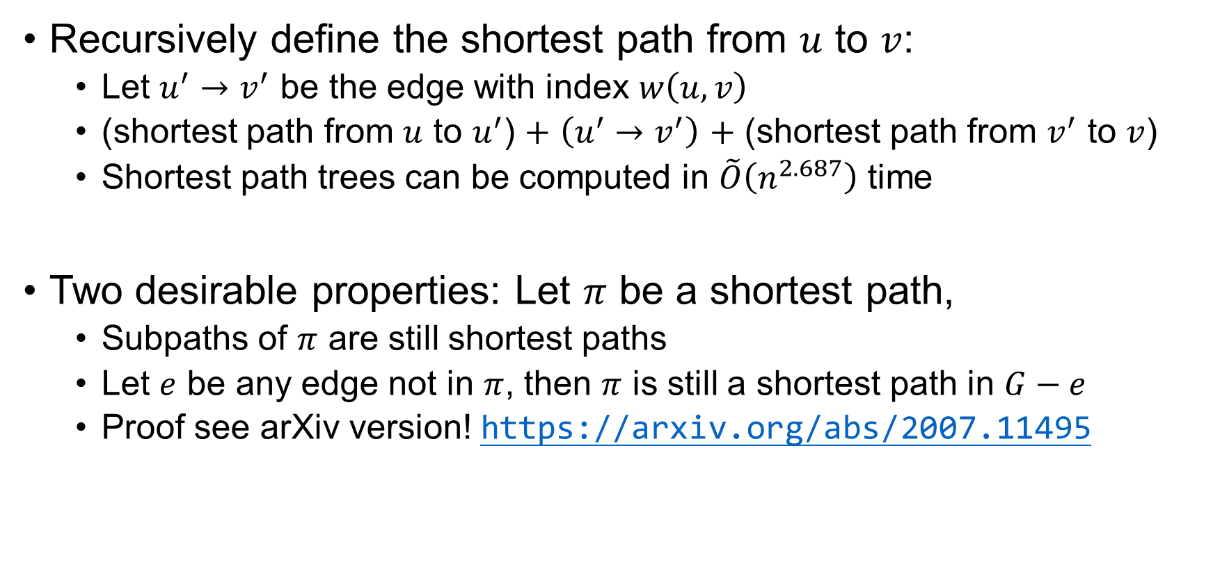
Bonus Slides: How to Break Ties?
Recursively define the shortest path from $u$ to $v$:
Let $u^{′}→v^{′}$ be the edge with index $w\left(u,v\right)$
(shortest path from $u$ to $u^{′}$) $+$ $\left(u^{′}→v^{′}\right)$ $+$ (shortest path from $v^{′}$ to $v$)
Shortest path trees can be computed in $\tilde{O}\left(n^{2.687}\right)$ time
Two desirable properties: Let $π$ be a shortest path,
Subpaths of $π$ are still shortest paths
Let $e$ be any edge not in $π$, then $π$ is still a shortest path in $G−e$
Proof see arXiv version! https://arxiv.org/abs/2007.11495
$$u$$
$$v$$

Slide 18
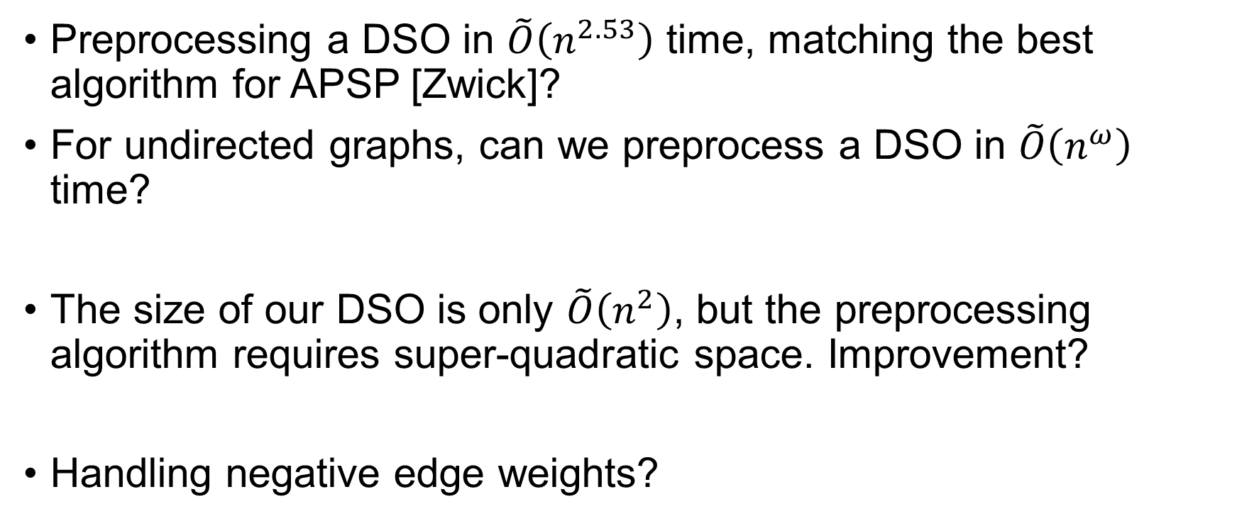
Open Questions?
Preprocessing a DSO in $\tilde{O}\left(n^{2.53}\right)$ time, matching the best algorithm for APSP [Zwick]?
For undirected graphs, can we preprocess a DSO in $\tilde{O}\left(n^{ω}\right)$ time?
The size of our DSO is only $\tilde{O}\left(n^{2}\right)$, but the preprocessing algorithm requires super-quadratic space. Improvement?
Handling negative edge weights?

Slide 19

New Progress
Ongoing work: DSO in $\tilde{O}\left(n^{\left(3+ω\right)/2}\right)$ preprocessing time!
New ingredient: symbolic computational methods from [van den Brand-Saranurak FOCS’19]

Slide 20
Thank you!

