Slide 1

Strong Average-Case Circuit Lower Bounds from Non-trivial Derandomization
Lijie Chen
MIT
Hanlin Ren
IIIS, Tsinghua

Slide 2
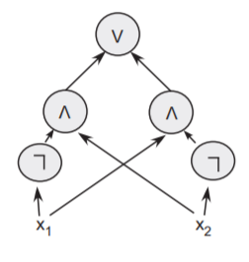
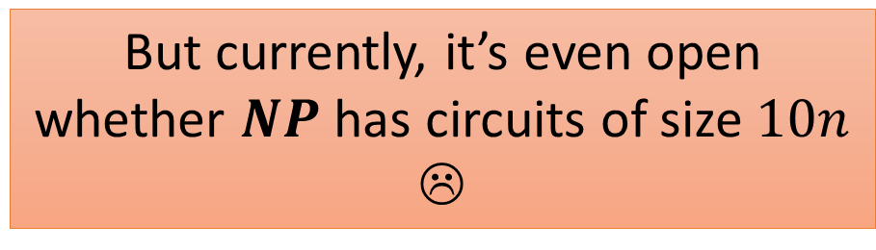


Motivation 1: Circuit Lower Bounds
People wanted to prove $P≠NP$ by proving circuit lower bounds…
The ultimate goal:
prove $NP$ does not have polynomial-size (general) circuits!
(hence proving $P≠NP$)
But currently, it’s even open whether $NP$ has circuits of size $10n$ ☹
A circuit computing $x_{1}⊕x_{2}$ from [Arora-Barak]

Slide 3
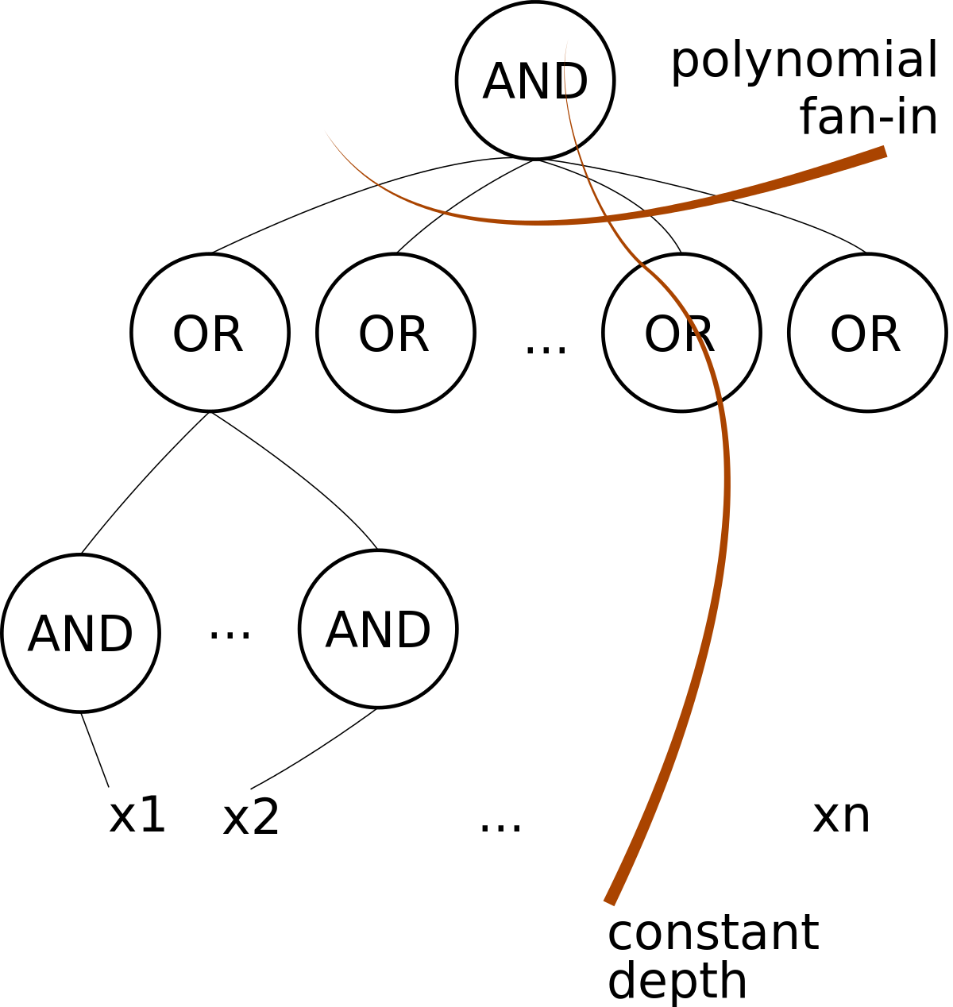
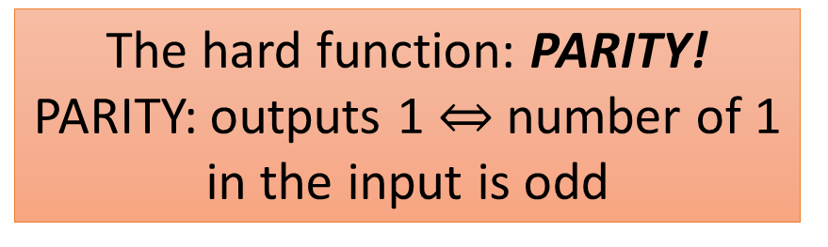
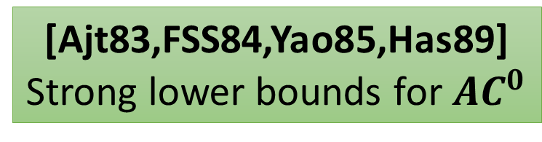
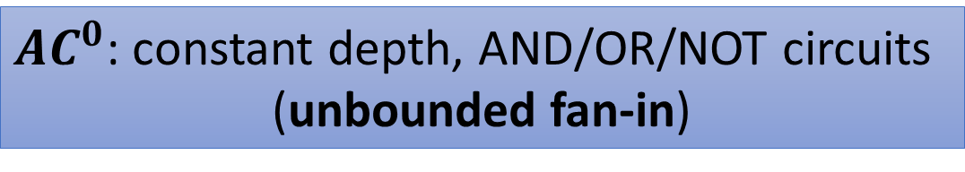

$AC^{0}$ circuits
$AC^{0}$: constant depth, AND/OR/NOT circuits
(unbounded fan-in)
[Ajt83,FSS84,Yao85,Has89]
Strong lower bounds for $AC^{0}$
The hard function: PARITY!
PARITY: outputs 1 $⇔$ number of 1 in the input is odd
Picture from https://en.wikipedia.org/wiki/AC0

Slide 4

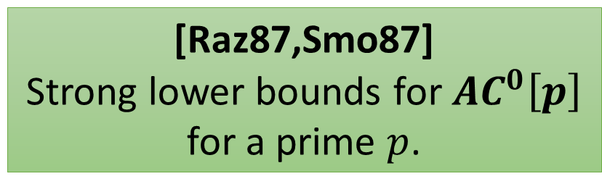
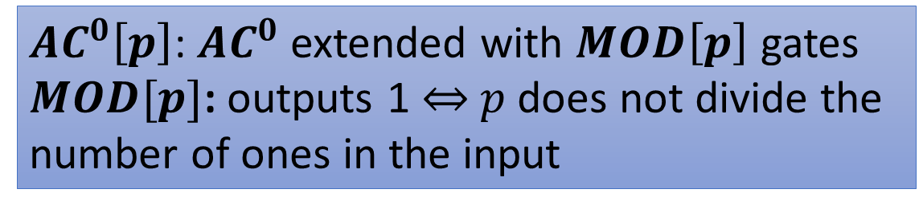


$AC^{0}\left[p\right]$ circuits
Okay, now we know PARITY is hard for $AC^{0}$. What about $AC^{0}$ with PARITY?
$AC^{0}\left[p\right]$: $AC^{0}$ extended with $MOD\left[p\right]$ gates
$MOD[p]$: outputs 1 $⇔$ $p$ does not divide the
number of ones in the input
[Raz87,Smo87]
Strong lower bounds for $AC^{0}\left[p\right]$
for a prime $p$.
The hard function for $AC^{0}\left[2\right]$ is
$$MOD\left[3\right]!$$

Slide 5
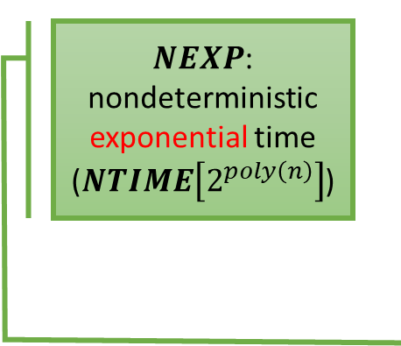
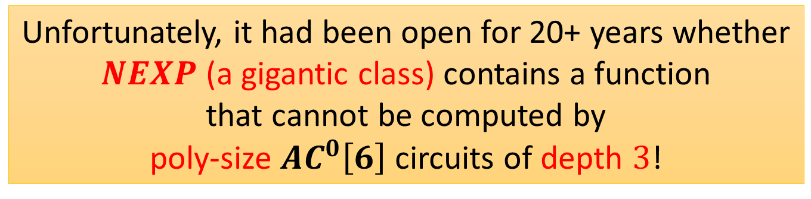



$AC^{0}\left[6\right]$ circuits
What about $AC^{0}\left[6\right]$, i.e. $AC^{0}\left[2\right]$ with $MOD\left[3\right]$?
$NEXP$: nondeterministic exponential time ($NTIME\left[2^{poly\left(n\right)}\right]$)
Shouldn’t be much stronger than $AC^{0}\left[2\right]$…???
Unfortunately, it had been open for 20+ years whether
$NEXP$ (a gigantic class) contains a function
that cannot be computed by
poly-size $AC^{0}\left[6\right]$ circuits of depth $3$!
Progress basically stops here, until…

Slide 6

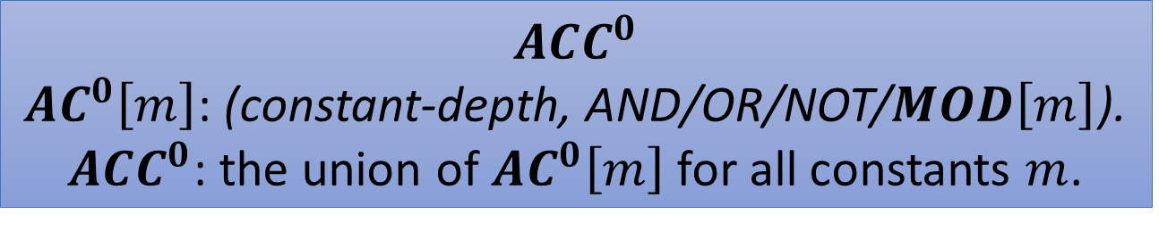
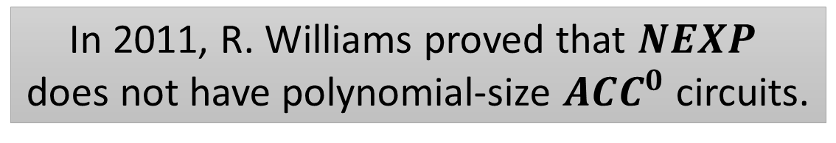
$$NEXP⊈ACC^{0}$$
In 2011, R. Williams proved that $NEXP$
does not have polynomial-size $ACC^{0}$ circuits.
$$ACC^{0}$$
$AC^{0}\left[m\right]$: (constant-depth, AND/OR/NOT/$MOD\left[m\right]$).
$ACC^{0}$: the union of $AC^{0}\left[m\right]$ for all constants $m$.
Proven by the so-called
Algorithmic Method!
Nontrivial circuit-analysis algorithms imply circuit lower bounds.

Slide 7
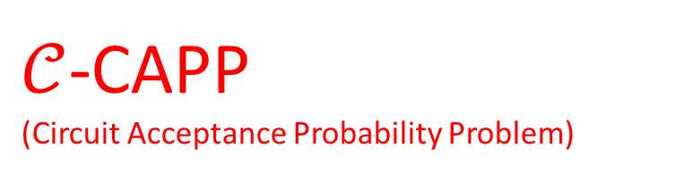
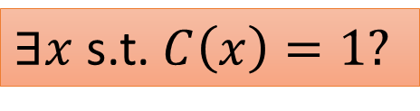
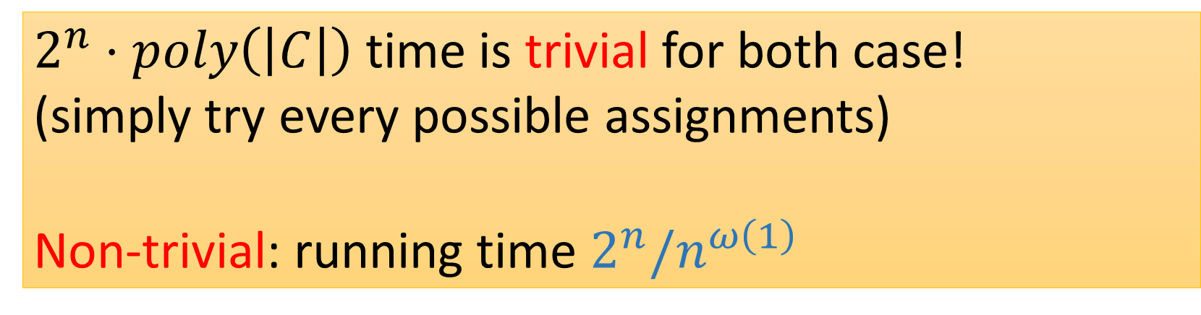
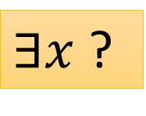


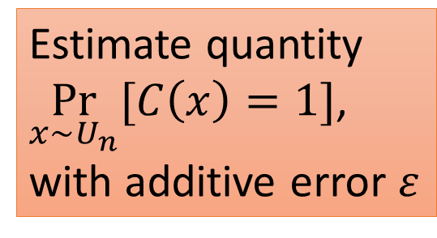


Circuit Analysis Problems
$𝒞$-SAT
$𝒞$-CAPP
(Circuit Acceptance Probability Problem)
$2^{n}⋅poly\left(\left|C\right|\right)$ time is trivial for both case!
(simply try every possible assignments)
Non-trivial: running time $2^{n}/n^{ω\left(1\right)}$
$$C∈𝒞$$
$$C∈𝒞$$
Estimate quantity
$\underset{x∼U_{n}}{Pr}{[C\left(x\right)=1]}$,
with additive error $ε$
$∃x$ s.t. $C\left(x\right)=1?$
$∃x$ ?
$$x∼U_{n}$$

Slide 8


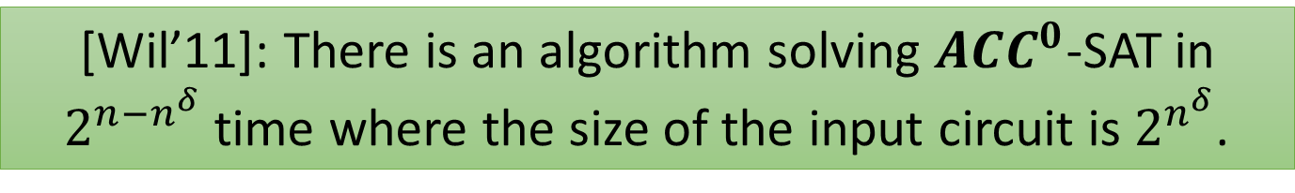

Algorithmic Method
For “typical” $𝒞$!
$2^{n}/n^{ω\left(1\right)}$ time SAT or CAPP for poly-size $𝒞$ circuits
$⟹NEXP⊈$ poly-size $𝒞$.
[Wil’11]: There is an algorithm solving $ACC^{0}$-SAT in $2^{n−n^{δ}}$ time where the size of the input circuit is $2^{n^{δ}}$.
$NEXP⊈ACC^{0}$!!

Slide 9
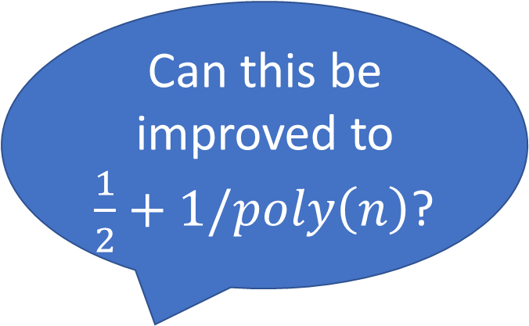
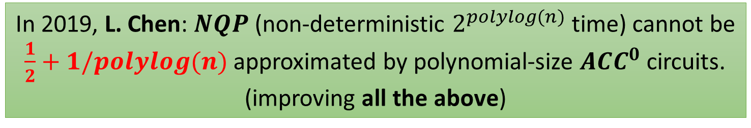
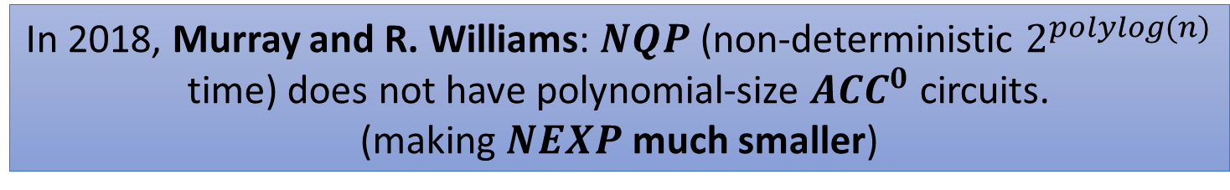
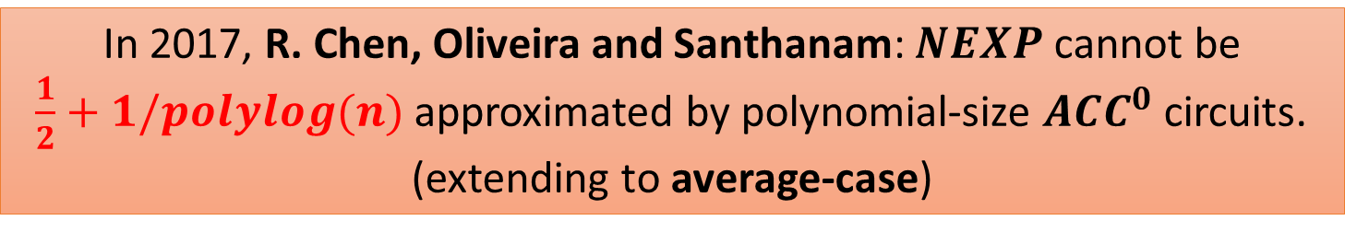
Subsequent Developments
In 2017, R. Chen, Oliveira and Santhanam: $NEXP$ cannot be
$\frac{1}{2}+1/polylog(n)$ approximated by polynomial-size $ACC^{0}$ circuits.
(extending to average-case)
Can this be improved to
$\frac{1}{2}+1/poly\left(n\right)$?
In 2018, Murray and R. Williams: $NQP$ (non-deterministic $2^{polylog(n)}$ time) does not have polynomial-size $ACC^{0}$ circuits.
(making $NEXP$ much smaller)
In 2019, L. Chen: $NQP$ (non-deterministic $2^{polylog(n)}$ time) cannot be
$\frac{1}{2}+1/polylog(n)$ approximated by polynomial-size $ACC^{0}$ circuits. (improving all the above)

Slide 10
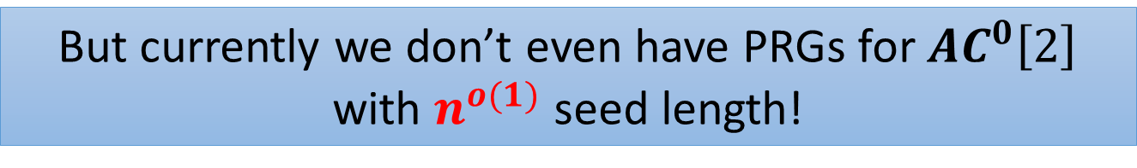
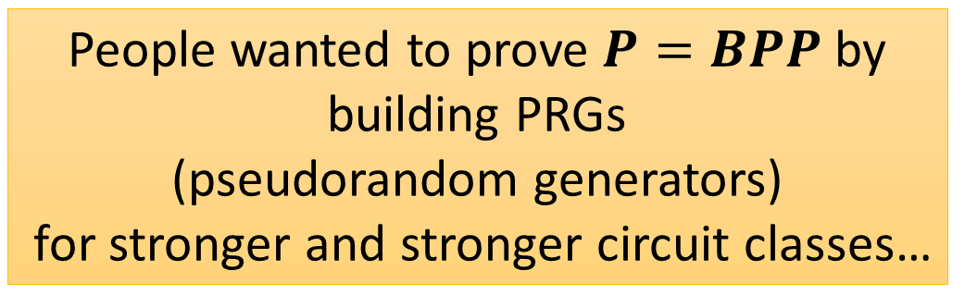





Motivation 2: Derandomization
People wanted to prove $P=BPP$ by building PRGs
(pseudorandom generators)
for stronger and stronger circuit classes…
$$BPTIME\left[T\right]⊆TIME\left[\left(T+T_{PRG}\right)⋅2^{s}\right]$$
We need to have a PRG for $P/poly$
(poly-size, unrestricted circuits)
with $O(log n)$-seed length
$$≈$$
PRG
Pr[adv(true rand)=1]
Pr[adv(pseudorandom)=1]
$s$ bits
$n$ bits
adversary
adversary
typically $s≪n$
true random bits
pseudorandom bits
PRG
But currently we don’t even have PRGs for $AC^{0}\left[2\right]$ with $n^{o(1)}$ seed length!
seed

Slide 11
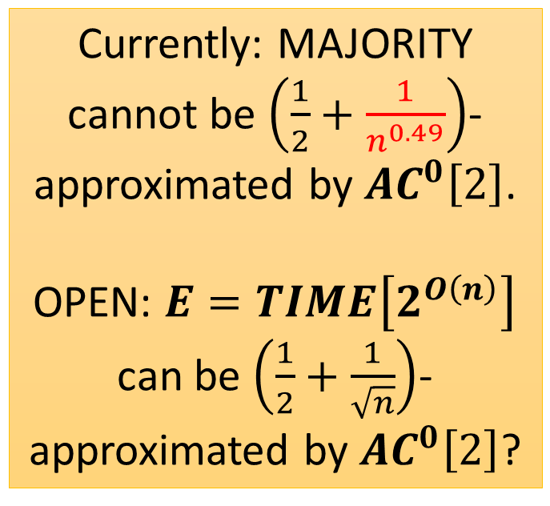

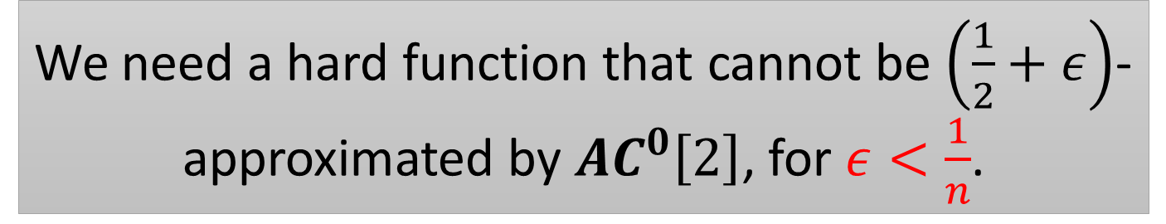
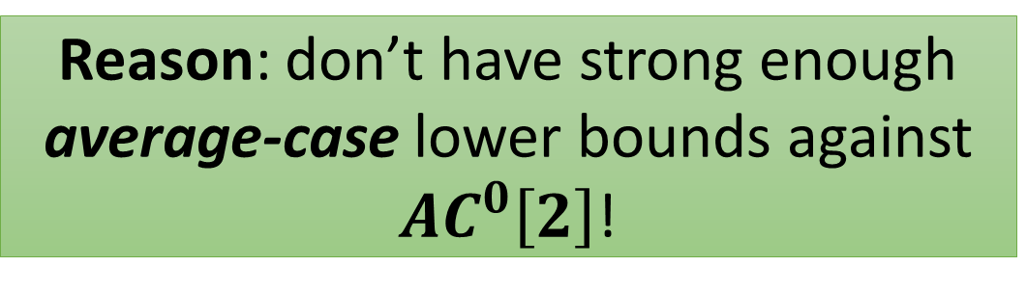


Pseudorandom Generators Fooling $AC^{0}\left[2\right]$?
But currently we don’t even have PRGs for $AC^{0}\left[2\right]$ with $n^{o(1)}$ seed length!
Currently: MAJORITY cannot be $\left(\frac{1}{2}+\frac{1}{n^{0.49}}\right)$-approximated by $AC^{0}\left[2\right]$.
OPEN: $E=TIME\left[2^{O\left(n\right)}\right]$ can be $\left(\frac{1}{2}+\frac{1}{\sqrt{n}}\right)$-approximated by $AC^{0}\left[2\right]$?
Reason: don’t have strong enough average-case lower bounds against $AC^{0}\left[2\right]$!
Nisan-Wigderson: hard function $⟹$ PRG!
We need a hard function that cannot be $\left(\frac{1}{2}+ε\right)$-approximated by $AC^{0}\left[2\right]$, for $ε<\frac{1}{n}$.
Not strong enough……

Slide 12
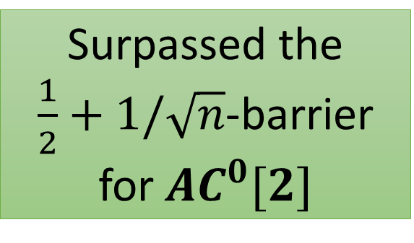
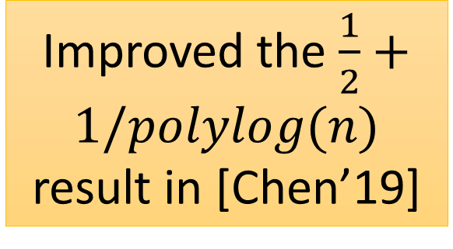

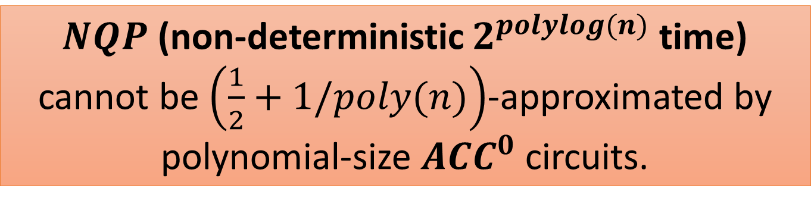
This Work: Strong Average-Case Circuit Lower Bounds for $ACC^{0}$
Improved the $\frac{1}{2}+1/polylog(n)$ result in [Chen’19]
$NQP$ (non-deterministic $2^{polylog(n)}$ time) cannot be $\left(\frac{1}{2}+1/poly(n)\right)$-approximated by polynomial-size $ACC^{0}$ circuits.
Surpassed the
$\frac{1}{2}+1/\sqrt{n}$-barrier for $AC^{0}[2]$

Slide 13
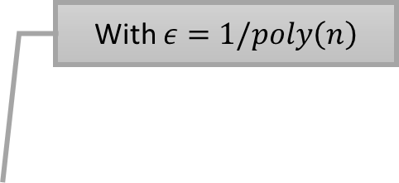
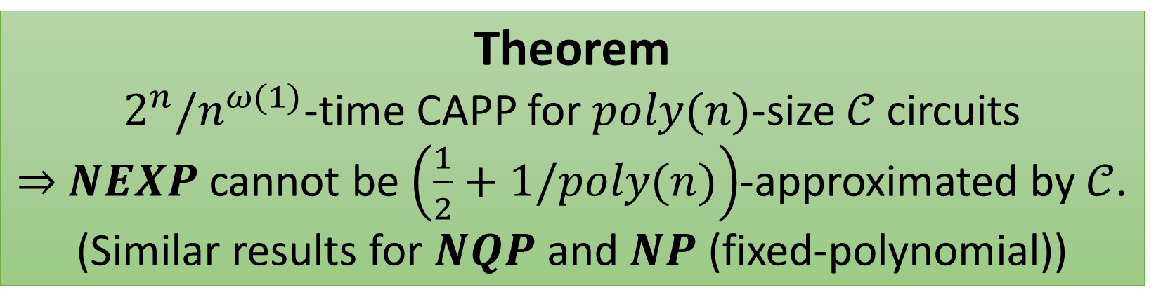
Strong Average-Case Lower Bounds from Non-trivial Derandomization
With $ε=1/poly\left(n\right)$
Theorem
$2^{n}/n^{ω(1)}$-time CAPP for $poly(n)$-size $𝒞$ circuits $⇒$ $NEXP$ cannot be $\left(\frac{1}{2}+1/poly(n)\right)$-approximated by $𝒞$.
(Similar results for $NQP$ and $NP$ (fixed-polynomial))

Slide 14
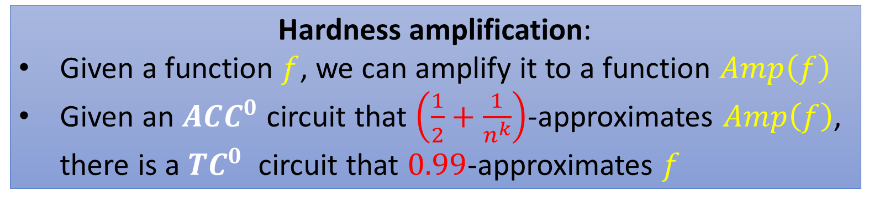
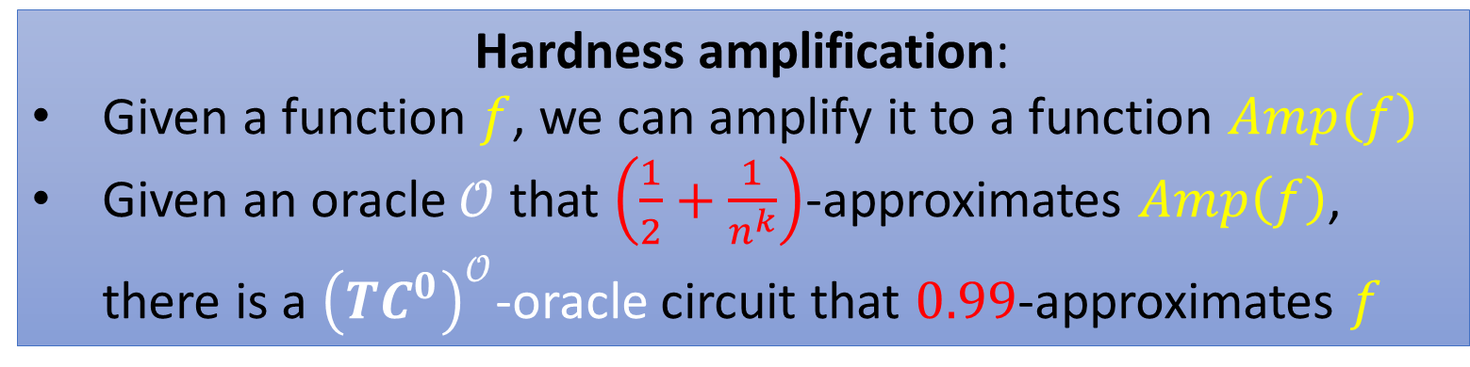


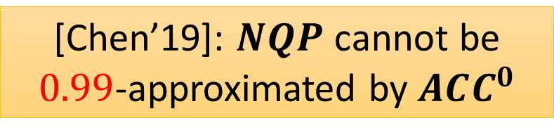

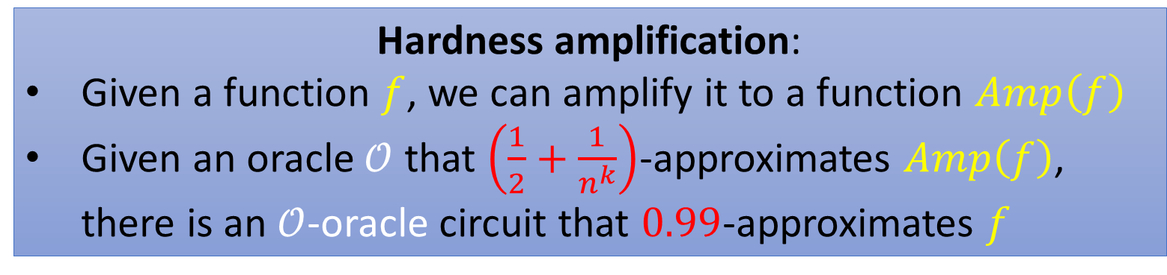

First Attempt: Hardness Amplification
Hardness amplification:
Given a function $f$, we can amplify it to a function $Amp\left(f\right)$
Given an oracle $𝒪$ that $\left(\frac{1}{2}+\frac{1}{n^{k}}\right)$-approximates $Amp\left(f\right)$, there is an $𝒪$-oracle circuit that $0.99$-approximates $f$
Hardness amplification:
Given a function $f$, we can amplify it to a function $Amp\left(f\right)$
Given an oracle $𝒪$ that $\left(\frac{1}{2}+\frac{1}{n^{k}}\right)$-approximates $Amp\left(f\right)$, there is a ${\left({TC}^{0}\right)}^{𝒪}$-oracle circuit that $0.99$-approximates $f$
Hardness amplification:
Given a function $f$, we can amplify it to a function $Amp\left(f\right)$
Given an $ACC^{0}$ circuit that $\left(\frac{1}{2}+\frac{1}{n^{k}}\right)$-approximates $Amp\left(f\right)$, there is a $TC^{0}$ circuit that $0.99$-approximates $f$
$$TC^{0}$$
Circuits with MAJORITY gates (of unbounded fanin)
MAJORITY is necessary…
[SV’10, Grinberg-Shaltiel-Viola’18]
We need a $TC^{0}$ lower bound now ☹
So we have $\left(\frac{1}{2}+1/poly\left(n\right)\right)$-inapproximability results?
So we have $\left(\frac{1}{2}+1/poly\left(n\right)\right)$-inapproximability results?
[Chen’19]: $NQP$ cannot be $0.99$-approximated by $ACC^{0}$

Slide 15
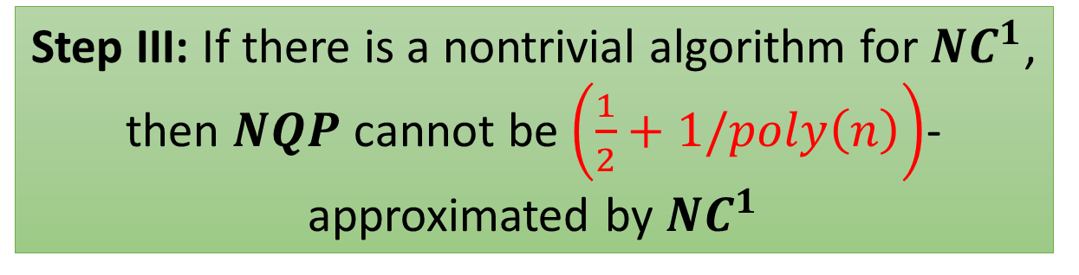
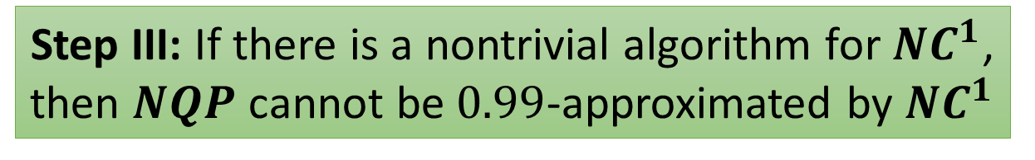
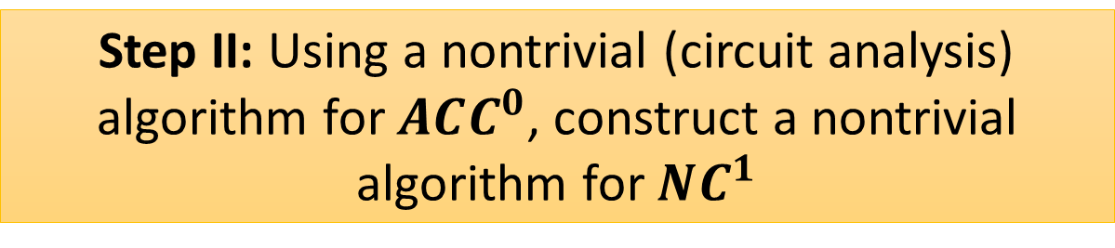

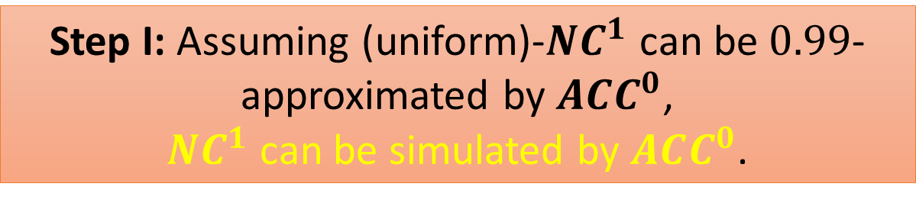
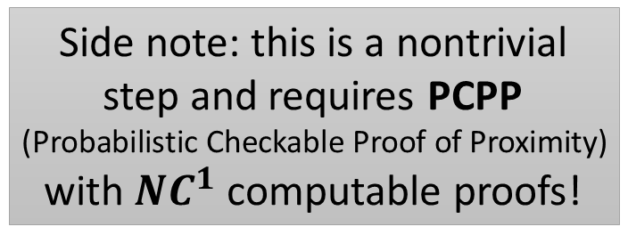


Now, let’s see how [Chen’19] proved
$0.99$-inapproximability…
Step I: Assuming (uniform)-$NC^{1}$ can be $0.99$-approximated by $ACC^{0}$,
$NC^{1}$ can be simulated by $ACC^{0}$.
$NC^{1}$: poly-size formula
Step II: Using a nontrivial (circuit analysis) algorithm for $ACC^{0}$, construct a nontrivial algorithm for $NC^{1}$
Side note: this is a nontrivial step and requires PCPP
(Probabilistic Checkable Proof of Proximity)
with $NC^{1}$ computable proofs!
Step III: If there is a nontrivial algorithm for $NC^{1}$, then $NQP$ cannot be $0.99$-approximated by $NC^{1}$
Step III: If there is a nontrivial algorithm for $NC^{1}$, then $NQP$ cannot be $\left(\frac{1}{2}+1/poly\left(n\right)\right)$-approximated by $NC^{1}$
$NC^{1}$ can compute MAJORITY, thus we can use hardness amplification!

Slide 16

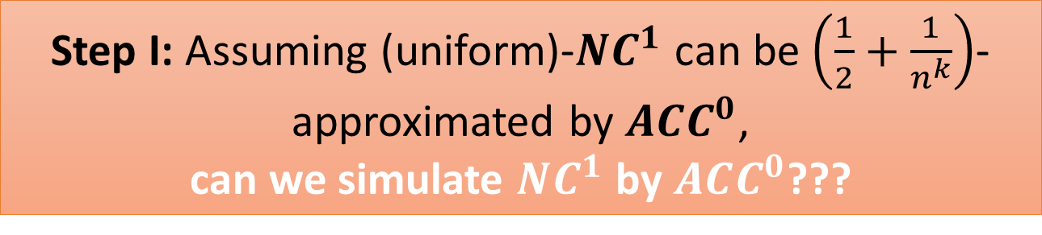
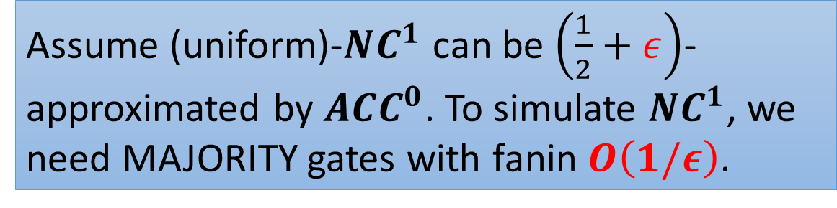
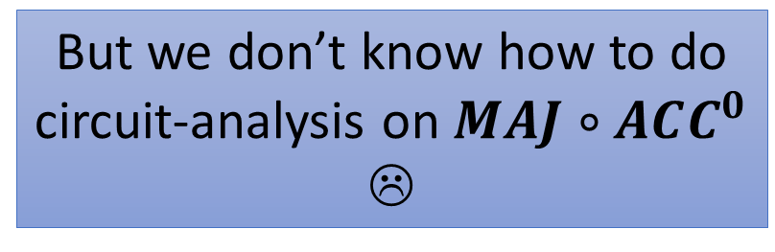

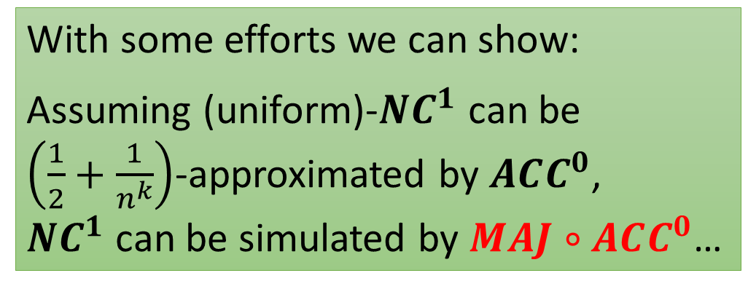

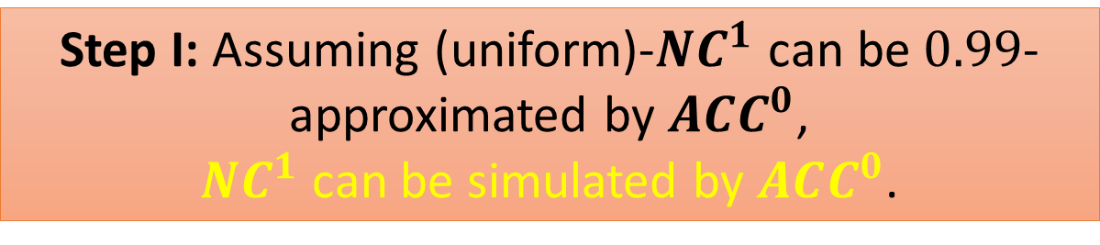

Still, Step I…?
Step I: Assuming (uniform)-$NC^{1}$ can be $\left(\frac{1}{2}+\frac{1}{n^{k}}\right)$-approximated by $ACC^{0}$,
can we simulate $NC^{1}$ by $ACC^{0}$???
Step I: Assuming (uniform)-$NC^{1}$ can be $0.99$-approximated by $ACC^{0}$,
$NC^{1}$ can be simulated by $ACC^{0}$.
$$MAJ$$
The MAJORITY issue again!
With some efforts we can show:
Assuming (uniform)-$NC^{1}$ can be $\left(\frac{1}{2}+\frac{1}{n^{k}}\right)$-approximated by $ACC^{0}$,
$NC^{1}$ can be simulated by $MAJ∘ACC^{0}$…
$$ACC^{0}$$
$$ACC^{0}$$
$$ACC^{0}$$
Assume (uniform)-$NC^{1}$ can be $\left(\frac{1}{2}+ε\right)$-approximated by $ACC^{0}$. To simulate $NC^{1}$, we need MAJORITY gates with fanin $O\left(1/ε\right)$.
But we don’t know how to do circuit-analysis on $MAJ∘ACC^{0}$ ☹
Our solution: use Approximate Sum!

Slide 17




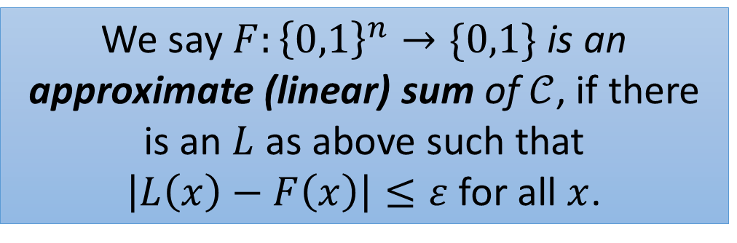
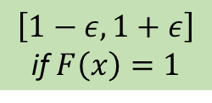


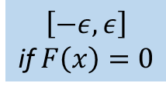




Approximate Sum
Let $𝒞$ be a circuit class. A Linear Sum of $𝒞$ is
$$L=α_{1}⋅C_{1}+α_{2}⋅C_{2}+…+α_{m}⋅C_{m}$$
where $α_{i}∈ℝ$, and $C_{i}∈𝒞$.
$$\left[−ε,ε\right]$$
if $F\left(x\right)=0$
$$\left[1−ε,1+ε\right]$$
if$F\left(x\right)=1$
$$SUM$$
We say $F:{\left\{0,1\right\}}^{n}→\{0,1\}$ is an approximate (linear) sum of $𝒞$, if there is an $L$ as above such that
$\left|L\left(x\right)−F\left(x\right)\right|≤ε$ for all $x$.
$$α_{1}$$
$$α_{2}$$
$$⋯$$
$$α_{m}$$
$$C_{1}$$
$$C_{2}$$
$$⋯$$
$$C_{m}$$

Slide 18



Circuit Analysis of Approximate Sum
Nontrivial algorithms for bottom $C_{i}$
$⟹$ nontrivial algorithms for Approx-Sum of $C_{i}$!
e.g, for CAPP:
$$𝔼\left[F\left(x\right)\right]≈\sum_{i}{α_{i}𝔼\left[C_{i}\left(x\right)\right]}$$
$$SUM$$
$$α_{1}$$
$$α_{2}$$
$$⋯$$
$$α_{m}$$
$$C_{1}$$
$$C_{2}$$
$$⋯$$
$$C_{m}$$
Corollary [Chen-Williams]: $NQP$ cannot be computed by an approx-sum of $ACC^{0}$

Slide 19



Hardness Amplification via Approximate Sum
Both $A$ and $B$ are $NC^{1}$-hard and
in poly-time
For some languages $A,B$:
If $A$ cannot be worst-case computed by approx-sum of $ACC^{0}$,
then $B$ cannot be $\left(\frac{1}{2}+\frac{1}{n^{k}}\right)$-approximated by $ACC^{0}$
Collapse Theorem
If $B$ can be $\left(\frac{1}{2}+\frac{1}{n^{k}}\right)$-approximated by $ACC^{0}$,
then $NC^{1}$ collapses to approx-sum of $ACC^{0}$!

Slide 20











A quick proof of $NQP⊈MAJ∘ACC^{0}$
1. If $NQP$ can be $\left(\frac{1}{2}+n^{−k}\right)$-approximated by $ACC^{0}$, then $NC^{1}$ collapses to approximate sum of $ACC^{0}$.
$$MAJ$$
$$ACC^{0}$$
$$ACC^{0}$$
$$ACC^{0}$$
2. [Chen-Williams, 2019]: $NQP$ is not in approximate sum of $ACC^{0}$. Hence, $NQP$ is not in $NC^{1}$ (also not in $MAJ∘ACC^{0}$).
Discriminator Lemma
[Hajnal et al.’93], a variant
Let $s=$ fanin of , then
there is some subcircuit that can $\left(\frac{1}{2}+\frac{1}{O\left(s\right)}\right)$-approximate the whole function.
$$MAJ$$
3. If $NQP$ cannot be $\left(\frac{1}{2}+n^{−k}\right)$-approximated by $ACC^{0}$, then $NQP$ cannot be computed by $MAJ∘ACC^{0}$.
(The Discriminator Lemma)
$$ACC^{0}$$

Slide 21



The Final Proof
Step I: Assuming $B$ can be $\left(\frac{1}{2}+\frac{1}{n^{k}}\right)$-approximated by $ACC^{0}$,
$NC^{1}$ can be simulated by approx-sum of $ACC^{0}$.
Step II: Using a nontrivial (circuit analysis) algorithm for approx-sum of $ACC^{0}$, construct a nontrivial algorithm for $NC^{1}$.
Step III: If there is a nontrivial algorithm for $NC^{1}$,
then $NQP$ cannot be $\left(\frac{1}{2}+\frac{1}{n^{k}}\right)$-approximated by $NC^{1}$.
Conclusion: $NQP$ cannot be $\left(\frac{1}{2}+\frac{1}{n^{k}}\right)$-approximated by $ACC^{0}$.

Slide 22


New Developments
[Chen-Lyu-Williams ’20]:
$E^{NP}$ cannot be $\left(\frac{1}{2}+\frac{1}{2^{n^{o\left(1\right)}}}\right)$-approximated by $ACC^{0}$ circuits of $2^{n^{o\left(1\right)}}$ size!
Moreover, this lower bound holds for almost every input length!
For comparison, this work:
$E^{NP}$ cannot be $\left(\frac{1}{2}+\frac{1}{g\left(n\right)}\right)$-approximated by $ACC^{0}\left[g\left(n\right)\right]$,
if $g\left(g{\left(n^{k}\right)}^{k}\right)=2^{n^{o\left(1\right)}}$ for every constant $k$

Slide 23
Thanks! Any Questions?

