Slide 1
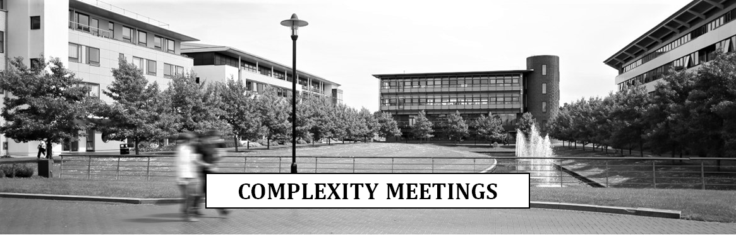

On the Range Avoidance Problem for Circuits
Hanlin Ren
Oxford
Rahul Santhanam
Oxford
Zhikun Wang
Xi’an Jiaotong
August 4, 2022
$$C$$
0 / 31

Slide 2
Range Avoidance
Range Avoidance
Algorithmic Method
Our Results
Proof Ideas
Summary
Finding a hay in the haystack

Slide 3
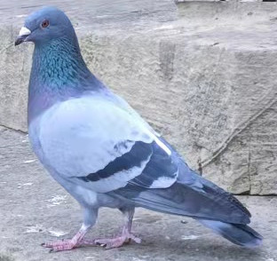
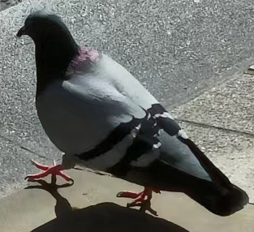



Motivation: The Empty Pigeonhole Principle
If you throw $N$ pigeons into $M$ holes, and $N<M$, then there is an empty pigeonhole.
Weak version: if you throw $N$ pigeons into $M$ holes, and $2N<M$, then there is an empty pigeonhole.
(These are REAL pigeons in Oxford)
empty
empty
empty
empty
1 / 31

Slide 4




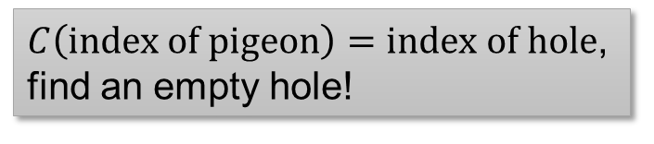

Range Avoidance Problem
Input: a (multi-output) circuit $C:{\left\{0,1\right\}}^{n}→{\left\{0,1\right\}}^{ℓ}$ ($ℓ>n$)
Output: any string $y∉Range\left(C\right)$
I.e. for every $x∈{\left\{0,1\right\}}^{n}$, $C\left(x\right)≠y$
Trivial randomised algorithm: Output a random $y←{\left\{0,1\right\}}^{ℓ}$.
Question: deterministic algorithms?
A “non-output” of $C$.
$$y∈{\left\{0,1\right\}}^{ℓ}$$
$C\left(index of pigeon\right)=index of hole$, find an empty hole!
$$C$$
A problem that captures the complexity of weak empty pigeonhole principle!
$$x∈{\left\{0,1\right\}}^{n}$$
2 / 31

Slide 5
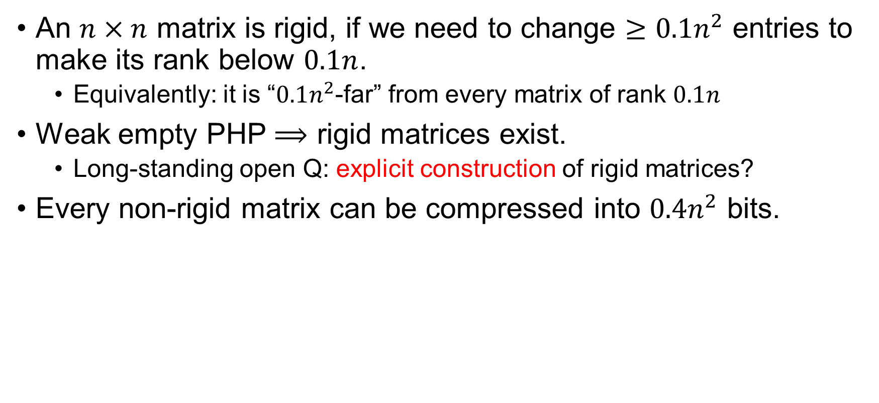
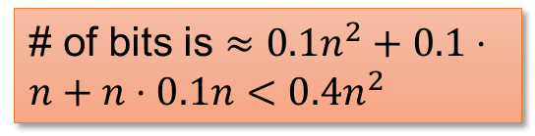



Example: Rigid Matrices
An $n×n$ matrix is rigid, if we need to change $≥0.1n^{2}$ entries to make its rank below $0.1n$.
Equivalently: it is “$0.1n^{2}$-far” from every matrix of rank $0.1n$
Weak empty PHP $⟹$ rigid matrices exist.
Long-standing open Q: explicit construction of rigid matrices?
Every non-rigid matrix can be compressed into $0.4n^{2}$ bits.
Let’s say rank is over $𝔽_{2}$
# of bits is $≈0.1n^{2}+0.1⋅n+n⋅0.1n<0.4n^{2}$
$$=$$
$$×$$
3 / 31

Slide 6




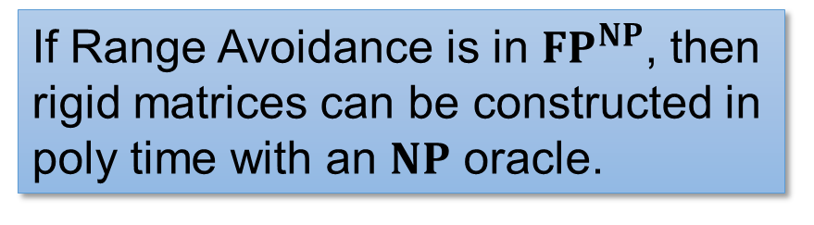

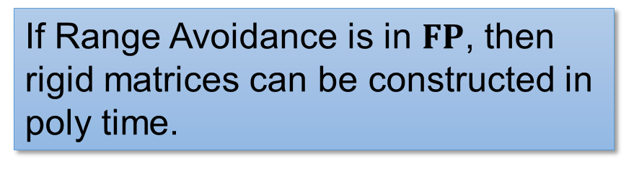


Example: Rigid Matrices
Weak empty PHP $⟹$ rigid matrices exist.
Open question: explicit construction of rigid matrices?
If Range Avoidance is in $FP$, then rigid matrices can be constructed in poly time.
A non-rigid matrix
$n^{2}$ bits
Decompressor for rigid matrices
If Range Avoidance is in $FP^{NP}$, then rigid matrices can be constructed in poly time with an $NP$ oracle.
$$⟨$$
$$,$$
$$,$$
$$⟩$$
$0.4n^{2}$ bits
4 / 31

Slide 7
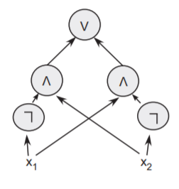
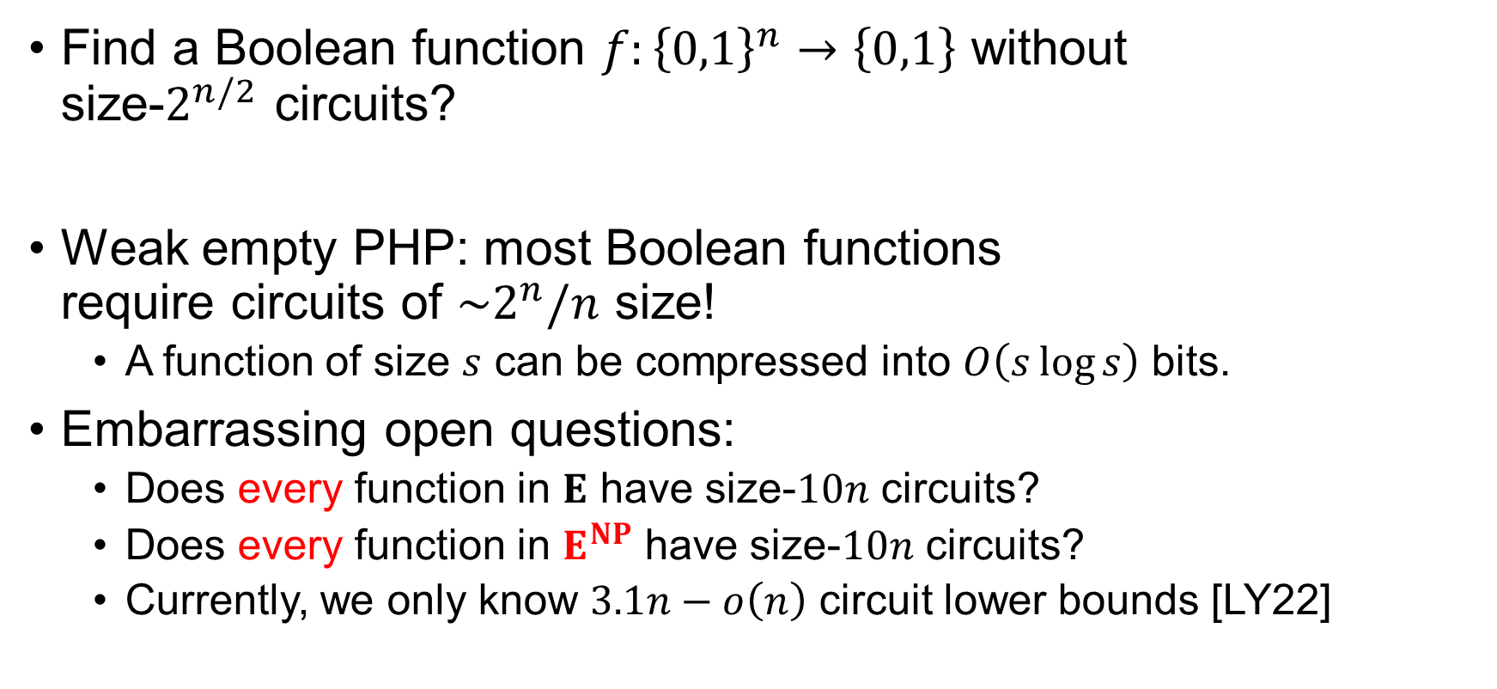
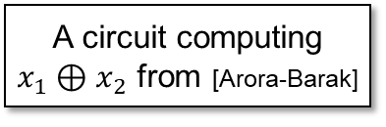
Example: Circuit Lower Bounds
Find a Boolean function $f:{\left\{0,1\right\}}^{n}→\left\{0,1\right\}$ without size-$2^{n/2}$ circuits?
Weak empty PHP: most Boolean functions require circuits of $\sim 2^{n}/n$ size!
A function of size $s$ can be compressed into $O\left(s\log{s}\right)$ bits.
Embarrassing open questions:
Does every function in $E$ have size-$10n$ circuits?
Does every function in $E^{NP}$ have size-$10n$ circuits?
Currently, we only know $3.1n−o\left(n\right)$ circuit lower bounds [LY22]
A circuit computing $x_{1}⊕x_{2}$ from [Arora-Barak]
5 / 31

Slide 8



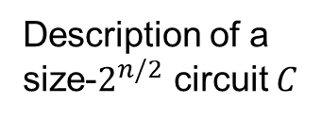






Example: Circuit Lower Bounds
Weak empty PHP: most Boolean functions require circuits of $\sim 2^{n}/n$ size!
Embarrassing open Q: $E^{NP}⊆SIZE\left[10n\right]$?
Truth table of $C$
If Range Avoidance is in $FP$, then
$$E⊈SIZE\left[2^{n/2}\right].$$
$$01100010011………………001010$$
$2^{n}$ bits
$$TT$$
If Range Avoidance is in $FP^{NP}$, then
$$E^{NP}⊈SIZE\left[2^{n/2}\right].$$
$2^{n/2}poly\left(n\right)$ bits
Description of a size-$2^{n/2}$ circuit $C$
$TT$ stands for “truth table”.
6 / 31

Slide 9
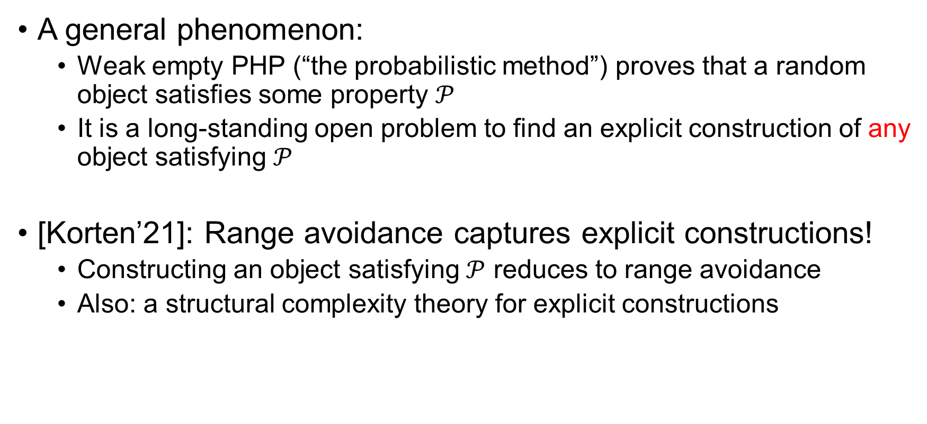
Explicit Constructions
A general phenomenon:
Weak empty PHP (“the probabilistic method”) proves that a random object satisfies some property $𝒫$
It is a long-standing open problem to find an explicit construction of any object satisfying $𝒫$
[Korten’21]: Range avoidance captures explicit constructions!
Constructing an object satisfying $𝒫$ reduces to range avoidance
Also: a structural complexity theory for explicit constructions
Rigid matrices, hard truth tables, Ramsey graphs, extractors, pseudorandom generators, hard data structure problems…
7 / 31

Slide 10

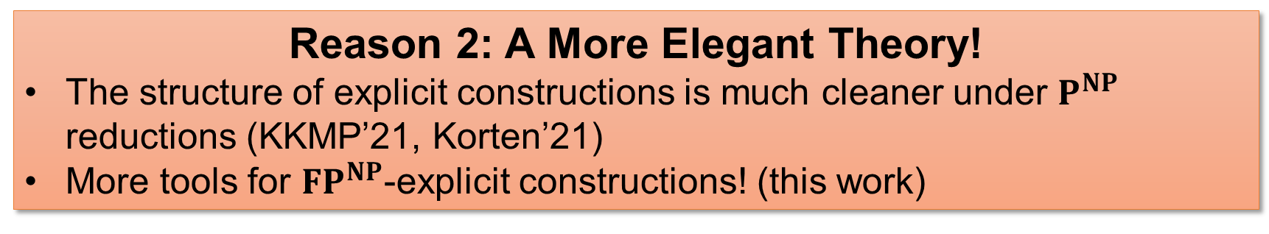
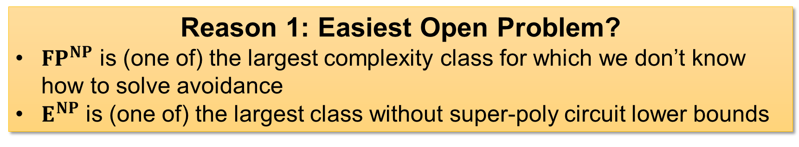

${FP}^{NP}$-Explicit Constructions
Why add this $NP$ oracle?
Significance of studying ${FP}^{NP}$-explicit constructions?
Reason 1: Easiest Open Problem?
${FP}^{NP}$ is (one of) the largest complexity class for which we don’t know how to solve avoidance
$E^{NP}$ is (one of) the largest class without super-poly circuit lower bounds
Reason 2: A More Elegant Theory!
The structure of explicit constructions is much cleaner under $P^{NP}$ reductions (KKMP’21, Korten’21)
More tools for ${FP}^{NP}$-explicit constructions! (this work)
8 / 31

Slide 11



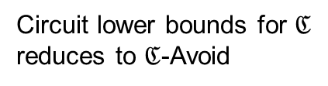


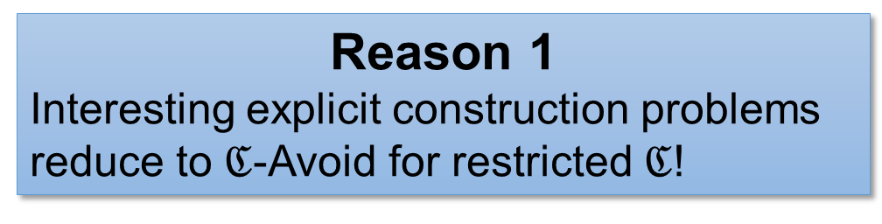
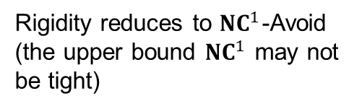
Range Avoidance for Restricted Circuits
Complexity of $ℭ$-Avoid for restricted circuit classes $ℭ$
Why study $ℭ$-Avoid?
Reason 1
Interesting explicit construction problems reduce to $ℭ$-Avoid for restricted $ℭ$!
Reason 2
Reveals some new phenomena…
$$01100010011………………001010$$
${NC}^{1}$-Avoid reduces to ${NC}^{0}$-Avoid (for very small stretch)!
$$⟨$$
$$,$$
$$,$$
$$⟩$$
Rigidity reduces to ${NC}^{1}$-Avoid (the upper bound ${NC}^{1}$ may not be tight)
Circuit lower bounds for $ℭ$ reduces to $ℭ$-Avoid
9 / 31

Slide 12
Algorithmic Method
Range Avoidance
Algorithmic Method
Our Results
Proof Ideas
Summary
Circuit lower bounds from algorithms!

Slide 13
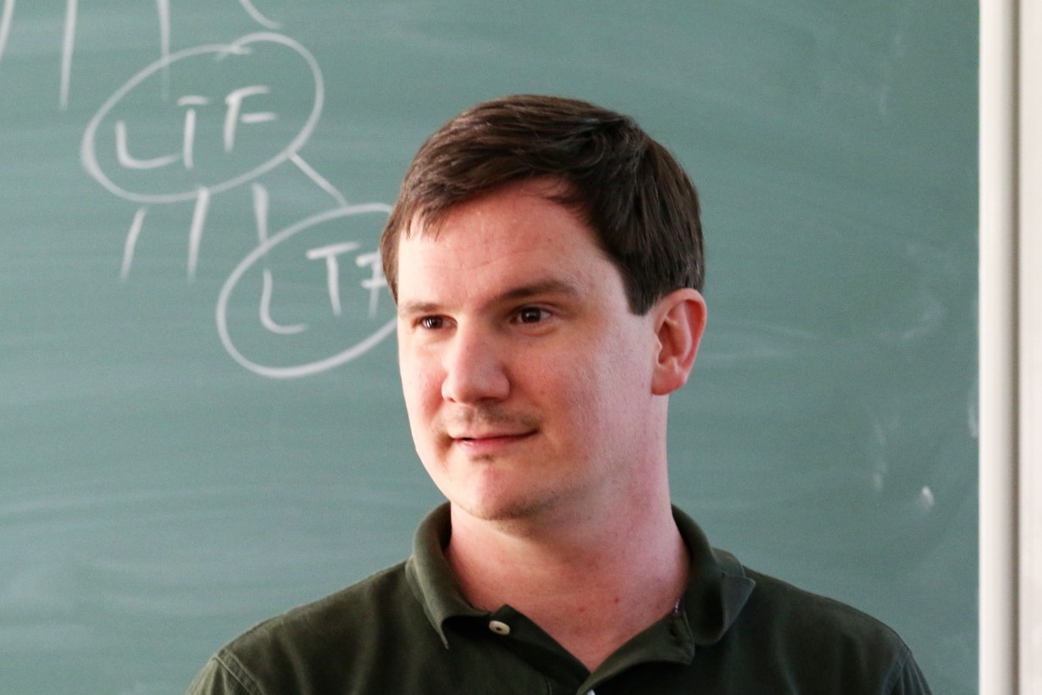
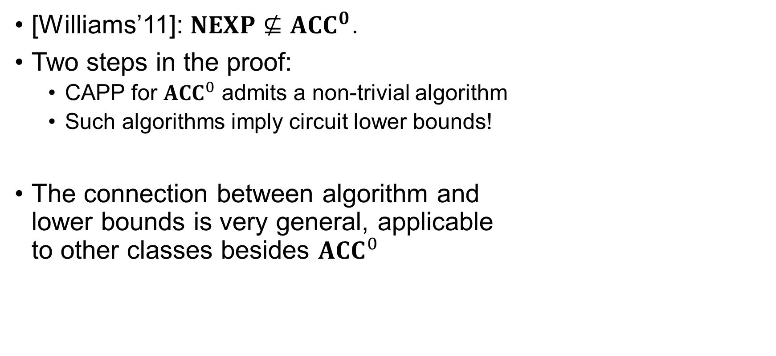
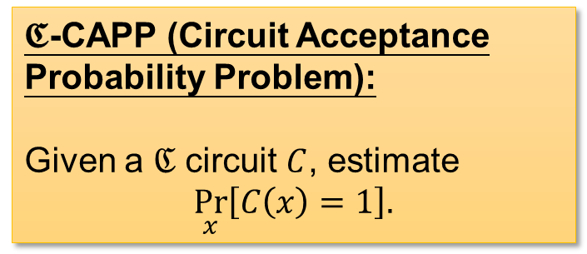

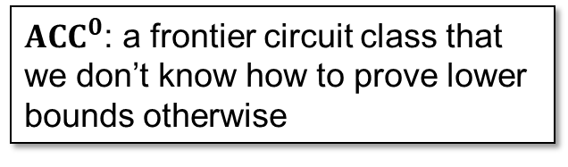
Circuit Lower Bounds via “Algorithmic Method”
${ACC}^{0}$: a frontier circuit class that we don’t know how to prove lower bounds otherwise
[Williams’11]: $NEXP⊈{ACC}^{0}$.
Two steps in the proof:
CAPP for ${ACC}^{0}$ admits a non-trivial algorithm
Such algorithms imply circuit lower bounds!
The connection between algorithm and lower bounds is very general, applicable to other classes besides ${ACC}^{0}$
Nontrivial: Running in $2^{n}/n^{ω\left(1\right)}$ time
$𝕮$-CAPP (Circuit Acceptance Probability Problem):
Given a $ℭ$ circuit $C$, estimate
$$\underset{x}{Pr}\left[C\left(x\right)=1\right].$$
10 / 31

Slide 14


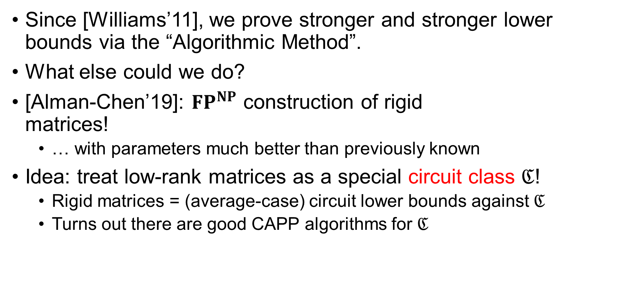
Algorithmic Method for Rigid Matrices
Since [Williams’11], we prove stronger and stronger lower bounds via the “Algorithmic Method”.
What else could we do?
[Alman-Chen’19]: ${FP}^{NP}$ construction of rigid matrices!
… with parameters much better than previously known
Idea: treat low-rank matrices as a special circuit class $ℭ$!
Rigid matrices = (average-case) circuit lower bounds against $ℭ$
Turns out there are good CAPP algorithms for $ℭ$
11 / 31

Slide 15









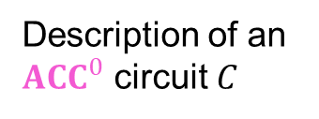

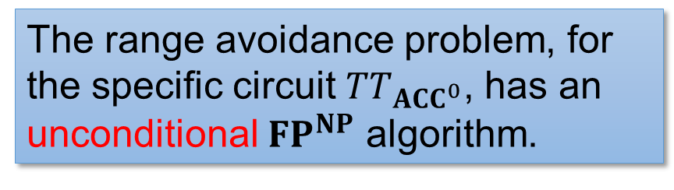
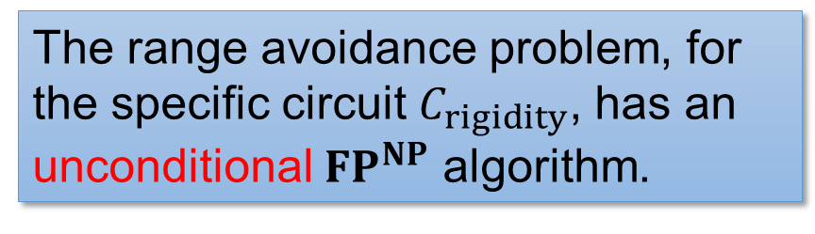



A Range Avoidance Interpretation?
${ACC}^{0}$ Circuit Lower Bounds
Rigid Matrices
Truth table of $C$
A non-rigid matrix
$$01100010011………………001010$$
$2^{n}$ bits
$n^{2}$ bits
$$TT_{{ACC}^{0}}$$
$$C_{rigidity}$$
$poly\left(n\right)$ bits
$$⟨$$
$$,$$
$$,$$
$$⟩$$
$0.4n^{2}$ bits
Description of an ${ACC}^{0}$ circuit $C$
The range avoidance problem, for the specific circuit $TT_{ACC^{0}}$, has an unconditional ${FP}^{NP}$ algorithm.
The range avoidance problem, for the specific circuit $C_{rigidity}$, has an unconditional ${FP}^{NP}$ algorithm.
(for different parameters)
12 / 31

Slide 16

Is it just circuit lower bounds & rigid matrices, or…?
Is there a general “Algorithmic Method” for range avoidance?
What analogue of “CAPP algorithms” imply $FP^{NP}$ algorithms for $𝕮$-Avoid?
13 / 31

Slide 17
Our Results
Range Avoidance
Algorithmic Method
Our Results
Proof Ideas
Summary
Algorithmic method is for range avoidance; circuit lower bounds are just one application

Slide 18



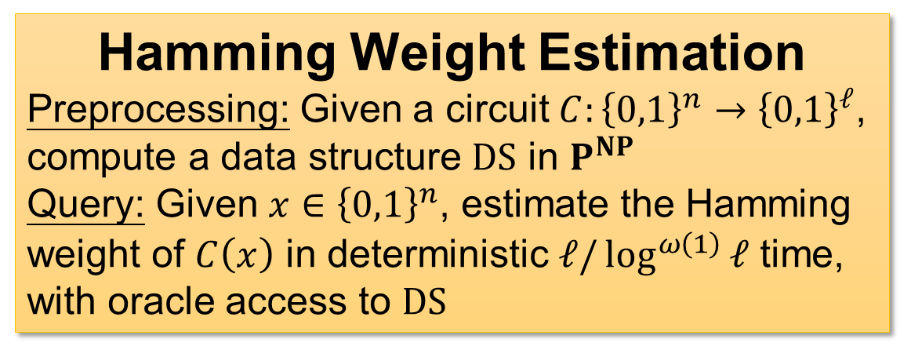
Our Results: Algorithmic Method for Range Avoidance
Non-trivial Hamming Weight Estimation data structures imply ${FP}^{NP}$ algorithms for range avoidance
output
Hamming Weight Estimation
Preprocessing: Given a circuit $C:{\left\{0,1\right\}}^{n}→{\left\{0,1\right\}}^{ℓ}$, compute a data structure $DS$ in $P^{NP}$
Query: Given $x∈{\left\{0,1\right\}}^{n}$, estimate the Hamming weight of $C\left(x\right)$ in deterministic $ℓ/\log^{ω\left(1\right)}{ℓ}$ time, with oracle access to $DS$
$$C$$
input
Remark: CAPP = Hamming Weight Est. for $TT$ (the truth table generator)!
This result generalises Williams’s Algorithmic Method!
14 / 31

Slide 19

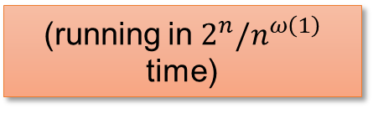



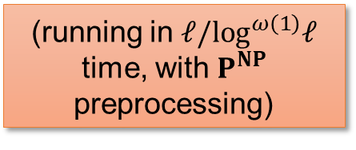
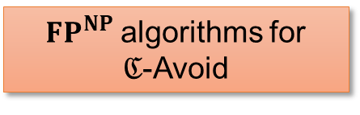
Comparison with the Algorithmic Method
The Algorithmic Method
Our results
(running in $ℓ/\log^{ω\left(1\right)}ℓ$ time, with $P^{NP}$ preprocessing)
(running in $2^{n}/n^{ω\left(1\right)}$ time)
Non-trivial algorithms
Hamming weight estimation of $ℭ$
… for
CAPP of $ℭ$
… implies
Circuit lower bounds against $ℭ$
${FP}^{NP}$ algorithms for
$ℭ$-Avoid
(Assuming $ℭ$ is “typical”)
15 / 31

Slide 20
Algorithmic Method Is For Avoidance!
Williams’11
Alman-Chen’19
This work
Alg Method can prove lower bounds!
Treat explicit construction problems as lower bounds, and use Alg Method!
Alg Method is essentially about explicit constructions; lower bounds are just its one application
16 / 31

Slide 21



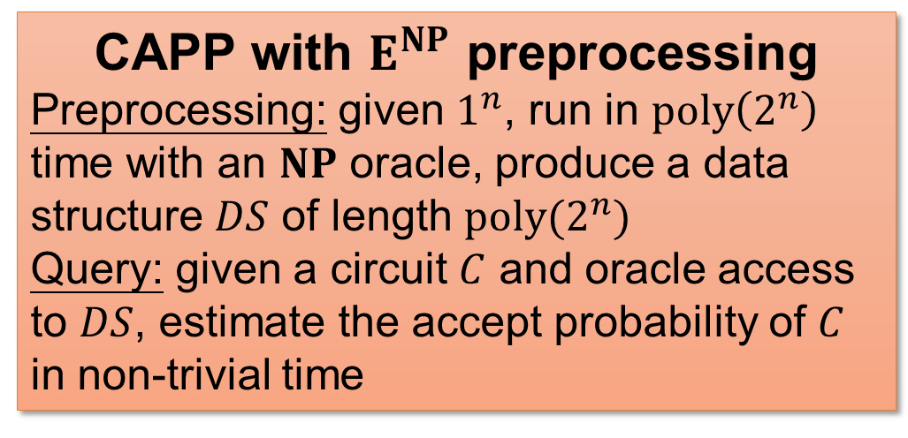

Characterisation of Circuit Lower Bounds for $E^{NP}$
Immediate corollary of the previous result: non-trivial CAPP algorithms, even with $E^{NP}$ preprocessing, imply lower bounds
CAPP with $E^{NP}$ preprocessing
Preprocessing: given $1^{n}$, run in $poly\left(2^{n}\right)$ time with an $NP$ oracle, produce a data structure $DS$ of length $poly(2^{n})$
Query: given a circuit $C$ and oracle access to $DS$, estimate the accept probability of $C$ in non-trivial time
Example: $E^{NP}$-computable PRGs
$G:{\left\{0,1\right\}}^{0.9n}→{\left\{0,1\right\}}^{n}$ computable in $E^{NP}$
Preprocessing: compute $G\left(s\right)$ for every $s∈{\left\{0,1\right\}}^{0.9n}$
Query: given $C$, output
$$\underset{s}{Pr}\left[C\left(G\left(s\right)\right)=1\right].$$
Our second result: Actually, CAPP with $E^{NP}$ preprocessing characterises $E^{NP}$ lower bounds!
17 / 31

Slide 22
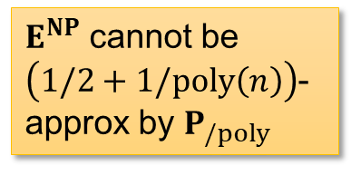
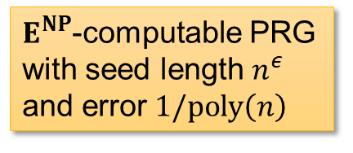




Characterisation of Circuit Lower Bounds for $E^{NP}$
Theorem: the following are equivalent
Non-trivial CAPP algorithm with $E^{NP}$ preprocessing
Our result
$$E^{NP}⊈P_{/poly}$$
Hardness
amplification
Unconditional speedup for “CAPP with $E^{NP}$-preprocessing!”
Subexponential-time CAPP algorithm with $E^{NP}$ preprocessing
$E^{NP}$-computable PRG with seed length $n^{ε}$ and error $1/poly\left(n\right)$
$E^{NP}$ cannot be $\left(1/2+1/poly\left(n\right)\right)$-approx by $P_{/poly}$
Nisan-Wigderson
18 / 31

Slide 23
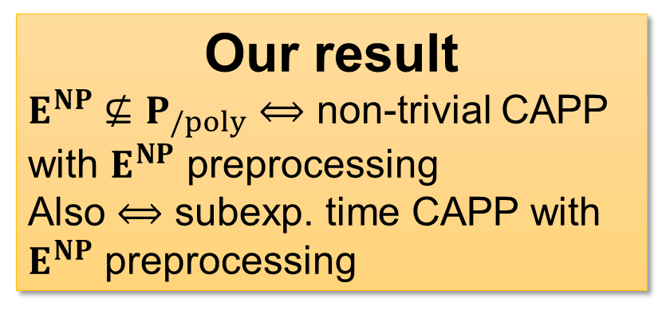
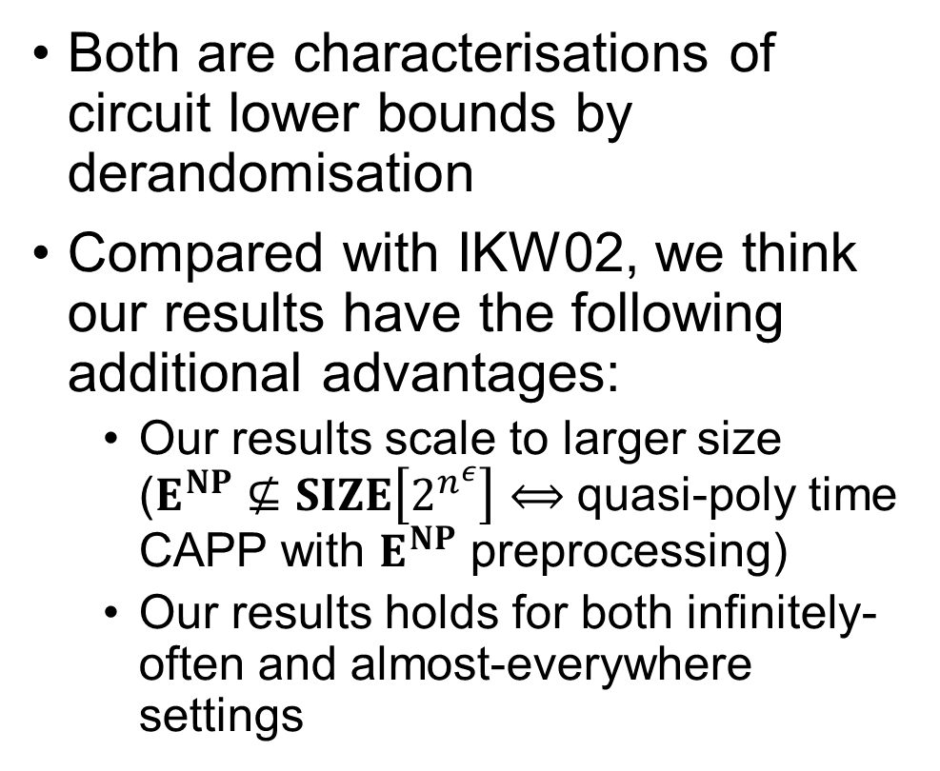
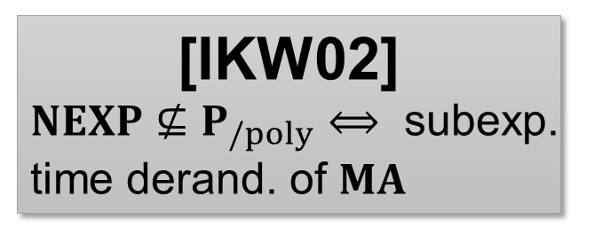
Comparison with IKW’02
Both are characterisations of circuit lower bounds by derandomisation
Compared with IKW02, we think our results have the following additional advantages:
Our results scale to larger size ($E^{NP}⊈SIZE\left[2^{n^{ε}}\right]⟺$ quasi-poly time CAPP with $E^{NP}$ preprocessing)
Our results holds for both infinitely-often and almost-everywhere settings
[IKW02]
$NEXP⊈P_{/poly}⟺$ subexp. time derand. of $MA$
Our result
$E^{NP}⊈P_{/poly}⟺$ non-trivial CAPP with $E^{NP}$ preprocessing
Also $⟺$ subexp. time CAPP with $E^{NP}$ preprocessing
19 / 31

Slide 24


Other Results
A reduction from ${NC}^{1}$-$Avoid$ to ${NC}^{0}$-$Avoid$
Using the randomised encoding tricks of Applebaum-Ishai-Kushilevitz
Characterising “$Avoid∈FP$” and “$Avoid∈FNP$”
In particular, “$Avoid∈FNP$” is connected to proof complexity generators
See the paper!
https://eccc.weizmann.ac.il/report/2022/048
Why study $ℭ$-$Avoid$?
Reason 2
Reveals some new phenomena…
20 / 31

Slide 25
Proof Ideas
Range Avoidance
Algorithmic Method
Our Results
Proof Ideas
Summary
Rectangular PCP (of proximity)!

Slide 26







Recap: $NEXP⊈{ACC}^{0}$
How would you prove $NEXP⊈{ACC}^{0}$?
Ingredient 1: nondeterministic time hierarchy theorem
$L∈NTIME\left[2^{n}\right] \backslash NTIME\left[2^{n}/n\right]$.
Plan: if $L$ has “easy witness”, then speed up $L$ into $NTIME\left[2^{n}/n\right]$!
Witnesses that are truth tables of ${ACC}^{0}$ circuits!
Using the non-trivial algorithm for ${ACC}^{0}$ circuits!
Speed-up attempt for $L$
On input $x∈{\left\{0,1\right\}}^{n}$:
Guess an ${ACC}^{0}$ circuit $C$ such that $tt\left(C\right)$ is a witness for $x$
Check that $tt\left(C\right)$ is indeed a witness for $x$
If this algorithm runs in $2^{n}/n$ time, then it must fail to compute $L$
How to implement step (2)?
An ${ACC}^{0}$ circuit lower bound!
21 / 31

Slide 27





Speed-Up via PCP
Given an ${ACC}^{0}$ circuit $C$, verify $tt\left(C\right)$ is a witness for $x∈L$
Ingredient 2: the PCP theorem!
Verify $tt\left(C\right)$ is a PCP proof that $x∈L$
Let $p_{acc}=\underset{seed}{Pr}{[V^{π}\left(seed\right) accepts]}.$
Completeness: if $x∈L$, then there is a proof $π$ s.t. $p_{acc}=1$
Soundness: if $x∉L$, then for any proof $π$, $p_{acc}≤1/2$
Efficiency: if $π$ is the truth table of an ${ACC}^{0}$ circuit, then $V^{π}\left(seed\right)$ is also an ${ACC}^{0}$ circuit
To check if $tt\left(C\right)$ is a valid PCP proof, we simply estimate $p_{acc}$
Using the non-trivial algorithm for ${ACC}^{0}$ circuits!
PCP verifier
$$seed$$
PCP proof for $x∈L$
$$C$$
22 / 31

Slide 28






Wrap Up: Proof of $NEXP⊈{ACC}^{0}$
Ingredient 1: nondeterministic time hierarchy theorem
$L∈NTIME\left[2^{n}\right] \backslash NTIME\left[2^{n}/n\right]$
Ingredient 2: PCP theorem
In step (2), it suffices to distinguish between $p_{acc}=1$ and $p_{acc}≤1/2$
We can use the non-trivial algorithm for ${ACC}^{0}$ to estimate $p_{acc}$
Speed-up attempt for $L$
On input $x∈{\left\{0,1\right\}}^{n}$:
Guess an ${ACC}^{0}$ circuit $C$ such that $tt\left(C\right)$ is a PCP witness for $x$
Check that $tt\left(C\right)$ is indeed a witness for $x$ by estimating $p_{acc}$
This algorithm runs in $2^{n}/n$ time, so it must fail to compute $L$
An ${ACC}^{0}$ circuit lower bound!
I’m cheating a bit: this only gives you a witness lower bound against ${ACC}^{0}$. To derive $NEXP⊈{ACC}^{0}$ we need to use the easy witness lemma. (But EWL is not needed in this talk.)
23 / 31

Slide 29












Adapting $NEXP⊈{ACC}^{0}$ To Avoidance?
Suppose we want to find a non-output of $C:{\left\{0,1\right\}}^{n}→{\left\{0,1\right\}}^{ℓ}$.
Again, we start with $L∈NTIME\left[T\left(N\right)\right] \backslash NTIME\left[o\left(T\left(N\right)\right)\right]$.
Plan: if $L$ has “easy witness”, then speed up $L$ into $NTIME\left[o\left(T\left(N\right)\right)\right]$!
Witnesses that are of the form $C\left(x\right)$
Speed-up attempt for $L$
On input $x∈{\left\{0,1\right\}}^{N}$:
Guess $w∈{\left\{0,1\right\}}^{n}$ such that $C\left(w\right)$ is a PCP witness for $x$
Check that $C\left(w\right)$ is indeed a witness for $x$ by estimating $p_{acc}$
Using the non-trivial data structure!
Here $ℓ\left(n\right)≈T\left(N\right)$
Big obstacle:
$C$ itself requires more than $ℓ\left(n\right)≥T\left(N\right)$ bits to describe!
If this algorithm runs in $o\left(T\left(N\right)\right)$ time, then it must fail to compute $L$
PCP verifier
$$seed$$
How could the speed-up algorithm run in $o\left(T\left(N\right)\right)$ time?
$C\left(w\right)=$ witness
Find a hard witness!
$$C$$
$$w$$
24 / 31

Slide 30









Idea 1: Make Copies!
Instead of avoidance for $C$, let’s solve avoidance for $C^{H}$
$C^{H}\left(w_{1},w_{2},…,w_{H}\right)=C\left(w_{1}\right)C\left(w_{2}\right)…C\left(w_{H}\right)$
If we find a non-output of $C^{H}$, then we can find a non-output of $C$ using an $NP$ oracle
Now, we need to estimate $p_{acc}≔\underset{seed}{Pr}{[V^{π}\left(seed\right) accepts]}$ in less than $o\left(T\left(N\right)\right)<H⋅ℓ$ time.
PCP verifier
$$seed$$
PCP witness for $x∈L$
$$C$$
$$C$$
$$C$$
$$⋯$$
$$C$$
$$π=C\left(w_{1}\right)C\left(w_{2}\right)…C\left(w_{H}\right)$$
Possible in principle!
But HOW?
Description length of $C≈ℓ$
Input length is $H⋅n≪H⋅ℓ$
25 / 31

Slide 31






Idea 2: Rectangular PCP!
We need to estimate $p_{acc}≔\underset{seed}{Pr}{[V^{π}\left(seed\right) accepts]}$
Where $π=C\left(w_{1}\right)C\left(w_{2}\right)…C\left(w_{H}\right)$ is the PCP proof
Our solution: rectangular PCPs! [BHPT’20]
Proof is an $H×W$ matrix ($HW≈T\left(N\right)$)
$seed$ is partitioned into $seed.row$ and $seed.col$
Rectangularity roughly means: query row indices only depend on $seed.row$ query column indices only depend on $seed.col$
The PCP should have some structures!
How the PCP verifier generates queries
$\left(r_{1},r_{2},…,r_{q}\right)←V_{row}\left(seed.row\right)$
$\left(c_{1},c_{2},…,c_{q}\right)←V_{col}\left(seed.col\right)$
Query $π\left[r_{1},c_{1}\right], π\left[r_{2},c_{2}\right],…,π\left[r_{q},c_{q}\right]$
$$π$$
$$seed.row$$
$$seed.col$$
PCP verifier
I’m cheating (again): this is perfect rect PCP, but we only have “almost” rect PCP…
26 / 31

Slide 32













Idea 2: Rectangular PCP!
We need to estimate $p_{acc}≔\underset{seed}{Pr}{[V^{π}\left(seed\right) accepts]}$
Where $π$ is an $H×W$ matrix, the $i$-th row is $C\left(w_{i}\right)$
Fix $seed.row$. Then the verifier only looks at the $r_{1},r_{2},…,r_{q}$-th row.
$$seed.col$$
$$c_{1}$$
$$c_{2}$$
$$c_{q}$$
$$C\left(w_{r_{1}}\right)$$
$$C\left(w_{r_{2}}\right)$$
$$⋯$$
$$C\left(w_{r_{q}}\right)$$
How the PCP verifier generates queries
$\left(r_{1},r_{2},…,r_{q}\right)←V_{row}\left(seed.row\right)$
$\left(c_{1},c_{2},…,c_{q}\right)←V_{col}\left(seed.col\right)$
Query $π\left[r_{1},c_{1}\right], π\left[r_{2},c_{2}\right],…,π\left[r_{q},c_{q}\right]$
$$π$$
$$C\left(w_{1}\right)$$
$$seed.row$$
$$seed.col$$
$$C\left(w_{2}\right)$$
$$⋮$$
PCP verifier
$$C\left(w_{H}\right)$$
27 / 31

Slide 33










Idea 2: Rectangular PCP!
For every $seed=\left(seed.row,seed.col\right)$, if we feed $\left(w_{r_{1}},w_{r_{2}},…,w_{r_{q}}\right)$ into $C^{′}$, then its $seed.col$-th output is 1 iff $V^{π}\left(seed\right)$ accepts!
Furthermore, $C′$ is an ${NC}^{0}∘C$ circuit with $2^{\left|seed.col\right|}$ many outputs.
$$seed.col=0^{\left|seed.col\right|}$$
$$seed.col=1^{\left|seed.col\right|}$$
$$seed.col$$
$$C\left(w_{r_{1}}\right)$$
$$C\left(w_{r_{2}}\right)$$
$$⋯$$
$$C\left(w_{r_{q}}\right)$$
$$C$$
$$C$$
$$C$$
Circuit $C^{′}$
$$w_{r_{1}}$$
$$w_{r_{2}}$$
$$w_{r_{q}}$$
28 / 31

Slide 34






Estimaing $p_{acc}$ via Rectangular PCP
For every $seed=\left(seed.row,seed.col\right)$, if we feed $\left(w_{r_{1}},w_{r_{2}},…,w_{r_{q}}\right)$ into $C^{′}$, then its $seed.col$-th output is 1 iff $V^{π}\left(seed\right)$ accepts!
Furthermore, $C′$ is an ${NC}^{0}∘C$ circuit with $2^{\left|seed.col\right|}$ many outputs.
To estimate $p_{acc}=\underset{seed}{Pr}{[V^{π}\left(seed\right) accepts]}$:
Preprocess $C′$ using the data structure
Enumerate $seed.row$, let $p_{acc}\left(seed.row\right)≔Hamming\left(C^{′}\left(w_{r_{1}},…,w_{r_{q}}\right)\right)$
Finally, $p_{acc}=𝔼_{seed.row}\left[p_{acc}\left(seed.row\right)\right]$
This is non-trivial time: $2^{\left|seed.row\right|}×o\left(2^{\left|seed.col\right|}\right)=o\left(T\left(N\right)\right)$
$$C^{′}$$
$$w_{r_{1}}$$
$$⋯$$
$$w_{r_{q}}$$
Use the non-trivial data structure!
(Non-trivial) query time of the data structure
29 / 31

Slide 35





Wrap-Up: Non-trivial Data Structures $⟹$ Avoidance in ${FP}^{NP}$
Ingredient 1: nondeterministic time hierarchy theorem
$L∈NTIME\left[T\left(N\right)\right] \backslash NTIME\left[o\left(T\left(N\right)\right)\right]$
Ingredient 2: rectangular PCP
I cheated a bit: we actually need an $NTIME$ hierarchy with a $P^{NP}$-refuter [CLW’20] and against $N/10$ advice
I cheated two bits: we actually need a rectangular PCP of proximity
Avoidance algorithm
On input $C$:
Preprocess $C′$ in $P^{NP}$
Construct the speed-up algorithm $L^{speed}$
Use the refuter to find (in $P^{NP}$) a string $x$, such that $L\left(x\right)≠L^{speed}\left(x\right)$ It must be the case that $x∈L$ but doesn’t have “easy witness”
Use the $NP$ oracle to find any witness of $x$, and cut it into $H$ pieces
There must be one piece that is a non-output of $C$, use the $NP$ oracle to find out which.
Speed-up attempt for $L$
On input $x∈{\left\{0,1\right\}}^{N}$:
Guess $w_{1},w_{2},…,w_{H}$ such that $C\left(w_{1}\right)C\left(w_{2}\right)…C\left(w_{H}\right)$ is a PCP proof for $x∈L$
Check the proofs by estimating $p_{acc}$: construct $C′$, enumerate $seed.row$, and use the non-trivial data structure.
30 / 31

Slide 36

Summary
Range Avoidance
Algorithmic Method
Our Results
Proof Ideas
Summary
This talk in one slide…

Slide 37


Summary
Range Avoidance: given a circuit $C:{\left\{0,1\right\}}^{n}→{\left\{0,1\right\}}^{ℓ}$ ($ℓ>n$), find a non-output of $C$
Captures many explicit construction problems
Want deterministic algorithms (or even ${FP}^{NP}$ ones!)
Our result I: non-trivial data structures for Hamming Weight Estimation implies ${FP}^{NP}$ algorithms for range avoidance!
Generalising Ryan Williams’s Algorithmic Method
Take-home msg: Alg method is for range avoidance; lower bounds are just one application ☺
Our result II: Lower bounds for $E^{NP}$ = “CAPP with $E^{NP}$ preprocessing”
$$C$$
Technical ingredient: rectangular PCPs
Thank you!
Questions are welcome! ☺
31 / 31

