Slide 1
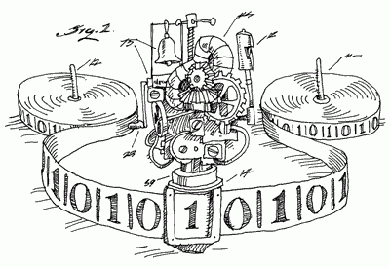
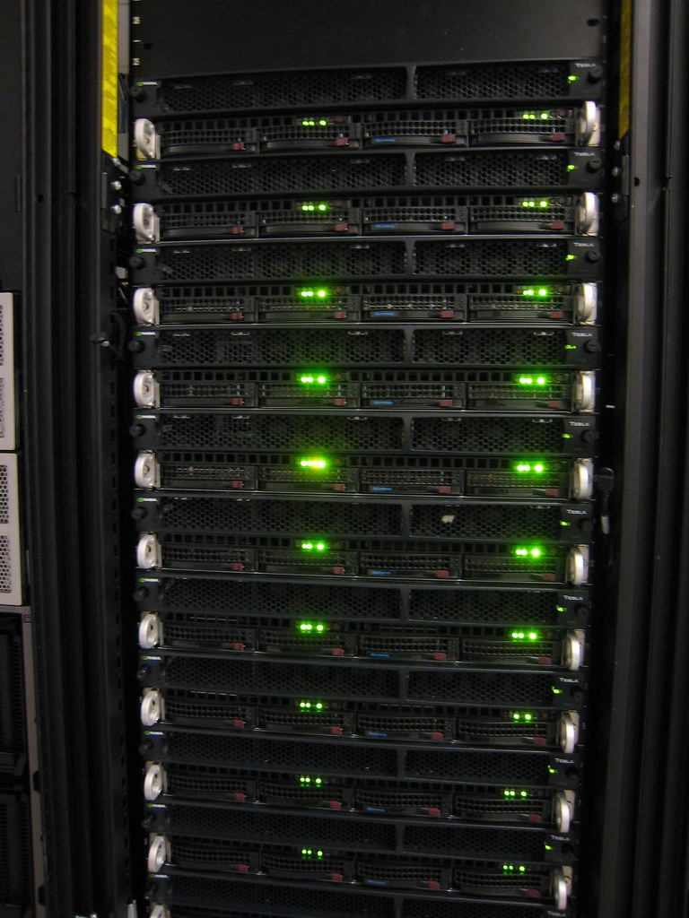

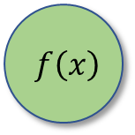
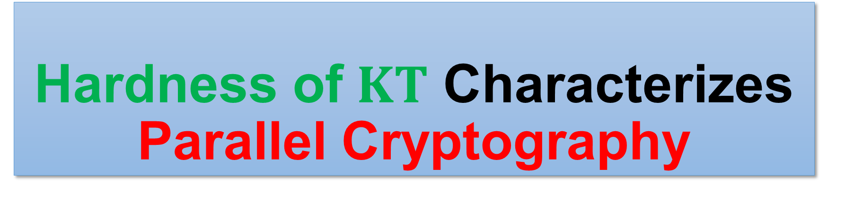



Hardness of $KT$ Characterizes Parallel Cryptography
Hanlin Ren (Oxford)
Based on a joint work with Rahul Santhanam (CCC’21)
DIMACS Workshop on Meta-Complexity, Barriers, and Derandomization
$$f\left(x\right)$$
$$f\left(x\right)$$
$$x$$
$$x$$
1 / 15

Slide 2
Background: Meta-Complexity
Background: Meta-Complexity
Background: Cryptography
Our Results
“Complexity of complexity”

Slide 3
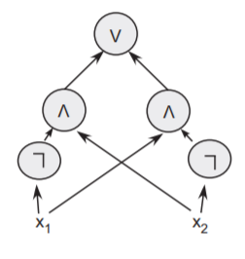

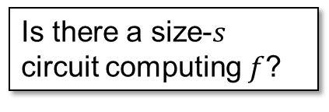


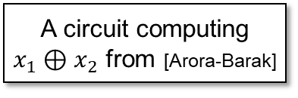
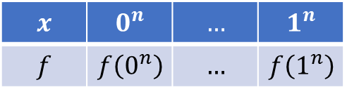
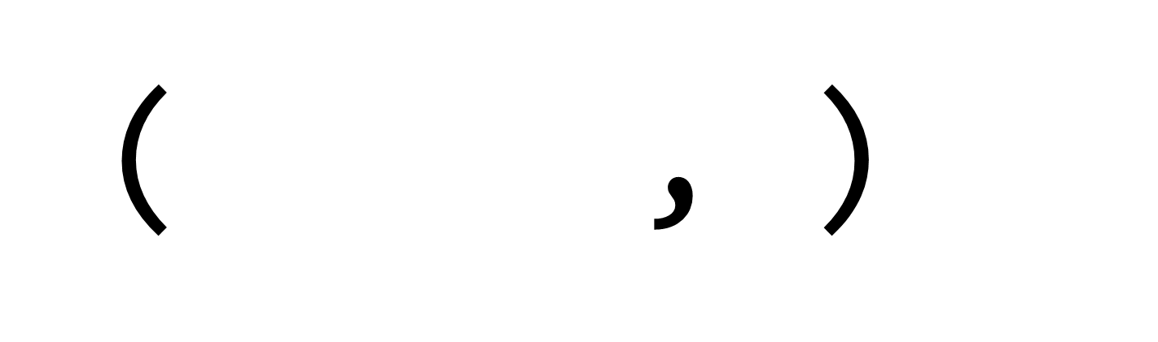

Minimum Circuit Size Problem
Circuits:
DAGs with AND/OR/NOT gates that compute some function
Circuit complexity: size of the smallest circuit computing a certain function (e.g. $SAT$)?
$MCSP$: Given an input function, what’s the smallest circuit computing it?
$MCSP=\left\{\left(f, s\right):Circuit_Complexity\left(f\right)≤s\right\}$
A circuit computing $x_{1}⊕x_{2}$ from [Arora-Barak]
( ,$s$)
$$s$$
$$⟹$$
$$x$$ | $$0^{n}$$ | $$…$$ | $$1^{n}$$
$$f$$ | $$f\left(0^{n}\right)$$ | $$…$$ | $$f\left(1^{n}\right)$$
Is there a size-$s$ circuit computing $f$?
2 / 15

Slide 4

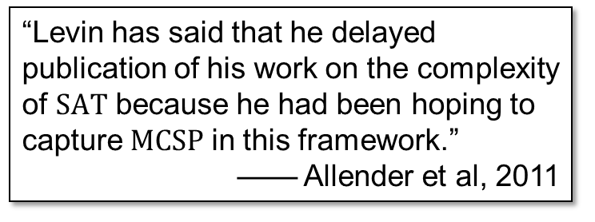
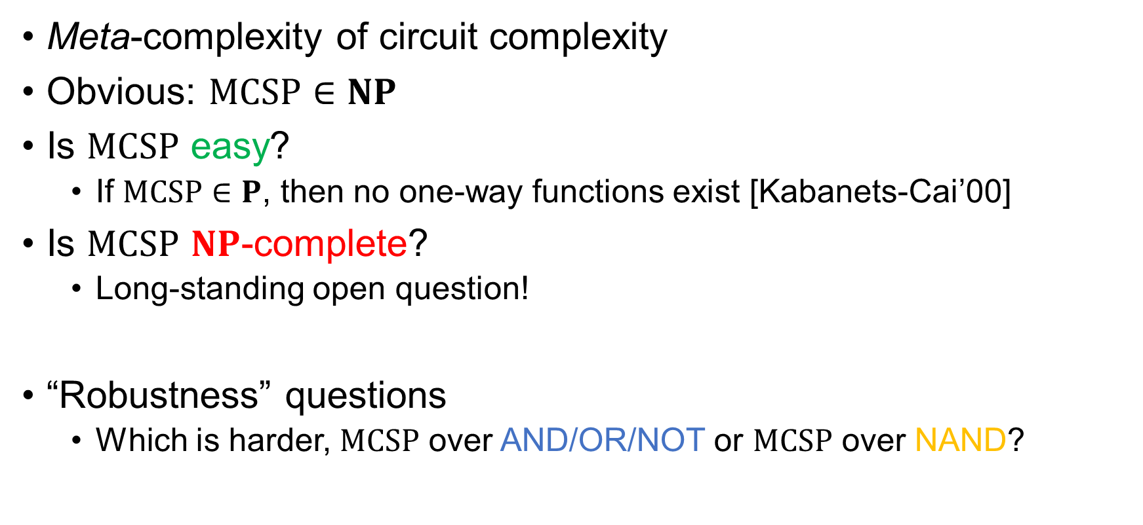
The Complexity of $MCSP$
Meta-complexity of circuit complexity
Obvious: $MCSP∈NP$
Is $MCSP$ easy?
If $MCSP∈P$, then no one-way functions exist [Kabanets-Cai’00]
Is $MCSP$ $NP$-complete?
Long-standing open question!
“Robustness” questions
Which is harder, $MCSP$ over AND/OR/NOT or $MCSP$ over NAND?
“Levin has said that he delayed publication of his work on the complexity of $SAT$ because he had been hoping to capture $MCSP$ in this framework.”
—— Allender et al, 2011
3 / 15

Slide 5
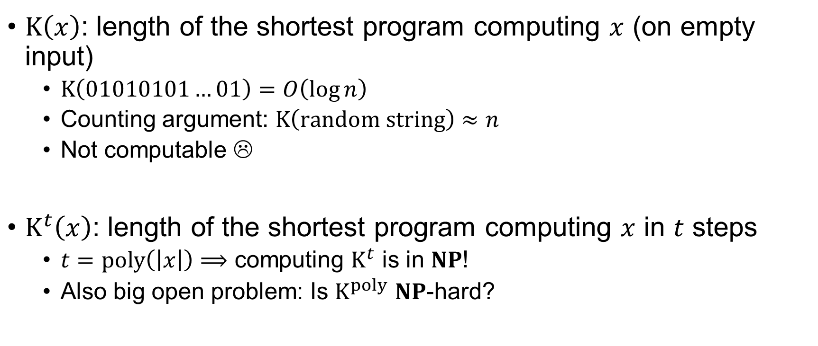

Time-Bounded Kolmogorov Complexity and Its Meta-Complexity
$K\left(x\right)$: length of the shortest program computing $x$ (on empty input)
$K\left(01010101…01\right)=O\left(\log{n}\right)$
Counting argument: $K\left(random string\right)≈n$
Not computable ☹
$K^{t}\left(x\right)$: length of the shortest program computing $x$ in $t$ steps
$t=poly\left(\left|x\right|\right)⟹$ computing $K^{t}$ is in $NP$!
Also big open problem: Is $K^{poly}$ $NP$-hard?
print("01" * (n/2))
Henceforth $K^{poly}$
4 / 15

Slide 6

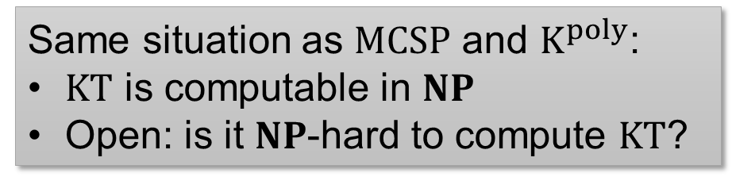

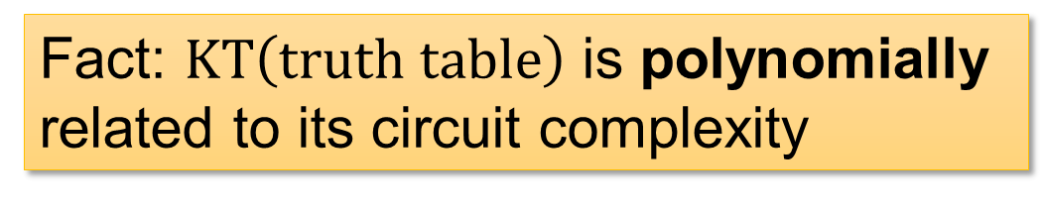
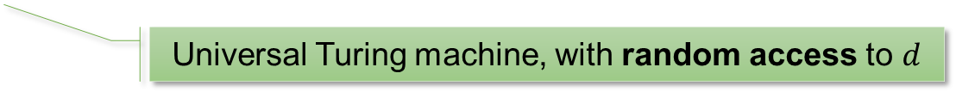





$KT$ Complexity
A Kolmogorov-version of circuit complexity [Allender’01]
$KT\left(x\right)≔\min\left\{\left|d\right|+t:∀i,U^{d}\left(i\right)=x_{i} in t steps\right\}$
Universal Turing machine, with random access to $d$
Fact: $KT\left(truth table\right)$ is polynomially related to its circuit complexity
$$x_{i}$$
$$x_{i}$$
… but $KT$ is sometimes more convenient to deal with.
circuit
$$≈$$
Same situation as $MCSP$ and $K^{poly}$:
$KT$ is computable in $NP$
Open: is it $NP$-hard to compute $KT$?
$$i$$
$$i$$
5 / 15

Slide 7
Background: Cryptography
Background: Meta-Complexity
Background: Cryptography
Our Results

Slide 8

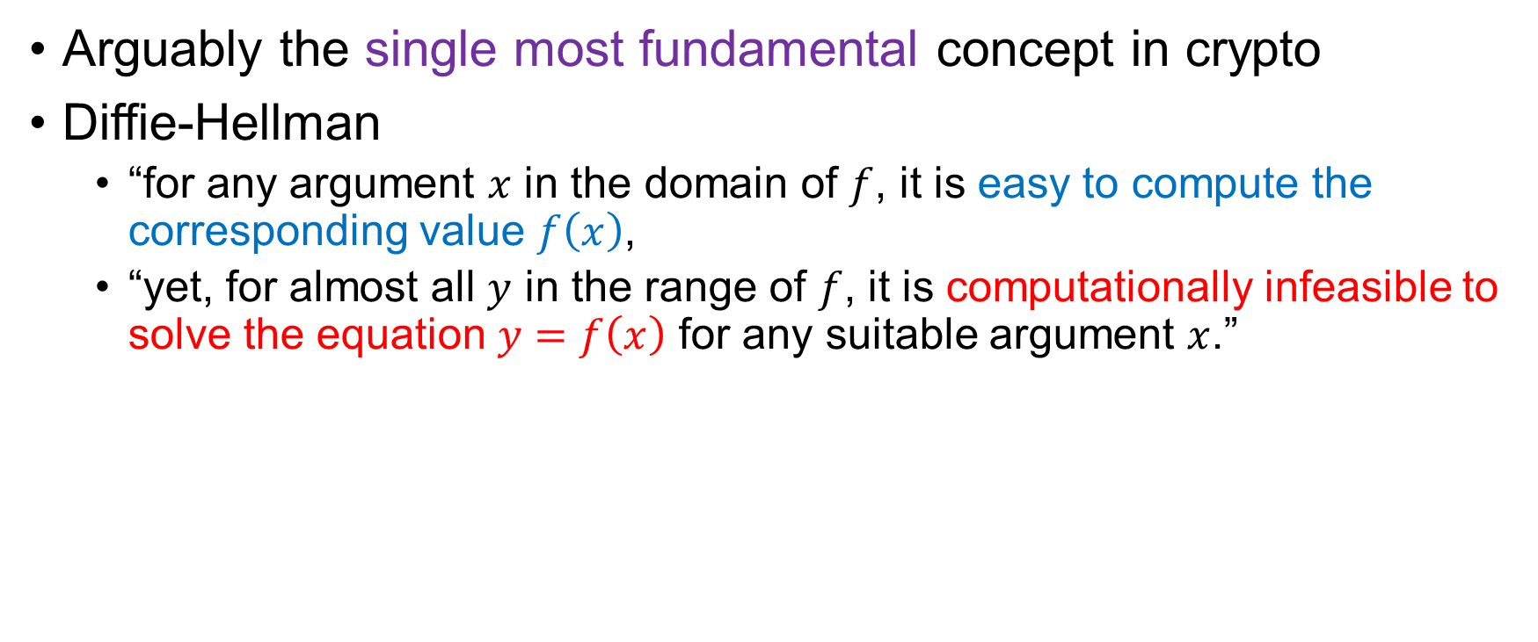
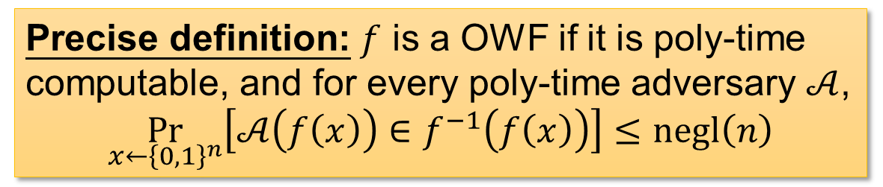

One-Way Functions
Arguably the single most fundamental concept in crypto
Diffie-Hellman
“for any argument $x$ in the domain of $f$, it is easy to compute the corresponding value $f\left(x\right)$,
“yet, for almost all $y$ in the range of $f$, it is computationally infeasible to solve the equation $y=f\left(x\right)$ for any suitable argument $x$.”
easy
A factoring-based candidate
1 def f(x):
2 use x as random bits to sample two primes p, q
3 return p*q
$$f\left(x\right)$$
$$x$$
hard
Precise definition: $f$ is a OWF if it is poly-time computable, and for every poly-time adversary $𝒜$,
$$\underset{x←{\left\{0,1\right\}}^{n}}{Pr}\left[𝒜\left(f\left(x\right)\right)∈f^{−1}\left(f\left(x\right)\right)\right]≤negl\left(n\right)$$
6 / 15
Notes:
The precise def is just to emphasize it’s an average-case definition

Slide 9



OWFs are Fundamental
Why are OWFs fundamental?
Reason 1: necessary for (almost all) crypto [IL’89]
Reason 2: sufficient for “minicrypt”
OWF $⟺$
Private-key encryption,
Pseudorandom generators,
Digital signatures,
Authentication schemes,
Pseudorandom functions,
Commitment schemes,
Coin-tossing,
ZK proofs…
(from Yanyi’s FOCS’20 slides)
NOT (known to) include:
Public-key encryption,
Obfuscation
easy
$$f\left(x\right)$$
$$x$$
hard
7 / 15

Slide 10
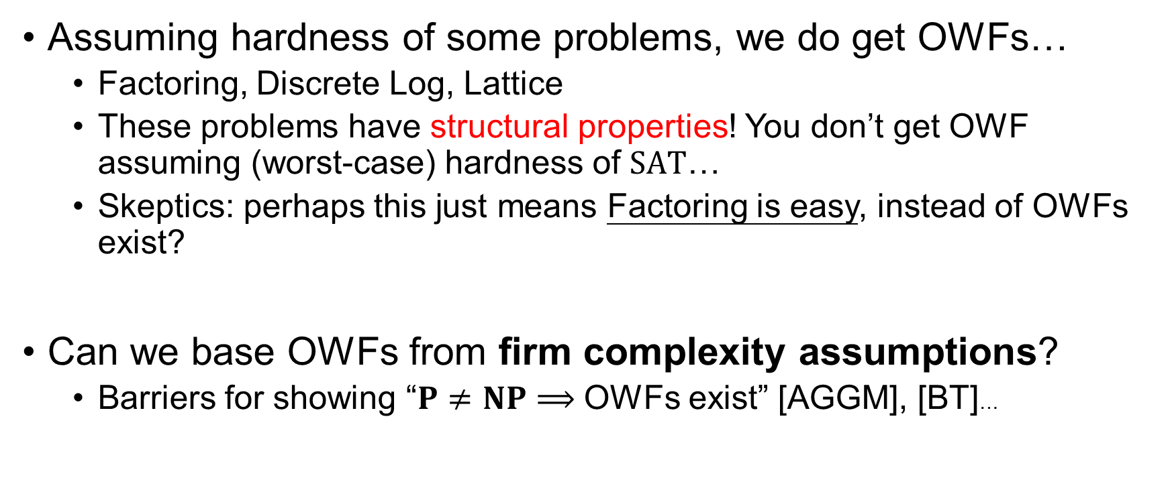
Do OWFs Exist?
Assuming hardness of some problems, we do get OWFs…
Factoring, Discrete Log, Lattice
These problems have structural properties! You don’t get OWF assuming (worst-case) hardness of $SAT$…
Skeptics: perhaps this just means Factoring is easy, instead of OWFs exist?
Can we base OWFs from firm complexity assumptions?
Barriers for showing “$P≠NP⟹$ OWFs exist” [AGGM], [BT]…
8 / 15

Slide 11

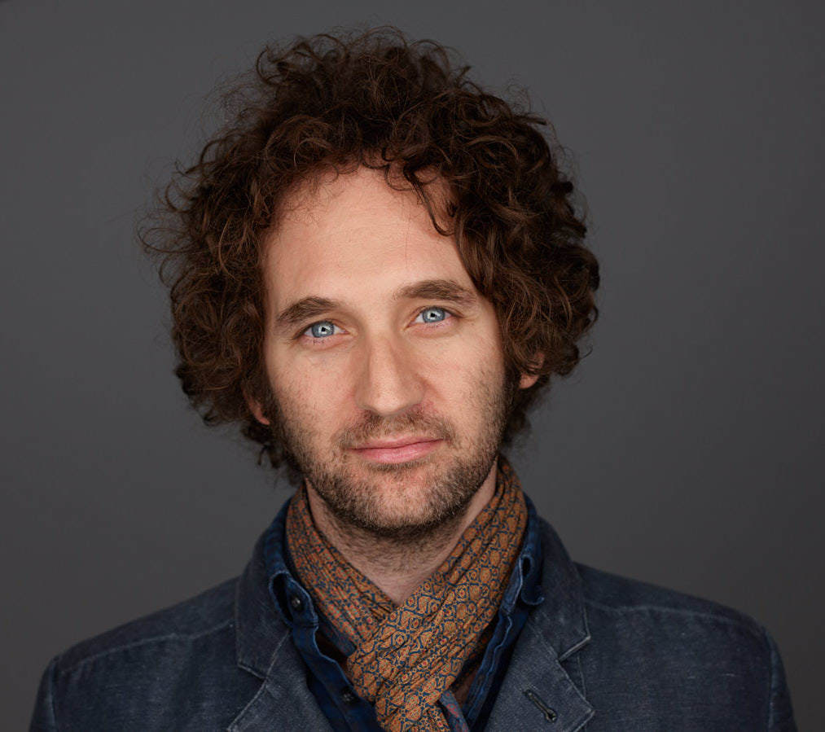

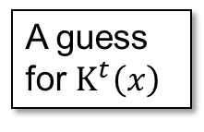

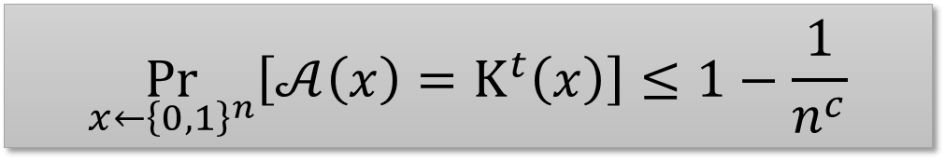
The Liu-Pass Result
“On One-Way Functions and Kolmogorov Complexity”
Theorem: $K^{poly}$ is bounded-error hard on average if and only if OWFs exist
Characterizing the central crypto primitive (OWF) by the complexity of a natural problem over the uniform distribution!
Poly-time heuristic
A guess for $K^{t}\left(x\right)$
$$x$$
Exists an absolute constant $c$, for every poly-time heuristic $𝒜$,
$$\underset{x←{\left\{0,1\right\}}^{n}}{Pr}\left[𝒜\left(x\right)=K^{t}\left(x\right)\right]≤1−\frac{1}{n^{c}}$$
Base crypto on firm complexity assumptions!
(How could you do better than a characterization?)
9 / 15
Notes:
K^poly is an independently interesting notion!

Slide 12
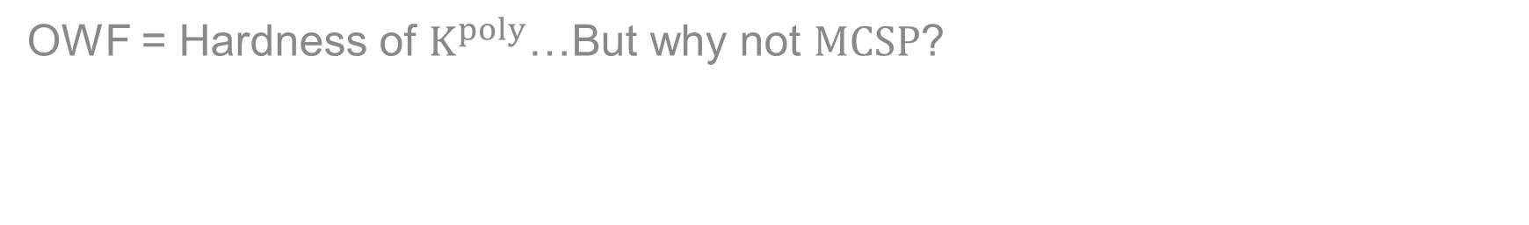
Our Results
Background: Meta-Complexity
Background: Cryptography
Our Results
OWF = Hardness of $K^{poly}$…But why not $MCSP$?

Slide 13







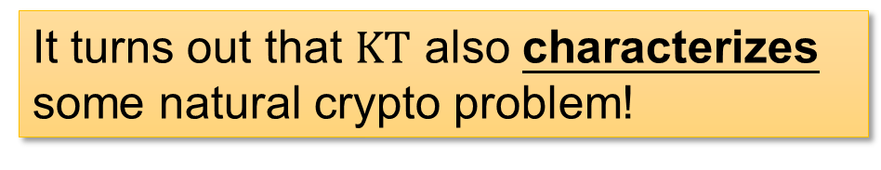

Our Result 1
Theorem (Main). $KT$ is (bounded-error) hard on average if and only if there exist one-way functions in (uniform) ${NC}^{0}$.
It turns out that $KT$ also characterizes some natural crypto problem!
SUPER easy (${NC}^{0}$)
$$output$$
$$f\left(x\right)$$
$$O\left(1\right)$$
$$x$$
$$input$$
hard
${NC}^{0}$: each output bit only depends on $O\left(1\right)$ input bits
10 / 15

Slide 14
















Cryptography in ${NC}^{0}$
[Applebaum-Ishai-Kushilevitz, FOCS’04]
OWF computable in ${NC}^{1}$ or even $LOGSPACE$ implies OWF computable in ${NC}^{0}$
${NC}^{0}$-OWF follows from most standard crypto assumptions!
$$P$$
$$⋯$$
$${NC}^{2}$$
$$LOGSPACE$$
$$LOGSPACE$$
$${NC}^{0}$$
$${NC}^{1}$$
$$f\left(x\right)$$
“AIK compiler”
$$f^{∗}\left(x\right)$$
$$x$$
$$x$$
$${TC}^{0}$$
(contains most arithmetic operations)
hard
ALSO hard
$${AC}^{0}$$
(could do addition)
$${NC}^{0}$$
11 / 15

Slide 15

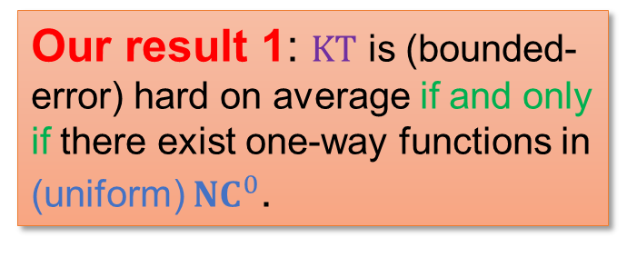


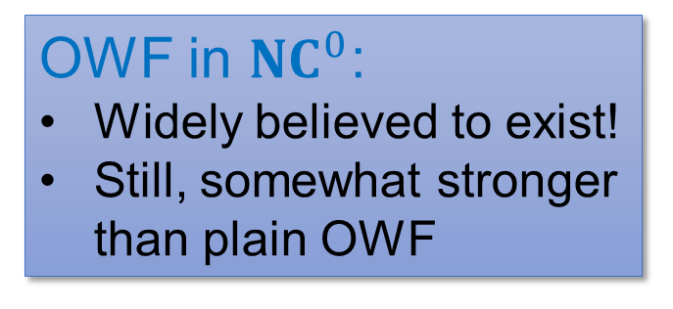








Wrap Up
$$KT\left(x\right)≔\min\left\{\left|d\right|+t:∀i,U^{d}\left(i\right)=x_{i} in t steps\right\}$$
${NC}^{0}$: a super easy class
$$x_{i}$$
$$output$$
$$O\left(1\right)$$
Polynomially related to circuit complexity…
$$input$$
${NC}^{0}$: each output bit only depends on $O\left(1\right)$ input bits
$$i$$
OWF in ${NC}^{0}$:
Widely believed to exist!
Still, somewhat stronger than plain OWF
Our result 1: $KT$ is (bounded-error) hard on average if and only if there exist one-way functions in (uniform) ${NC}^{0}$.
SUPER easy (${NC}^{0}$)
$$f\left(x\right)$$
$$x$$
hard
12 / 15

Slide 16


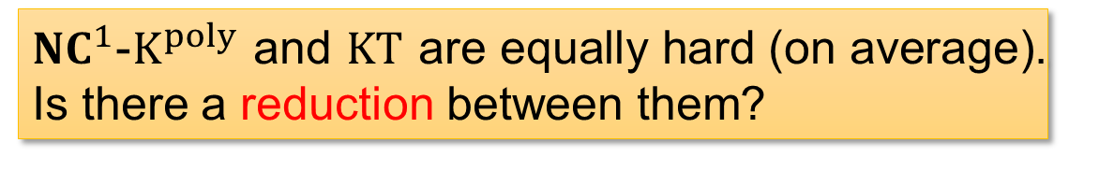
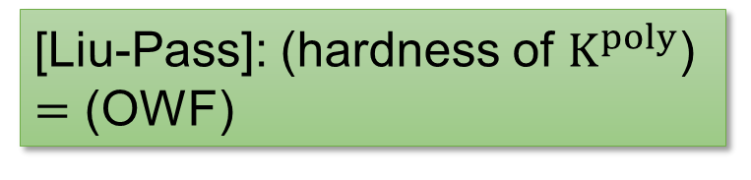
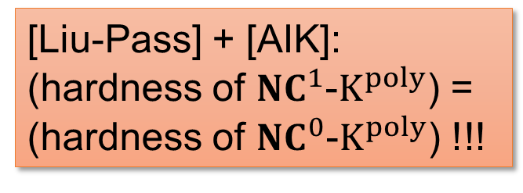
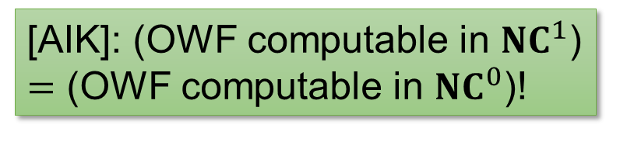


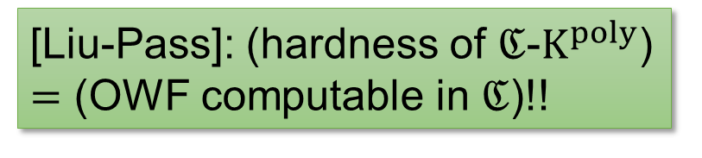
Our Result 2: AIK as a Reduction
[Liu-Pass]: (hardness of $K^{poly}$) $=$ (OWF)
[Liu-Pass]: (hardness of $ℭ$-$K^{poly}$) $=$ (OWF computable in $ℭ$)!!
[AIK]: (OWF computable in ${NC}^{1}$) $=$ (OWF computable in ${NC}^{0}$)!
(for “reasonable” $ℭ$)
[Liu-Pass]
[AIK]
[Liu-Pass] + [AIK]: (hardness of ${NC}^{1}$-$K^{poly}$) = (hardness of ${NC}^{0}$-$K^{poly}$) !!!
For now, think of ${NC}^{0}$-$K^{poly}≈KT$
${NC}^{1}$-$K^{poly}$ and $KT$ are equally hard (on average). Is there a reduction between them?
13 / 15
Notes:
Crypto techniques (?) to understand meta-complexity

Slide 17
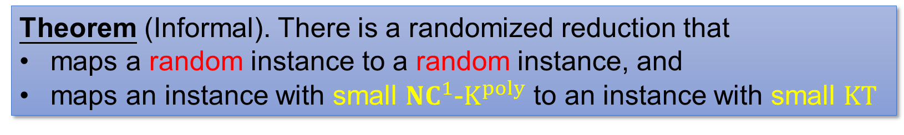
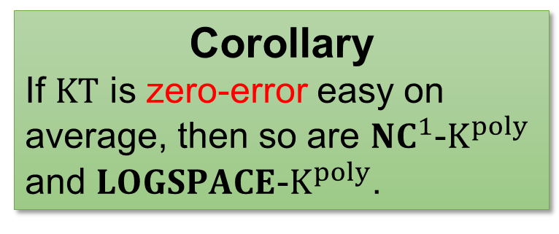
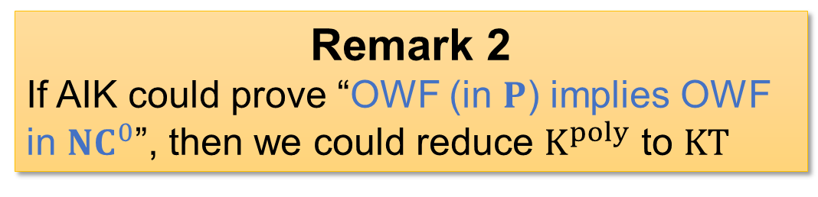
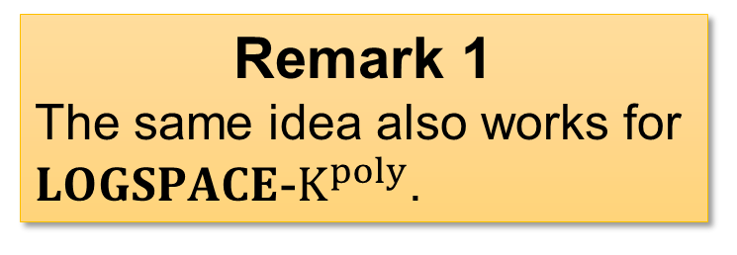
Our Result 2: AIK as a Reduction
Theorem (Informal). There is a randomized reduction that
maps a random instance to a random instance, and
maps an instance with small ${NC}^{1}$-$K^{poly}$ to an instance with small $KT$
Remark 1
The same idea also works for $LOGSPACE$-$K^{poly}$.
Remark 2
If AIK could prove “OWF (in $P$) implies OWF in ${NC}^{0}$”, then we could reduce $K^{poly}$ to $KT$
Previously, it’s unknown if $K^{poly}$ and $KT$ has ANY connection at all!!!
Corollary
If $KT$ is zero-error easy on average, then so are ${NC}^{1}$-$K^{poly}$ and $LOGSPACE$-$K^{poly}$.
Lesson: By opening the magical black-box of AIK, we also obtain nontrivial consequences on zero-error average-case complexity of meta-complexity!
14 / 15

Slide 18



One Slide for $MCSP$…
Circuit complexity is messier to deal with…
Theorem. If $MCSP$ is exponentially hard on average, then there is a (super-poly) hard OWF.
Theorem. If there is an exponentially-hard (weak) OWF in ${NC}^{0}$, then $MCSP$ is (exponentially) hard on average.
Open: implement this OWF in ${NC}^{0}$!
If $KT$ is (super-poly) hard on average, then there is a (super-poly) OWF in ${NC}^{0}$
If there is a (super-poly) OWF in ${NC}^{0}$, then $KT$ is (super-poly) hard on average
15 / 15

Slide 19
Thank you!

