Slide 1

Maintaining Exact Distances under Multiple Edge Failures
Ran Duan
Tsinghua
Hanlin Ren
Oxford
STOC’22
1 / 16

Slide 2

The Problem
Problem: given a graph, deal with failures.
Example: $Query\left(u,v,D\right)=$ shortest path from $u$ to $v$ that avoids $D$
source vertex
target vertex
failed edge
optimal path
2 / 16

Slide 3
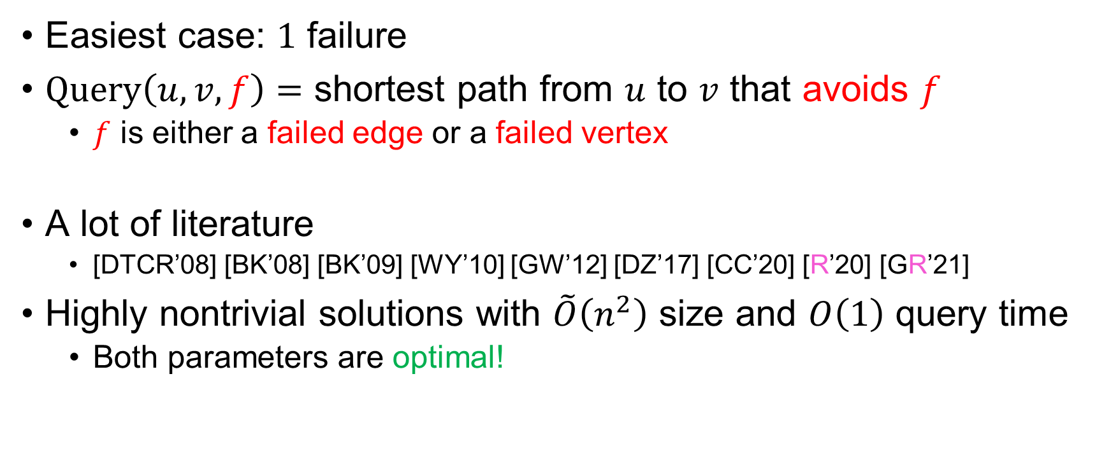
How Hard Is the Problem?
Easiest case: $1$ failure
$Query\left(u,v,f\right)=$ shortest path from $u$ to $v$ that avoids $f$
$f$ is either a failed edge or a failed vertex
A lot of literature
[DTCR’08] [BK’08] [BK’09] [WY’10] [GW’12] [DZ’17] [CC’20] [R’20] [GR’21]
Highly nontrivial solutions with $\tilde{O}\left(n^{2}\right)$ size and $O\left(1\right)$ query time
Both parameters are optimal!
3 / 16

Slide 4
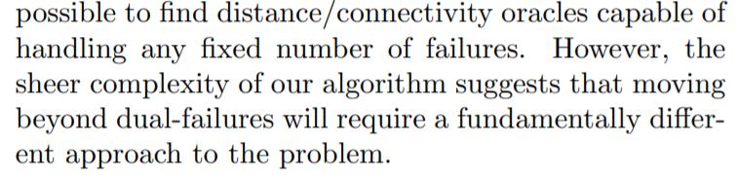

How Hard Is the Problem?
$2$ failures: considerably more complicated
[DP’09]
Space complexity: $\tilde{O}\left(n^{2}\right)$, query time: $O\left(\log{n}\right)$
4 / 16

Slide 5

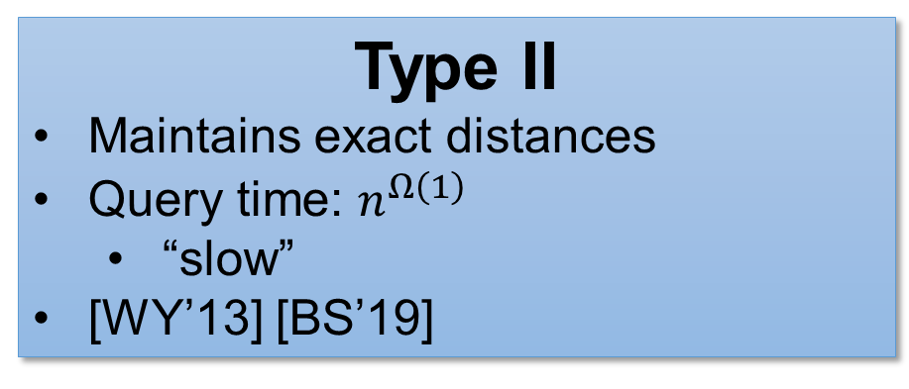
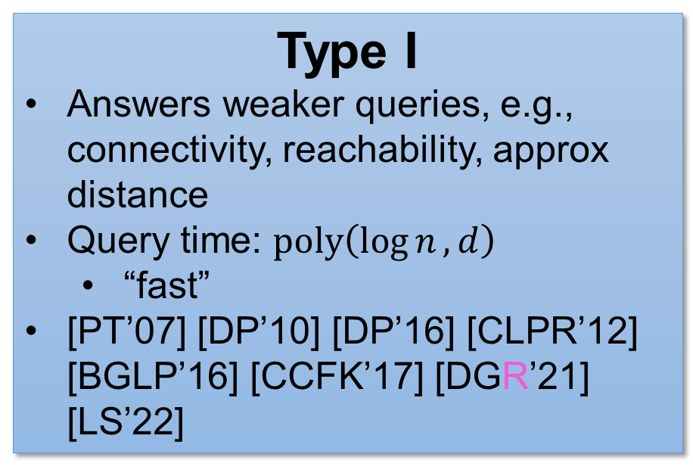
Okay, What about More Failures?
$d$ (vertex / edge) failures
Previous work can be categorised into two types:
Type I
Answers weaker queries, e.g., connectivity, reachability, approx distance
Query time: $poly\left(\log{n},d\right)$
“fast”
[PT’07] [DP’10] [DP’16] [CLPR’12] [BGLP’16] [CCFK’17] [DGR’21] [LS’22]
Type II
Maintains exact distances
Query time: $n^{Ω\left(1\right)}$
“slow”
[WY’13] [BS’19]
5 / 16

Slide 6


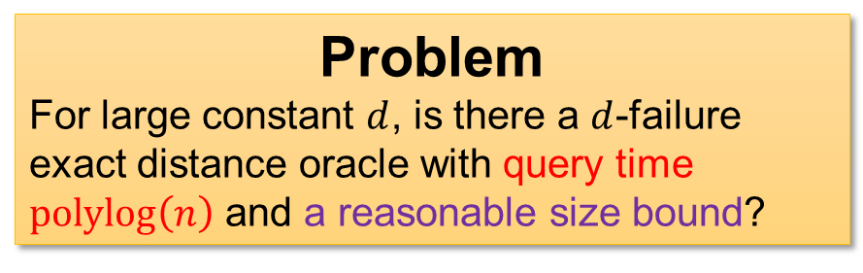
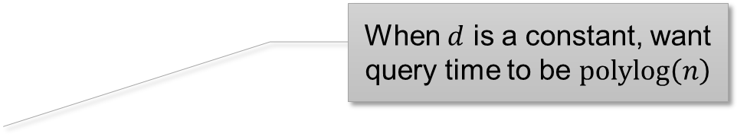
Let’s Focus on Exact Distances…
$d$ (vertex / edge) failures, maintain exact distance
Naïve solution: enumerate all possible queries
Size $O\left(n^{d+2}\right)$, query $O\left(1\right)$
[DP’09]: can achieve size $\tilde{O}\left(n^{d}\right)$, query $O\left(\log{n}\right)$
No other results with fast query time known…
When $d$ is a constant, want query time to be $polylog\left(n\right)$
Problem
For large constant $d$, is there a $d$-failure exact distance oracle with query time $polylog\left(n\right)$ and a reasonable size bound?
An Easier Problem
Is there a $100$-failure exact distance oracle with query time $polylog\left(n\right)$ and size $O\left(n^{99}\right)$?
6 / 16

Slide 7
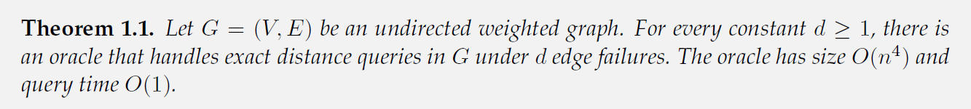


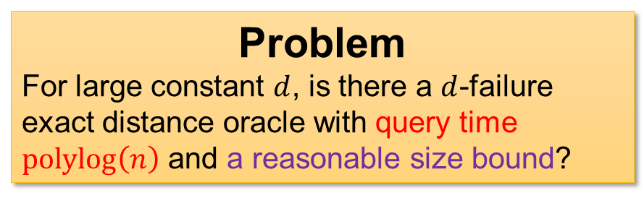
Our Results
√
√
We show the answer is YES!
for undirected graphs and edge failures
Main Result: Query time $d^{O\left(d\right)}$, size $O\left(dn^{4}\right)$.
Problem
For large constant $d$, is there a $d$-failure exact distance oracle with query time $polylog\left(n\right)$ and a reasonable size bound?
An Easier Problem
Is there a $100$-failure exact distance oracle with query time $polylog\left(n\right)$ and size $O\left(n^{99}\right)$?
7 / 16

Slide 8




A Structural Theorem
[ABKCM’02]: Any shortest path under $d$ edge failures can be decomposed into the concatenation of at most $d+1$ shortest paths (in the original graph) interleaved with at most $d$ edges.
An example where $d=3$
$3$ interleaving edges
$4$ shortest paths
8 / 16

Slide 9
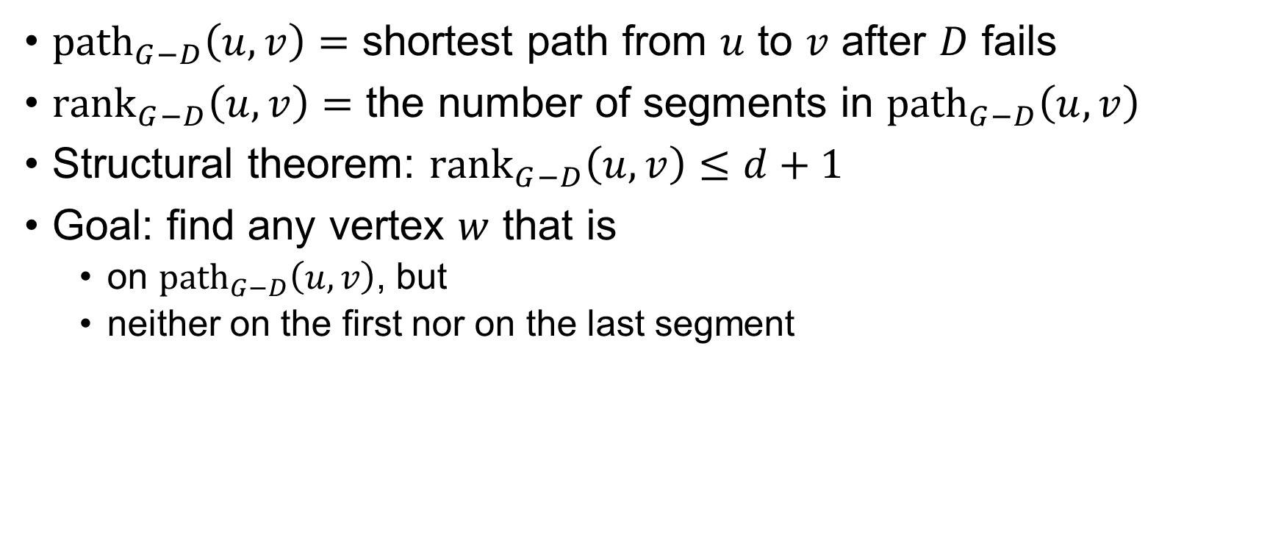



A Recursive Approach
${path}_{G−D}\left(u,v\right)=$ shortest path from $u$ to $v$ after $D$ fails
${rank}_{G−D}\left(u,v\right)=$ the number of segments in ${path}_{G−D}\left(u,v\right)$
Structural theorem: ${rank}_{G−D}\left(u,v\right)≤d+1$
Goal: find any vertex $w$ that is
on ${path}_{G−D}\left(u,v\right)$, but
neither on the first nor on the last segment
“segments” = shortest path in the original (failure-free) graph
$${rank}_{G−D}\left(u,w\right),{rank}_{G−D}\left(w,v\right)<{rank}_{G−D}(u,v)$$
bad (not on the wanted path)
okay
okay
bad (on the first segment)
$$v$$
$$u$$
bad (on the last segment)
9 / 16

Slide 10
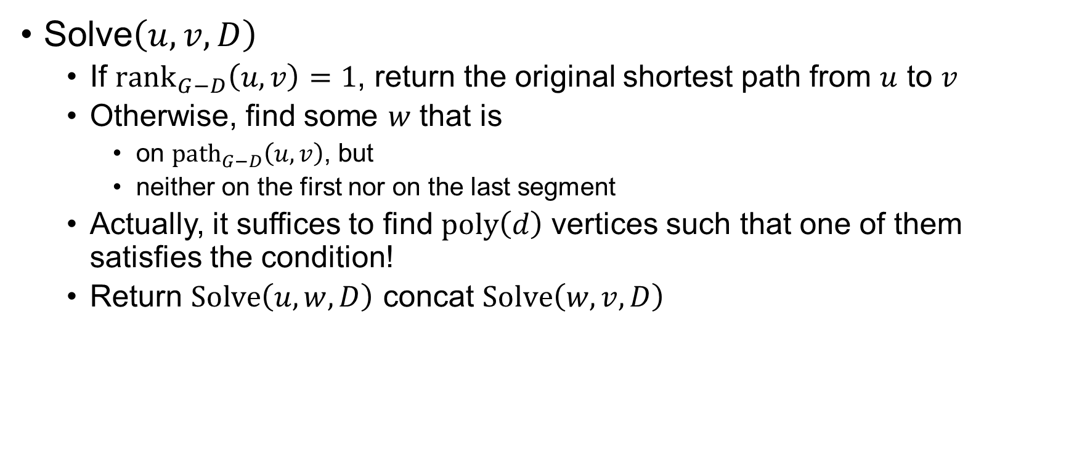

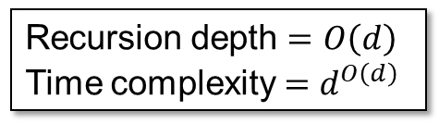
A Recursive Approach
Solve$\left(u,v,D\right)$
If ${rank}_{G−D}\left(u,v\right)=1$, return the original shortest path from $u$ to $v$
Otherwise, find some $w$ that is
on ${path}_{G−D}\left(u,v\right)$, but
neither on the first nor on the last segment
Actually, it suffices to find $poly\left(d\right)$ vertices such that one of them satisfies the condition!
Return $Solve\left(u,w,D\right)$ concat $Solve\left(w,v,D\right)$
This path doesn’t contain failures
Recursion depth $=O\left(d\right)$
Time complexity $=d^{O\left(d\right)}$
$$w$$
$$u$$
$$v$$
10 / 16

Slide 11
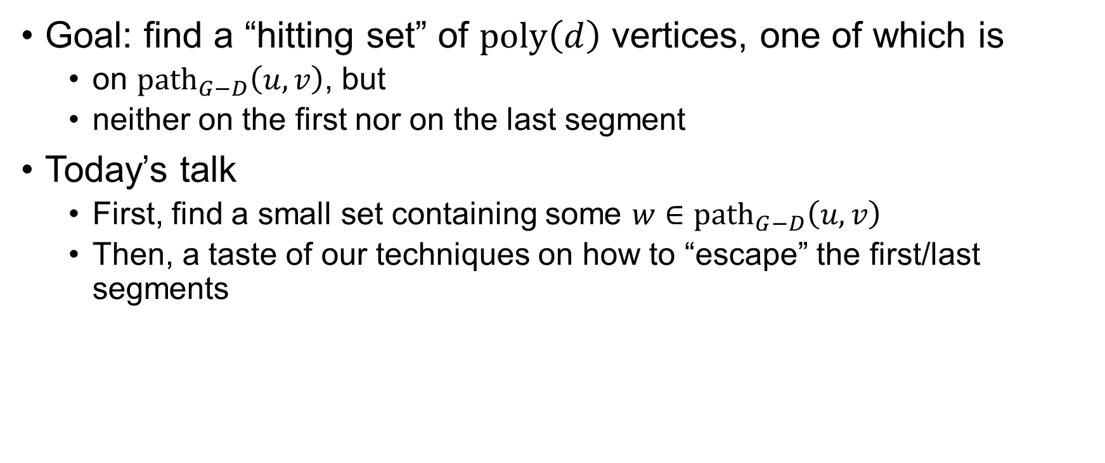
Finding a Hitting Set
Goal: find a “hitting set” of $poly\left(d\right)$ vertices, one of which is
on ${path}_{G−D}\left(u,v\right)$, but
neither on the first nor on the last segment
Today’s talk
First, find a small set containing some $w∈{path}_{G−D}\left(u,v\right)$
Then, a taste of our techniques on how to “escape” the first/last segments
This is actually very simple!
Escaping the first/last segments turns out to be the most technical part of our work…
$$w$$
$$u$$
$$v$$
11 / 16

Slide 12
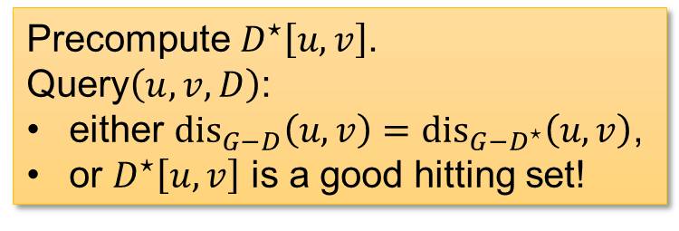

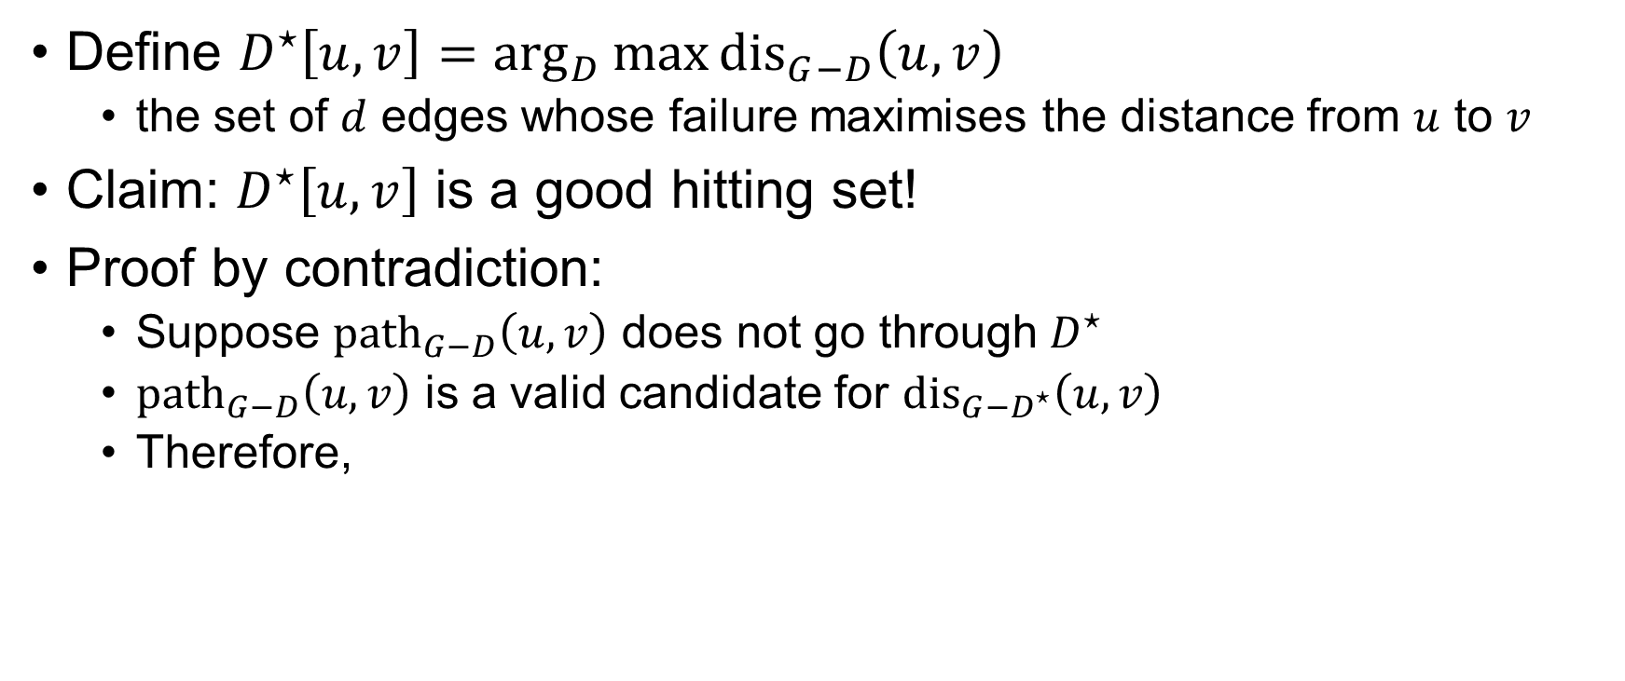
Finding a Hitting Set
Define $D^{⋆}\left[u,v\right]=\arg_{D}{\max{{dis}_{G−D}\left(u,v\right)}}$
the set of $d$ edges whose failure maximises the distance from $u$ to $v$
Claim: $D^{⋆}\left[u,v\right]$ is a good hitting set!
Proof by contradiction:
Suppose ${path}_{G−D}\left(u,v\right)$ does not go through $D^{⋆}$
${path}_{G−D}\left(u,v\right)$ is a valid candidate for ${dis}_{G−D^{⋆}}\left(u,v\right)$
Therefore,
${dis}_{G−D}\left(u,v\right)=$ length of ${path}_{G−D}\left(u,v\right)$
$${dis}_{G−D}\left(u,v\right)={dis}_{G−D^{⋆}}\left(u,v\right)$$
$${dis}_{G−D}\left(u,v\right)≥{dis}_{G−D^{⋆}}\left(u,v\right)$$
Precompute $D^{⋆}\left[u,v\right]$.
Query$\left(u,v,D\right)$:
either ${dis}_{G−D}\left(u,v\right)={dis}_{G−D^{⋆}}\left(u,v\right)$,
or $D^{⋆}\left[u,v\right]$ is a good hitting set!
12 / 16

Slide 13

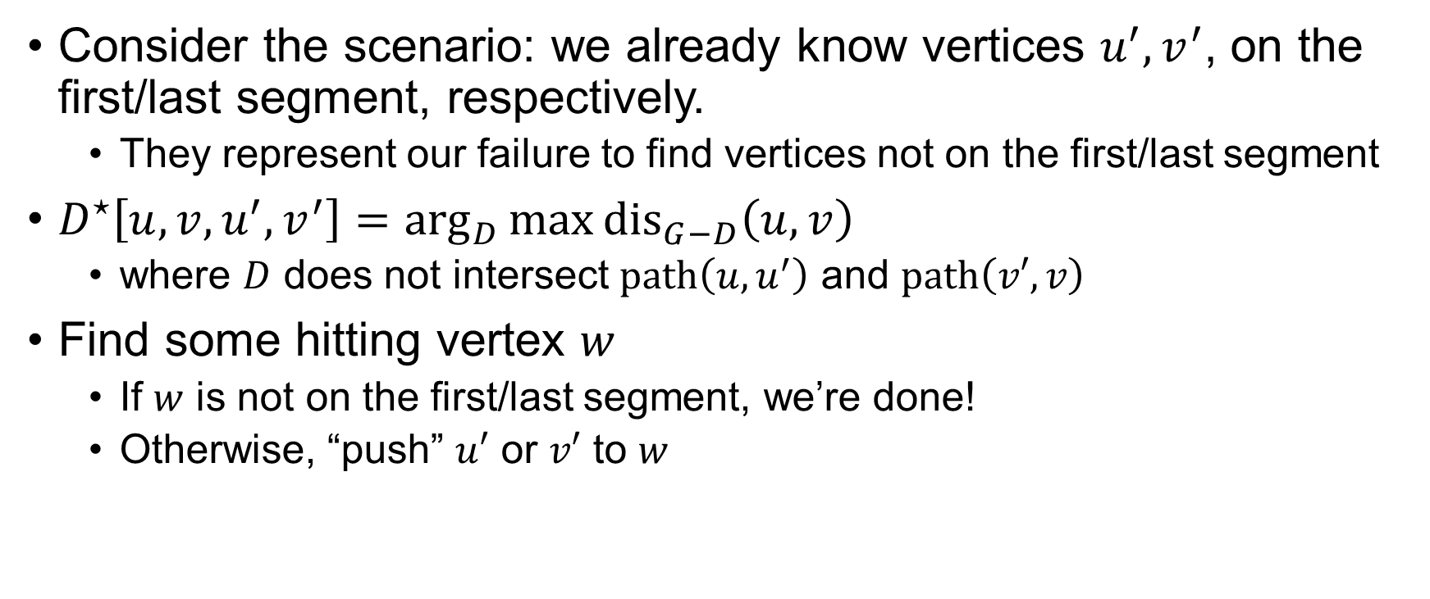





Escaping the First/Last Segment
Consider the scenario: we already know vertices $u^{′},v^{′}$, on the first/last segment, respectively.
They represent our failure to find vertices not on the first/last segment
$D^{⋆}\left[u,v,u^{′},v^{′}\right]=\arg_{D}{\max{{dis}_{G−D}\left(u,v\right)}}$
where $D$ does not intersect $path\left(u,u^{′}\right)$ and $path\left(v′,v\right)$
Find some hitting vertex $w$
If $w$ is not on the first/last segment, we’re done!
Otherwise, “push” $u′$ or $v′$ to $w$
$$u^{′}$$
$$w$$
$$w$$
$$v^{′}$$
$$u$$
$$v$$
13 / 16

Slide 14

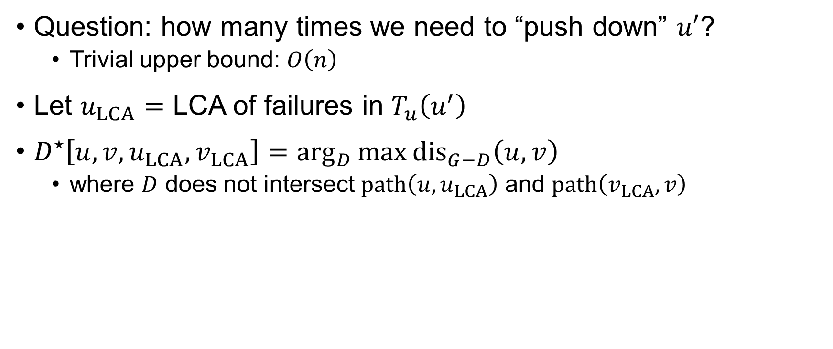



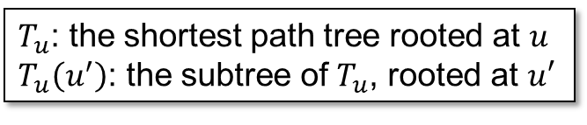
Escaping the First/Last Segment
Question: how many times we need to “push down” $u′$?
Trivial upper bound: $O\left(n\right)$
Let $u_{LCA}=$ LCA of failures in $T_{u}\left(u^{′}\right)$
$D^{⋆}\left[u,v,u_{LCA},v_{LCA}\right]=\arg_{D}{\max{{dis}_{G−D}\left(u,v\right)}}$
where $D$ does not intersect $path\left(u,u_{LCA}\right)$ and $path\left(v_{LCA},v\right)$
$T_{u}$: the shortest path tree rooted at $u$
$T_{u}\left(u^{′}\right)$: the subtree of $T_{u}$, rooted at $u′$
$$T_{u}\left(u^{′}\right)$$
$$u$$
$$u^{′}$$
$$u_{LCA}$$
failed edge
first segment
14 / 16

Slide 15
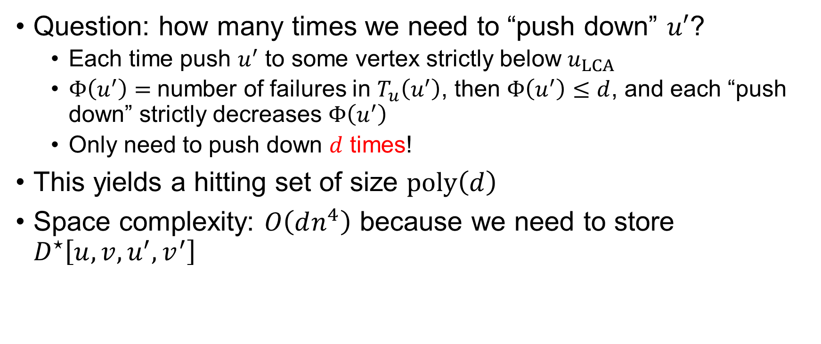

Escaping the First/Last Segment
Question: how many times we need to “push down” $u′$?
Each time push $u^{′}$ to some vertex strictly below $u_{LCA}$
$Φ\left(u^{′}\right)=$number of failures in $T_{u}\left(u^{′}\right)$, then $Φ\left(u^{′}\right)≤d$, and each “push down” strictly decreases $Φ\left(u^{′}\right)$
Only need to push down $d$ times!
This yields a hitting set of size $poly\left(d\right)$
Space complexity: $O\left(dn^{4}\right)$ because we need to store $D^{⋆}\left[u,v,u^{′},v^{′}\right]$
$$T_{u}\left(u^{′}\right)$$
$$u$$
$$u^{′}$$
$$u_{LCA}$$
failed edge
first segment
15 / 16

Slide 16
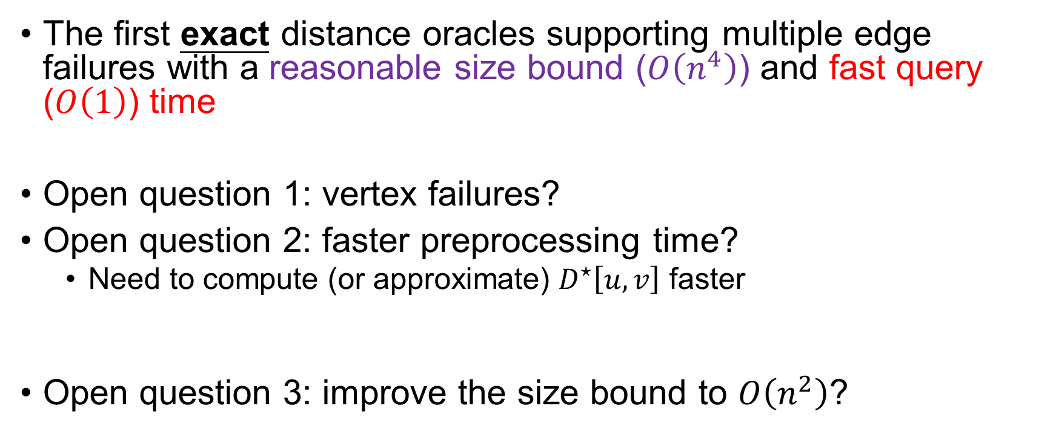
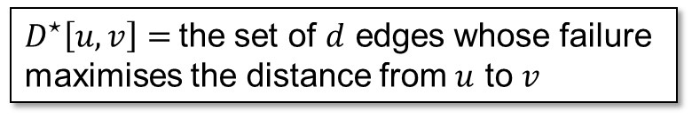
Conclusions & Open Problems
The first exact distance oracles supporting multiple edge failures with a reasonable size bound ($O\left(n^{4}\right)$) and fast query ($O\left(1\right)$) time
Open question 1: vertex failures?
Open question 2: faster preprocessing time?
Need to compute (or approximate) $D^{⋆}\left[u,v\right]$ faster
Open question 3: improve the size bound to $O\left(n^{2}\right)$?
The structural lemma doesn’t work for vertex failures…
$D^{⋆}\left[u,v\right]=$the set of $d$ edges whose failure maximises the distance from $u$ to $v$
16 / 16

Slide 17
Thank you!
Questions are welcome! ☺

