Slide 1

Maintaining Exact Distances under Multiple Edge Failures
Ran Duan
Tsinghua
Hanlin Ren
Oxford
STOC’22
1 / 10

Slide 2

The Problem
Problem: given a graph, deal with failures.
Example: $Query\left(u,v,D\right)=$ shortest path from $u$ to $v$ that avoids $D$
source vertex
target vertex
failed edge
optimal path
2 / 10

Slide 3
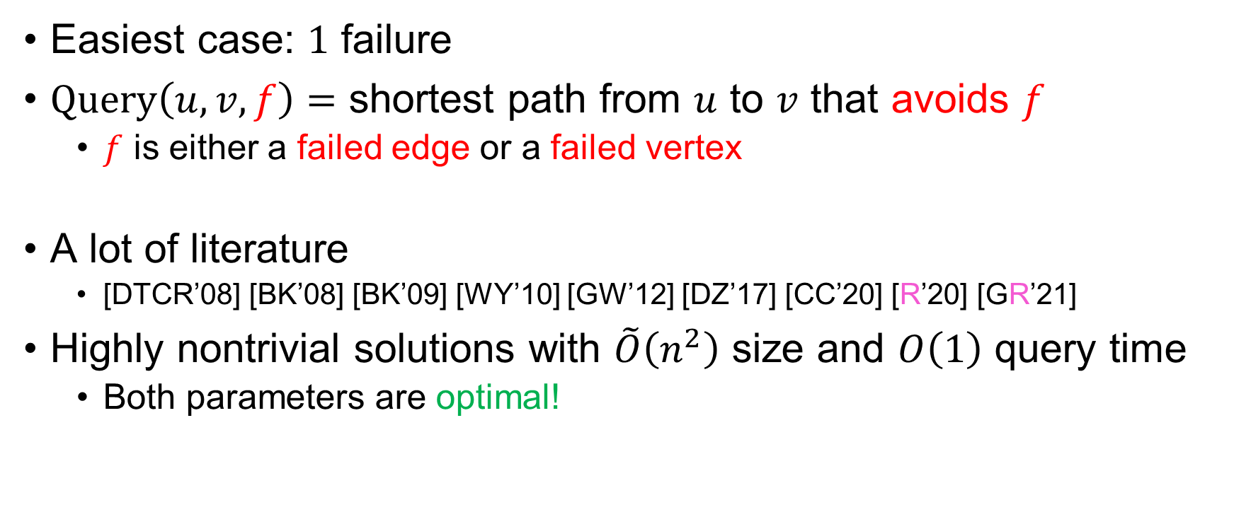
How Hard Is the Problem?
Easiest case: $1$ failure
$Query\left(u,v,f\right)=$ shortest path from $u$ to $v$ that avoids $f$
$f$ is either a failed edge or a failed vertex
A lot of literature
[DTCR’08] [BK’08] [BK’09] [WY’10] [GW’12] [DZ’17] [CC’20] [R’20] [GR’21]
Highly nontrivial solutions with $\tilde{O}\left(n^{2}\right)$ size and $O\left(1\right)$ query time
Both parameters are optimal!
3 / 10

Slide 4
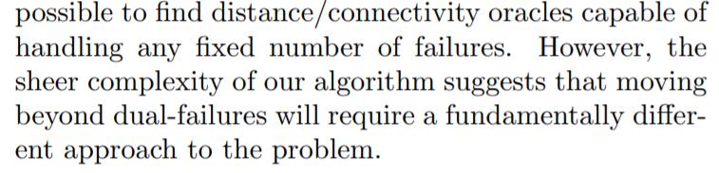

How Hard Is the Problem?
$2$ failures: considerably more complicated
[DP’09]
Space complexity: $\tilde{O}\left(n^{2}\right)$, query time: $O\left(\log{n}\right)$
4 / 10

Slide 5

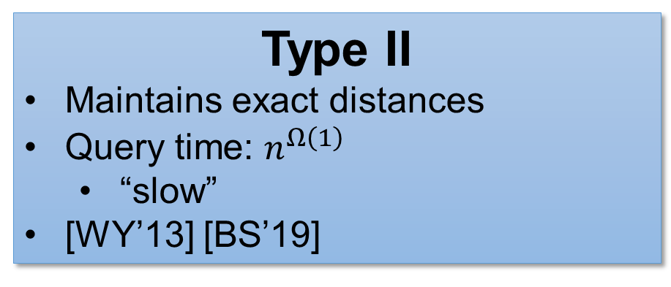
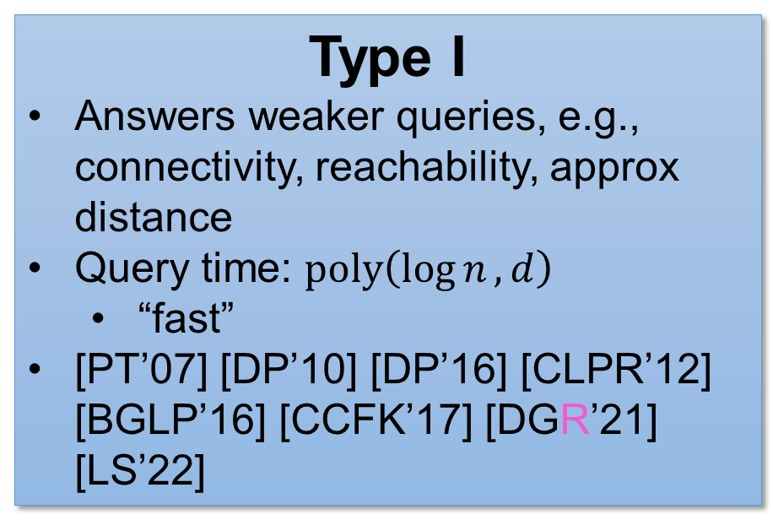
Okay, What about More Failures?
$d$ (vertex / edge) failures
Previous work can be categorised into two types:
Type I
Answers weaker queries, e.g., connectivity, reachability, approx distance
Query time: $poly\left(\log{n},d\right)$
“fast”
[PT’07] [DP’10] [DP’16] [CLPR’12] [BGLP’16] [CCFK’17] [DGR’21] [LS’22]
Type II
Maintains exact distances
Query time: $n^{Ω\left(1\right)}$
“slow”
[WY’13] [BS’19]
5 / 10

Slide 6


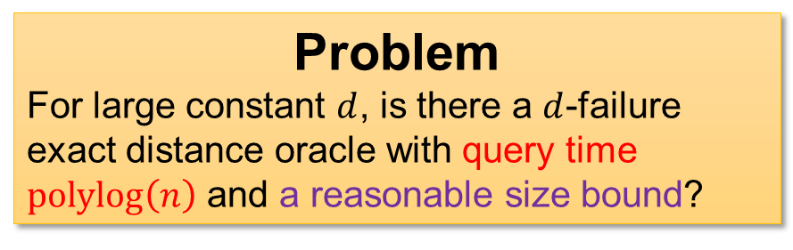
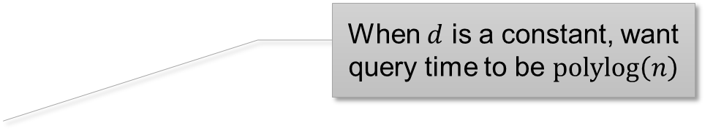
Let’s Focus on Exact Distances…
$d$ (vertex / edge) failures, maintain exact distance
Naïve solution: enumerate all possible queries
Size $O\left(n^{d+2}\right)$, query $O\left(1\right)$
[DP’09]: can achieve size $\tilde{O}\left(n^{d}\right)$, query $O\left(\log{n}\right)$
No other results with fast query time known…
When $d$ is a constant, want query time to be $polylog\left(n\right)$
Problem
For large constant $d$, is there a $d$-failure exact distance oracle with query time $polylog\left(n\right)$ and a reasonable size bound?
An Easier Problem
Is there a $100$-failure exact distance oracle with query time $polylog\left(n\right)$ and size $O\left(n^{99}\right)$?
6 / 10

Slide 7
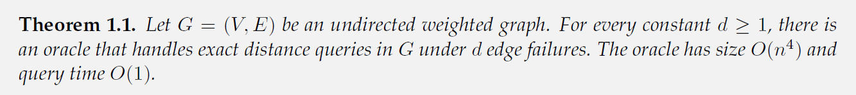


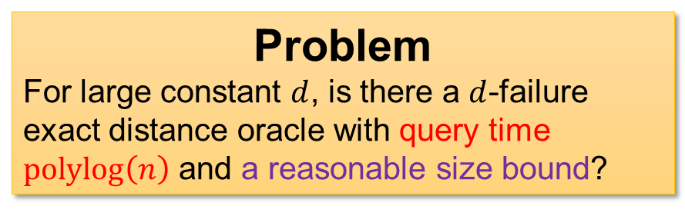
Our Results
√
√
We show the answer is YES!
for undirected graphs and edge failures
Main Result: Query time $d^{O\left(d\right)}$, size $O\left(dn^{4}\right)$.
Problem
For large constant $d$, is there a $d$-failure exact distance oracle with query time $polylog\left(n\right)$ and a reasonable size bound?
An Easier Problem
Is there a $100$-failure exact distance oracle with query time $polylog\left(n\right)$ and size $O\left(n^{99}\right)$?
7 / 10

Slide 8
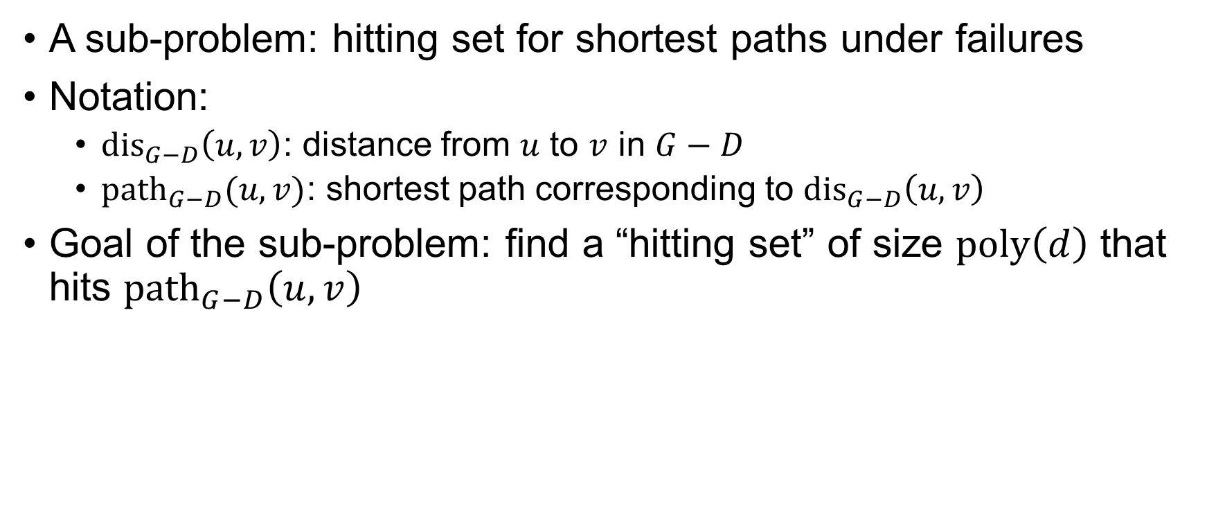



Finding a Hitting Set
A sub-problem: hitting set for shortest paths under failures
Notation:
${dis}_{G−D}\left(u,v\right)$: distance from $u$ to $v$ in $G−D$
${path}_{G−D}(u,v)$: shortest path corresponding to ${dis}_{G−D}\left(u,v\right)$
Goal of the sub-problem: find a “hitting set” of size $poly\left(d\right)$ that hits ${path}_{G−D}\left(u,v\right)$
$$w$$
$$u$$
$$v$$
8 / 10

Slide 9
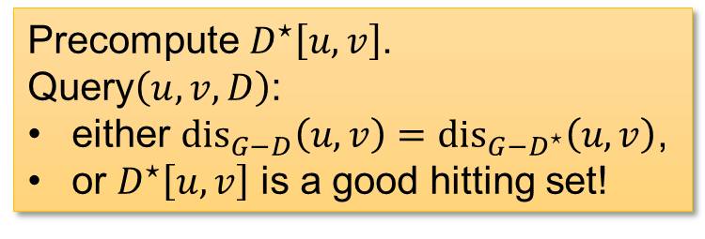
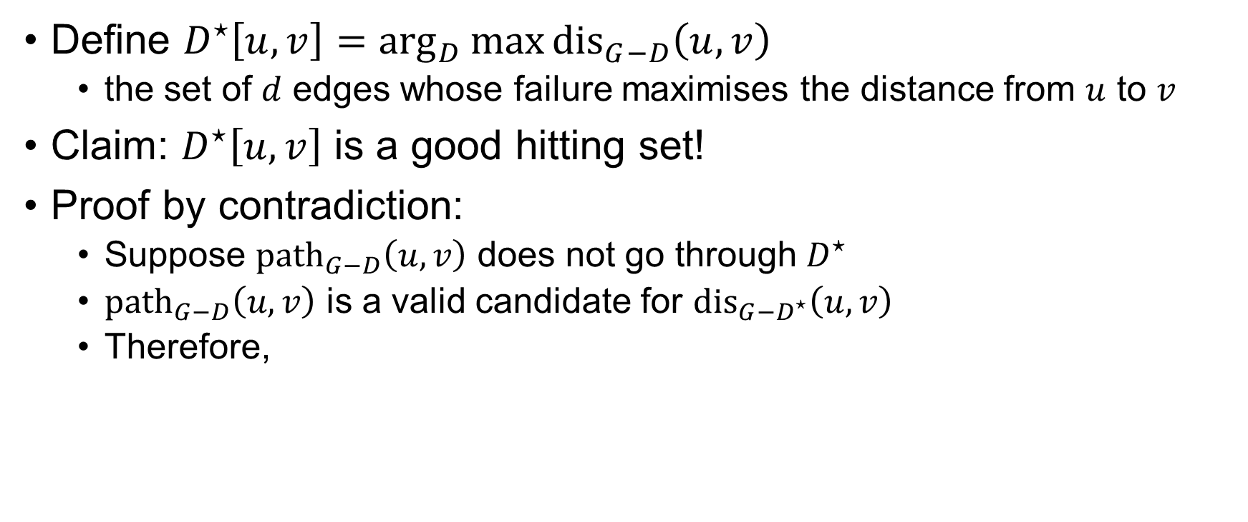
Finding a Hitting Set
Define $D^{⋆}\left[u,v\right]=\arg_{D}{\max{{dis}_{G−D}\left(u,v\right)}}$
the set of $d$ edges whose failure maximises the distance from $u$ to $v$
Claim: $D^{⋆}\left[u,v\right]$ is a good hitting set!
Proof by contradiction:
Suppose ${path}_{G−D}\left(u,v\right)$ does not go through $D^{⋆}$
${path}_{G−D}\left(u,v\right)$ is a valid candidate for ${dis}_{G−D^{⋆}}\left(u,v\right)$
Therefore,
$${dis}_{G−D}\left(u,v\right)={dis}_{G−D^{⋆}}\left(u,v\right)$$
$${dis}_{G−D}\left(u,v\right)≥{dis}_{G−D^{⋆}}\left(u,v\right)$$
Precompute $D^{⋆}\left[u,v\right]$.
Query$\left(u,v,D\right)$:
either ${dis}_{G−D}\left(u,v\right)={dis}_{G−D^{⋆}}\left(u,v\right)$,
or $D^{⋆}\left[u,v\right]$ is a good hitting set!
9 / 10

Slide 10
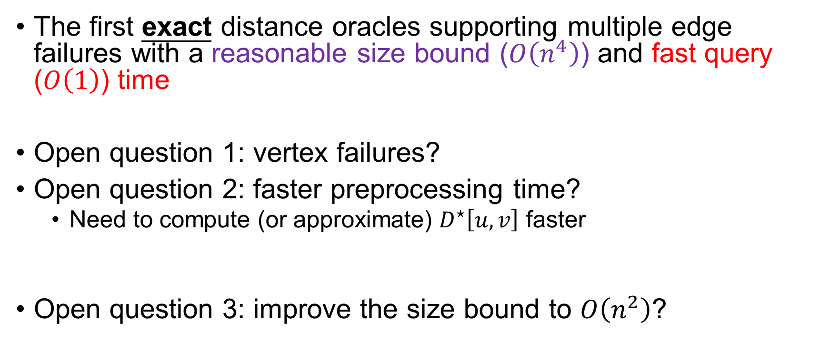
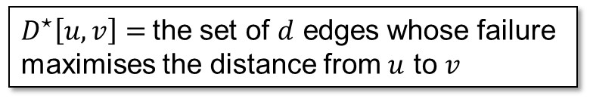
Conclusions & Open Problems
The first exact distance oracles supporting multiple edge failures with a reasonable size bound ($O\left(n^{4}\right)$) and fast query ($O\left(1\right)$) time
Open question 1: vertex failures?
Open question 2: faster preprocessing time?
Need to compute (or approximate) $D^{⋆}\left[u,v\right]$ faster
Open question 3: improve the size bound to $O\left(n^{2}\right)$?
$D^{⋆}\left[u,v\right]=$the set of $d$ edges whose failure maximises the distance from $u$ to $v$
10 / 10

Slide 11
Thank you!
Questions are welcome! ☺

