Slide 1


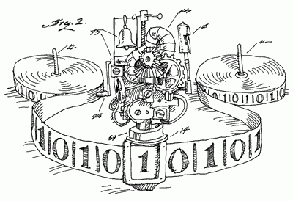


Polynomial-Time Pseudodeterminstic Construction of Primes
Hanlin Ren
University of Oxford
Joint work with Lijie Chen, Zhenjian Lu, Igor Carboni Oliveira, and Rahul Santhanam
June 12, 2023
DIMAP Seminar @ Warwick
$$PRIMES$$
$$Recon$$
Win-win?
YES
NO
0 / 23

Slide 2


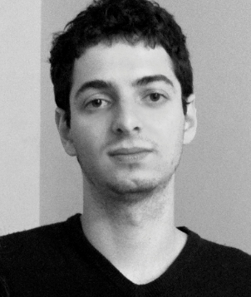

My Amazing Coauthors
Lijie Chen
(Berkeley)
Zhenjian Lu
(Oxford)
Igor C. Oliveira
(Warwick)
Rahul Santhanam
(Oxford)
1 / 23

Slide 3
The task: finding primes

Slide 4




Finding a prime
Problem: Given an integer $n$, find an $n$-bit prime.
Sample I
Input: $n=6$
Output: 100101
Explanation: this is $37$ in binary, which is a prime
Sample II
Input: $n=82,589,933$
Output: 111111111…11111
Explanation: Left as an easy exercise ☺
$n$ 1’s
Today’s question: can we find a prime in $poly\left(n\right)$ time?
2 / 23

Slide 5
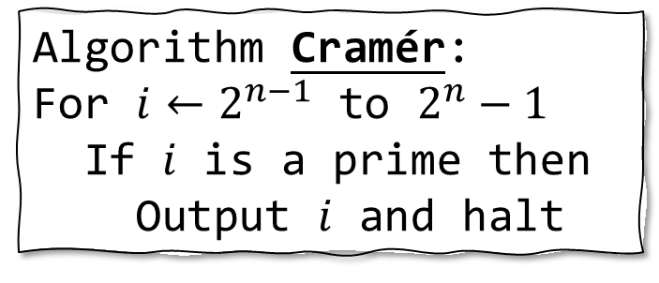
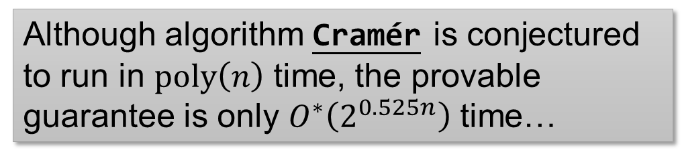
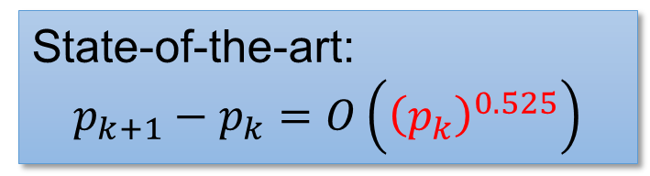
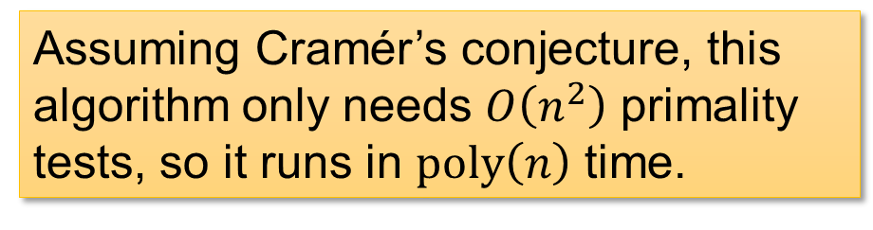
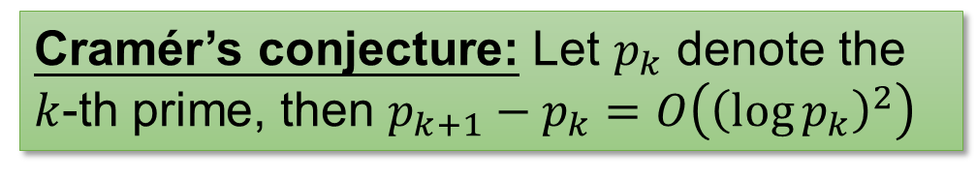
Solution 1: Cramér
Algorithm Cramér:
For $i←2^{n−1}$ to $2^{n}−1$
If $i$ is a prime then
Output $i$ and halt
Cramér’s conjecture: Let $p_{k}$ denote the $k$-th prime, then $p_{k+1}−p_{k}=O\left({\left(\log{p_{k}}\right)}^{2}\right)$
Assuming Cramér’s conjecture, this algorithm only needs $O\left(n^{2}\right)$ primality tests, so it runs in $poly\left(n\right)$ time.
Can use [AKS04] deterministic primality test!
State-of-the-art:
$$p_{k+1}−p_{k}=O\left({\left(p_{k}\right)}^{0.525}\right)$$
Although algorithm Cramér is conjectured to run in $poly\left(n\right)$ time, the provable guarantee is only $O^{∗}\left(2^{0.525n}\right)$ time…
3 / 23

Slide 6

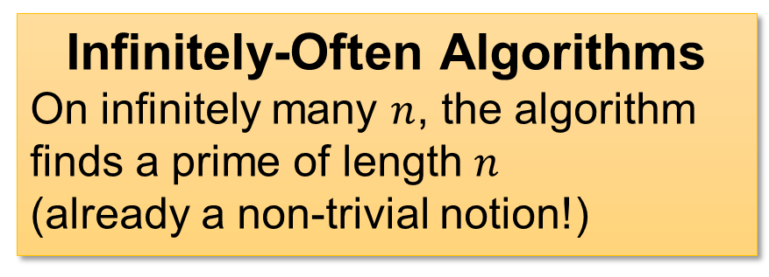
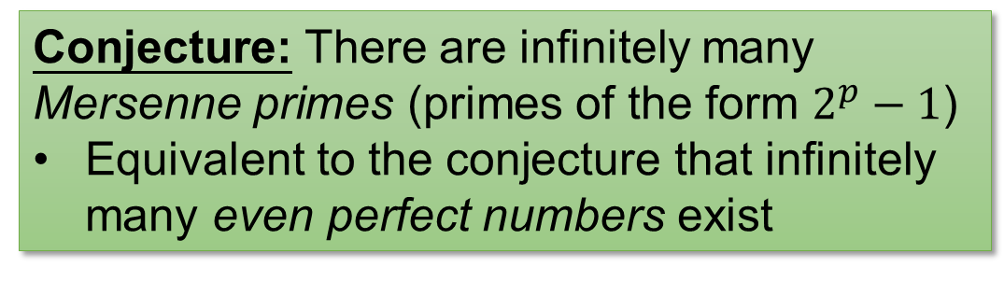
Solution 2: Mersenne
Algorithm Mersenne:
Output $n$ ones (!!!)
Conjecture: There are infinitely many Mersenne primes (primes of the form $2^{p}−1$)
Equivalent to the conjecture that infinitely many even perfect numbers exist
Under the conjecture, algorithm Mersenne is an infinitely-often polynomial-time algorithm for finding primes.
Infinitely-Often Algorithms
On infinitely many $n$, the algorithm finds a prime of length $n$
(already a non-trivial notion!)
4 / 23

Slide 7

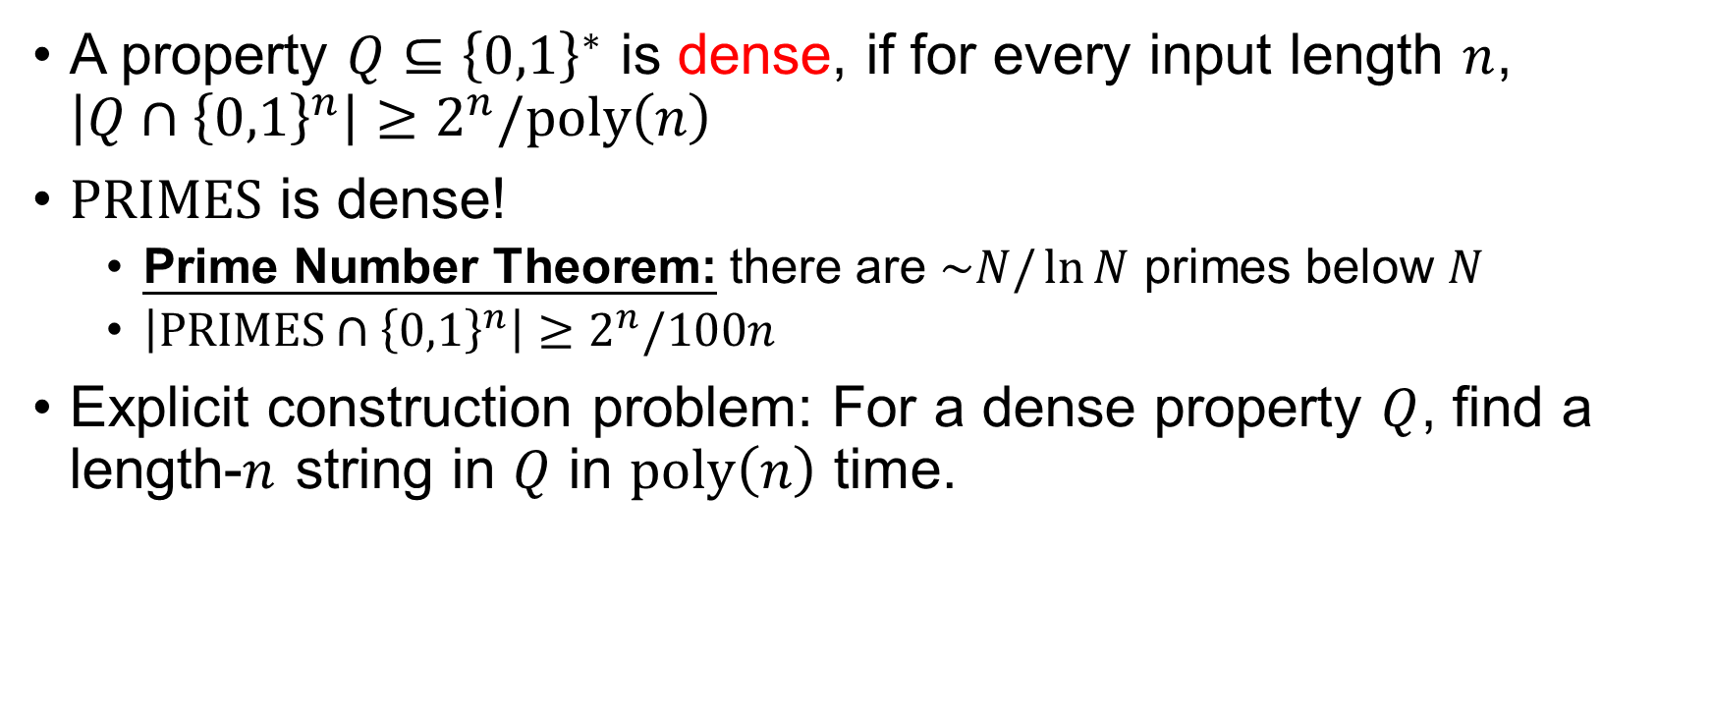
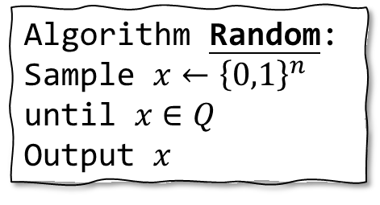
Dense Properties
A property $Q⊆{\left\{0,1\right\}}^{∗}$ is dense, if for every input length $n$, $\left|Q∩{\left\{0,1\right\}}^{n}\right|≥2^{n}/poly\left(n\right)$
$PRIMES$ is dense!
Prime Number Theorem: there are $\sim N/\ln{N}$ primes below $N$
$\left|PRIMES∩{\left\{0,1\right\}}^{n}\right|≥2^{n}/100n$
Explicit construction problem: For a dense property $Q$, find a length-$n$ string in $Q$ in $poly\left(n\right)$ time.
Algorithm Random:
Sample $x←{\left\{0,1\right\}}^{n}$ until $x∈Q$
Output $x$
Easy with randomness!
Deterministic algorithms are open…
5 / 23

Slide 8
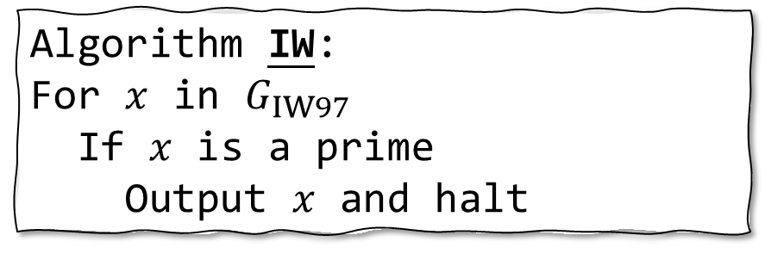

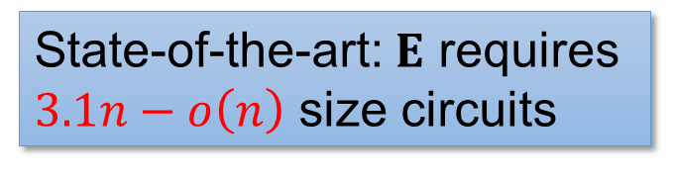
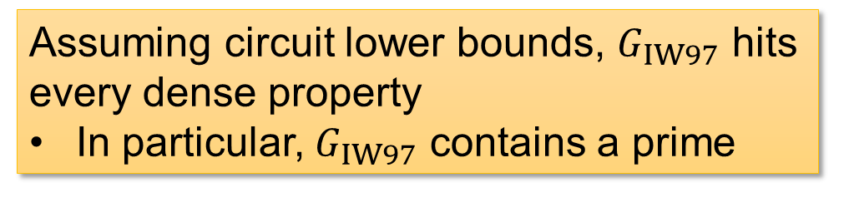
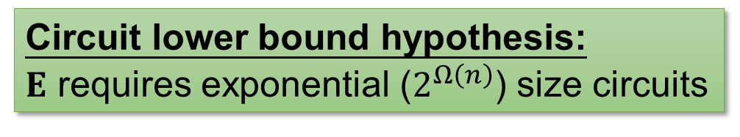
Solution 3: Impagliazzo-Wigderson
Algorithm IW:
For $x$ in $G_{IW97}$
If $x$ is a prime
Output $x$ and halt
Circuit lower bound hypothesis: $E$ requires exponential ($2^{Ω\left(n\right)}$) size circuits
Assuming circuit lower bounds, $G_{IW97}$ hits every dense property
In particular, $G_{IW97}$ contains a prime
$G_{IW97}$: the generator presented in IW97
State-of-the-art: $E$ requires $3.1n−o\left(n\right)$ size circuits
Although algorithm IW is conjectured to find a prime, we seem very far from proving this conjecture…
6 / 23

Slide 9

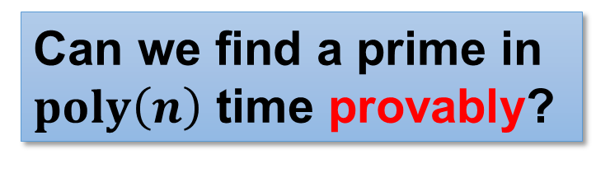
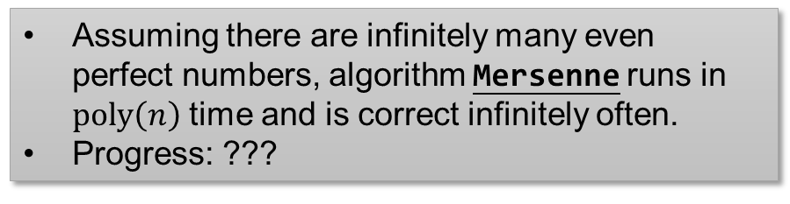
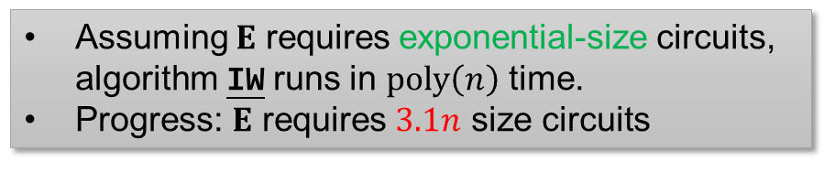
What we have
Assuming $p_{n+1}−p_{n}=polylog\left(p_{n}\right)$, algorithm Cramér runs in $poly\left(n\right)$ time.
Progress: $p_{n+1}−p_{n}=O\left({\left(p_{n}\right)}^{0.525}\right)$
Algorithm Cramér
Assuming there are infinitely many even perfect numbers, algorithm Mersenne runs in $poly\left(n\right)$ time and is correct infinitely often.
Progress: ???
Algorithm Mersenne
Assuming $E$ requires exponential-size circuits, algorithm IW runs in $poly\left(n\right)$ time.
Progress: $E$ requires $3.1n$ size circuits
Algorithm IW
Can we find a prime in $poly\left(n\right)$ time provably?
Polymath 4: tried to use number-theoretic techniques, but did not obtain unconditional improvement
7 / 23

Slide 10
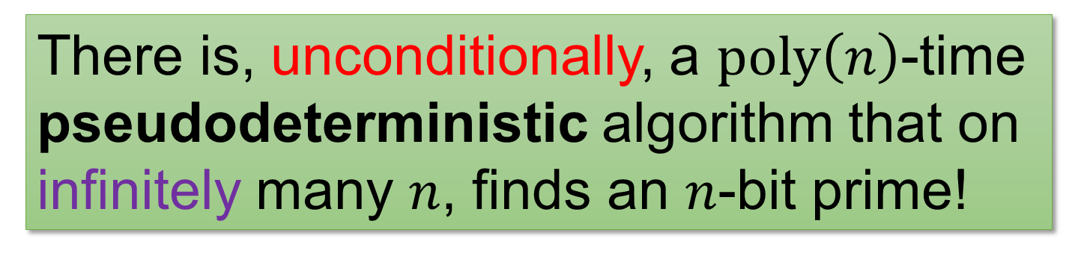
Our result
There is, unconditionally, a $poly\left(n\right)$-time pseudodeterministic algorithm that on infinitely many $n$, finds an $n$-bit prime!
Next: what’s a pseudodeterministic algorithm?
8 / 23

Slide 11






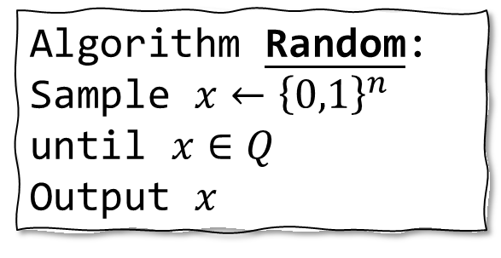
Intermediate notion between deterministic and randomized algorithms?
Algorithm Random:
Sample $x←{\left\{0,1\right\}}^{n}$ until $x∈Q$
Output $x$
Any intermediate notion between deterministic algorithms and randomized algorithms?
Deterministic algorithms
One drawback of Random:
it outputs different primes on different executions
Randomized algorithms
Algorithm DET
Algorithm RAND
$$p$$
Let’s require different execution of RAND to output the same prime!
$$p_{1}$$
$$p_{2}$$
❌
$$p_{3}$$
$$p_{2}$$
$$p_{4}$$
9 / 23

Slide 12




Pseudodeterministic algorithms
A randomized algorithm is pseudodeterministic, if on most of its computational branches, it outputs the same answer.
Any (bounded) observer thinks the algorithm is deterministic!
Pseudodeterministic algorithms
Deterministic algorithms
Randomized algorithms
Algorithm DET
Algorithm RAND
Algorithm PSEUDO
$$p$$
$$p_{1}$$
$$p_{2}$$
❌
$$p_{3}$$
$$p_{2}$$
$$p_{4}$$
$$p_{1}$$
$$p_{1}$$
❌
$$p_{2}$$
$$p_{1}$$
$$p_{1}$$
10 / 23

Slide 13
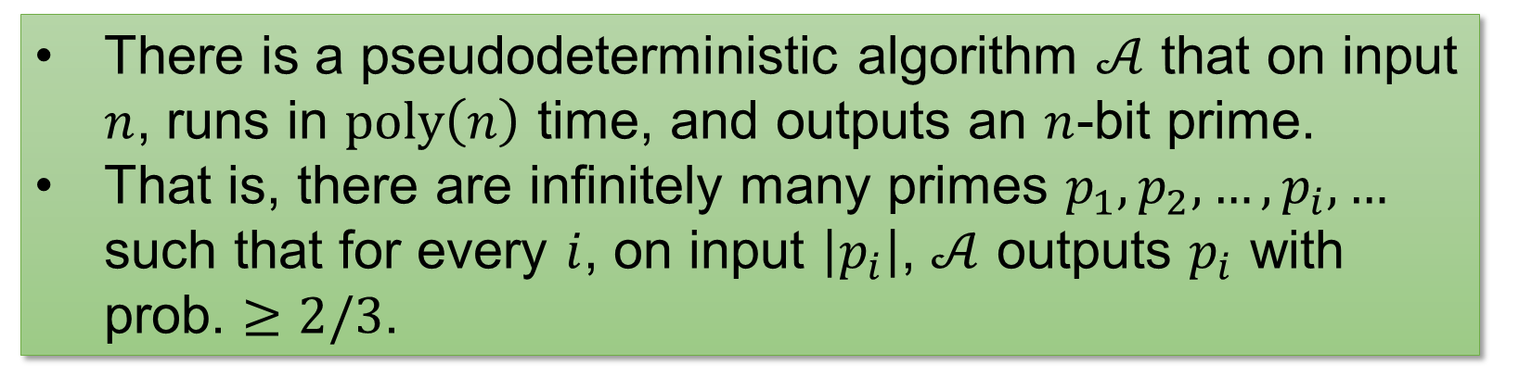


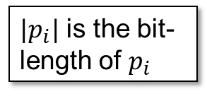
Our result
There is a pseudodeterministic algorithm $𝒜$ that on input $n$, runs in $poly\left(n\right)$ time, and outputs an $n$-bit prime.
That is, there are infinitely many primes $p_{1},p_{2},…,p_{i},…$ such that for every $i$, on input $\left|p_{i}\right|$, $𝒜$ outputs $p_{i}$ with prob. $≥2/3$.
“canonical” primes
$|p_{i}|$ is the bit-length of $p_{i}$
Previously, Oliveira-Santhanam’17 achieved subexponential ($2^{n^{o\left(1\right)}}$) time for the same task.
Moreover, This holds for every dense property in poly-time, not only $PRIMES$!
Spoiler ahead: little number theory but heavy complexity theory ☺
11 / 23

Slide 14
Techniques: a new win-win analysis

Slide 15

Warm-up: Pseudodeterministic constructions in subexponential time
Oliveira-Santhanam 17: there is a pseudodeterministic algorithm that finds $n$-bit primes in $2^{n^{o\left(1\right)}}$ time infinitely often.
Idea I: Uniform hardness vs randomness
Idea II: Win-win arguments
12 / 23

Slide 16


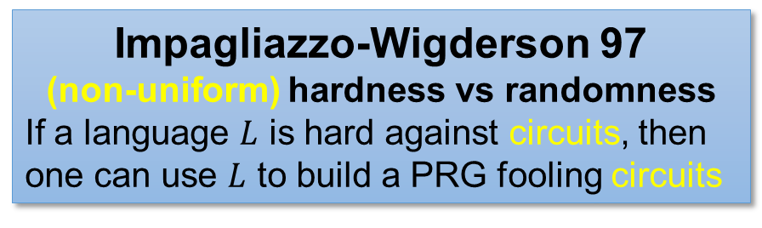
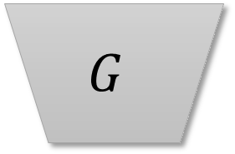
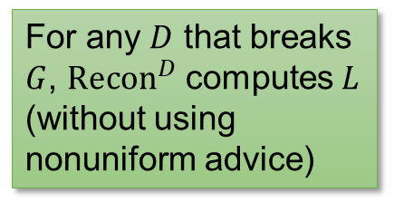

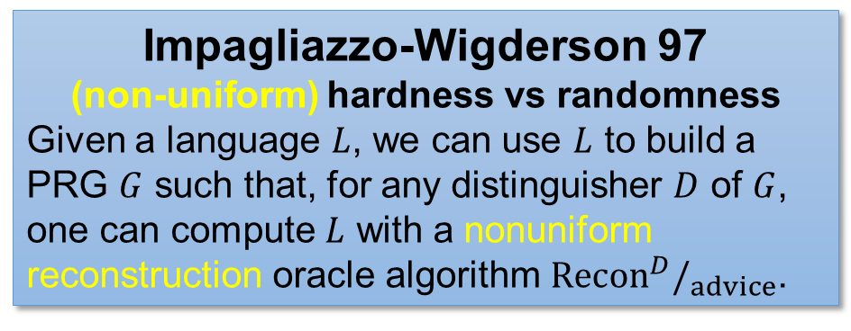

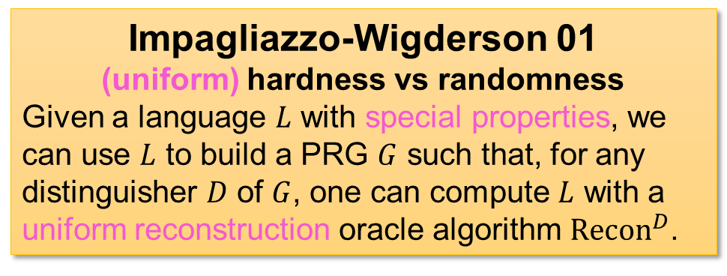
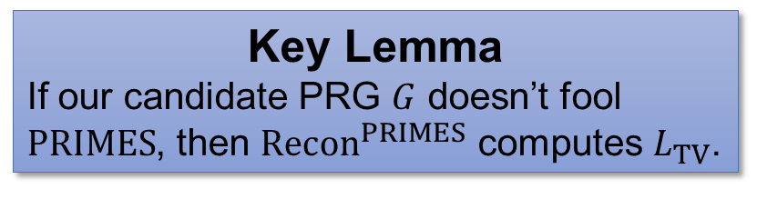
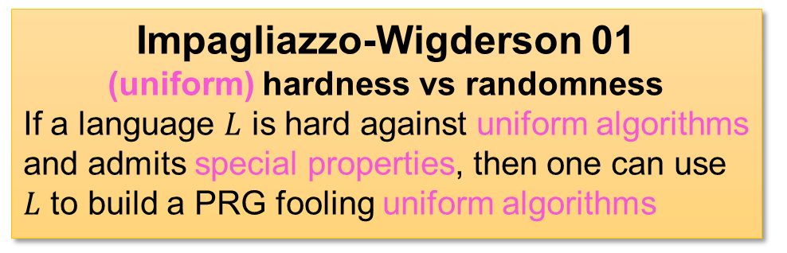
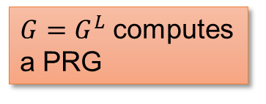

Uniform Hardness vs Randomness
Impagliazzo-Wigderson 97
(non-uniform) hardness vs randomness
Given a language $L$, we can use $L$ to build a PRG $G$ such that, for any distinguisher $D$ of $G$, one can compute $L$ with a nonuniform reconstruction oracle algorithm ${Recon}^{D}/_{advice}$.
Impagliazzo-Wigderson 01
(uniform) hardness vs randomness
If a language $L$ is hard against uniform algorithms and admits special properties, then one can use $L$ to build a PRG fooling uniform algorithms
Impagliazzo-Wigderson 01
(uniform) hardness vs randomness
Given a language $L$ with special properties, we can use $L$ to build a PRG $G$ such that, for any distinguisher $D$ of $G$, one can compute $L$ with a uniform reconstruction oracle algorithm ${Recon}^{D}$.
Impagliazzo-Wigderson 97
(non-uniform) hardness vs randomness
If a language $L$ is hard against circuits, then one can use $L$ to build a PRG fooling circuits
$$G$$
$$Recon$$
$$D$$
For any $D$ that breaks $G$, ${Recon}^{D}$ computes $L$ (without using nonuniform advice)
$$L$$
$G=G^{L}$ computes a PRG
Key Lemma
If our candidate PRG $G$ doesn’t fool $PRIMES$, then ${Recon}^{PRIMES}$ computes $L_{TV}$.
Trevisan-Vadhan 07
a language $L_{TV}$ with special properties that is $PSPACE$-complete
(from $IP=PSPACE$)
13 / 23

Slide 17
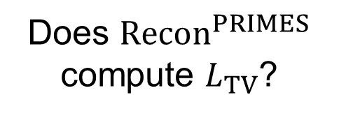
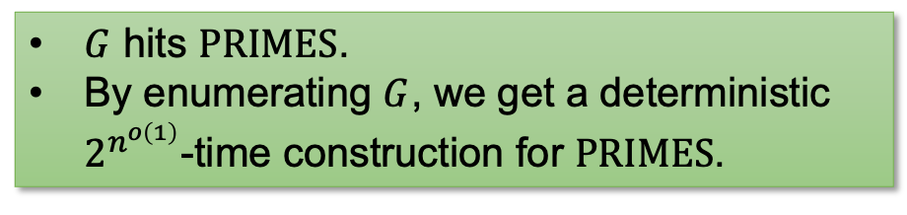
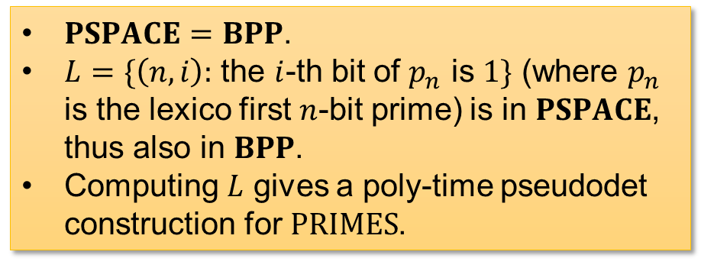
Win-win Analysis
$PSPACE=BPP$.
$L=\{\left(n,i\right):$ the $i$-th bit of $p_{n}$ is $1\}$ (where $p_{n}$ is the lexico first $n$-bit prime) is in $PSPACE$, thus also in $BPP$.
Computing $L$ gives a poly-time pseudodet construction for $PRIMES$.
YES
Does ${Recon}^{PRIMES}$ compute $L_{TV}$?
NO
$G$ hits $PRIMES$.
By enumerating $G$, we get a deterministic $2^{n^{o\left(1\right)}}$-time construction for $PRIMES$.
Key Lemma
If our candidate PRG $G$ doesn’t fool $PRIMES$, then ${Recon}^{PRIMES}$ computes $L_{TV}$.
14 / 23

Slide 18


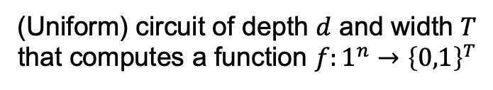

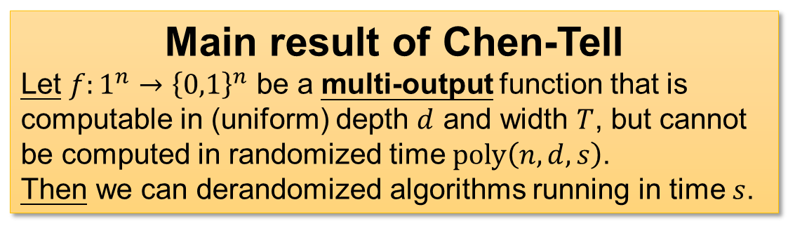




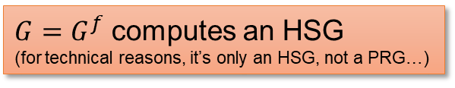


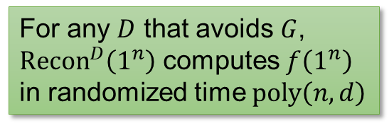
Key Technical Tool: Chen-Tell Generator
$$G$$
Main result of Chen-Tell
Let $f:1^{n}→{\left\{0,1\right\}}^{n}$ be a multi-output function that is computable in (uniform) depth $d$ and width $T$, but cannot be computed in randomized time $poly\left(n,d,s\right)$.
Then we can derandomized algorithms running in time $s$.
$$f$$
$G=G^{f}$ computes an HSG
(for technical reasons, it’s only an HSG, not a PRG…)
$$T≫d$$
$$Recon$$
$$D$$
(Uniform) circuit of depth $d$ and width $T$
that computes a function $f:1^{n}→{\left\{0,1\right\}}^{T}$
$$∧$$
$$∨$$
$$∨$$
$$d$$
For any $D$ that avoids $G$, ${Recon}^{D}\left(1^{n}\right)$ computes $f\left(1^{n}\right)$ in randomized time $poly\left(n,d\right)$
15 / 23

Slide 19





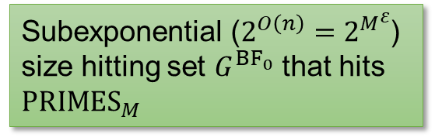
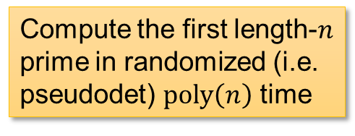



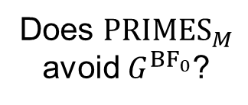


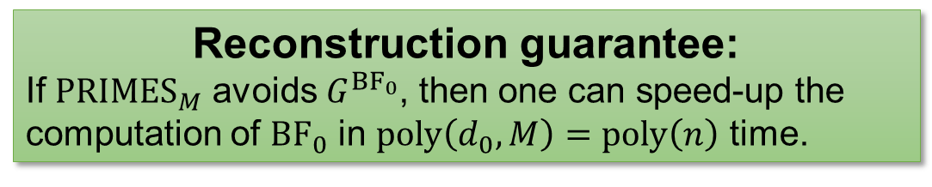
Pseudodeterministic Constructions from Chen-Tell?
Fix $n$ and $M=poly\left(n\right)$.
$$T_{0}=2^{O\left(n\right)}$$
$$G$$
${BF}_{0}$: Brute Force
Enumerate all strings of length $n$, and output the first prime
$${BF}_{0}$$
$$d_{0}=poly\left(n\right)$$
Plug in $f={BF}_{0}$ as the “hard function”
Reconstruction guarantee:
If ${PRIMES}_{M}$ avoids $G^{{BF}_{0}}$, then one can speed-up the computation of ${BF}_{0}$ in $poly\left(d_{0},M\right)=poly\left(n\right)$ time.
$${PRIMES}_{M}$$
$$Recon$$
Does ${PRIMES}_{M}$ avoid $G^{{BF}_{0}}$?
YES
NO
Use ${PRIMES}_{M}$ as distinguisher
Compute the first length-$n$ prime in randomized (i.e. pseudodet) $poly\left(n\right)$ time
Subexponential ($2^{O\left(n\right)}=2^{M^{ε}}$) size hitting set $G^{{BF}_{0}}$ that hits ${PRIMES}_{M}$
16 / 23

Slide 20


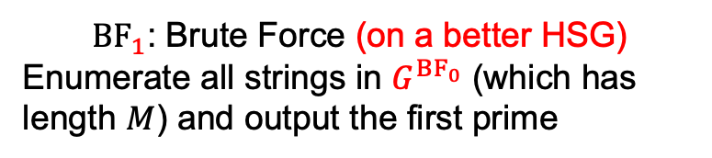
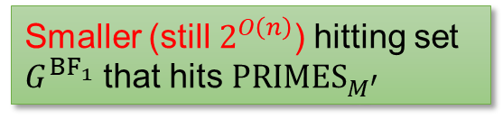
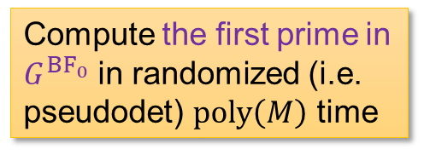

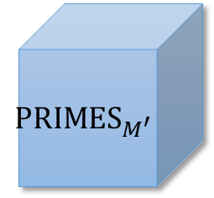

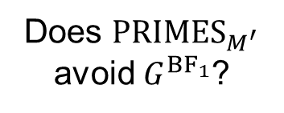



Just Apply It Again…
Fix $M$ and $M′=poly\left(M\right)$.
$$T_{1}=2^{M^{ε}}$$
$$G$$
${BF}_{1}$: Brute Force (on a better HSG)
Enumerate all strings in $G^{{BF}_{0}}$ (which has length $M$) and output the first prime
$${BF}_{1}$$
$$d_{1}=poly\left(M\right)$$
Plug in $f={BF}_{1}$ as the “hard function”
Point: $T_{1}=2^{O\left(n\right)}≤2^{M^{ε}}$ is much smaller than the naïve $2^{O\left(M\right)}$!
$${PRIMES}_{M^{′}}$$
$$Recon$$
Does ${PRIMES}_{M^{′}}$ avoid $G^{{BF}_{1}}$?
YES
NO
Use ${PRIMES}_{M^{′}}$ as distinguisher
Compute the first prime in $G^{{BF}_{0}}$ in randomized (i.e. pseudodet) $poly\left(M\right)$ time
Smaller (still $2^{O\left(n\right)}$) hitting set $G^{{BF}_{1}}$ that hits ${PRIMES}_{M^{′}}$
17 / 23

Slide 21













… and Again
$G_{0}={\left\{0,1\right\}}^{n_{0}}$: trivial HSG for ${PRIMES}_{n_{0}}$
$G_{1}=G^{{BF}_{0}}$ hits ${PRIMES}_{n_{1}}$ and has size $2^{O\left(n_{0}\right)}$
$G_{2}=G^{{BF}_{1}}$ hits ${PRIMES}_{n_{2}}$ and has size $2^{O\left(n_{0}\right)}$
$$…$$
${BF}_{0}$: go through $G_{0}$ and find the first prime
${BF}_{1}$: go through $G_{1}$ and find the first prime
${BF}_{2}$: go through $G_{2}$ and find the first prime
NO
NO
NO
Does ${PRIMES}_{n_{1}}$ avoid $G^{{BF}_{0}}$?
Does ${PRIMES}_{n_{2}}$ avoid $G^{{BF}_{1}}$?
Does ${PRIMES}_{n_{3}}$ avoid $G^{{BF}_{2}}$?
YES
YES
YES
Compute the first length-$n_{0}$ prime in randomized (i.e. pseudodet) $poly\left(n_{1}\right)$ time
Compute the first prime in $G_{1}$ in randomized (i.e. pseudodet) $poly\left(n_{2}\right)$ time
Compute the first prime in $G_{2}$ in randomized (i.e. pseudodet) $poly\left(n_{3}\right)$ time
18 / 23

Slide 22













Each Iteration
$n_{i}=$ length of prime that we want to find
$G_{i}=$ HSG containing an $n_{i}$-bit prime
$T_{i}=$ size of $G_{i}$
(Turns out that depth is not bottleneck)
$$T_{i}$$
$${BF}_{i}$$
Enumerate all strings in $G_{i}$ and output the first prime
$$d_{i}$$
$$T_{0}=2^{O\left(n_{0}\right)}$$
Each iteration:
$n_{i}←{\left(n_{i−1}\right)}^{β}$ for some $β$ that we set
$T_{i}←{\left(T_{i−1}\right)}^{α}$ for some $α$ depending on Chen-Tell
Compute the first prime in $G_{i}$ in randomized (i.e. pseudodet) $poly\left(n_{i+1}\right)$ time
YES
Does ${PRIMES}_{n_{i+1}}$ avoid $G^{{BF}_{i}}$?
Hope: when you set $β$ large enough, $\left\{n_{i}\right\}$ will grow faster than $\left\{T_{i}\right\}$!!
NO
A small hitting set
$$G_{i+1}≔G^{{BF}_{i}}$$
that hits ${PRIMES}_{n_{i+1}}$
$$T_{i}$$
$$n_{i}$$
$$i$$
19 / 23

Slide 23



$\left\{n_{i}\right\}$ vs $\left\{T_{i}\right\}$?
$n_{i}={\left(n_{i−1}\right)}^{β}⇒n_{i}={\left(n_{0}\right)}^{β^{i}}$
$T_{i}={\left(T_{i−1}\right)}^{α}⇒T_{i}={\left(2^{n_{0}}\right)}^{α^{i}}$, for some $α$
$\frac{\log{T_{i}}}{\log{n_{i}}}=\frac{α^{i}\log{n_{0}}}{β^{i}n_{0}}≈{\left(α/β\right)}^{i}n_{0}$, set $β=2α$.
Therefore, when $t=O\left(\log{n_{0}}\right)$, $T_{t}$ will be comparable with $n_{t}$.
Hope: when you set $β$ large enough, $\left\{n_{i}\right\}$ will grow faster than $\left\{T_{i}\right\}$!!
$$T_{i}$$
$$n_{i}$$
$$i$$
20 / 23

Slide 24



Algorithm CLORS23
Algorithm CLORS23:
Let’s say $n=n_{i}$ for some $i$
If $i=t$ (recall that $T_{t}≤poly\left(n_{t}\right)$)
Find the first prime in $G_{i}$ by brute force
Else
Use ${Recon}^{{PRIMES}_{n_{i+1}}}$ to output an $n_{i}$-bit prime
If $G_{t}$ doesn’t contain a prime
But $G_{0}$ does…
There is some $i$, $G_{i}$ contains a prime but $G_{i+1}=G_{{BF}_{i}}$ doesn’t.
${PRIMES}_{n_{i+1}}$ avoids $G_{{BF}_{i}}$, so ${Recon}^{{PRIMES}_{n_{i+1}}}$ computes ${BF}_{i}$ correctly!
If $G_{t}$ contains a prime
We can find this prime using brute force!
21 / 23

Slide 25

Open Problems
Immediate one: a cool name for this win-win technique?
There are sooo many win-wins in complexity theory, all of which stops at half-exponential bounds. Improvements?
Our algorithm has two-sided error. Zero-error pseudodeterministic construction?
22 / 23

Slide 26




Summary
Chen-Tell generator
New win-win analysis
$$G$$
$$…$$
$$f$$
NO
NO
NO
$$Recon$$
$$D$$
YES
YES
YES
YES
Solve ${PRIMES}_{n}$
Use ${PRIMES}_{M}$ to help construct ${PRIMES}_{n}$?
Thank you!
NO
Make progress on ${PRIMES}_{M}$
Questions are welcome!
23 / 23

Slide 27










Omitted Details: Shaltiel-Umans Generator
$$f$$
$$\tilde{f}$$
$$CT\left(f\right)=\bigcup_{i}{NW\left({\tilde{f}}_{i}\right) }$$
Nisan-Wigderson
Problem with NW: size of $CT\left(f\right)$ is quasi-poly in $T$!
This paper: Shaltiel-Umans as a HSG with learning reconstruction!
$$Recon$$
$$D$$
$$G$$
$$P$$
$$P$$
Shaltiel-Umans
Given a low-deg polynomial $P$, $G^{P}$ produces an HSG
${Recon}^{D,P}$ outputs a $D$-oracle circuit computing $P$ (exactly)
24 / 27

Slide 28

Using SU in Chen-Tell
Shaltiel-Umans
Inside Chen-Tell: each row of $\tilde{f}$ is a low-deg polynomial!
Algorithm ChenTell.$Recon$:
$C_{0}←$trivial circuit for ${row}_{0}$
For $i←$1 to d:
Use downward self-reducibility to obtain a circuit $C_{i}^{′}$ for ${row}_{i}$
//$C_{i}^{′}$ is too large
$C_{i}←$SU.${Recon}^{C_{i}^{′},D}$
Return $C_{d}$
$$Recon$$
$$D$$
$$G$$
$$P$$
$$P$$
Given a low-deg polynomial $P$, $G^{P}$ produces an HSG
${Recon}^{D,P}$ outputs a $D$-oracle circuit computing $P$ (exactly)
25 / 27

Slide 29


Circuit Lower Bounds for $BPE^{MCSP}/_{1}$?
Corollary: If $MCSP∈P$, then $BPE/_{1}⊈SIZE\left[2^{n}/n\right]$.
Proof: “has circuit complexity $>2^{n}/n$” is a dense property in $P$, run pseudodeterministic construction on it.
Open problem: Prove that $BPE^{MCSP}/_{1}⊈SIZE\left[2^{n}/n\right]$
Previously
$ZPE^{MCSP}/_{1}⊈P/_{poly}$ (IKV18)
$BPE^{MCSP}/_{2^{εn}}⊈SIZE\left[2^{n}/n\right]$ (HLR23)
26 / 27

Slide 30

Bounded Relativization
OS17 is $PSPACE$-relativizing!
For every oracle $O∈PSPACE$ and every dense property $Q∈P^{O}$, there is a pseudodeterministic construction for $Q$ in $2^{n^{o\left(1\right)}}$ time with oracle access to $O$
$ZPE^{MCSP}/_{1}⊈P/_{poly}$: relativize OS17 with the $MCSP$ oracle
Our proof is not $PSPACE$-relativizing…
Reason: left as an easy exercise ☺
But my conjecture: our result is $PSPACE$-relativizing
27 / 27

