Slide 1

On the Range Avoidance Problem for Circuits
Hanlin Ren
Oxford
Rahul Santhanam
Oxford
Zhikun Wang
Xi’an Jiaotong
July 5, 2022
1 / 17

Slide 2
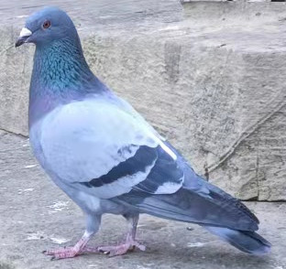
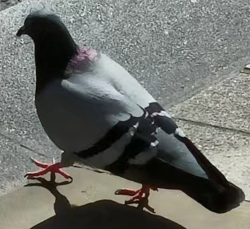

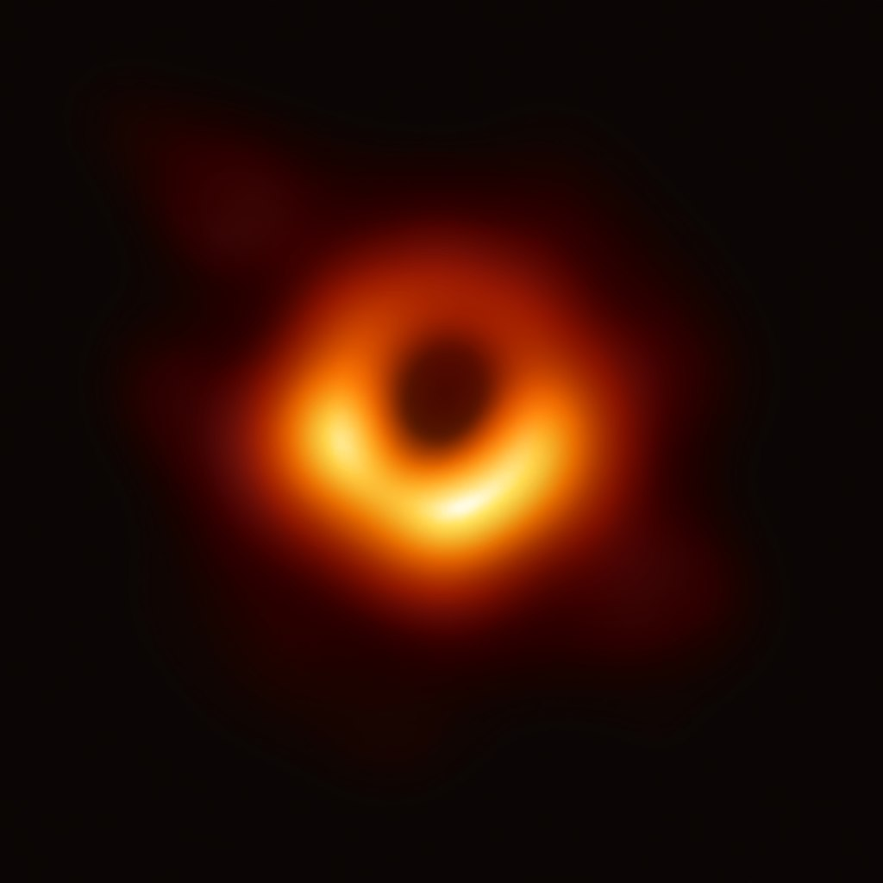

The Empty Pigeonhole Principle
If you throw $N$ pigeons into $M$ holes, and $N<M$, then there is an empty pigeonhole.
Weak version: if you throw $N$ pigeons into $M$ holes, and $2N<M$, then there is an empty pigeonhole.
(These are REAL pigeons in Oxford)
empty
empty
empty
empty
2 / 17

Slide 3




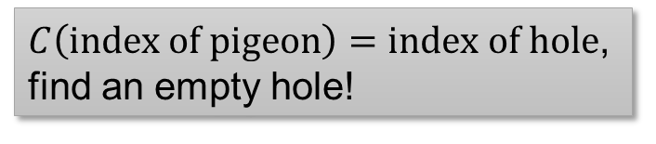

Range Avoidance Problem
Input: a (multi-output) circuit $C:{\left\{0,1\right\}}^{n}→{\left\{0,1\right\}}^{ℓ}$ ($ℓ>n$)
Output: any string $y∉Range\left(C\right)$
I.e. for every $x∈{\left\{0,1\right\}}^{n}$, $C\left(x\right)≠y$
A total problem in $TFΣ_{2}$, complete for the class $APEPP$ [ITCS’21]
Abundant Polynomial Empty Pigeonhole Principle
A “non-output” of $C$.
$$y∈{\left\{0,1\right\}}^{ℓ}$$
A problem that captures the complexity of weak empty pigeonhole principle!
$$C$$
$C\left(index of pigeon\right)=index of hole$, find an empty hole!
$$x∈{\left\{0,1\right\}}^{n}$$
3 / 17

Slide 4
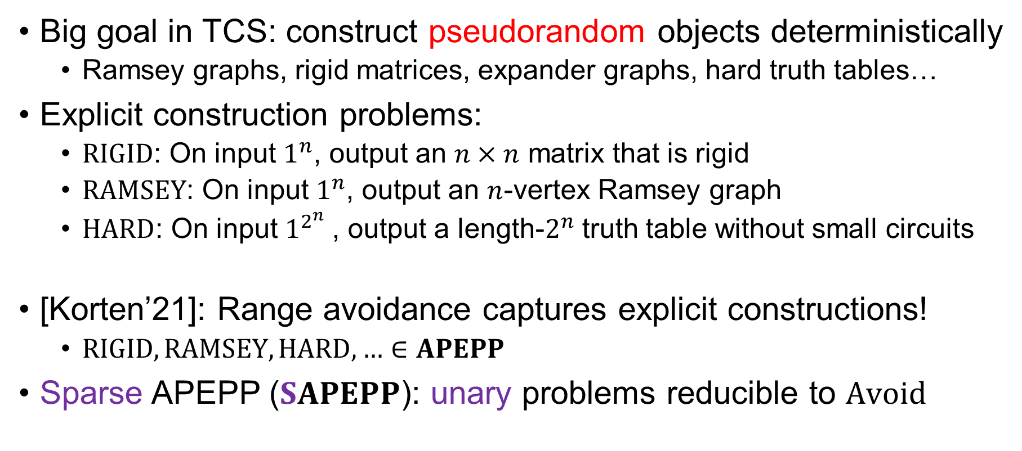
Explicit Constructions
Big goal in TCS: construct pseudorandom objects deterministically
Ramsey graphs, rigid matrices, expander graphs, hard truth tables…
Explicit construction problems:
$RIGID$: On input $1^{n}$, output an $n×n$ matrix that is rigid
$RAMSEY$: On input $1^{n}$, output an $n$-vertex Ramsey graph
$HARD$: On input $1^{2^{n}}$, output a length-$2^{n}$ truth table without small circuits
[Korten’21]: Range avoidance captures explicit constructions!
$RIGID, RAMSEY, HARD, …∈APEPP$
Sparse APEPP ($SAPEPP$): unary problems reducible to $Avoid$
4 / 17

Slide 5
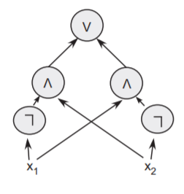

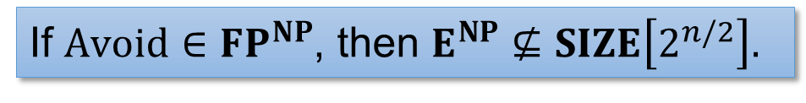

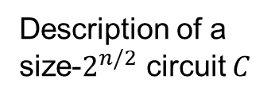
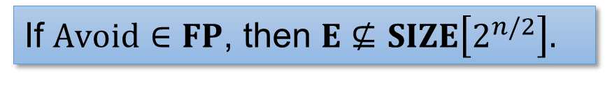





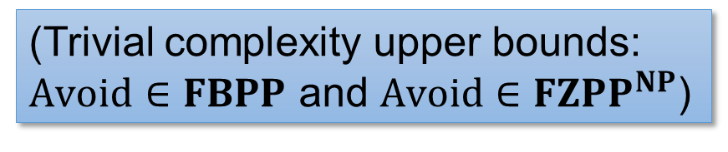
Example: Circuit Lower Bounds
Weak empty PHP: most Boolean functions require circuits of $>2^{n/2}$ size!
Embarrassing open Q: $E^{NP}⊆SIZE\left[10n\right]$?
Truth table of $C$
If $Avoid∈FP$, then $E⊈SIZE\left[2^{n/2}\right].$
$$01100010011………………001010$$
$2^{n}$ bits
If $Avoid∈FP^{NP}$, then $E^{NP}⊈SIZE\left[2^{n/2}\right].$
$$TT$$
(Trivial complexity upper bounds: $Avoid∈FBPP$ and $Avoid∈{FZPP}^{NP}$)
$2^{n/2}poly\left(n\right)$ bits
Description of a size-$2^{n/2}$ circuit $C$
$TT$ stands for “truth table”.
5 / 17

Slide 6

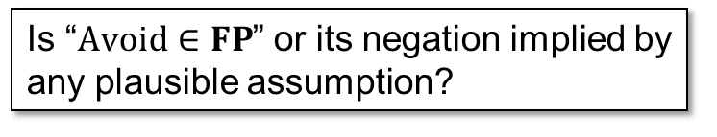


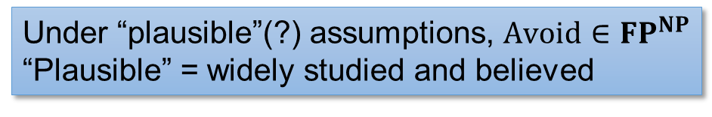
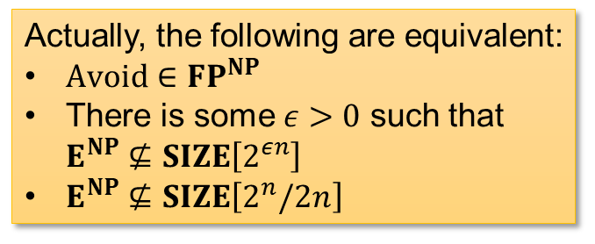
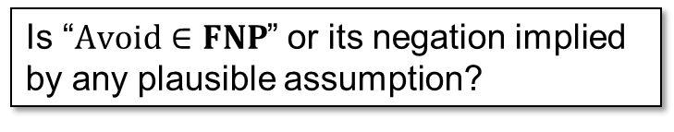


The Complexity of $Avoid$
Korten (FOCS’21): $Avoid∈{FP}^{NP}$ if and only if $E^{NP}⊈SIZE\left[2^{0.1n}\right]$
Under “plausible”(?) assumptions, $Avoid∈{FP}^{NP}$
“Plausible” = widely studied and believed
Actually, the following are equivalent:
$Avoid∈{FP}^{NP}$
There is some $ε>0$ such that $E^{NP}⊈SIZE\left[2^{εn}\right]$
$E^{NP}⊈SIZE\left[2^{n}/2n\right]$
Question 1: is $Avoid∈FP$?
Is “$Avoid∈FP$” or its negation implied by any plausible assumption?
It’s entirely conceivable that you can take a circuit as input, “scramble” it using some fancy crypto stuff, and somehow produce a non-output in poly-time…
Question 2: is $Avoid∈FNP$?
Is “$Avoid∈FNP$” or its negation implied by any plausible assumption?
6 / 17

Slide 7
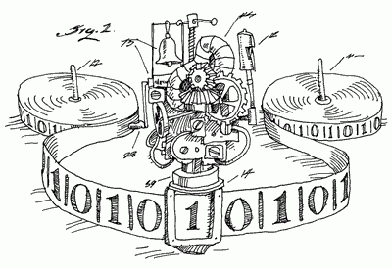
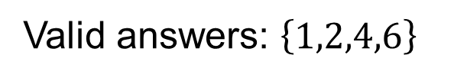









Recap: $FNP$ Algorithms
Nondeterministic poly-time algorithms which
Accepts at least one nondeterministic branch
On each accepted branch, outputs a valid answer
Input:
Valid answers: $\left\{1,2,4,6\right\}$
$$1$$
$$rej$$
$$4$$
$$rej$$
$$rej$$
$$rej$$
$$1$$
$$rej$$
7 / 17

Slide 8
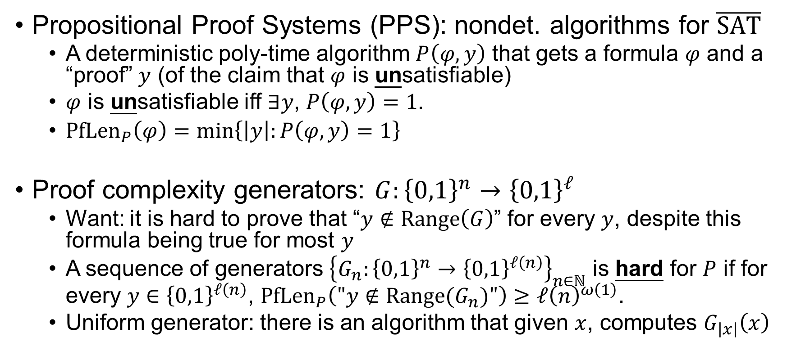

Recap: Proof Complexity
Propositional Proof Systems (PPS): nondet. algorithms for $\overline{SAT}$
A deterministic poly-time algorithm $P\left(φ,y\right)$ that gets a formula $φ$ and a “proof” $y$ (of the claim that $φ$ is unsatisfiable)
$φ$ is unsatisfiable iff $∃y$, $P\left(φ,y\right)=1$.
${PfLen}_{P}\left(φ\right)=\min\left\{\left|y\right|:P\left(φ,y\right)=1\right\}$
Proof complexity generators: $G:{\left\{0,1\right\}}^{n}→{\left\{0,1\right\}}^{ℓ}$
Want: it is hard to prove that “$y∉Range\left(G\right)$” for every $y$, despite this formula being true for most $y$
A sequence of generators ${\left\{G_{n}:{\left\{0,1\right\}}^{n}→{\left\{0,1\right\}}^{ℓ\left(n\right)}\right\}}_{n∈ℕ}$ is hard for $P$ if for every $y∈{\left\{0,1\right\}}^{ℓ\left(n\right)}$, ${PfLen}_{P}\left("y∉Range(G_{n})"\right)≥{ℓ\left(n\right)}^{ω\left(1\right)}$.
Uniform generator: there is an algorithm that given $x$, computes $G_{\left|x\right|}\left(x\right)$
If $φ$ is satisfiable then ${PfLen}_{P}\left(φ\right)=+∞$.
8 / 17

Slide 9







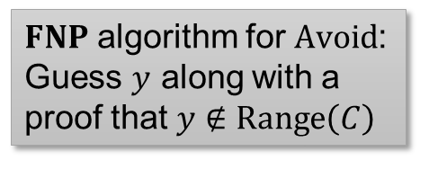

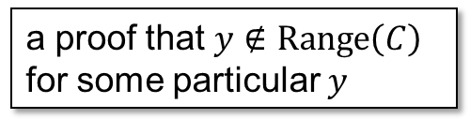
$FNP$ Algorithms for $Avoid$ vs. Proof Complexity Generators
Theorem: The following are equivalent:
$Avoid∈FNP$
There exists a PPS breaking every (non-uniform) proof complexity generator
A PPS breaking every generator
$$=$$
Proof complexity generator
$FNP$ algorithm for $Avoid$: Guess $y$ along with a proof that $y∉Range\left(C\right)$
Input circuit
$FNP$ algorithm
$$=$$
PPS
$$y∈{\left\{0,1\right\}}^{ℓ}$$
a proof that $y∉Range\left(C\right)$ for some particular $y$
$$C$$
$$x∈{\left\{0,1\right\}}^{n}$$
9 / 17

Slide 10
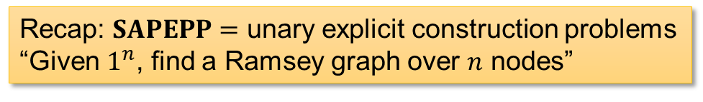

$FNP$ Algorithms for $Avoid$ vs. Proof Complexity Generators
Theorem: The following are equivalent:
$SAPEPP⊆FNP$
There exists a PPS breaking every uniform proof complexity generator
Recap: $SAPEPP=$ unary explicit construction problems
“Given $1^{n}$, find a Ramsey graph over $n$ nodes”
10 / 17

Slide 11

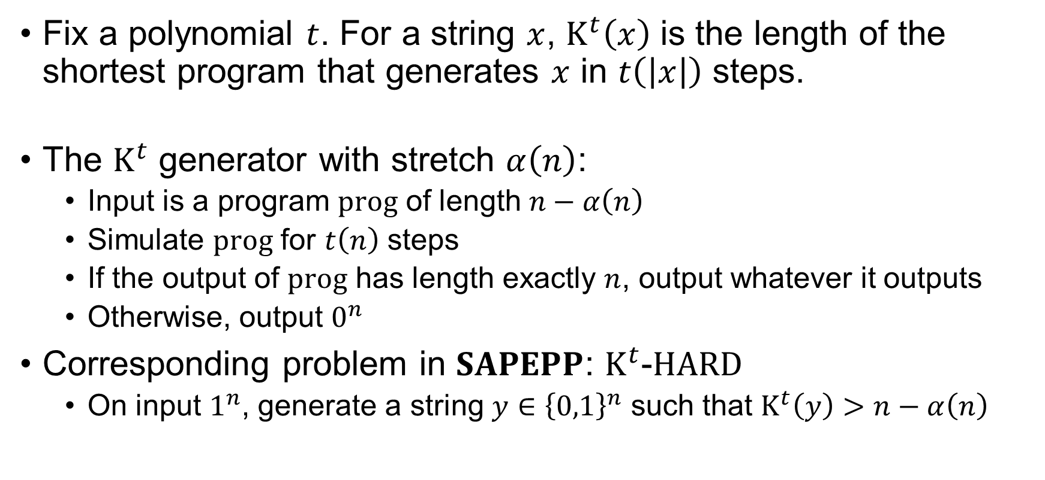
The $K^{t}$ Generator
Fix a polynomial $t$. For a string $x$, $K^{t}\left(x\right)$ is the length of the shortest program that generates $x$ in $t\left(\left|x\right|\right)$ steps.
The $K^{t}$ generator with stretch $α\left(n\right)$:
Input is a program $prog$ of length $n−α\left(n\right)$
Simulate $prog$ for $t\left(n\right)$ steps
If the output of $prog$ has length exactly $n$, output whatever it outputs
Otherwise, output $0^{n}$
Corresponding problem in $SAPEPP$: $K^{t}$-$HARD$
On input $1^{n}$, generate a string $y∈{\left\{0,1\right\}}^{n}$ such that $K^{t}\left(y\right)>n−α\left(n\right)$
“time-bounded Kolmogorov complexity”
11 / 17

Slide 12

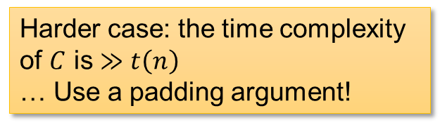

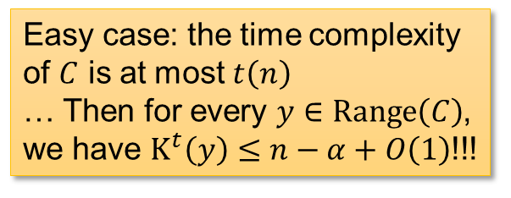


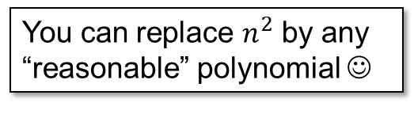




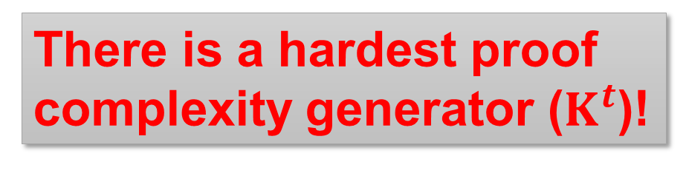



$FNP$ Algorithms for $Avoid$ vs. Proof Complexity Generators
*: up to $ω\left(1\right)$ factors in the stretch
Theorem: The following are equivalent:*
$SAPEPP⊆FNP$
There exists a PPS breaking every uniform proof complexity generator
There exists a PPS breaking the $K^{t}$ generator for $t\left(n\right)=n^{2}$
$K^{t}$-$HARD∈FNP$
There is a hardest proof complexity generator ($K^{t}$)!
You can replace $n^{2}$ by any “reasonable” polynomial ☺
A PPS breaking the $K^{t}$ generator
Harder case: the time complexity of $C$ is $≫t\left(n\right)$
… Use a padding argument!
Easy case: the time complexity of $C$ is at most $t\left(n\right)$
… Then for every $y∈Range\left(C\right)$, we have $K^{t}\left(y\right)≤n−α+O\left(1\right)$!!!
$$y∈{\left\{0,1\right\}}^{n}$$
$$C$$
$$y∈{\left\{0,1\right\}}^{n}$$
$$z_{pad}$$
$$C$$
$$x∈{\left\{0,1\right\}}^{n−α}$$
A uniform generator
$$x∈{\left\{0,1\right\}}^{n−α}$$
$$z_{pad}$$
12 / 17

Slide 13
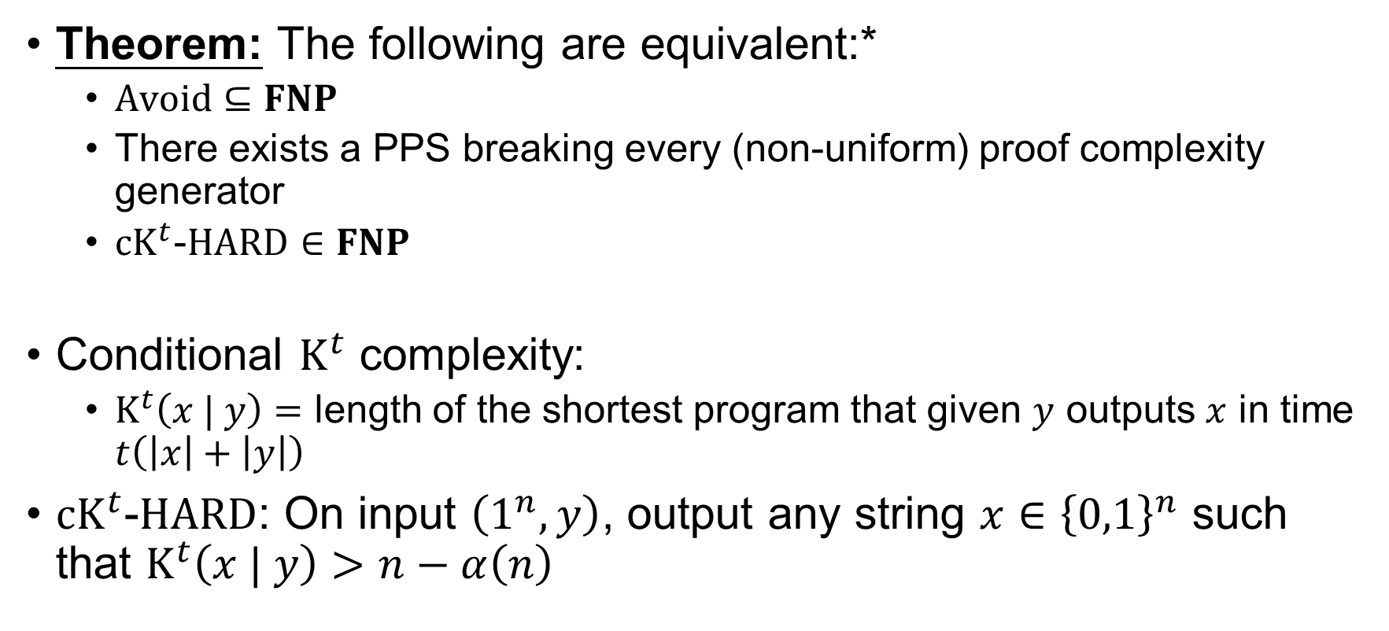
$FNP$ Algorithms for $Avoid$ vs. Proof Complexity Generators
*: up to $ω\left(1\right)$ factors in the stretch
Theorem: The following are equivalent:*
$Avoid⊆FNP$
There exists a PPS breaking every (non-uniform) proof complexity generator
${cK}^{t}$-$HARD∈FNP$
Conditional $K^{t}$ complexity:
$K^{t}\left(x | y\right)=$ length of the shortest program that given $y$ outputs $x$ in time $t\left(\left|x\right|+\left|y\right|\right)$
${cK}^{t}$-$HARD$: On input $\left(1^{n},y\right)$, output any string $x∈{\left\{0,1\right\}}^{n}$ such that $K^{t}\left(x | y\right)>n−α\left(n\right)$
13 / 17

Slide 14


$FP$ Algorithms for $Avoid$ vs. Time Hierarchy against Advice
*: up to $ω\left(1\right)$ factors in the stretch
Theorem: The following are equivalent:*
$SAPEPP⊆FP$
$K^{t}$-$HARD∈FP$
There is a language $L∈E∖i.o.DTIME{\left[2^{n+1}\right]}_{/\left(2^{n}−ω\left(1\right)\right)}$
Time hierarchy against (near-maximum) advice...
14 / 17

Slide 15
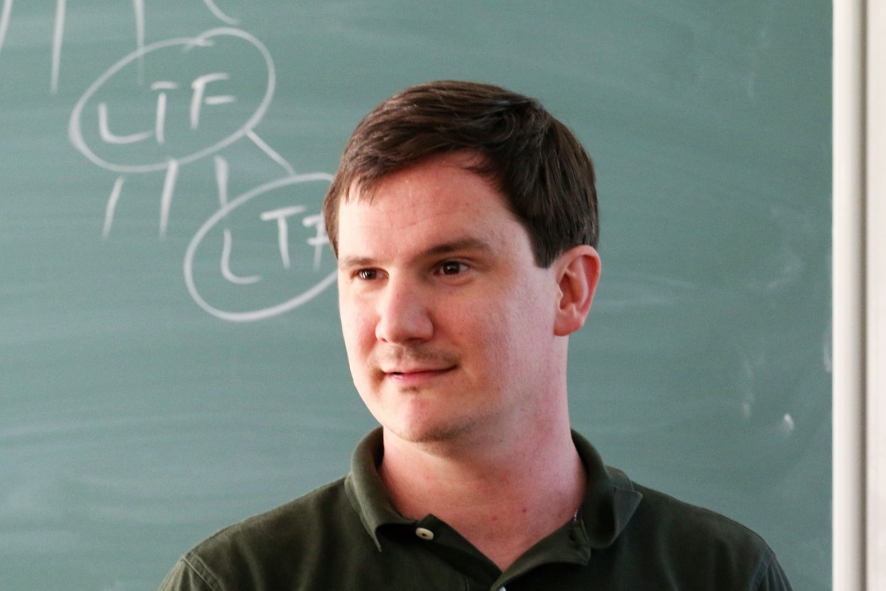
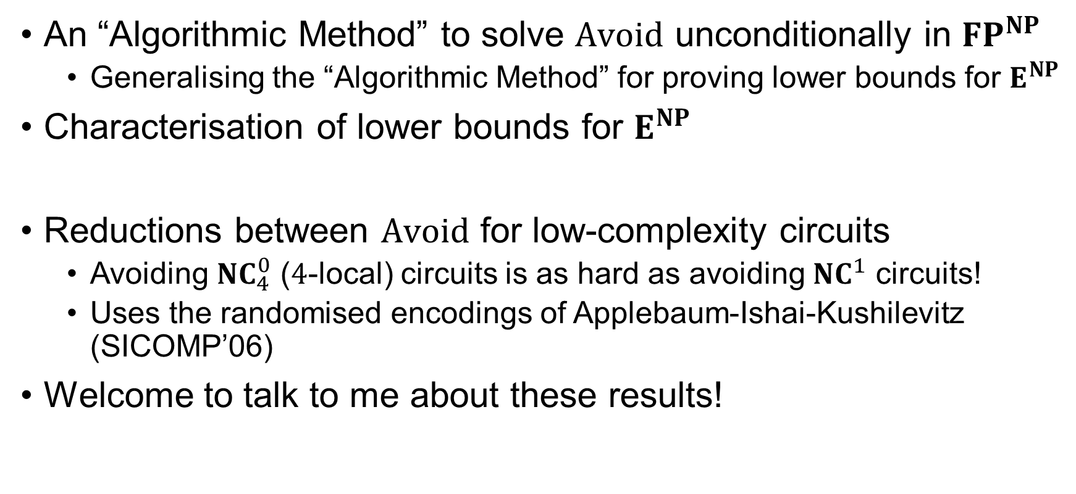
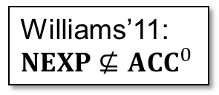
Other Results (Advertisement)
An “Algorithmic Method” to solve $Avoid$ unconditionally in ${FP}^{NP}$
Generalising the “Algorithmic Method” for proving lower bounds for $E^{NP}$
Characterisation of lower bounds for $E^{NP}$
Reductions between $Avoid$ for low-complexity circuits
Avoiding ${NC}_{4}^{0}$ ($4$-local) circuits is as hard as avoiding ${NC}^{1}$ circuits!
Uses the randomised encodings of Applebaum-Ishai-Kushilevitz (SICOMP’06)
Welcome to talk to me about these results!
Williams’11: $NEXP⊈{ACC}^{0}$
15 / 17

Slide 16

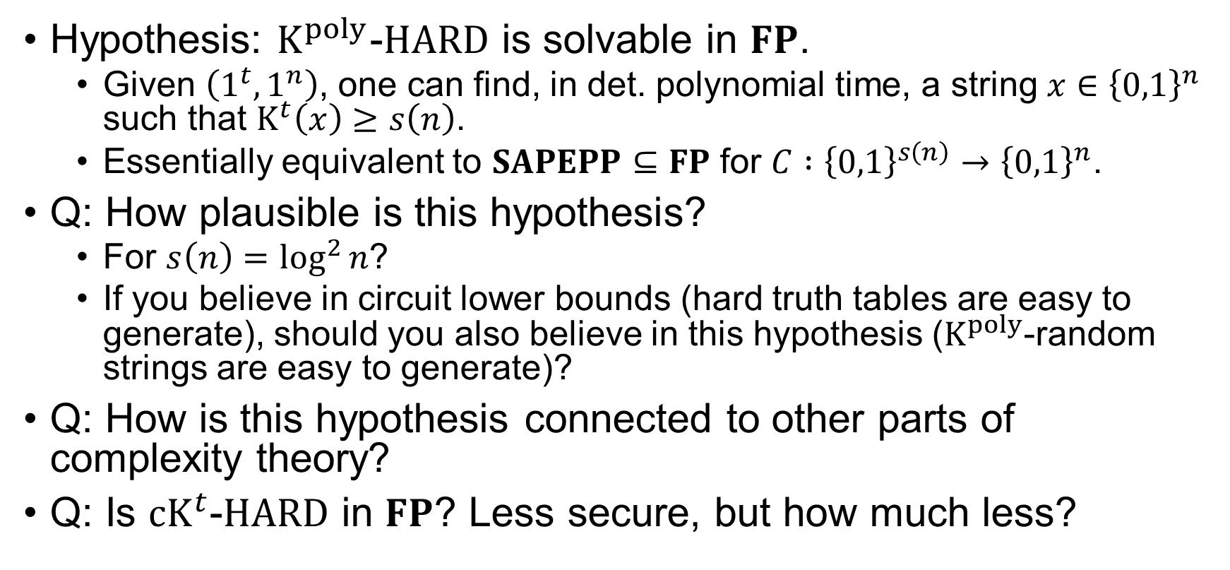
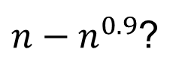
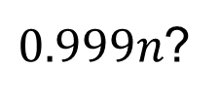
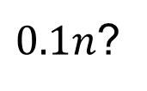
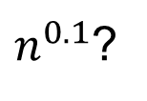
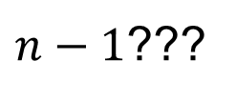
Finally, A Hypothesis…
Hypothesis: $K^{poly}$-$HARD$ is solvable in $FP$.
Given $\left(1^{t},1^{n}\right)$, one can find, in det. polynomial time, a string $x∈{\left\{0,1\right\}}^{n}$ such that $K^{t}\left(x\right)≥s\left(n\right)$.
Essentially equivalent to $SAPEPP⊆FP$ for $C :{\left\{0,1\right\}}^{s\left(n\right)}→{\left\{0,1\right\}}^{n}$.
Q: How plausible is this hypothesis?
For $s\left(n\right)=\log^{2}{n}$?
If you believe in circuit lower bounds (hard truth tables are easy to generate), should you also believe in this hypothesis ($K^{poly}$-random strings are easy to generate)?
Q: How is this hypothesis connected to other parts of complexity theory?
Q: Is $cK^{t}$-$HARD$ in $FP$? Less secure, but how much less?
$n^{0.1}$?
$0.1n$?
$0.999n$?
$n−n^{0.9}$?
$n−\log^{2}{n}$?
$n−1$???
New hypothesis for derandomization?
16 / 17

Slide 17
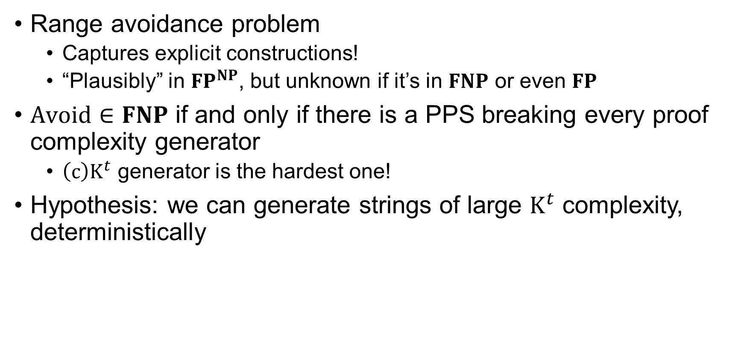
Summary
Range avoidance problem
Captures explicit constructions!
“Plausibly” in ${FP}^{NP}$, but unknown if it’s in $FNP$ or even $FP$
$Avoid∈FNP$ if and only if there is a PPS breaking every proof complexity generator
$\left(c\right)K^{t}$ generator is the hardest one!
Hypothesis: we can generate strings of large $K^{t}$ complexity, deterministically
17 / 17

Slide 18
Thank you!
Questions are welcome! ☺

