Slide 1


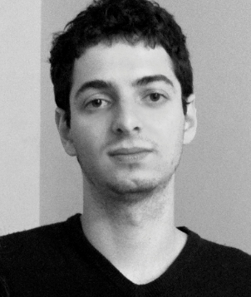


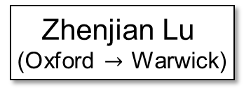
Polynomial-Time Pseudodeterminstic Construction of Primes
Lijie Chen
(Berkeley)
Zhenjian Lu
(Oxford $→$ Warwick)
Igor C. Oliveira
(Warwick)
Hanlin Ren
(Oxford)
Rahul Santhanam
(Oxford)
Jan 22, 2024
Theory Seminar @ UIUC
0 / 25

Slide 2
Primes & Dense Properties

Slide 3




Finding a prime
Problem: Given an integer $n$, find an $n$-bit prime number.
Binary number $N∈\left[2^{n−1},2^{n}\right)$ without divisors except $1$ and $N$ itself
Example I
Input: $n=6$
Output: 100101
Explanation: this is $37$ in binary, which is a prime
Example II
Input: $n=82,589,933$
Output: 111111111…11111
Explanation: Left as an easy exercise ☺
$n$ 1’s
Today’s question: can we find a prime in $poly\left(n\right)$ time?
1 / 25

Slide 4
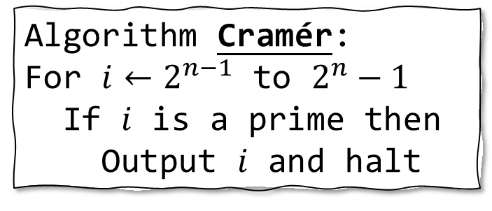
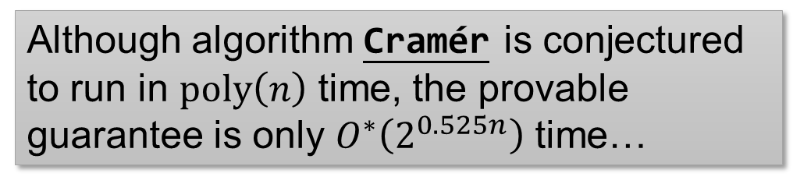
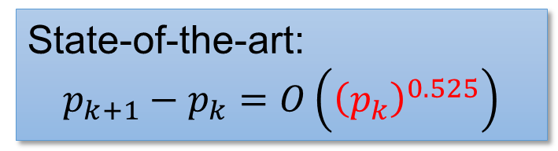
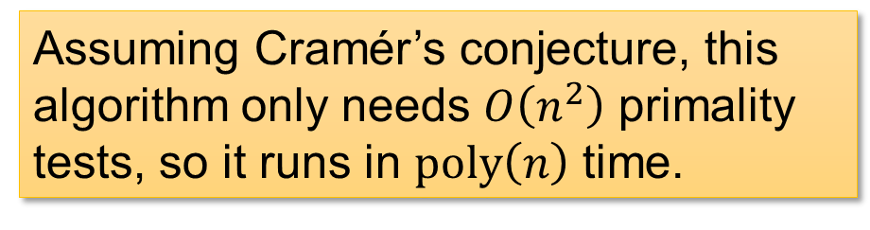
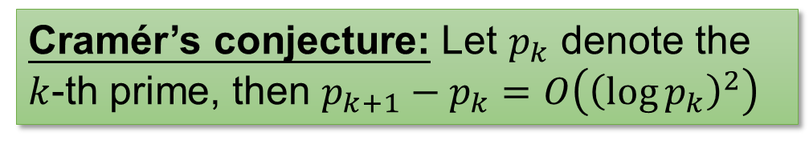
Solution 1: Cramér
Algorithm Cramér:
For $i←2^{n−1}$ to $2^{n}−1$
If $i$ is a prime then
Output $i$ and halt
Cramér’s conjecture: Let $p_{k}$ denote the $k$-th prime, then $p_{k+1}−p_{k}=O\left({\left(\log{p_{k}}\right)}^{2}\right)$
Assuming Cramér’s conjecture, this algorithm only needs $O\left(n^{2}\right)$ primality tests, so it runs in $poly\left(n\right)$ time.
Can use [AKS04] deterministic primality test!
State-of-the-art:
$$p_{k+1}−p_{k}=O\left({\left(p_{k}\right)}^{0.525}\right)$$
Although algorithm Cramér is conjectured to run in $poly\left(n\right)$ time, the provable guarantee is only $O^{∗}\left(2^{0.525n}\right)$ time…
2 / 25

Slide 5

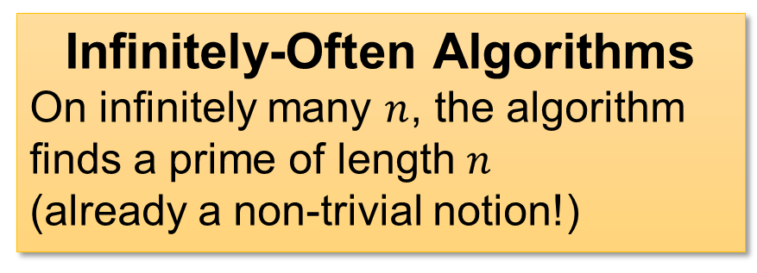
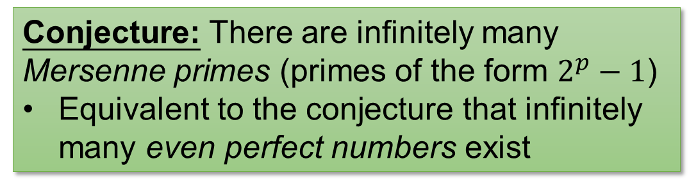
Solution 2: Mersenne
Algorithm Mersenne:
Output $n$ ones (!!!)
Conjecture: There are infinitely many Mersenne primes (primes of the form $2^{p}−1$)
Equivalent to the conjecture that infinitely many even perfect numbers exist
Under the conjecture, algorithm Mersenne is an infinitely-often polynomial-time algorithm for finding primes.
Infinitely-Often Algorithms
On infinitely many $n$, the algorithm finds a prime of length $n$
(already a non-trivial notion!)
3 / 25

Slide 6

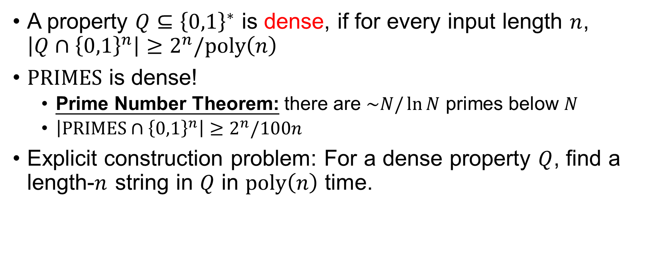

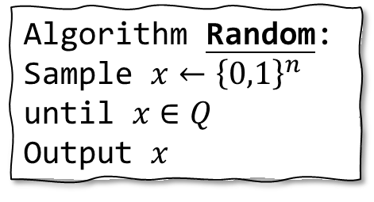
Dense Properties
A property $Q⊆{\left\{0,1\right\}}^{∗}$ is dense, if for every input length $n$, $\left|Q∩{\left\{0,1\right\}}^{n}\right|≥2^{n}/poly\left(n\right)$
$PRIMES$ is dense!
Prime Number Theorem: there are $\sim N/\ln{N}$ primes below $N$
$\left|PRIMES∩{\left\{0,1\right\}}^{n}\right|≥2^{n}/100n$
Explicit construction problem: For a dense property $Q$, find a length-$n$ string in $Q$ in $poly\left(n\right)$ time.
Algorithm Random:
Sample $x←{\left\{0,1\right\}}^{n}$ until $x∈Q$
Output $x$
Easy with randomness!
Deterministic algorithms are open…
(even for the special case of $PRIMES$)
4 / 25

Slide 7

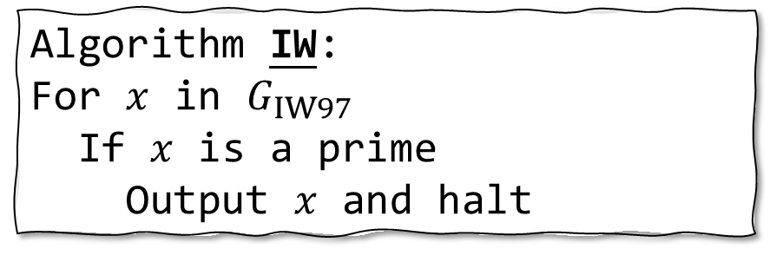

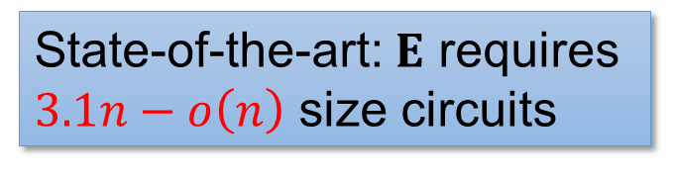
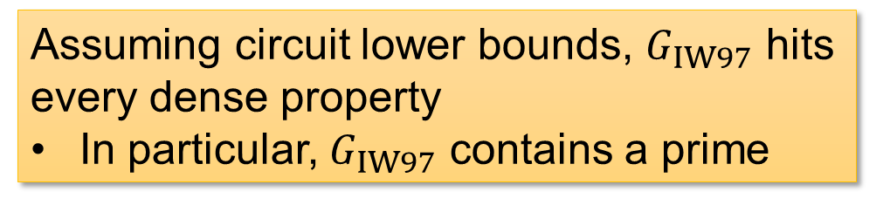
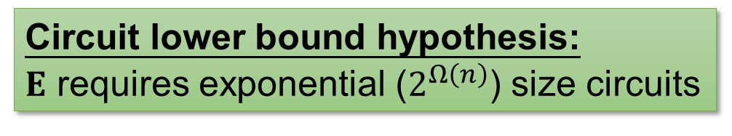
Solution 3: Impagliazzo-Wigderson
Algorithm IW:
For $x$ in $G_{IW97}$
If $x$ is a prime
Output $x$ and halt
Circuit lower bound hypothesis: $E$ requires exponential ($2^{Ω\left(n\right)}$) size circuits
Assuming circuit lower bounds, $G_{IW97}$ hits every dense property
In particular, $G_{IW97}$ contains a prime
$G_{IW97}$: the generator presented in IW97
State-of-the-art: $E$ requires $3.1n−o\left(n\right)$ size circuits
Although algorithm IW is conjectured to find a prime in $poly\left(n\right)$ time, we seem very far from proving this conjecture…
5 / 25

Slide 8
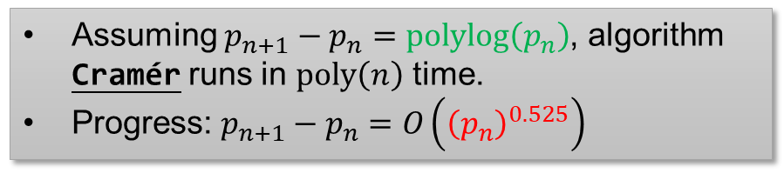
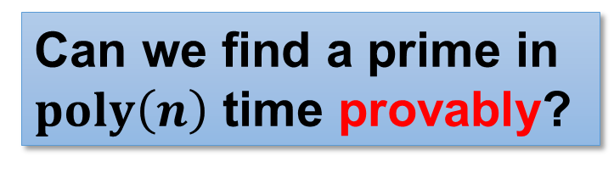
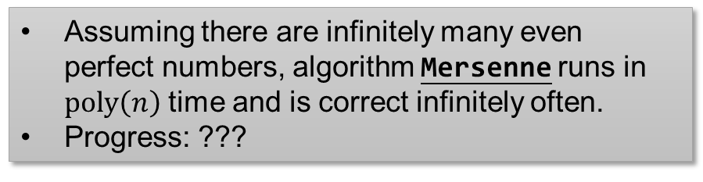
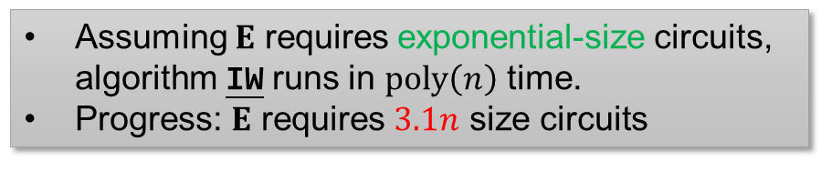
What we have
Algorithm Cramér
Assuming $p_{n+1}−p_{n}=polylog\left(p_{n}\right)$, algorithm Cramér runs in $poly\left(n\right)$ time.
Progress: $p_{n+1}−p_{n}=O\left({\left(p_{n}\right)}^{0.525}\right)$
Algorithm Mersenne
Assuming there are infinitely many even perfect numbers, algorithm Mersenne runs in $poly\left(n\right)$ time and is correct infinitely often.
Progress: ???
Algorithm IW
Assuming $E$ requires exponential-size circuits, algorithm IW runs in $poly\left(n\right)$ time.
Progress: $E$ requires $3.1n$ size circuits
Can we find a prime in $poly\left(n\right)$ time provably?
Polymath 4: tried to use number-theoretic techniques, but did not obtain unconditional improvement
6 / 25

Slide 9
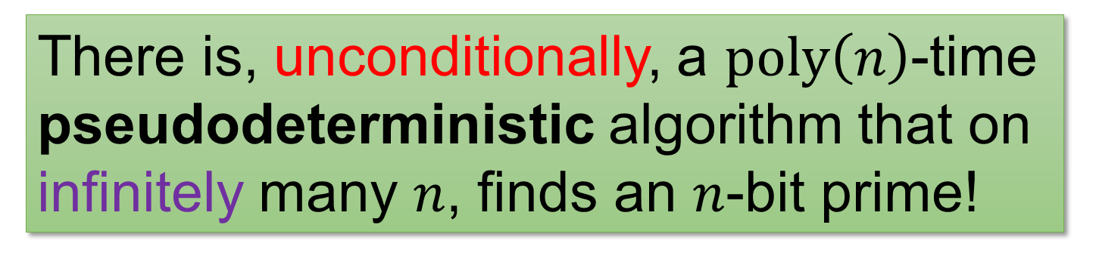
Our result
There is, unconditionally, a $poly\left(n\right)$-time pseudodeterministic algorithm that on infinitely many $n$, finds an $n$-bit prime!
Next: what’s a pseudodeterministic algorithm?
7 / 25

Slide 10






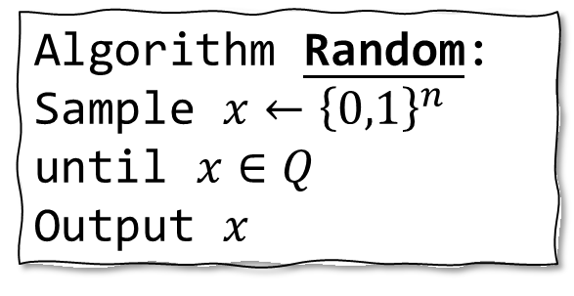
Intermediate notion between deterministic and randomized algorithms
Algorithm Random:
Sample $x←{\left\{0,1\right\}}^{n}$ until $x∈Q$
Output $x$
One drawback of Random:
it outputs different primes on different executions
Deterministic algorithms
Randomized algorithms
Algorithm DET
Let’s require different executions of RAND to output the same prime!
Algorithm RAND
$$p$$
$$p_{1}$$
$$p_{2}$$
❌
$$p_{3}$$
$$p_{2}$$
$$p_{4}$$
8 / 25

Slide 11




Pseudodeterministic algorithms
A randomized algorithm is pseudodeterministic, if on most of its computational branches, it outputs the same answer.
Any (bounded) observer thinks the algorithm is deterministic!
Pseudodeterministic algorithms
Deterministic algorithms
Randomized algorithms
Algorithm DET
Algorithm RAND
Algorithm PSEUDO
$$p$$
$$p_{1}$$
$$p_{2}$$
❌
$$p_{3}$$
$$p_{2}$$
$$p_{4}$$
$$p_{1}$$
$$p_{1}$$
❌
$$p_{2}$$
$$p_{1}$$
$$p_{1}$$
9 / 25

Slide 12
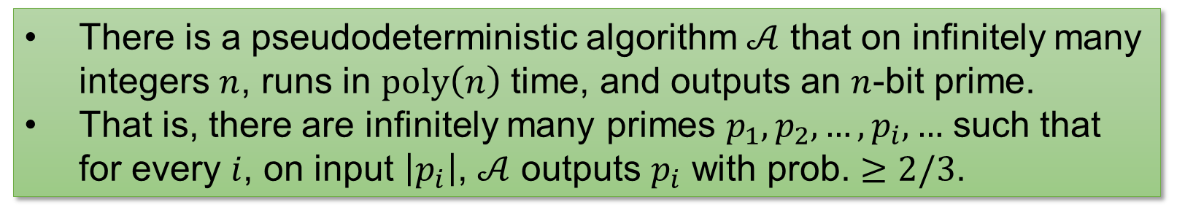


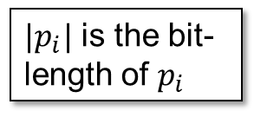
Our result
There is a pseudodeterministic algorithm $𝒜$ that on infinitely many integers $n$, runs in $poly\left(n\right)$ time, and outputs an $n$-bit prime.
That is, there are infinitely many primes $p_{1},p_{2},…,p_{i},…$ such that for every $i$, on input $\left|p_{i}\right|$, $𝒜$ outputs $p_{i}$ with prob. $≥2/3$.
“canonical” primes
$|p_{i}|$ is the bit-length of $p_{i}$
Previously, Oliveira-Santhanam’17 achieved subexponential ($2^{n^{o\left(1\right)}}$) time for the same task.
Moreover, this holds for every dense property in poly-time, not only $PRIMES$!
Spoiler ahead: little number theory but heavy complexity theory ☺
10 / 25

Slide 13
Warm-Up: sub-exponential time

Slide 14

Warm-up: Pseudodeterministic constructions in subexponential time
Oliveira-Santhanam 17: there is a pseudodeterministic algorithm that finds $n$-bit primes in $2^{n^{o\left(1\right)}}$ time infinitely often.
Idea I: Uniform hardness vs randomness
Idea II: Win-win analysis
11 / 25

Slide 15

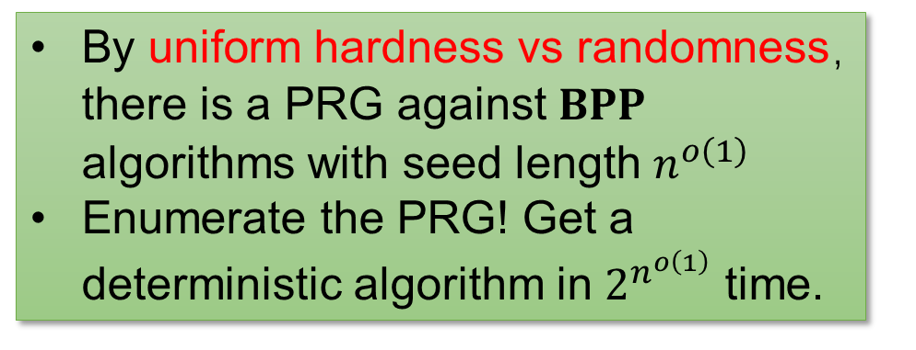
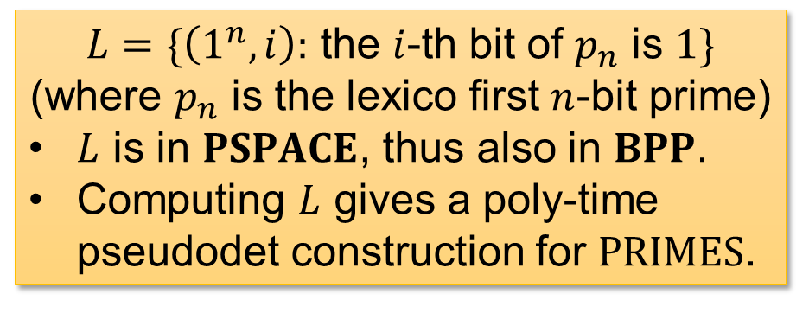
Idea II: Win-win Analysis
Is $PSPACE=BPP$?
YES
NO
$L=\{\left(1^{n},i\right):$ the $i$-th bit of $p_{n}$ is $1\}$
(where $p_{n}$ is the lexico first $n$-bit prime)
$L$ is in $PSPACE$, thus also in $BPP$.
Computing $L$ gives a poly-time pseudodet construction for $PRIMES$.
By uniform hardness vs randomness，there is a PRG against $BPP$ algorithms with seed length $n^{o\left(1\right)}$
Enumerate the PRG! Get a deterministic algorithm in $2^{n^{o\left(1\right)}}$ time.
PRG: Pseudorandom generator
12 / 25

Slide 16







Idea I: Hardness vs Randomness
These results need $IP=PSPACE$!
Given a hard function $f$
$$f∈PSPACE$$
against non-uniform circuits
Recap
uniform $BPP$ machines?
Is $PSPACE=BPP$?
NW94, IW97
IW01, TV07
YES
NO
Randomness is powerful, so pseudodet algo possible
Derand. is possible, so det algo possible
Can construct a PRG $G_{f}$
against non-uniform circuits
uniform $BPP$ machines!
13 / 25

Slide 17


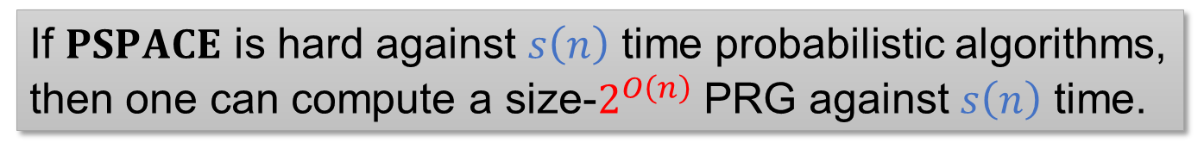


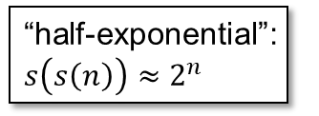
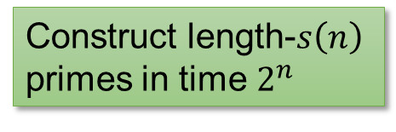

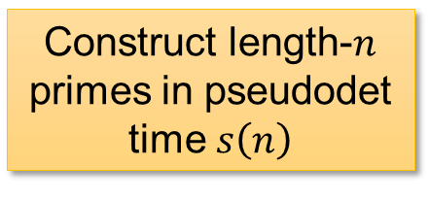


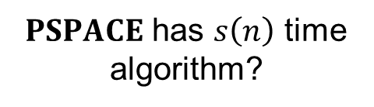


Subexponential Time…?
If $PSPACE$ is hard against $s\left(n\right)$ time probabilistic algorithms, then one can compute a size-$2^{O\left(n\right)}$ PRG against $s\left(n\right)$ time.
$PSPACE$ has $s\left(n\right)$ time algorithm?
Time complexity of…
$$2^{o\left(n\right)}$$
… the overall algorithm
… YES case
$$2^{n^{o\left(1\right)}}$$
YES
NO
“half-exponential”: $s\left(s\left(n\right)\right)≈2^{n}$
Construct length-$n$ primes in pseudodet time $s\left(n\right)$
$$2^{polylog\left(n\right)}$$
Construct length-$s\left(n\right)$ primes in time $2^{n}$
… NO case
$$poly(n)$$
$$poly(n)$$
$$2^{polylog\left(n\right)}$$
$$2^{n^{o\left(1\right)}}$$
$$2^{o\left(n\right)}$$
$$s\left(n\right)$$
14 / 25

Slide 18

An iterated win-win analysis!
Over not only $2$ cases, but $O\left(\log{n}\right)$ many ☺

Slide 19




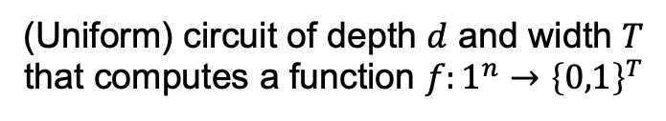

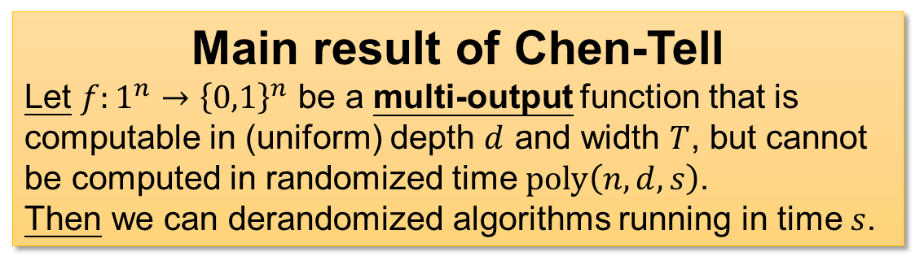

The Chen-Tell generator: Scaled-down uniform hardness-randomness tradeoff
H vs R
Generators in IW01, TV07
$$T≫d$$
$$IP=PSPACE$$
(Uniform) circuit of depth $d$ and width $T$
that computes a function $f:1^{n}→{\left\{0,1\right\}}^{T}$
scaled-down
scaled-down
$$d$$
The GKR protocol
H vs R
Chen-Tell Generator
Main result of Chen-Tell
Let $f:1^{n}→{\left\{0,1\right\}}^{n}$ be a multi-output function that is computable in (uniform) depth $d$ and width $T$, but cannot be computed in randomized time $poly\left(n,d,s\right)$.
Then we can derandomized algorithms running in time $s$.
$$∧$$
$$∨$$
$$∨$$
15 / 25

Slide 20
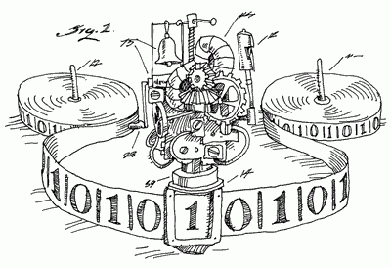

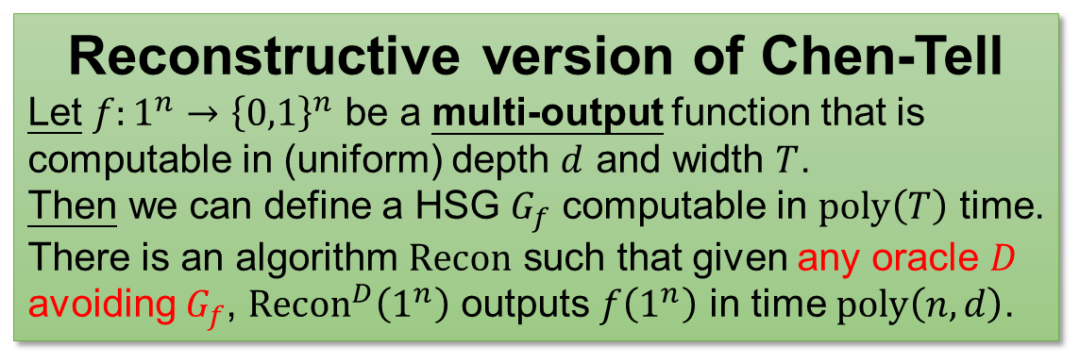


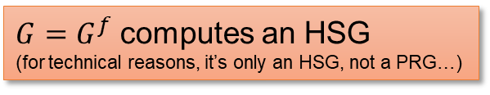
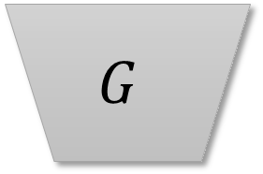
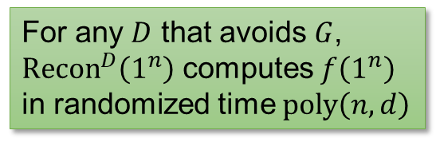
The Chen-Tell generator (reconstructive version)
$$G$$
Reconstructive version of Chen-Tell
Let $f:1^{n}→{\left\{0,1\right\}}^{n}$ be a multi-output function that is computable in (uniform) depth $d$ and width $T$.
Then we can define a HSG $G_{f}$ computable in $poly\left(T\right)$ time.
There is an algorithm $Recon$ such that given any oracle $D$ avoiding $G_{f}$, ${Recon}^{D}\left(1^{n}\right)$ outputs $f\left(1^{n}\right)$ in time $poly\left(n,d\right)$.
$$f$$
$G=G^{f}$ computes an HSG
(for technical reasons, it’s only an HSG, not a PRG…)
$$Recon$$
$$D$$
Main result of Chen-Tell
Let $f:1^{n}→{\left\{0,1\right\}}^{n}$ be a multi-output function that is computable in (uniform) depth $d$ and width $T$, but cannot be computed in randomized time $poly\left(n,d,s\right)$.
Then we can derandomized algorithms running in time $s$.
For any $D$ that avoids $G$, ${Recon}^{D}\left(1^{n}\right)$ computes $f\left(1^{n}\right)$ in randomized time $poly\left(n,d\right)$
16 / 25

Slide 21
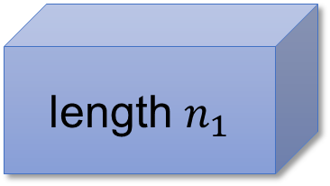
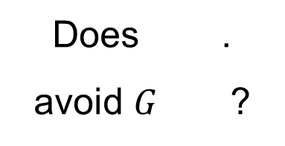

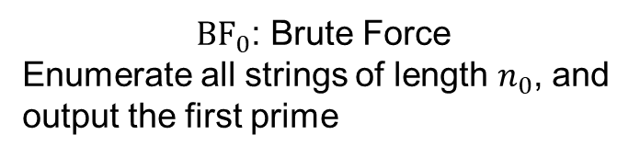













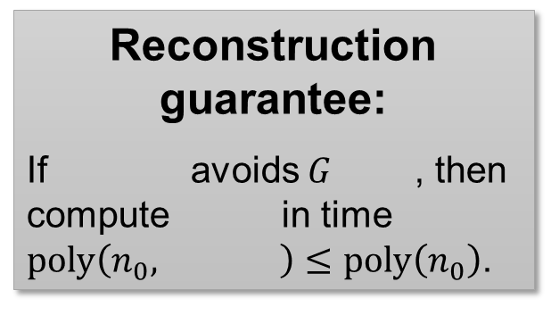

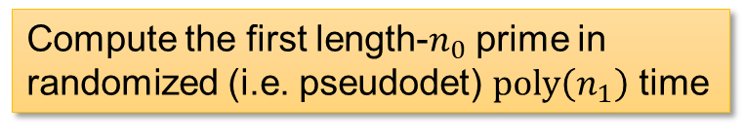


Pseudodeterministic Constructions from Chen-Tell?
Fix $n_{0}$ and $n_{1}=poly\left(n_{0}\right)$.
Compute the first length-$n_{0}$ prime in randomized (i.e. pseudodet) $poly\left(n_{1}\right)$ time
YES
Does .
avoid $G$ ?
$$PRIMES$$
$n_{1}$
“$BPP$ is powerful”, so get pseudodet. algo
$$…$$
$${BF}_{0}$$
NO
Subexponential ($2^{O\left(n_{0}\right)}≤2^{{\left(n_{1}\right)}^{ε}}$) size hitting set $G^{{BF}_{0}}$ that hits ${PRIMES}_{n_{1}}$
length $n_{1}$
Does “$PSPACE=BPP$”?
“derand. is possible”, so get det. algo
Reconstruction guarantee:
If avoids $G$ , then compute in time $poly\left(n_{0}, \right)≤poly\left(n_{0}\right)$.
$$…$$
$$T_{0}=2^{O\left(n_{0}\right)}$$
$n_{1}$
$${BF}_{0}$$
${BF}_{0}$: Brute Force
Enumerate all strings of length $n_{0}$, and output the first prime
length $n_{0}$
$$d_{0}=poly\left(n_{0}\right)$$
$${BF}_{0}$$
$n_{1}$
$$…$$
17 / 25

Slide 22
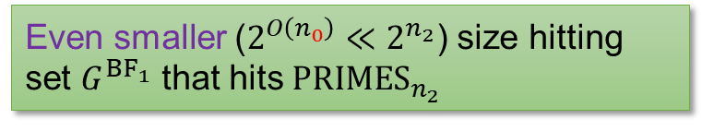


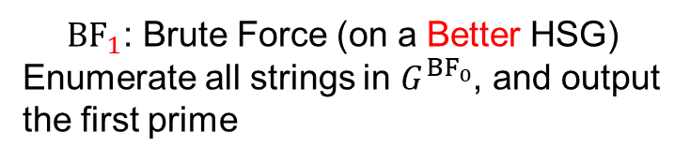
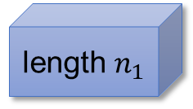















Apply it again?
Now, let $n_{2}=poly\left(n_{1}\right)$.
Compute the first length-$n_{1}$ prime in the HSG $G^{{BF}_{0}}$ in pseudodet $poly\left(n_{2}\right)$ time
YES
Does .
avoid $G$ ?
$$PRIMES$$
$n_{2}$
$$…$$
$${BF}_{1}$$
NO
Even smaller ($2^{O\left(n_{0}\right)}≪2^{n_{2}}$) size hitting set $G^{{BF}_{1}}$ that hits ${PRIMES}_{n_{2}}$
length $n_{2}$
$$…$$
$T_{1}=2^{O\left(n_{0}\right)}$ (still!)
Reconstruction guarantee:
If avoids $G$ , then compute in time $poly\left(n_{1}, \right)≤poly\left(n_{1}\right)$.
length $n_{1}$
${BF}_{1}$: Brute Force (on a Better HSG)
Enumerate all strings in $G^{{BF}_{0}}$, and output the first prime
$$d_{1}=poly\left(n_{1}\right)$$
$n_{2}$
$${BF}_{1}$$
$$…$$
$${BF}_{1}$$
$n_{2}$
length $n_{0}$
$$…$$
18 / 25

Slide 23























… and again
$$PRIMES$$
$G_{0}={\left\{0,1\right\}}^{n_{0}}$: trivial HSG for ${PRIMES}_{n_{0}}$
$G_{1}=G^{{BF}_{0}}$ hits ${PRIMES}_{n_{1}}$ and has size $2^{O\left(n_{0}\right)}$
$G_{2}=G^{{BF}_{1}}$ hits ${PRIMES}_{n_{2}}$ and has size $2^{O\left(n_{0}\right)}$
$$…$$
$$…$$
length $n_{i}$
${BF}_{0}$: go through $G_{0}$ and find the first prime
NO
${BF}_{1}$: go through $G_{1}$ and find the first prime
NO
${BF}_{2}$: go through $G_{2}$ and find the first prime
NO
$$…$$
Does ${PRIMES}_{n_{1}}$ avoid $G^{{BF}_{0}}$?
Does ${PRIMES}_{n_{2}}$ avoid $G^{{BF}_{1}}$?
Does ${PRIMES}_{n_{3}}$ avoid $G^{{BF}_{2}}$?
length $n_{2}$
$$…$$
YES
YES
YES
length $n_{1}$
first length-$n_{0}$ prime in pseudodet $poly\left(n_{1}\right)$ time
first prime in $G_{1}$ in pseudodet $poly\left(n_{2}\right)$ time
first prime in $G_{2}$ in pseudodet $poly\left(n_{3}\right)$ time
$$…$$
length $n_{0}$
$$…$$
19 / 25

Slide 24













Each Iteration
$n_{i}=$ length of prime that we want to find
$G_{i}=$ HSG containing an $n_{i}$-bit prime
$T_{i}=$ size of $G_{i}$
(Turns out that $d_{i}≤poly\left(n_{i}\right)$ is not bottleneck)
$$T_{i}$$
$${BF}_{i}$$
Enumerate all strings in $G_{i}$ and output the first prime
$$d_{i}$$
$$T_{0}=2^{O\left(n_{0}\right)}$$
Each iteration:
$n_{i+1}←{\left(n_{i}\right)}^{β}$ for some $β$ that we set
$T_{i+1}←{\left(T_{i}\right)}^{α}$ for some $α$ depending on Chen-Tell
Compute the first prime in $G_{i}$ in randomized (i.e. pseudodet) $poly\left(n_{i+1}\right)$ time
YES
Does ${PRIMES}_{n_{i+1}}$ avoid $G^{{BF}_{i}}$?
Hope: when you set $β$ large enough, $\left\{n_{i}\right\}$ will grow faster than $\left\{T_{i}\right\}$!!
NO
A small hitting set
$$G_{i+1}≔G^{{BF}_{i}}$$
that hits ${PRIMES}_{n_{i+1}}$
$$T_{i}$$
$$n_{i}$$
$$i$$
20 / 25

Slide 25



$\left\{n_{i}\right\}$ vs $\left\{T_{i}\right\}$?
$n_{i}={\left(n_{i−1}\right)}^{β}⇒n_{i}={\left(n_{0}\right)}^{β^{i}}$
$T_{i}={\left(T_{i−1}\right)}^{α}⇒T_{i}={\left(2^{n_{0}}\right)}^{α^{i}}$, for some $α$
$\frac{\log{T_{i}}}{\log{n_{i}}}=\frac{α^{i}\log{n_{0}}}{β^{i}n_{0}}≈{\left(α/β\right)}^{i}n_{0}$, set $β=2α$.
Therefore, when $t=O\left(\log{n_{0}}\right)$, $T_{t}$ will be comparable with $n_{t}$.
Hope: when you set $β$ large enough, $\left\{n_{i}\right\}$ will grow faster than $\left\{T_{i}\right\}$!!
$$T_{i}$$
$$n_{i}$$
$$i$$
21 / 25

Slide 26



Algorithm CLORS23
Algorithm CLORS23:
Let’s say $n=n_{i}$ for some $i$
If $i=t$ (recall that $T_{t}≤poly\left(n_{t}\right)$)
Find the first prime in $G_{i}$ by brute force
Else
Use ${Recon}^{{PRIMES}_{n_{i+1}}}$ to output an $n_{i}$-bit prime
If $G_{t}$ doesn’t contain a prime
But $G_{0}$ does…
There is some $i$, $G_{i}$ contains a prime but $G_{i+1}=G_{{BF}_{i}}$ doesn’t.
${PRIMES}_{n_{i+1}}$ avoids $G_{{BF}_{i}}$, so ${Recon}^{{PRIMES}_{n_{i+1}}}$ computes ${BF}_{i}$ correctly!
If $G_{t}$ contains a prime
We can find this prime using brute force!
22 / 25

Slide 27




Open Question: Circuit Lower Bounds for $BPE^{MCSP}/_{1}$?
Corollary: If $MCSP∈P$, then $BPE/_{1}⊈SIZE\left[2^{n}/n\right]$.
Open problem: Prove that $BPE^{MCSP}/_{1}⊈SIZE\left[2^{n}/n\right]$
Previously
$ZPE^{MCSP}/_{1}⊈P/_{poly}$ (IKV18)
$BPE^{MCSP}/_{2^{εn}}⊈SIZE\left[2^{n}/n\right]$ (HLR23)
$MCSP$: Minimum Circuit Size Problem
Input: truth table of a Boolean function $f:{\left\{0,1\right\}}^{n}→\left\{0,1\right\}$
Output: Circuit complexity of $f$
Proof: “has circuit complexity $>2^{n}/n$” is a dense property in $P$, run pseudodeterministic construction on it.
23 / 25

Slide 28

Bounded Relativization
OS17 is $PSPACE$-relativizing!
For every oracle $O∈PSPACE$ and every dense property $Q∈P^{O}$, there is a pseudodeterministic construction for $Q$ in $2^{n^{o\left(1\right)}}$ time with oracle access to $O$
$ZPE^{MCSP}/_{1}⊈P/_{poly}$: relativize OS17 with the $MCSP$ oracle
Our proof is not $PSPACE$-relativizing…
Reason: left as an exercise ☺
Is our result $PSPACE$-relativizing? A positive answer implies a near-maximum circuit lower bound for ${BPE}^{MCSP}/_{1}$!
24 / 25

Slide 29





Summary
$$PRIMES$$
Win-win over $O\left(log n\right)$ input lengths
$$…$$
$$…$$
Use ${PRIMES}_{N}$ to help construct ${PRIMES}_{n}$?
length $n_{i}$
NO
NO
NO
YES
NO
$$…$$
YES
YES
YES
length $n_{2}$
Solve ${PRIMES}_{n}$
Make progress on ${PRIMES}_{N}$
$$…$$
length $n_{1}$
Thank you!
$$…$$
length $n_{0}$
$$…$$
Questions are welcome!
25 / 25

Slide 30












Omitted Details: Shaltiel-Umans Generator
$$f$$
$$\tilde{f}$$
$$CT\left(f\right)=\bigcup_{i}{NW\left({\tilde{f}}_{i}\right) }$$
Nisan-Wigderson
Problem with NW: size of $CT\left(f\right)$ is quasi-poly in $T$!
This paper: Shaltiel-Umans as a HSG with learning reconstruction!
$$Recon$$
$$D$$
$$G$$
$$P$$
$$P$$
Shaltiel-Umans
Given a low-deg polynomial $P$, $G^{P}$ produces an HSG
${Recon}^{D,P}$ outputs a $D$-oracle circuit computing $P$ (exactly)
26 / 27

Slide 31

Using SU in Chen-Tell
Shaltiel-Umans
Inside Chen-Tell: each row of $\tilde{f}$ is a low-deg polynomial!
Algorithm ChenTell.$Recon$:
$C_{0}←$trivial circuit for ${row}_{0}$
For $i←$1 to $d$:
Use downward self-reducibility to obtain a circuit $C_{i}^{′}$ for ${row}_{i}$
//$C_{i}^{′}$ is too large
$C_{i}←$SU.${Recon}^{C_{i}^{′},D}$
Return $C_{d}$
$$Recon$$
$$D$$
$$G$$
$$P$$
$$P$$
Given a low-deg polynomial $P$, $G^{P}$ produces an HSG
${Recon}^{D,P}$ outputs a $D$-oracle circuit computing $P$ (exactly)
27 / 27

