Slide 1



Faster Algorithms for Distance Sensitivity Oracles
Hanlin Ren (University of Oxford)
Joint work with Yong Gu
Nov 14, Yaoclass Seminar
* Work done in Tsinghua
$$x$$
$$b$$
$$a$$
1 / 16

Slide 2




Distance Sensitivity Oracles (DSOs)
Given a directed graph $G=\left(V,E\right)$
Query$\left(a,b,x\right)$: the shortest $a→b$ path not passing through $x$?
A natural and well-studied problem in graph algorithms.
$$x$$
$$b$$
$$a$$
2 / 16

Slide 3
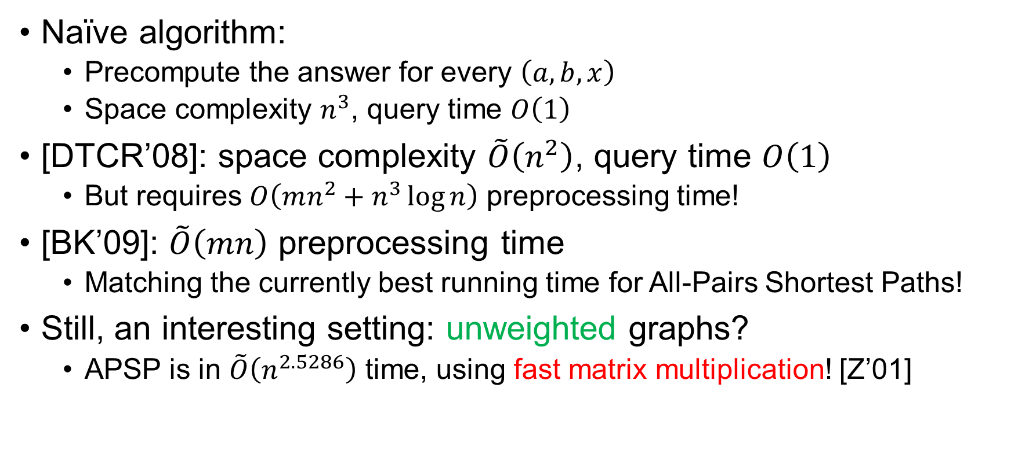
Previous Work
Naïve algorithm:
Precompute the answer for every $\left(a,b,x\right)$
Space complexity $n^{3}$, query time $O\left(1\right)$
[DTCR’08]: space complexity $\tilde{O}\left(n^{2}\right)$, query time $O\left(1\right)$
But requires $O\left(mn^{2}+n^{3}\log{n}\right)$ preprocessing time!
[BK’09]: $\tilde{O}\left(mn\right)$ preprocessing time
Matching the currently best running time for All-Pairs Shortest Paths!
Still, an interesting setting: unweighted graphs?
APSP is in $\tilde{O}\left(n^{2.5286}\right)$ time, using fast matrix multiplication! [Z’01]
We consider unweighted graphs in this talk, for simplicity.
Our results extend to graphs with small positive integer weights.
3 / 16

Slide 4
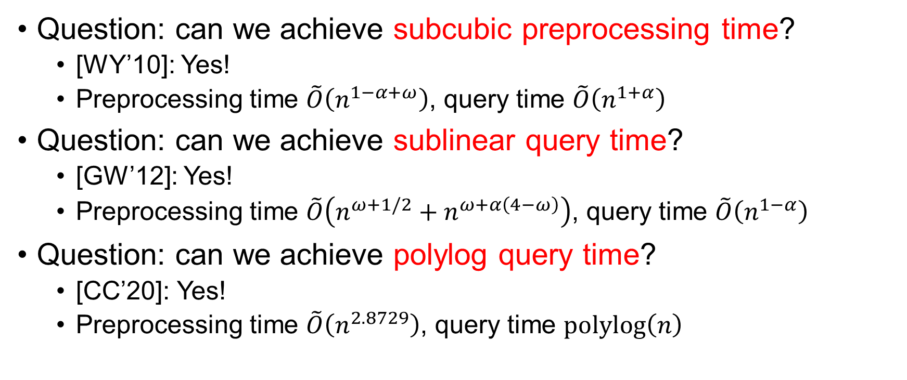

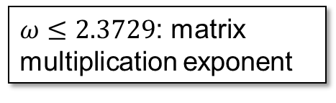
Previous Work via Fast Matrix Mult?
Question: can we achieve subcubic preprocessing time?
[WY’10]: Yes!
Preprocessing time $\tilde{O}\left(n^{1−α+ω}\right)$, query time $\tilde{O}\left(n^{1+α}\right)$
Question: can we achieve sublinear query time?
[GW’12]: Yes!
Preprocessing time $\tilde{O}\left(n^{ω+1/2}+n^{ω+α\left(4−ω\right)}\right)$, query time $\tilde{O}\left(n^{1−α}\right)$
Question: can we achieve polylog query time?
[CC’20]: Yes!
Preprocessing time $\tilde{O}\left(n^{2.8729}\right)$, query time $polylog\left(n\right)$
$ω≤2.3729$: matrix multiplication exponent
$α∈\left(0,1\right)$ is a parameter
4 / 16

Slide 5
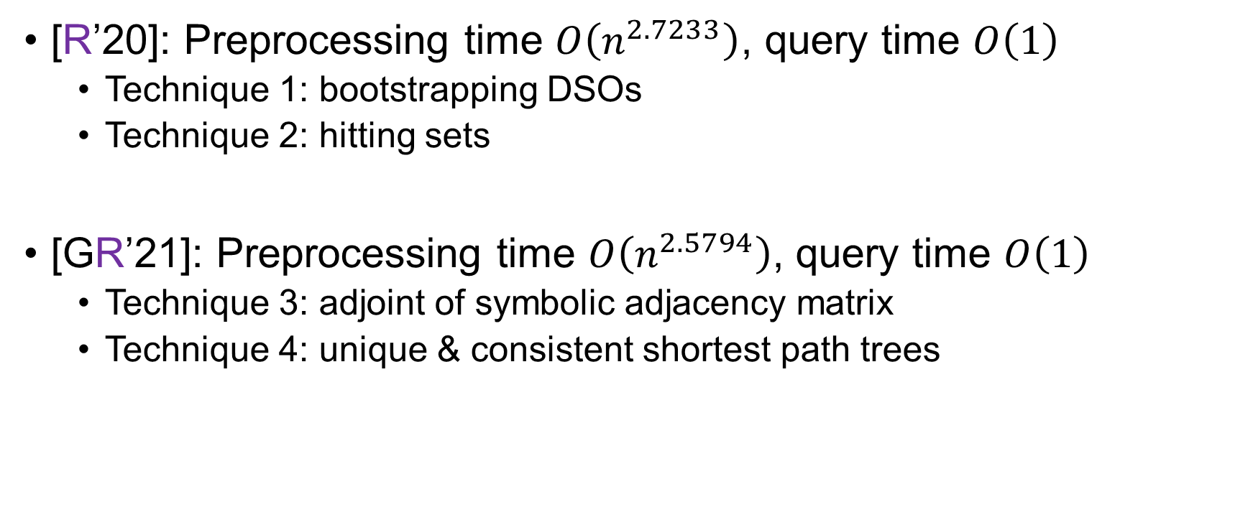
Our Results
[R’20]: Preprocessing time $O\left(n^{2.7233}\right)$, query time $O\left(1\right)$
Technique 1: bootstrapping DSOs
Technique 2: hitting sets
[GR’21]: Preprocessing time $O\left(n^{2.5794}\right)$, query time $O\left(1\right)$
Technique 3: adjoint of symbolic adjacency matrix
Technique 4: unique & consistent shortest path trees
5 / 16

Slide 6
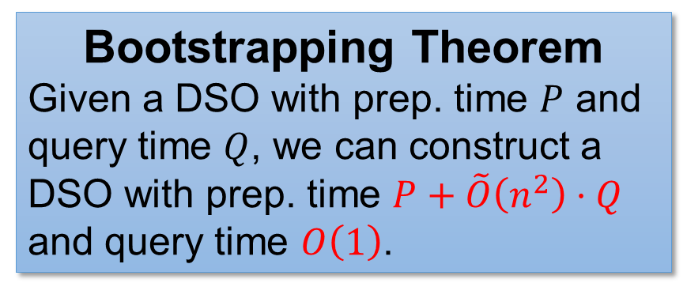

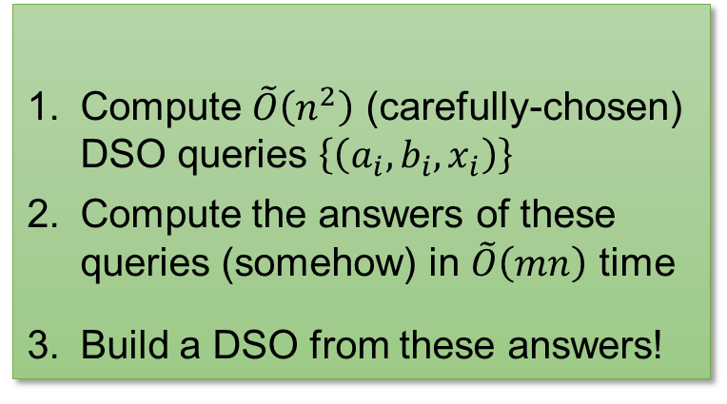

Bootstrapping DSOs
A byproduct of [BK’09]!
Compute $\tilde{O}\left(n^{2}\right)$ (carefully-chosen) DSO queries $\left\{\left(a_{i},b_{i},x_{i}\right)\right\}$
Compute the answers of these queries (somehow) in $\tilde{O}\left(mn\right)$ time
Build a DSO from these answers!
The [BK’09] prep. algorithm
Proof of Bootstrapping Thm
Bootstrapping Theorem
Given a DSO with prep. time $P$ and query time $Q$, we can construct a DSO with prep. time $P+\tilde{O}\left(n^{2}\right)⋅Q$ and query time $O\left(1\right)$.
Using the slower DSO
$$P+\tilde{O}\left(n^{2}\right)⋅Q$$
$P+n^{2}Q$ measures the “complexity” of DSO!
Question: any other data structure problem where we could “unify” preprocessing and query time?
6 / 16

Slide 7

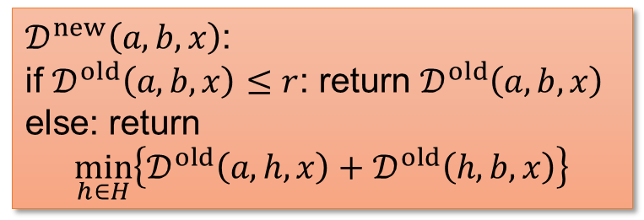


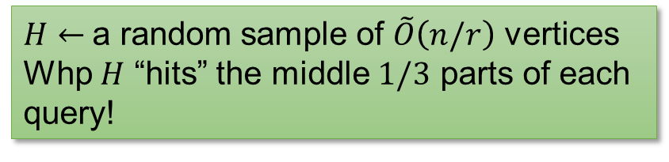


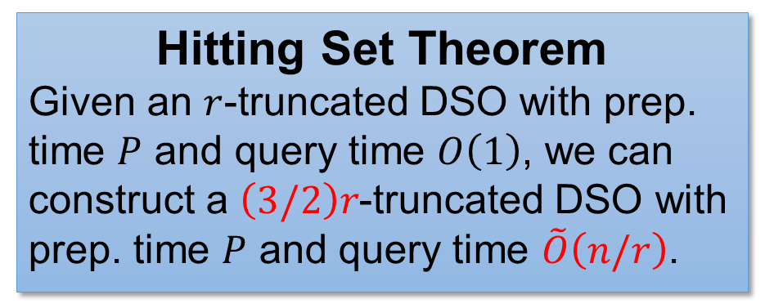




$r$-Truncated DSO & Hitting Sets
An $r$-truncated DSO is a DSO that returns the correct answer if the answer is $≤r$, and returns $+∞$ otherwise
Hitting Set Theorem
Given an $r$-truncated DSO with prep. time $P$ and query time $O\left(1\right)$, we can construct a $\left(3/2\right)r$-truncated DSO with prep. time $P$ and query time $\tilde{O}\left(n/r\right)$.
$𝒟^{new}\left(a,b,x\right)$:
if $𝒟^{old}\left(a,b,x\right)≤r$: return $𝒟^{old}\left(a,b,x\right)$
else: return
$$\min_{h∈H}\left\{𝒟^{old}\left(a,h,x\right)+𝒟^{old}\left(h,b,x\right)\right\}$$
$$≥\left(1/3\right)r$$
$H←$a random sample of $\tilde{O}\left(n/r\right)$ vertices
Whp $H$ “hits” the middle $1/3$ parts of each query!
$$a$$
$$≤r$$
$$h$$
$$≤r$$
$$b$$
$$x$$
7 / 16

Slide 8
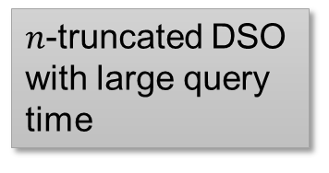

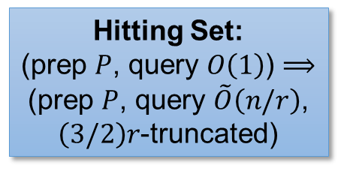

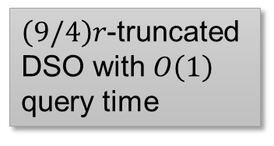

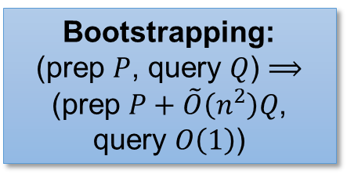








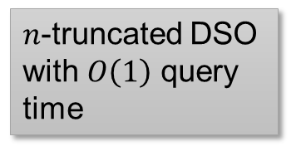

Putting It Together
$r$-truncated DSO in
tradeoff
Using rect. mat. mul.
[R’20]: $r^{4−ω}n^{ω}$ preprocessing time
$$r^{4−ω}n^{ω}+n^{3}/r→n^{2.7613}$$
$$n^{2.7233}$$
$r$-truncated DSO
[GR’21]: $rn^{ω}$ preprocessing time
$$rn^{ω}+n^{3}/r→n^{2.6865}$$
$$n^{2.5794}$$
Hitting set
$\left(3/2\right)r$-truncated DSO with $\tilde{O}\left(n/r\right)$ query time
$\left(9/4\right)r$-truncated DSO with $\tilde{O}\left(n/r\right)$ query time
$n$-truncated DSO with large query time
Bootstrapping:
(prep $P$, query $Q$) $⟹$ (prep $P+\tilde{O}\left(n^{2}\right)Q$, query $O\left(1\right)$)
$$…$$
Hitting set
Hitting set
Hitting set
Bootstrapping
Bootstrapping
Bootstrapping
$\left(3/2\right)r$-truncated DSO with $O\left(1\right)$ query time
$\left(9/4\right)r$-truncated DSO with $O\left(1\right)$ query time
$n$-truncated DSO with $O\left(1\right)$ query time
Hitting Set:
(prep $P$, query $O\left(1\right)$) $⟹$ (prep $P$, query $\tilde{O}\left(n/r\right)$, $\left(3/2\right)r$-truncated)
*Bootstrapping also works for $r$-truncated DSOs!
8 / 16

Slide 9

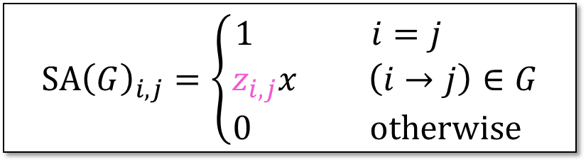


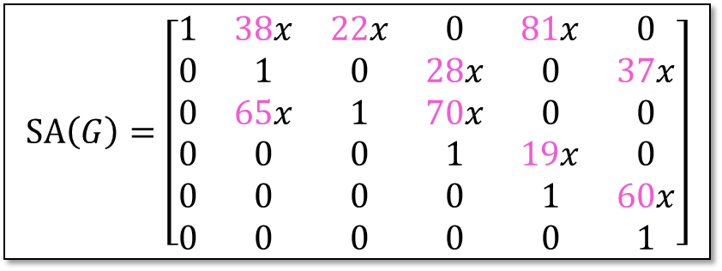


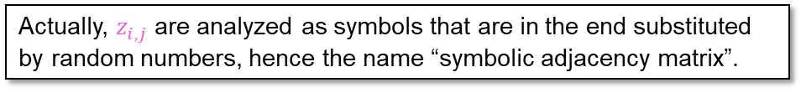



The Starting $r$-Truncated DSO
Goal: $r$-truncated DSO in $\tilde{O}\left(rn^{ω}\right)$ preprocessing time
Technical tool: symbolic adjacency matrix!
Let $z_{i,j}$ be random numbers.
Actually, $z_{i,j}$ are analyzed as symbols that are in the end substituted by random numbers, hence the name “symbolic adjacency matrix”.
$$SA{\left(G\right)}_{i,j}=\left\{\begin{aligned}1 i=j \\ z_{i,j}x \left(i→j\right)∈G \\ 0 otherwise \end{aligned}\right.$$
$$2$$
$$SA\left(G\right)=\left[\begin{matrix}1 & 38x & 22x & 0 & 81x & 0 \\ 0 & 1 & 0 & 28x & 0 & 37x \\ 0 & 65x & 1 & 70x & 0 & 0 \\ 0 & 0 & 0 & 1 & 19x & 0 \\ 0 & 0 & 0 & 0 & 1 & 60x \\ 0 & 0 & 0 & 0 & 0 & 1\end{matrix}\right]$$
$$6$$
$$5$$
$$1$$
$$4$$
$$3$$
9 / 16

Slide 10

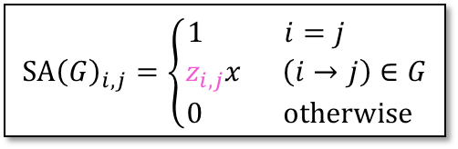


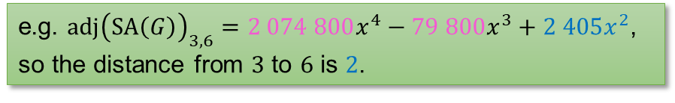

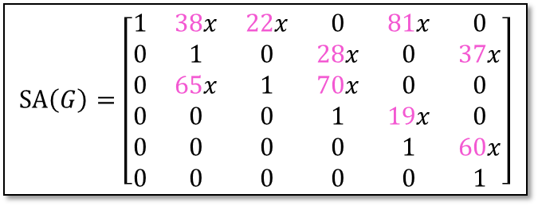




Adjoint of $SA\left(G\right)$
Adjoint: $adj\left(M\right)=\det\left(M\right)⋅M^{−1}$
Theorem [Sankowski’05]. Whp over the choices of $\left\{z_{i,j}\right\}$, the distance from $a$ to $b$ is the lowest degree of $x$ in $adj{\left(SA\left(G\right)\right)}_{a,b}$.
$$2$$
$$SA\left(G\right)=\left[\begin{matrix}1 & 38x & 22x & 0 & 81x & 0 \\ 0 & 1 & 0 & 28x & 0 & 37x \\ 0 & 65x & 1 & 70x & 0 & 0 \\ 0 & 0 & 0 & 1 & 19x & 0 \\ 0 & 0 & 0 & 0 & 1 & 60x \\ 0 & 0 & 0 & 0 & 0 & 1\end{matrix}\right]$$
$$6$$
$$5$$
$$1$$
$$4$$
$$3$$
e.g. $adj{\left(SA\left(G\right)\right)}_{3,6}=2 074 800x^{4}−79 800x^{3}+2 405x^{2}$, so the distance from $3$ to $6$ is $2$.
$$SA{\left(G\right)}_{i,j}=\left\{\begin{aligned}1 i=j \\ z_{i,j}x \left(i→j\right)∈G \\ 0 otherwise \end{aligned}\right.$$
10 / 16

Slide 11
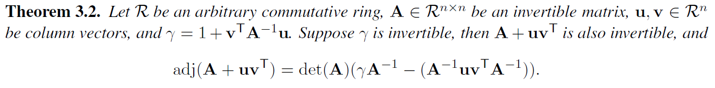
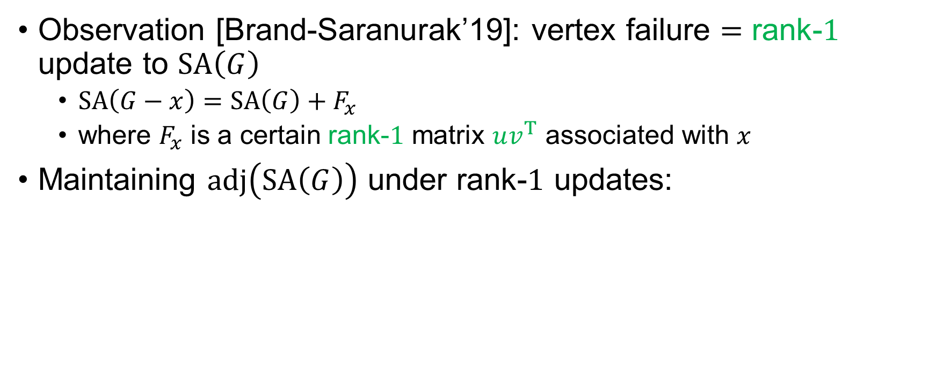
Handling a Vertex Failure
Observation [Brand-Saranurak’19]: vertex failure $=$ rank-$1$ update to $SA\left(G\right)$
$SA\left(G−x\right)=SA\left(G\right)+F_{x}$
where $F_{x}$ is a certain rank-$1$ matrix $uv^{T}$ associated with $x$
Maintaining $adj\left(SA\left(G\right)\right)$ under rank-$1$ updates:
Proof: Sherman-Morrison-Woodbury formula $+$ matrix determinant lemma.
$$SA{\left(G\right)}_{i,j}=\left\{\begin{aligned}1 i=j \\ z_{i,j}x \left(i→j\right)∈G \\ 0 otherwise \end{aligned}\right.$$
11 / 16

Slide 12
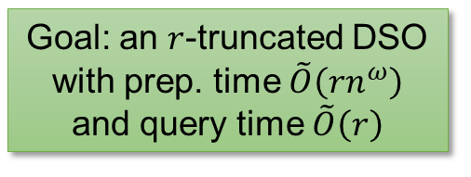


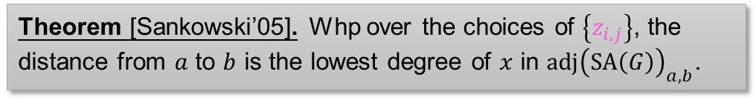
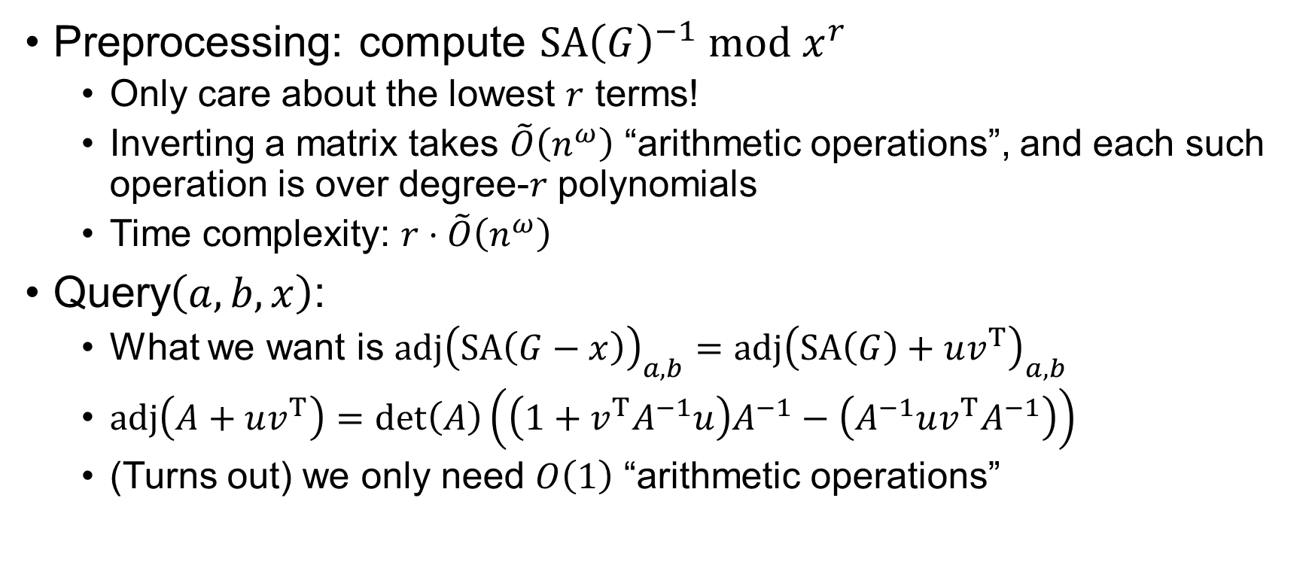
The $r$-Truncated DSO
Goal: an $r$-truncated DSO with prep. time $\tilde{O}\left(rn^{ω}\right)$ and query time $\tilde{O}\left(r\right)$
Preprocessing: compute $SA{\left(G\right)}^{−1} mod x^{r}$
Only care about the lowest $r$ terms!
Inverting a matrix takes $\tilde{O}\left(n^{ω}\right)$ “arithmetic operations”, and each such operation is over degree-$r$ polynomials
Time complexity: $r⋅\tilde{O}\left(n^{ω}\right)$
Query$\left(a,b,x\right)$:
What we want is $adj{\left(SA\left(G−x\right)\right)}_{a,b}=adj{\left(SA\left(G\right)+uv^{T}\right)}_{a,b}$
$adj\left(A+uv^{T}\right)=\det\left(A\right)\left(\left(1+v^{T}A^{−1}u\right)A^{−1}−\left(A^{−1}uv^{T}A^{−1}\right)\right)$
(Turns out) we only need $O\left(1\right)$ “arithmetic operations”
Can be accelerated by fast rectangular mat. mult.!
Shortest path from $a$ to $b$, $x$ is the failed vertex
Theorem [Sankowski’05]. Whp over the choices of $\left\{z_{i,j}\right\}$, the distance from $a$ to $b$ is the lowest degree of $x$ in $adj{\left(SA\left(G\right)\right)}_{a,b}$.
12 / 16

Slide 13
Wrap Up
$r$-truncated DSO in
tradeoff
Using rect. mat. mul.
[R’20]: $r^{4−ω}n^{ω}$ preprocessing time
$$r^{4−ω}n^{ω}+n^{3}/r→n^{2.7613}$$
$$n^{2.7233}$$
$r$-truncated DSO
[GR’21]: $rn^{ω}$ preprocessing time
$$rn^{ω}+n^{3}/r→n^{2.6865}$$
$$n^{2.5794}$$
Hitting set
$\left(3/2\right)r$-truncated DSO with $\tilde{O}\left(n/r\right)$ query time
$\left(9/4\right)r$-truncated DSO with $\tilde{O}\left(n/r\right)$ query time
$n$-truncated DSO with large query time
Bootstrapping:
(prep $P$, query $Q$) $⟹$ (prep $P+\tilde{O}\left(n^{2}\right)Q$, query $O\left(1\right)$)
$$…$$
Hitting set
Hitting set
Hitting set
Bootstrapping
Bootstrapping
Bootstrapping
$\left(3/2\right)r$-truncated DSO with $O\left(1\right)$ query time
$\left(9/4\right)r$-truncated DSO with $O\left(1\right)$ query time
$n$-truncated DSO with $O\left(1\right)$ query time
Hitting Set:
(prep $P$, query $O\left(1\right)$) $⟹$ (prep $P$, query $\tilde{O}\left(n/r\right)$, $\left(3/2\right)r$-truncated)
*Bootstrapping also works for $r$-truncated DSOs!
13 / 16

Slide 14




















Unique & Consistent Shortest Paths
(We somehow need this result to bootstrap an $r$-truncated DSO to a full DSO)
Problem: given an unweighted directed graph, compute incoming & outgoing shortest path trees that are consistent
If a $u→v$ path exists in two different trees, they should be the same path
$$u$$
$$v$$
$$T_{in}\left(b\right)$$
×
$$a$$
$$b$$
$$u$$
$$v$$
$$u$$
$$v$$
$$a$$
$$b$$
$$a$$
$$b$$
$$u$$
$$v$$
$$T_{in}\left(b\right)$$
√
$$T_{out}\left(a\right)$$
$$a$$
$$b$$
14 / 16

Slide 15
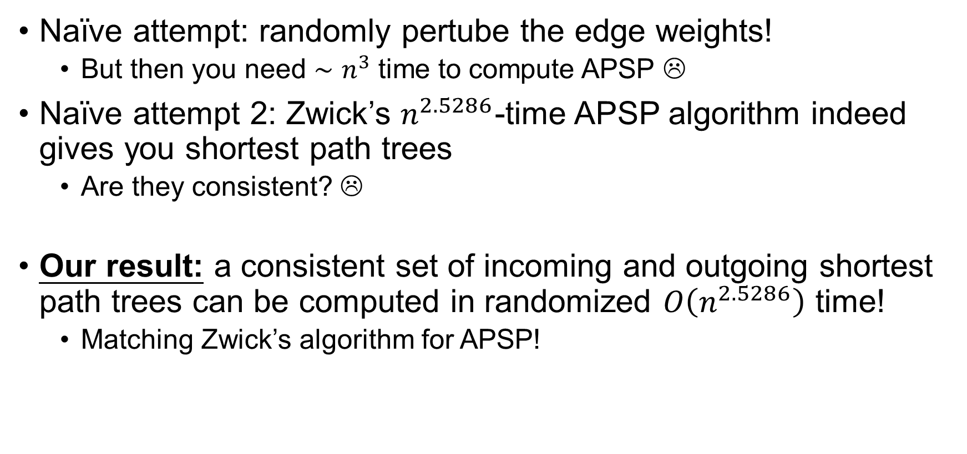
Unique & Consistent Shortest Paths
Naïve attempt: randomly pertube the edge weights!
But then you need $∼n^{3}$ time to compute APSP ☹
Naïve attempt 2: Zwick’s $n^{2.5286}$-time APSP algorithm indeed gives you shortest path trees
Are they consistent? ☹
Our result: a consistent set of incoming and outgoing shortest path trees can be computed in randomized $O\left(n^{2.5286}\right)$ time!
Matching Zwick’s algorithm for APSP!
Other applications of this besides DSO?
15 / 16

Slide 16
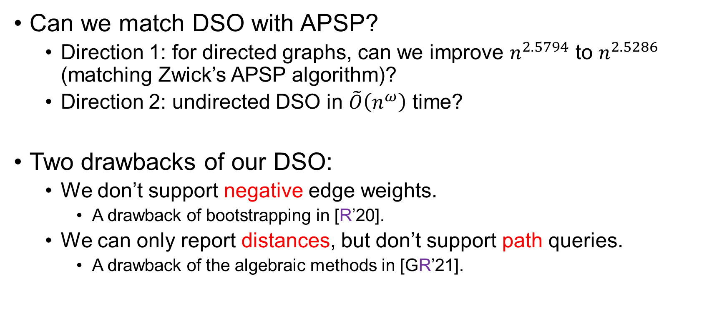
Further Directions
Can we match DSO with APSP?
Direction 1: for directed graphs, can we improve $n^{2.5794}$ to $n^{2.5286}$ (matching Zwick’s APSP algorithm)?
Direction 2: undirected DSO in $\tilde{O}\left(n^{ω}\right)$ time?
Two drawbacks of our DSO:
We don’t support negative edge weights.
A drawback of bootstrapping in [R’20].
We can only report distances, but don’t support path queries.
A drawback of the algebraic methods in [GR’21].
16 / 16

Slide 17
Thank you!
Questions are welcome! ☺

