Slide 1
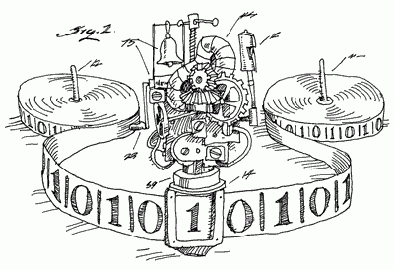
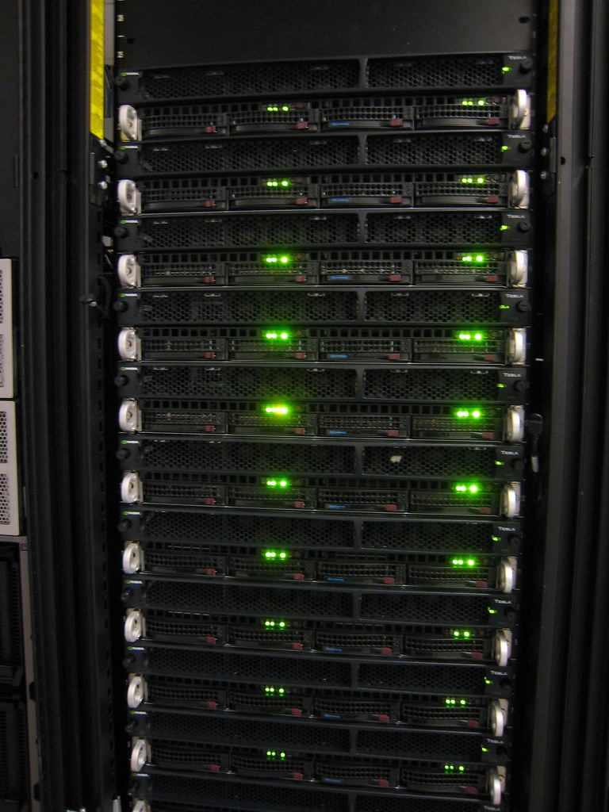


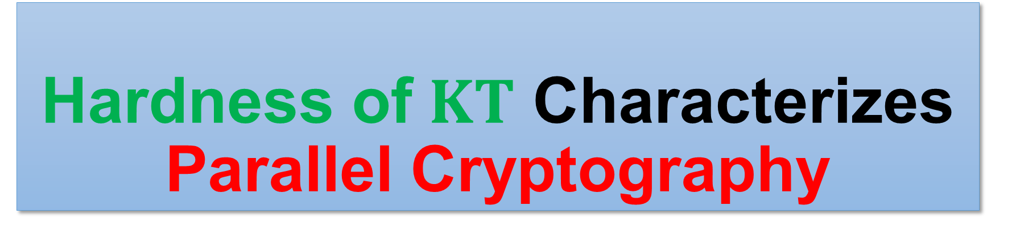
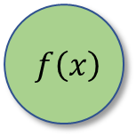



Hardness of $KT$ Characterizes Parallel Cryptography
Hanlin Ren, Tsinghua $→$ Oxford
Joint work with Rahul Santhanam (Oxford)
CCC 2021
$$f\left(x\right)$$
$$f\left(x\right)$$
$$x$$
$$x$$
1 / 7

Slide 2

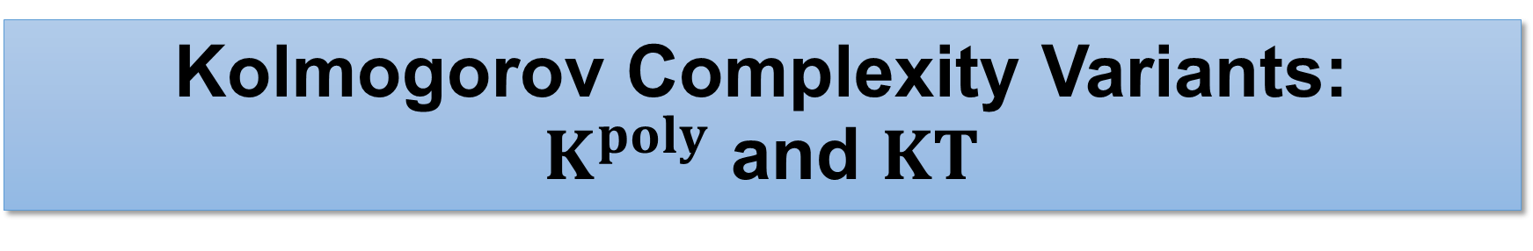

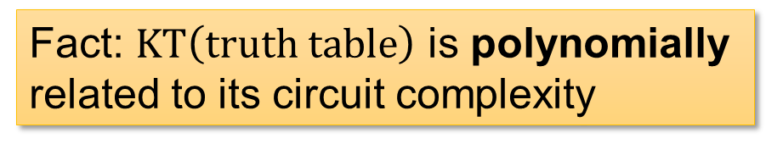
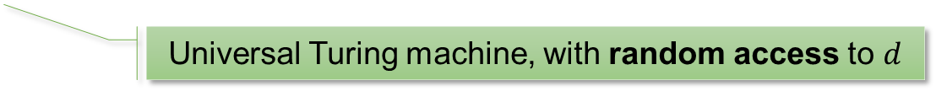



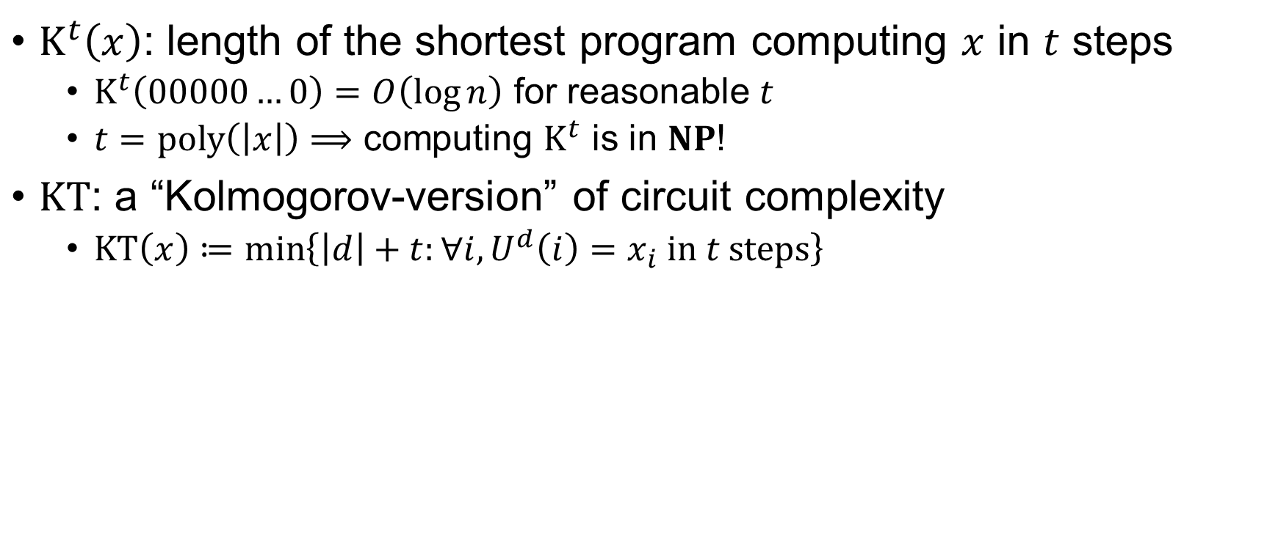

Kolmogorov Complexity Variants: $K^{poly}$ and $KT$
$K^{t}\left(x\right)$: length of the shortest program computing $x$ in $t$ steps
$K^{t}\left(00000…0\right)=O\left(\log{n}\right)$ for reasonable $t$
$t=poly\left(\left|x\right|\right)⟹$ computing $K^{t}$ is in $NP$!
$KT$: a “Kolmogorov-version” of circuit complexity
$KT\left(x\right)≔\min\left\{\left|d\right|+t:∀i,U^{d}\left(i\right)=x_{i} in t steps\right\}$
print("0"*n)
Henceforth $K^{poly}$
Universal Turing machine, with random access to $d$
$$x_{i}$$
$$x_{i}$$
circuit
Fact: $KT\left(truth table\right)$ is polynomially related to its circuit complexity
$$≈$$
$$i$$
$$i$$
2 / 7

Slide 3


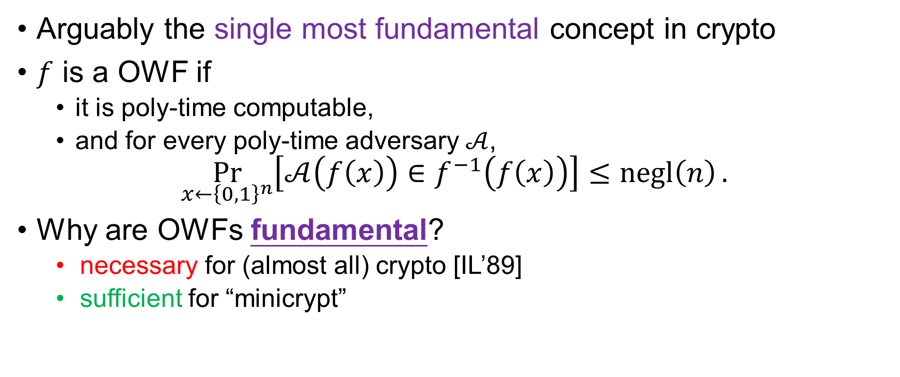

One-Way Functions
Arguably the single most fundamental concept in crypto
$f$ is a OWF if
it is poly-time computable,
and for every poly-time adversary $𝒜$,
$$\underset{x←{\left\{0,1\right\}}^{n}}{Pr}\left[𝒜\left(f\left(x\right)\right)∈f^{−1}\left(f\left(x\right)\right)\right]≤negl\left(n\right).$$
Why are OWFs fundamental?
necessary for (almost all) crypto [IL’89]
sufficient for “minicrypt”
OWF $⟺$
Private-key encryption,
Pseudorandom generators,
Digital signatures,
Authentication schemes,
Pseudorandom functions,
Commitment schemes,
Coin-tossing,
ZK proofs…
(from Yanyi’s FOCS’20 slides)
easy
$$f\left(x\right)$$
$$x$$
hard
3 / 7

Slide 4

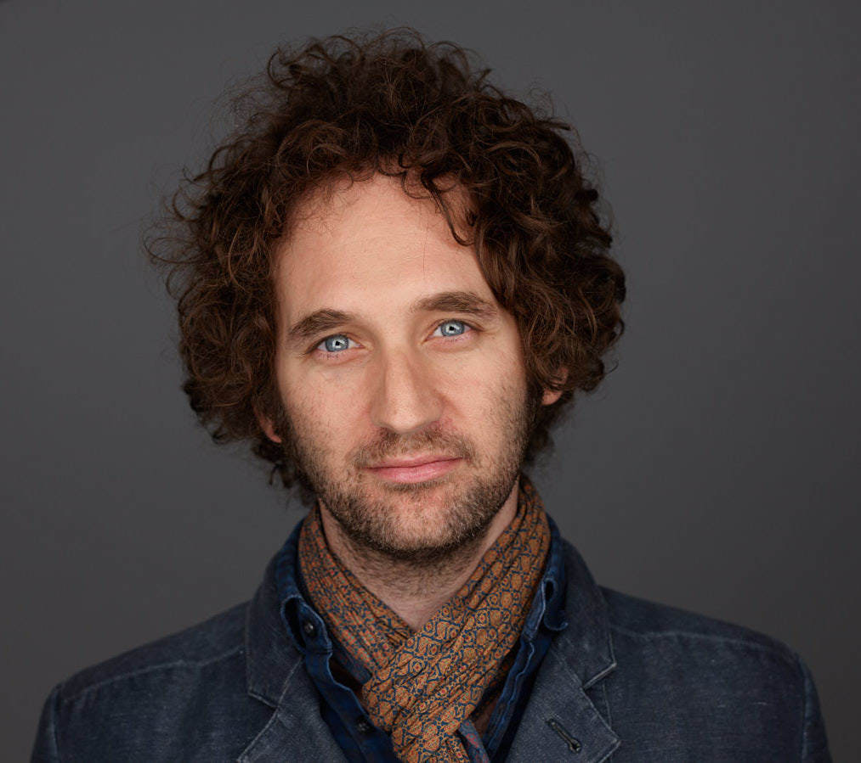

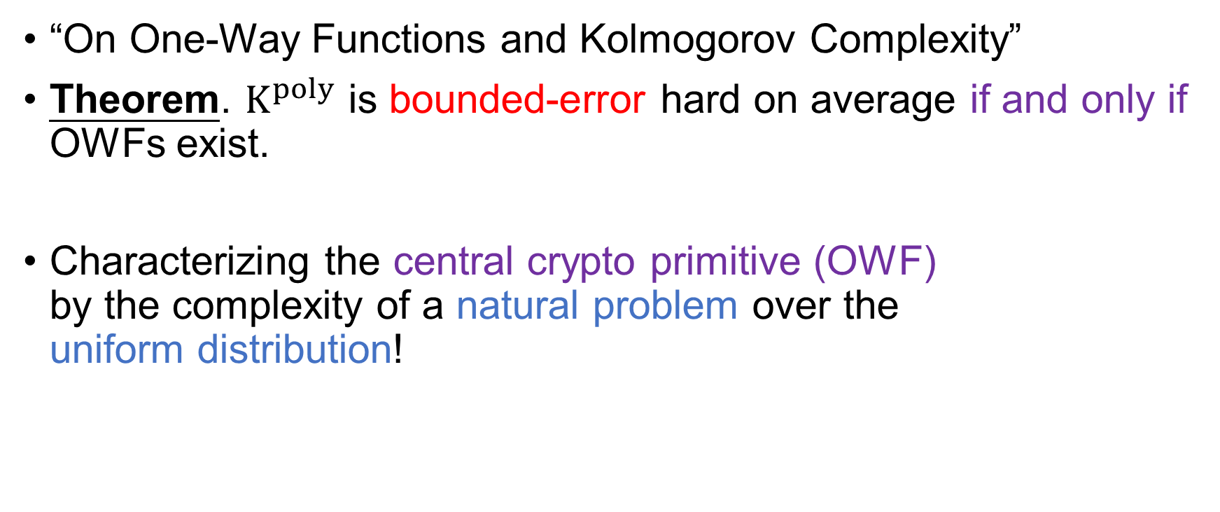
The Liu-Pass Result
“On One-Way Functions and Kolmogorov Complexity”
Theorem. $K^{poly}$ is bounded-error hard on average if and only if OWFs exist.
Characterizing the central crypto primitive (OWF) by the complexity of a natural problem over the uniform distribution!
4 / 7
Notes:
K^poly is an independently interesting notion!

Slide 5

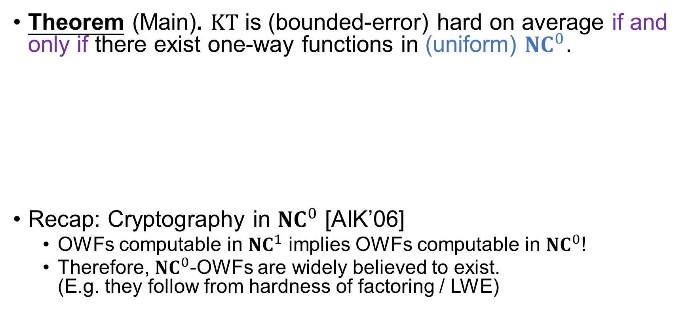



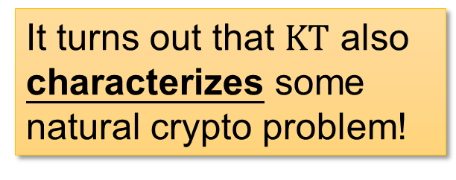


Our Result 1
Theorem (Main). $KT$ is (bounded-error) hard on average if and only if there exist one-way functions in (uniform) ${NC}^{0}$.
Recap: Cryptography in ${NC}^{0}$ [AIK’06]
OWFs computable in ${NC}^{1}$ implies OWFs computable in ${NC}^{0}$!
Therefore, ${NC}^{0}$-OWFs are widely believed to exist. (E.g. they follow from hardness of factoring / LWE)
$$x_{i}$$
SUPER easy (${NC}^{0}$)
It turns out that $KT$ also characterizes some natural crypto problem!
$$⟺$$
$$f\left(x\right)$$
$$x$$
hard
$$i$$
5 / 7

Slide 6
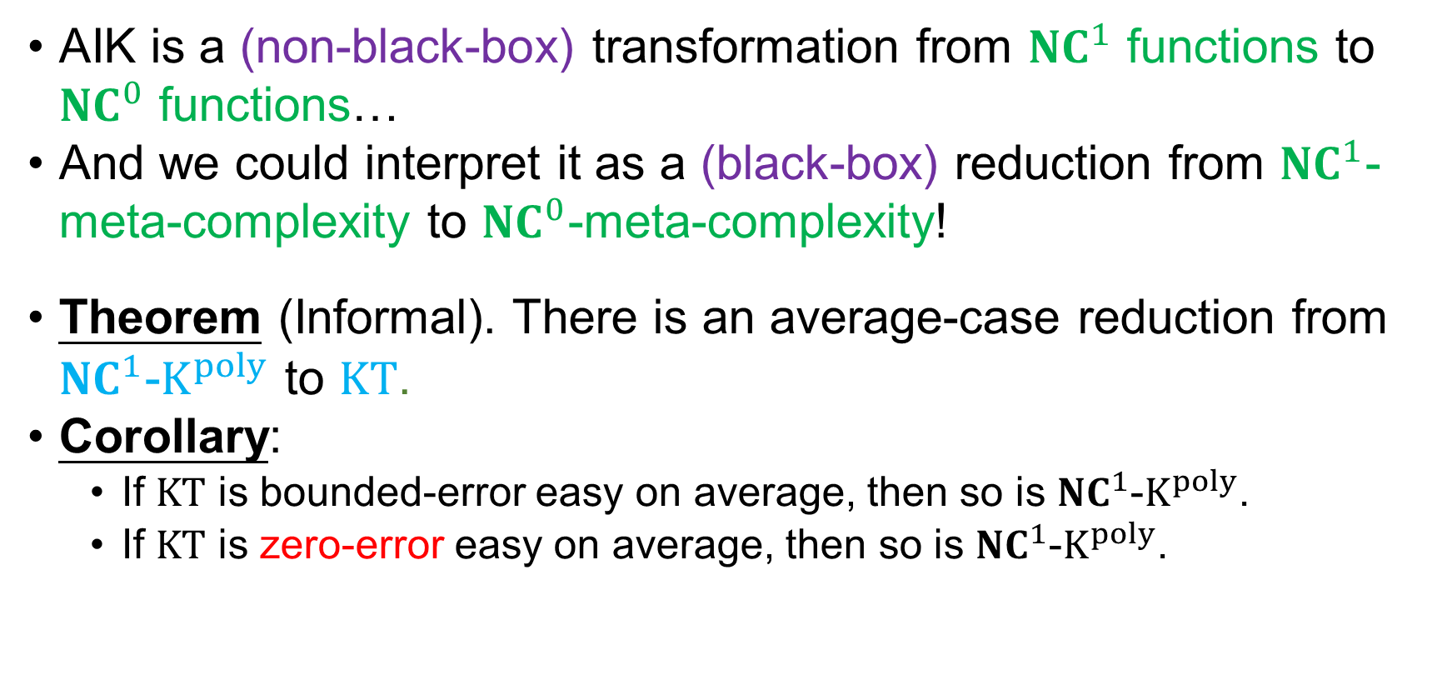
Our Result 2: AIK as a Reduction
AIK is a (non-black-box) transformation from ${NC}^{1}$ functions to ${NC}^{0}$ functions…
And we could interpret it as a (black-box) reduction from ${NC}^{1}$-meta-complexity to ${NC}^{0}$-meta-complexity!
Theorem (Informal). There is an average-case reduction from ${NC}^{1}$-$K^{poly}$ to $KT$.
Corollary:
If $KT$ is bounded-error easy on average, then so is ${NC}^{1}$-$K^{poly}$.
If $KT$ is zero-error easy on average, then so is ${NC}^{1}$-$K^{poly}$.
Previously, it’s unknown if $K^{poly}$ and $KT$ has ANY connection at all!!!
6 / 7

Slide 7
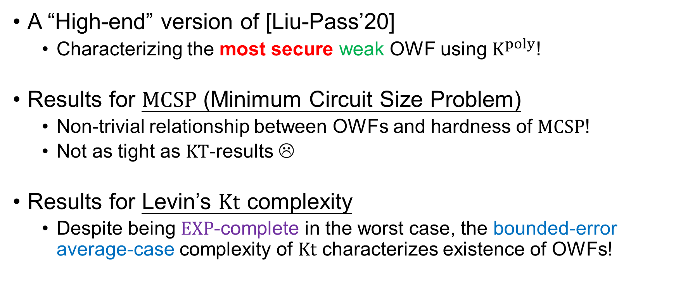
Other Results…
A “High-end” version of [Liu-Pass’20]
Characterizing the most secure weak OWF using $K^{poly}$!
Results for $MCSP$ (Minimum Circuit Size Problem)
Non-trivial relationship between OWFs and hardness of $MCSP$!
Not as tight as $KT$-results ☹
Results for Levin’s $Kt$ complexity
Despite being $EXP$-complete in the worst case, the bounded-error average-case complexity of $Kt$ characterizes existence of OWFs!
7 / 7

Slide 8
Thank you!

