Slide 1
Approximate Distance Oracles Subject to Multiple Vertex Failures
Hanlin Ren, IIIS, Tsinghua University
Joint work with Ran Duan & Yong Gu

Slide 2


$d$-Failure Model
Failures are unavoidable in networks!
Problem: given a graph, deal with failures.
Example: $Query\left(u,v,D\right)=$ shortest path from $u$ to $v$ that avoids $D$
source vertex
target vertex
failed vertex
optimal path

Slide 3
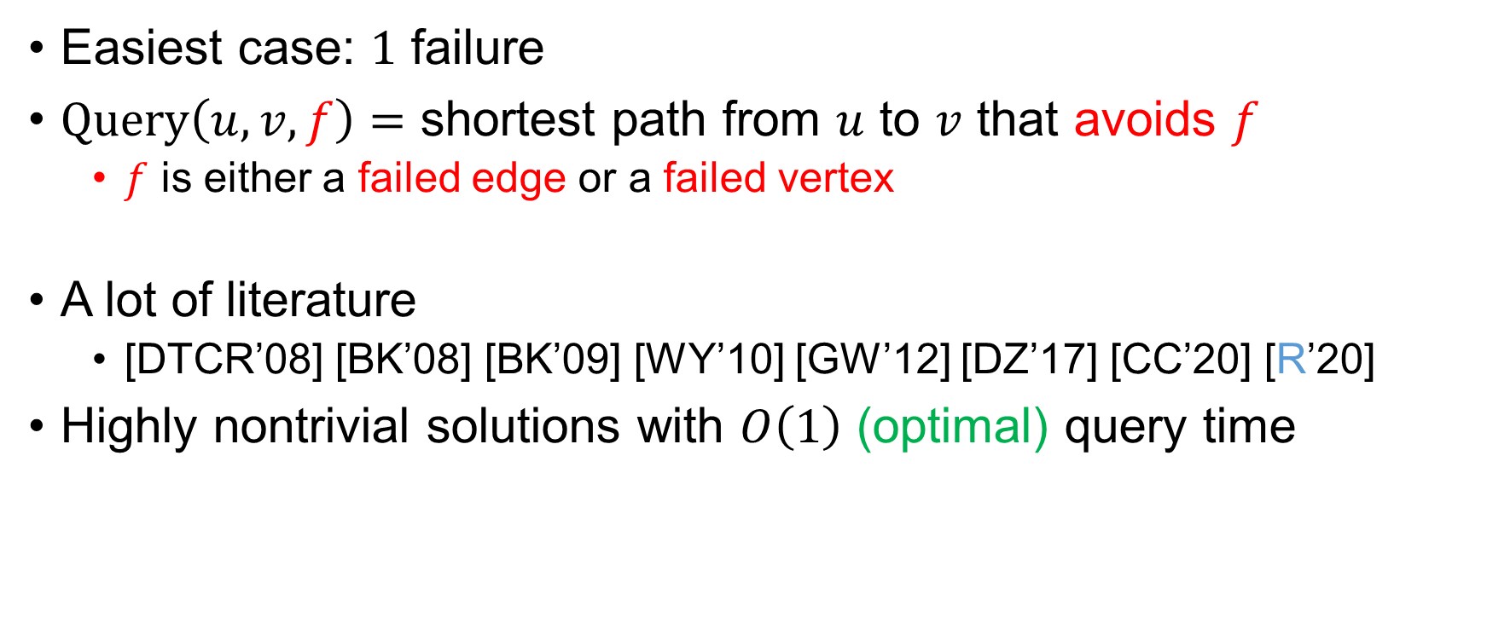
How Hard Is the Problem?
Easiest case: $1$ failure
$Query\left(u,v,f\right)=$ shortest path from $u$ to $v$ that avoids $f$
$f$ is either a failed edge or a failed vertex
A lot of literature
[DTCR’08] [BK’08] [BK’09] [WY’10] [GW’12] [DZ’17] [CC’20] [R’20]
Highly nontrivial solutions with $O\left(1\right)$ (optimal) query time

Slide 4
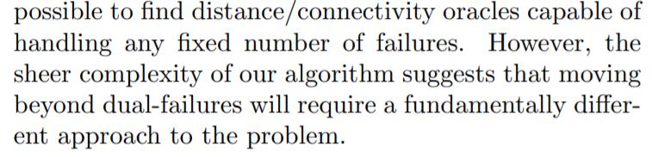

How Hard Is the Problem?
$2$ failures: considerably more complicated
[DP’09]
Query time: $O\left(\log{n}\right)$

Slide 5
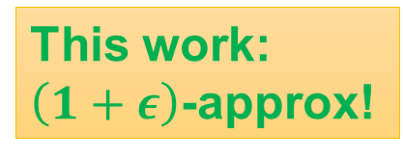



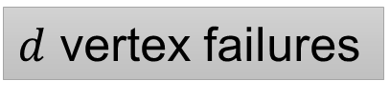
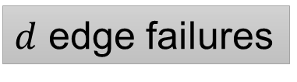
How Hard Is the Problem?
$d$ failures, undirected graph
Desired query time: $poly\left(d,\log{n}\right)$
approx. distance
connectivity
[PT’07]
[DP’10]
[CLPR’10]: $O\left(d\right)$-approx
$d$ edge failures
Fully dynamic connectivity
[CCFK’17]: $\left(1+ε\right)$-approx
This work: $\left(1+ε\right)$-approx!
??
$d$ vertex failures
[DP’10]
[DP’17]

Slide 6

Rest of This Talk
Review the $d$-edge-failure oracle
A few attempts on how to handle vertex failures…
And finally, our solution

Slide 7





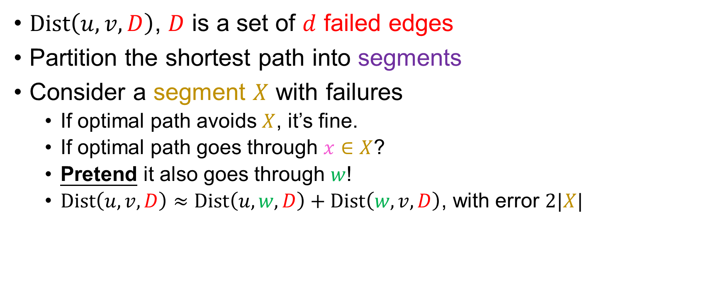
Oracles for $d$ Edge Failures
$Dist\left(u,v,D\right)$, $D$ is a set of $d$ failed edges
Partition the shortest path into segments
Consider a segment $X$ with failures
If optimal path avoids $X$, it’s fine.
If optimal path goes through $x∈X$?
Pretend it also goes through $w$!
$Dist\left(u,v,D\right)≈Dist\left(u,w,D\right)+Dist\left(w,v,D\right)$, with error $2|X|$
$$u$$
$$v$$
$$w$$
$$x$$

Slide 8

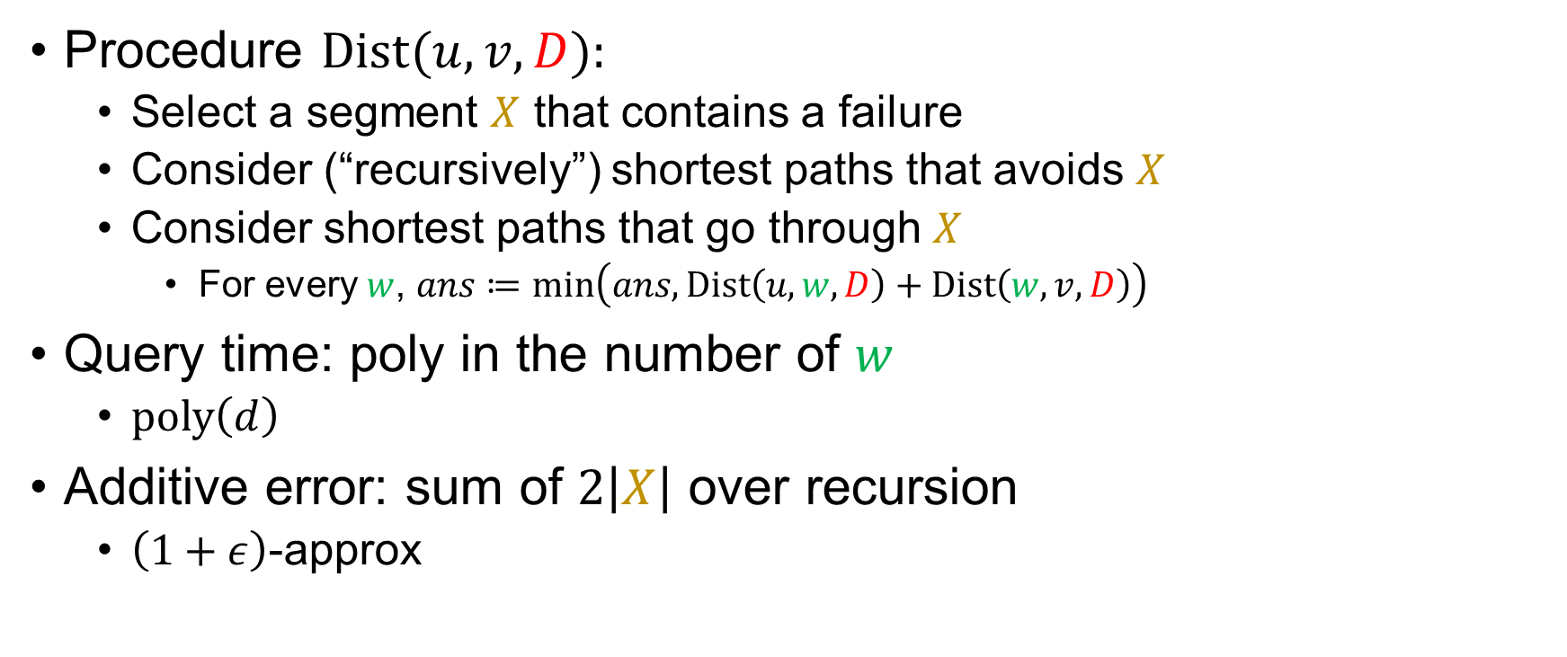
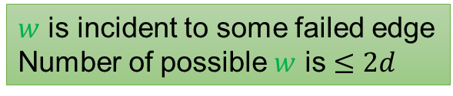
Oracles for $d$ Edge Failures
Procedure $Dist(u,v,D)$:
Select a segment $X$ that contains a failure
Consider (“recursively”) shortest paths that avoids $X$
Consider shortest paths that go through $X$
For every $w$, $ans≔min\left(ans, Dist\left(u,w,D\right)+Dist\left(w,v,D\right)\right)$
Query time: poly in the number of $w$
$poly\left(d\right)$
Additive error: sum of $2\left|X\right|$ over recursion
$\left(1+ε\right)$-approx
$w$ is incident to some failed edge
Number of possible $w$ is $≤2d$
$$\left|X\right|=\tilde{O}\left(ε\right)Dist\left(u,v,D\right)$$
$$u$$
$$v$$
$$w$$
$$x$$

Slide 9
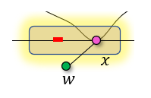
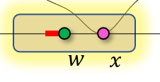

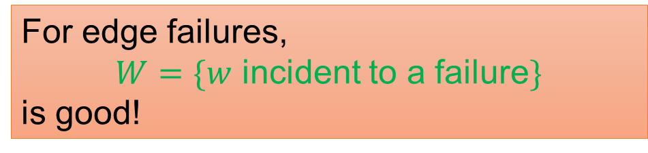



The Art of Finding $W$
Our goal is to find a set of vertices $W$ to “guard the failures”
If $x$ is close to a failure, then $x$ is also close to $W$
$|W|$ is small.
Controls additive error.
Query time $=poly\left(\left|W\right|\right)$
For edge failures,
$W=\{w$ incident to a failure$\}$
is good!
$$x$$

Slide 10
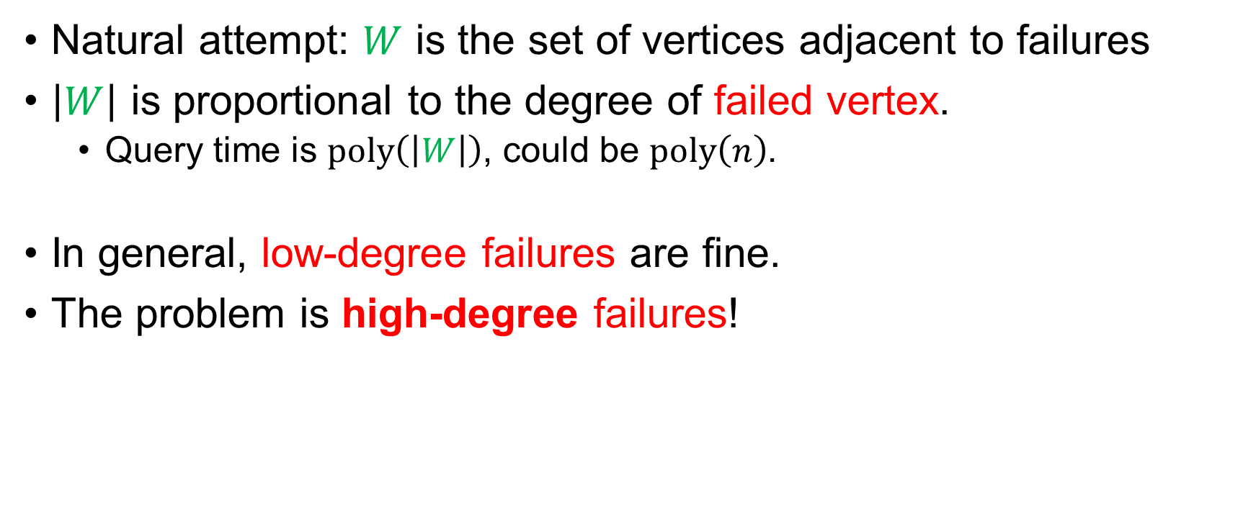
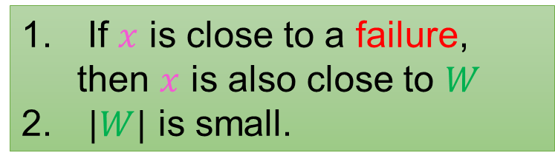
What about Vertex Failures?
Natural attempt: $W$ is the set of vertices adjacent to failures
$\left|W\right|$ is proportional to the degree of failed vertex.
Query time is $poly\left(\left|W\right|\right)$, could be $poly\left(n\right)$.
In general, low-degree failures are fine.
The problem is high-degree failures!
If $x$ is close to a failure, then $x$ is also close to $W$
$|W|$ is small.
☺
☹

Slide 11

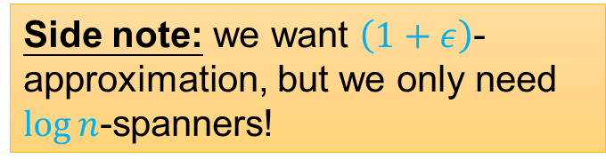
Spanners
A $\log{n}$-spanner of a graph $G$ is a sparse subgraph $G′$ that preserves pairwise distances.
For every $u,v$, $dis_{G}\left(u,v\right)≤dis_{G^{′}}\left(u,v\right)≤\log{n}⋅dis_{G}\left(u,v\right)$
Thm: We can construct a $\log{n}$-spanner with $O\left(n\right)$ edges
Side note: we want $\left(1+ε\right)$-approximation, but we only need $\log{n}$-spanners!

Slide 12
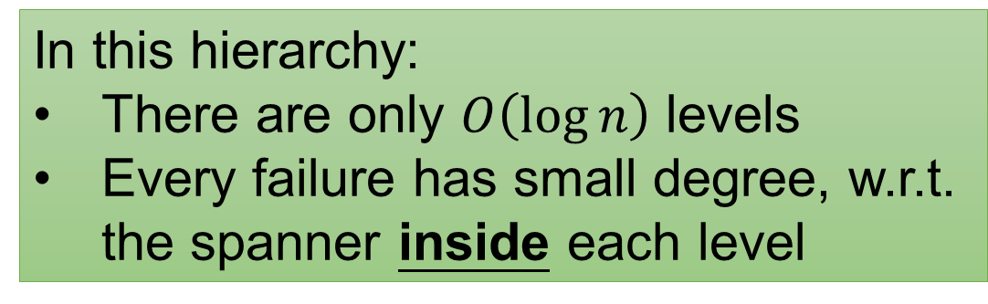
Attempt 2: High-Degree Hierarchy
Used in [DP’10] for connectivity under vertex failures!
In this hierarchy:
There are only $O\left(\log{n}\right)$ levels
Every failure has small degree, w.r.t. the spanner inside each level
Two caveats: spanners, inside each level

Slide 13


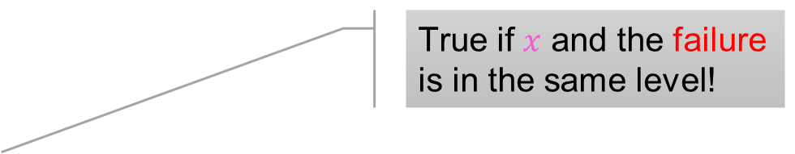

Attempt 2: Inside Each Spanner?
in the spanner!
$W$ is the set of vertices adjacent to a failure
in the same level.
$$x$$
How to keep track of inter-level paths?
True if $x$ and the failure is in the same level!
But false in general…
If $x$ is close to a failure, then $x$ is also close to $W$
$|W|$ is small.
☹
☺

Slide 14


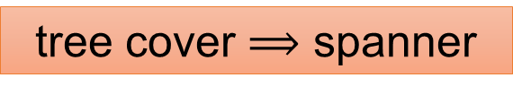
Tree Covers
Another powerful tool for preserving distances!
More powerful than spanners!
1. For every two vertices, exists
a tree that “covers” them
2. Every vertex is in $O\left(\log^{2}{n}\right)$ trees
$$dis\left(u,v\right)≤dis_{Tree}\left(u,v\right)≤\log{n}⋅dis\left(u,v\right)$$
tree cover $⟹$ spanner
Notes:
搞张spanner的图

Slide 15
Attempt 2: Inside Each Tree Cover?
Attempt 3: Grow Down the Trees!
in the tree cover!
$W$ is the set of vertices adjacent to a failure
in the same level.
It turns out that there is a natural way to grow the trees into lower levels!
If $x$ is close to a failure, then $x$ is also close to $W$
$|W|$ is small.
☹
☺

Slide 16
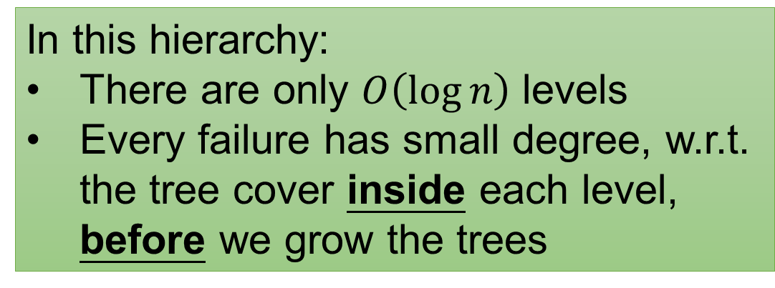

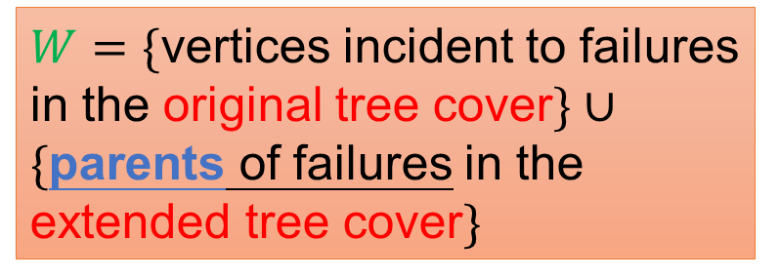
Attempt 3: Grow Down the Trees!
In this hierarchy:
There are only $O\left(\log{n}\right)$ levels
Every failure has small degree, w.r.t. the tree cover inside each level, before we grow the trees
THREE caveats: tree covers, inside each level, before we grow the trees
$W=\{$vertices incident to failures in the original tree cover$\}∪$
$\{$parents of failures in the extended tree cover$\}$
$$\left|W\right|+=\tilde{O}\left(d\right)$$

Slide 17
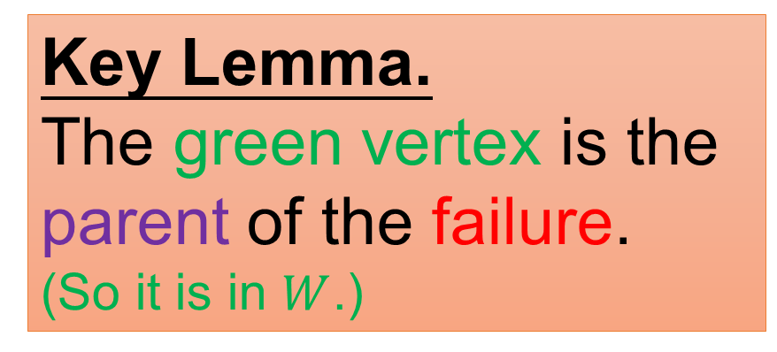



If $x$ Is Close to a Failure, Then …?
We want: if $x$ is close to a failure, then $x$ is also close to $W$
Assume $x$ is higher than the failure
Key Lemma.
The green vertex is the parent of the failure.
(So it is in $W$.)
$$x$$
Extended tree cover
$$dis\left(x,f\right)≤dis_{Tree}\left(x,f\right)≤\log{n}⋅dis\left(x,f\right)$$

Slide 18


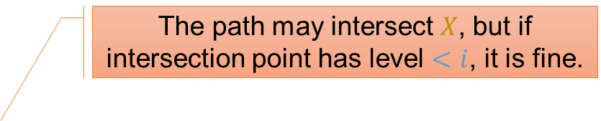


Oracles for $d$ Vertex Failures
$Dist\left(u,v,D\right)$, $D$ is a set of $d$ failed vertices
Consider a segment $X$ that contains some failure
$i≔$largest level of any failure in $X$
If optimal path avoids $X∩Level_{≥i}$, deal with it recursively.
If optimal path goes through $x∈X∩Level_{≥i}$?
$level\left(x\right)≥i≥level\left(failure\right)$, can find a guard $w$!
$Dist\left(u,v,D\right)≈Dist\left(u,w,D\right)+Dist\left(w,v,D\right)$, with error $2\left|X\right|\log{n}$
$i≔$max of their level
The path may intersect $X$, but if intersection point has level $<i$, it is fine.
$$u$$
$$v$$
$$x$$
$$w$$

Slide 19


Oracles for $d$ Vertex Failures
Query time: poly in the number of $w$
$poly\left(d,\log{n}\right)$
Additive error: sum of $2\left|X\right|\log{n}$ over recursion
$\left(1+ε\right)$-approx
Main Theorem
Given an undirected graph, we can maintain $\left(1+ε\right)$-approx. distance under $d$ vertex failures in $poly\left(d,\log{n}\right)$ query time.

Slide 20
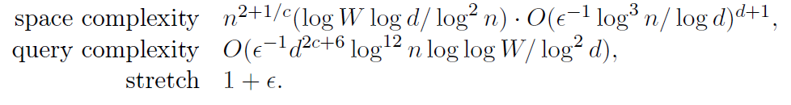
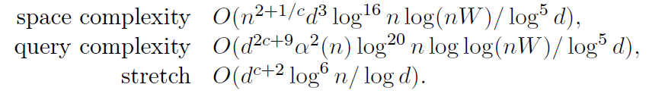
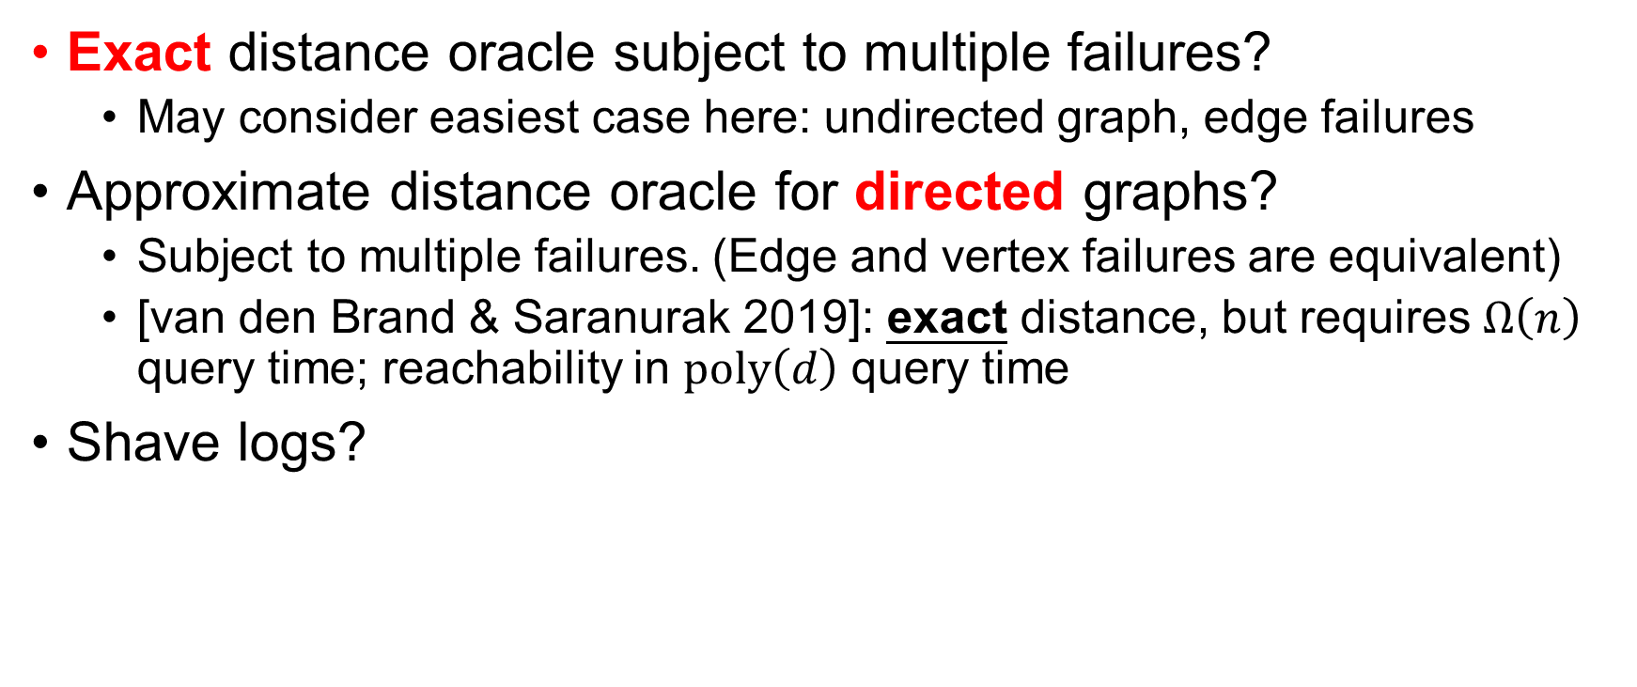
Open Problems
Exact distance oracle subject to multiple failures?
May consider easiest case here: undirected graph, edge failures
Approximate distance oracle for directed graphs?
Subject to multiple failures. (Edge and vertex failures are equivalent)
[van den Brand & Saranurak 2019]: exact distance, but requires $Ω\left(n\right)$ query time; reachability in $poly\left(d\right)$ query time
Shave logs?

Slide 21
Thank you!

