Slide 1
IBM BOB 2.0 HACKATHON
MutantHunter
Finds the bugs a test suite misses, writes tests that catch them, and proves the gain on mutants the agents never saw.
An IBM Bob skill plus a deterministic Python harness, run on the python-validators library.
Evan tool, skill, test generation chu evaluation, dashboard, video
Notes:
MutantHunter finds the bugs a test suite misses, writes tests that catch them, and proves the gain on mutants the agents never saw. It is an IBM Bob skill plus a deterministic Python harness, evaluated on the python-validators library.

Slide 2

THE PROBLEM
Coverage is not the same as catching bugs
91.9%
line + branch coverage of url.py
23 of 58
injected bugs (mutants) survive its human tests
35 killed
23 survived
url.py · 58 mutants
A plain “write more tests” prompt pins today’s behaviour, bugs included: in finance it wrote tests around the broken ISIN check digit.
MutantHunter
2 / 10
Notes:
In python-validators, url.py has 91.9% line and branch coverage, yet the human tests kill only 35 of 58 injected mutants. Across the 10 weakest modules, 155 of 481 mutants survive. A plain AI prompt helps, but it writes tests that pin down whatever the code does today, including its bugs: in finance it noticed the broken ISIN check and wrote tests around it.

Slide 3
HOW IT WORKS
One sentence in Bob runs the whole loop
IN PARALLEL
2a Broad subagent
regression tests
Suspected spec violation
the failing test is kept, categorised and reviewed as a bug report
fails
1 Mutate
agents see split A; split B stays hidden
3 Check
run every new test
2b Spec subagent
expected results from RFC / Wikipedia PDFs
4 Targeted subagent
remaining survivors
5 Score once
hidden split B + exam C
passes
› Use the mutant-hunter skill on the module url.
The harness is deterministic and never calls an LLM.
MutantHunter
3 / 10
Notes:
One sentence in Bob runs .bob/skills/mutant-hunter/SKILL.md. 1: mutanthunter mutate injects mutants into an isolated copy; only split A (half, chosen by a seeded hash) is shown to agents. 2: a broad subagent and a spec subagent run in parallel; the spec one reads the module's RFC, ISO or Wikipedia PDF, writes numbered rules and derives expected results from the spec. 3: mutanthunter check runs every new test; a test that fails on the current code is never deleted but becomes a suspected spec violation with a category. 4: a targeted subagent attacks remaining split-A survivors. 5: after generation is frozen, tests are scored once on hidden split B and on exam C, mutant operators that did not exist while the tests were written.

Slide 4






IBM BOB FEATURES USED
Six Bob features, each doing real work
1 task
Product code
1 sentence
Plan mode
Agent mode
Skill
wrote the build plan, sub-tasks ST1–ST9
harness, stats, dashboard, 128 unit tests
runs the whole pipeline on a module
1 rules file
13
10 → 137
Rules
Parallel subagents
Document understanding
spec first; failing tests are never deleted
broad + spec side by side, targeted on url
spec PDFs turned into numbered rules
22 Bob tasks (Evan 8, chu 14) · ≈88.4 Bobcoins · every session exported in bob_sessions/
MutantHunter
4 / 10
Notes:
Plan mode: Bob read the design and wrote docs/track-a-plan.md, splitting the work into ST1 to ST9. Agent mode: Bob wrote all product code (harness, statistics, dashboard generator, replay, exam C, 128 unit tests) and fixed defects we found. Skill: .bob/skills/mutant-hunter/SKILL.md, run on 6 modules. Rules: .bob/rules/testing.md. Parallel subagents: broad + spec per module plus a targeted one for url, 13 in total. Document understanding: 10 spec PDFs (RFC 3986, 5321, 5322, 1123, 952; Wikipedia ISIN, CUSIP, SEDOL, cron, MAC address) became 137 numbered rules cited by the tests. 22 tasks (Evan 8, chu 14), about 88.4 Bobcoins.

Slide 5
RESULTS · HIDDEN SPLIT B
Hidden split B: an honest tie with the plain prompt
KILLED BY ONLY ONE SUITE
2
3
B1 only
MH only
McNemar p = 1.00
Both AI suites add ~17 points over the human tests. On split B, MutantHunter does not beat the plain prompt.
Kill rate on 141 hidden mutants, 4 main modules. Whiskers: 95% Wilson CI (B0 52.0–68.0, B1 69.7–83.4, MH 70.5–84.1).
MutantHunter
5 / 10
Notes:
Split B is the hidden half of the mutants, never shown to the agents, scored once after test generation was frozen. Main modules url, finance, cron, email: 141 mutants. B0 human tests 85 killed, 60.3% (52.0-68.0). B1 human + plain prompt 109, 77.3% (69.7-83.4). MH 110, 78.0% (70.5-84.1). McNemar B1 vs MH: 2 killed only by B1, 3 only by MH, p = 1.00. This is a tie. Extra modules: 17/19 for all three suites.

Slide 6
RESULTS · EXAM C
Exam C, unseen operators: a trend toward MH
KILLED BY ONLY ONE SUITE
1
9
B1 only
MH only
McNemar p = 0.0215
Not significant after Bonferroni correction over 4 tests, so a trend: spec-derived tests seem to generalise better to unseen bugs.
Kill rate on 146 mutants from operators that did not exist while the tests were written. Whiskers: 95% Wilson CI (B0 57.7–73.0, B1 69.2–82.8, MH 75.2–87.5).
MutantHunter
6 / 10
Notes:
Exam C uses mutant operators written after the tests were frozen, scored once. Main modules, 146 mutants: B0 96 killed, 65.8% (57.7-73.0); B1 112, 76.7% (69.2-82.8); MH 120, 82.2% (75.2-87.5). McNemar B1 vs MH: 1 only by B1, 9 only by MH, p = 0.0215. We ran four McNemar tests; after Bonferroni this is not significant, so we read it as a trend, not a win. Extra modules on exam C: 14/33, 25/33, 26/33.

Slide 7
HISTORICAL BUG REPLAY
Real upstream bugs, re-introduced
Each fix commit is reverted and every suite runs on the pre-fix code. Two bugs still escape today’s human tests:
402b351
mac_address
Human tests
MutantHunter
Plain prompt (B1)
accepted mixed ‘:’ and ‘-’ separators
✗ missed
✓ caught
✓ caught
41f3d6d
hostname
Human tests
MutantHunter
Plain prompt (B1)
rejected single-character labels (RFC 1123 allows them)
✗ missed
✓ caught
✓ caught
Honest note: the plain prompt catches both too. Context only: on 8 url/email rows, human 7/8, MH 7/8, B1 5/8.
MutantHunter
7 / 10
Notes:
Historical replay: each upstream fix commit is reverted and the tests are run on the pre-fix and fixed code. The meaningful rows are the two extra-set bugs that today's human tests still miss: 402b351 (mac_address accepted mixed ':' and '-' separators) and 41f3d6d (hostname rejected single-character labels). MutantHunter's tests catch both; the plain-prompt B1 tests also catch both. On the 8 main rows of url and email (spec-ambiguous 1231f6a excluded), human 7/8, MH 7/8, B1 5/8; this is context only because tests written today encode today's fixed behaviour.

Slide 8
BUGS FOUND
13 suspected violations, 5 confirmed bugs
13
suspected violations
Bug | Code (src/validators/) | Upstream
ISIN check digit is never verified | finance.py:34-51 | known, #440
Hostname capped at 61 chars; RFC 1123 says 63 | hostname.py:27-29 | not reported
Email [IPv6:…] literal (RFC 5321) rejected | email.py:70 | not reported
Quoted email local part with space or @ rejected | email.py:58, 93-95 | not reported
URL with empty port rejected (RFC 3986 allows) | hostname.py:18-21 | not reported
9
confirmed entries
5
distinct bugs
4 rejected as library design choices (single-character TLD, dotted MAC, port 0, strict_query)
All 5 still present on upstream master (checked 2026-09-26); 4 are not reported upstream.
MutantHunter
8 / 10
Notes:
The spec subagents logged 13 suspected violations. We reviewed each by reading the code and searching upstream issues: 9 entries confirmed, which are 5 distinct bugs, and 4 rejected as design choices. The ISIN check digit bug is known upstream as issue #440; the other four are not reported upstream. All five are still on upstream master as of 2026-09-26. In contrast, the plain B1 prompt wrote tests around the ISIN flaw and asserted that a quoted local part with a space must be rejected.

Slide 9




COST, HONESTY AND LIMITS
What it costs, and where it falls short
BOBCOINS FOR 6 MODULES
LIMITS WE REPORT
Budget: 6 of 12 planned modules run
Split B: no gain over the plain prompt
Exam C: a trend, not significant after correction
≈13×
the cost of the plain prompt
One library, one seed, simple operators
Median per module: 6.1 Bobcoins, 9.2 minutes
Every score comes with n, a 95% CI and its cost.
MutantHunter
9 / 10
Notes:
Cost: the 6 MutantHunter runs used 37.5 Bobcoins (median 6.1 per module, median 9.2 minutes); the 6 plain B1 prompts used 2.9 Bobcoins, about 13 times less. Limits: Bobcoin budget allowed 6 of the 12 planned modules (4 of 10 main) and the targeted subagent ran only for url; on split B MH does not beat the plain prompt; the exam C advantage is not significant after correcting for four tests; one target project, one seed, simple mutation operators, and equivalent mutants detected automatically only for the falsy-preserving case. Recorded manually outside Bob: the cron test count, the review of suspected violations and a small dashboard layout fix.

Slide 10

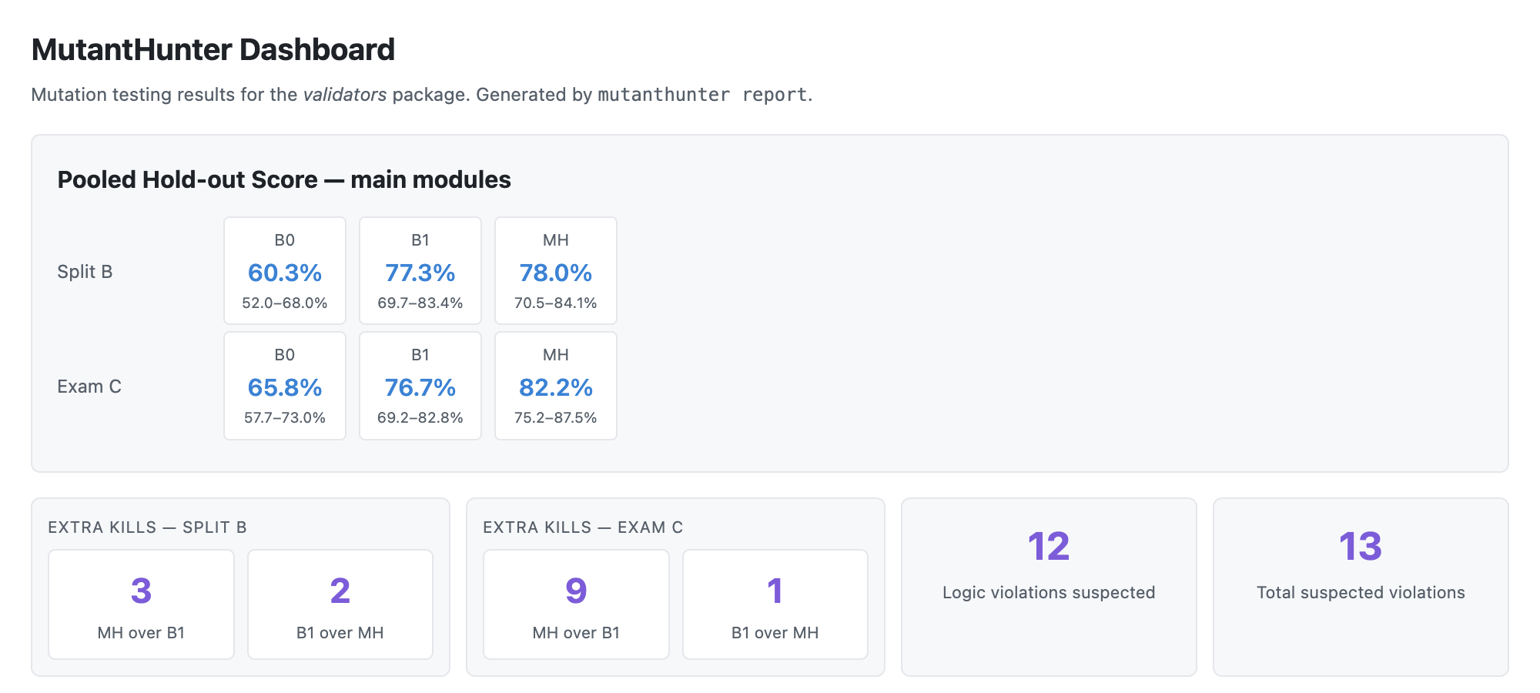

TEAM AND LINKS
Try it: one sentence in IBM Bob
Evan
tool, skill, test generation
chu
evaluation, dashboard, video
Repository
github.com/hanlinji4002/MutantHunter
Dashboard
hanlinji4002.github.io/MutantHunter
The dashboard: pooled scores with 95% CIs, per-module results and every suspected violation.
Spec-derived tests turn disagreements with the specification into reviewable bug reports.
MutantHunter
10 / 10
Notes:
Team: Evan built the tool, skill and test generation; chu ran the evaluation, the dashboard and the video. Repository: https://github.com/hanlinji4002/MutantHunter. Dashboard: https://hanlinji4002.github.io/MutantHunter/. Takeaway: spec-derived tests turn disagreements with the specification into reviewable bug reports instead of silently encoding them.

