Slide 1
SF2528 : Parallel Computations for large scale problems N-Body Problem
Mathurin LAGREE – Hanlin SUN

Slide 2
Introduction
→ Determining trajectories and energy distribution of N electrons

Slide 3

Introduction
Determining trajectories and energy distribution of N electrons
Coulomb interaction :

Slide 4
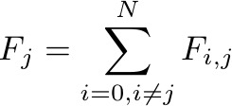
Introduction
Determining trajectories and energy distribution of N electrons
Coulomb interaction :
Contributions :

Slide 5
Plan
[I] Algorithm and strategies used
(a) Barnes-Hut algorithm
(b) Structures used
(c) Parallel implementation
(d) Pseudo-code [II] 2D version : Results and complexity
[III] 3D version : Results and complexity

Slide 6
[I] Algorithm and strategies used

Slide 7


(a) Barnes-Hut algorithm
→Goal : construct a tree. Deepest leaves are the particles.
$$d$$
$$d$$

Slide 8
(a) Barnes-Hut algorithm
Goal : construct a tree. Deepest leaves represents the particles.
Each stage of the tree represents a sub-cube
$$d$$
$$d$$

Slide 9
(a) Barnes-Hut algorithm
Goal : construct a tree. Deepest leaves represents the particles.
Each stage of the tree represents a sub-cube
$$d$$
…
$$d$$

Slide 10
We now have a tree with :
- a depth of ;
- up to N leaves at the deepest stage ;

Slide 11
We now have a tree with :
- a depth of ;
- up to N leaves at the deepest stage ;
GOAL : compute all contributions/forces applied on the N particules

Slide 12
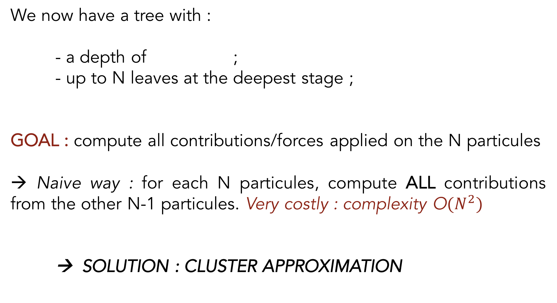
We now have a tree with :
- a depth of ;
- up to N leaves at the deepest stage ;
GOAL : compute all contributions/forces applied on the N particules
→ Naive way : for each N particules, compute ALL contributions from the other N-1 particules. Very costly : complexity O${(N}^{2})$
→ SOLUTION : CLUSTER APPROXIMATION

Slide 13


Cluster approximation :
A cluster of distant bodies can be approximated as a single distant body :
$$d$$
$$r$$

Slide 14
Cluster approximation :
A cluster of distant bodies can be approximated as a single distant body :
n particules of charge 1
1 particule of charge n
$$d$$
$$r$$

Slide 15

Cluster approximation :
A cluster of distant bodies can be approximated as a single distant body :
n particules of charge 1
1 particule of charge n
→ Only valid when :
$$d$$
$$r$$
: parameter
: sub-cube length

Slide 16

Root
…
…
…
…
Deepest leaves
>
> … >

Slide 17

Valid when :
If $θ$ $=0$ : never true. We will traverse all the tree for all particles.
Root
…
…
…
…
Deepest leaves
>
> … >

Slide 18
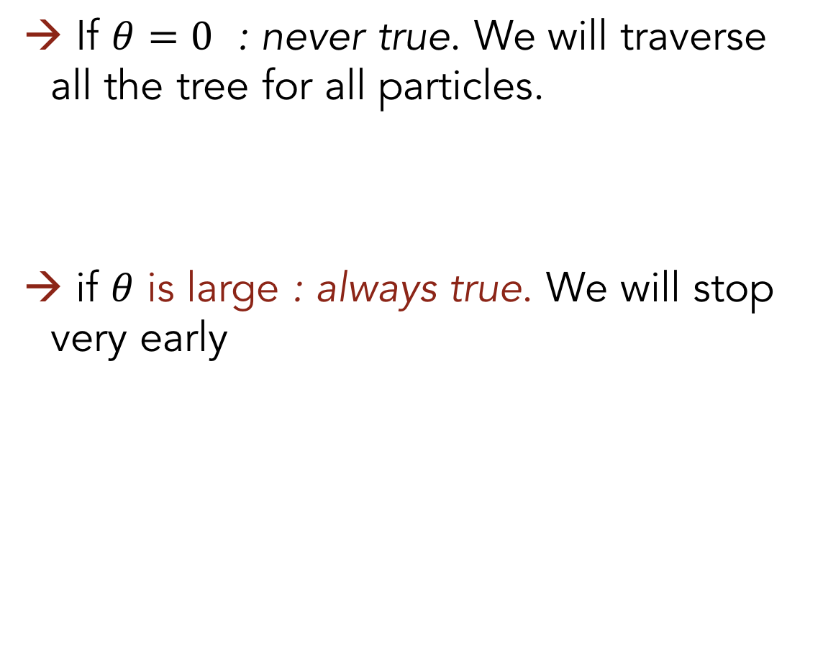
Valid when :
If $θ$ $=0$ : never true. We will traverse all the tree for all particles.
if $θ$ is large : always true. We will stop very early
Root
…
…
…
…
Deepest leaves
>
> … >

Slide 19
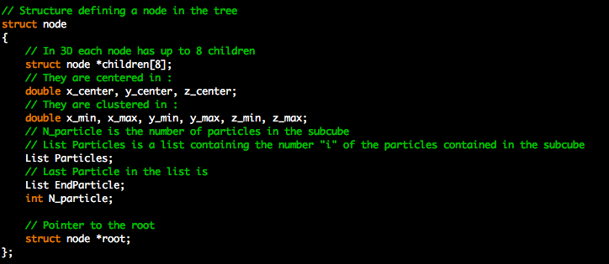
(b) Structure used

Slide 20
(c) Parallel implementation
→ About the tree construction. Every processors will have the entire tree.

Slide 21
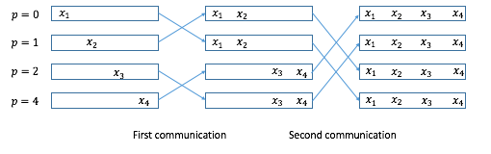
(c) Parallel implementation
→ About the tree construction. Every processors will have the entire tree.
About the forces computation : - divide linearly the number of particles between the P processors - compute forces - communicate using recursive doubling

Slide 22
(c) Pseudo code
. Declare parameters, allocate memory, initialize MPI

Slide 23
(c) Pseudo code
. Declare parameters, allocate memory, initialize MPI
. Define the data partionning between different processors

Slide 24
(c) Pseudo code
. Declare parameters, allocate memory, initialize MPI
. Define the data partionning between different processors
. FOR each time step
. Construct the tree
. ENDFOR

Slide 25
(c) Pseudo code
. Declare parameters, allocate memory, initialize MPI
. Define the data partionning between different processors
. FOR each time step
. Construct the tree
. FOR each particules considered by processor p
. Compute the forces applied on each particules / Update their velocity and position
. ENDFOR
. ENDFOR

Slide 26
(c) Pseudo code
. Declare parameters, allocate memory, initialize MPI
. Define the data partionning between different processors
. FOR each time step
. Construct the tree
. FOR each particules considered by processor p
. Compute the forces applied on each particules / Update their velocity and position
. ENDFOR
. Communicate the data using recursive doubling
. ENDFOR

Slide 27
(c) Pseudo code
. Declare parameters, allocate memory, initialize MPI
. Define the data partionning between different processors
. FOR each time step
. Construct the tree
. FOR each particules considered by processor p
. Compute the forces applied on each particules / Update their velocity and position
. ENDFOR
. Communicate the data using recursive doubling
. Wait for all processors to finish their time step
. ENDFOR

Slide 28
3.Implementation

Slide 29
3.Implementation
(a) Videos to show simulation result

Slide 30
3.Implementation
(a) Videos to show simulation result
(b) Theoretical performance estimation

Slide 31
3.Implementation
(a) Videos to show simulation result
(b) Theoretical performance estimation
(c) Real execution time (complexity) and parallel speed up on 2D

Slide 32
3.Implementation
(a) Videos to show simulation result
(b) Theoretical performance estimation
(c) Real execution time (complexity) and parallel speed up on 2D
(d) Real execution time (complexity) and parallel speed up on 3D

Slide 33
3.Implementation
(a) Videos to show simulation result
(b) Theoretical performance estimation
(c) Real execution time (complexity) and parallel speed up on 2D
(d) Real execution time (complexity) and parallel speed up on 3D
(e) Physics problem in real case: An uniformly charged sphere

Slide 34
(a) Videos of 2D and 3D version
2D version
3D version

Slide 35
(b) Theoretical performance estimation
Sequential version
T(total) = T(construct the tree) + T(traverse the tree)
In Barnes-Hut algorithm, time of constructing the tree : Nlog₄Nt_{a}
Time of traverse the tree :Nt_{a} to 2N(N-1)t_{a}, depend on the parameter

Slide 36
(b) Theoretical performance estimation
Sequential version
T(total) = T(construct the tree) + T(traverse the tree)
In Barnes-Hut algorithm, time of constructing the tree : Nlog₄Nt_{a}
Time of traverse the tree :Nt_{a} to 2N(N-1)t_{a}, depend on the parameter
Parallel version
T(total) = T(construct the tree) + T(traverse the tree)
Time of constructing the tree : Nlog₄Nt_{a}
Time of traverse the tree: Nt_{a}/P to 2N(N-1)t_{a}/P², P is number of processor.
Time of communication: log₄(P)(2t_{startup} + Nt_{data}/P)

Slide 37
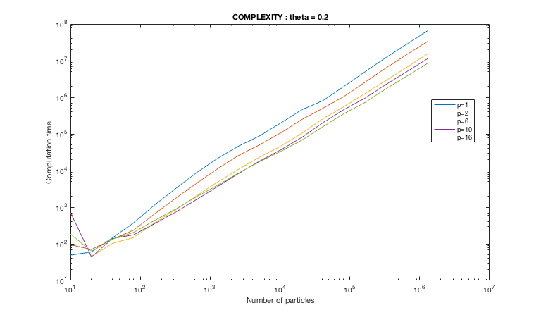
(c) Execution time and speed up (2D)
Fig.1 :Computational time (μs) vs number of particles for parameter θ=0.2 and different number of processors.

Slide 38
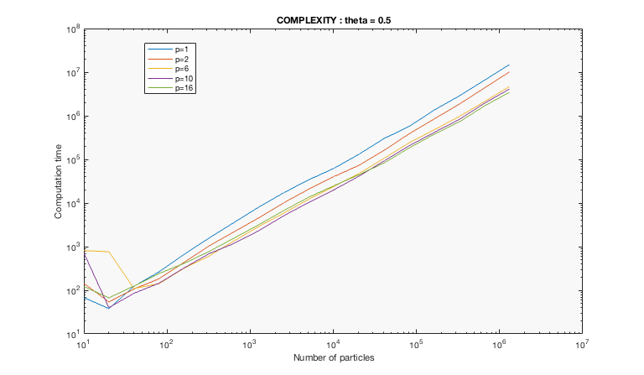
(c) Execution time and speed up (2D)
Fig.2 :Computational time (μs) vs number of particles for parameter θ=0.5 and different number of processors.

Slide 39
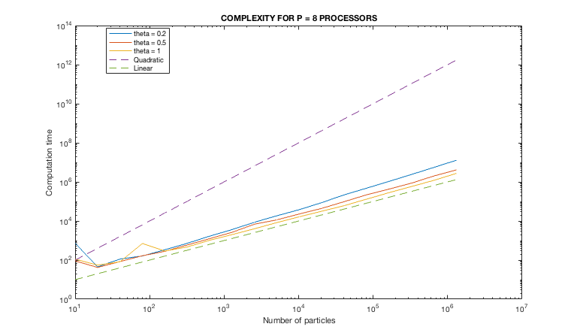
(c) Execution time and speed up (2D)
Fig.3 : Comparison between three different parameter θ = 0.2,0.5,1 for same number of processor (P = 8 here). Computational time (μs) vs number of particles. Quadratic and linear bounds have also been plotted.

Slide 40
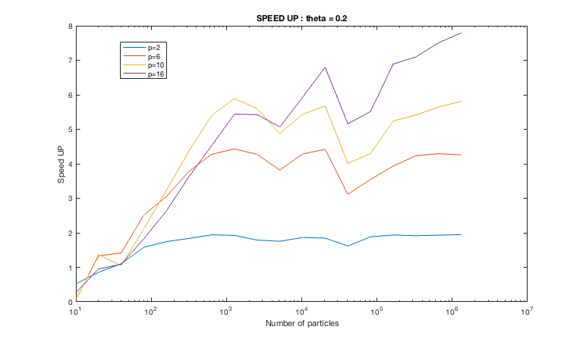
(c) Execution time and speed up (2D)
Fig.4: Speedup vs number of particles for parameter θ=0.2 and different number of processors.

Slide 41
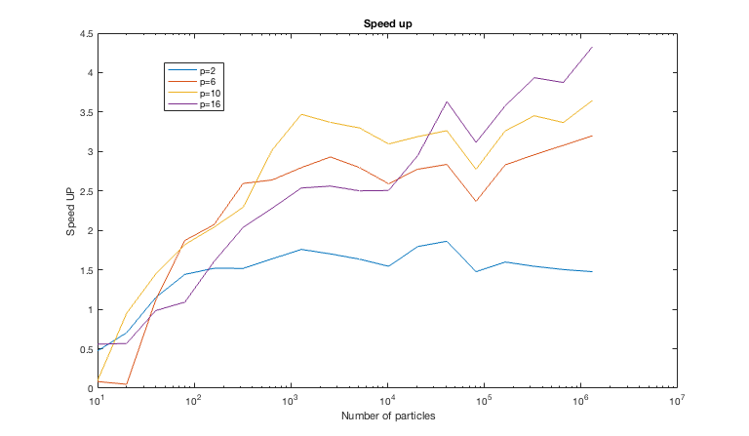
(c) Execution time and speed up (2D)
Fig.5: Speedup vs number of particles for parameter θ=0.5 and different number of processors.

Slide 42
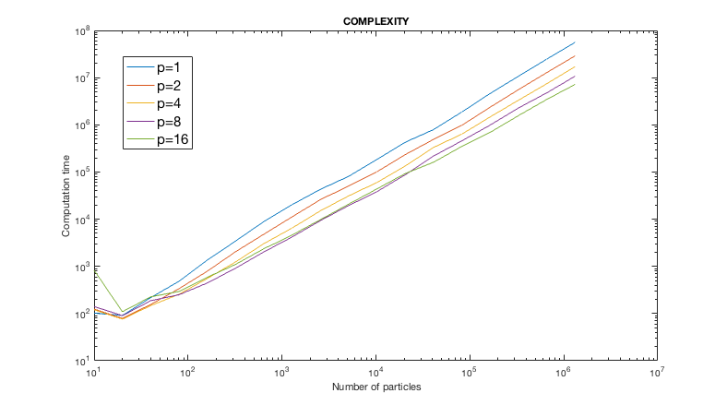
(d) Execution time and speed up (3D)
Fig.6 :Computational time (μs) vs number of particles for parameter θ=0.5 and different number of processors.

Slide 43
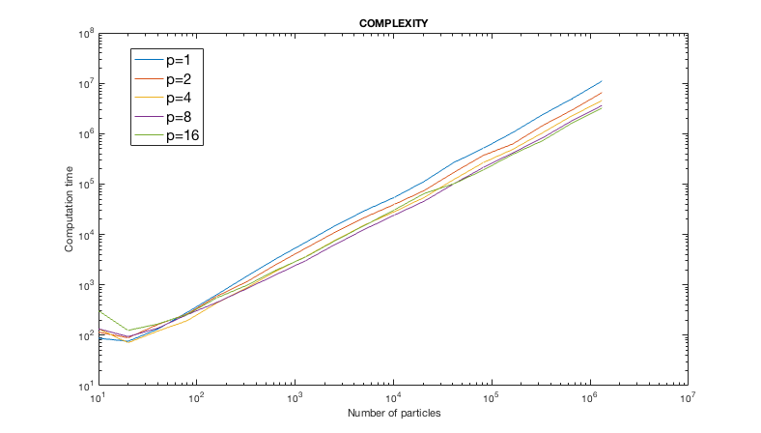
(d) Execution time and speed up (3D)
Fig.7 :Computational time (μs) vs number of particles for parameter θ=1 and different number of processors.

Slide 44
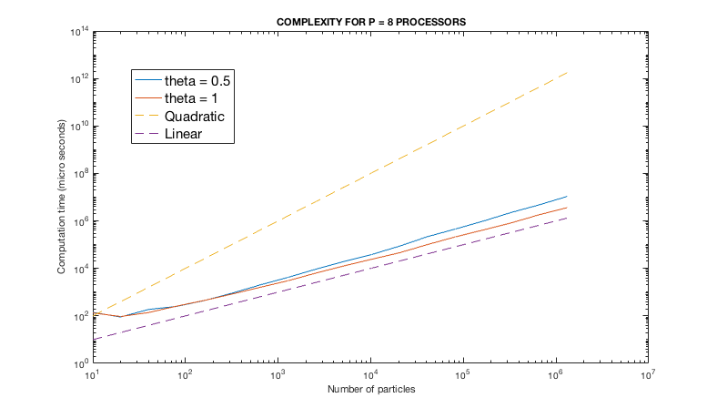
(d) Execution time and speed up (3D)
Fig.8 : Comparison between three different parameter θ = 0.5,1 for same number of processor (P = 8 here). Computational time (μs) vs number of particles. Quadratic and linear bounds have also been plotted.

Slide 45
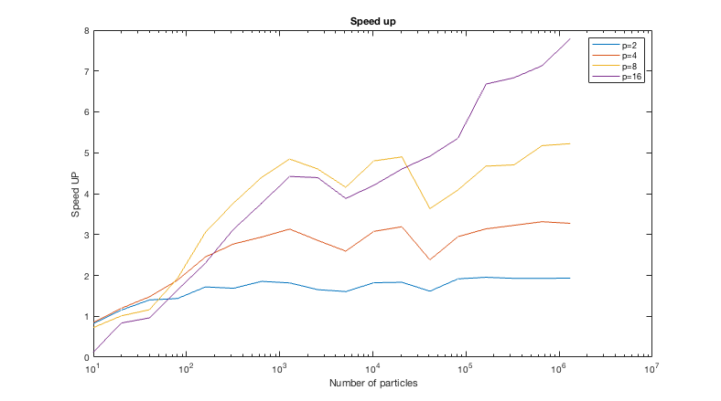
(d) Execution time and speed up (3D)
Fig.9: Speedup vs number of particles for parameter θ=0.5 and different number of processors.

Slide 46
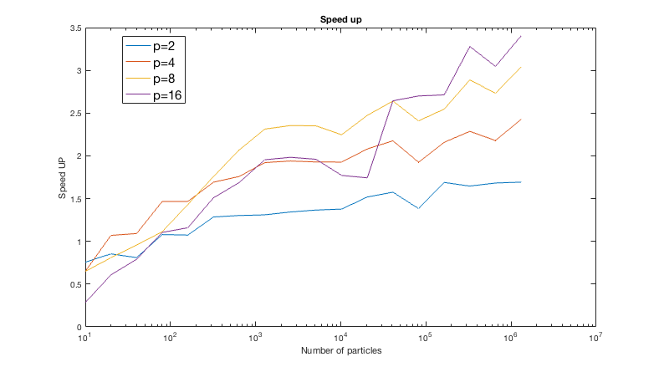
(d) Execution time and speed up (3D)
Fig.10: Speedup vs number of particles for parameter θ=1 and different number of processors.

Slide 47
(e) Physics problem in real case: An uniform charged sphere
Problem : An uniformly charged sphere consist by many particles. The particles will move under Coulomb force. We want to compute the kinetic energy distribution at a certain t.

Slide 48
(e) Physics problem in real case: An uniform charged sphere
Problem : An uniformly charged sphere consist by many particles. The particles will move under Coulomb force. We want to compute the kinetic energy distribution at a certain t.
Analytical method: Gaussian Theorem and numerical integral

Slide 49
(e) Physics problem in real case: An uniform charged sphere
Problem : An uniformly charged sphere consist by many particles. The particles will move under Coulomb force. We want to compute the kinetic energy distribution at a certain t.
Analytical method: Gaussian Theorem and numerical integral
Comparison: Theoretical result VS experimental result

Slide 50
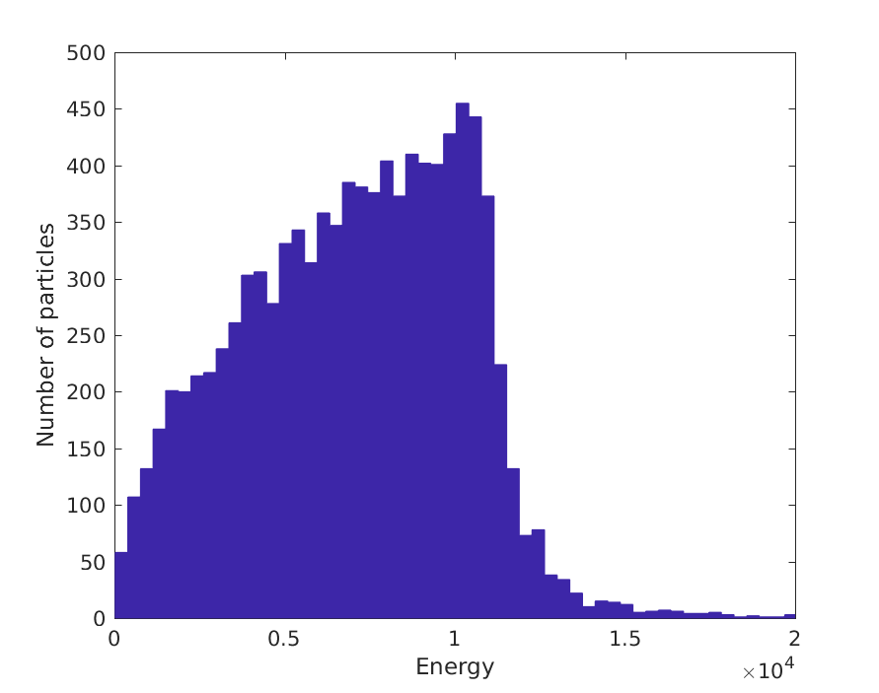
(e) Physics problem in real case: Experimental result
Fig.11 : Number of particles with different energy (θ=0.2)

Slide 51
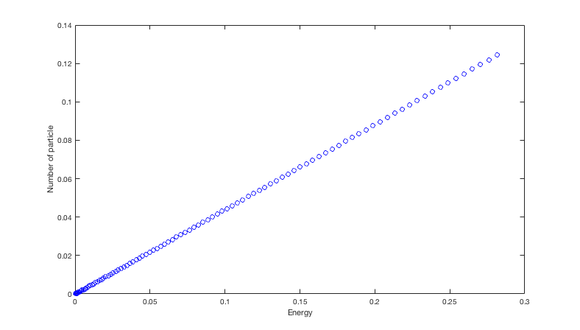
(e) Physics problem in real case: Theoretical result
Possible reasons of differences:
Parameter theta: Inaccuracy of computation.
Number of particle: The charges are not uniformly distributed perfectly.
Fig.12 : Number of particles with different energy
*NOTE : The values of x axis and y axis do not have any real meanings.

Slide 52
Conclusion

