Slide 1

Pulse shaping filters applied to SC-FDMA systems considering the PAPR and BER.
Jaime Aranda
16 Noviembre 2017

Slide 2
Literature Review
[1] 2007. Analytical expression of SER using: AWGN, Fading AWGN, Multipath.
[2] 2008. Analytical expression of BER for MMSE and ZFE EQ for an AWGN channel.
[3] 2009. Study of the bit error rate over Rayleigh fading channels for BPSK and M-QAM modulations.
[4] 2011. Study of the bit error rate over nakagami-m fading channels for BPSK and M-QAM modulations with ZF-equalization.
* None of the above papers discuss the use of pulse shaping filters.
* Derive analytical expression of BER over SC-FDMA in fading channels using PS, seems very difficult !

Slide 3
Introduction
In [5] a hybrid filter to reduce the PAPR on the Tx side was proposed.
The design of the filter is based in 2 key components: FIR filter + Nyquist-I pulse.
An envelope constrain (EC) is used to optimize the impulse response of the filter in terms of PAPR.
How ? Decreasing the magnitude of the output side lobes of the impulse response
[5] Kamal, S., Meza, C. A. A., Tran, N. H., & Lee, K. (2017). Low-PAPR Hybrid Filter for SC-FDMA. IEEE Communications Letters, 21(4), 905-908.

Slide 4
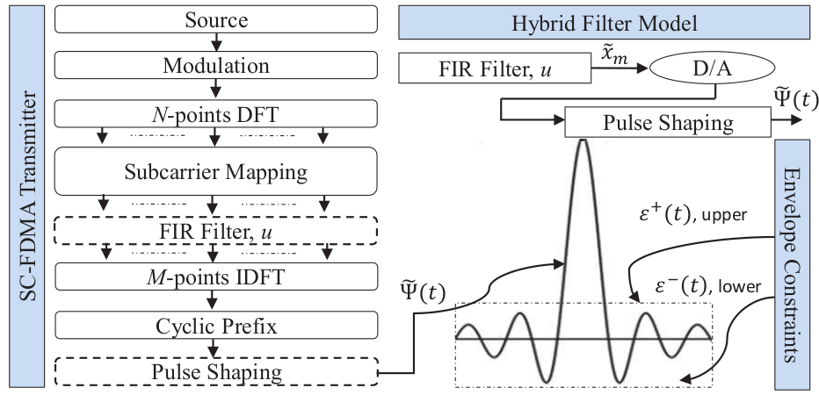

System Model

Slide 5
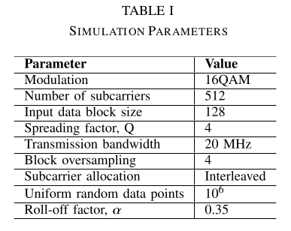
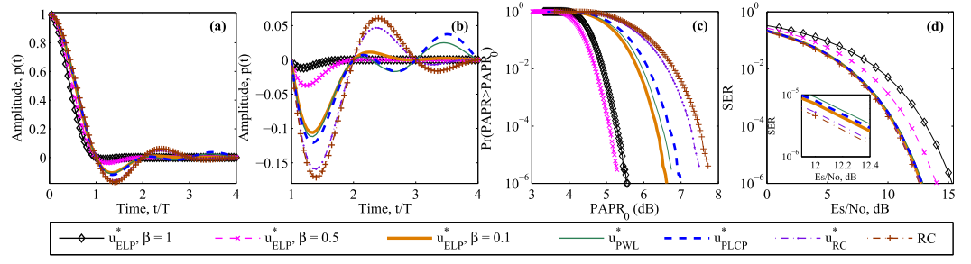
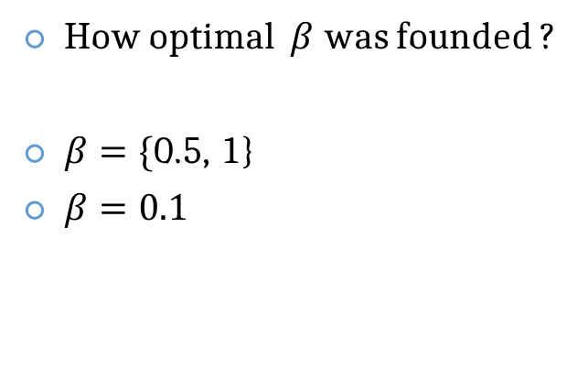
Results
How optimal $β$ was founded ?
$β=\{$0.5, 1}
$β=0.1$

Slide 6
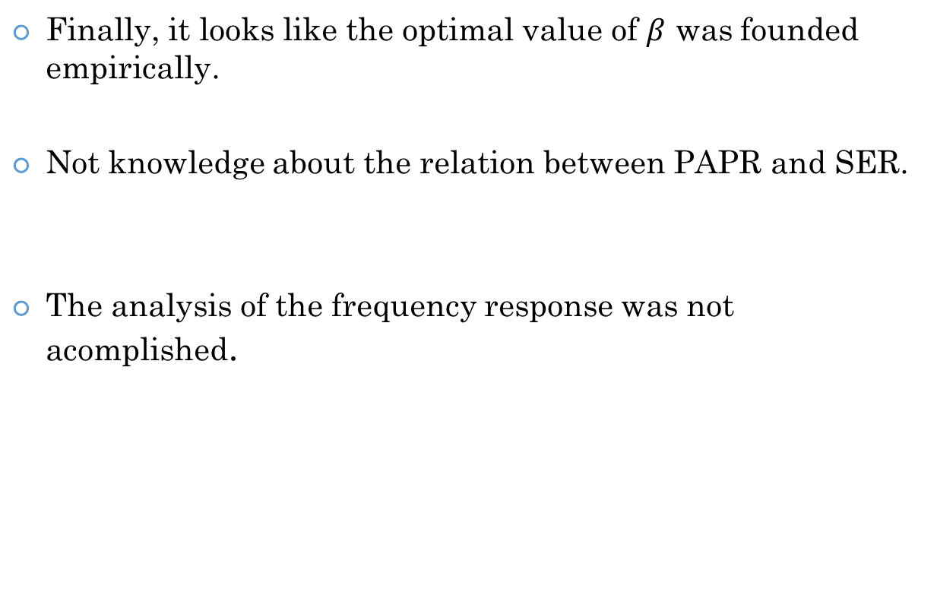
Drawbacks
Finally, it looks like the optimal value of $β$ was founded empirically.
Not knowledge about the relation between PAPR and SER.
The analysis of the frequency response was not acomplished.
Formulation of problem (min PAPR).
Decrease the magnitude of the side lobes.
The shape of the IR change every iteration

Slide 7
Genetic Algorithms
Algoritmos para solucionar problemas de optimización complejos y multidimensionales.
Se requiere:
Una representación genética del dominio de soluciones.
Una función de fitness para evaluar la solución.
Video !

Slide 8

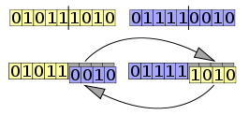
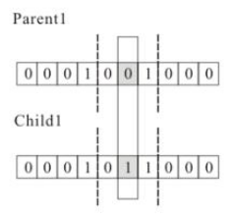
Genetic algorithm (2)
Selection
Retain the best subjects from one generation to the next
Crossover:
Mutation:

Slide 9
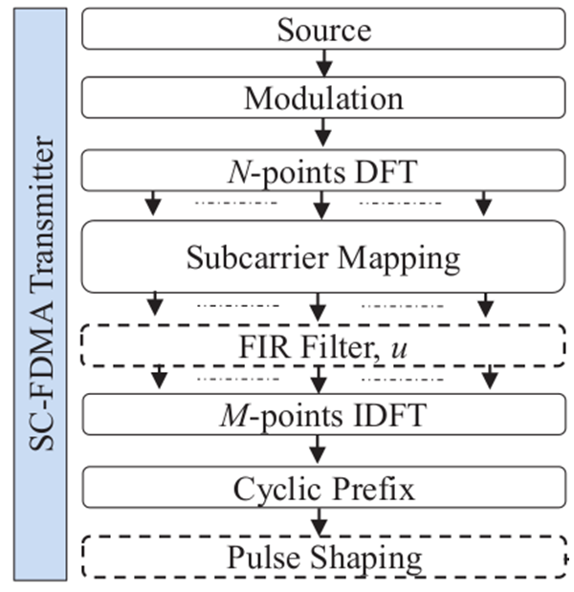
GA applied to PS
Optimized by GA
Fitness function

Slide 10
GA applied to PS (2)
How to encode Shaping filters to GA ?
Represent the filter with n-tap FIR filter
If n=16, we encode every tap with a sequence of bits.
If we decide to use 4 bits, and we decide to limit the maximum and minimum amplitude of pulse to {-1,1}
The y-axis step of the filter would be 0.125
If we use 6 bits, the step would be 0.03125.
After the algorithm proposed a solution, the pulse will look like step function.
We need to applied low-pass filter.

Slide 11
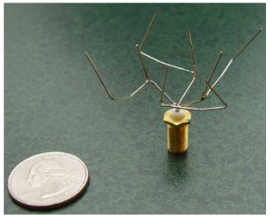
GA applied to PS (2)
Advantages:
We can use any fitness functions and mix of it. We can solve a multidimensional problem considering PAPR in the Tx and BER in the Rx. Also we can include the bandwidth used for the pulse.
Drawbacks:
No mathematical expression for the optimized pulse.
Can stop in local minima.
No mathematical formalism ??

Slide 12
Carta Gantt

Slide 13
References
[1] Nisar, M. D., Nottensteiner, H., & Hindelang, T. (2007, July). On performance limits of DFT spread OFDM systems. In Mobile and Wireless Communications Summit, 2007. 16th IST (pp. 1-4). IEEE.
[2] Wang, H., You, X., Jiang, B., & Gao, X. (2008, May). Performance analysis of frequency domain equalization in SC-FDMA systems. In Communications, 2008. ICC'08. IEEE International Conference on (pp. 4342-4347). IEEE.
[3] J. J. Sánchez-Sánchez, U. Fernández-Plazaola, M. C. Aguayo-Torres,and J. Entrambasaguas, “Closed-form BER expression for interleavedSC-FDMA with M-QAM,” in Proc. IEEE 70th VTC, 2009, pp. 1–5.
[4] J. J. Sánchez-Sánchez, M. C. Aguayo-Torres, and U. Fernández-Plazaola, “BER analysis for zero-forcing SC-FDMA over Nakagami-m fading channels,” IEEE Trans. Veh. Technol., vol. 60, no. 8, pp. 4077–4081,Oct. 2011

