Slide 2
Introduction
In [1] a hybrid filter to reduce the PAPR on the Tx side was proposed.
The design of the filter is based in 2 key components: FIR filter + Nyquist-I pulse.
An envelope constrain (EC) is used to optimize the impulse response of the filter in terms of PAPR.
[1] Kamal, S., Meza, C. A. A., Tran, N. H., & Lee, K. (2017). Low-PAPR Hybrid Filter for SC-FDMA. IEEE Communications Letters, 21(4), 905-908.

Slide 3
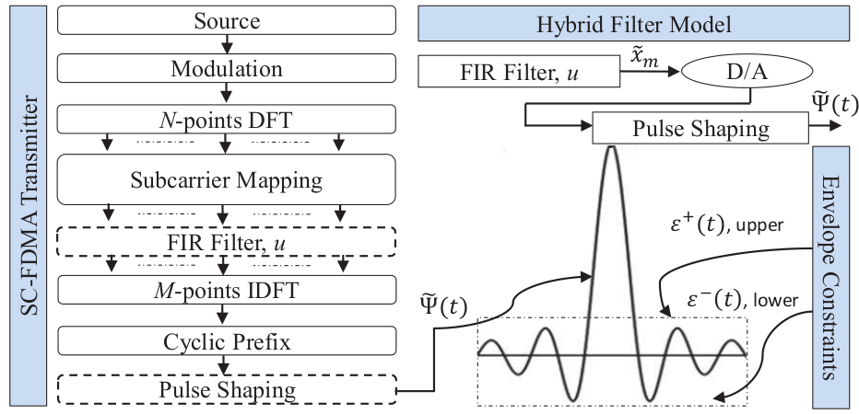
System Model

