Slide 1
CONTROL-IT
Mark Hanlon
HDCBIBM Final Project Presentation
Thursday 14th December 2017

Slide 2
Introduction
What is the motivation of your project?
To build a web application which could encourage diabetes patients to engage with an interactive program, benefitting themselves & their healthcare providers
Secure application which could suit ‘less technical’ user-base
Problem approached?
To facilitate secure electronic management of medical records
Customers?
Diabetes patients & their doctors/nurses, engaging in electronically interactive treatment monitoring

Slide 3
Goals
What did you try to achieve?
My goal for this project was to gain experience of web application development, apply new skills learned on the HDip course, whilst simultaneously attempting to address Cybersecurity concerns associated with web applications (e.g. threats identified by OWASP), and be able demonstrate my understanding of them.

Slide 4
Solution
How did you solve the problem?
Via application which:
Permits registered and logged-in patients to submit blood-glucose test results daily (i.e. insert records into secure back-end database)
Allows the doctor/nurse administering the treatment program to review those test results for all their patients (i.e. securely read records out of the database)

Slide 5
Demonstration
Demo of final application
URL: https://control-it.eu-gb.mybluemix.net

Slide 6
Implementation
Main classes ‘Insert records’ ‘Read from database’ ‘Register/Login’
Technologies used
HTML/CSS/Bootstrap
Javascript/jQuery/AJAX
PHP
Apache webserver
MySQL
NetBeans IDE
Google reCAPTCHA
jQuery UI Datepicker
IBM Cloud/BLUEMIX

Slide 7
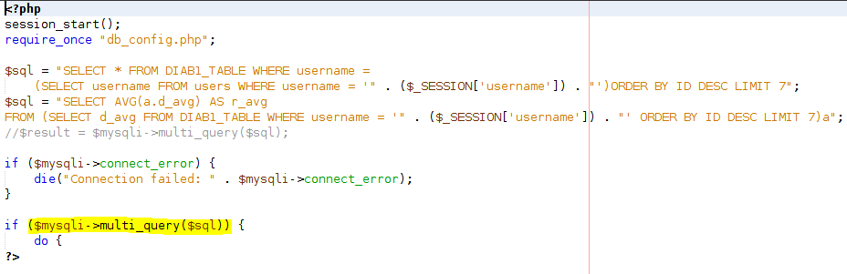
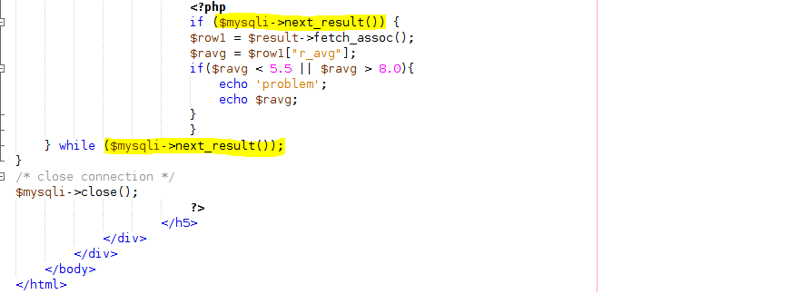
Code challenge
PHP mysqli_multi_query
(Execute multiple MySQL statements in one PHP script)
This was to be used for ‘generate alert function’ not implemented

Slide 8
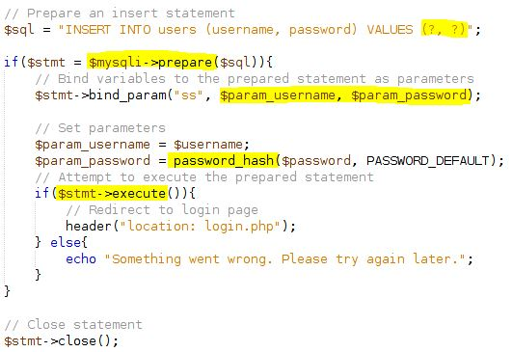
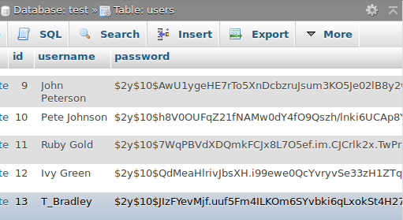
Security snippet
PHP prepared statement – avoid SQL injection
password_hash function – uses bCrypt algorithm built-in

Slide 9
Conclusions and Future Work
General conclusions Achieved basic targets
Opportunities and limits Extra security features
Future perspectives Numerous feature enhancements possible e.g. authentication by Google framework, generate alerts & send by email, further data analysis & manipulation

Slide 10
Q&A
Answer Questions
FEEDBACK
Incompleteness – registration system for ‘admin user’
Testing – lack of testing reports

Slide 11
BACK-UP

Slide 12
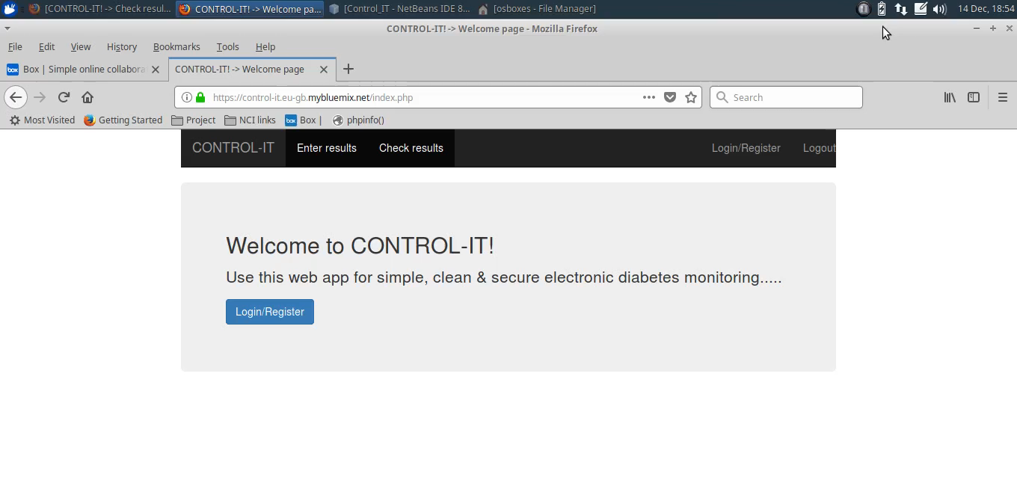
Demonstration video - application

Slide 13
Demonstration video – code challenge
Code challenge video found at:
https://github.com/hanlonmk1/control-it/tree/master/docs/ref

Slide 14
Demonstration video -Kali SQLMAP test
SQLMAP video found at:
https://github.com/hanlonmk1/control-it/tree/master/docs/test

Slide 15
System
Description
Architecture
Main algorithms

Slide 16
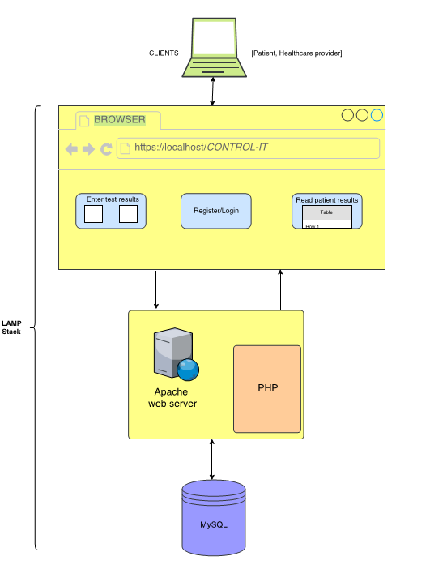
System Architecture

Slide 17
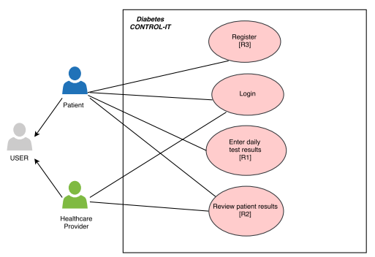
Design
Main requirements
Functional - ‘Enter daily test results’ - ‘Review patient results’ - ‘Register’ - ‘Login’
Data - Security - Encryption - Meet standards
System - Technologies used - Secure frameworks

Slide 18
Testing and Evaluation
Unit testing
Integration testing
Security testing
What are the results?

Slide 19
Application access information
----Example application usernames for demonstration purposes----
Healthcare provider
ControlDoc pwd-> mko09ijn
ControlNurse pwd-> nji90okm
Patient
John Peterson pwd-> zaq12wsx
Peter Johnson pwd-> xsw21qaz

