Slide 1
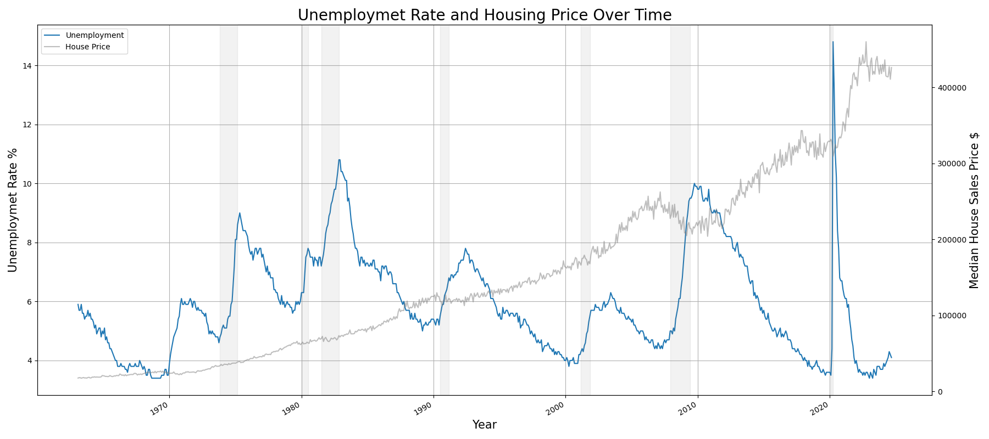
Agenda
Problem Statement:
Unemployment rate goes up in recessions
Housing Market usually goes down before or during recessions
Q1: Would there be a negative correlation between them?
Q2: Would there be any lagging effect between the movement? If so, how many months would that be? (Housing Price is a Predictor for Unemployment Rate)
Problem Statement
Exploratory Analysis
Correlation and Lags
Result with Lags
Reporting Process
Example Reports
Time Series Plot of Unemployment Rate vs. Median Housing Price (Bottom)

Slide 2
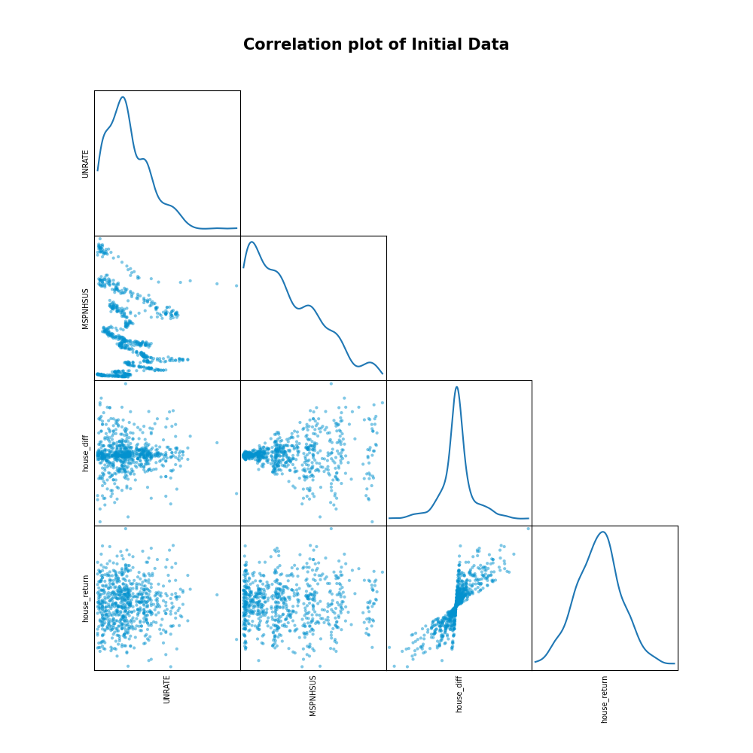
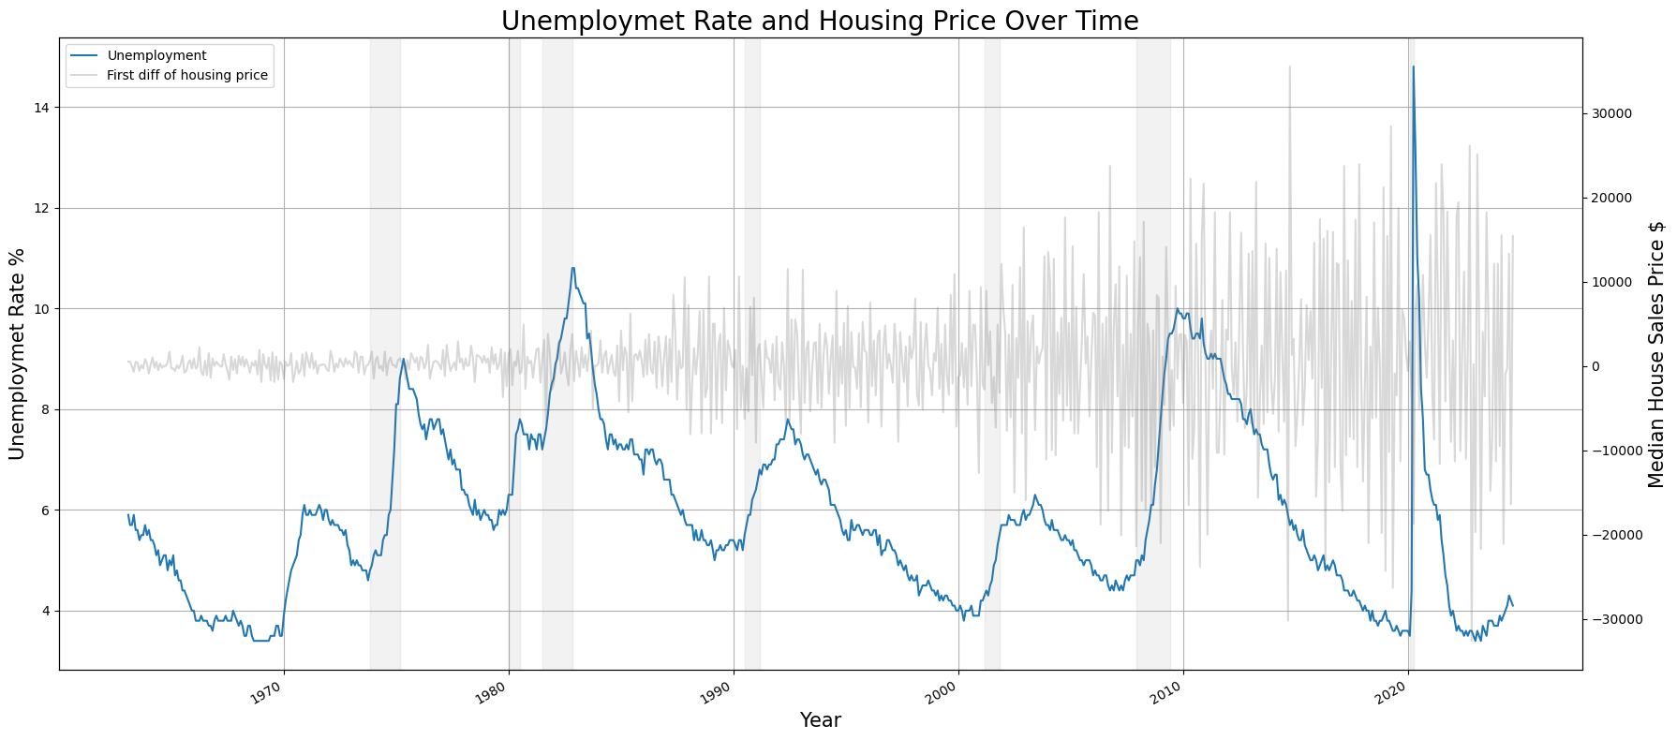
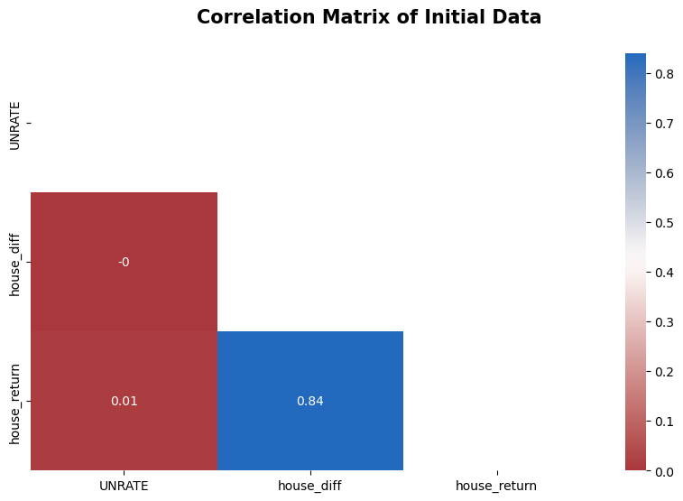
Exploratory Analysis
Stationary Summary Table
Description | P-Value | Result
Unemployment Rate | 0.017 | stationary
Median Housing Price Over Time | 0.997 | non-stationary
First diff of housing Price | 0.000001 | stationary
Return of housing Price | 0.000023 | stationary
Stationary Test:
If P-Value < 0.05 ➔ Stationary
Housing Price is not stationary, remove the trends and seasonality
Time Series Plot of Unemployment Rate vs. Median Housing Price 1st Difference
Correlation of Stationary Data:
No significant correlation can be found
Correlation plot (Upper Right)
Correlation Matrix (Lower Right)

Slide 3
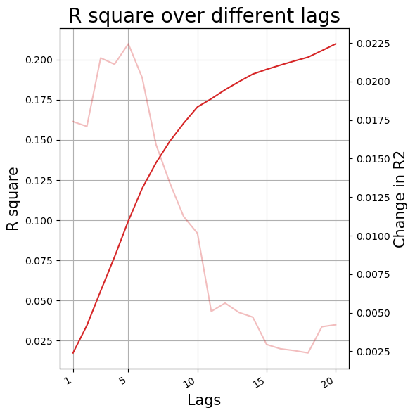
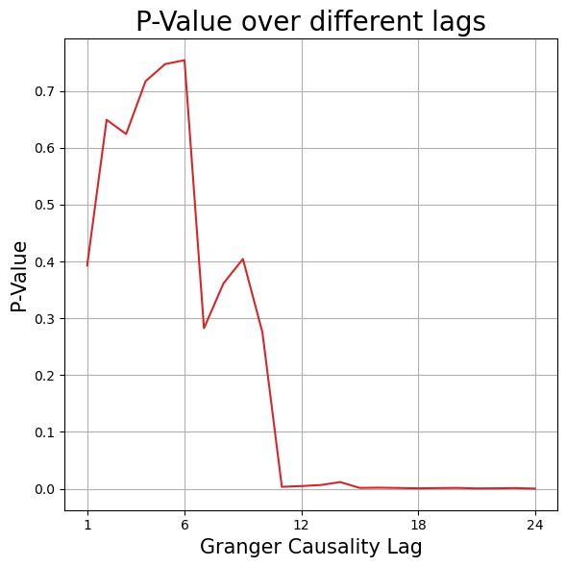
Correlation and Lags
Granger Causality:
H1: Past values of Housing Price have a statistically significant effect on the current value of Unemployment Rate
Housing Price is the granger cause to Unemployment rate
P-value<0.05 starting at 11th lags
Regression Test:
Run Regression adding different # of lags
Adding lags significantly increases the R2
R2 is more flat and stable after 11 lags
Change in R2 is minimal after 11 lags

Slide 4
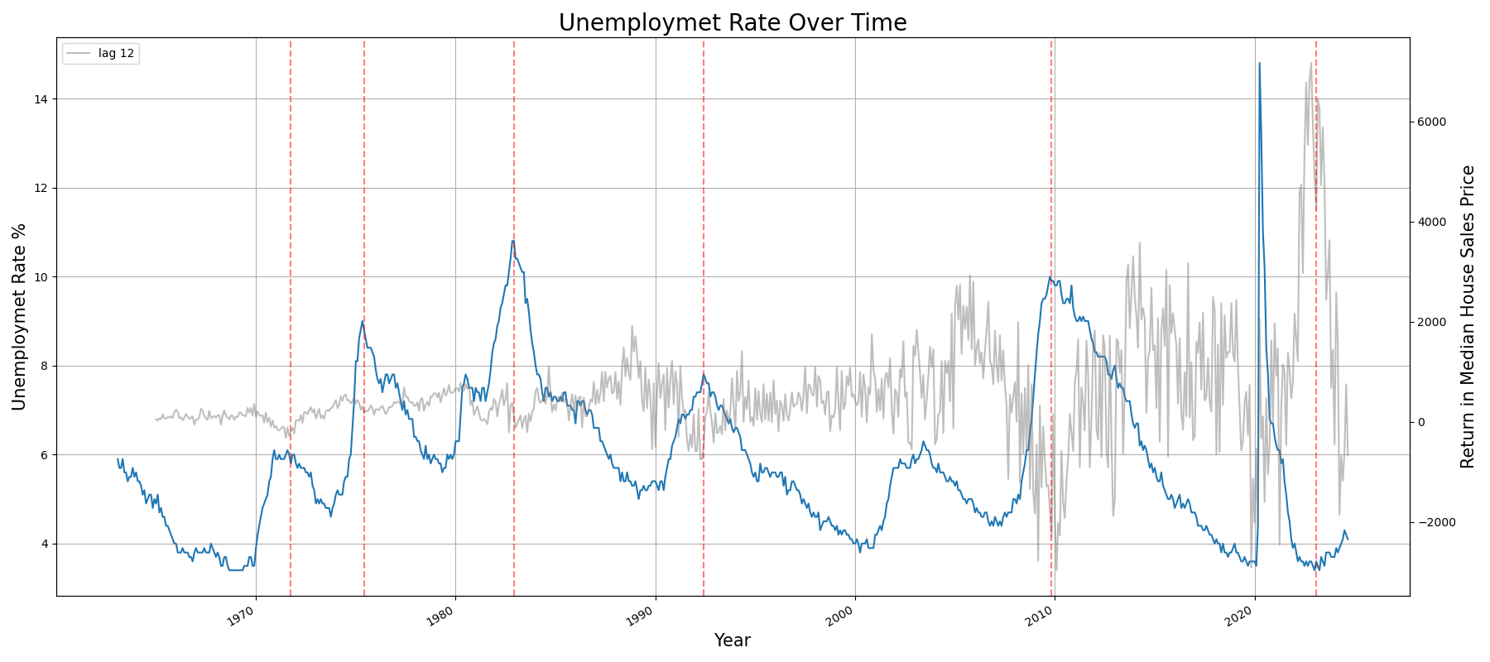
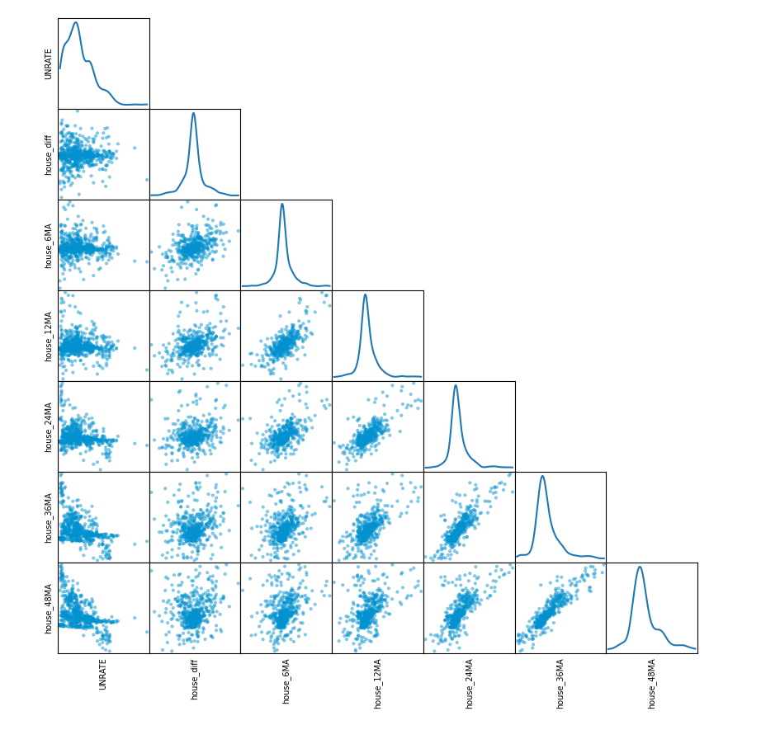
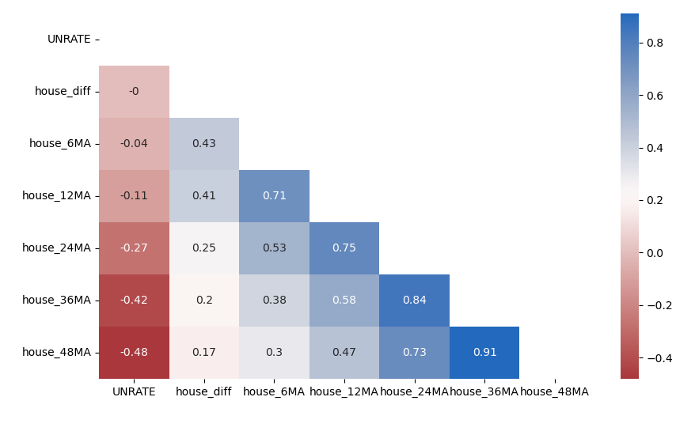
Result with lags
Using Moving Averages to includes information from all past months:
6 months, 12 months, 24 months, 36 months, 48 months
Significantly Increase in Negative Correlation
Correlation Plot of Unemployment Rate Against Different Moving Averages Months
Correlation Matrix of Unemployment Rate Against Different Moving Averages Months
Housing Price with12 months lags (Smoothed) over unemployment rate
Unemployment rate peaks matches the housing price trough

Slide 5
Reporting Process
Package Used:
Numpy
Pandas
Matplotlib
Statsmodels
Seaborn
Plotly
MiKTeX
User define which report to generate
PDF Report
(Non-Interactive)
Read in csv file
(Or replaced with Database Connection to auto-refresh)
Add more available report options if needed
Run user selected report in config
Data Manipulation and Analysis in Python
Python Env
(Virtual Env)
HTML Report
(Interactive)
Or let Tableau connect with Database Directly
User Input configs/args
(Date, directory, etc..)
Excel Report
(Non-Interactive)
Tableau Report
(Interactive)
Check All Examples at My GitHub: https://github.com/hanlulu-0201/Unemployment_House

