Slide 1

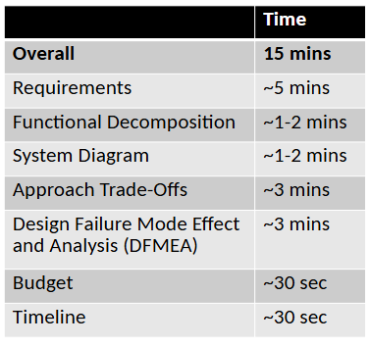
Preliminary Design Review
Team 24: Hands-Free Reading

Slide 2
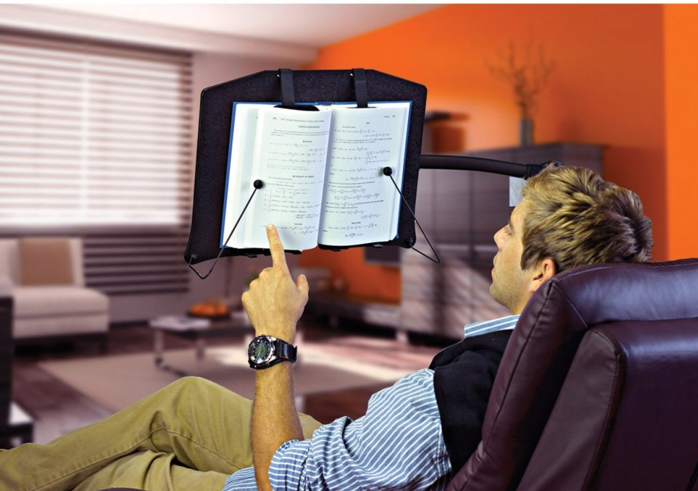
Functional Requirements
Orientation: Product usable when placed upright on a flat surface
Page Handling: Turning mechanism should not damage (scratch or tear) the pages
Compatibility: System needs to work with a compatible book type
Mostly hands-free: The user needs to be able to use the product entirely hands-free aside from the initial setup
Portable: Product needs to be rechargeable.
To be used in standard lighting (100-500 lux)
Page should be flipped within 15 seconds of the user's trigger
Notes:
Portable – handheld, light, easy use (no power port needed) The user needs to be able to use the product almost anywhere and in portrait orientation
Near Compatibility - Compatible with common book trims, cover types and thicknesses
Mostly hands-free - The user needs to be able to use the product entirely hands-free aside from the initial setup of the book on the holder.
Easy to use and set up
Rechargeable
To be used in standard lighting environment

Slide 3
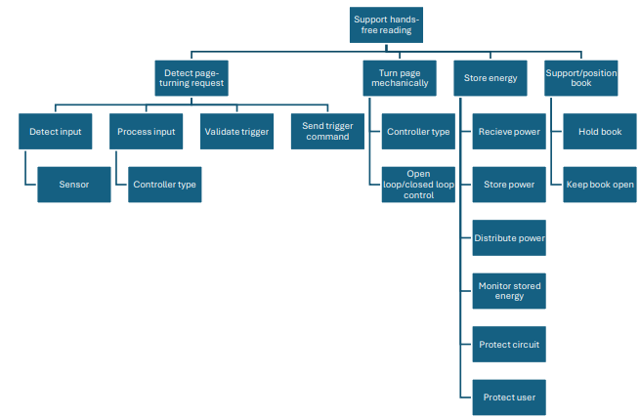
Functional Decomposition

Slide 4
System Diagram
Backward/Forward/No turn
USB-C Power Input
User’s Eyes
Servo Control Signals
Charging/Circuit Proteciton Module
Rasberry Pi Camera Module 3 NoIR
Servo Motors
Movement Feedback
Rasberry Pi 4
Page Turning Arm
Rechargable Battery
Image
DC Power
Page Turning Wheel
Power Regulation & Distribution
Book Page
Battery Indicator
Control Signal

Slide 5
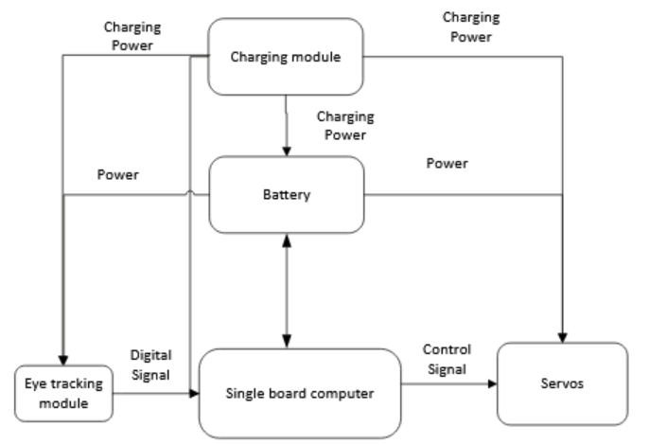
System Diagram

Slide 6
Approach Trade-Offs: Page Turn Trigger
 | Accessibility (Weight = 0.6) | cost (Weight = 0.05 ) | Power consumption (Weight = 0.05) | Portability (Weight = 0.1) | accuracy (weight = 0.2) | Total
Eye tracking | 3 | 1 | 1 | 3 | 2 | 1.88
Speech | 2 | 2 | 2 | 2 | 1 | 1.07
Foot pedal | 1 | 3 | 3 | 1 | 3 | 1.6

Slide 7
Approach Trade-Offs: Move Page
 | Cost (weight = 0.2) | Damage Risk (weight = 0.3) | accuracy (weight = 0.3) | Ease of implementation (weight = 0.2) | Total
Wheel | 4 | 1 | 1 | 4 | 2.2
arm | 4 | 3 | 1 | 2 | 2.4
wheel + arm | 3 | 4 | 4 | 3 | 3.6
Grippy finger | 1 | 2 | 3 | 1 | 1.9

Slide 8
Approach Trade-Offs: Receive Power
 | portability (weight = 0.4) | build cost (weight = 0.1) | user cost (weight = 0.2) | Capacity (weight = 0.3) | total
Wall Power | 1 | 3 | 3 | 3 | 2.2
rechargeable battery | 3 | 1 | 2 | 2 | 2.3
Single use battery | 2 | 2 | 1 | 1 | 1.5

Slide 9
Approach Trade-Offs: Support/Position Book
 | setup ease (weight = 0.4) | Cost (weight = 0.2) | portability (weight = 0.3) | Power Consumption (Weight = 0.1) | total
stand with clips | 3 | 3 | 4 | 4 | 3.4
Nothing | 4 | 4 | 1 | 4 | 3.1
Vertically adjustable stand | 1 | 1 | 3 | 4 | 1.9
stand with light | 3 | 2 | 4 | 1 | 2.9

Slide 10
Design Failure Mode Effect and Analysis (DFMEA)
Function | Failure Mode | Effect of Failure | Cause of Failure | Severity | Occurrence | Detection | Rating | Recommended Action
Detect eye position | Incorrect tracking | No page turning trigger, false page turning trigger | Inaccurate calibration, image processing error | 8 | 2 | 10 | 160 | Add recalibration functionality, ensure computation ability
Detect eye position | Eye/face not detected | No page turning trigger | Obstruction near eye/face, inadequate lighting | 8 | 2 | 1 | 16 | Obstruction detection and user alert system
Notes:
Function: Detect eye position
Failure modes: Incorrect tracking or inability to detect eye
Causes: Inaccurate calibration, obstruction
Highest rated was incorrect tracking due to lack of detection
Actions: Recalibration function, alert system for user to tell about obstruction

Slide 11
Design Failure Mode Effect and Analysis (DFMEA)
Function | Failure Mode | Effect of Failure | Cause of Failure | Severity | Occurrence | Detection | Rating | Recommended Action
Turn page | Multiple pages turned simultaneously | User skips pages | Pages stick together or inadequate page separation | 8 | 3 | 10 | 240 | Consider backwards turn functionality
Turn page | Page not lifted/grabbed | Page does not turn | Insufficient friction, force, or poor arm/motor alignment | 4 | 2 | 10 | 80 | Add pressure sensor
Turn page | Motor(s) stall/jam | Page turning stops | Mechanical obstruction | 10 | 1 | 5 | 50 | Add feedback loop with motor, alert user
Notes:
Function: Turn page
Failure modes: Multiple pages turning, pages not being lifted, motor jamming
Causes: Page material,
Highest rated was multiple pages turned due to lack of detection
Actions: Backwards turn, pressure sensor, alert system previously discussed

Slide 12
Design Failure Mode Effect and Analysis (DFMEA)
Function | Failure Mode | Effect of Failure | Cause of Failure | Severity | Occurrence | Detection | Rating | Recommend Action
Power | Unexpected device shut down | Interrupted reading experience | No low-power warning | 2 | 8 | 3 | 48 | Indicating light/display for battery SOC
Power | Battery faulting | Limited battery life/explosive | Overvoltage, undervoltage, overcurrent, overheat | 10 | 8 | 4 | 320 | Ensure analog circuit protection is included in design
Notes:
Function: Power
Failure modes: Device shut down, battery faulting
Highest rated was battery faulting due to severity
Actions: Alert system for low power, analog circuit protection to prevent over/undervoltage and overcurrent

Slide 13
Budget
Function | Part Name | Cost
Eye tracking sensor | Raspberry Pi Camera Module 3 NoIR | $27.50
Main computing module | Raspberry Pi 4 Module B 2GB | $67.50
Turning page | Servo wheel | $3.48
Li-ion charge management controller | MCP73831-2-OT | $0.76x5
Low-dropout Regulation | XC6220B331MR | $0.98x5
Li-ion battery |  | TBD
Estimated Total |  | $107.18
General parts (to be found in ECE shop and DIY):
  USB-C port
  PMOS for power selection
  Decoupling capacitors
  Resistors
  Page turning arm (3D print)

Slide 14
Timeline (1st Semester)
Problem Definition & Research
Identify user needs, establish design requirements, research existing solutions, and develop system concepts.
Design Selection & Planning
Finalize subsystems, select components, develop block diagrams and DFMEA.
Purchase initial components
Individual Subsystem Prototyping
Develop eye-tracking algorithm, test servo-driven page-turning mechanisms, and design power circuitry (PCB).
Independent Subsystem Testing
Test eye-tracking and page turning accuracy individually and make improvements. Place order for PCB.
Select components, design power circuit, and order necessary hardware.
Sept 25th – Oct 20th
Oct 28th – Nov 28th
Aug 24th – Sept 24th
Oct 20th – Oct 27th
Nov 29th ~

