Slide 1
Epidemic Modelling
Hannah Craddock
Supervisors: Dr Simon Spencer, Prof Xavier Didelot
Date: Thursday July 8th 2021
Notes:
Hi everyone, thanks for taking the time out today.
So I’m working under the sup of Simon & Xavier & working on Epidemic modelling.
So just to give an overview of what I’ll talk through today.
We have started building up the models starting with a simple baseline model so I’ll firstly talk you through that. MCMC scheme
and recently looking into super-spreading models.
The real aim is to look into the influence of certain datapoints individuals or ss events.
Recent covid pandemic has really shone light on the importance of epidemic modelling, and as you are all aware there are
the data & scenariors are constantly changing and we think it would be nice to be able to quantify what effect these changes are having on the model parameters
To do
Format presentation?
Plots == orange

Slide 2

Contents
Baseline Model
Simulations
Bayesian model
MCMC Inference for $R_{0}$
Simple Adaptive Monte Carlo for $R_{0}$
MCMC Results
Super spreading Model
Future Directions
Notes:
R_0 which I think we all know is the expected number of secondary people each infected subsequently infects.
So just to give an overview of what I’ll talk through today.
Start by introducing our first baseline model, MCMC inference for R_0
We have started building up the models starting with a simple baseline model so I’ll firstly talk you through that.
Also developed a simple MCMC scheme
and recently looking into super-spreading models so I’ll take you through that model
The real aim is to look into the influence of certain datapoints individuals or ss events.
Recent covid pandemic has really shone light on the importance of epidemic modelling, and as you are all aware there are many researchers tiredlessly working on models.
And since the data & scenariors are constantly changing and we think it would be useful to be able to quantify what effect such changes are having on the model parameters
Results
Superspreading model
Future directions

Slide 3
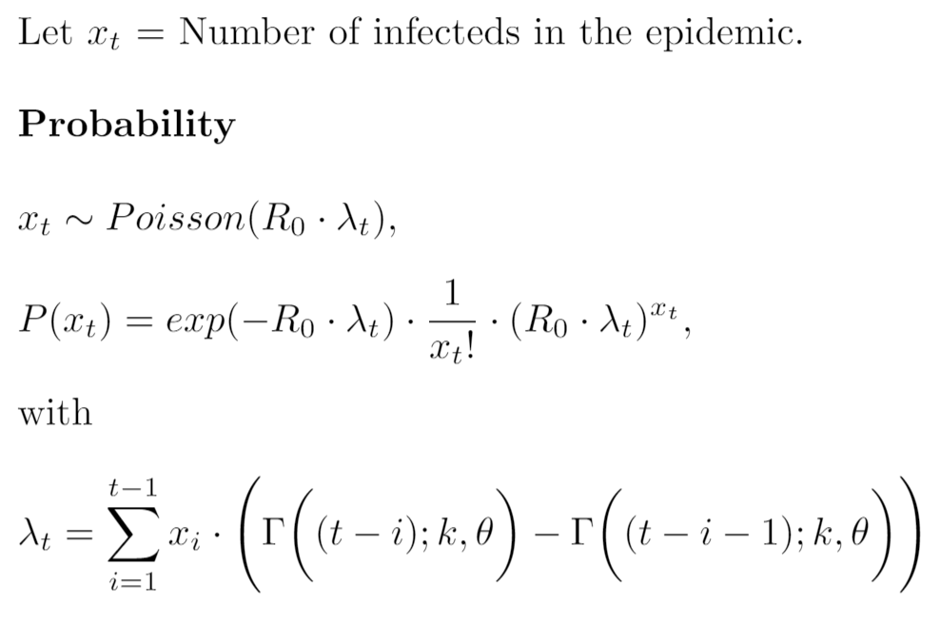
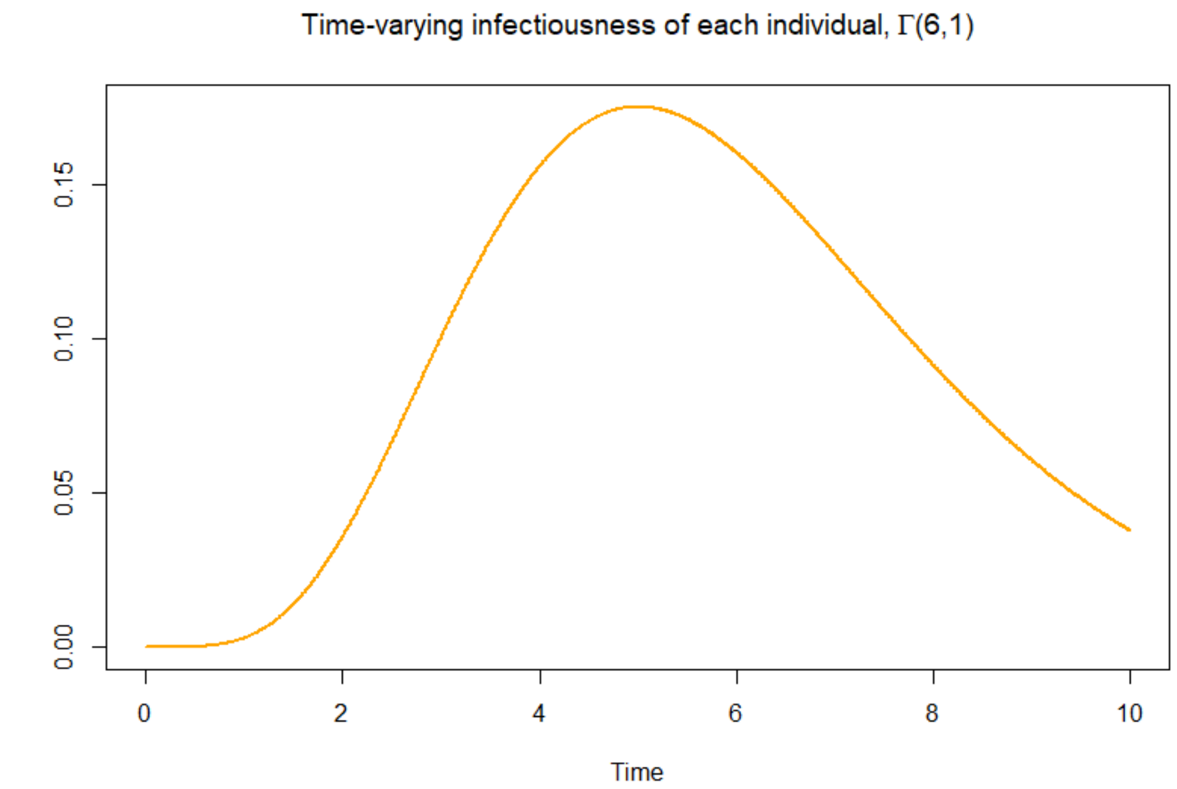
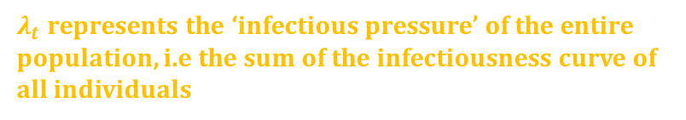
Model
Discrete time model with Branching process characteristics
Unique model characteristic; Time-varying infectivity
$λ_{t}$ represents the ‘infectious pressure’ of the entire population, i.e the sum of the infectiousness curve of all individuals
Notes:
Discrete time model with branching process characteristics (Start with one infected)
Unique model characteristic; Time-varying infectivity
More realistic
R_0 which I think we all know is the average number of additional people each infected subsequently infects in a completely susceptibe population
But the choice of gamma is flexible & not restricted to a gamma distribution . Different variants
With 2 peaks, for example HIV. d
References?

Slide 4
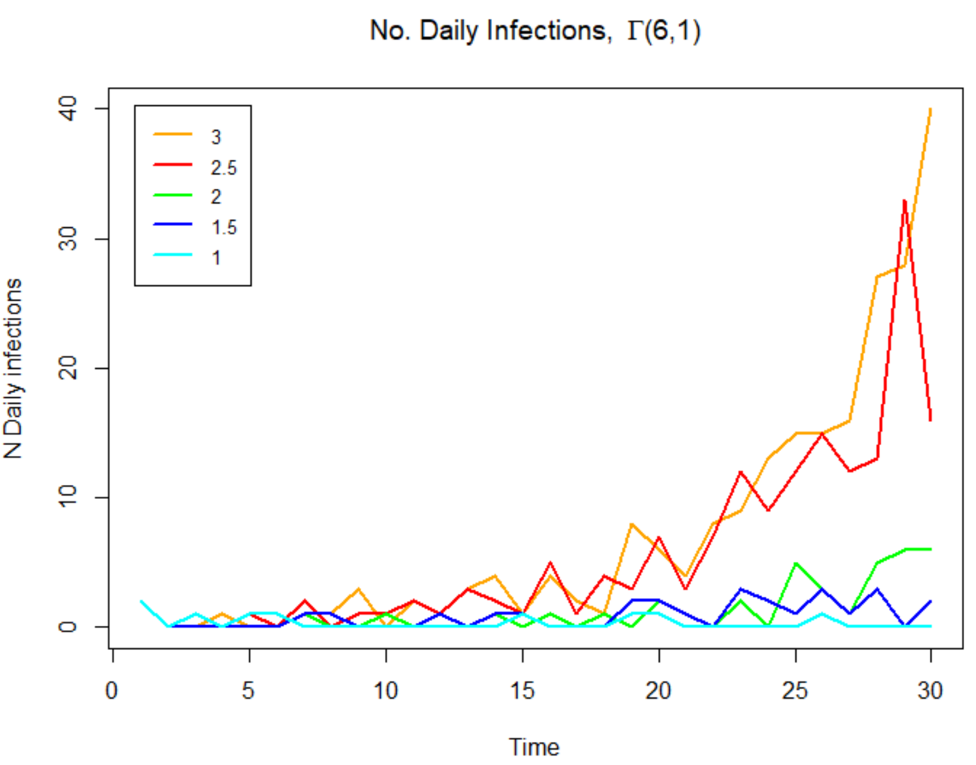
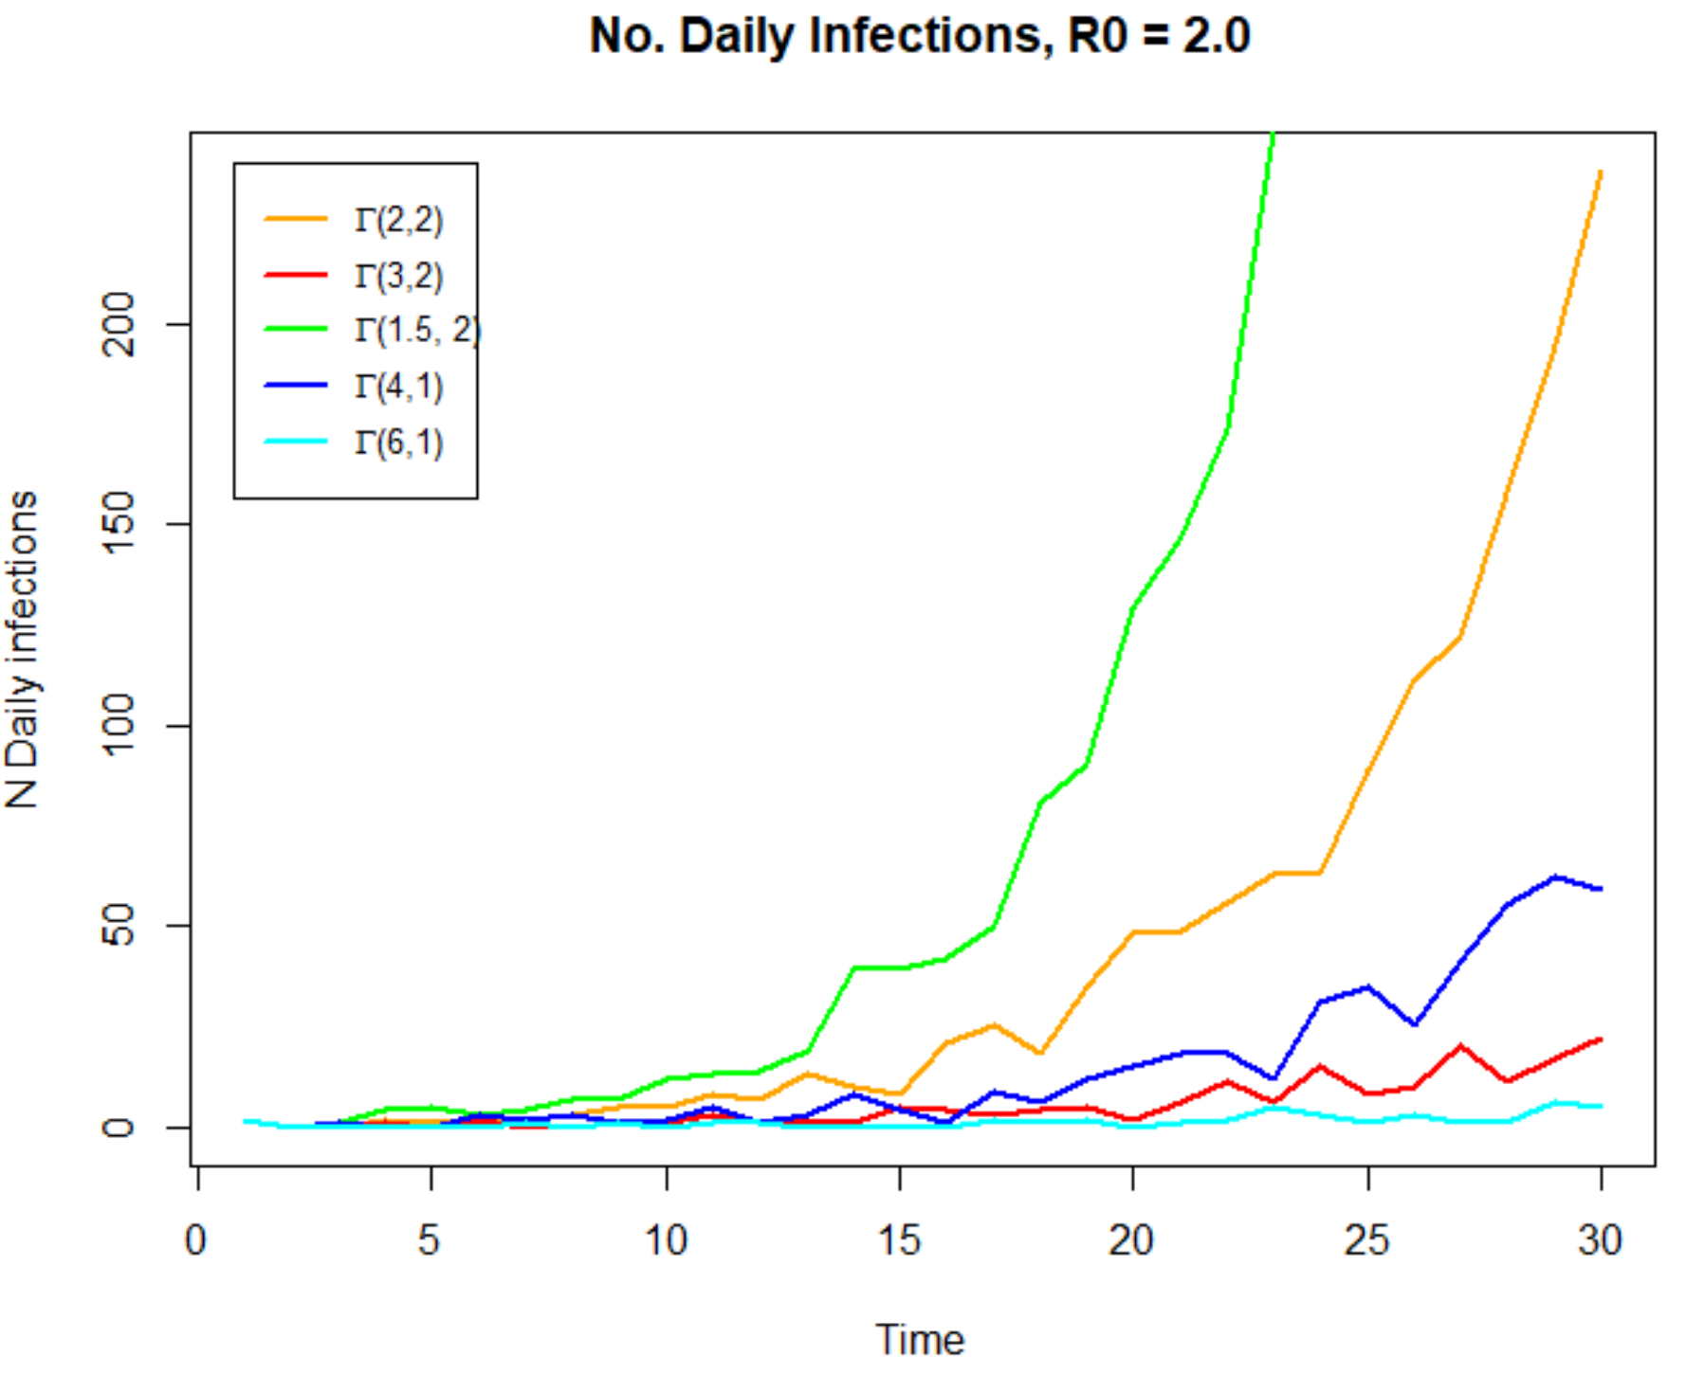
Simulations of Epidemics
Notes:
Mulitple plots!! – Different r0

Slide 5
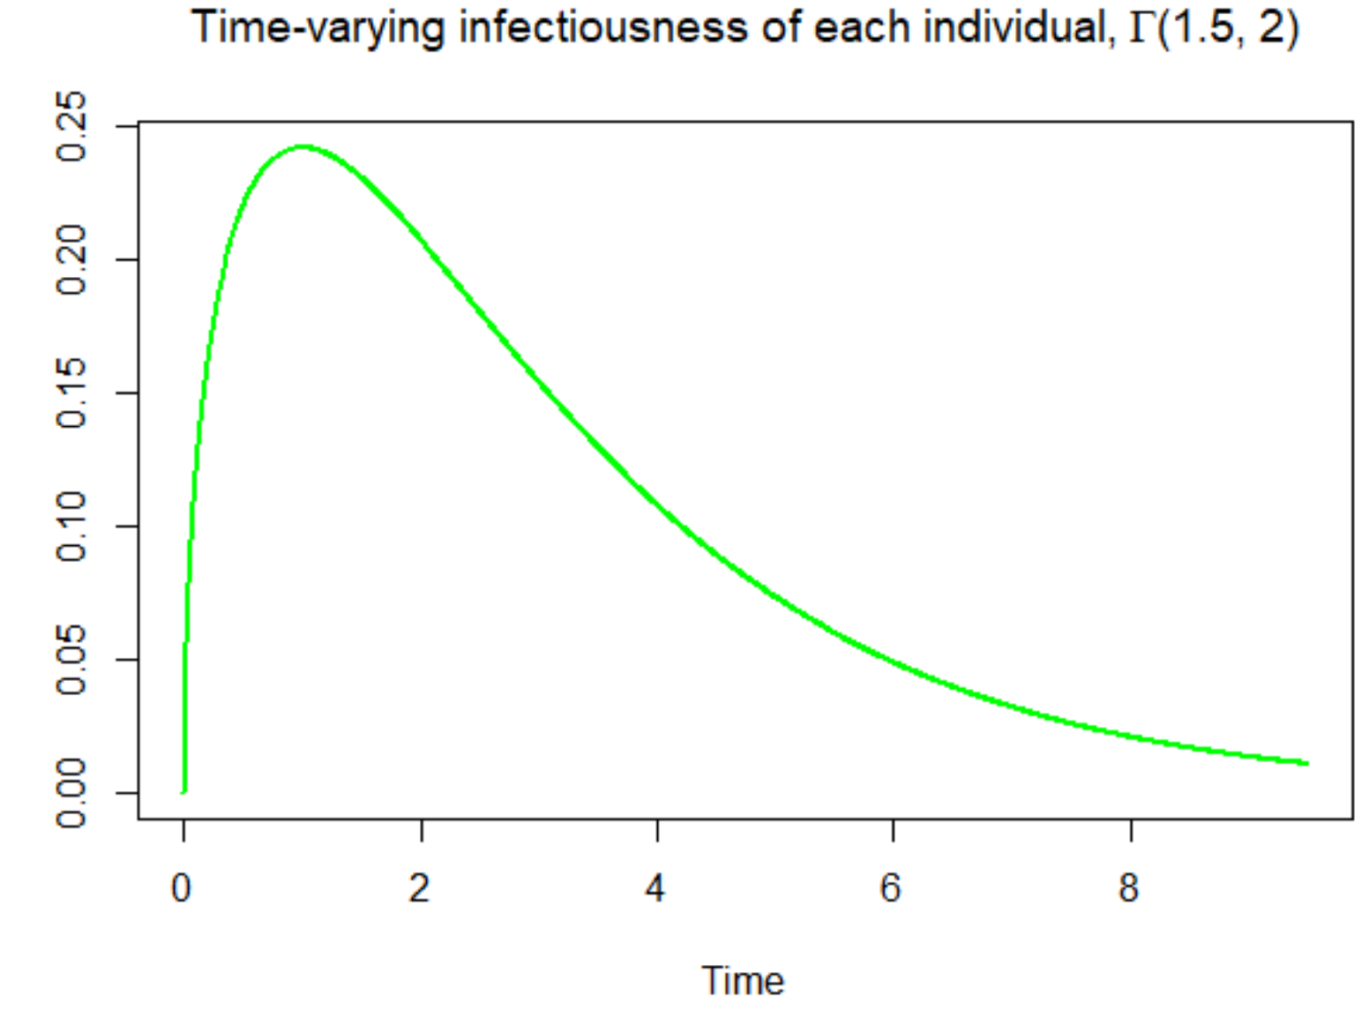
Simulations of Epidemics
Notes:
Mulitple plots!! – Different r0

Slide 6
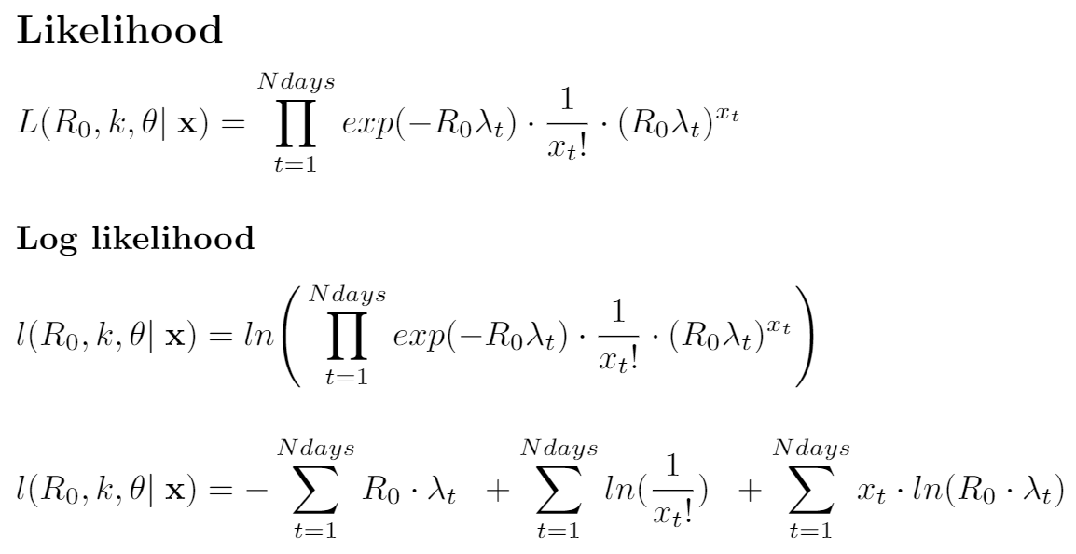
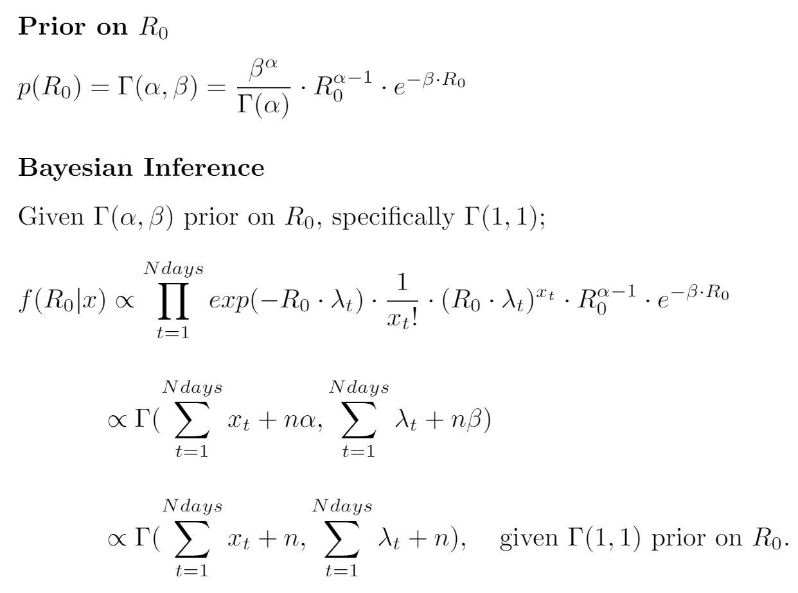
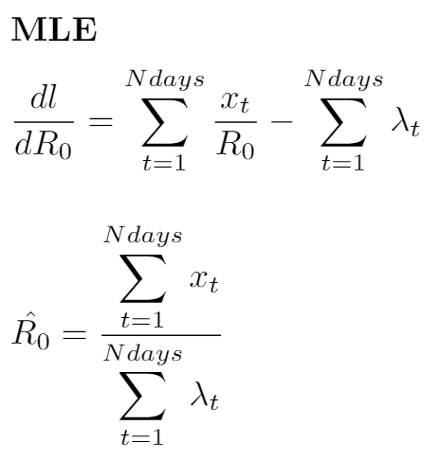
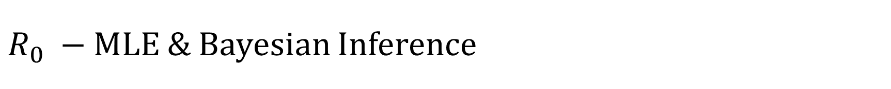
$R_{0} −$MLE & Bayesian Inference
Closed form
Analytical solution available
Notes:
Analytical solution.
Closed form solution to the posterior given the poisson-gamma conjugacy.
Shape

Slide 7
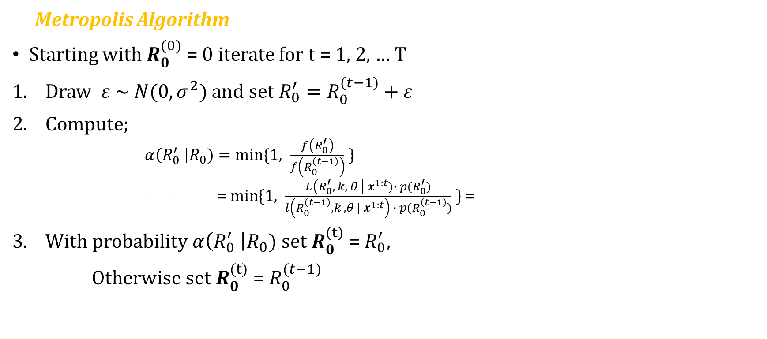
MCMC Inference for $R_{0}$
Metropolis Algorithm
Starting with $R_{0}^{(0)}$ = 0 iterate for t = 1, 2, … T
Draw $ε \sim N(0, σ^{2})$ and set $R_{0}^{′}=R_{0}^{(t−1)}+ε$
Compute;
$α\left(R_{0}^{′} \right|R_{0})=min⁡\{1, \frac{f\left(R_{0}^{′}\right)}{f\left(R_{0}^{\left(t−1\right)}\right)} \}$
$α\left(R_{0}^{′} \right|R_{0})$= $min⁡\{1, \frac{L\left(R_{0}^{′}, k, θ \right| x^{1:t})∙ p(R_{0}^{′})}{l\left(R_{0}^{\left(t−1\right)}, k , θ | x^{1:t}\right) ∙ p(R_{0}^{\left(t−1\right)})} \}$ =
With probability $α\left(R_{0}^{′} \right|R_{0})$ set $R_{0}^{(t)}$ = $R_{0}^{′}$,
Otherwise set $R_{0}^{(t)}$ = $R_{0}^{(t−1)}$
Notes:
So looking at the MCMC scheme for R0, i.e the Metropolis alg.
Simply a computational exercise as we have
And this is merly just a comp. exercise given that we have an analytical solution for R0 already
Set up for the more complicated models

Slide 8
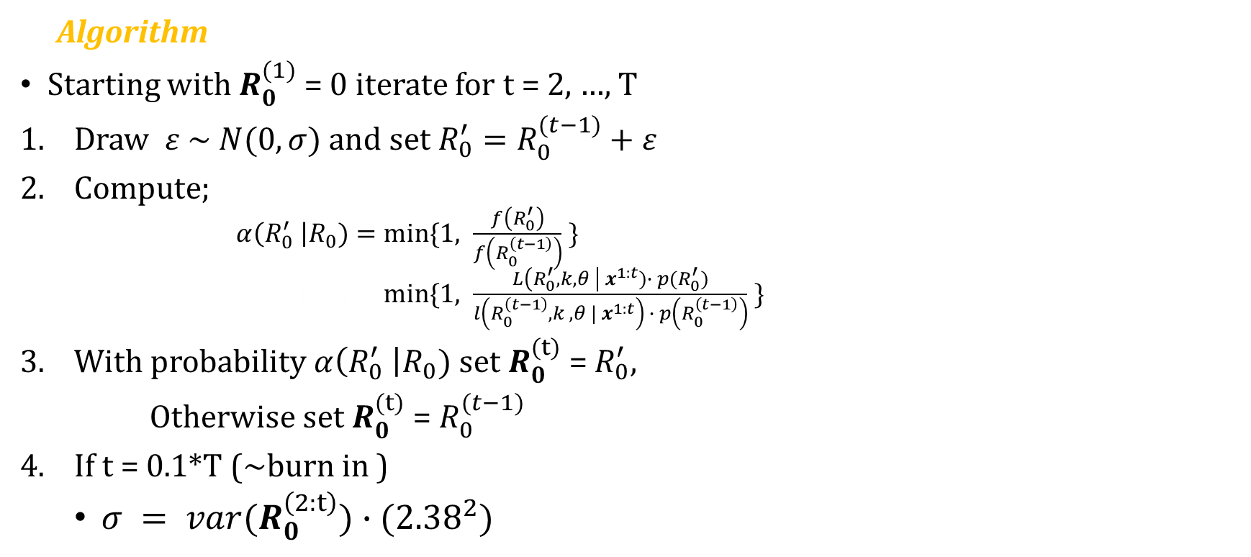
Simple Adaptive Monte Carlo
Algorithm
Starting with $R_{0}^{(1)}$ = 0 iterate for t = 2, …, T
Draw $ε \sim N(0,σ)$ and set $R_{0}^{′}=R_{0}^{(t−1)}+ε$
Compute;
$α\left(R_{0}^{′} \right|R_{0})=min⁡\{1, \frac{f\left(R_{0}^{′}\right)}{f\left(R_{0}^{\left(t−1\right)}\right)} \}$
$α\left(R_{0}^{′} \right|R_{0})=min⁡\{1, \frac{L\left(R_{0}^{′}, k, θ \right| x^{1:t})∙ p(R_{0}^{′})}{l\left(R_{0}^{\left(t−1\right)}, k , θ | x^{1:t}\right) ∙ p\left(R_{0}^{\left(t−1\right)}\right)} \}$
With probability $α\left(R_{0}^{′} \right|R_{0})$ set $R_{0}^{(t)}$ = $R_{0}^{′}$,
Otherwise set $R_{0}^{(t)}$ = $R_{0}^{(t−1)}$
If t = 0.1*T (~burn in )
$σ = var(R_{0}^{\left(2:t\right)})∙({2.38}^{2})$
Notes:
Simple

Slide 9
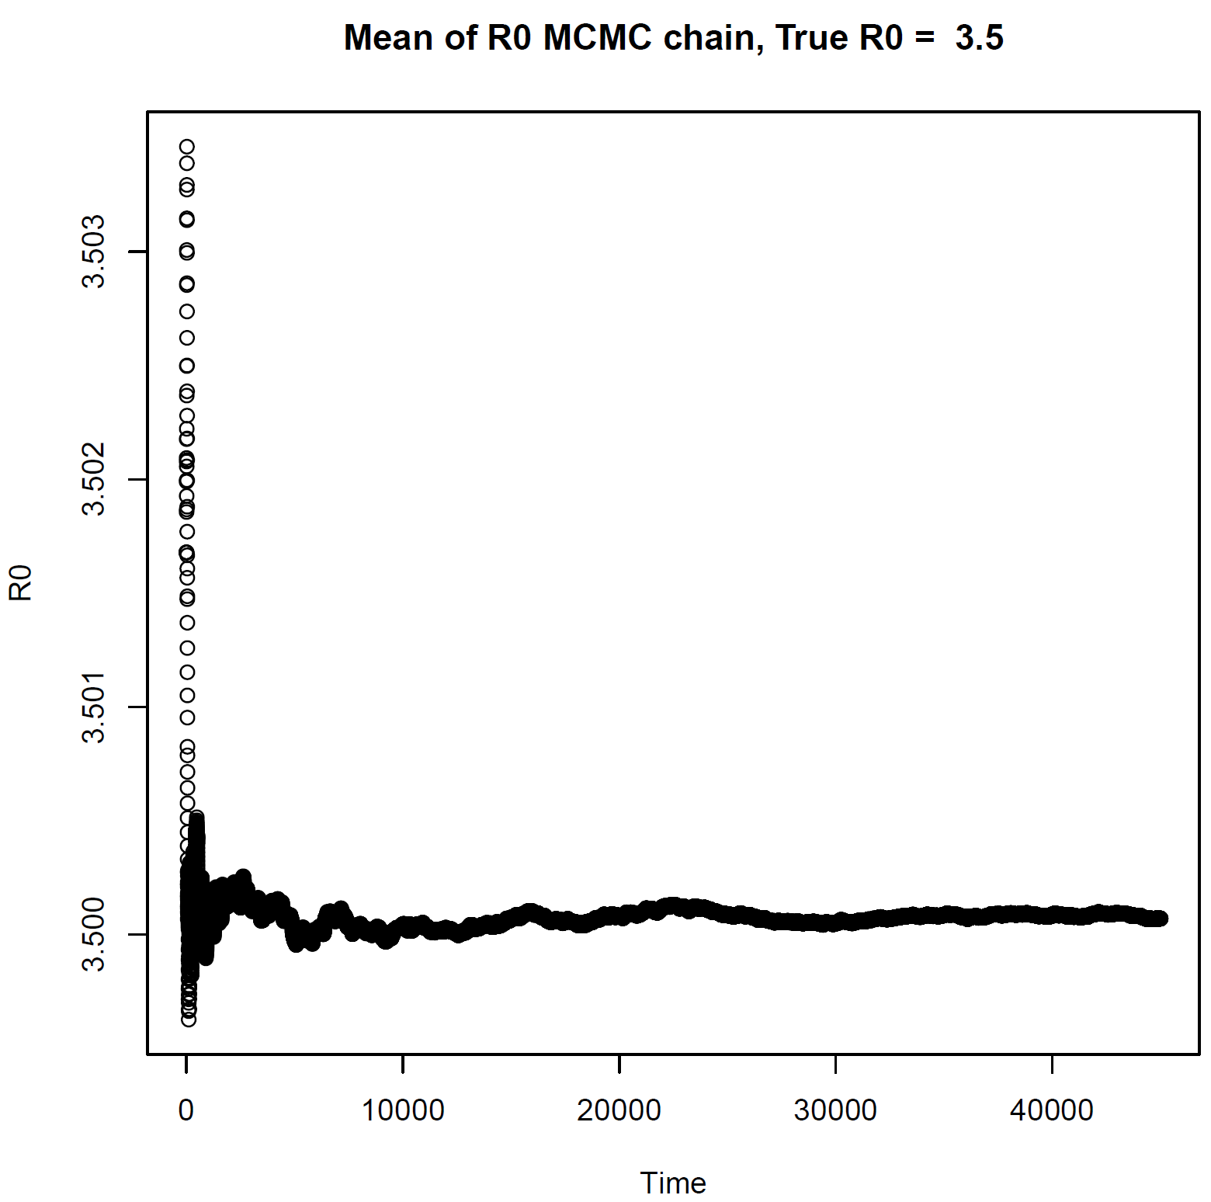
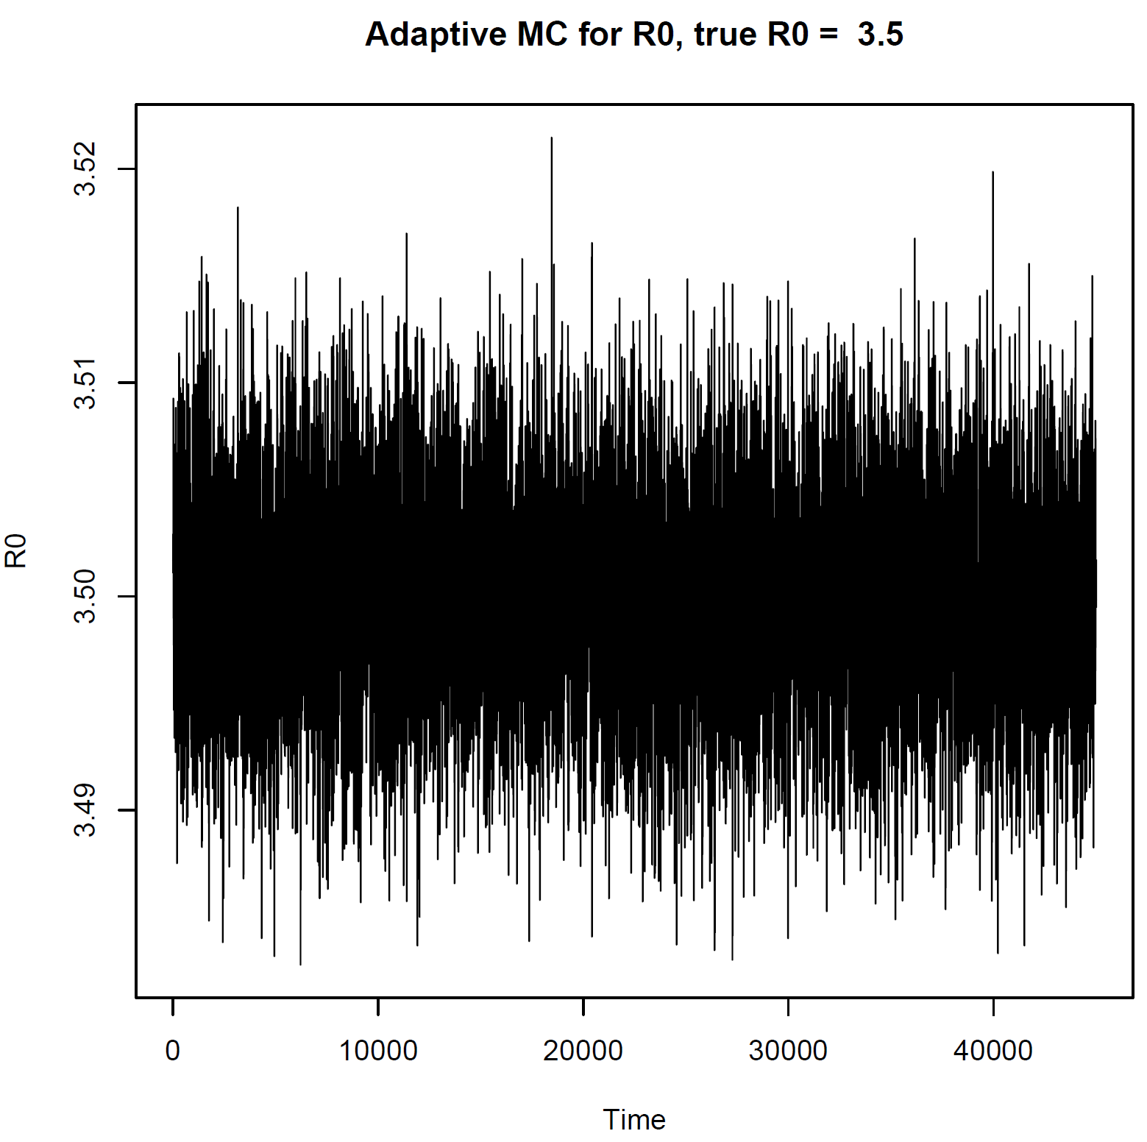
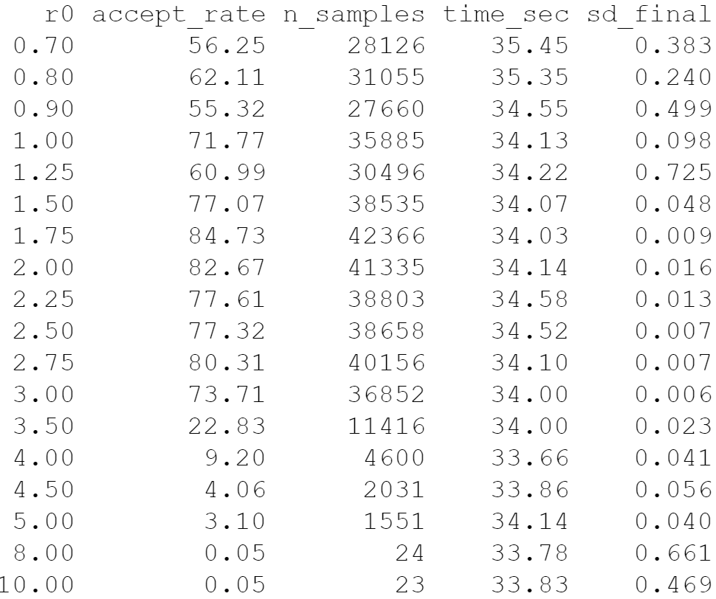
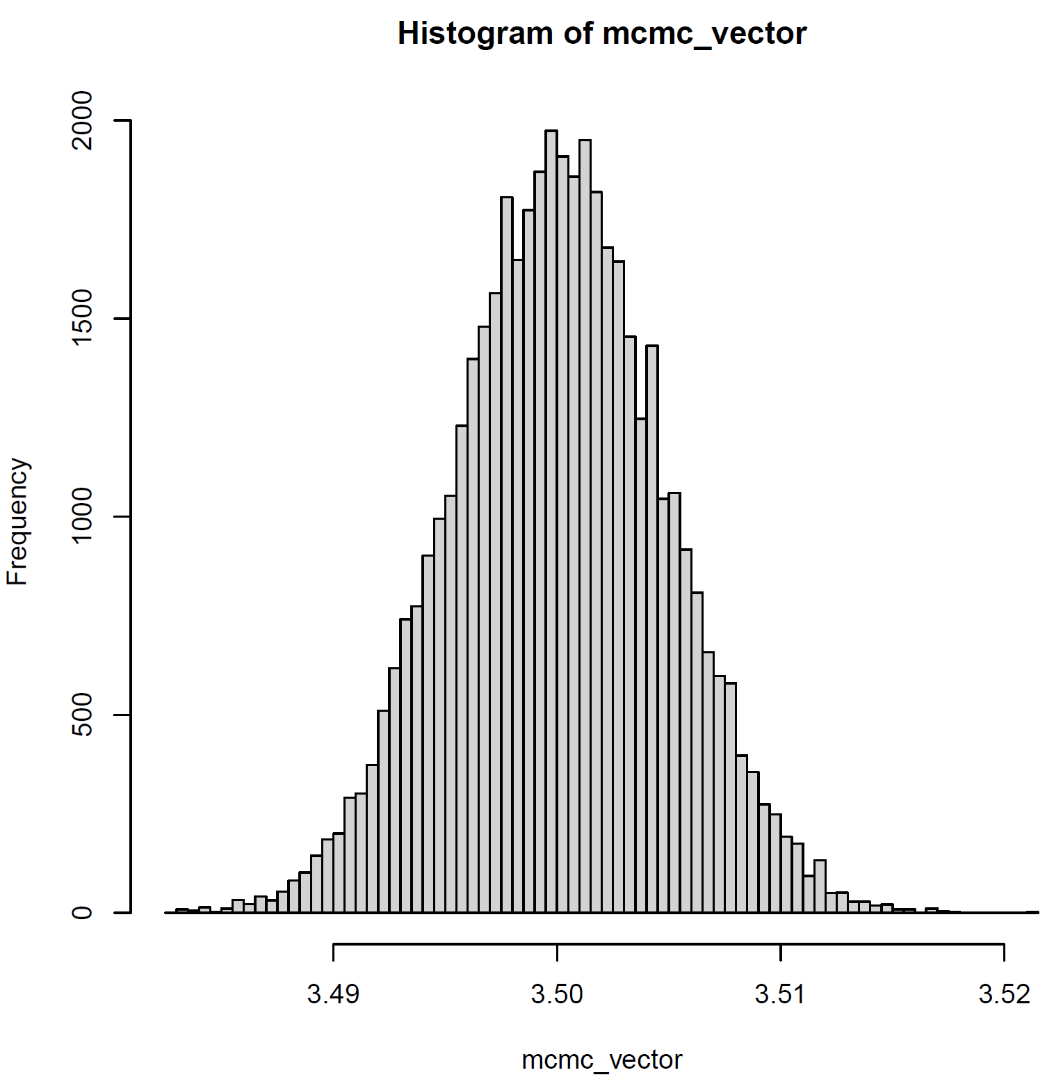

Results - Adaptive Monte Carlo
$R_{0}$ of simulated data = 3.5
Notes:
Results
Trace. Nice trace – exploring the space.

Slide 10
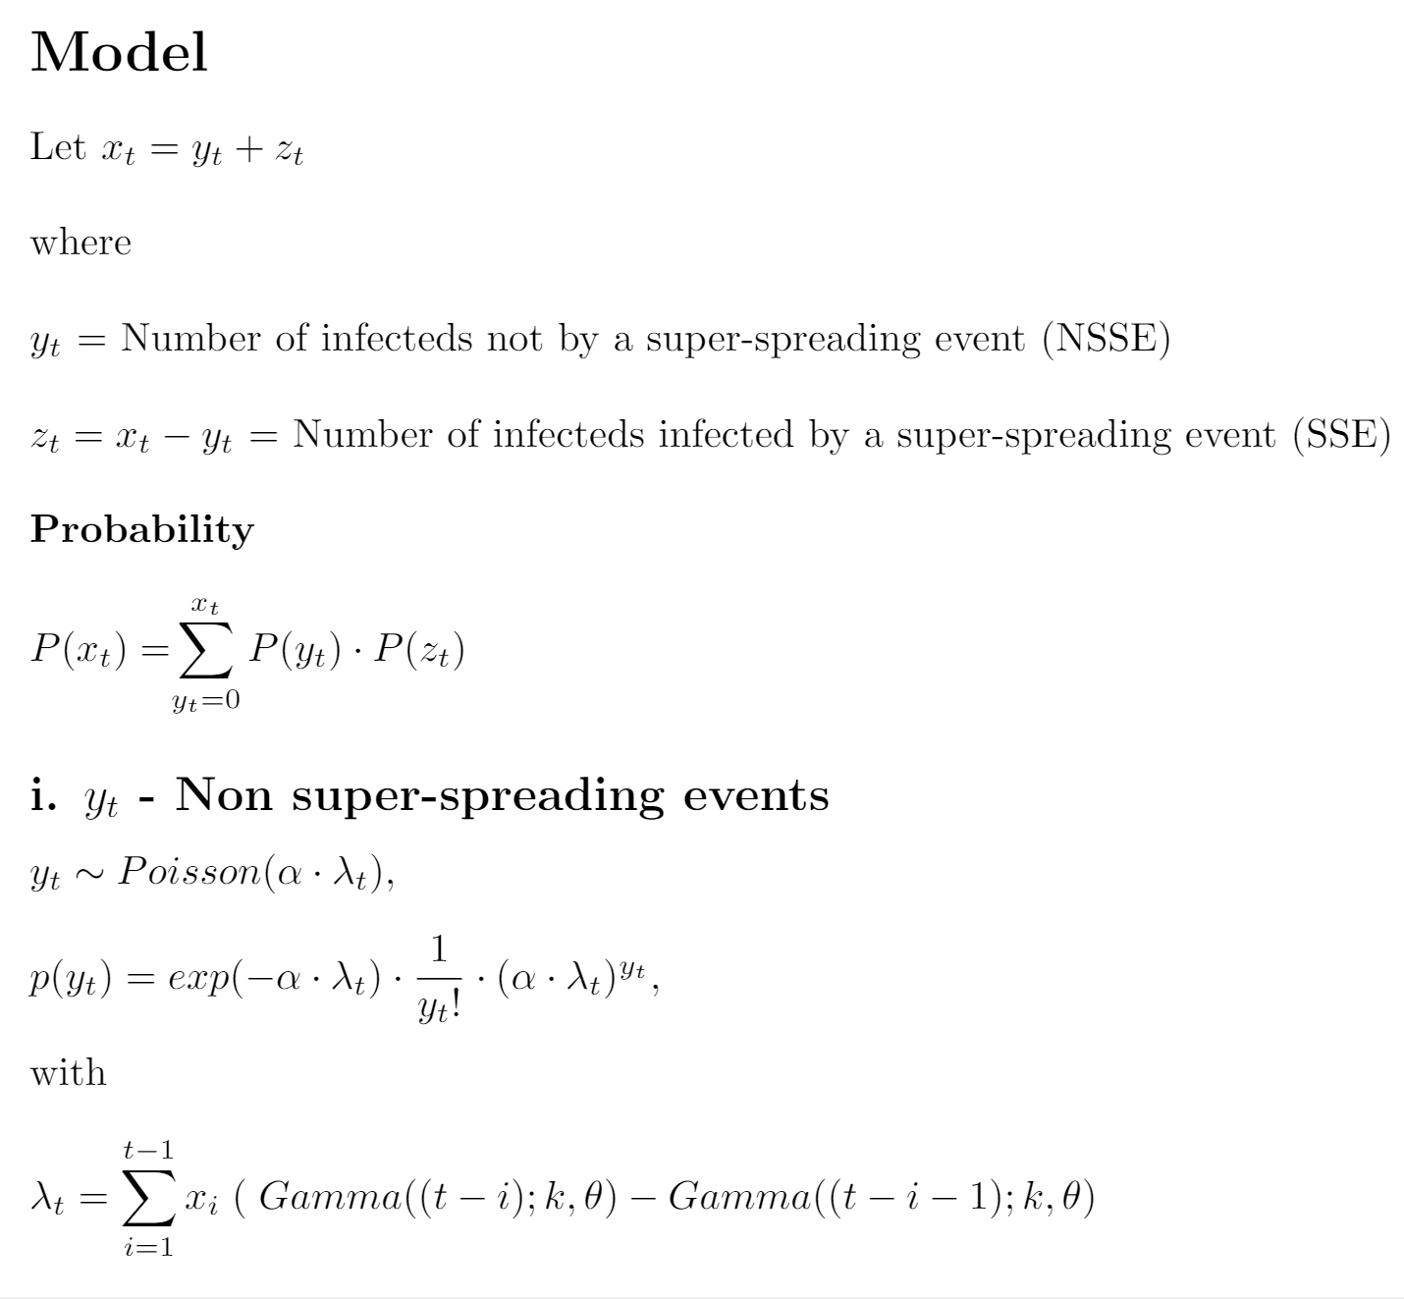
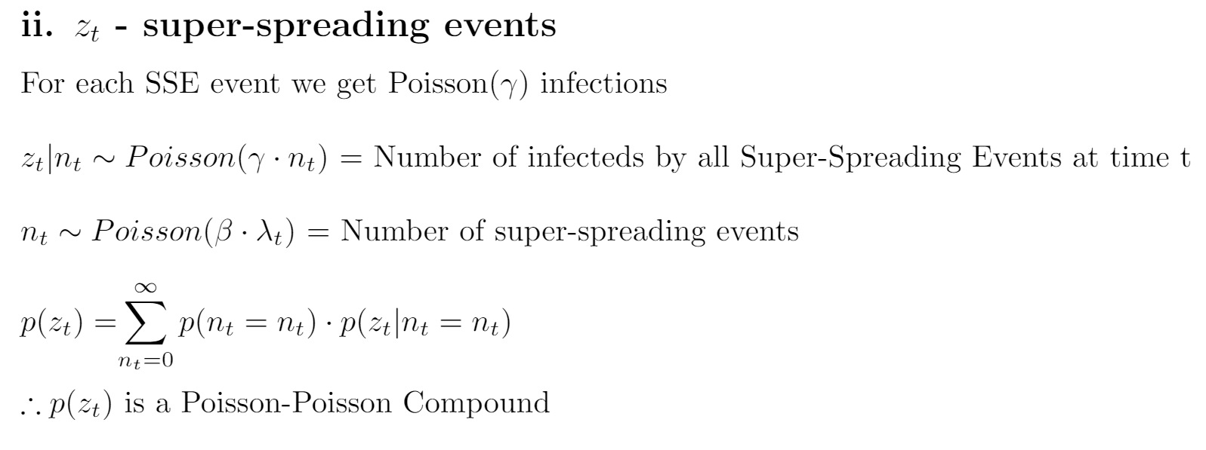
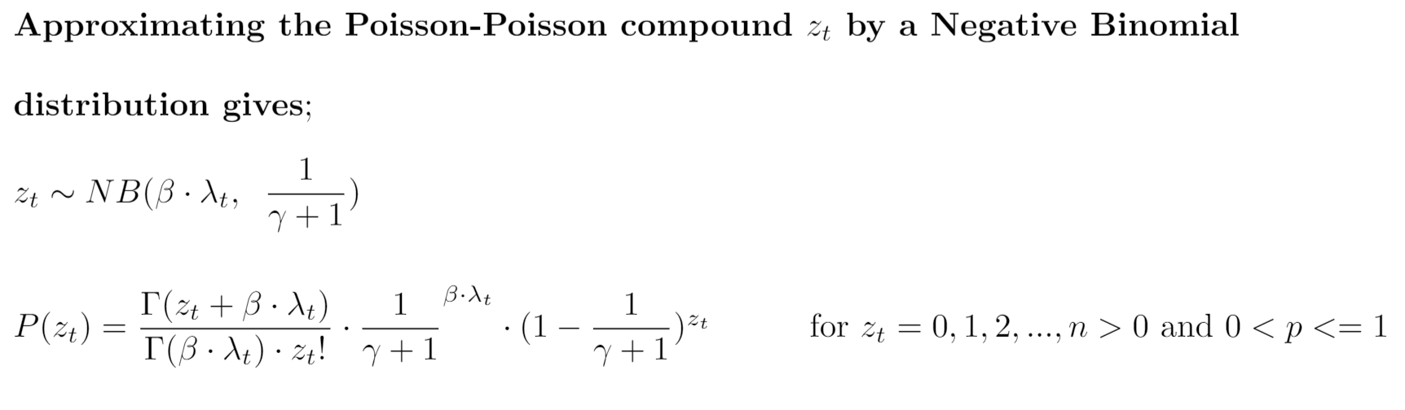
Super-Spreading Events Model
Notes:
SS as before
Replaced r0 with alpha
Prop to num of infections
Neyman type A

Slide 11
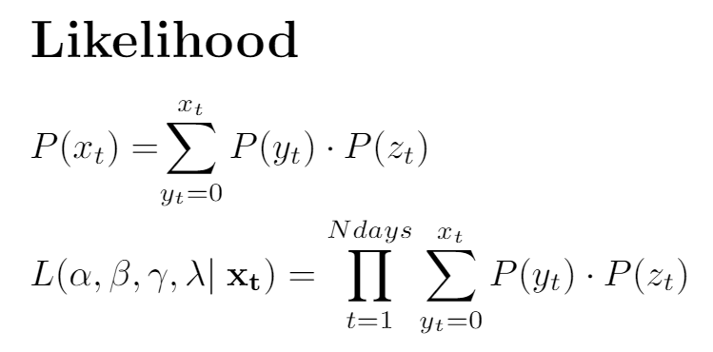
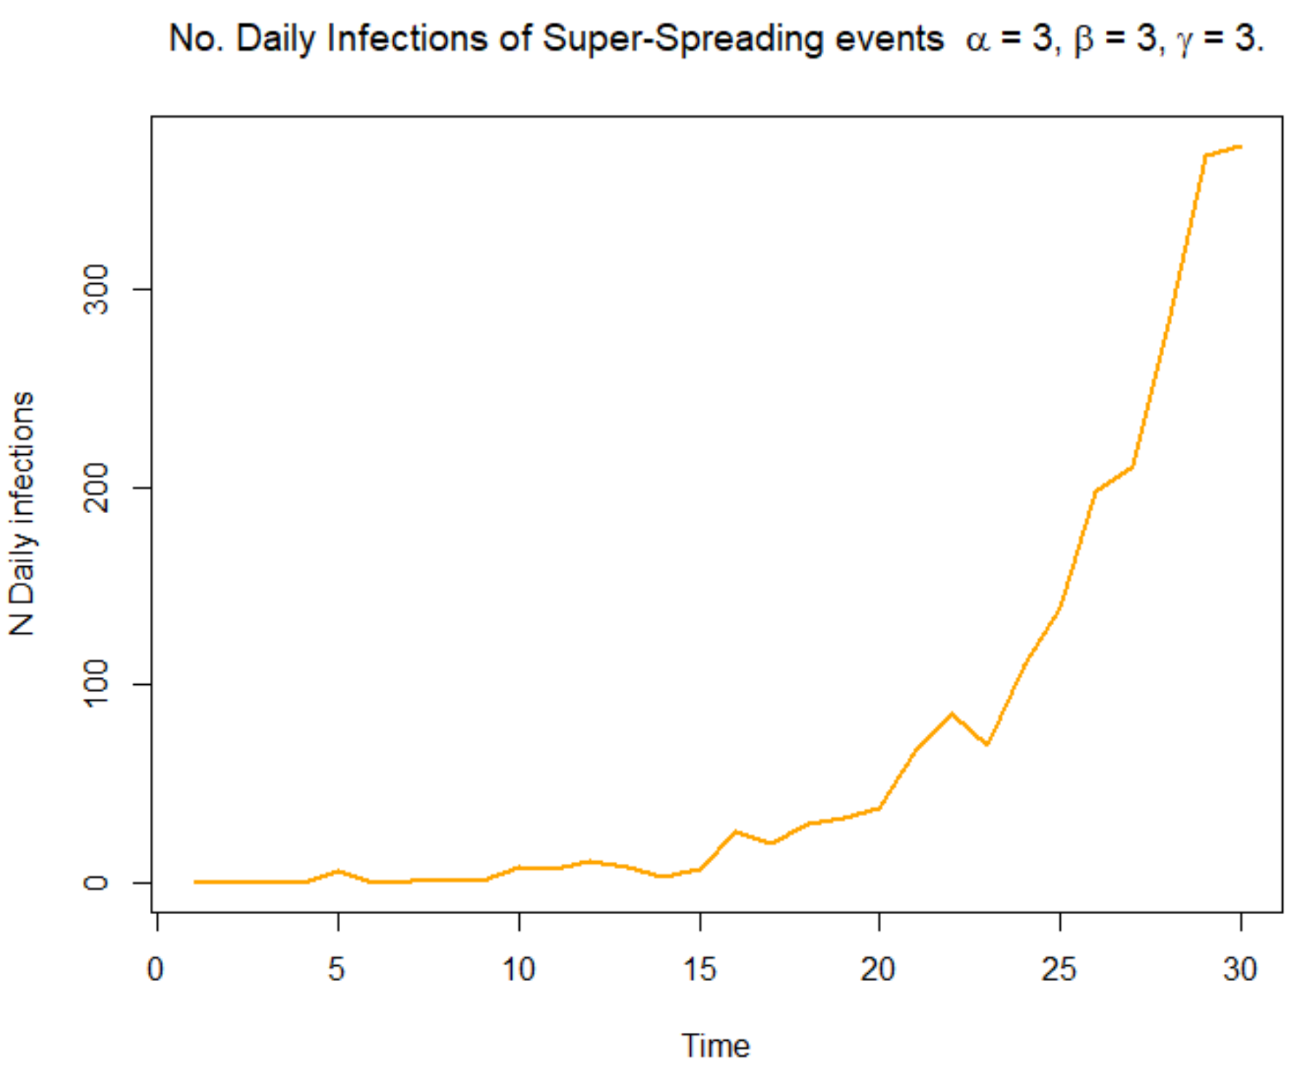
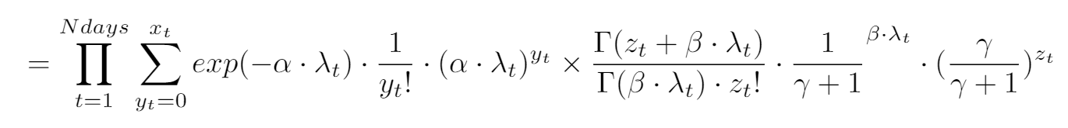
Super-Spreading Events Model
Notes:
SS – orange, a, b, r0??
See the numbers jump up

Slide 12
Future Directions
Super-spreading events model
Investigate effect of model parameters on pandemic
Infer model parameters via MCMC
Super-spreading individuals
Model Checking, Influence & Diagnostics
Influence of individual events & individuals
Influence of time within epidemic on data & model
Importance sampling – reweight posterior with point removed
Integration with Data
Contract tracing data (inc super-spreading events)
Spatial data
*Lau, Max SY, et al. "New model diagnostics for spatio-temporal systems in epidemiology and ecology." Journal of The Royal Society Interface 11.93 (2014): 20131093.
Notes:
**Reference papers
As before
Regression
Reweighing posterior
Latent residuals

Slide 13
Thank you for listening.

