Slide 1
Bayesian Epidemic Modelling
Hannah Craddock
Supervisors: Dr Simon Spencer, Prof Xavier Didelot
Date: Wednesday October 20th 2021

Slide 2
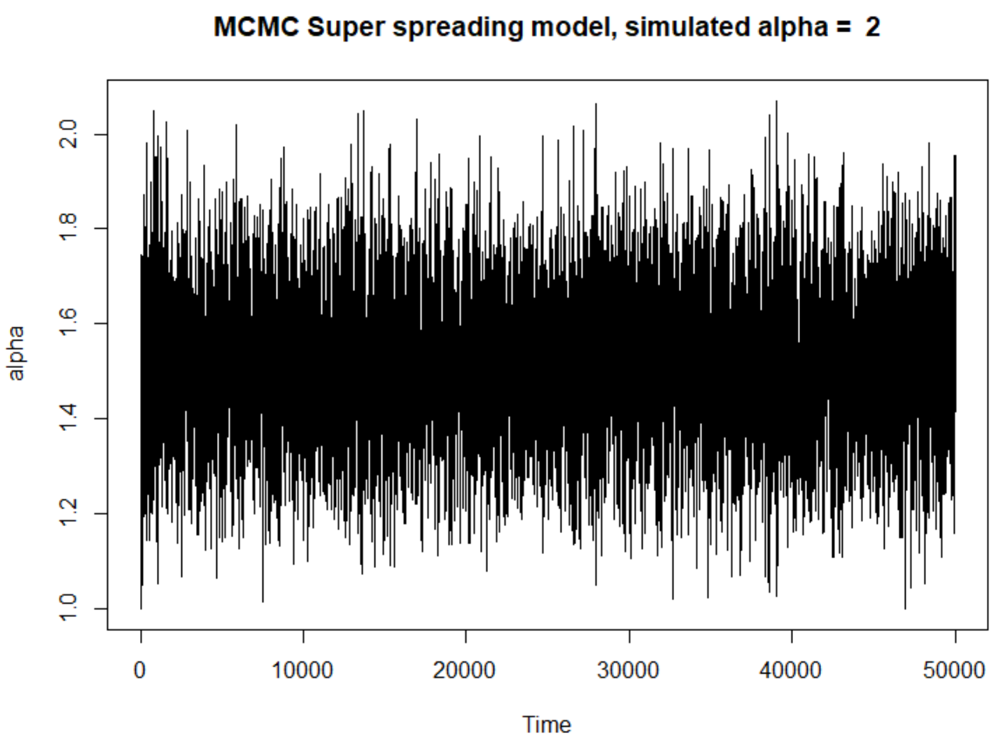
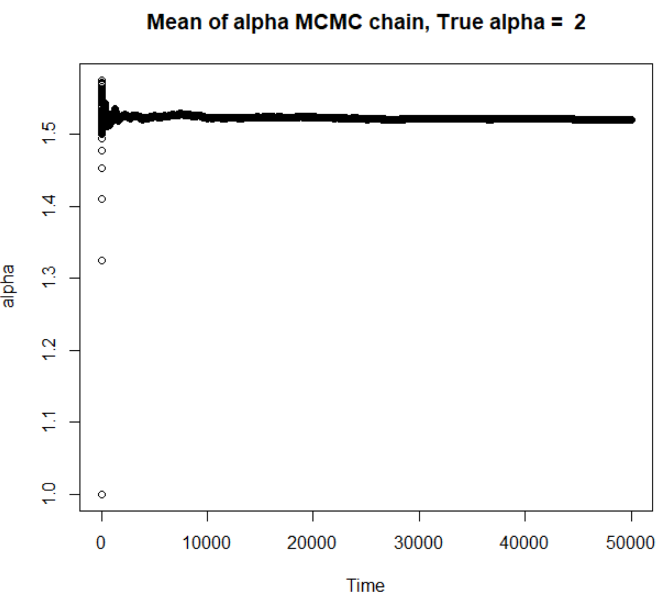
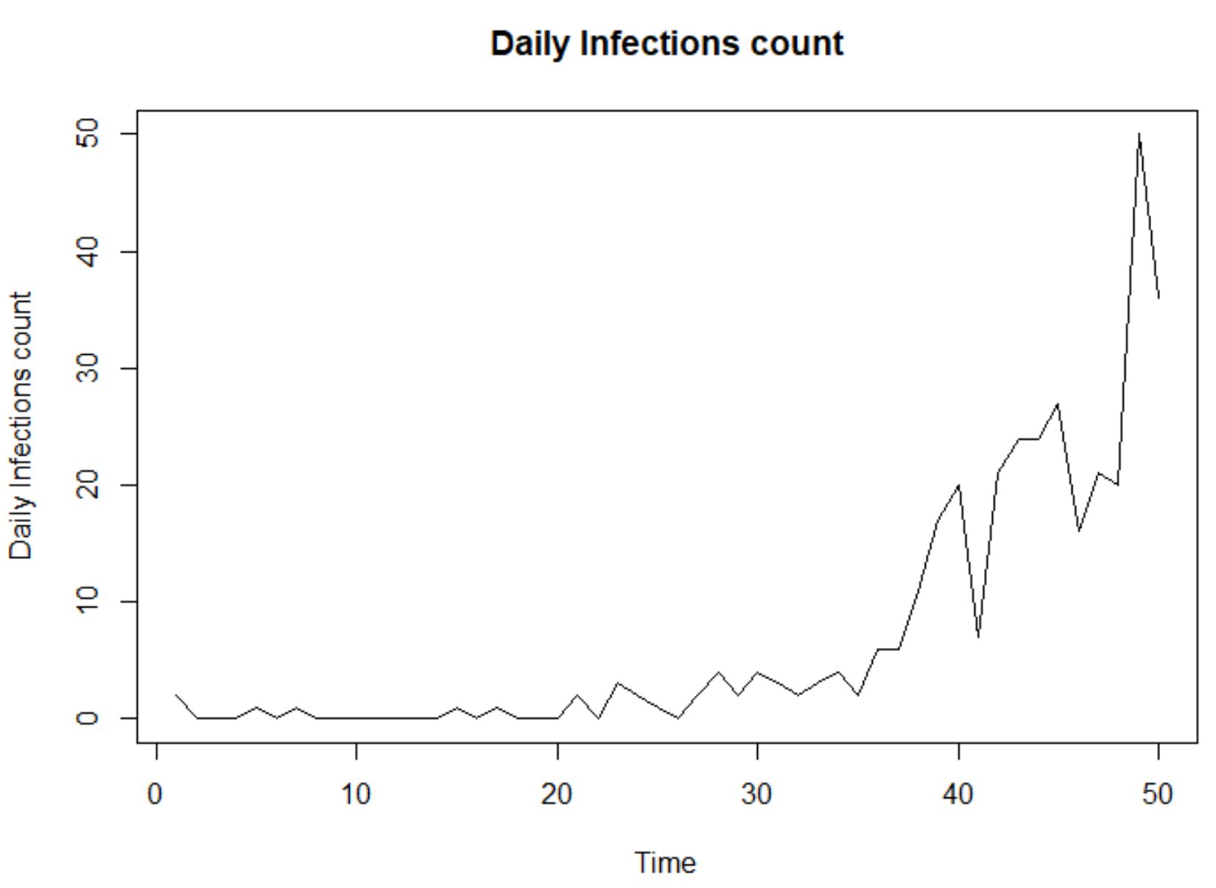
Results – MCMC S. Spreading (Single parameter)
α; mcmc sample
γ = 10, β = 0.05 (constants)

Slide 3
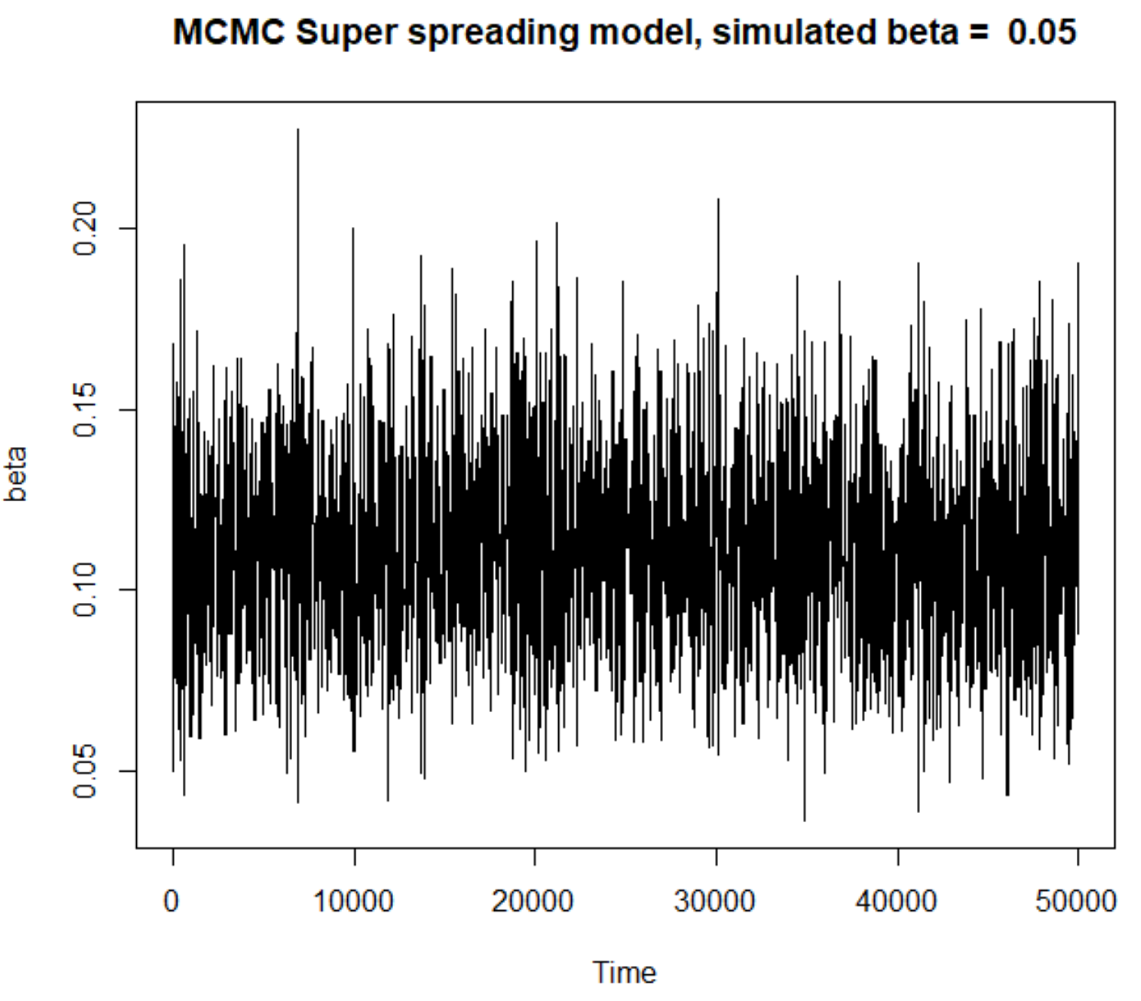
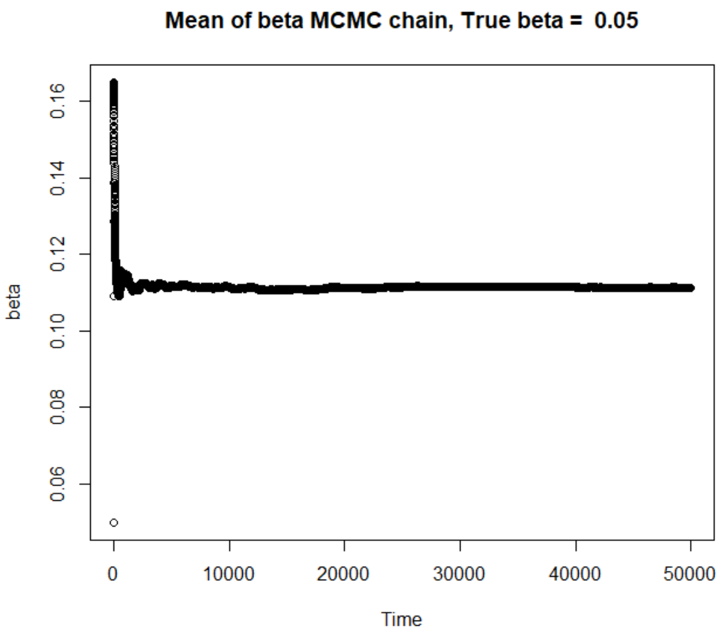
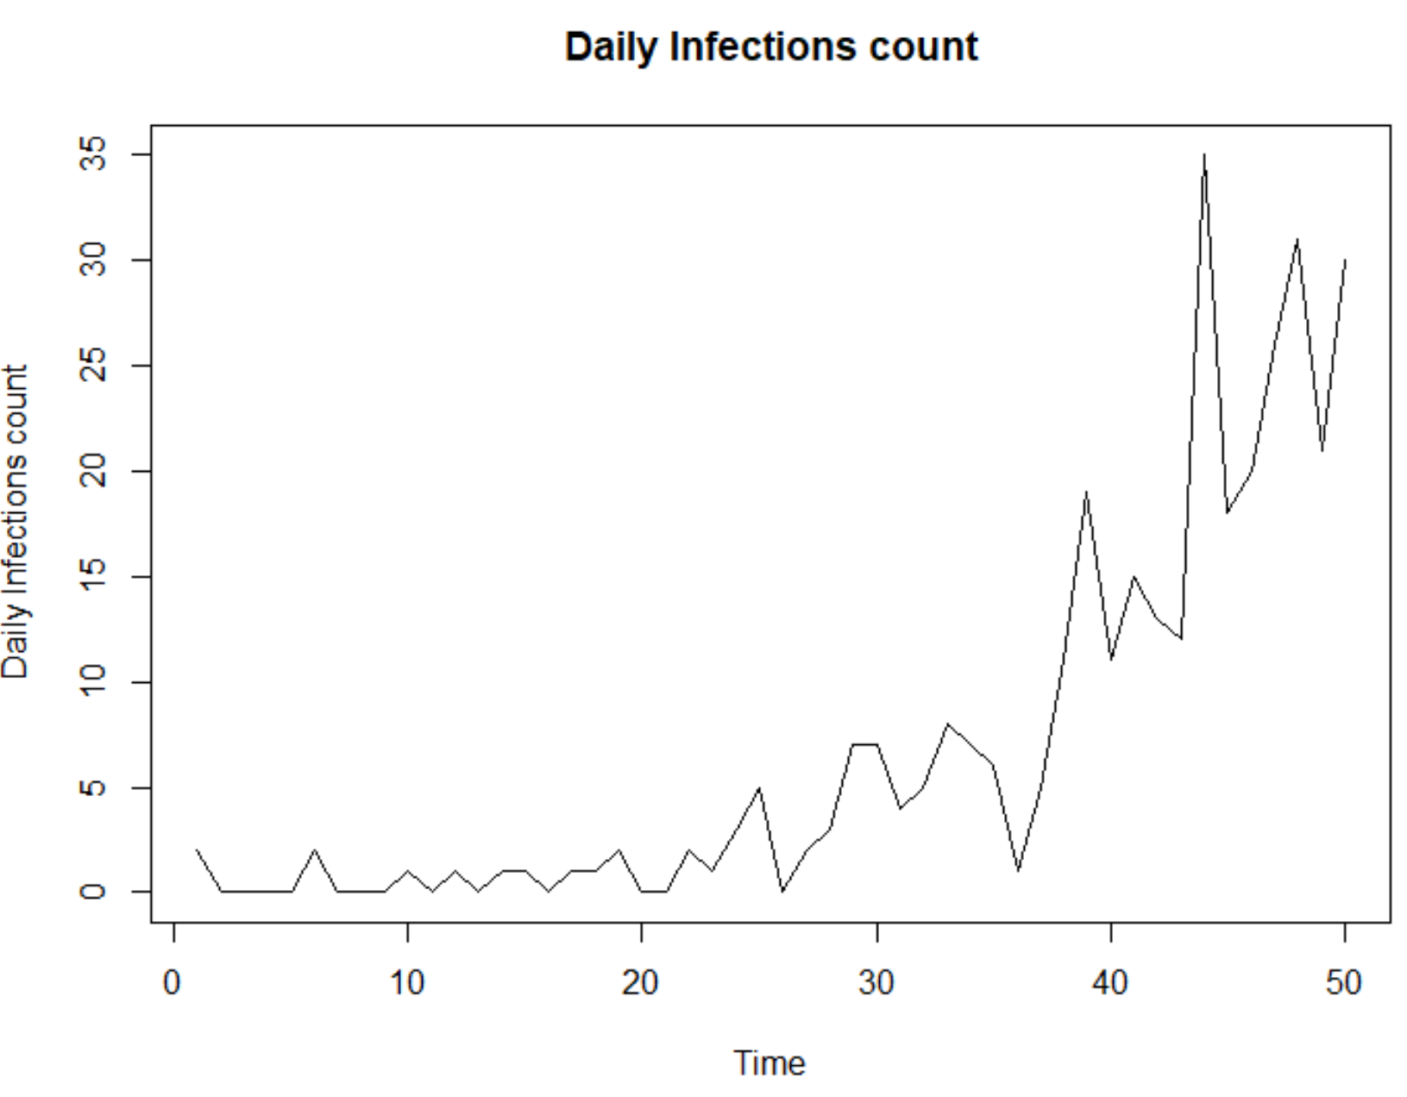
Results – MCMC S. Spreading (Single parameter)
β; mcmc sample
α = 2, γ = 10 (constants)

Slide 4
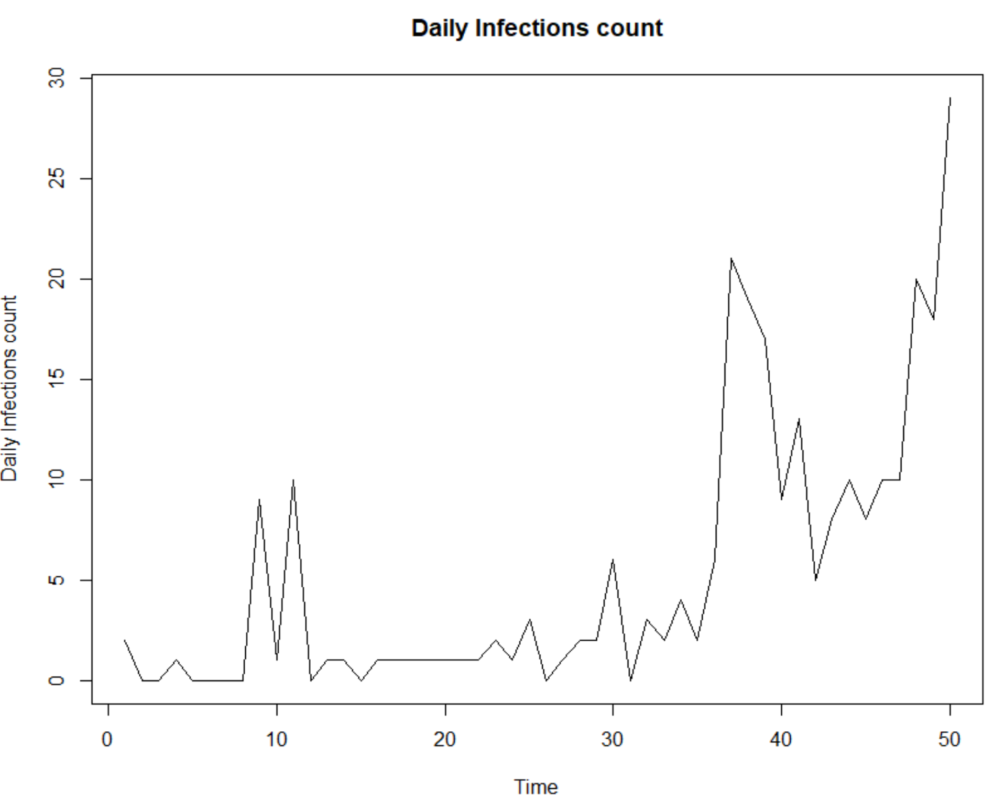
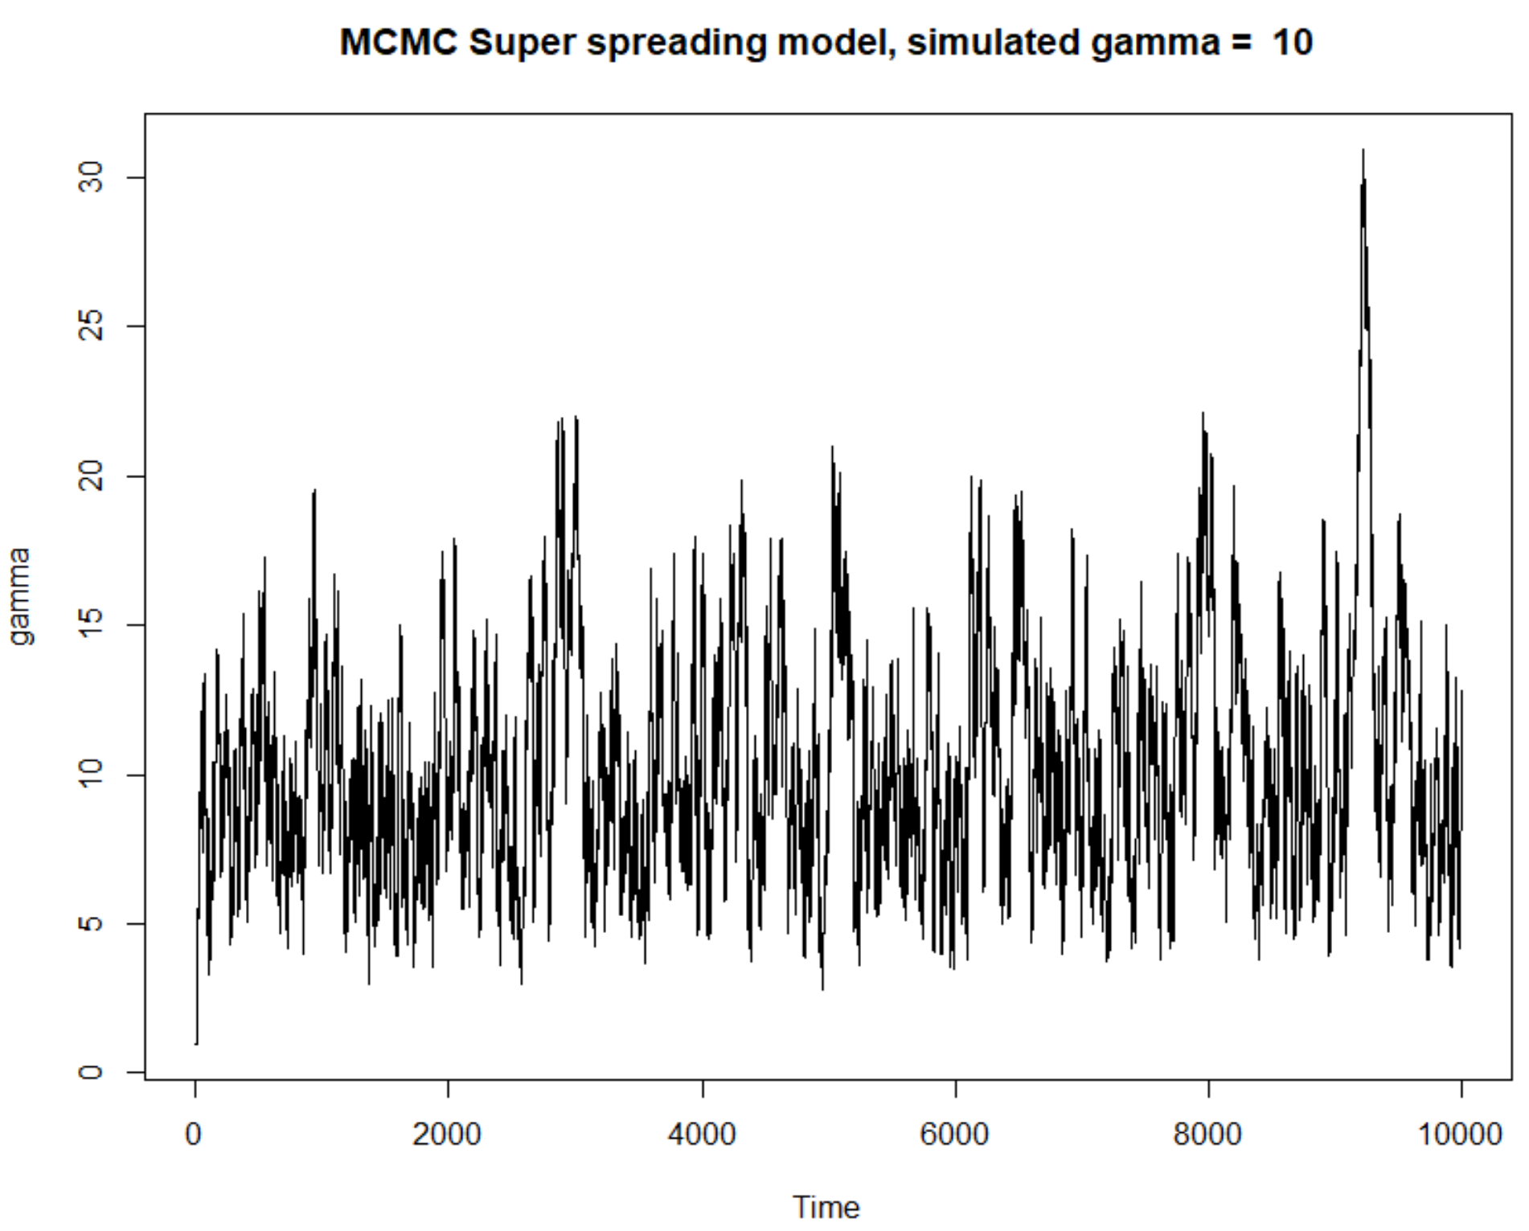
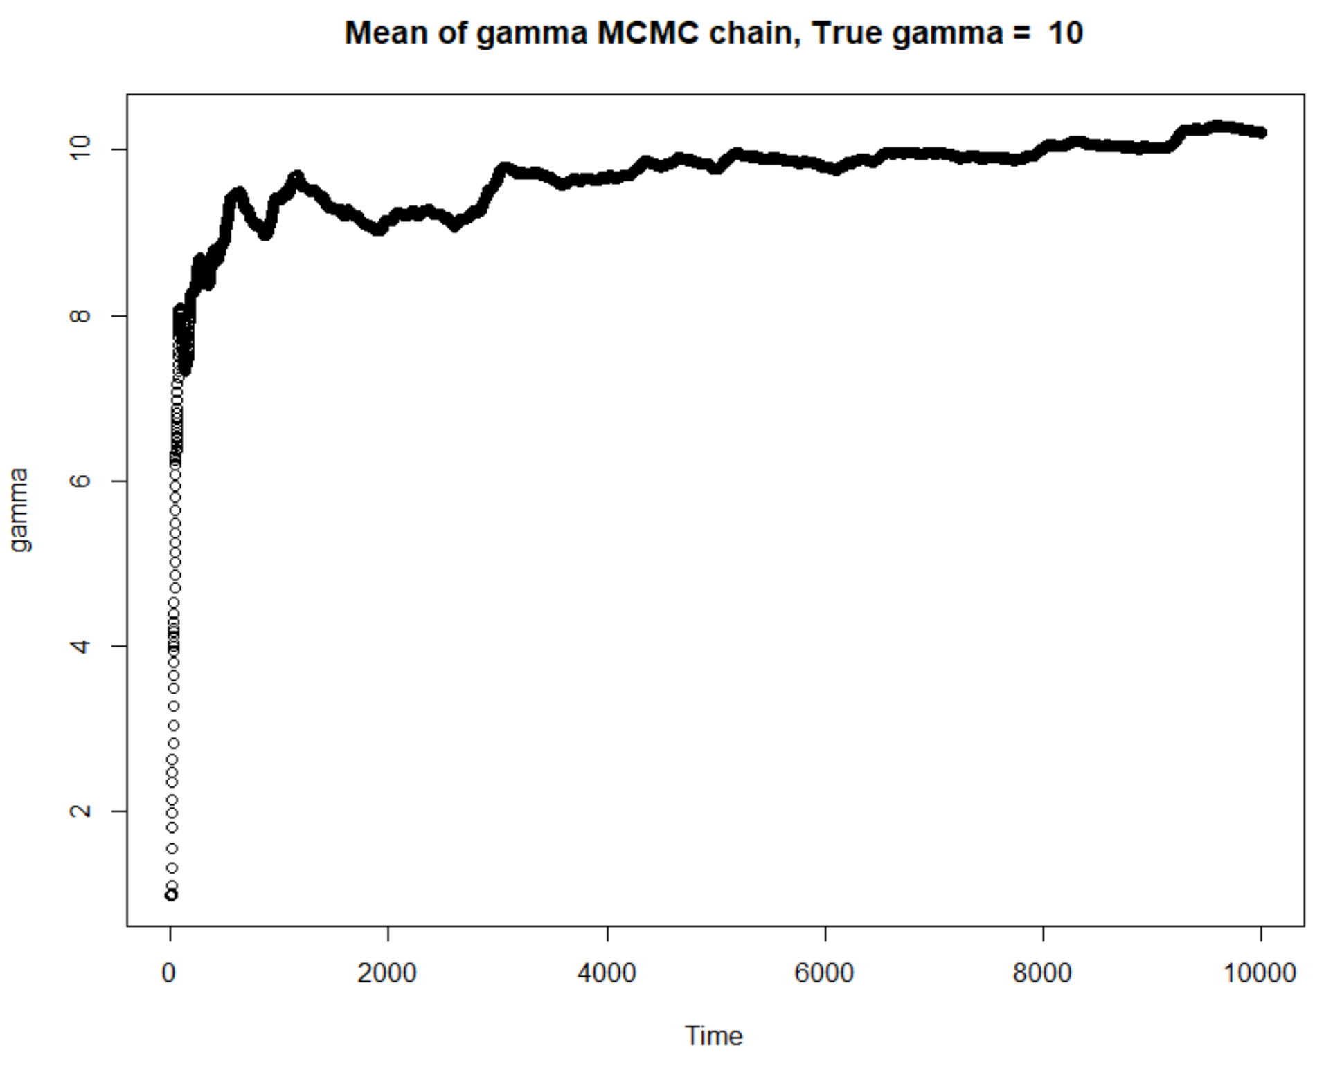
Results – MCMC S. Spreading (Single parameter)
γ; mcmc sample
α = 2, β = 0.05 (constants)

Slide 5
Comparison; Original likelihood + R package functions (dnbinom, dpois)

Slide 6
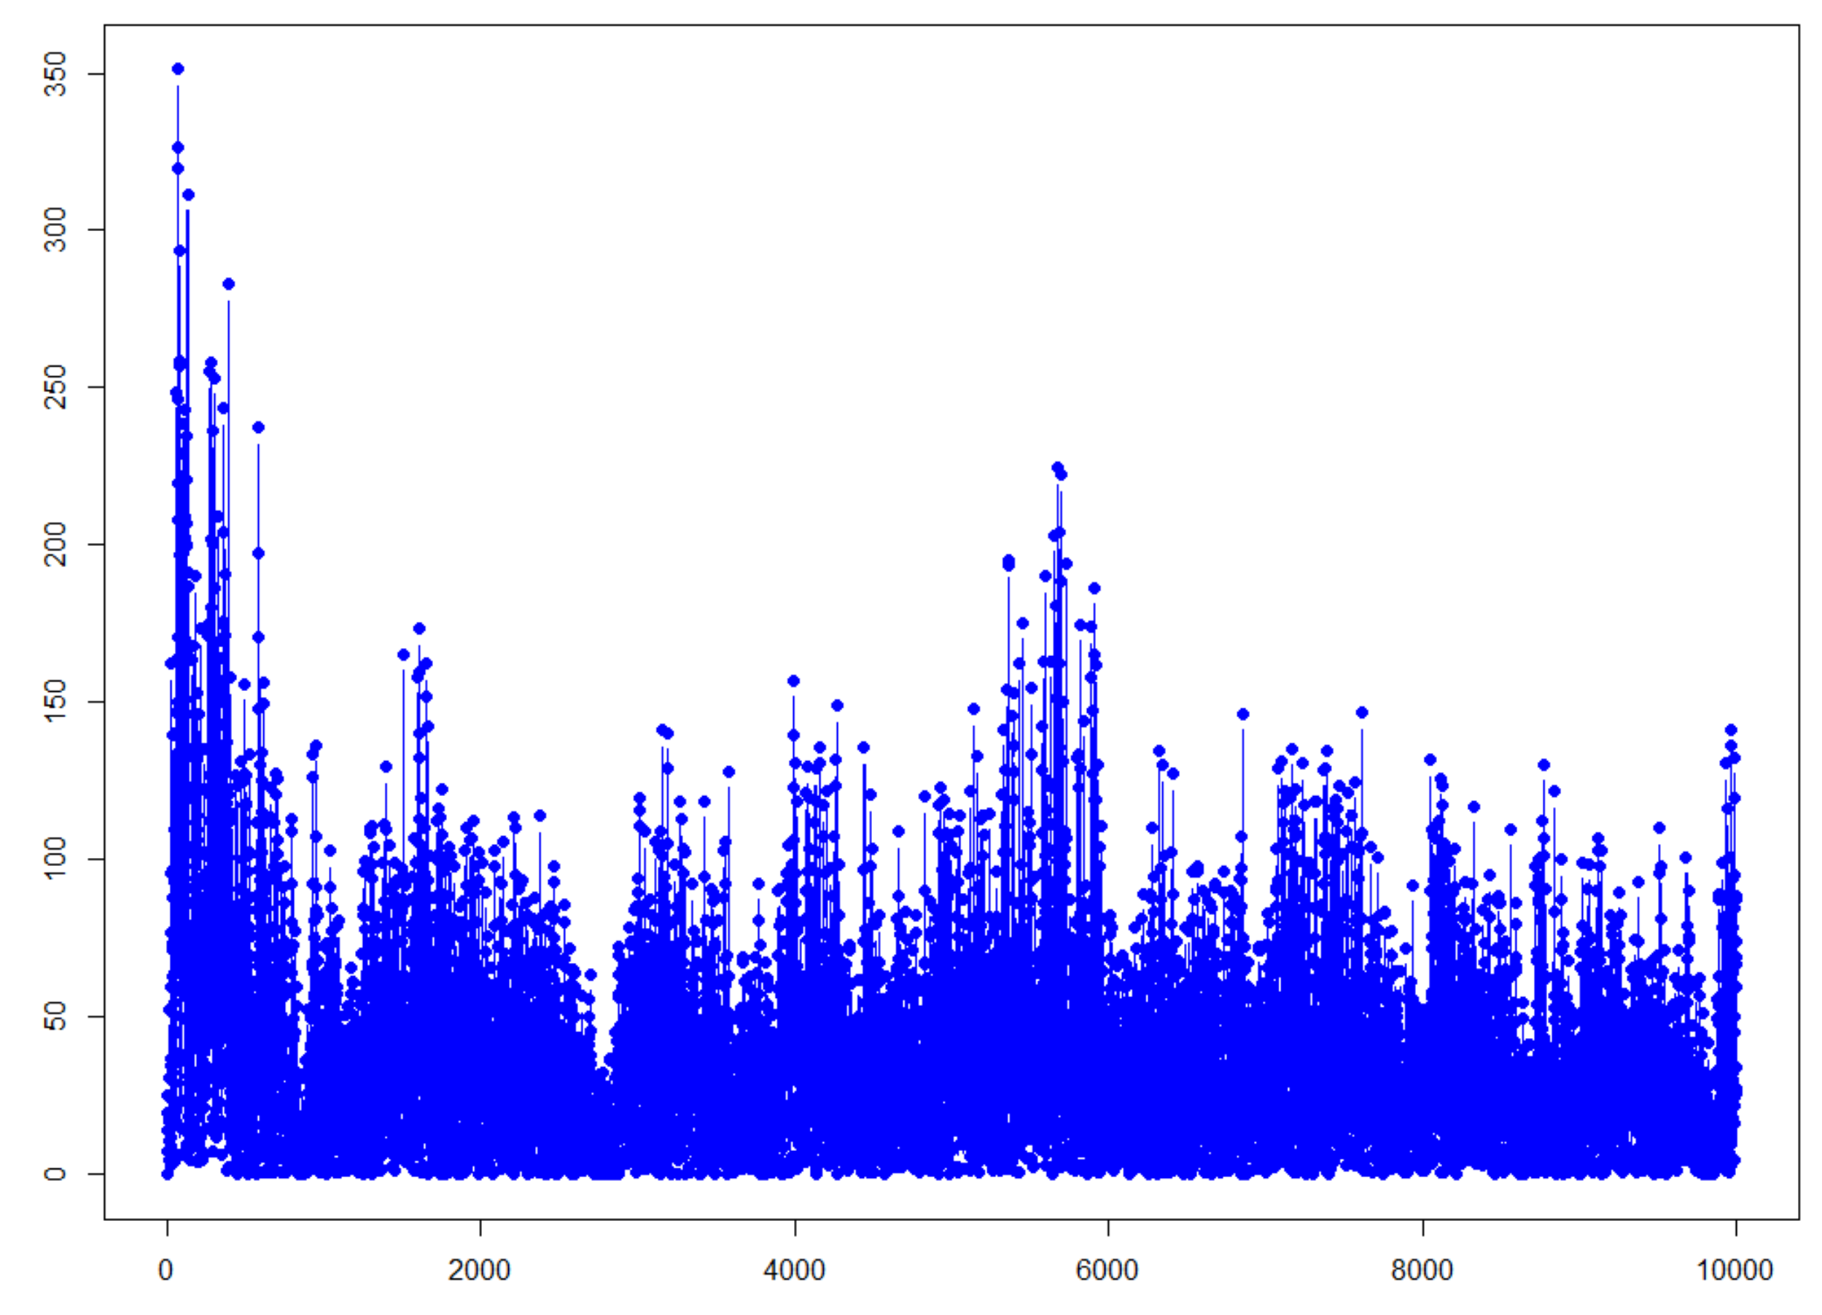
Comparison; Original + R package functions
Absolute difference between the log of the acceptance probability generated using;
Original functions
R package functions (dnbinom, dpois)
I.e There is a Mistake!
Absolute difference

Slide 7
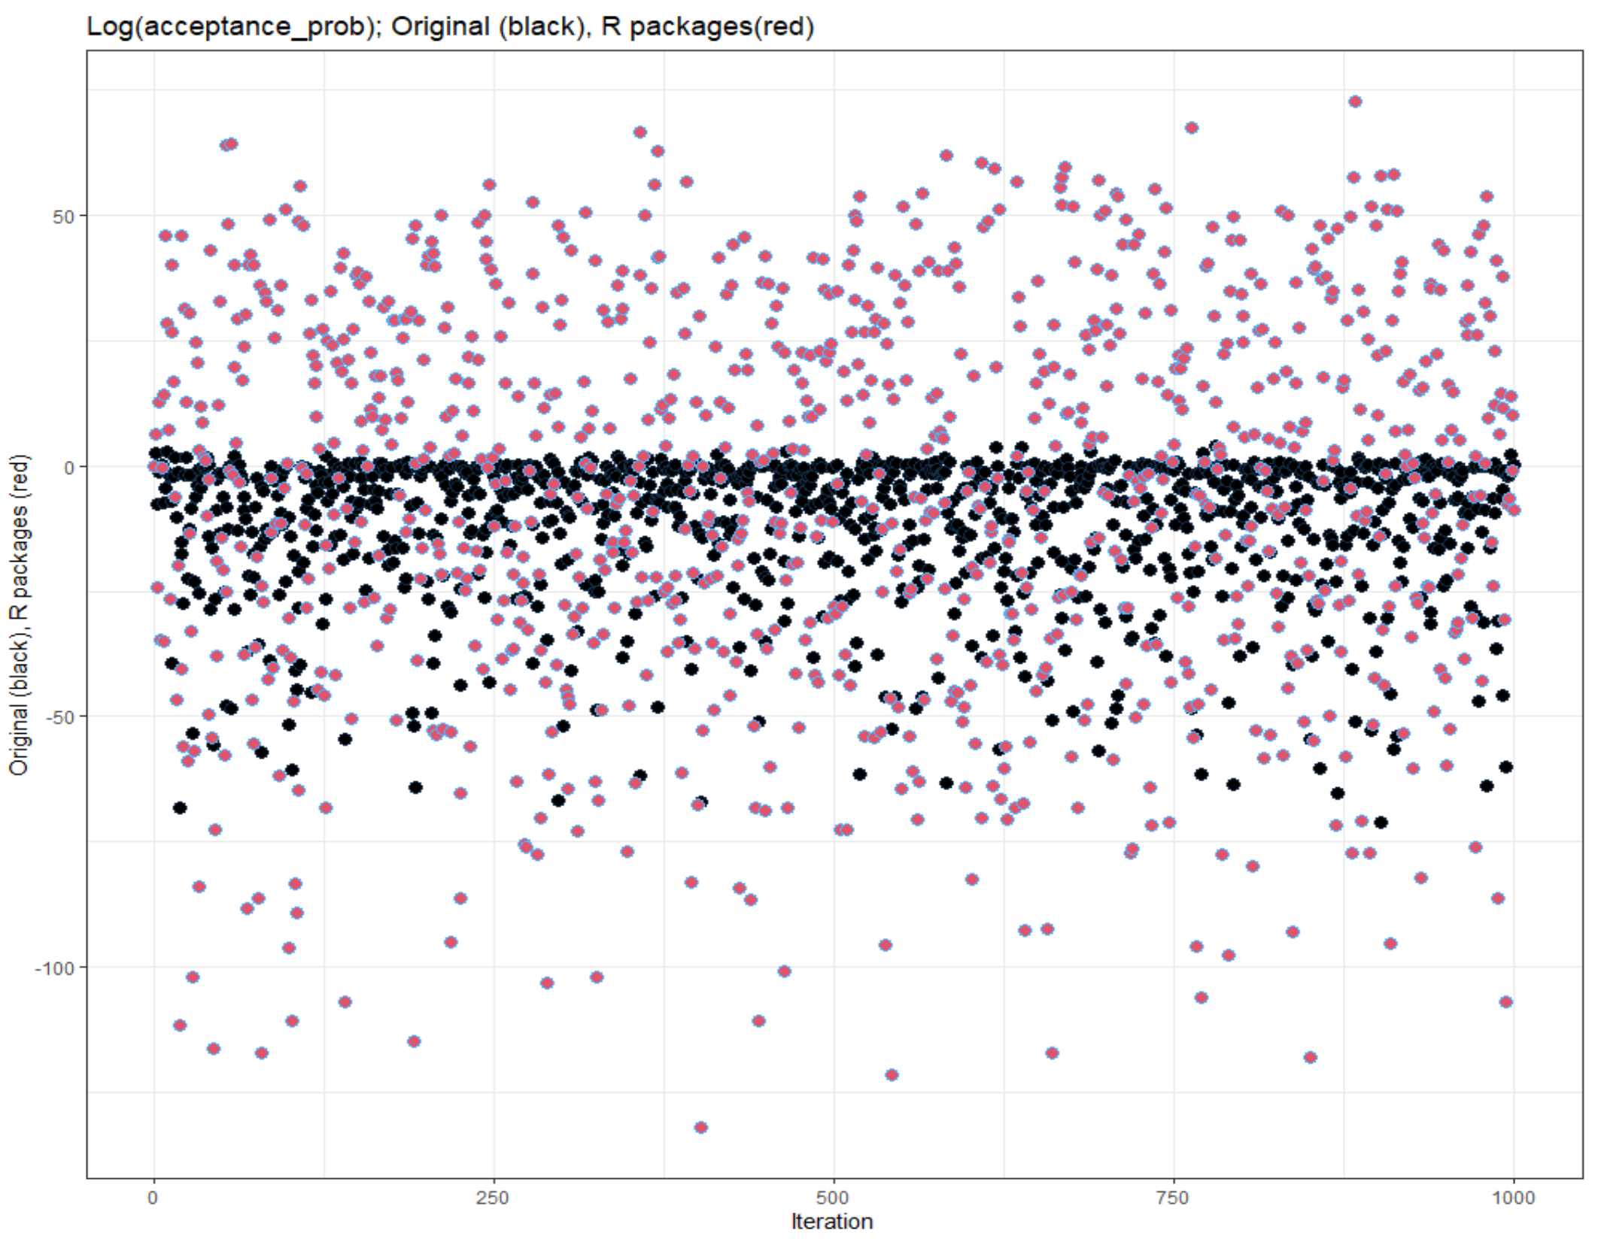
Comparison; Original + R package functions
Two values shown; the log of the acceptance probability generated using;
Original functions
R package functions (dnbinom, dpois)
I.e There is a Mistake!

Slide 8
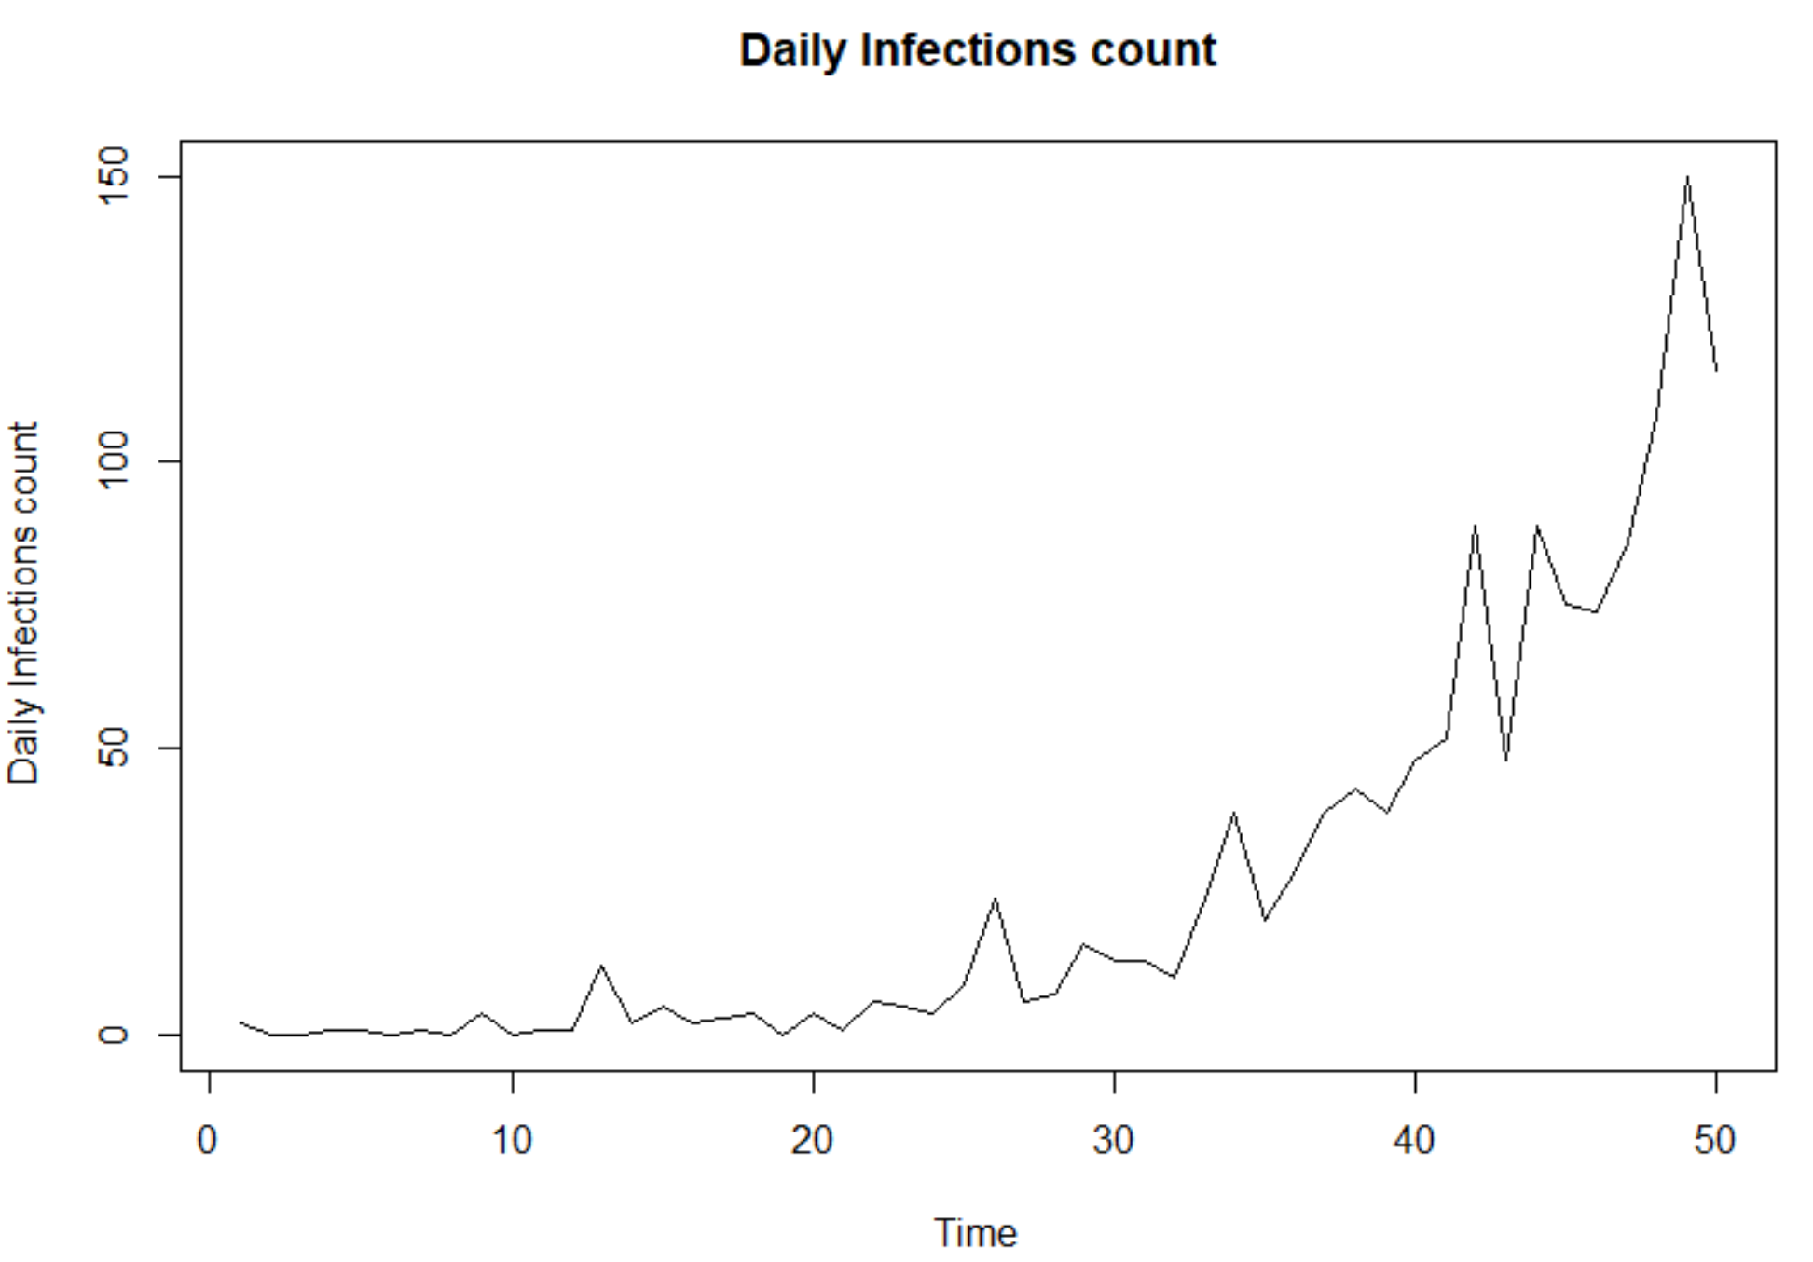
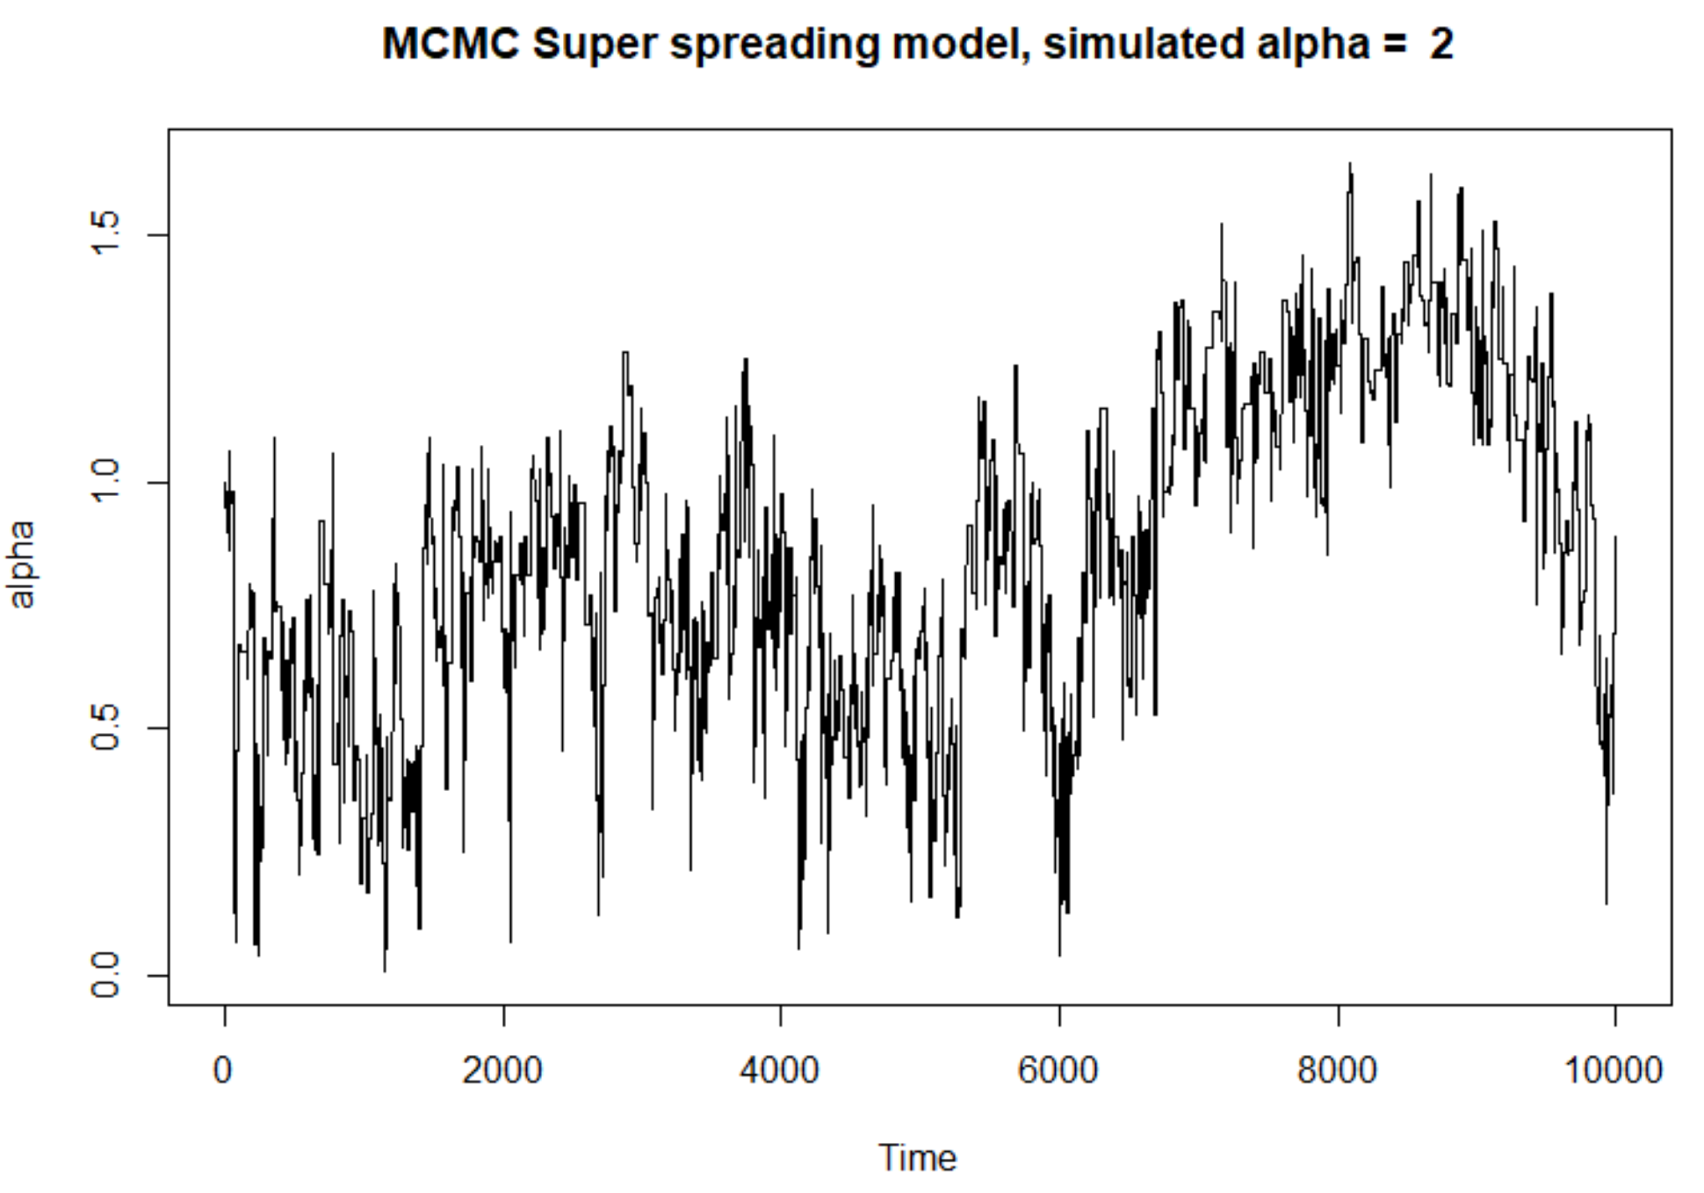
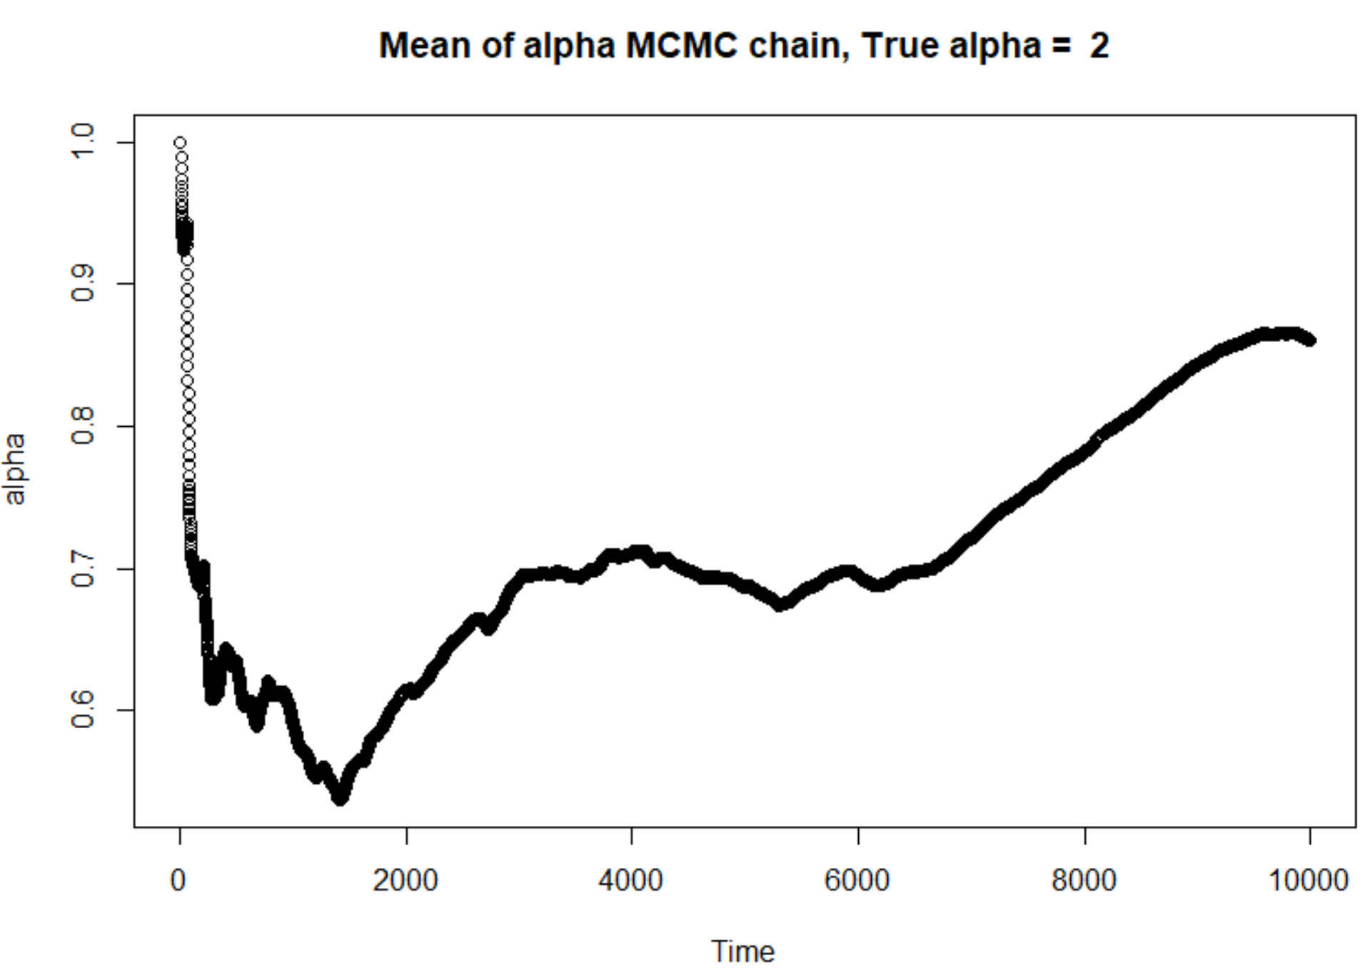
Results of MCMC (From this run)
All three parameters allowed to vary
α

Slide 9
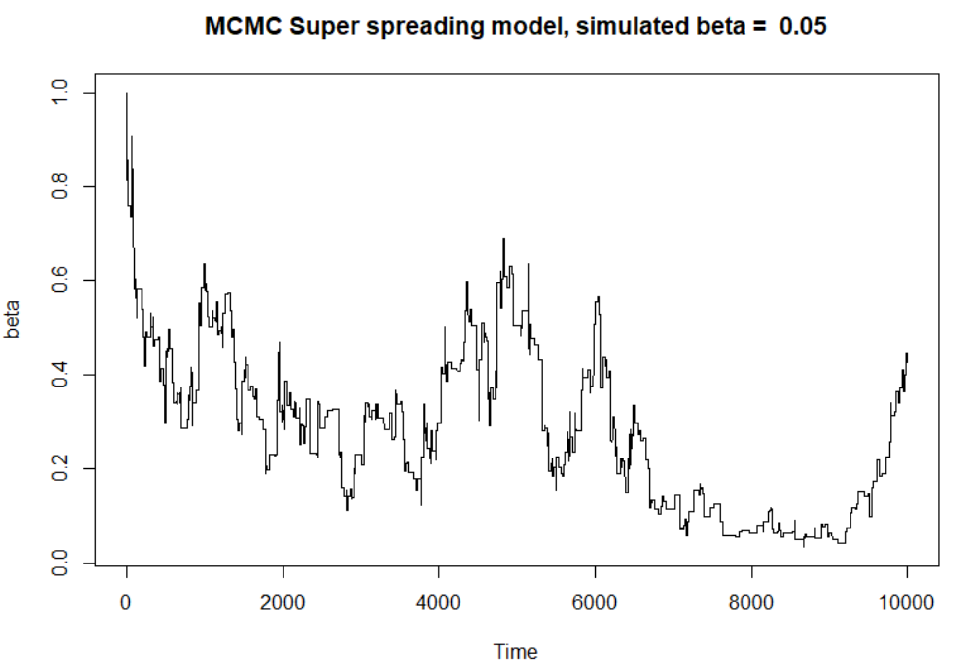
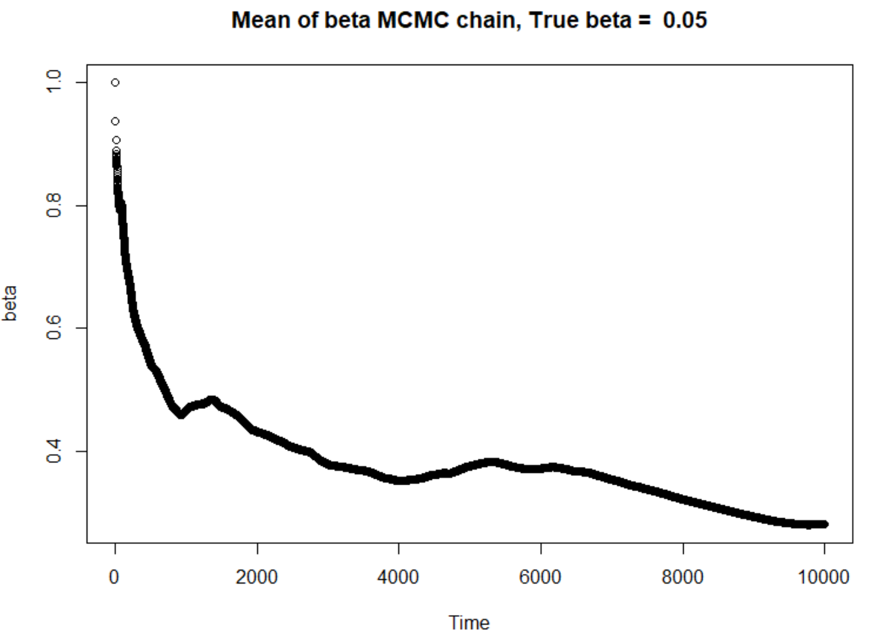
Results of MCMC
β

Slide 10
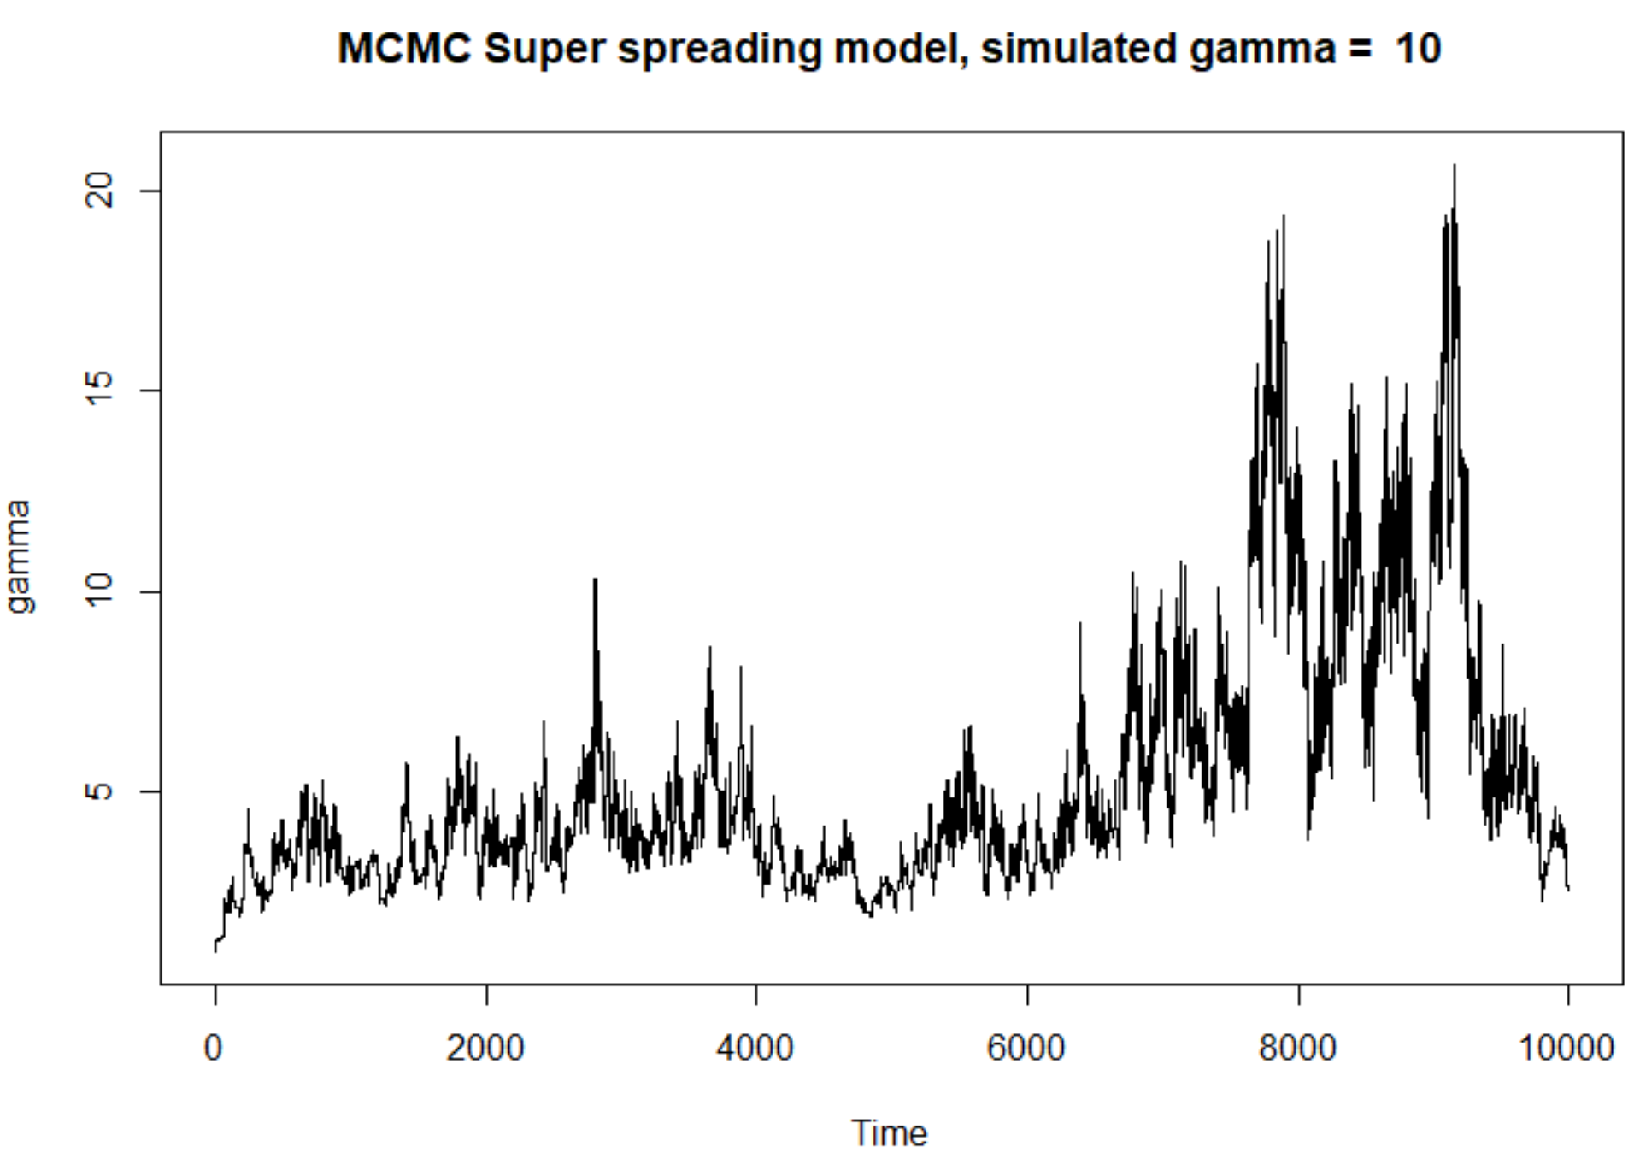
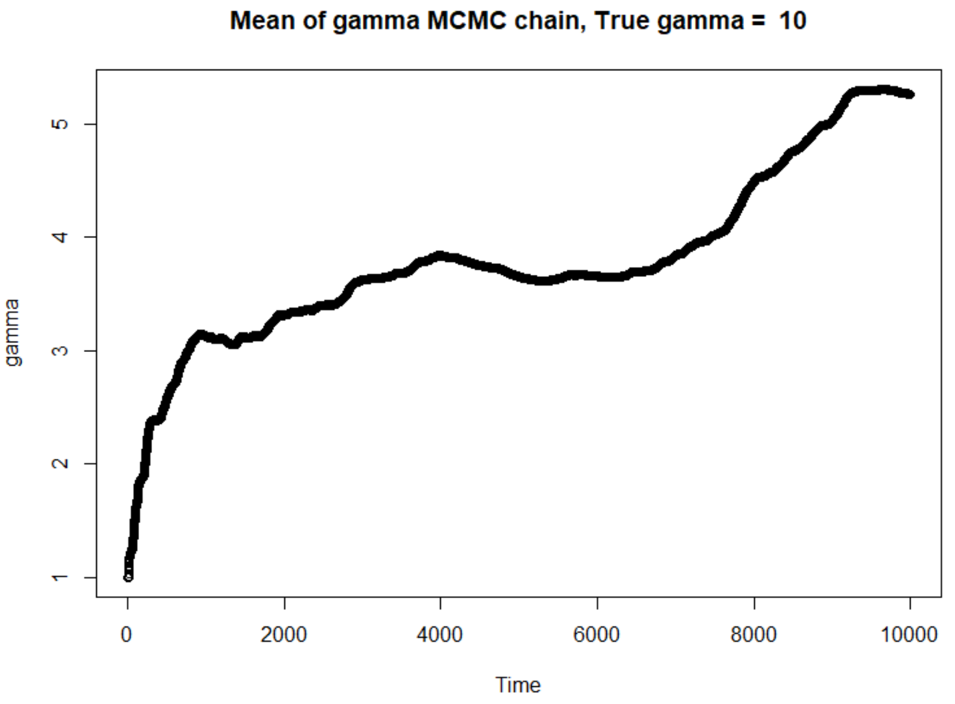
Results of MCMC
γ

