Slide 1
Bayesian Epidemic Modelling
Hannah Craddock
Supervisors: Dr Simon Spencer, Prof Xavier Didelot
Date: Wed October 13th 2021

Slide 2
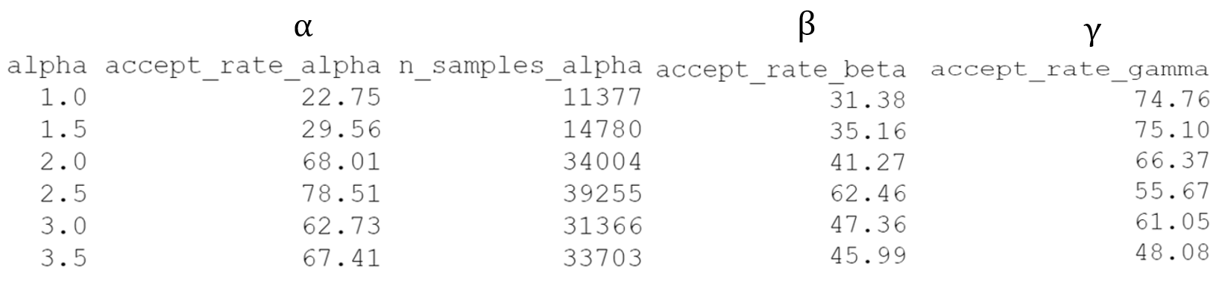
MCMC Super-Spreading Model
Simulated data for alpha = {1.0, 1.5, 2.0, 2.5, 3, 3.5}, beta = 3, gamma = 3
MCMC – One parameter at a time
Results;

Slide 3
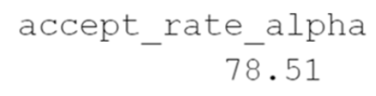


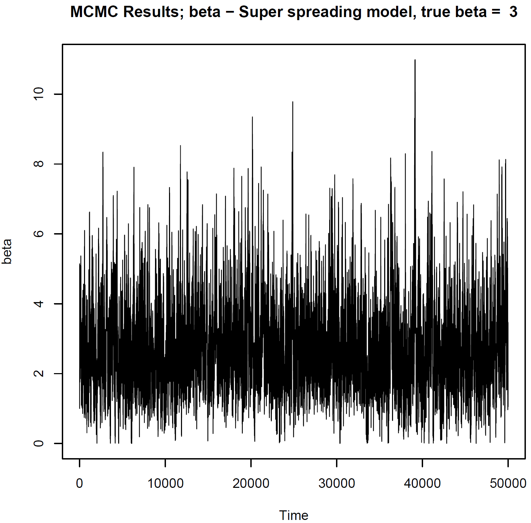
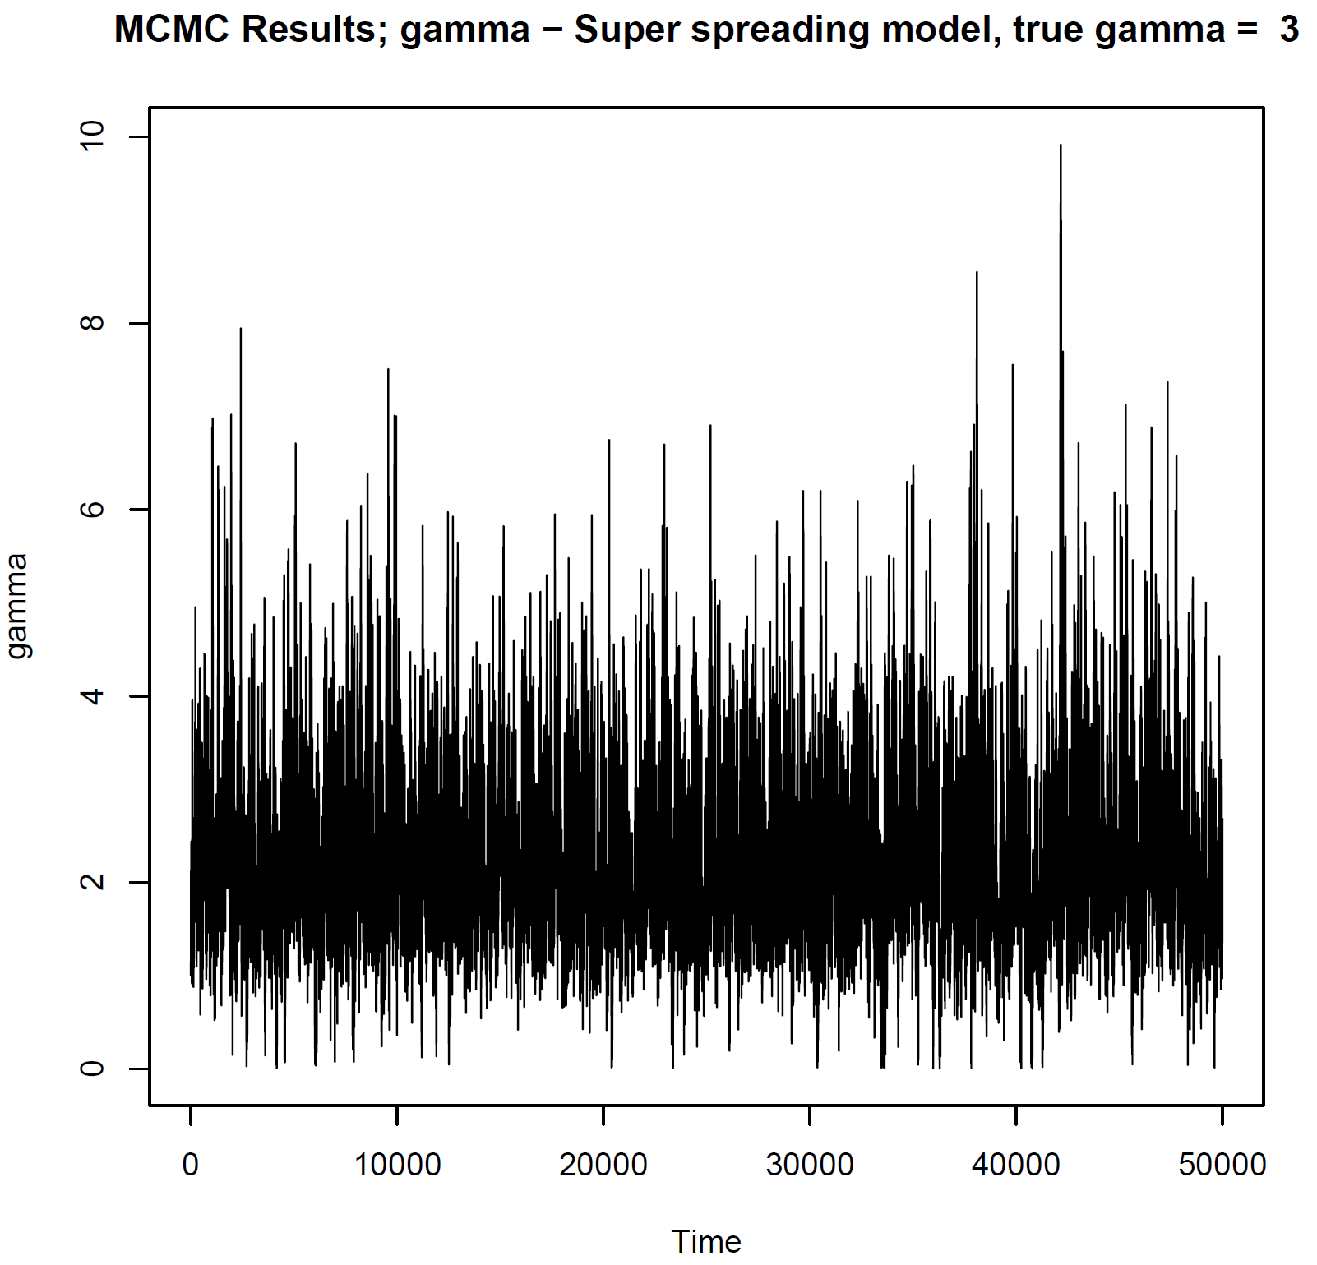
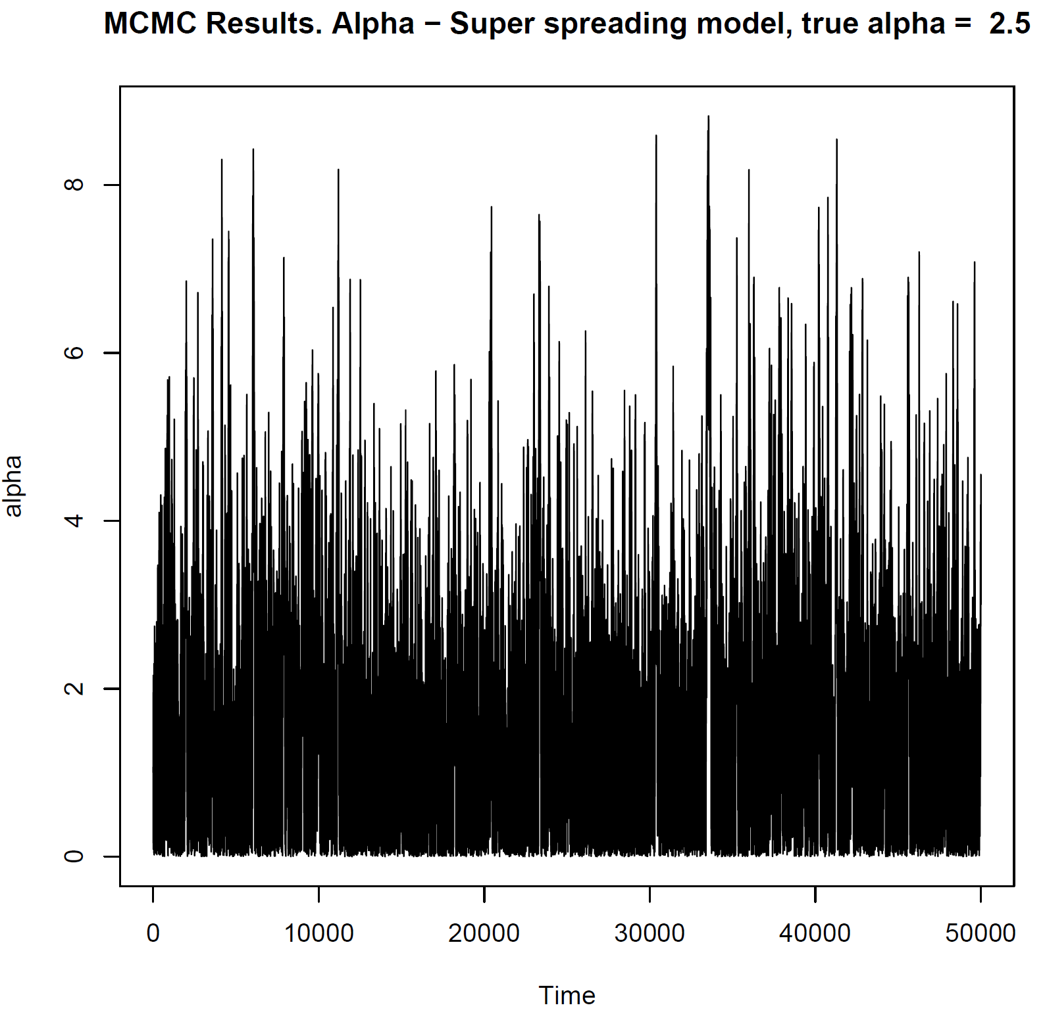
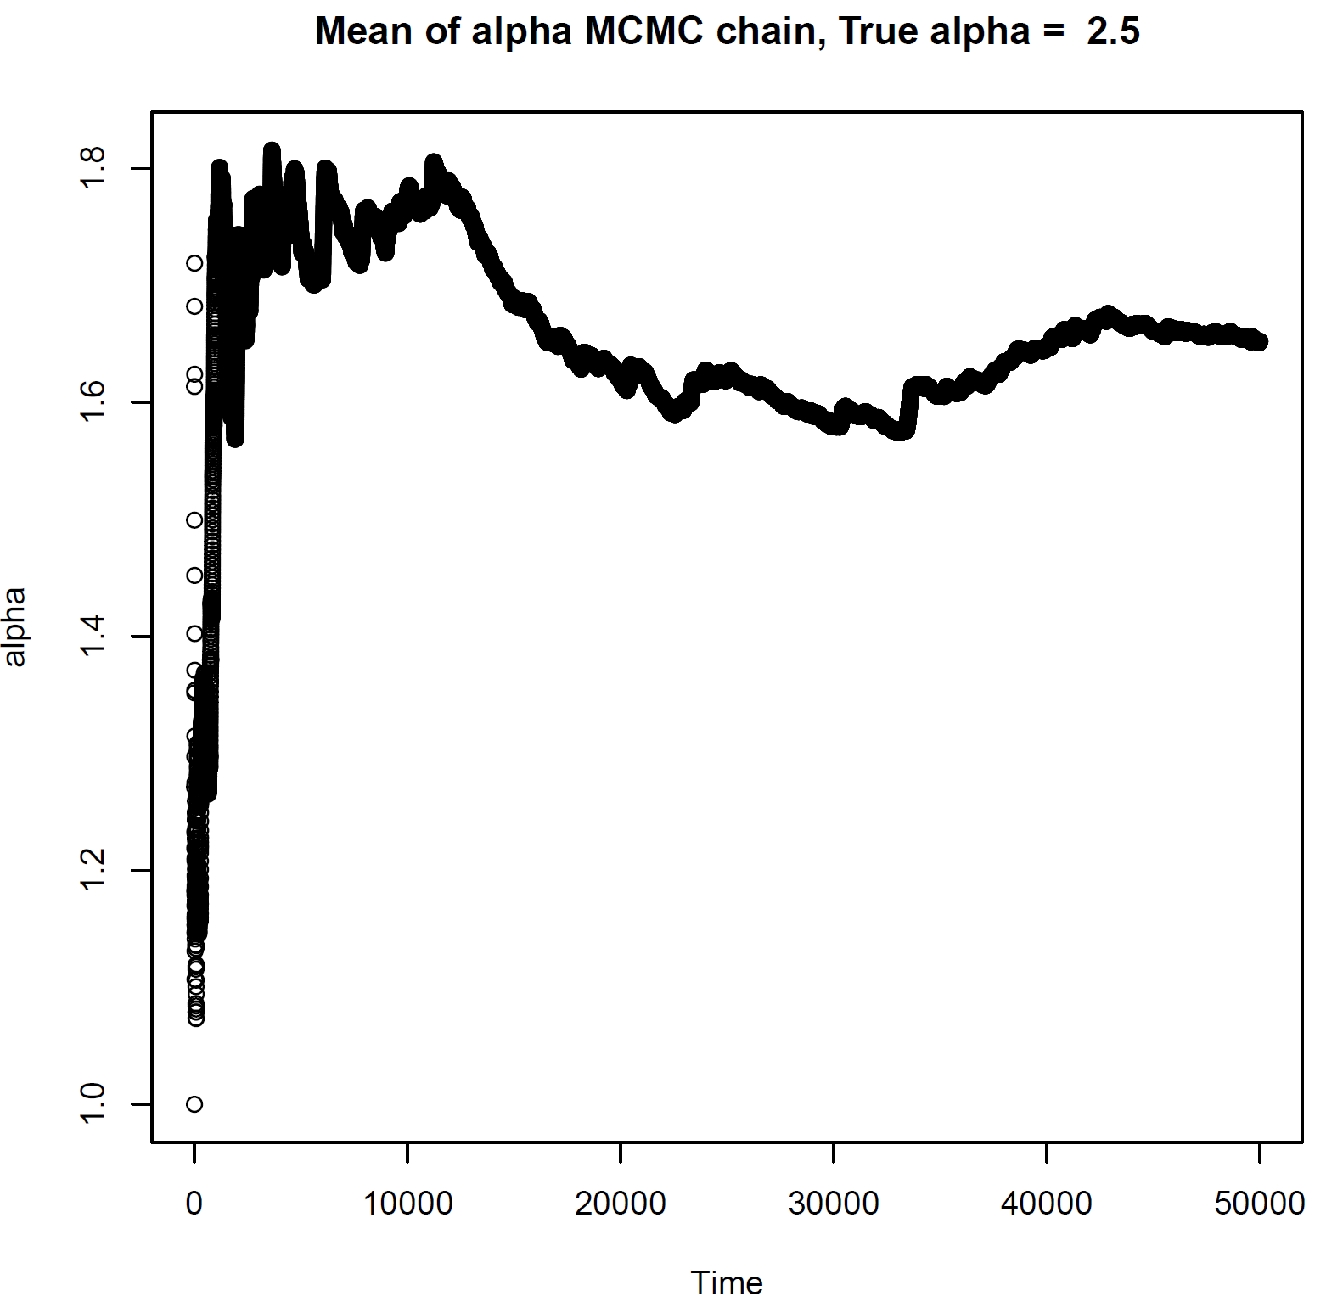
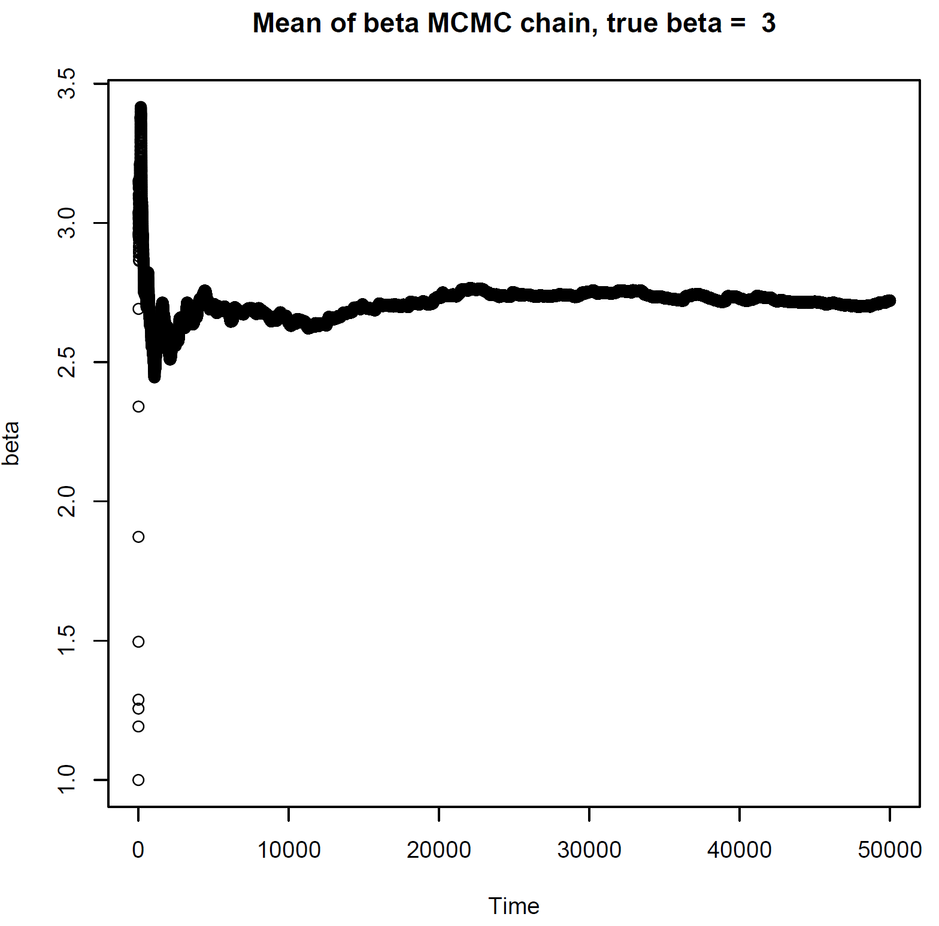
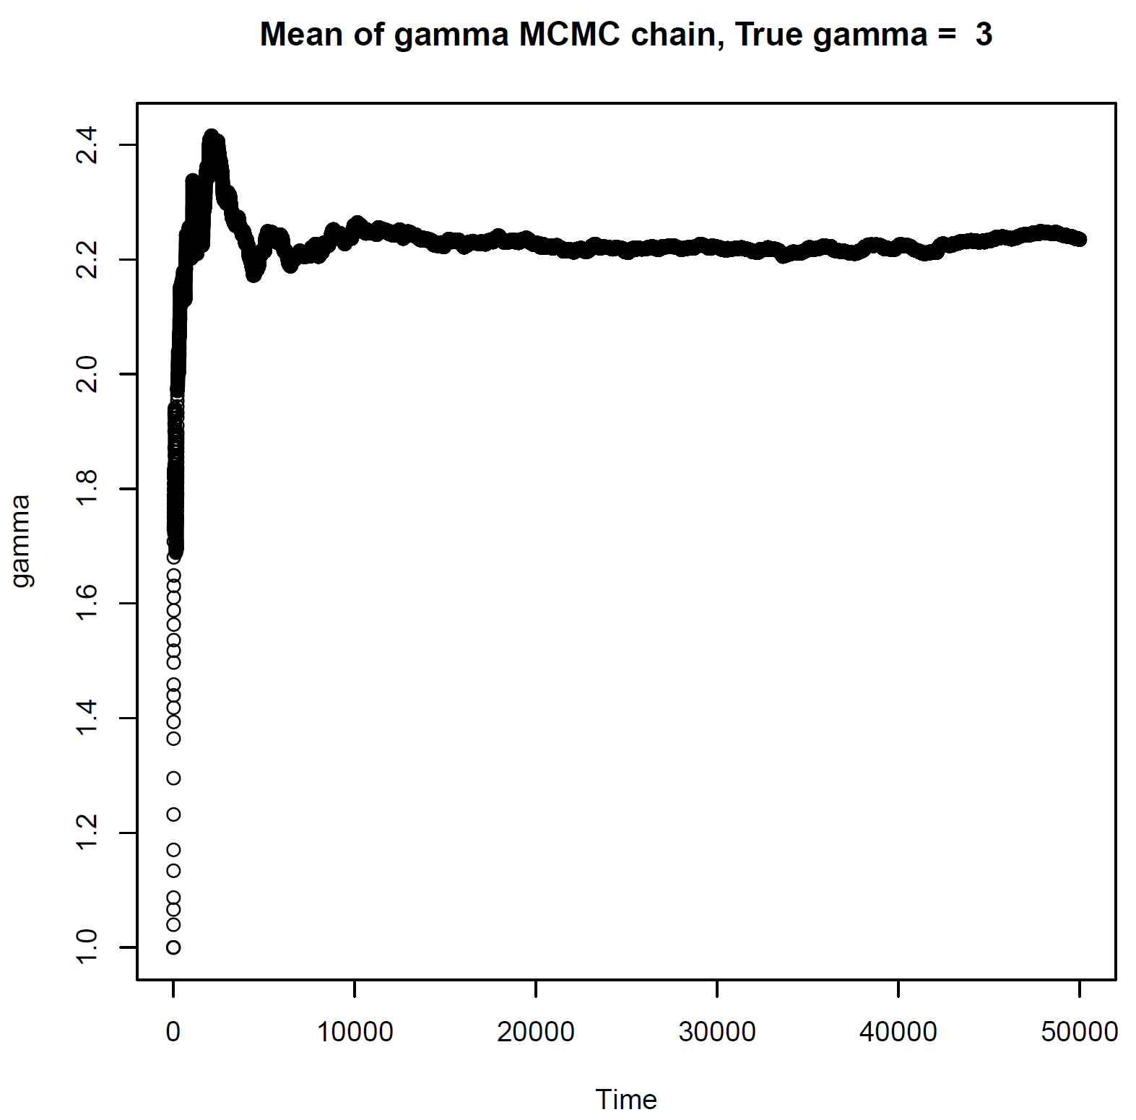
Results – MCMC S. Spreading (Single parameter)
α (simulated data) = 2.5
γ
α
β

Slide 4
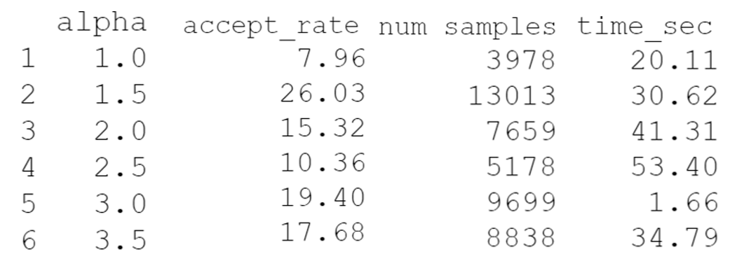
MCMC Super-spreading model (All parameters at once)
Simulated data for alpha = {1.0, 1.5, 2.0, 2.5, 3, 3.5}, beta = 3, gamma = 3
MCMC – One parameter at a time
Results;

Slide 5
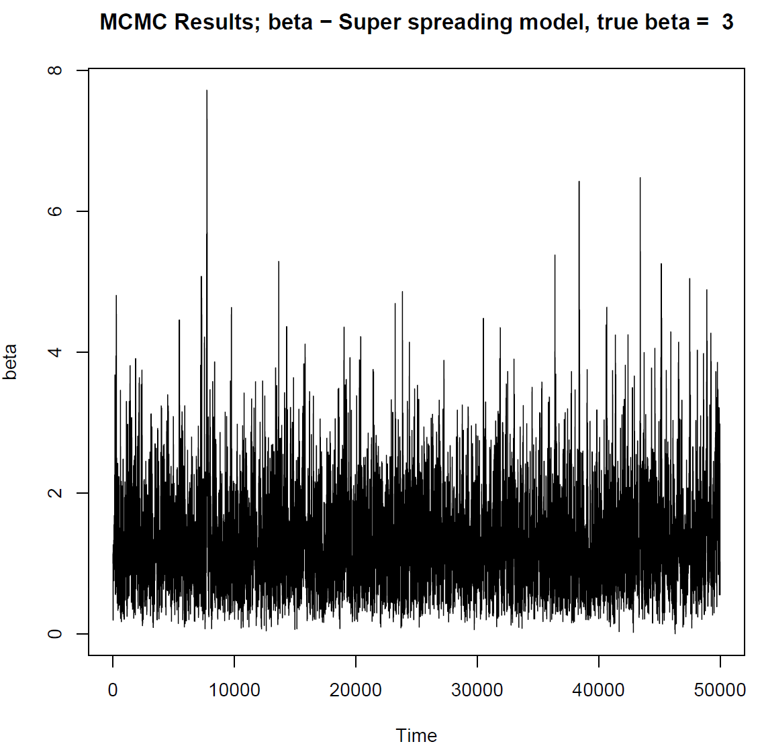
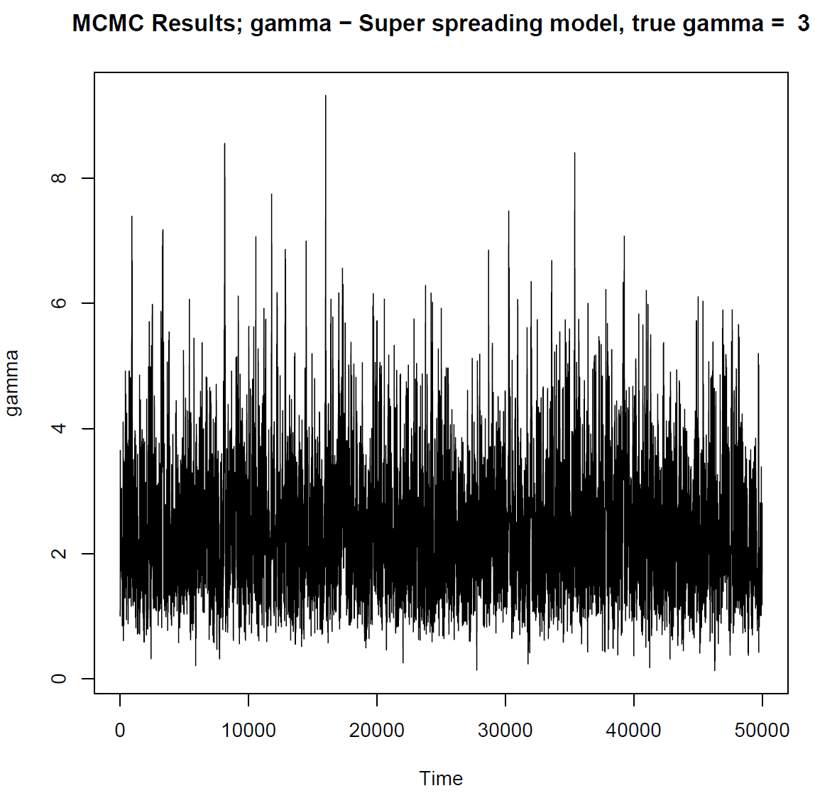
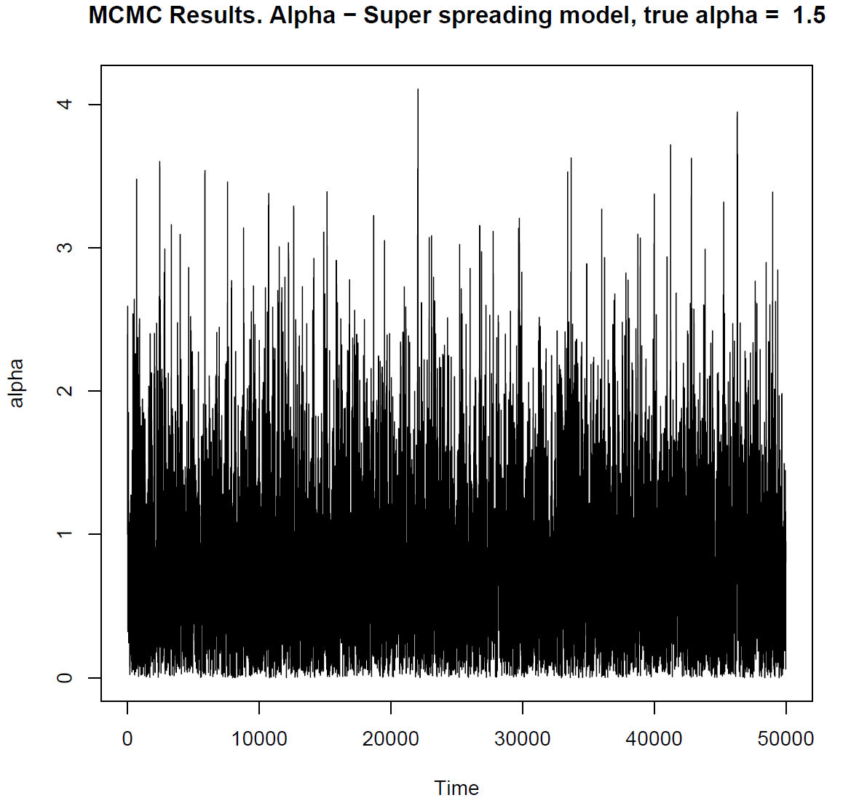
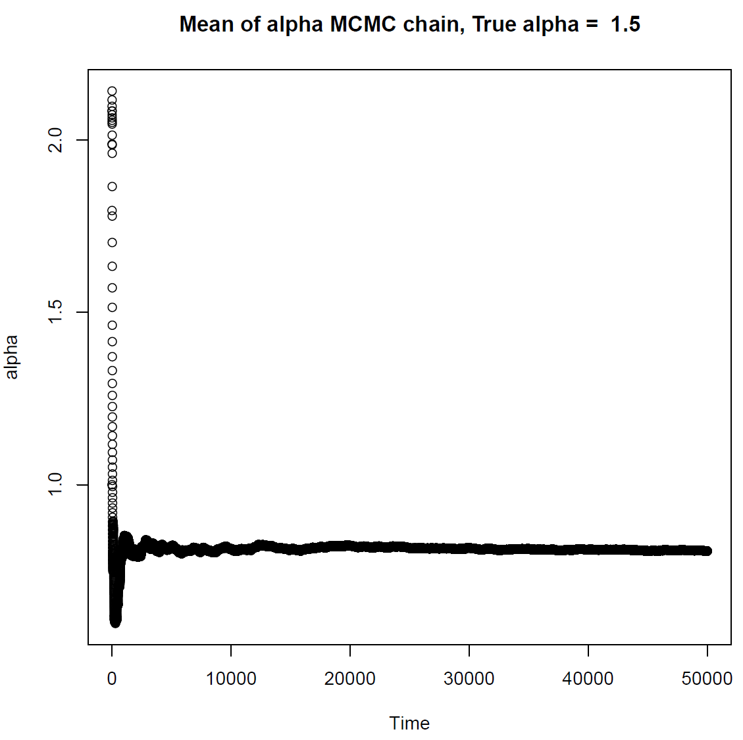
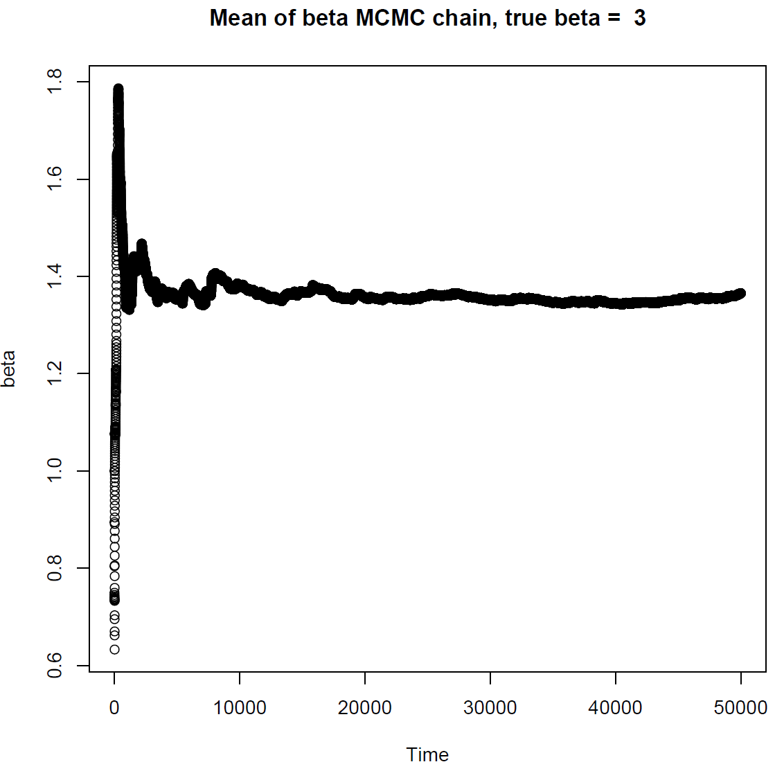
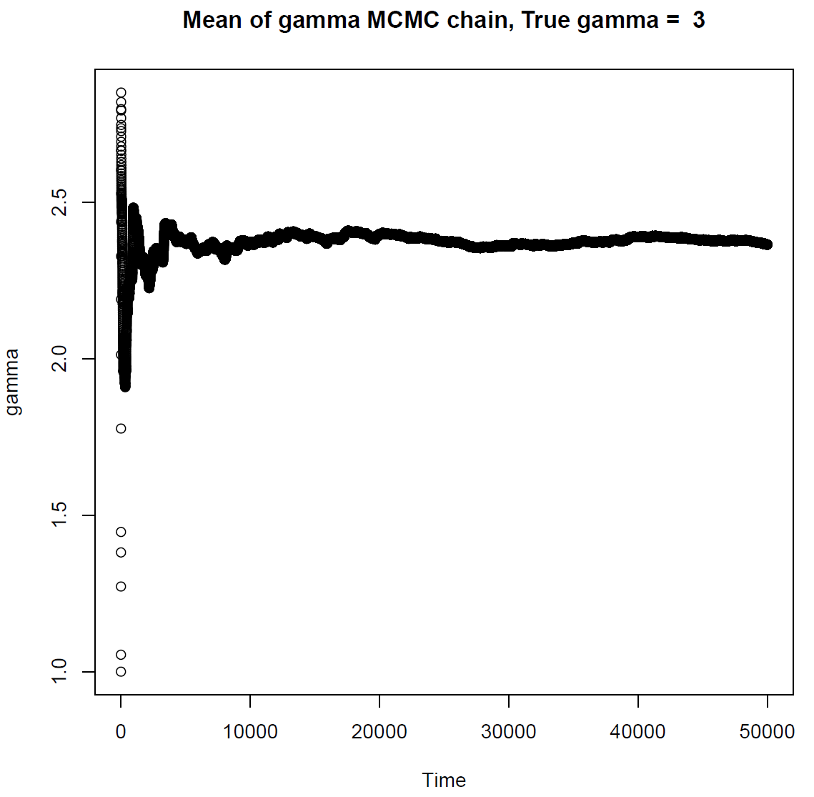
Results – MCMC S. Spreading (All parameters at once)
α (simulated data) = 1.5
Acceptance rate = 26%
β
γ
α

