Slide 1
Hospital Rating System
- Developed by:
Lakshmi Narayan
Pradeep Dubhasi
Meena Madhuri Sudhansu Dash

Slide 2
Objective
Develop a model to rate the hospitals in United states.
Use the model to identify areas of improvement for certain providers.
To achieve the same we have followed Three step approach after identifying the major 64 measures and their corresponding impact on Ratings by performing EDA.
1. Supervised Learning-Based Rating System
2. Clustering-Based Rating (Unsupervised)
3. Recommendations for Hospitals

Slide 3
Data Understanding & Data Preparation
Required data has been collected from CMS repository* for Hospital compare.
Out of total 189 measures which CMS collects on weekly, monthly and yearly basis, identified 62 measures which decides the Rating of particular Provider.
Identified corresponding scores of each of the 64 measures and scaled them.
Missing score values or ‘Not Available’ values have been imputed using Regression.
All the measures are grouped into below 7 major groups .
Mortality
Safety of care
Readmission
Patient experience
Effectiveness of care
Timeliness of care
Efficient use of Medical imaging

Slide 4
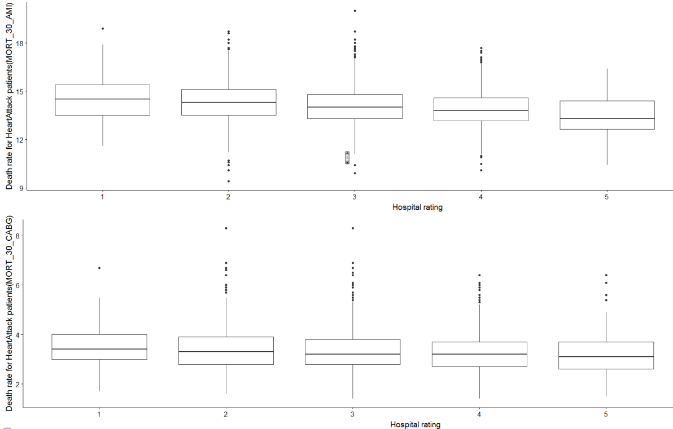
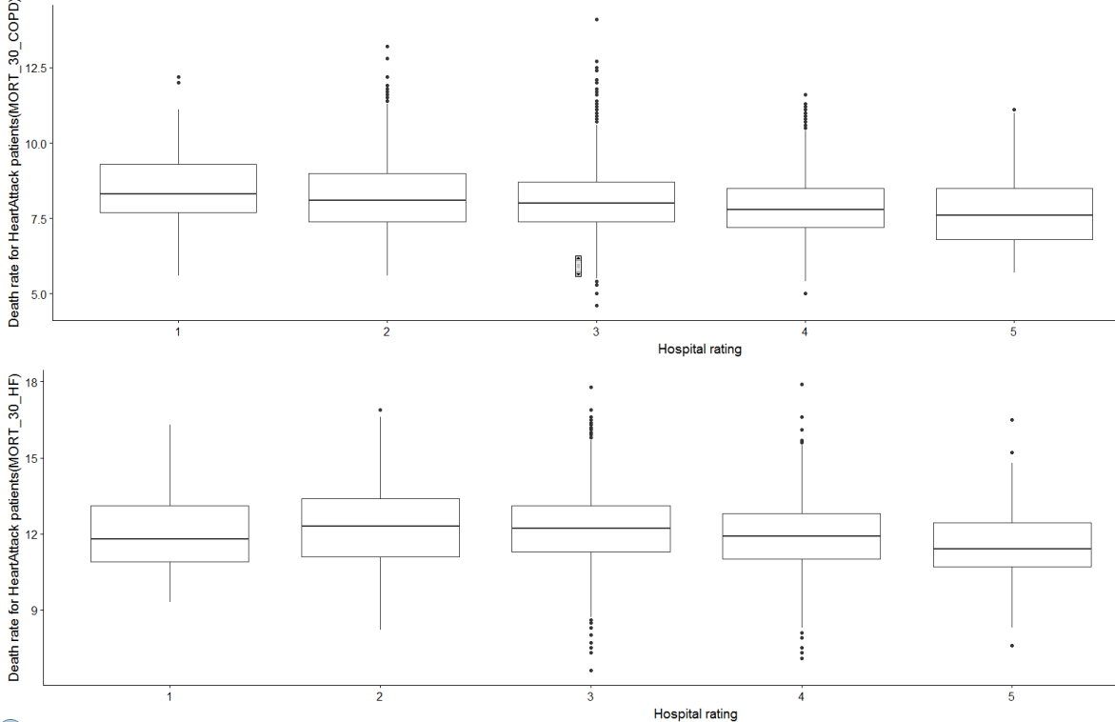
Exploratory Data Analysis
Morality measures : These measures tell about the death rate of patients because of various diseases. MORT_30_AMI, MORT_30_CABG, MORT_30_COPD, MORT_30_HF, MORT_30_PN, MORT_30_STK, PSI_4_SURG_COMP
The mortality scores must be as low as possible for a provider to get higher Rating.

Slide 5
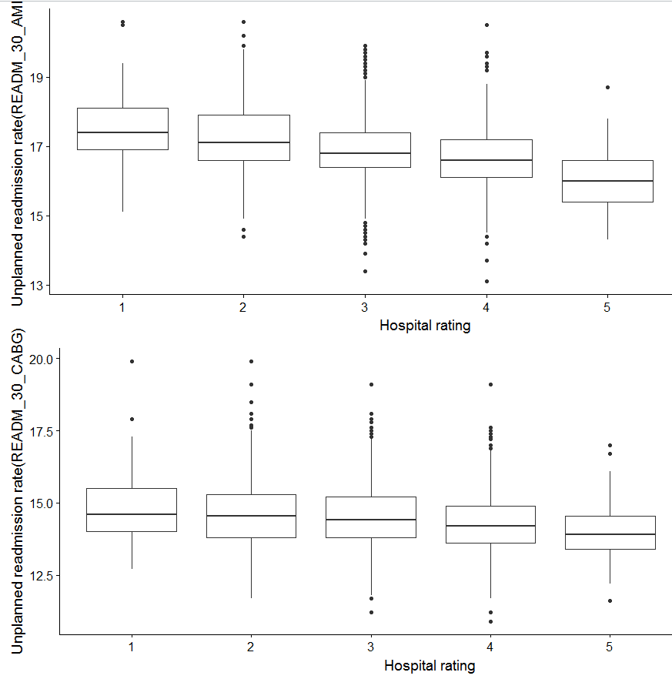
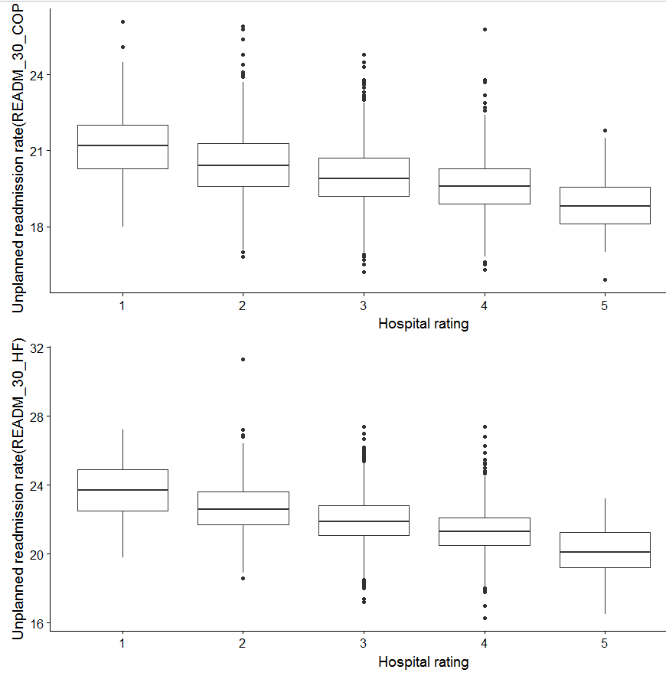
Exploratory Data Analysis (Cont.)
Readmission Measures : These measures tell about the rate at which various kings of patients revisit the hospital which is an unexpected event.
Hospital's readmission rate must be less than 15 to achieve 4 or 5 rating.

Slide 6
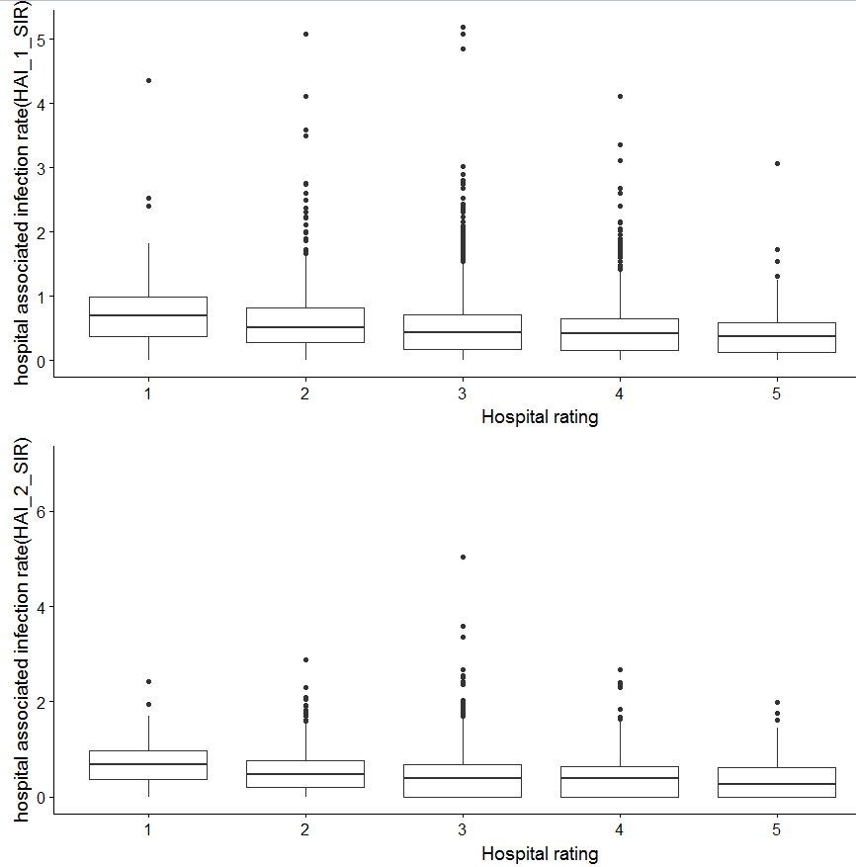
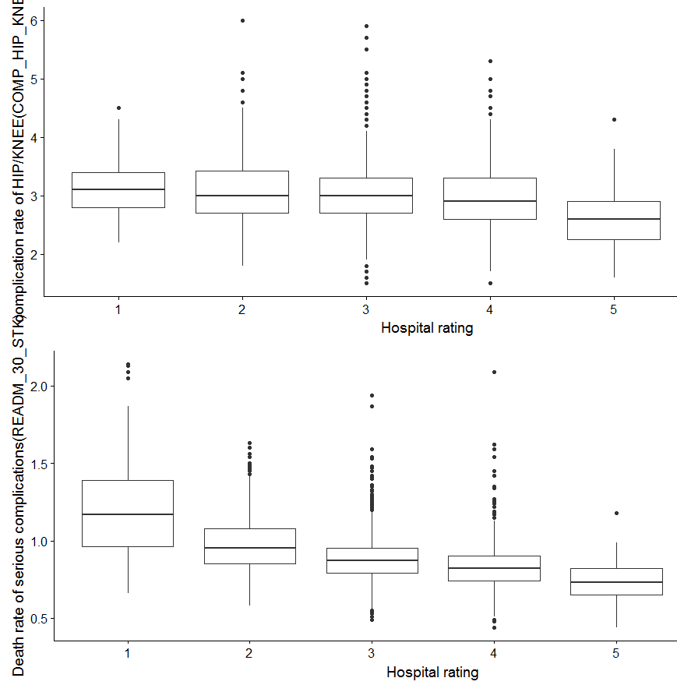
Exploratory Data Analysis (Cont.)
Safety measures : These measures tell about the rate at which patients get infected during the hospital stay.
Hospital's HAI (hospital associated infections) must be less than 1% to get rating among 3,4 & 5.
Also the KNEE complications rate should be less than 3 for hospital to get 5 rating.

Slide 7
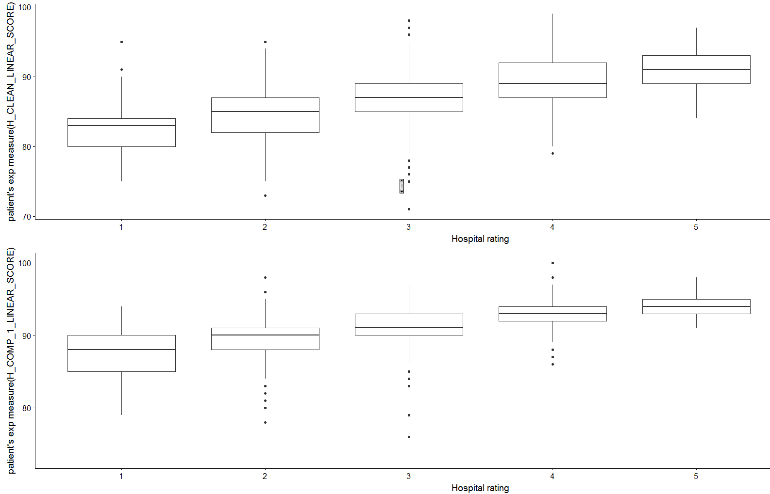
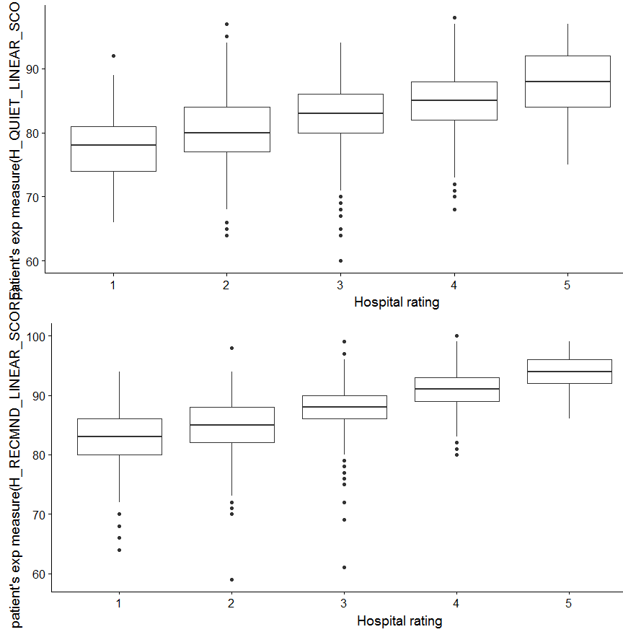
Exploratory Data Analysis (Cont.)
Patient experience measures: These measures tell about the patient’s feedback based on their experience during the hospital visit.
Patients should rate the hospital more 80 or 90% in terms of cleanliness for hospital to get 4 or 5 rating.

Slide 8
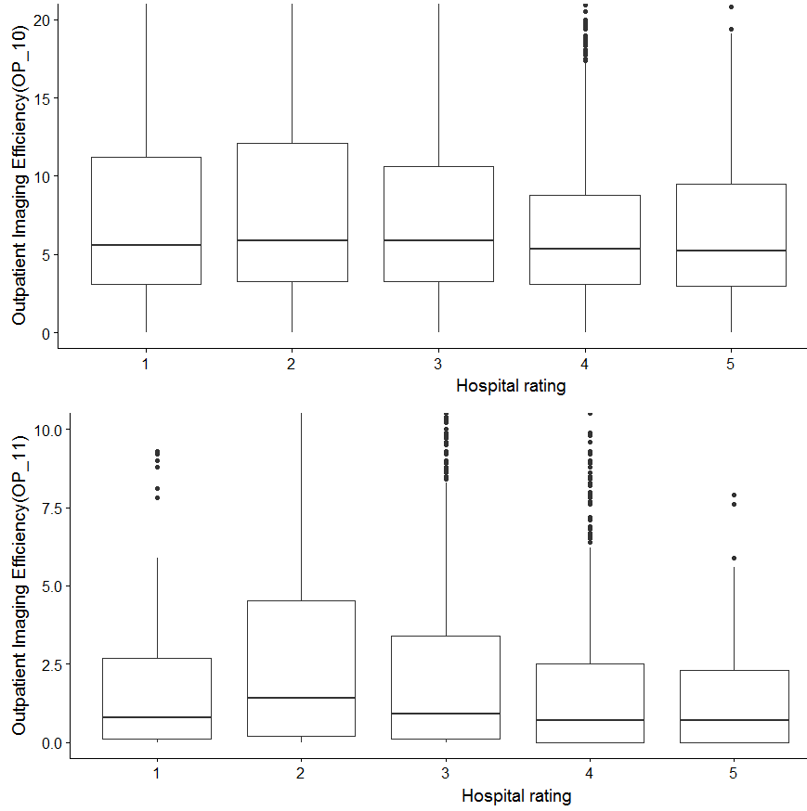
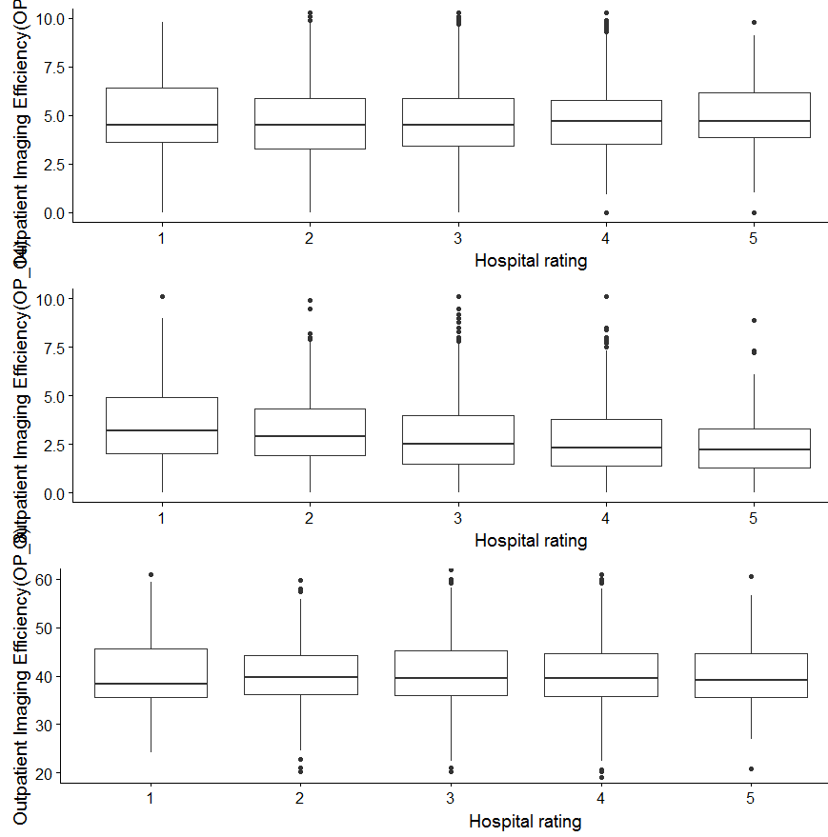
Exploratory Data Analysis (Cont.)
Imaging measures: These measures tell about the frequency at which hospitals prescribe more than one scan to the patience where one scan is sufficient to diagnose the patients.
Imaging efficiency measures should be low in values so that patients doesn’t have to go through unnecessary scanning.

Slide 9
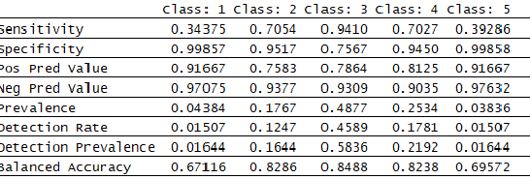
Supervised Learning-Based Rating System:
After preparing the data, it has been divided into two sets train(80%) and test (20%).
Train dataset has been used to develop supervised learning model.
We have chosen Radom Forest to categories the data and derive the corresponding rating.
Model Building
We used random forest model with prepared 62 measures and tuned the model by mtry and ntree hyper parameters .
After tuning the final model is developed with 400 decision trees and 22 variables to check for split at each node.
Model Evaluation
We got an accuracy of 79.45 % and evaluate the model by using confusion,sensitivity ,specificity matrix .

Slide 10
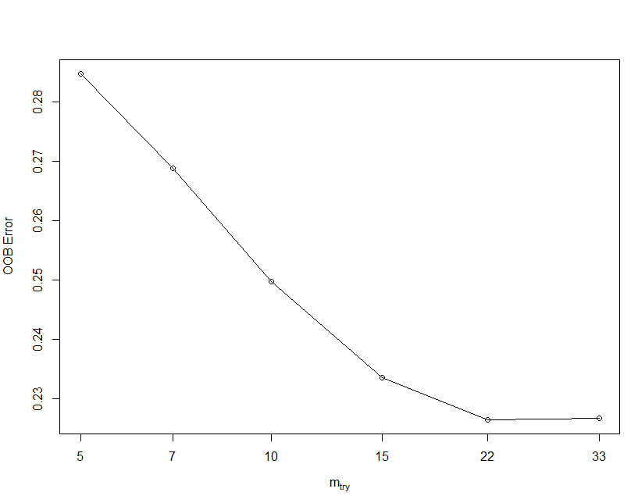
Supervised Learning-Based Rating System:
Initial parameters of Random Forest model :
ntree = 400
mtry = 15
After finding out the OOB error with respect to mtry value, the optimal value which minimizes the OOB error comes to be 22.
The final model has been built with below parameters.
ntree = 400
mtry = 22

Slide 11
Unsupervised Clustering-Based Rating System
We are building our Second model that using Unsupervised learning model in order to do so, we are reducing the dimension of the data set by applying Factor analysis.
Applied factor analysis to reduce the dimension from 62 measures to 7 measures which gives us the combined group score of the measures within that group.
Hospital score matric has been calculated by using these 7 group scores to get better clusters.

Slide 12
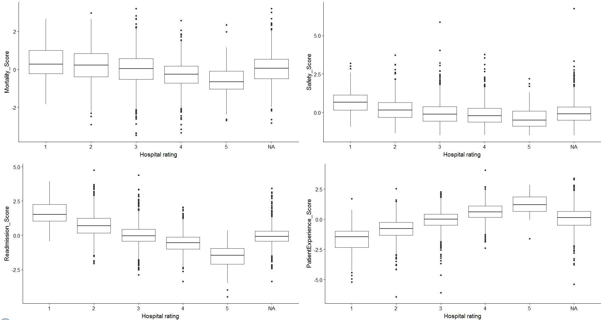
EDA after Factor Analysis
Here the group scores clearly shows the measure that hospital need to follow to get higher rating.
Mortality measure should be very low.
Safety related to hospital associated infections must be very low.
Readmission of patients should not happen more frequently.
Patients should be happy so that their feedback is more positive.

Slide 13
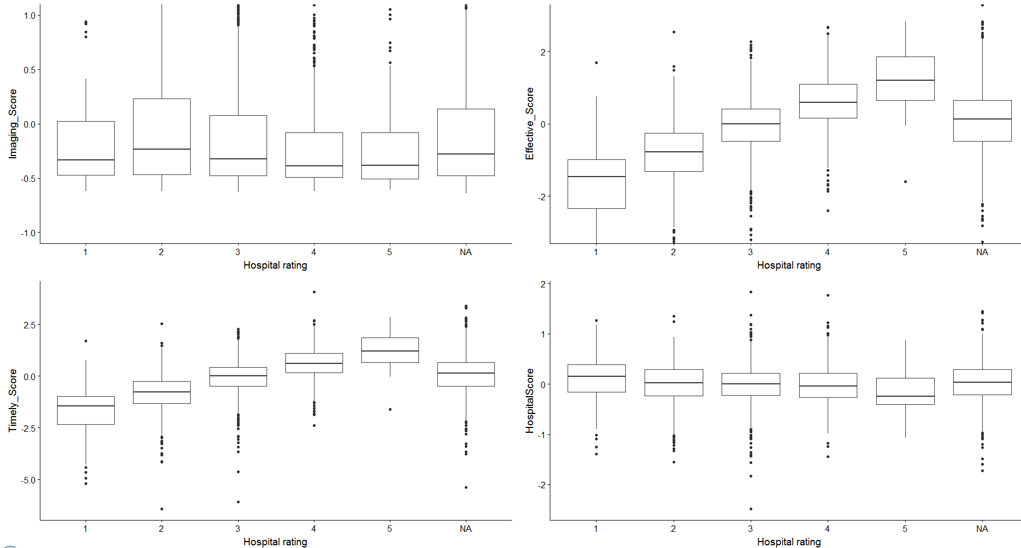
EDA after Factor Analysis (Cont.)
Hospitals must not prescribe more scans to patients than necessary scans to do diagnosis.
Health care providers must serve the patients quickly and effectively so that patients need to wait longer time to get their illness diagnosed and cured.
Providers must deliver effective care to the patients so that they achieve 5 rating while comparing with other providers.
Hospital score index must be low to achieve high ratings.

Slide 14
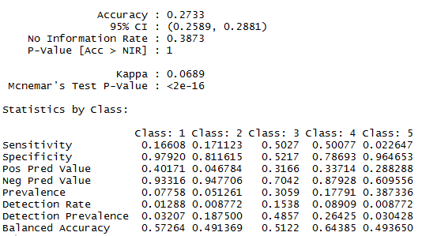
K-Means Clustering
K – Means has been chosen as unsupervised clustering model to develop our rating system.
This model has been chosen because we already new that we need to categories the health care providers in 5 different segment (i.e. Rating from 1 to 5)
This model works on the Euclidean distance method which is more suitable for the data with higher number of dimensions.

Slide 15
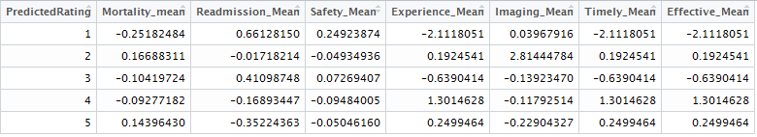
Recommendation for a particular provider
Our interest is to find out the current state of a particular provider whose Provider ID = 140010.
Current state of that provider is as below :
Based on our clustering here are the mean values of the measure with group scores with respect to the rating of the providers.
Recommendations :
Provider needs to improve in Safety measures because the number of patients reported to have hospital associated infections during the stay are more in case of this provider.
Feed back from the patients based on their experience is not that great. Provider need to take measures towards patients satisfaction. It needs to educated the staff to comfort the patients.
Needs to improve the time taken by the provider to diagnose, prescribe and cure the patients.
Provider need to improve in delivering the effect treatment to the patients in order to achieve higher rating.

Slide 16
Thank You ☺

