Slide 1
Rx Prior Authorization Case Study

Slide 2
Problem Statement
Adjudicating Rx Prior Authorizations is time consuming for Optum and costs millions of dollars every year.
Delayed authorizations results in delay in drug purchase for the member and hence, lead to poor NPS scores.
Objective is to build a Machine Learning model to automate Rx Prior Authorization work flow.
Requirement is to Use 2 Numeric variables, 5 Categorical variables and 2 textual variables.

Slide 3
Data Understanding & Data Cleaning
Data is related Pharmacy Claims of Prior Authorization type restricted to March 2017.
Analysis needs to be done over STATUS variable. (restricted to RESOLVED-APPROVED and RESOLVED-DENIED).
It is a balanced dataset having 3:2 ratio for STATUS and has 64 duplicates. It has 16 Categorical variables, 4 numeric variables, 3 date/timestamp variables and 4 text type variables. It has overall 564881 observations of Prior Authorization of Rx claims.
Data Cleaning steps:
      Removed 64 duplicate observations.
      Identified % of NA/(null) values in the columns and corresponding of STATUS distribution for those observations then removed them from the dataset if the decision doesn’t vary much.
      If NAs are considerably high then mapped them to high frequency category(for UOM), default category (like Not Provided for text fields) or created a new category ‘NA’ (for STATE_CODE and UOM)
      DATE_OF_BIRTH, STATE_CODE, PLAN_CODE, DIRECTION_OF_USE,DIAGNOSIS_COMMENTS have invalid values. Mapped them to NAs/Default categories.
      List of Invalid values identified :
      DATE_OF_BIRTH: Have future dates – created Age variable and replaced the negative age with mean Age.
      STATE_CODE : XX, ON, FS, NB, AE – mapped them to new category ‘NA’.
      PLAN_CODE : Oct-3 – made them as NULLs.
      DIRECTION_OF_USE : [‘.’ , ‘..’ , ‘…’] – converted to nulls then then replaced as NOT PROVIDED.
      DIAGNOSIS_COMMENTS : [‘**-’, ‘***-’, ‘****-’, ‘.-’, ‘..-’, ‘.-.’, ‘..-..’, ‘…-..’, ‘……-’, ‘0-’] - converted to nulls then then replaced as NOT PROVIDED.
      Removed PA_CREATED_DATE of timestamp data type because it is an insignificant variable and PA_CREATED_DATE_ONLY has the same information without the time.
      Removed DRUG_PACKAGE_SIZE and DRUG_PACKAGE_QTY to avoid multicollinearity , because we have which TOTAL_DRUG_PCKAGE_QTY is direct multiplication of these two columns.

Slide 4
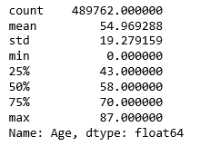
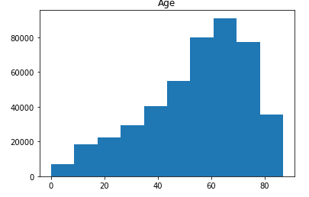
Feature Engineering
Created new variable ‘Age’ as :
Age = DAYS(PA_CREATED_DATE_ONLY-DATE_OF_BIRTH)/365.25
Since DATE_OF_BIRTH has future dates, Age is negative for few observations.
For Negative age distribution of STATUS is : RESOLVED-APPROVED - 10446
RESOLVED-DENIED - 5585
For negative Age there are 50% chances that claim can be denied.
So replaced the negative values with the mean to keep the distribution same.
Statistics of Age variable: Distribution of Age :

Slide 5
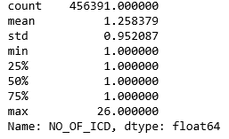
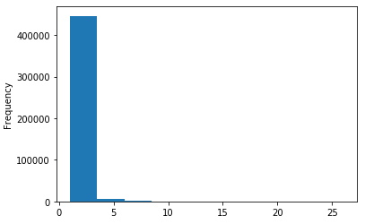
Feature Engineering (Cont.)
Created new variable ‘NO_OF_ICD’ as :
NO_OF_ICD = ICD_CODE.str.count(‘\|’)+1
This will tell us the over all number of diagnosis codes presented with the pharmacy claim.
Statistics of No of ICD codes: Frequency distribution of ICD codes:
It is observed that 99.22 % of the claims have less than 5 ICD codes, So this helps us deriving a new variables called ‘Comorbidity Matrix’ which can make more sense to the machine instead of text variable ICD_CODE.

Slide 6
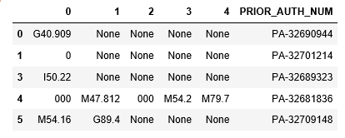
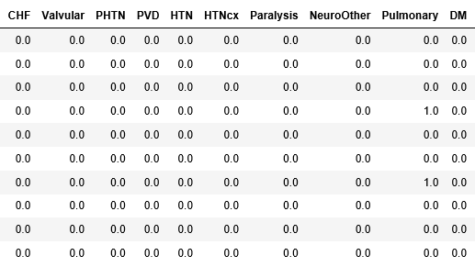
Feature Engineering (Cont.)
Created new variables ‘Comorbidity Matrix’
Presence of additional DIAG_CD along with the primary DIAG_CD represents a health disease or severity of .the health condition. So the combination of DIAG_CDs will tell us a health condition of the member.
Comorbidity matrix is mapping between the ICD codes and the disease presence. Since this mapping is not available for ICD 10 codes in python. Separate R script is created to convert the ICD codes into comorbidity matrix.
1. Since 99% of the pharmacy claims have less 5 ICD codes considered only 5 ICD codes for Comorbidity matrix
derivation.
2. There are 30 diseases available in the current mapping (i.e. icd10_map_ahrq mapping is used)
Sample of ICD codes :
Sample of Comorbidity matrix:

Slide 7
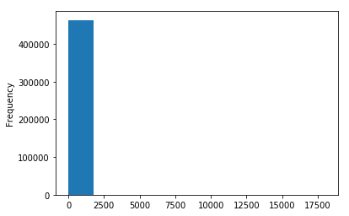
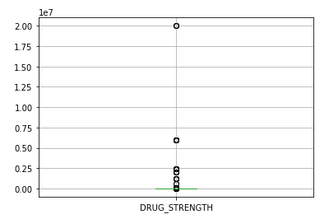
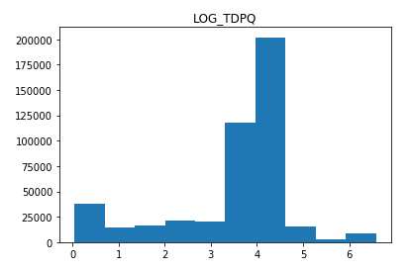
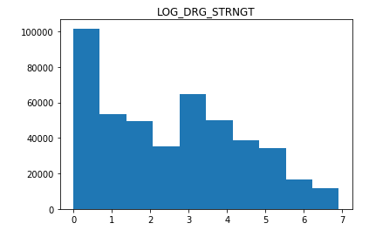
Feature Engineering(cont.)
Variable transformations :
The TOTAL_DRUG_PACKAGE_QTY and DRUG_STRENGTH columns have very skewed distribution and have considerably less number of outliers. So removed the outliers and applied log transformation to both the columns to make the distribution of the variables near the normal distribution.
Distribution of TOTAL_DRUG_PACKAGE_QTY and DRUG_STRENGTH before transformation.
Distribution after removing the outliers and applying log transformation.

Slide 8
Feature Engineering(cont.)
Converting DIRECTION_OF_USE to vectors :
Intuition is the combination of DRUG_LABEL_NAME, DRUG_STRENGTH, DIRECTION_OF_USE along with the AGE is strong factor in deciding the claim approval or denial.
Using TF-IDF vectorization algorithm converted the Direction of use to vectors.
Limited the number of vector to 300 because of the space and memory constraints. Otherwise 11,318 vectors found in direction of use. These 300 vectors are features having high term frequency.
Used Stop words as ‘English’ to remove the most recurring pronouns/conjunctional words.
Tried ngram to check for the sets of words but the dimension increases by a factor of 10 and total vectors became around 118567.
Future Scope : we can use PCA to reduce the dimensionality of the vectors.

Slide 9
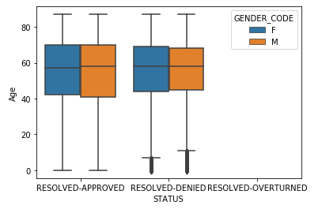
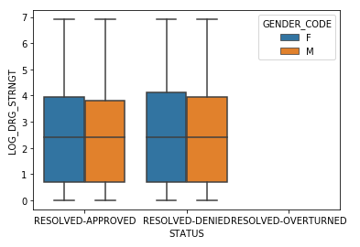
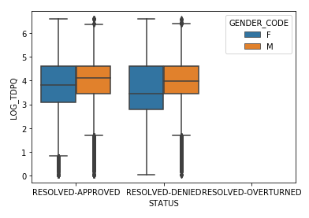
Exploratory Data analysis
Comparing the median values of Age of Males and Females
with respect to STATUS of the claim.
The median values of Age are almost equal in
each category.
Comparing the median values of the DRUG_STRENGTH with
respect to gender and STATUS of the claims.
The median values of DRUG_STRENGTH is also equal
in case of both approved and denied claims and with respect to
claim status as well.
Since it is a log scale it would be difficult to interpret the exact
difference but the difference seems to be very minimal.
Comparing the median values of TOTAL_DRUG_PACKAGE_QUANTITY
with respect to the gender and STATUS of the claims.
It seems the quantity is less for Female members compared to
Male members.

Slide 10
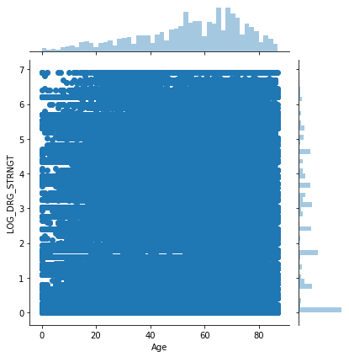
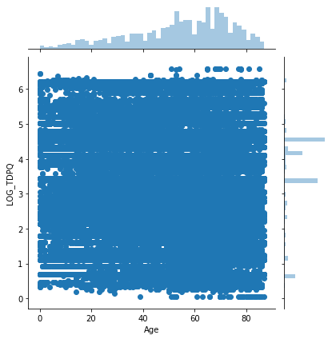
Exploratory Data analysis(Cont.)
From joint plot we can say that the Total Drug Package Quantity as well as DRUG_STENGTH are more for members having age greater than 60.

Slide 11
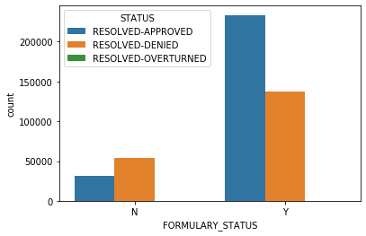
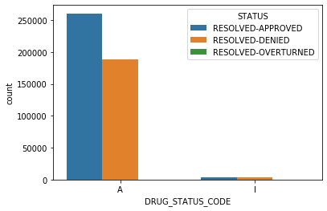
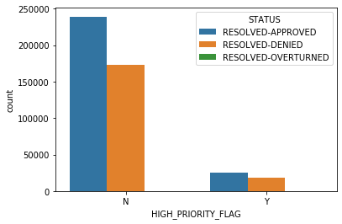
Exploratory Data analysis(Cont.)
Chances of denial of claims is more if the FORMULARY_STATUS is ‘N’.
There are very few observations where DRUG_STATUS_CODE=‘I’ and when it happens there are 50% chances that claim gets denied.
Seems high priority flag doesn’t effect the decision of denial in both the cases there are 42% chances that claim can get denied based on the dataset.

Slide 12
Data Modeling
Selected Family of Models : Classification Model
As we need to find out whether a Pharmacy claim submitted for Prior Authorization will be accepted or rejected.
List of models tried :
1. Logistic Regression
2. Random Forest Model
3. Gradient Boosting Model
Evaluation metrics chosen were AUC and f1 score.
Module used for modeling : H2O

Slide 13
Logistic regression
Logistic regression was modelled using H2OGeneralizedLinearEstimator in two ways one is without any regularization and the other one is with regularization.
The data given to the model has categorical variables and h2o converted them using one-hot encoding default.
Enabled the regularization by keeping lambda_search = True (takes values from grid search)
also added remove_collinear_columns=True.
Without regularization | On Train Data | On Test Data
AUC | 82.1 | 81.38
f1 | 0.712 | 0.705
With regularization | On Train Data | On Test Data
AUC | 83.61 | 82.44
f1 | 0.725 | 0.713

Slide 14
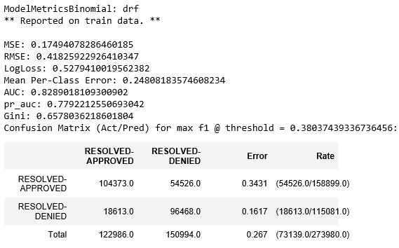
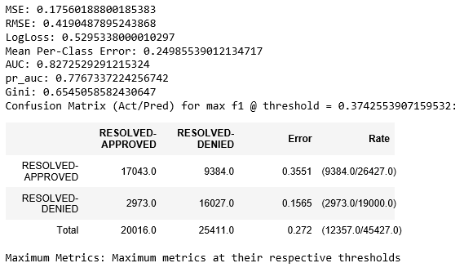
Random Forest
The next classification model chosen was Random Forest because it is immune to over fitting and brings better result than logistic regression and Decission tree.
Model performance on train data :
Model performance on test Data:

Slide 15
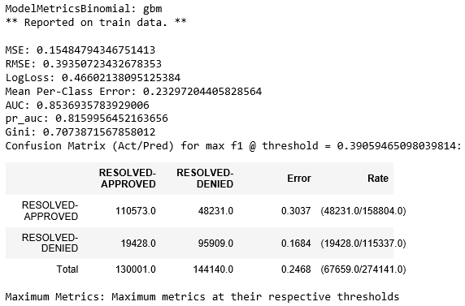
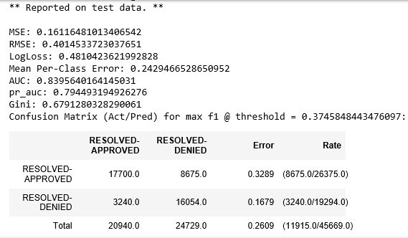
Gradient Boosting
The next classification model chosen was Light Gradient Boosting because it updates the coefficients of the independent variable using boosting algorithm.
Model performance on train data :
Model performance on test Data:

Slide 16
Summary
It is observed that Gradient Boosting performed better on both train and test data sets compared against logistic regression and random forest models.
Future scope :
In the modeling perspective we can eXtreeme Gradient Boosting (XGB) as well to make better predictions.
Because of the infrastructure constraints XGB is not tried.
In data engineering/ Data preparation perspective:
In the current analysis hierarchal values columns CARRIER_ID, GROUP_CODE, EMPLOYER_CODE and PLAN_ID were ignored as the all provide the source of the pharmacy claims and there is no major dependency on them in decision making.
In future we can use these columns by reducing the no of categories for example :
PLAN_ID we can categorize the claims based on 1st character in PLAN_ID which makes 32 categories.
If we take the distribution of CARRIER_ID there are 10 major groups which can cover 96% overall pharmacy claims data.
From feature engineering perspective :
We can use the other text columns like DIAGNOSIS_COMMENTS and ICD_DESCRIPTION, convert them into vectors and apply PCA to reduce the dimensionality of the columns.

Slide 17
Thank You

