Slide 1

Botbrain assignment
Hanmanthrao
24UG00458

Slide 2
Introduction: Getting around a big campus can be tricky, especially for new students. BotBrain is a smart campus navigator designed to make finding places at Chanakya University easy and fast. It uses simple search methods to find the shortest paths between buildings and answers questions through an easy chat interface. This tool helps students save time and feel confident moving around campus.

Slide 3
Objectives Help students find shortest paths between campus buildings. Provide detailed campus info: locations, FAQs. Create a scalable backend for real-time route planning.

Slide 4
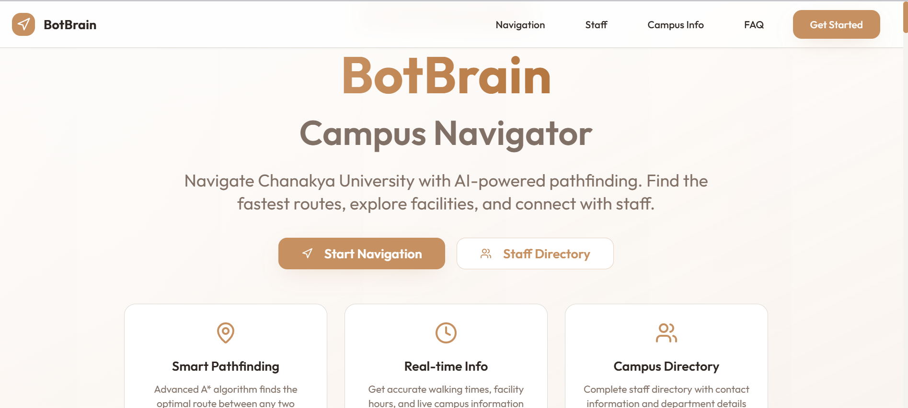
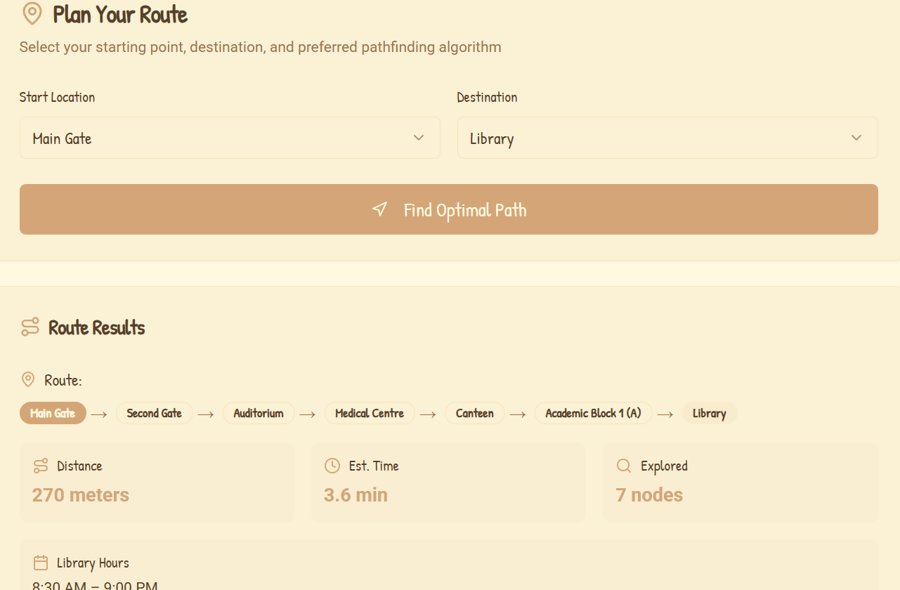
UI for mobile or website

Slide 5
Conclusion BotBrain enhances campus navigation efficiency and student comfort. Future plans: Integrate Google Maps API and mobile app support. Expand chatbot abilities for more queries and services.

