Slide 1
SAMPLING
Notes:
‹#›

Slide 2
SAMPLING
The process of obtaining information from a subset (sample) of a larger group (population)
The results for the sample are then used to make estimates of the larger group
Faster and cheaper than asking the entire population

Slide 3
Two keys
  Selecting the right people
    Have to be selected scientifically so that they are representative of the population
  Selecting the right number of the right people
    To minimize sampling errors I.e. choosing the wrong people by chance

Slide 4
SAMPLING
Sample -- contacting a portion of the population (e.g., 10% or 25%)
  best with a very large population (n)
  easiest with a homogeneous population
Census -- the entire population
  most useful is the population ("n") is small
  or the cost of making an error is high
Notes:
‹#›

Slide 5
Population Vs. Sample
Population of Interest
Population Sample
Parameter Statistic
Sample
We measure the sample using statistics in order to draw
inferences about the population and its parameters.
Notes:
‹#›

Slide 6
…this (bad)…
Population
Sample
Notes:
‹#›

Slide 7
…or this (VERY bad)…
Sample
Population
Notes:
‹#›

Slide 8
Terminology
Population
  The entire group of people of interest from whom the researcher needs to obtain information.
  All the units in the field of inquiry constitute a ‘universe’ or ‘population’.
Sampling unit
  one unit from a population
  Family, school, state, district. Sampling unit may be geographical such as family, institution etc.
Notes:
‹#›

Slide 9
Sampling Frame
  Listing of population from which a sample is chosen
  Obtaining a “list” of population (how will you reach sample)
  Students who eat at McDonalds?
  young people at random in the street?
  phone book
  students union listing
  University mailing list

Slide 10
Characteristics of a Good Sample
Accurate and representative of the universe.
Goal-oriented
Economical
Precision
Random selection
Proportional
Proper selection of sample units
Low sampling error, high confidence level & least degree of variability.
Actual information provider.

Slide 11
Sampling Error
Sampling error arises from the fact that samples differ from their population.
It refers to the difference between the sample & the population.
Sampling errors occur because inferences about the entire population are based on information obtained from only a sample of that population.

Slide 12
Non-sampling Error
Occur due to mistakes made while collecting the data or sample observations correctly.
It may include data entry errors, biased questions in a questionnaire, poorly worded questions, improperly trained personnel, false information provided by respondents.
Examples: in the form of refusals, not-at-home, unreturned or lost questionnaires, long interviews result in inaccurate responses.
Wrong interpretation of the questions due to wrong wordings etc.

Slide 13
A response or data error is any systematic bias that occurs during data collection, analysis or interpretation
  Respondent error (e.g., lying, forgetting, etc.)
  Interviewer bias
  Recording errors
  Poorly designed questionnaires

Slide 14
Methods to reduce errors
Investigate the entire survey process & identifying the sources of the error.
Understand the cause of the error.
Identify the impact of error so as to decide the extent.

Slide 15
Sample size constraint
Sample size represents number of observations taken to conduct a statistical analysis
It is composed of people, food batches, machines etc.
The sample size is the larger the better because as sample size increases, the estimates become more accurate.
But as the sample size increases, it means more expensive in terms of time and money.

Slide 16
Non-response
Researcher needs to minimize the non-response.
Response rates in a survey can be improved through good survey design, clarity of purpose, questions etc.
Assurances of privacy & confidentiality can improve the response rates considerably.
Suggested measures for non-response:
1.Try to identify reasons for refusals.
2. use positive language
3. Focus on the importance of the survey & explain role of the respondents in the survey. 4. Assure confidentiality of the responses.

Slide 17
Steps in Sampling Process
1. Define the population
2. Identify the sampling frame
3. Select a sampling design or procedure
4. Determine the sample size
5. Draw the sample
Notes:
‹#›

Slide 18
Sampling Design Process
Define Population
Determine Sampling Frame
Determine Sampling Procedure
Probability Sampling
Type of Procedure
Simple Random Sampling
Stratified Sampling
Cluster Sampling
Non-Probability Sampling
Type of Procedure
Convenience
Judgmental
Quota
Determine Appropriate
Sample Size
Execute Sampling
Design
Notes:
‹#›

Slide 19
1. Define the Target Population
It addresses the question “Ideally, who do you want to survey?” i.e. those who have the information sought What are their characteristics. Who should be excluded?
  age, gender, product use, those in industry
  Geographic area
It involves
  defining population units
  setting population boundaries
  Screening (e.g. security questions, product use )
Notes:
‹#›

Slide 20
1. Define the Target Population
The Element ...... individuals
families
seminar groups
sampling Unit…. individuals over 20
families with 2 kids
seminar groups at ”new” university
Notes:
‹#›

Slide 21
Sampling Methods
Probability sampling - equal chance of being included in the sample (random)
  simple random sampling
  systematic sampling
  stratified sampling
  cluster sampling
Non-probability sampling - - unequal chance of being included in the sample (non-random)
  convenience sampling
  judgement sampling
  snowball sampling
  quota sampling
Notes:
‹#›

Slide 22
1. Probability Sampling
An objective procedure in which the probability of selection is nonzero and is known in advance for each population unit.
Every unit in the population has equal chance of getting selected
It is also called random sampling.
Ensures information is obtained from a representative sample of the population
Sampling error can be computed
Survey results can be projected to the population
More expensive than non-probability samples
Notes:
‹#›

Slide 23
Simple Random Sampling (SRS)
Population members are selected directly from the sampling frame
Equal probability of selection for every member (sample size/population size)
400/10,000 = .04
Use random number table or random number generator
Each element in the population has a known and equal probability of selection.
Each possible sample of a given size (n) has a known and equal probability of being the sample actually selected.
Notes:
‹#›

Slide 24
Simple Random Sampling
This implies that every element is selected independently of every other element.
It uses Lottery Method and Random number method.
Each element in the population has a known and equal probability of selection.
Each possible sample of a given size (n) has a known and equal probability of being the sample actually selected.
This implies that every element is selected independently of every other element.

Slide 25
Systematic Sampling
Order all units in the sampling frame based on some variable and number them from 1 to N
Choose a random starting place from 1 to N and then sample every k units after that
Notes:
‹#›

Slide 26
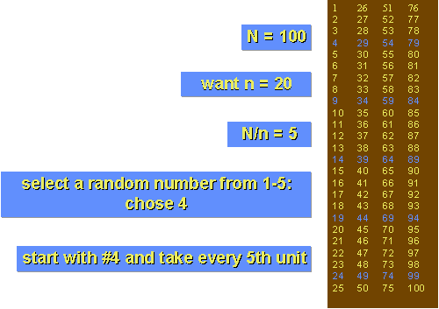
Systematic Random Sample
number the units in the population from 1 to N
decide on the n (sample size) that you want or need
k = N/n = the interval size
randomly select an integer between
1 to k
then take
every kth unit
Notes:
‹#›

Slide 27
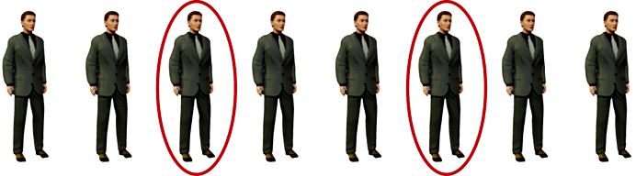
Systematic Sampling
As described above, systematic sampling is an EPS method, because all elements have the same probability of selection (in the example given, one in ten). It is not 'simple random sampling' because different subsets of the same size have different selection probabilities - e.g. the set {4,14,24,...,994} has a one-in-ten probability of selection, but the set {4,13,24,34,...} has zero probability of selection.
‹#›

Slide 28
Systematic Sampling
ADVANTAGES:
Sample easy to select
Suitable sampling frame can be identified easily
Sample evenly spread over entire reference population
DISADVANTAGES:
Sample may be biased if hidden periodicity in population coincides with that of selection.
Difficult to assess precision of estimate from one survey.

Slide 29
Stratified Sampling
The heterogeneous population is divided into distinct, non-overlapping homogenous subgroups called “strata” according to some characteristics or variables like income, education, age etc. & then a random sample is selected from within each subgroup.
Example of stratum is according to gender male-female, according to cadre manager-non manager etc.
    year in school, geographic area, product use, etc.
Notes:
‹#›

Slide 30
Stratified Sampling
Steps:
  Population is divided into mutually exclusive and exhaustive strata based on an appropriate population characteristic. (e.g. race, age, gender etc.)
  Simple random samples are then drawn from each stratum.
Notes:
‹#›

Slide 31
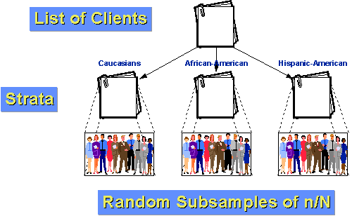
Stratified Random Sampling
Notes:
‹#›

Slide 32
Stratified Random Sampling
Population is divided on the basis of characteristic of interest in the population e.g. male and female may have different consumption patterns
Has a smaller sampling error than simple random sample since a source of variation is eliminated
Ensures representativeness when proportional sampling used
Notes:
‹#›

Slide 33
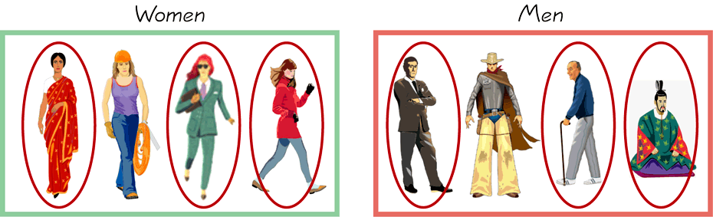
Stratified Sampling
        Draw a sample from each stratum

Slide 34
Methods of Stratified Sampling
Proportionate Allocate Method
  The sample size in each stratum is proportional to the stratum size in the population
Non-proportionate Allocate Method
  The sample size in each stratum is NOT proportional to the stratum size in the population
  Used if
  1) some strata are too small
  2) some strata are more important than others
  3) some strata are more diversified than others
Notes:
‹#›

Slide 35
Example: Let a population of 100 employees be divided into the following manner
Group/strata | Characteristics (experience in years) | Number of employees | Non-proportional allocation | 20% sample proportional allocation
A | Less than 5 years | 10 | 5 | 2
B | 5 to 10 years | 30 | 5 | 6
C | 10-20 years | 40 | 5 | 8
D | 200 and above | 20 | 5 | 4
 | Total | 100 | 20 | 20

Slide 36
Cluster Sampling
Clusters of population units are selected at random and then all or some randomly chosen units in the selected clusters are studied.
The population is divided into heterogonous groups called clusters.
Steps:
  Population is divided into mutually exclusive and exhaustive subgroups, or clusters. Ideally, each cluster adequately represents the population.
  A simple random sample of a few clusters is selected.
  All or some randomly chosen units in the selected clusters are studied.
Notes:
‹#›

Slide 37
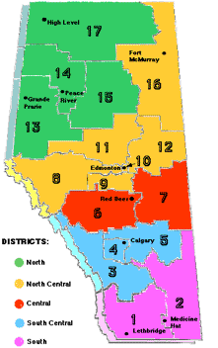
Cluster or Area Random Sampling
Divide population into clusters (usually along geographic boundaries)
randomly sample clusters
measure units within sampled clusters
Notes:
‹#›

Slide 38
Cluster Sampling
Cluster sampling is an example of 'two-stage sampling' .
First stage a sample of areas is chosen;
Second stage a sample of respondents within those areas is selected.
Population divided into clusters of homogeneous units, usually based on geographical contiguity.
Sampling units are groups rather than individuals.
A sample of such clusters is then selected.
All units from the selected clusters are studied.

Slide 39
Cluster Sampling
Two types of cluster sampling methods.
One-stage sampling. All of the elements within selected clusters are included in the sample.
Two-stage sampling. A subset of elements within selected clusters are randomly selected for inclusion in the sample.

Slide 40
Cluster Sampling
Advantages :
Cuts down on the cost of preparing a sampling frame.
This can reduce travel and other administrative costs.
Disadvantages: sampling error is higher for a simple random sample of same size.
Often used to evaluate vaccination coverage in EPI

Slide 41
When to use stratified sampling
If primary research objective is to compare groups
Using stratified sampling may reduce sampling errors
When to use cluster sampling
If there are substantial fixed costs associated with each data collection location
When there is a list of clusters but not of individual population members
Notes:
‹#›

Slide 42
II. Non-Probability Sampling
Subjective procedure in which the probability of selection for some population units are zero or unknown before drawing the sample.
information is obtained from a non-representative sample of the population
Sampling error can not be computed
Survey results cannot be projected to the population
Notes:
‹#›

Slide 43
Non-Probability Sampling
Advantages
Cheaper and faster than probability
Reasonably representative if collected in a thorough manner
Notes:
‹#›

Slide 44
Types of Non-Probability Sampling
Convenience Sampling
  A researcher's convenience forms the basis for selecting a sample.
    people in my classes
    Mall intercepts
    People with some specific characteristic (e.g. bald)
Notes:
‹#›

Slide 45
Convenience Sampling
Sometimes known as grab or opportunity sampling or accidental or haphazard sampling.
A type of non-probability sampling which involves the sample being drawn from that part of the population which is close to hand. That is, readily available and convenient.
The researcher using such a sample cannot scientifically make generalizations about the total population from this sample because it would not be representative enough.

Slide 46
Convenience Sampling
For example, if the interviewer was to conduct a survey at a shopping center early in the morning on a given day, the people that he/she could interview would be limited to those given there at that given time, which would not represent the views of other members of society in such an area, if the survey was to be conducted at different times of day and several times per week.
This type of sampling is most useful for pilot testing.

Slide 47
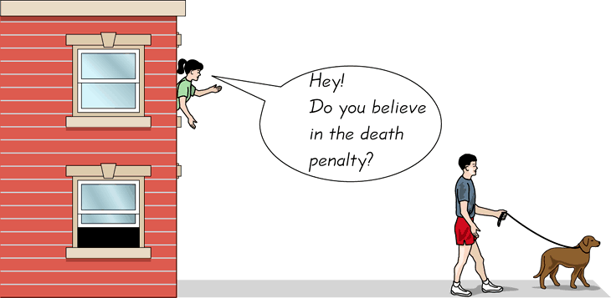
Convenience Sampling
  Use results that are easy to get
Notes:
‹#›
‹#›

Slide 48
2.Judgmental Sampling
Judgmental sampling is a form of convenience sampling in which the population elements are selected based on the judgment of the researcher.
  test markets
  purchase engineers selected in industrial marketing research
  bellwether precincts selected in voting behavior research
  expert witnesses used in court

Slide 49
Judgmental Sampling
The researcher chooses the sample based on who they think would be appropriate for the study. This is used primarily when there is a limited number of people that have expertise in the area being researched

Slide 50
3.Snowball Sampling
  Selection of additional respondents is based on referrals from the initial respondents.
    friends of friends
  Used to sample from low incidence or rare populations.
In snowball sampling, an initial group of respondents is selected, usually at random.
  After being interviewed, these respondents are asked to identify others who belong to the target population of interest.
  Subsequent respondents are selected based on the referrals.
Notes:
‹#›

Slide 51
4. Quota Sampling
  The population is divided into cells on the basis of relevant control characteristics.
  A quota of sample units is established for each cell.
    50 women, 50 men
  A convenience sample is drawn for each cell until the quota is met.
  (similar to stratified sampling)

Slide 52
Quota Sampling
Quota sampling may be viewed as two-stage restricted
judgmental sampling.
  The first stage consists of developing control categories, or quotas, of population elements.
  In the second stage, sample elements are selected based on convenience or judgment.
  Population Sample
  composition composition
  Control
  Characteristic% Sex % Number
  Male 48 48 480
  Female 52 52 520
  ____ ____ ____
  100 100 1000

Slide 53
Probability Vs. Non-Probability Sampling
Non-probability sampling is less time consuming and less expensive.
The probability of selecting one element over another is not known and therefore the estimates cannot be projected to the population with any specified level of confidence. Quantitative generalizations about population can only be done under probability sampling.
However, in practice, marketing researchers also apply statistics to study non-probability samples.
Notes:
‹#›

Slide 54
Drawing Inferences from Samples
Population estimates
  % who smoke, buy your product, etc
    25% of sample
    what % of population?
  very dangerous with a non-representative sample or with low response rates
Notes:
‹#›

Slide 55
Thank You

