Slide 1
What github tells you?

Slide 2
Highlight
GitHub, the world's largest code hosting platform, generates thousands of projects every hour.
Our team used NetworkX graphic to analyze GitHub, using GitHub‘s rich data.
We used the Github user, code, and repository information to create an interest graph.

Slide 3
Data source and API
Github API in json format :
https://developer.github.com/v3/
Using API to get user’s information data pack
Example: { “login”: ”cathy wong", "id": 15256911, "avatar_url": "https://avatars.githubusercontent.com/u/15256911?v=3", "gravatar_id": "", "url": "https://api.github.com/users/cathywong", "html_url": "https://github.com/cw", ... }

Slide 4
Questions we eager to know
Who is the “master of code” on Github?
Which project(repo) is the most popular?
What is the programming languages people tend to use these days?

Slide 5
Techniques we used
NetworkX
Degree Centrality
Between Centrality
Closeness Centrality
Access and make use of API
Pygithub
Graph
Krackhardt kite graph
Data visulization
Heatmap
D3

Slide 6
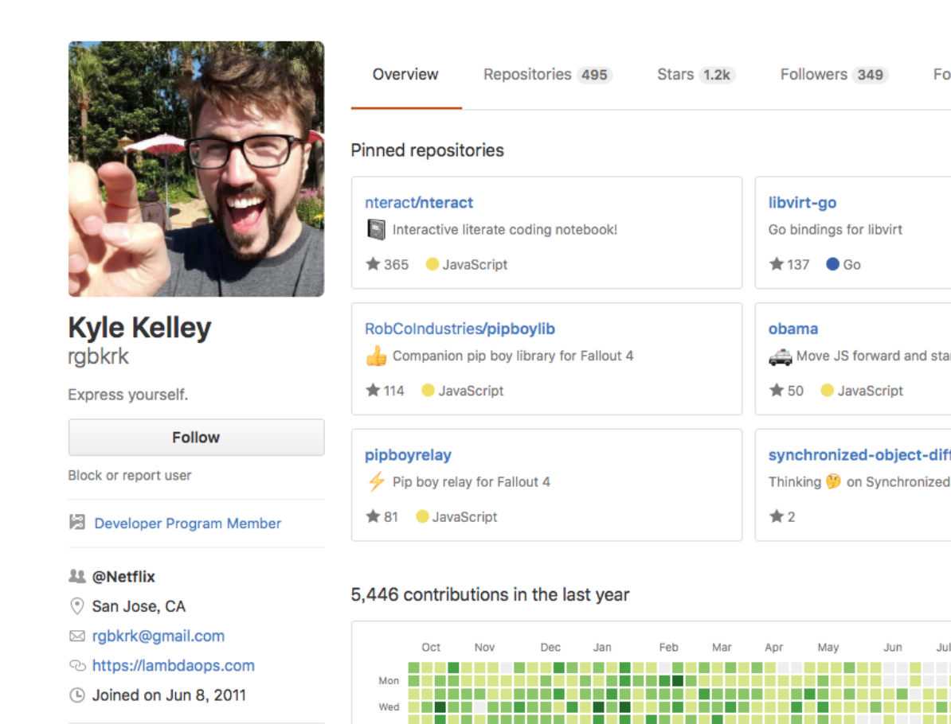
Insights we found
Hottest user:

Slide 7
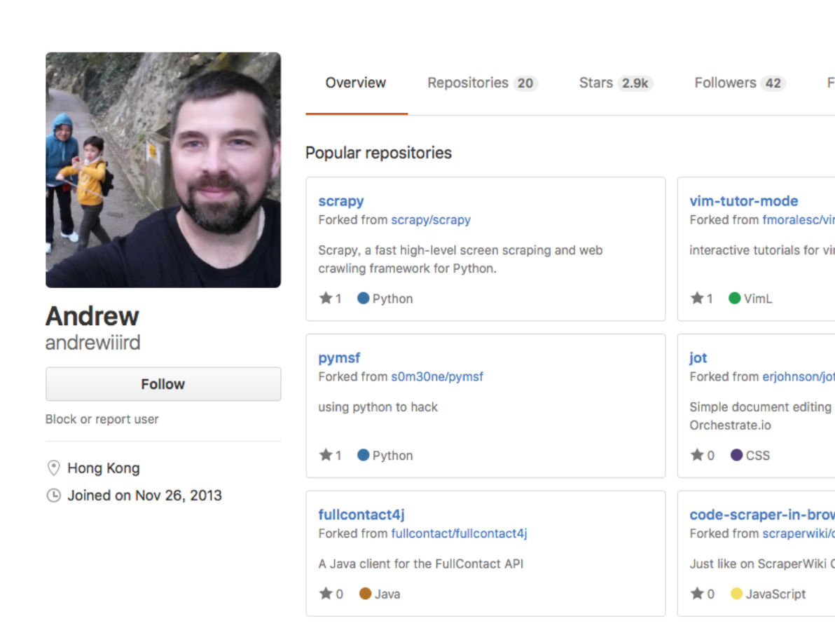
Insights we found
Hottest user:

Slide 8




Insights we found
Hottest projects:
Findspark, spark, tensorflow,luigi

Slide 9
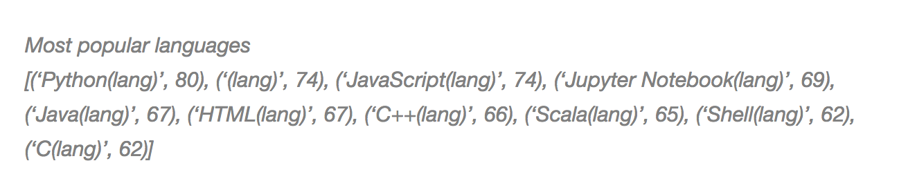
Insights we found
Hottest languages:
Javascript, python, R. Scripting languages are popular!
Go, Scala

Slide 10
Further investigation
What is the relationship between language and nation wealth…?
What is the difference between developed countries and other countries regarding to favorite technologies?
Languages?
Why interesting?
Better know developer around the world
Make use of the difference and trend

