Slide 1
Hello
Basic HTML
HTML & CSS: Foundations and Best Practices
September, 2019

Slide 2
1
HTML
HyperText Markup Language
Notes:
Html es un lenguaje demarcado que nos permite estructurar u organizar la información o contenido de una página web mediante etiquetas

Slide 3
Two-dimensional Layouts
<TAG>
It’s a code that defines every structure on an HTML page.
</TAG>

Slide 4
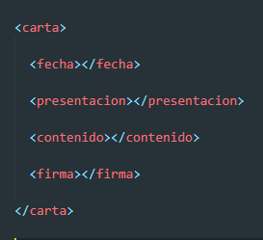

Slide 5
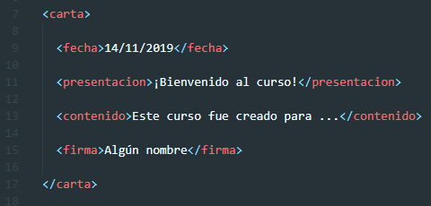

Slide 6
Considerations
Semantic Elements
Close your tags
External files
Validate your code

Slide 7
Considerations
Before
<div id="nav"> <div class="header"> <div id="footer">
After
<nav> <header> <footer>

Slide 8
Considerations
Semantic Elements
Close your tags
External files
Validate your code

Slide 9
Considerations
<header>
</header>
<img src=“image.png”/>

Slide 10
Considerations
Semantic Elements
Close your tags
External files
Validate your code

Slide 11
Considerations
<head>
<link rel=“stylesheet” href=“style.css”>
</head>
<body>
<script scr=“script.js”>
</body>

Slide 12
Considerations
Semantic Elements
Close your tags
External files
Validate your code

Slide 13
Considerations
https://validator.w3.org/

Slide 14
2
Styles

Slide 15
Two-dimensional Layouts
Inline Syle
Internal Style
External Style

Slide 16
Inline Style
<section style=“background-color: red; ”></section>

Slide 17
Internal Style
<style>
section {
Background-color: red;
}
</style>

Slide 18
External Style
<link rel=“stylesheet” href=“style.css”/>

Slide 19
3
Exercise

Slide 20
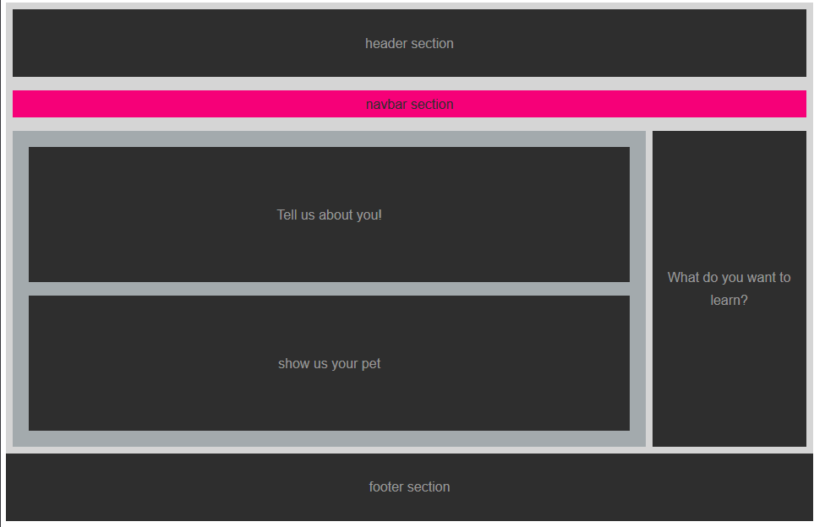
Exercise 1

Slide 21
TAGS
STYLES
<div>
<header>
<nav>
<section>
<article>
<aside>
<footer>
align-items: ;
padding: ;
margin: ;
background-color: ;
color: ;
Width: ;
height: ;
display: ;
justify-content: ;
text-align: ;
flex-direction: ;

Slide 22
7
References

Slide 23
References
https://www.htmlquick.com/tutorials/tags-attributes.html#tags
https://www.abrirllave.com/html/estilos.php
https://developer.mozilla.org/es/docs/Web/CSS/Introducci%C3%B3n/Selectors

Slide 24
CSS Grid - Templates Areas
September 2019

