Slide 1
Pro Dendron:
Capstone Presentation
Titilayo Agbabiaka, Hanna Grossman, Sara Kien, Samuel Omosuyi

Slide 2




OUR TEAM
 | Titilayo Agbabiaka | Hanna Grossman | Sara Kien | Samuel Omosuyi
Role(s): | Project Manager DS Support Data Eng Support | DS Lead ML Support SME Liaison | ML Lead DS Support PM Support | Product Manager Data Eng Lead Dev Lead
Domain Knowledge | SQL Python Statistical Modeling | Python RStudio Modeling | Python Machine Learning Research | Javascript AWS Data Infra

Slide 3
Our Mission
Enhancing reforestation strategies by offering predictive insights about tree mortality with comprehensive visualizations and tree-based machine learning algorithms.
We will build an interactive dashboard that presents model predictions and visualizations about:
Where trees have died throughout California
Factors that characterize tree death
Within particular plots or counties
Over time (i.e., historical trends)
Our product will service the forest industry and provide impact to ongoing legally mandated reforestation efforts

Slide 4
Domain Expert Insights
US Forest Service’s Data Team, Agerpoint’s CEO, Carbon Direct’s Chief Science Officer, UC Berkeley Forestry Professors
Data Visualization
Predicting Tree Death
Challenging to gain insights from tabular data
Importance of dashboard to digest data and answer key questions
Highly complex problem
Importance of having models to better understand this problem
Model Interpretability
Modeling to understand the problem space and relationship between key variables

Slide 5
EDA and Data Structure
(USFS) Forest Inventory and Analysis Program
CA_PLOT with 38,492 rows x 72 columns
CA_TREE with 390,955 rows x 211 columns
CA_Condition 46,549 rows x 159 columns
One row per tree
Around 50 total variables
Tree level data from T1
Diameter, height, species
Plot and condition level data from T2
Elevation, ecological subsection code, slope
Also included a few plot and condition level variables from T1 where change would be meaningful
Water code, basal area, disturbance code, treatment code
Outcome variables
Tree dead or alive at T2
Cause of death at T2
T1: Alive
T2: Alive
T1: Alive
T2: Dead

Slide 6
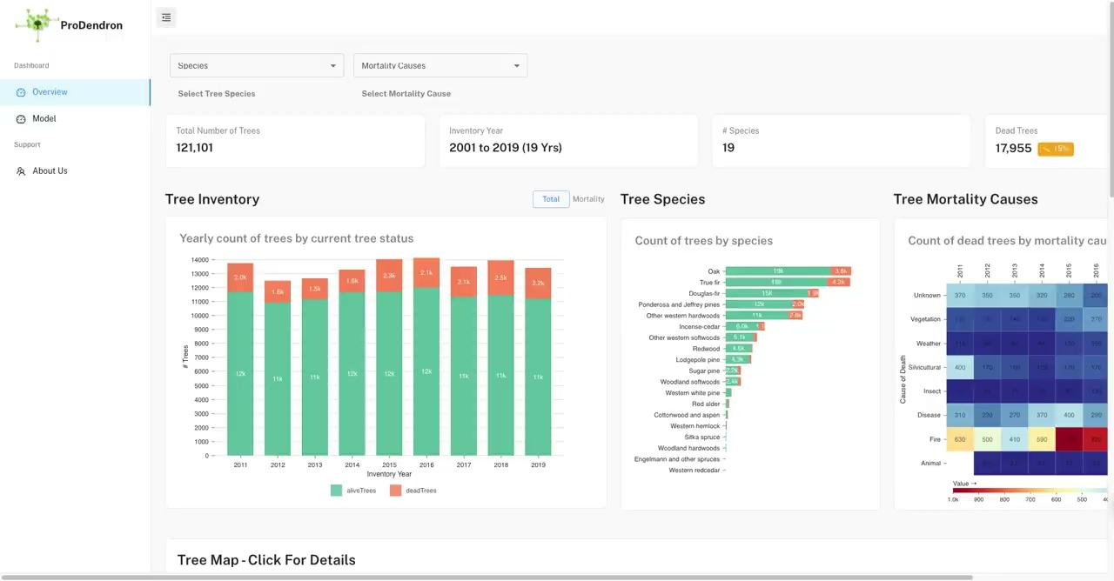
Demo
Notes:
Challenging to gain insights from tabular data → interactive dashboard, saves time and effort, enormous insights
Importance of dashboard to digest data and answer key questions → Years, cause of death, inventory years, Location is key
Reforestation - easily spotted
Exporting the data to enable experts gain insights into the way we structure our data for a tree measured in a time period 1 vs time period 2
Change in measured variables
Then we exposed our models
2 key models
Predicting tree mortality. Is this tree dead or alive
Expose misclassification in the model for easy validation
Show our accuracy and this would proof pivotal to utilizing modeling technique to both highlight important variables for tree mortality prediction
And help in the classification of tree death causes based on the same features

Slide 7
Feature Selection
Guided by previous research, expert input, and EDA
Previous Research - McNellis et al. (2021)
Species identity, ecological section, tree diameter at previous inventory, tree maturity index, basal area at previous inventory
“Contrary to expectations, model accuracy was most improved by inclusion of species identity and ecological section rather than soil or climate variables.”
Expert input
soil, water on plot, disturbance, treatment, owner group
EDA
Included additional features related to tree/plot condition
Many variables excluded due to missing data
E.g., tree maturity - 99.5% missing data
Total features = 30

Slide 8
Modeling Approach
Two models
Binary: Predict mortality (live vs. dead)
Multiclass: Predict cause of death
Insect, Disease, Fire, Animal, Weather, Vegetation,
and Silvicultural (forest management removals)
“Unknown” class removed
Modeling Approach
Compare XGBoost and Random Forest
Interpretable
Can handle missing values
Can handle correlated features
Techniques
Label-encode categorical variables
Split data into train, validation, and test sets
Class weights = majority class / minority class
Tune hyperparameters via grid search
Identify the best model

Slide 9
Model Evaluation Metrics
Model Selection metrics vs. Public Facing metrics
F1 Score
Accuracy
Harmonic mean of precision and recall
Overall percentage of correct tree death predictions
AUC
Precision
How good the model is at distinguishing between classes
When predicting dead trees and their causes, what proportion of those predictions are correct?
Recall
What proportion of total dead trees and relevant causes did the model accurately detect?

Slide 10
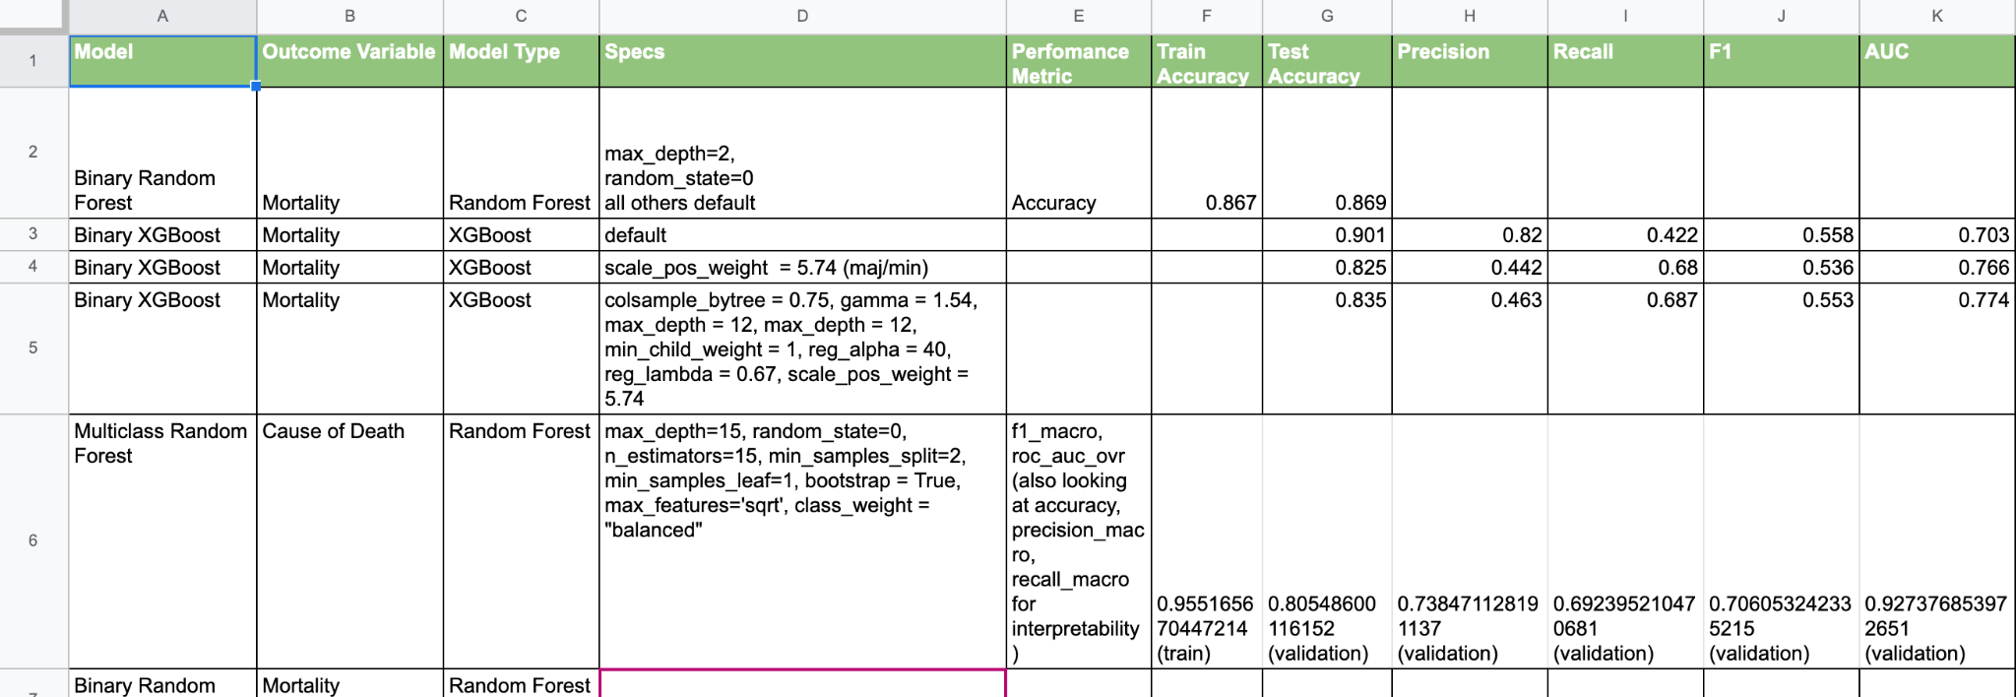
Model Tracker
Tracking Evaluation Metrics

Slide 11
The Best Model for Mortality: XGBoost
Baseline from Previous Research: Accuracy = 71.3%, AUC = 0.71
F1 Score
Accuracy
AUC
Precision
Recall
HYPERPARAMETERS:
colsample_bytree = 0.3, learning_rate = 0.1, max_depth = 10, n_estimators = 1000, gamma = 1.5, min_child_weight = 1, reg_alpha = 1, reg_lambda = 0, scale_pos_weight = 5.74
Notes:
K-fold validation - SD was .01 or less

Slide 12
The Best Model for Mortality: XGBoost
Baseline from Previous Research: Accuracy = 71.3%, AUC = 0.71
F1 Score
Accuracy
AUC
Precision
Recall
HYPERPARAMETERS:
colsample_bytree = 0.3, learning_rate = 0.1, max_depth = 10, n_estimators = 1000, gamma = 1.5, min_child_weight = 1, reg_alpha = 1, reg_lambda = 0, scale_pos_weight = 5.74
Notes:
K-fold validation - SD was .01 or less

Slide 13
The Best Model for Mortality: XGBoost
Baseline from Previous Research: Accuracy = 71.3%, AUC = 0.71
F1 Score
Accuracy
0.88
AUC
Precision
0.75
Recall
HYPERPARAMETERS:
colsample_bytree = 0.3, learning_rate = 0.1, max_depth = 10, n_estimators = 1000, gamma = 1.5, min_child_weight = 1, reg_alpha = 1, reg_lambda = 0, scale_pos_weight = 5.74
Notes:
K-fold validation - SD was .01 or less.

Slide 14
The Best Model for Mortality: XGBoost
F1 Score
Accuracy
0.58 dead, 0.75 macro
0.88
AUC
Precision
0.75
0.58 dead, 0.76 macro
Recall
0.58 dead, 0.75 macro
HYPERPARAMETERS:
colsample_bytree = 0.3, learning_rate = 0.1, max_depth = 10, n_estimators = 1000, gamma = 1.5, min_child_weight = 1, reg_alpha = 1, reg_lambda = 0, scale_pos_weight = 5.74
Note: “macro” gives equal weight to each class
Notes:
K-fold validation - SD was .01 or less

Slide 15
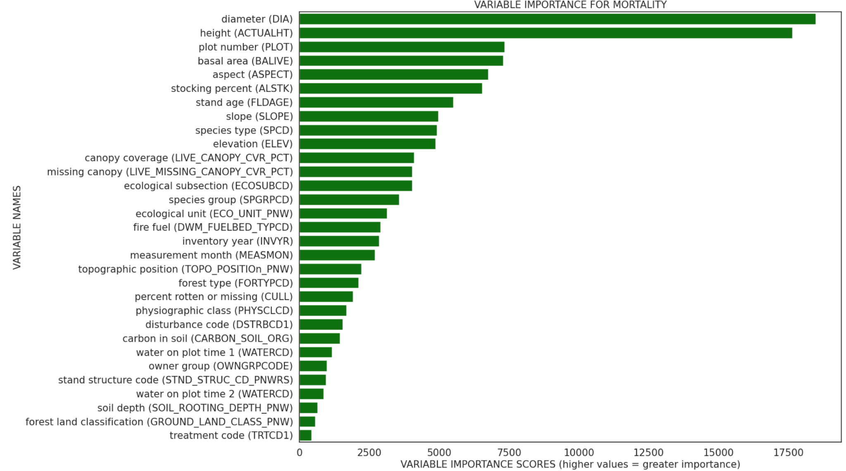
Important Features: Mortality

Slide 16
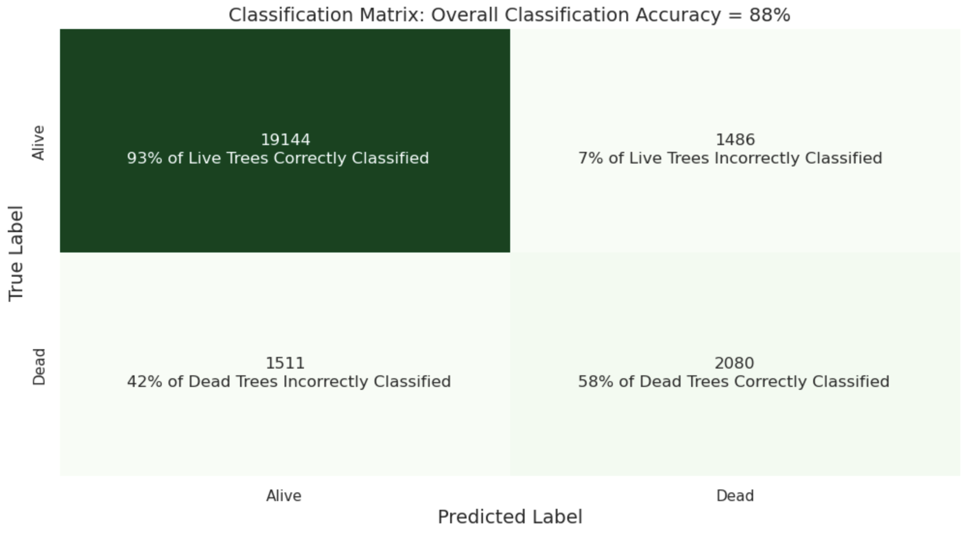
Confusion Matrix: Mortality
Despite significant complexity in modeling tree mortality, our model was able to correctly classify 58% of the dead trees.

Slide 17
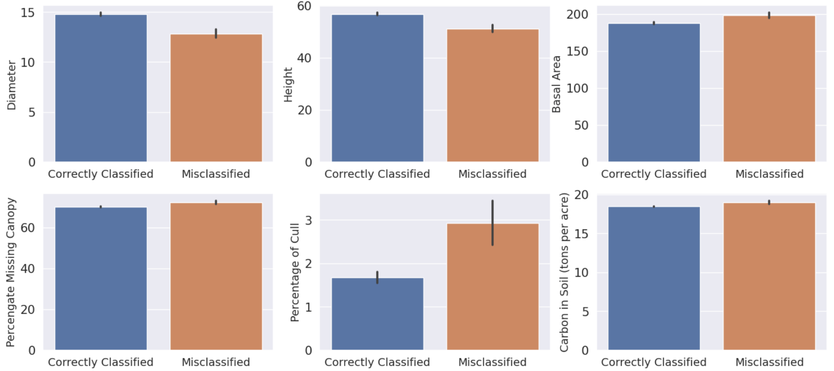
Differences between Correctly Classified vs. Misclassified Trees
Tree diameter and height is lower for misclassified trees, while basal area, percentage of missing canopy, percentage of cull, and amount of carbon in the soil is higher for misclassified trees.

Slide 18
The Best Model for Cause of Death: XGBoost
F1 Score
Accuracy
0.88
0.88
AUC
Precision
0.98
0.82
Recall
HYPERPARAMETERS:
colsample_bytree = 0.7, learning_rate = 0.05, max_depth = 10, n_estimators = 500, gamma = 0.5, min_child_weight = 1, reg_alpha = 0, reg_lambda = 1
0.78
Notes:
K-fold validation - SD was .04 or less

Slide 19
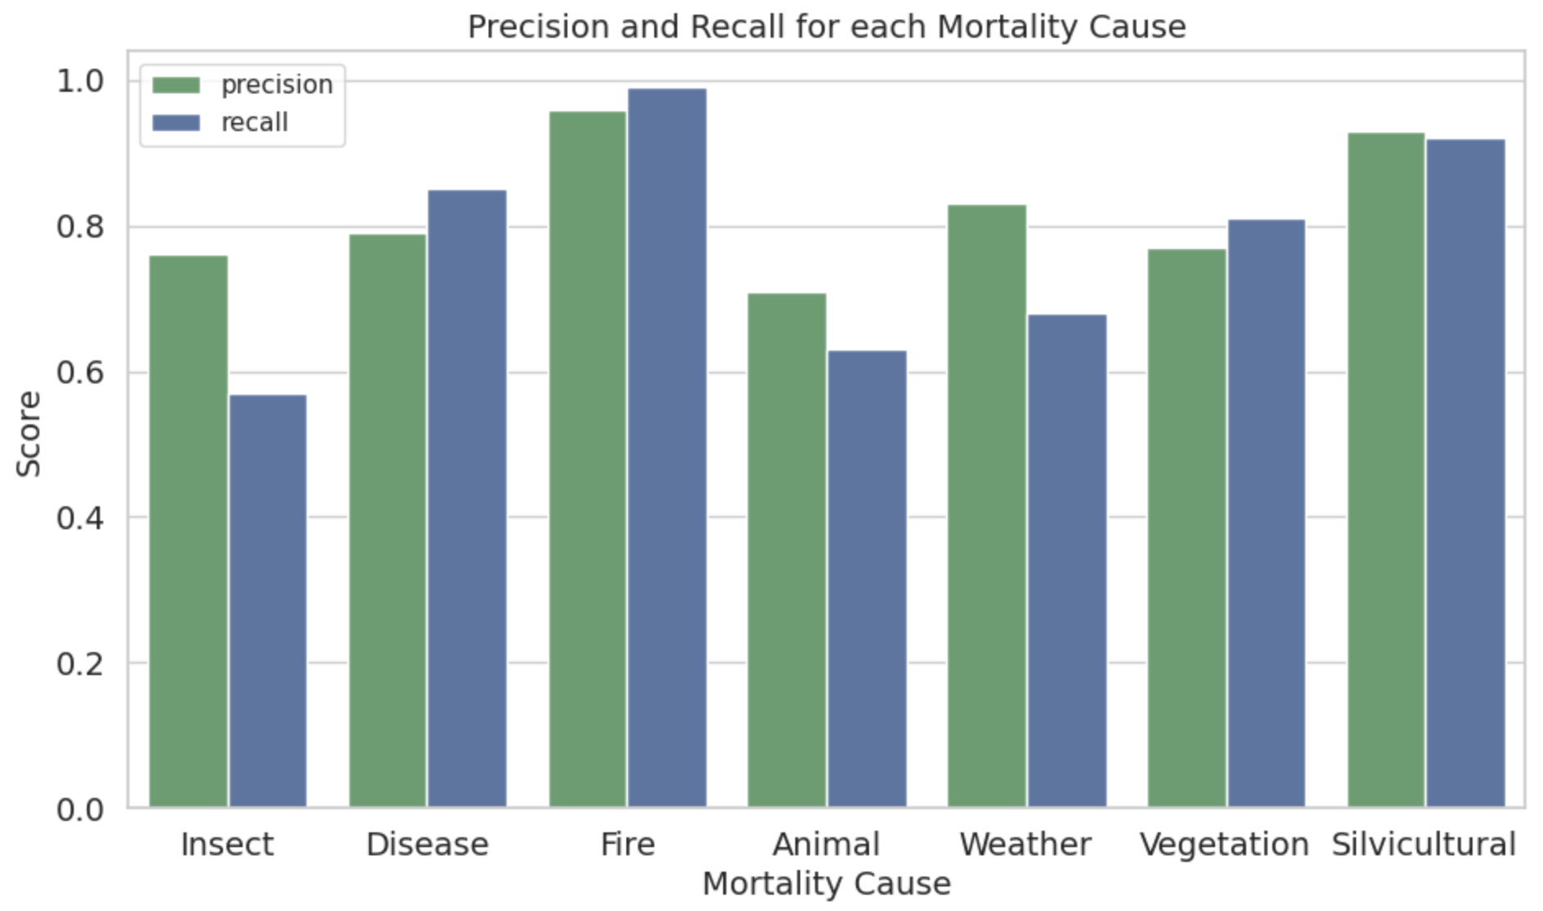
Precision and Recall for each Cause of Death
Precision and Recall are highest for fire and silviculture (i.e., forest management removals)

Slide 20
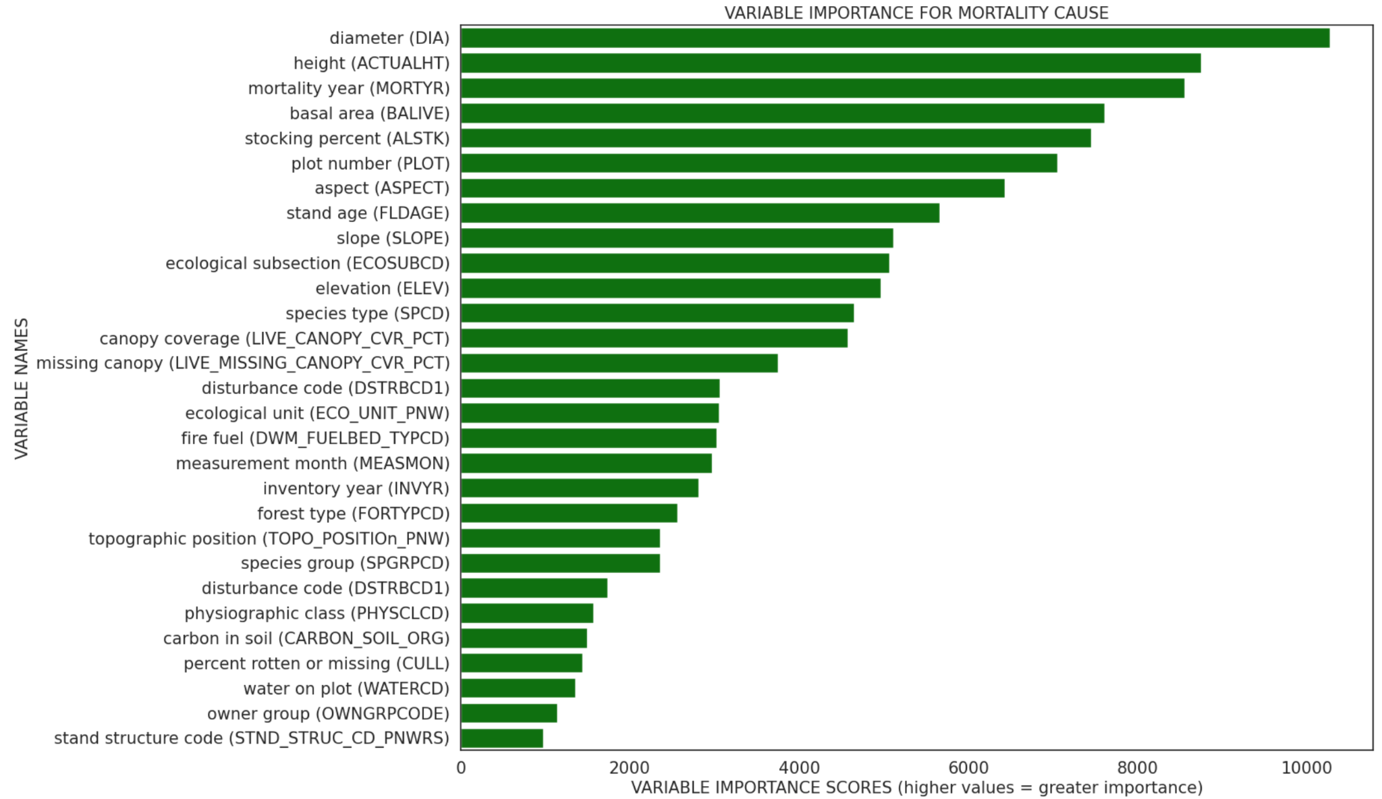
Important Features: Cause of Death

Slide 21
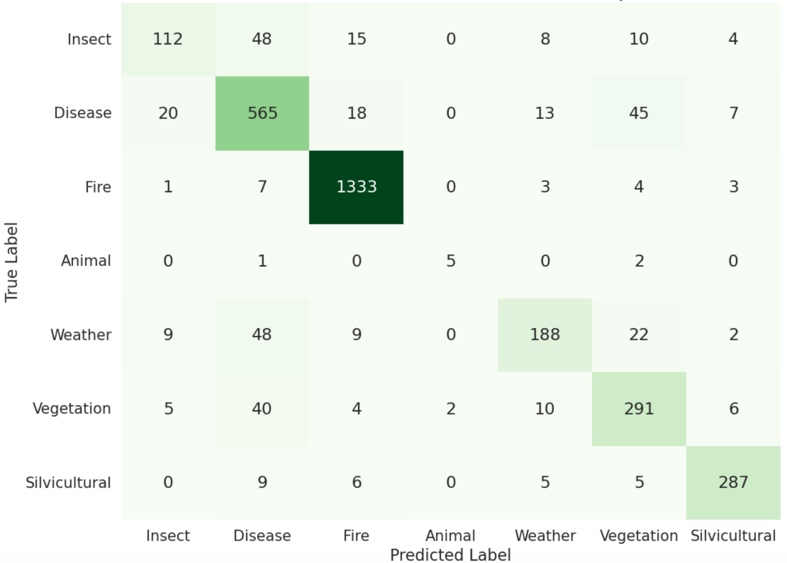
Confusion Matrix: Cause of Death
Accuracy was greatest for fire as a cause of death, followed by disease.

Slide 22
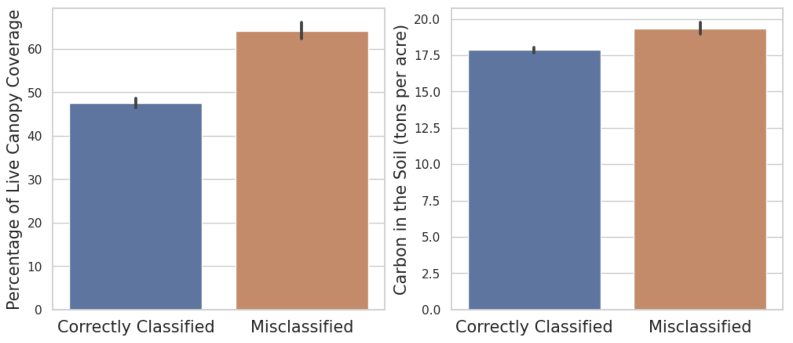
Differences between Correctly Classified vs. Misclassified Trees
(Cause of Death)
Percentage of live canopy and amount of carbon in the soil is higher for misclassified trees.

Slide 23
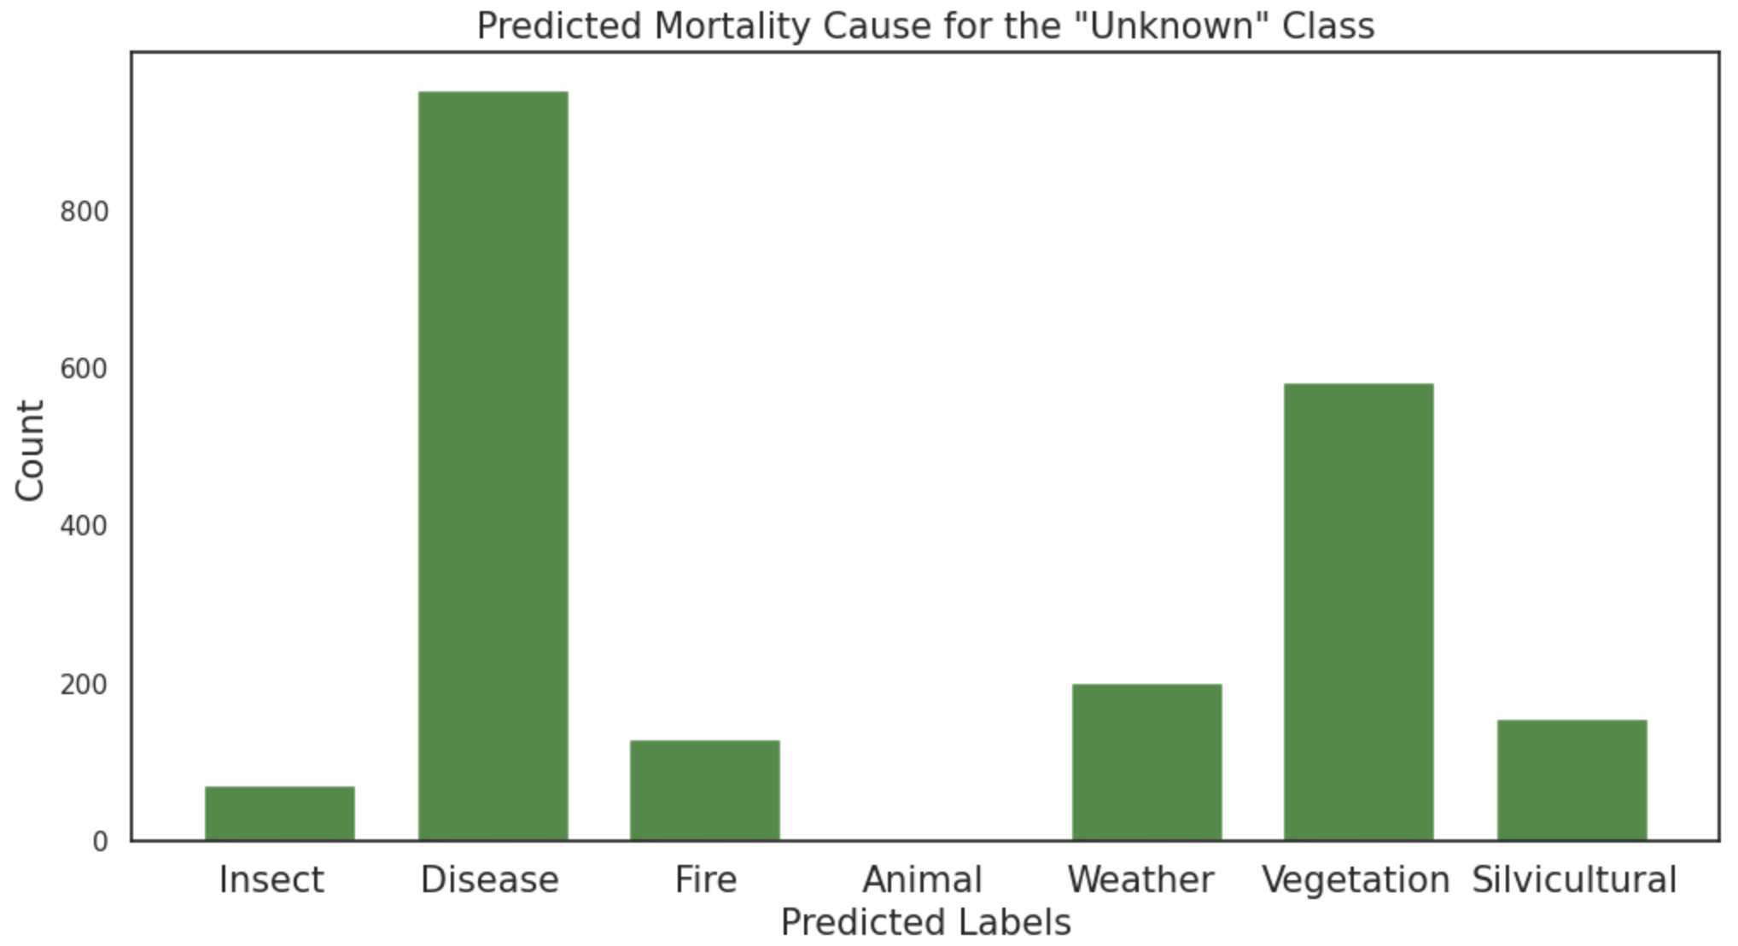
Predicting the “Unknown” Class
Most likely to predict “unknown” cause of death as either due to disease or to suppression/competition by other vegetation.

Slide 24
Impact & Next Steps
As of 2021, there are 9,500 foresters in the US who could leverage our product
Expanding - California is home to only 5% of the countries foresters.
Model improvement and refinement
Notes:
Number of foresters source: https://www.bls.gov/oes/current/oes191032.htm

Slide 25
Summary
Overall ProDendron was able to:
Product
Model
Users
Build an interactive dashboard that provides insights on trees have died throughout California and the factors that characterize tree death
Significantly outperform previous research with regards to modeling tree mortality and also providing an additional model that predict causes of tree death
Empower over 500 foresters with both a product and ML model that saves time and effort analyzing the FIA data needed for the legally mandated reforestation efforts
Notes:
Number of foresters source: https://www.bls.gov/oes/current/oes191032.htm

Slide 26
Acknowledgements
Special Thanks to:
Our industry experts
Glenn Christensen
Olaf Kuegler
Jane Terzibashian
Jeff Chambers
Matthew Potts
Van Butsic
Miranda Redmond
Kevin Lang

Slide 27
Questions

Slide 28
Appendix: Links
Website: https://sites.google.com/berkeley.edu/prodendron/home
Dashboard: https://www.prodendron.com/

Slide 29
Appendix: Modeling Summary
Technical Takeaways
Our models substantially outperform previous research
Tree diameter and height, plot basal area, tree stand age, slope, aspect, stocking percent, ecological subsection, elevation, canopy, species are important for both models
Mortality year is important for predicting cause of death
Fire is the most common cause of tree death
The model is most likely to predict the “Unknown” causal class as disease or vegetation
Three technical challenges we’ve overcome
Data joining and cleaning, feature selection, improving performance

Slide 30
Important Features: Mortality

