Slide 1
Survey Participation Incentives
MIDS W241 Summer 2022
Allie Ayrapetyan, Alexa Coughlin, Hanna Grossman, & Theresa Kuruvilla

Slide 2
Table of Contents
Introduction
Research Question, Motivation, Hypothesis
Setup
Treatment, Outcome Measure, Randomization
Flow & ROXO
Experiment Flow and ROXO Notation
Outcomes
Distribution of Outcomes
Results
Analysis, Discussion, Looking Forward
Questions
Hearing from You!
Notes:
Aim for 5 min each
Allie: 4-6, 11
Hanna: 7-9
Alexa: 1-3, 10

Slide 3
Introduction
Background
Research Question
Surveys are a crucial research tool, critical to the success of many studies. Understanding what drives an increase in survey participation rates will benefit future research.
In this study, we aim to test the effectiveness of two common survey incentives: social good and financial.
Incentive?
Financial
Social Good
None
Do social good or monetary incentives impact survey taking behavior (time spent and number of questions answered)?
Hypothesis: Financial and social good incentives have a positive treatment effect on the amount of time taken and number of questions answered by people responding to surveys.

Slide 4
Experimental Design
Treatments
Tool
Survey in Qualtrics
Financial Incentive
Randomization
Social Incentive
Subjects randomized into one of three groups via Qualtrics randomization feature (33.3% chance of being assigned to any group by clicking link)
No Incentive
Outcome Measures
Number of survey questions answered
Amount of time spent on survey

Slide 5
Survey
Intro Message to Everyone
“You are invited to participate in a research study. Please take a few minutes to complete this pre-questionnaire so we get to know you a little bit. All your responses will be kept anonymous and confidential. Thank you for your time.”
Pre-Questionnaire of 7 Demographic Questions
How did you get this survey?
In the past, what percentages of surveys did you complete?
How much time, on average, do you spend on a given survey?
What is your gender?
What is your age?
What is your ethnicity?
What is your highest degree or level of education?
Randomized Treatment Assignment
100 questions regarding employment, unemployment, and job market
Multiple choice and open ended

Slide 6

Treatments
Incentive
Initial Message
Reminder Message
No Incentive
“Now that we got a sense of who you are, we are inviting you to complete the rest of the survey regarding employment and unemployment. All your responses will be kept confidential and anonymous. Thank you for your participation. Click next to begin.”
You will be entered to win one of five $25
Amazing gift cards for your time!
“Now that we got a sense of who you are, we are inviting you to complete the rest of the survey regarding employment and unemployment. You will be entered to win one of five $25 Amazon gift cards for your time. All your responses will be kept confidential and anonymous. Thank you for your participation. Click next to begin.”
Financial Incentive
“Now that we got a sense of who you are, we are inviting you to complete the rest of the survey regarding employment and unemployment. By taking part in this study, you will help contribute to research on unemployment mitigation. The results of this study will be used to promote job security and help individuals navigate unemployment and its risks. All your responses will be kept confidential and anonymous. Thank you for your participation. Click next to begin.”
You are helping contribute to research on unemployment mitigation. The results of this study will be used to promote job security and help individuals navigate unemployment and its risks.
Social Good Incentive

Slide 7
Flow & ROXO
Social Media Group Members / MTurk
N = ~1,000+
R = Random
O = Control
X = Treatment
Y = Outcome
Clicked on Link
N = 417
Financial Incentive Treatment Group | RX₁Y
Social Incentive Treatment Group | RX₂Y
Control Group | ROY
Assigned
Financial Treatment
N = 139
Assigned
Social Treatment
N = 139
Assigned
Control
N = 139
Notes:
Mention attrition here (not an issue); mention social media platforms (FB, Slack, Insta, LinkedIn)

Slide 8
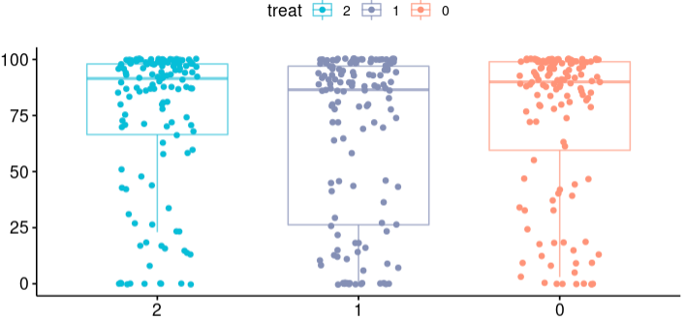
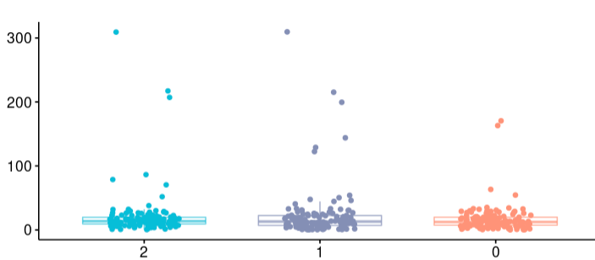
Outcomes
Incentive Type
Control
Financial
Social Good
Number of Questions Answered by Group
Time by Group
Questions Answered
Time (min)
Social Good
Financial
Control
Social Good
Financial
Control
Group
Group
Treatment | ATE Questions Answered (Mean / SD) | ATE Time (Mean / SD)
Financial | -7.8133 (66.18 / 37.82) | 6.1654 (22.69 / 39.78)
Social Good | 0.8658 (74.86 / 32.65) | 4.4722 (20.99 / 36.88)

Slide 9
Results
Data Checks
Models
Data Limitations
Covariate balance checks
Assess outliers
Assumptions
Randomization
Spillover
Excludability
Model diagnostics
LM with no covariates
LM with some covariates
LM with all covariates
LM with log duration (all 3)
Poisson questions answered (all 3)
Heterogeneous treatment effects
Sample population does not generalize to world at large
Residuals not normal
Switch to MTurk data
No major violations
No significant effects
Imperfect data
Takeaway: The results of this study do not indicate that financial nor social good incentives have a positive treatment effect on the number of questions answered or amount of time taken on a survey

Slide 10
Looking Forward
How might we improve future iterations of this study with more time and resources?
This Iteration
Future Iterations
While the results of this study did not allow us to reject our null hypothesis, we believe, based on grounding research and identified limitations of this experiment, that future iterations of this research may support the theory.
With additional time and resources, this experiment can be improved in the future with:
Larger sample size
Broader, more reliable sample population
Larger / more meaningful treatment dosage
Subtler study intentions
Notes:
Can discuss ATEs we saw, but the fact that it was not significant

Slide 11
Questions?
Notes:
Emily

Slide 12
Appendix
Notes:
Emily

Slide 13
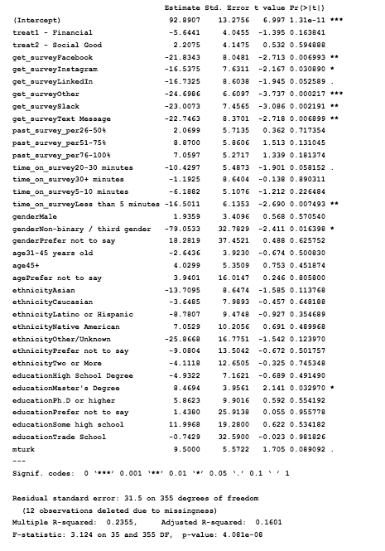

LM with questions answered
All covariates
Notes:
Emily

Slide 14
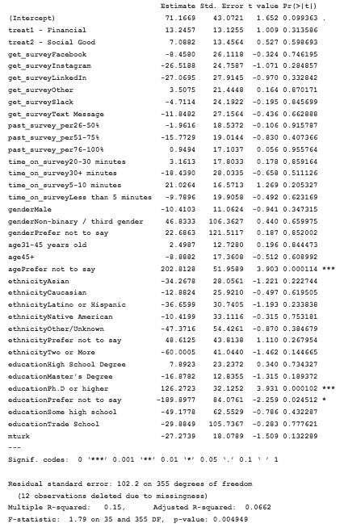

LM with duration
All covariates
Notes:
Emily

Slide 15
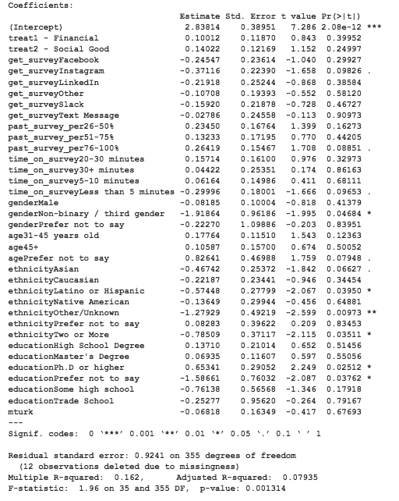

LM with log duration
All covariates
Notes:
Emily

Slide 16
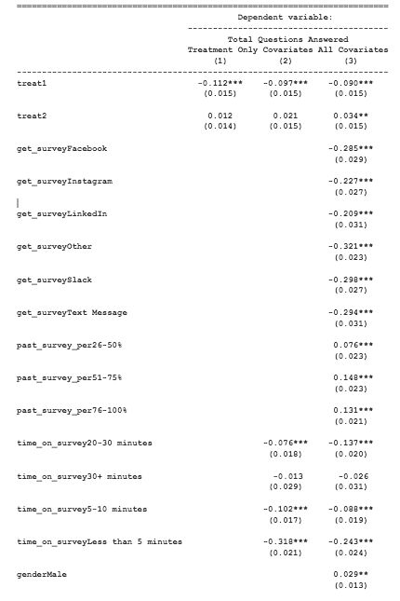
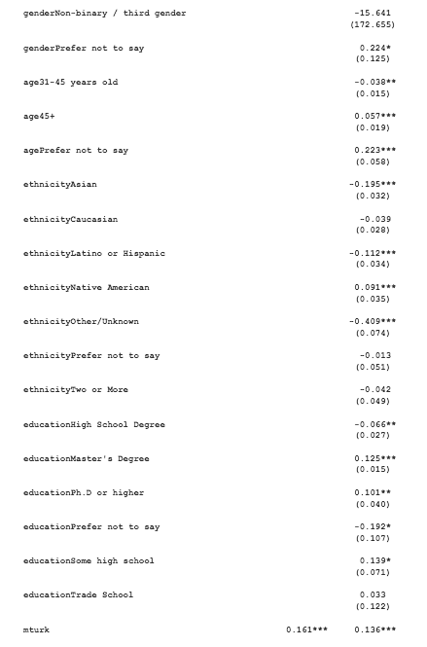
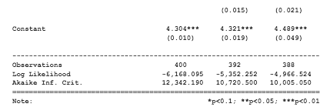
Poisson with questions answered
All covariates
Notes:
Emily

Slide 17
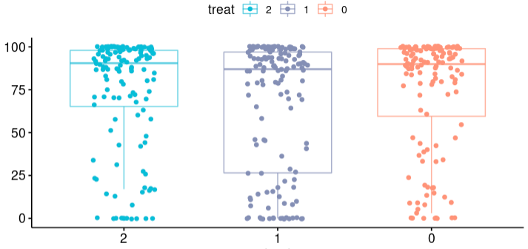
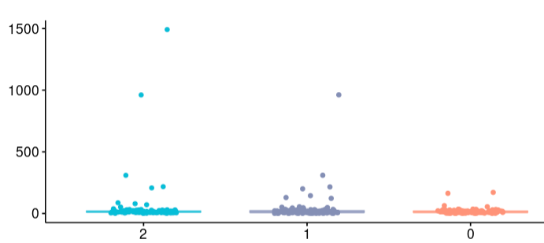
Outcomes
Incentive Type
With outliers
Control
Financial
Social Good
Number of Questions Answered by Group
Time by Group
Questions Answered
Time (min)
Group
Group
Treatment | ATE Questions Answered | ATE Time (min)
Financial | -7.8133 (37.8151) | 6.1654 (39.7792)
Social Good | 0.8658 (32.6529) | 4.4722 (36.8782)

